Slide 1





How to show, measure, and enhance the impact of research
By Dr. Olga Koz & Dr. Jorrín-Abellán

Slide 2
You are applying for tenure, promotion or a new job
You need to prepare for your performance appraisal
You try to decide in which journal to submit the article
You are writing a biographical sketch for a grant proposal
All hyperlinks and additional instructions could be found here: http://libguides.kennesaw.edu/RI
This webinar is for you if:

Slide 3
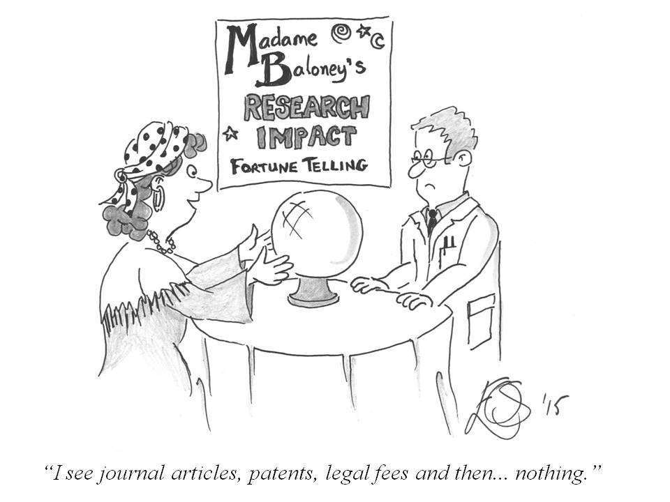
Who assess our research impact?
Institutions we work for – institutional effectiveness
Promotion & tenure committee
Hiring managers and committee
Funding agencies
Research consumers and promoters
Librarians

Slide 4
Why is it important to understand and show the impact of our research?
To be able to justify the dissemination of our work.
To justify the relevance and significance of our work.
To keep track of the evolution of our work.

Slide 5
Gaming the system or “enhancing research impact”
How easy is to find your work? The role of discovery systems and indexes.
The quality and “impact” of the journal
Access to the publication (open or hidden behind a paid wall)
Does the publisher's platform collect article level metrics?

Slide 6
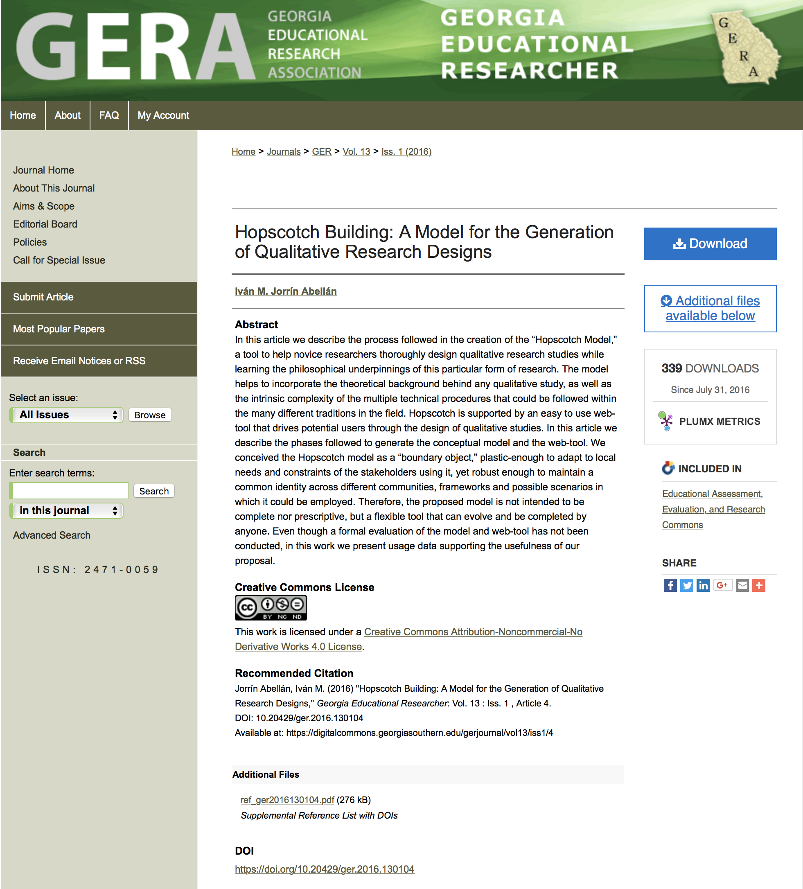

Slide 7

? The evaluator should consider a broad range of impact measures including qualitative indicators of research impact, such as influence on policy and practice.
? In terms of metrics, evaluation is mainly based on researchers’ prestige, which, very often, is inferred from the prestige of the journals (JIF) in which researchers publish their works.
? Outputs of scientific research should include more than just publications, an idea endorsed by DORA.
San Francisco Declaration on Research Assessment
Known issues with research assessment

Slide 8
Checklist for collecting evidence
1. Register with online services that offer creating an "Academic or Author profile" and start collecting citation, views, or downloads.
2. Create ORCID profile (https://orcid.org/register) and Researcher ID to collect all your publications
2. Set up Citation Alert.

Slide 9
3. Download software from the Publish or Perish website https://harzing.com
4. Check your h-index, g-index or i10-indexes using InCites (Web of Science), Scopus, or Google Scholar http://libguides.kennesaw.edu/RI/hindex

Slide 10
5. Learn about the alternative metrics for research impact – “downloads” and “views” of your works published at non-traditional venues Altmetrics (http://libguides.kennesaw.edu/RI/altmetrics)
6. Collect of evidence of impact on practice and forming new scholars

Slide 11
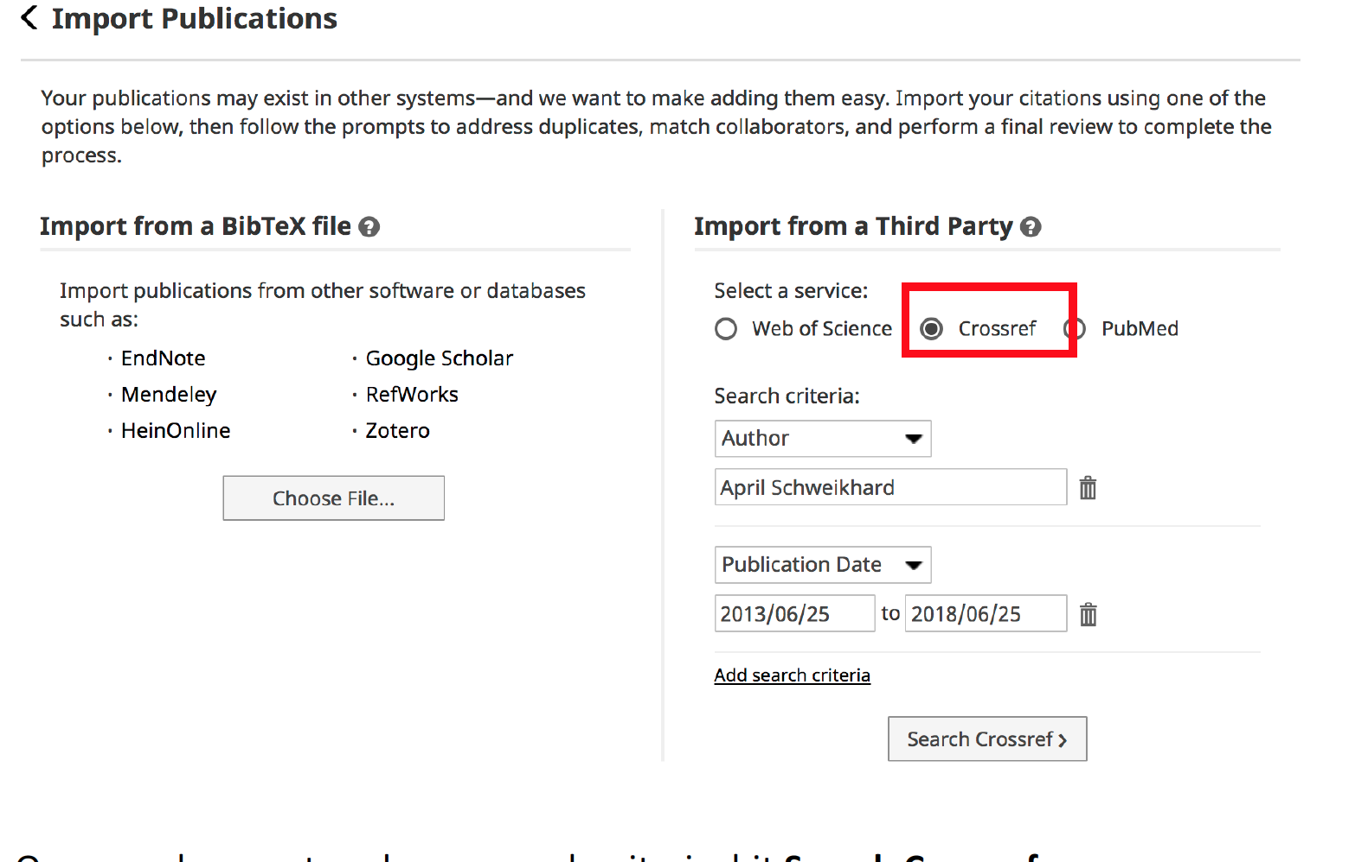
Digital Measures and importing citations

Slide 12
Author’s Impact Factor Metrics
An author's impact on their field or discipline has traditionally been measured using quantitative methods (citation counts). Lately, with the development of indexing databases, numerous algorithms have appeared.
Learn more about each metric at
h-Index http://libguides.kennesaw.edu/RI/hindex
g, e, and other indexes https://libguides.kennesaw.edu/RI/g_index
i10-Index https://libguides.kennesaw.edu/RI/i10

Slide 13
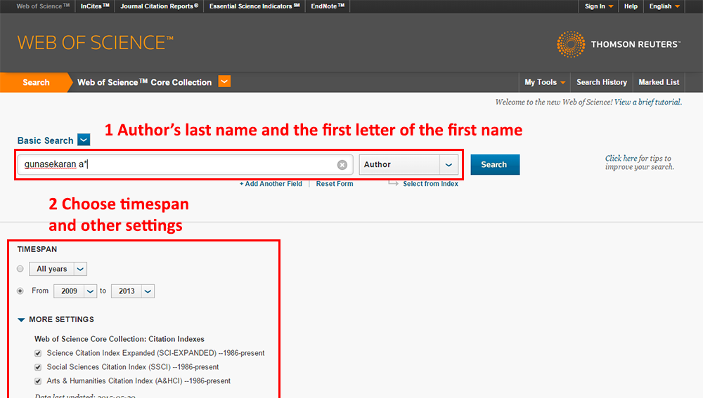
Web of Science H-index
An h-index of 20 means there are 20 items that have 20 citations or more.

Slide 14
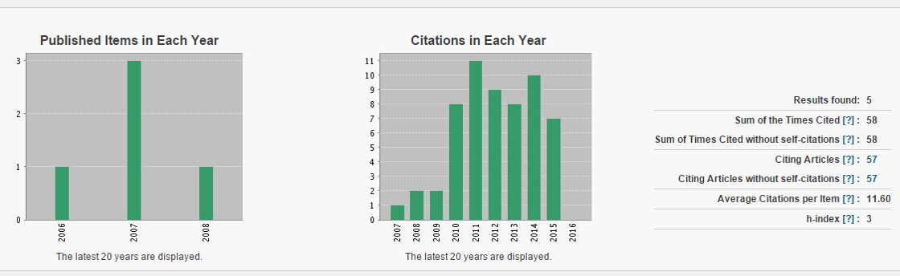
Web of Science Citation Profile for Pausch, Randy

Slide 15
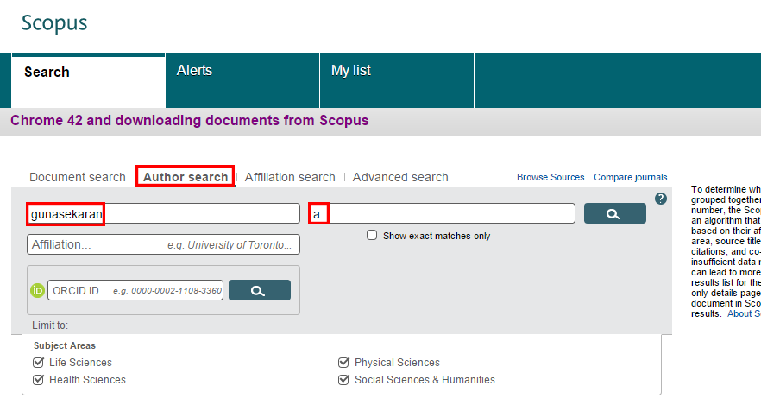
Scopus – finding author’s level metrics

Slide 16
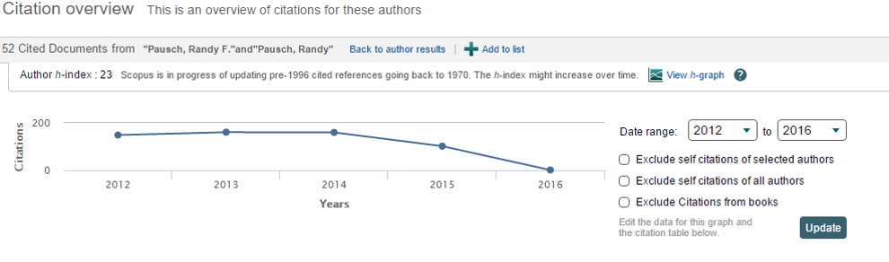
Scopus metrics – author h-index

Slide 17
Limitations of H-index
Does not give an accurate measure for early-career researchers.
Calculated by using only articles that are indexed by particular Indexing Service (Web of Science or Scopus).
Calculation is based on different timeframe (by institutional subscription, such as Web of Science, or by a certain date, such as Scopus).

Slide 18
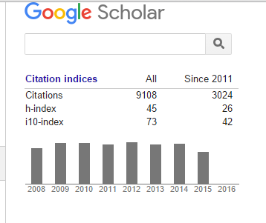
Google Scholar i10-Index
i10-Index = the number of publications with at least 10 citations

Slide 19
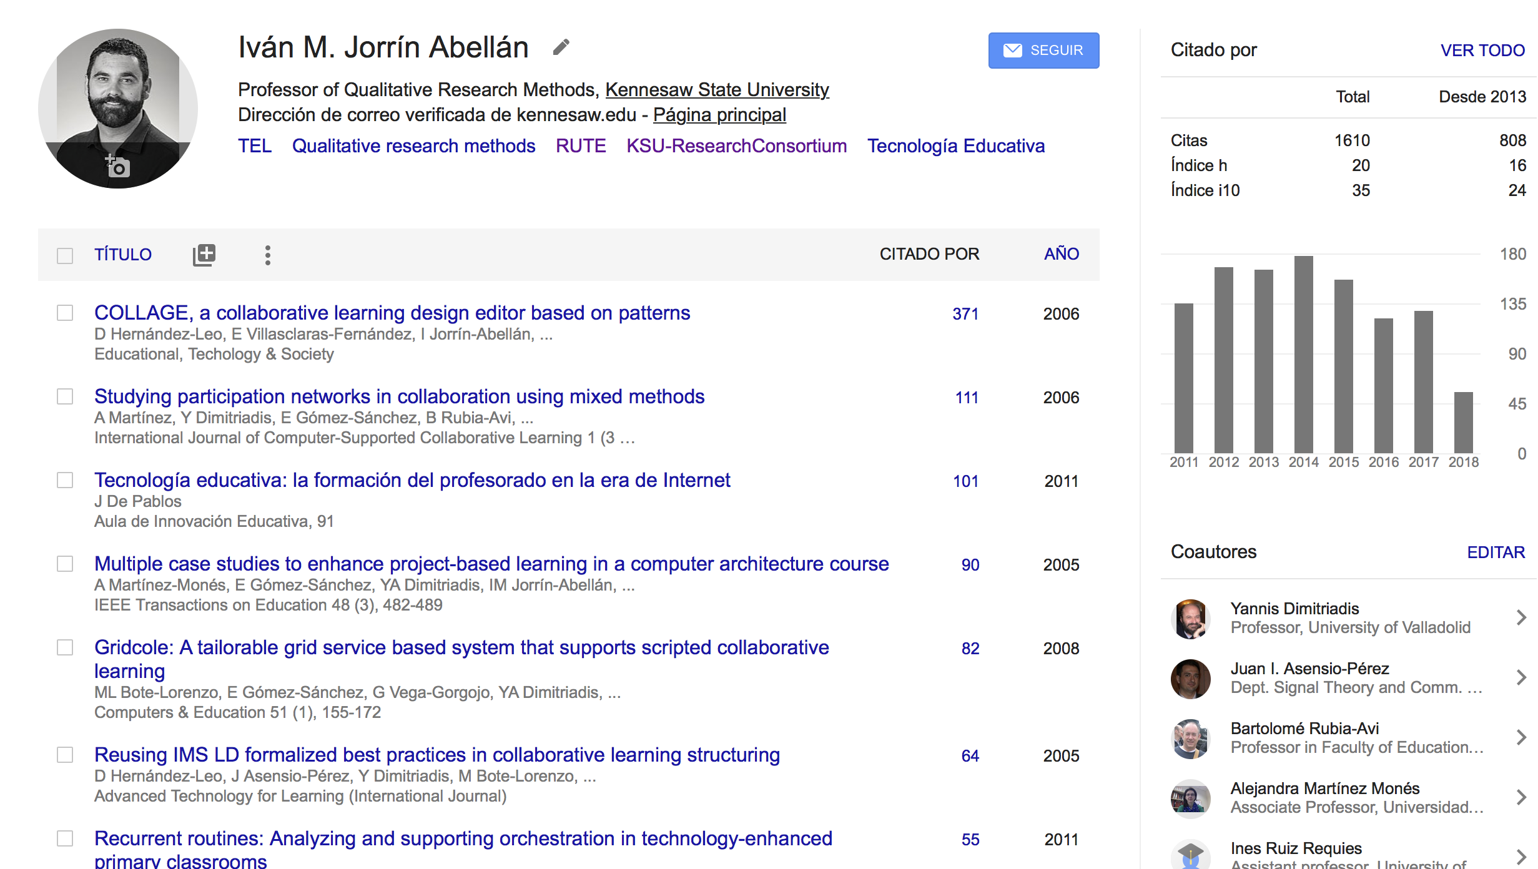
Google Scholar Profile for Dr. Jorrin Abellan

Slide 20
Altmetrics
These are common tools for measuring altmetrics or alternative research impact:
ImpactStory
Altmetric.com
PlumAnalytics (EBSCOhost and other databases)
IR (institutional repositories)
Learn more here https://libguides.kennesaw.edu/RI/altmetrics

Slide 21
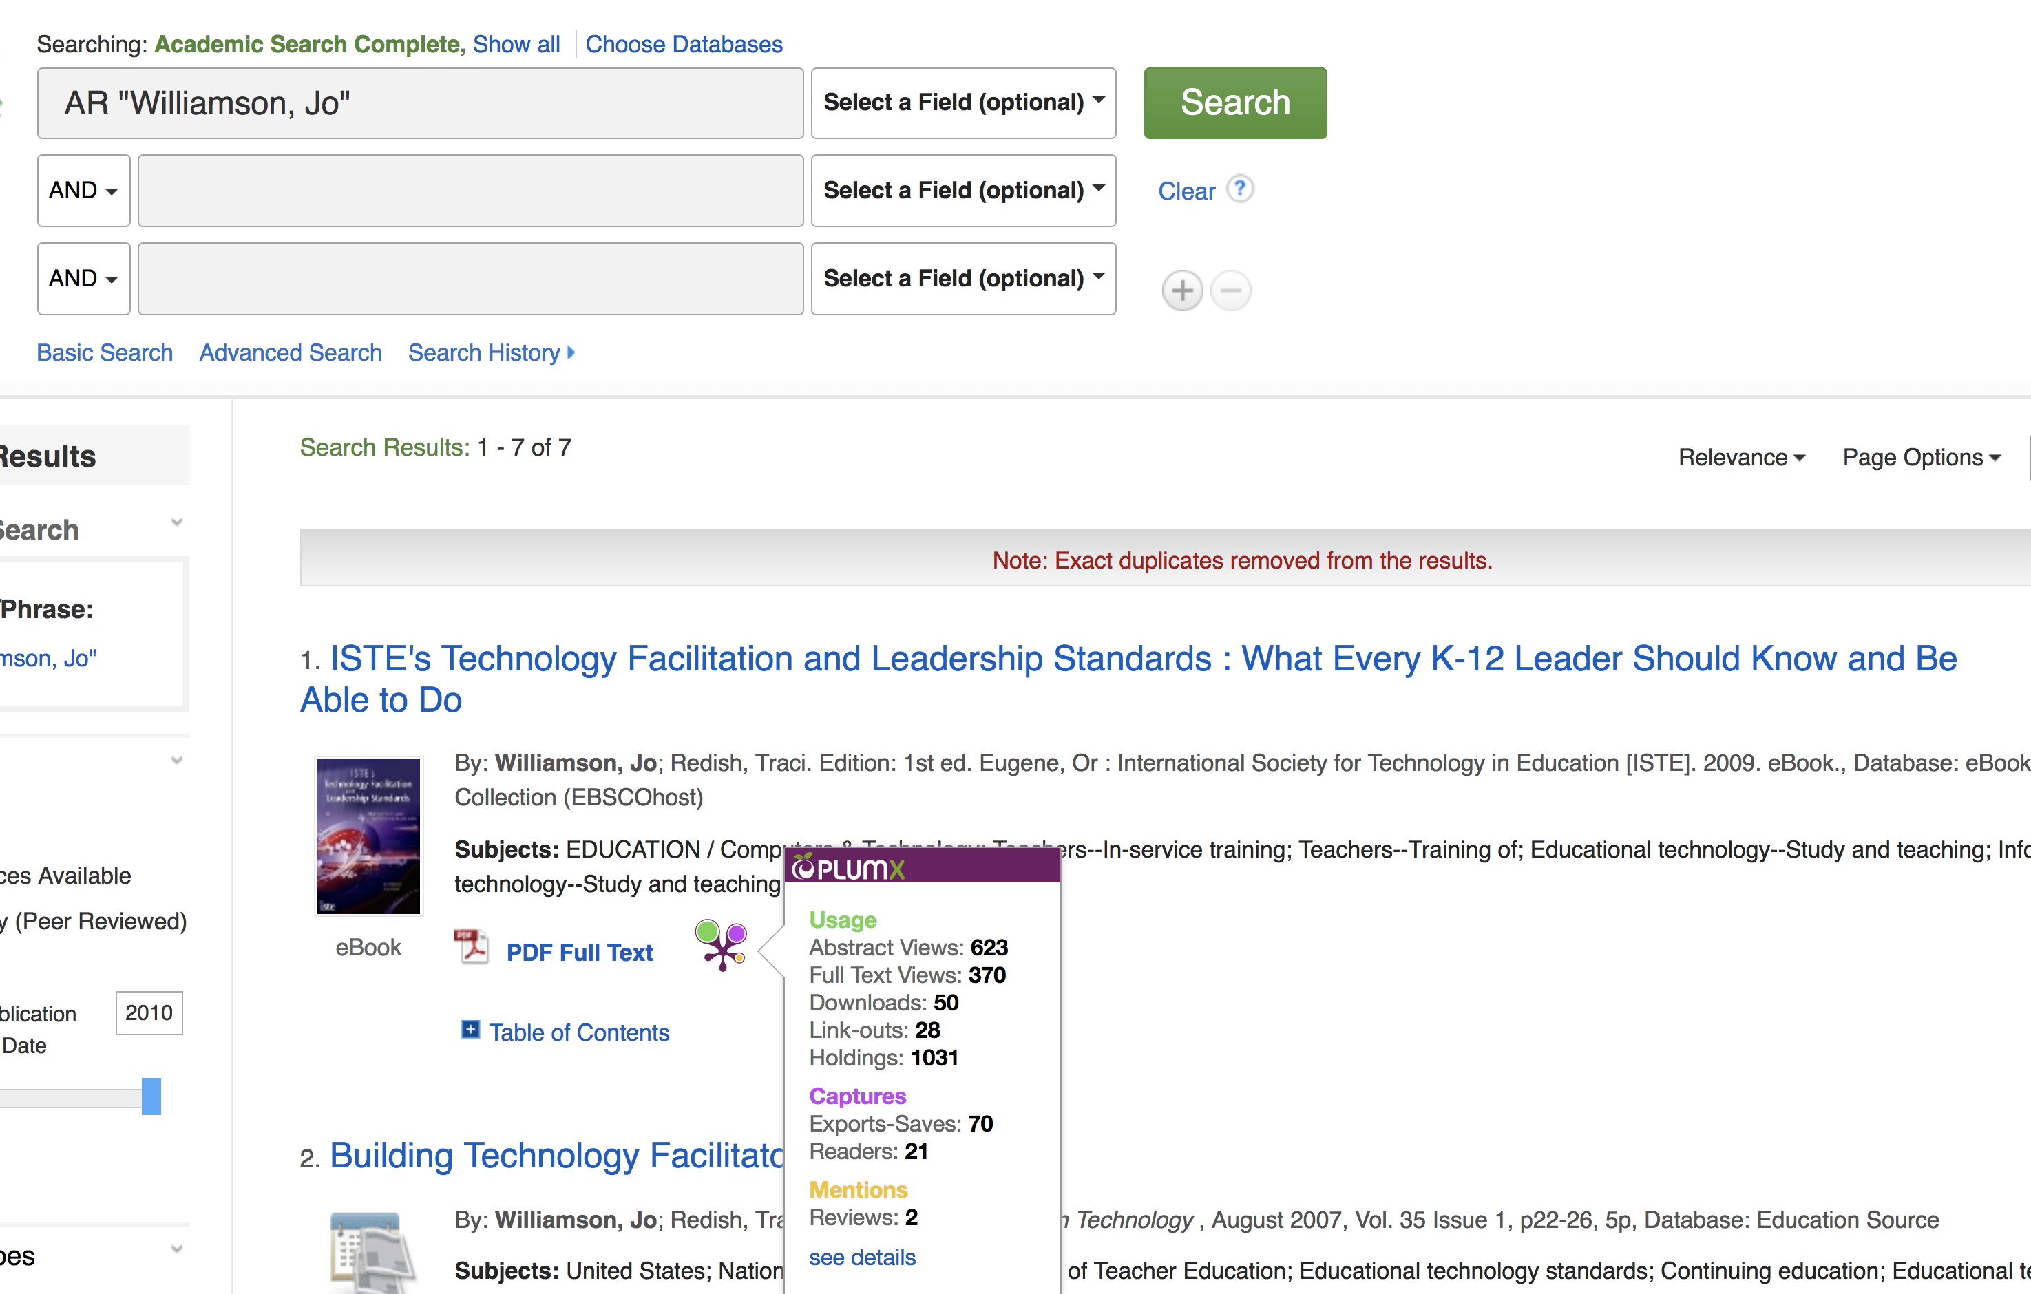
PlumX metric in EBSCOhost databases

Slide 22
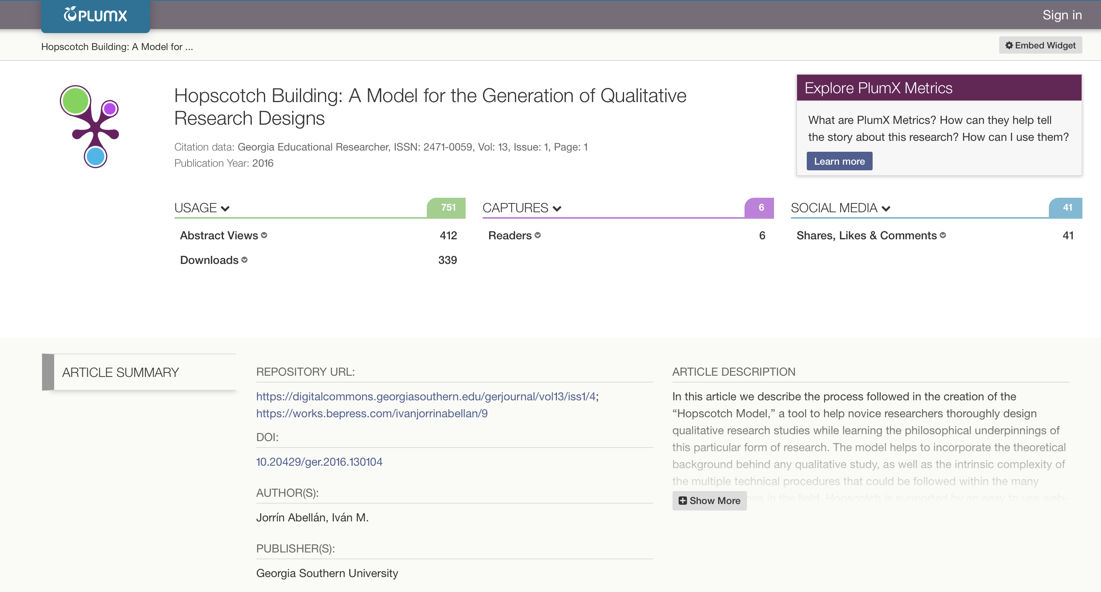

Slide 23
Author’s Profile
Academia.edu
Mendeley
ResearchGate
Vivo
Google Scholar Profile
SciENcv
MyScienceWork
Selected Work Gallery
All hyperlinks to academic profile services are available here
https://libguides.kennesaw.edu/RI/profile

Slide 24
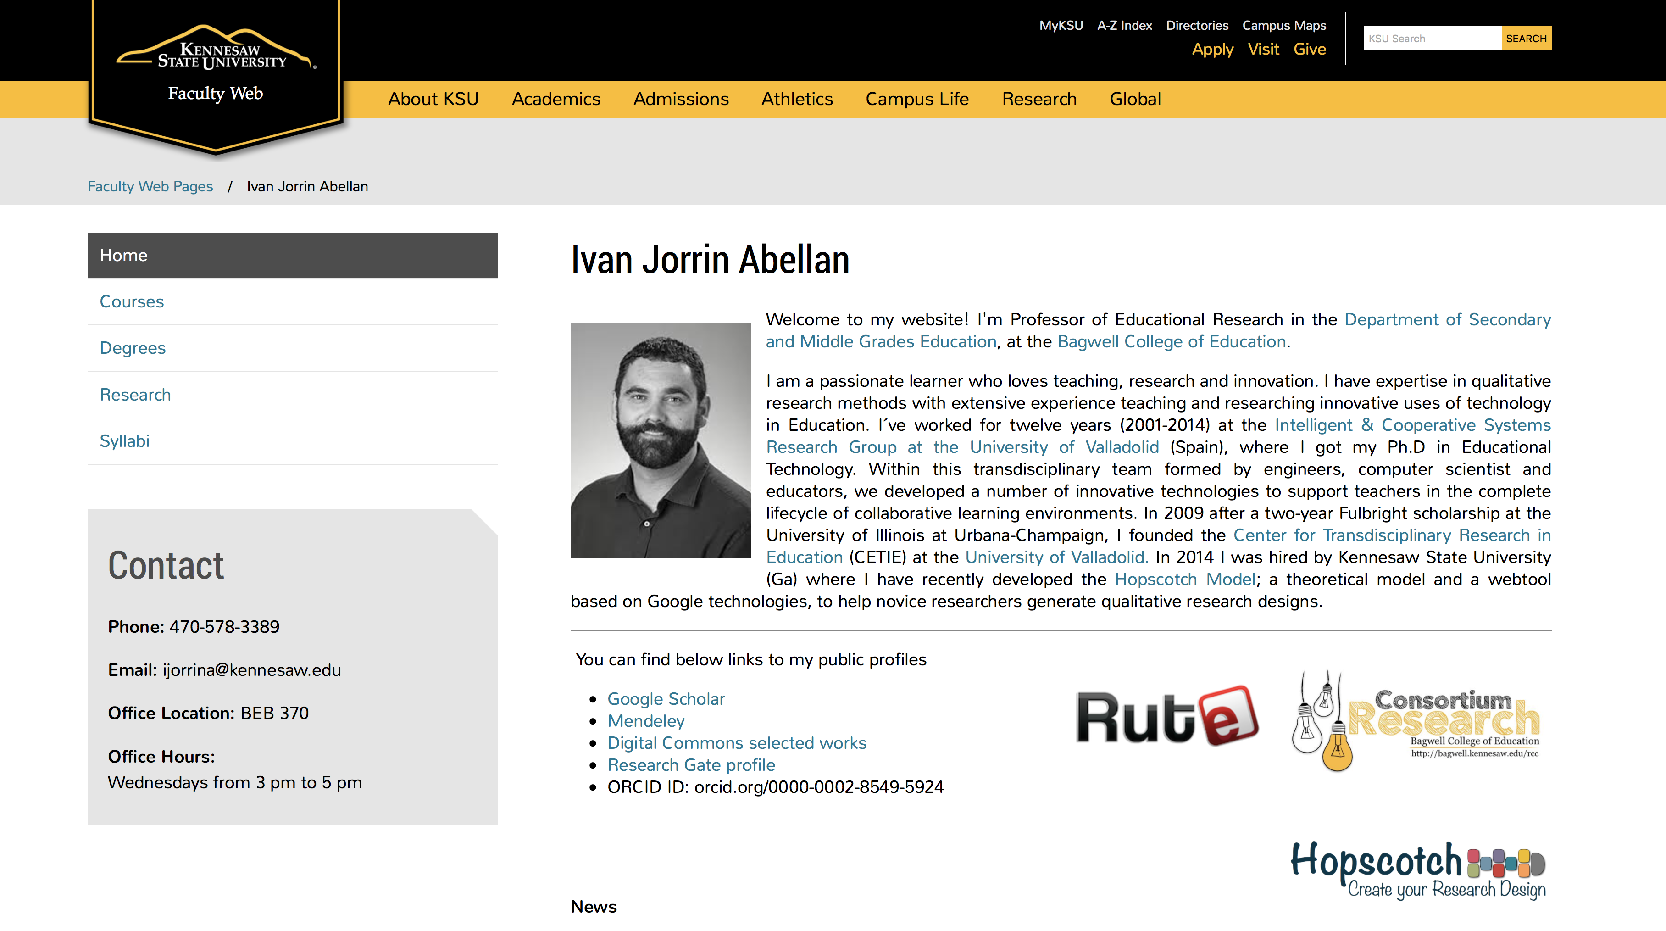
Author’s website

Slide 25
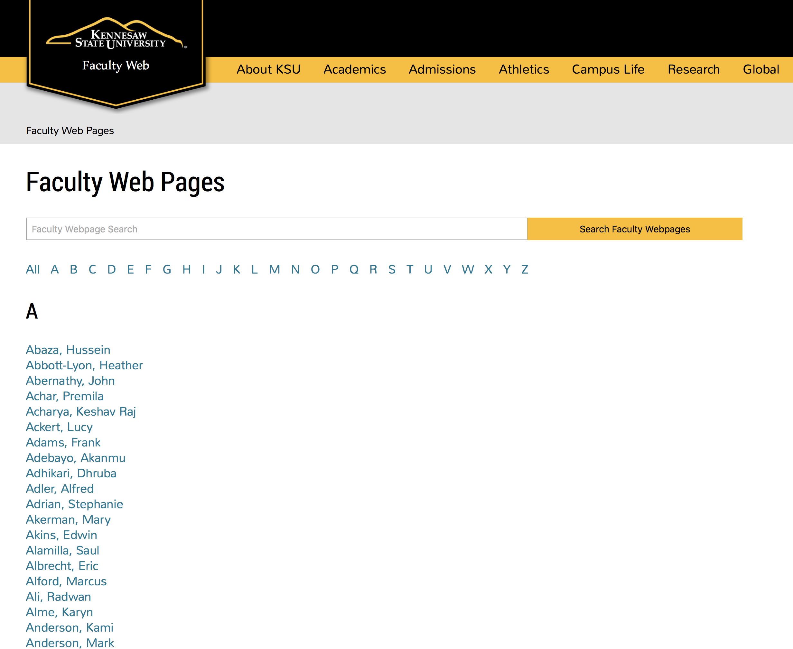
Author’s website
If you want to create your website within http://facultyweb.kennesaw.edu
send an email to <service@kennesaw.edu>

Slide 26
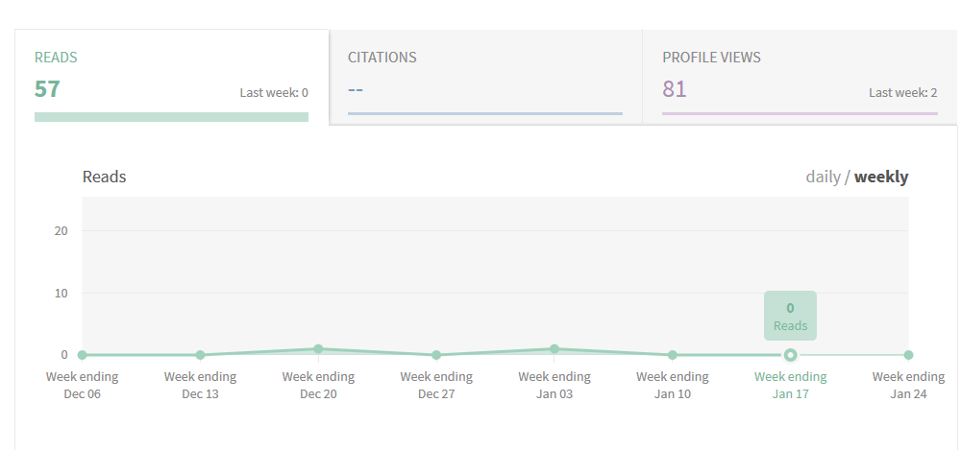
Example of Metrics from Academic Profile Services (ResearchGate)
How is your RG Score calculated?
ResearchGate calculates your score based on how other researchers interact with your content, how often, and who they are. The higher their score, the more yours will increase.

Slide 27
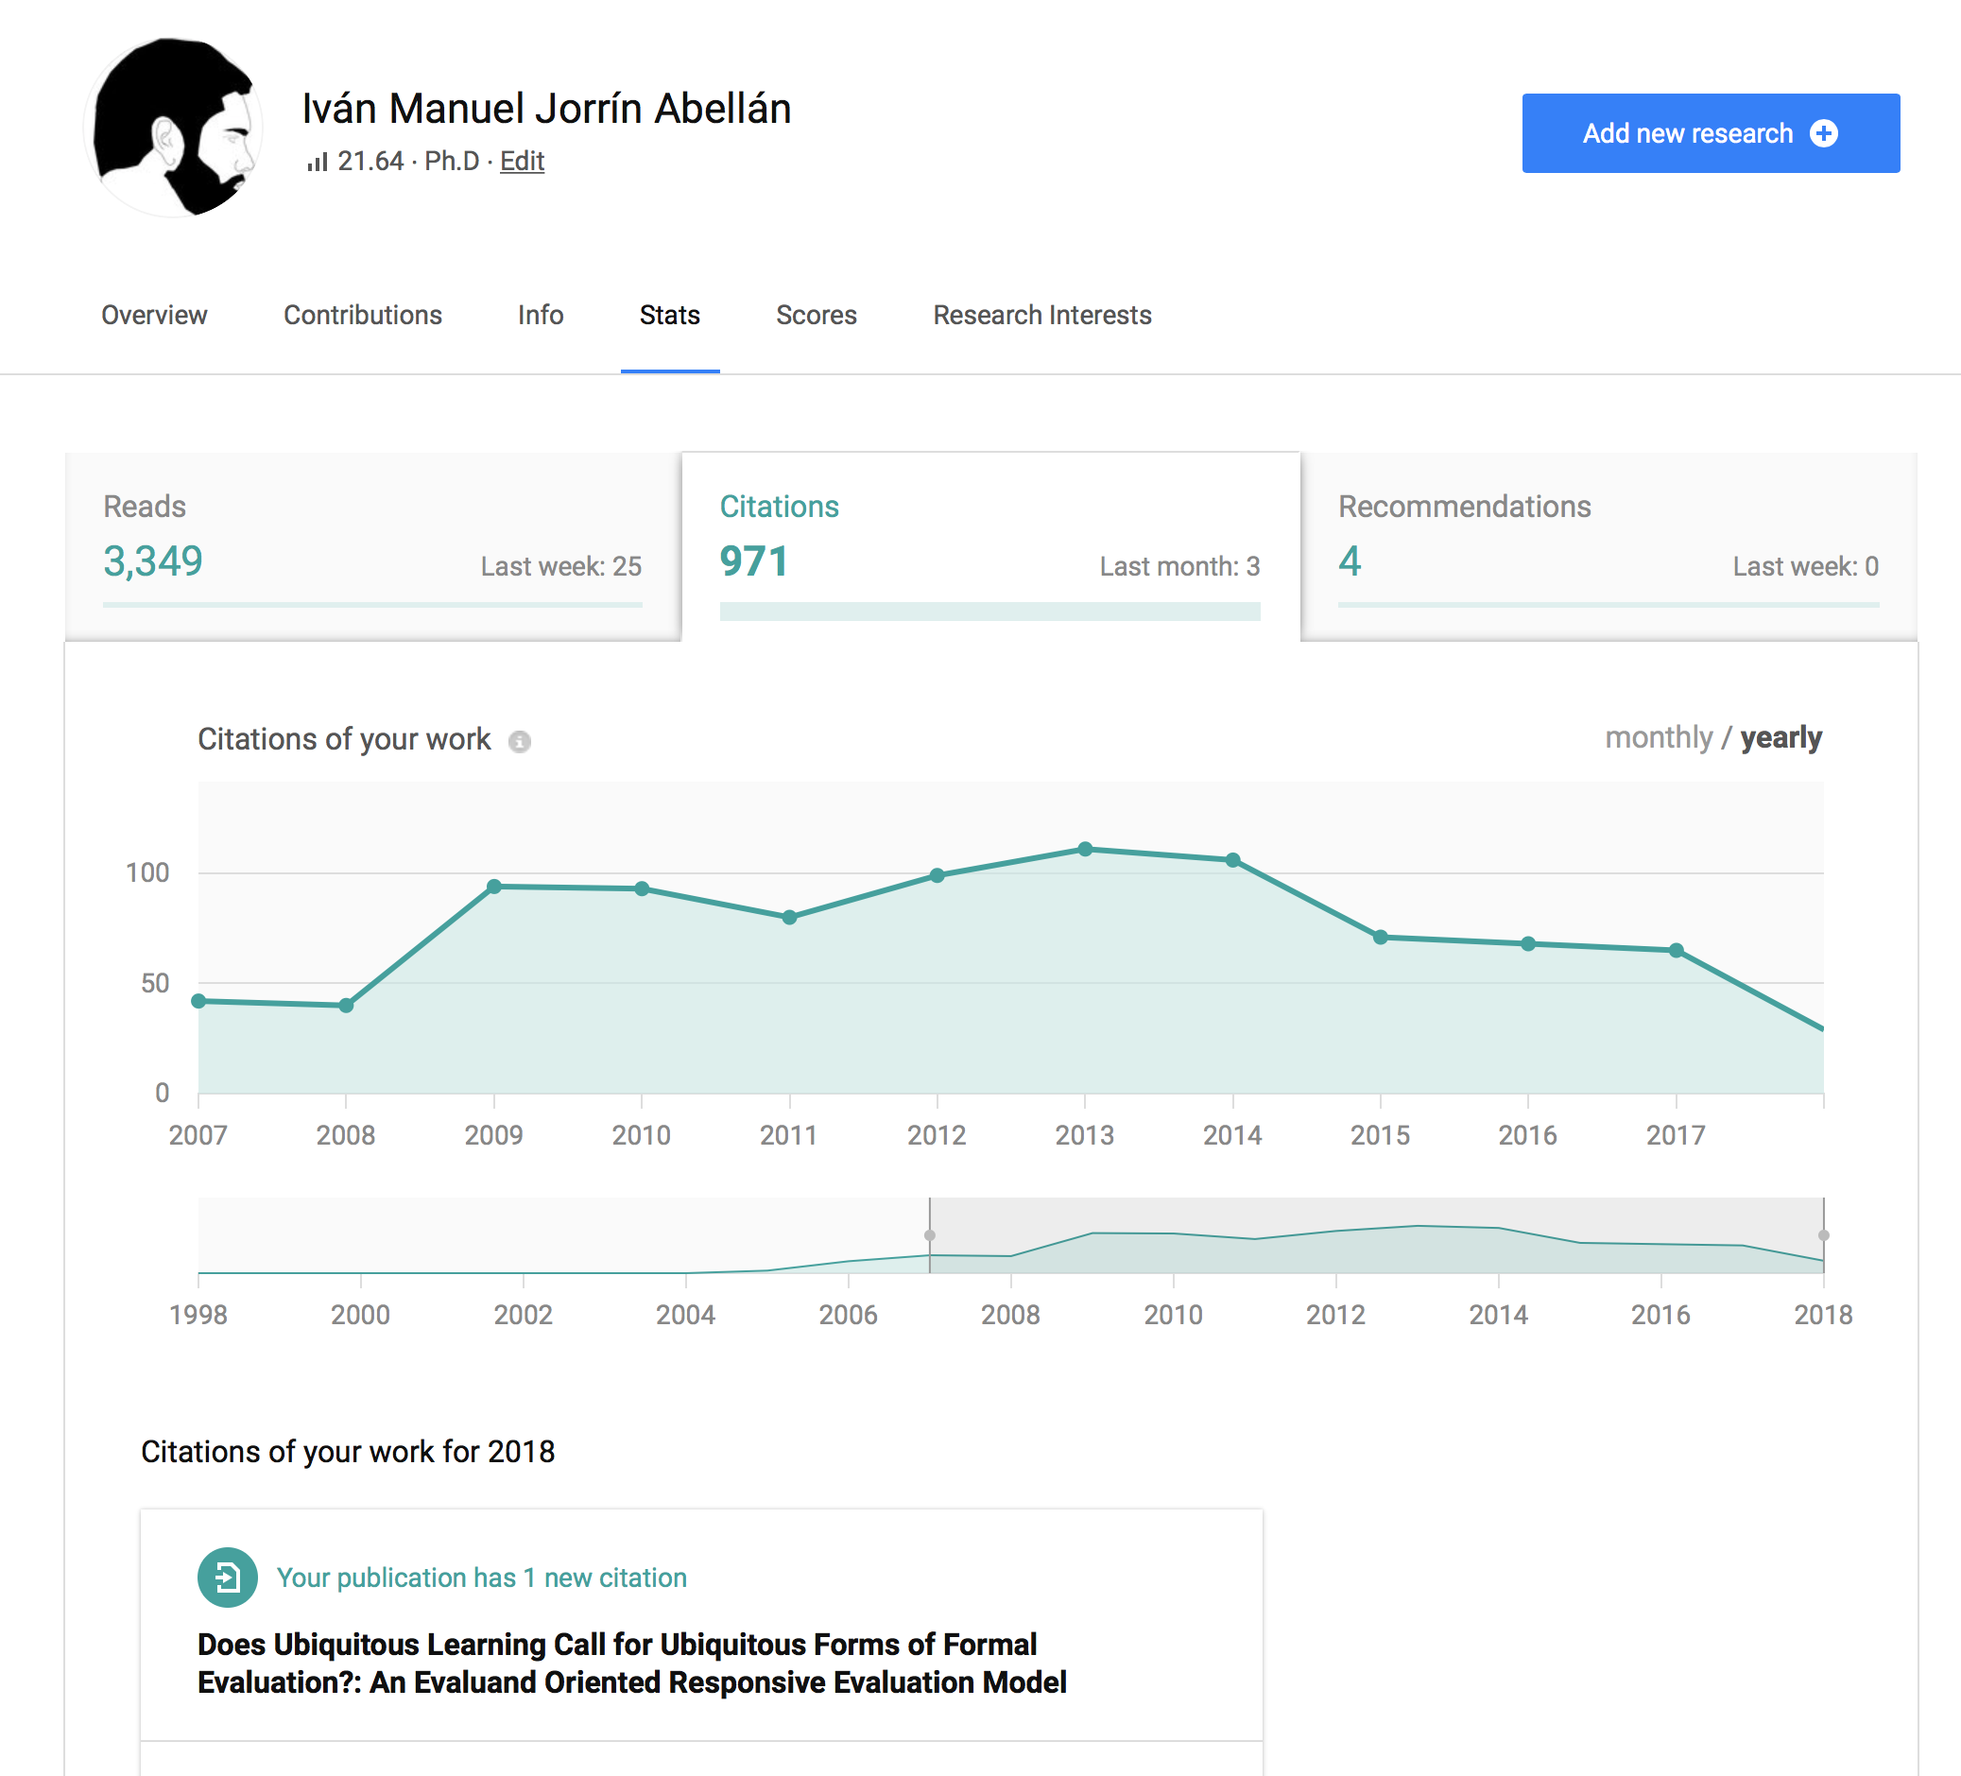
Research Gate

Slide 28
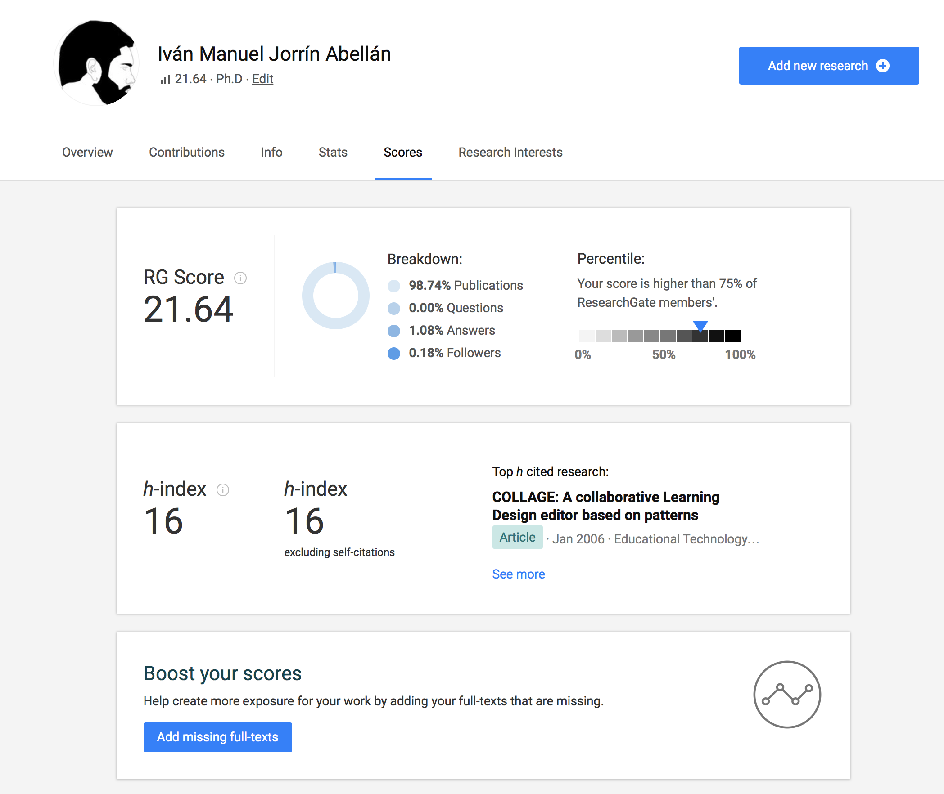
ResearchGate

Slide 29
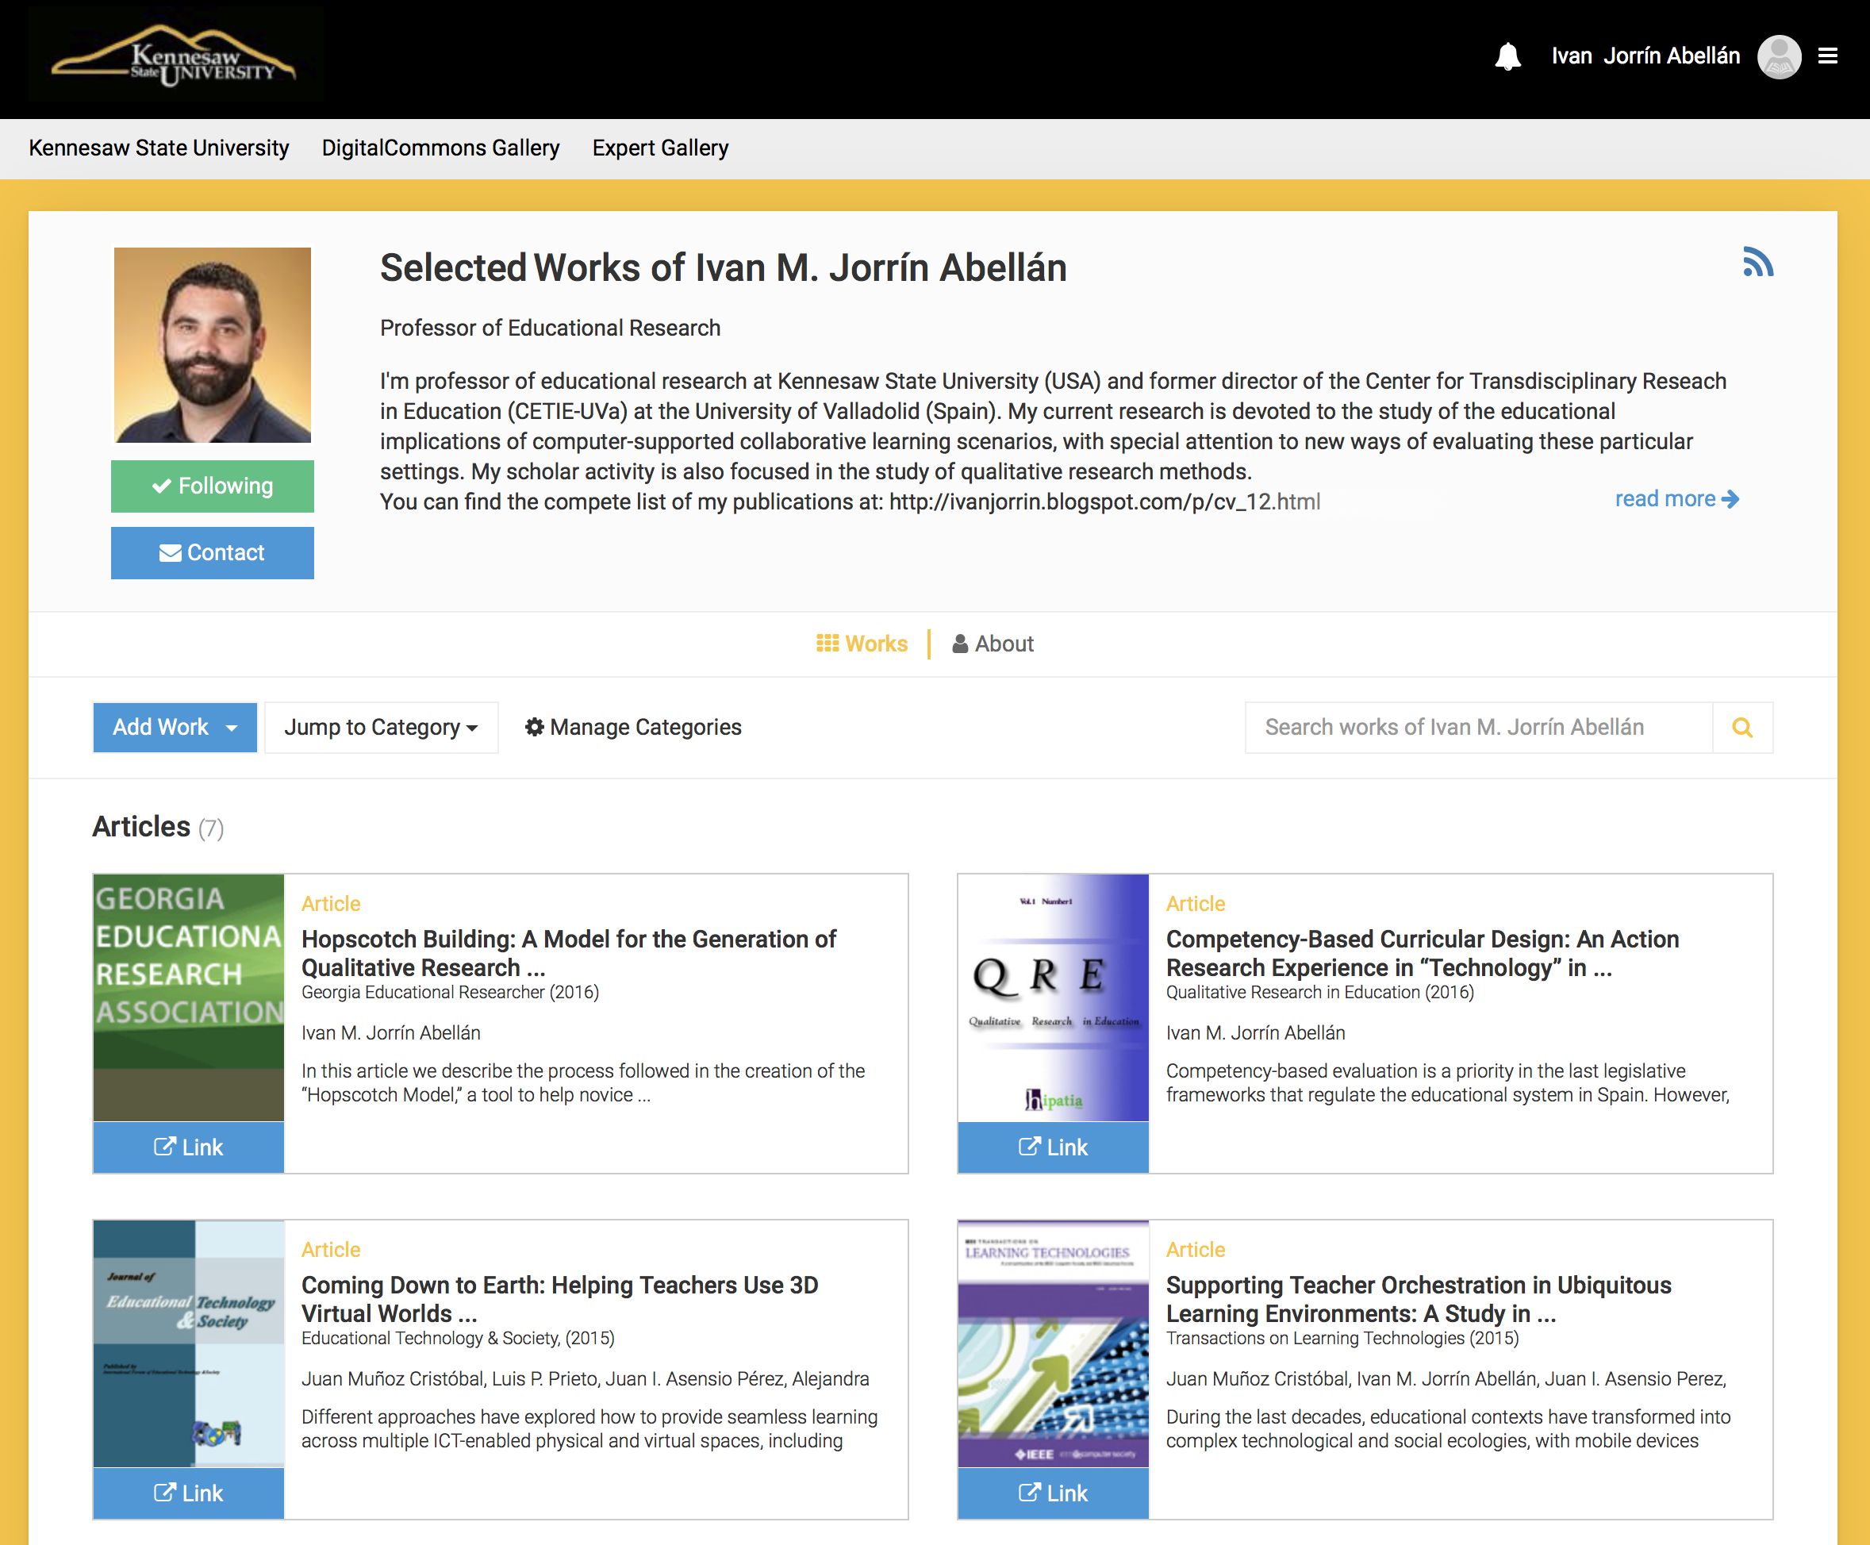

Slide 30
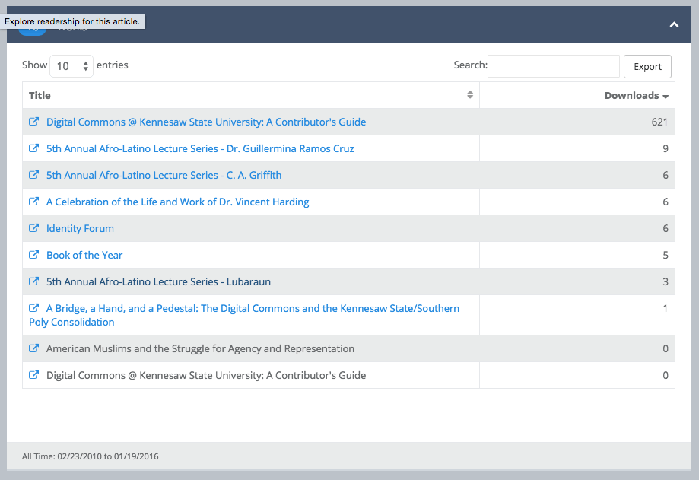
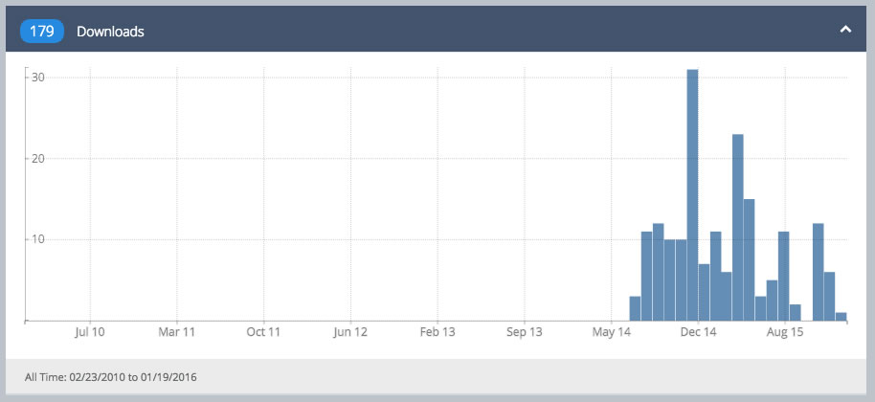
KSU Digital Commons SelectedWorks Metrics (Downloads)
SelectedWorks http://digitalcommons.kennesaw.edu/sw_gallery.html

Slide 31
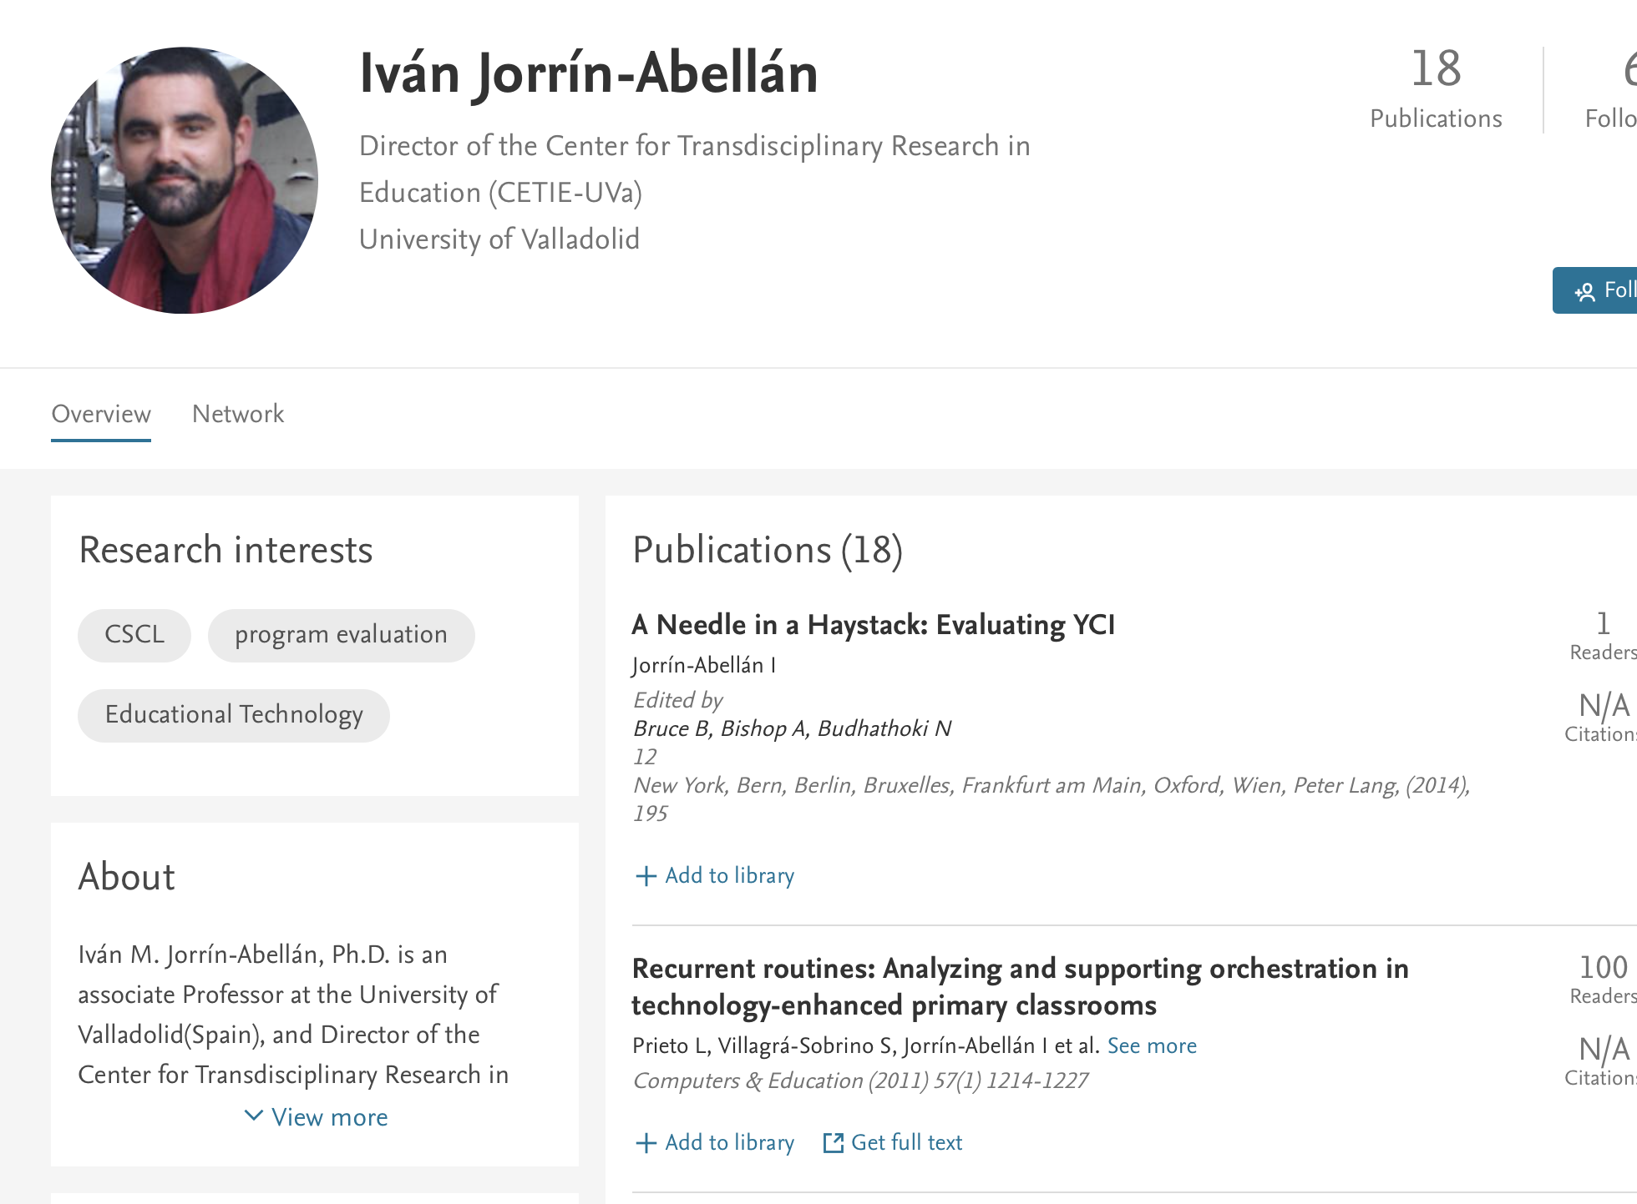
Mendeley

Slide 32
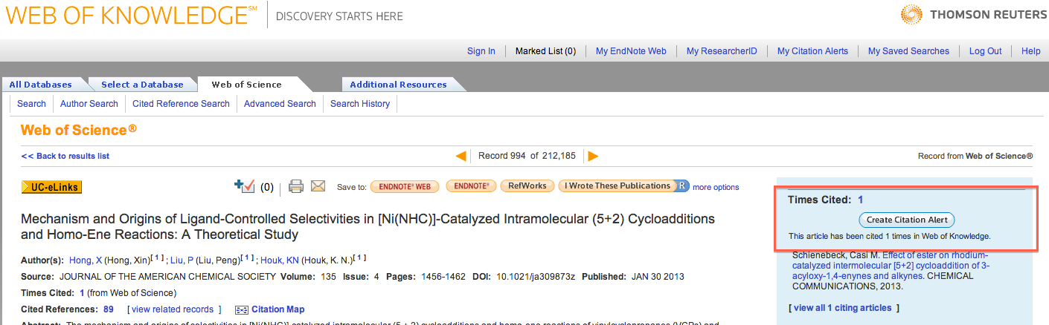
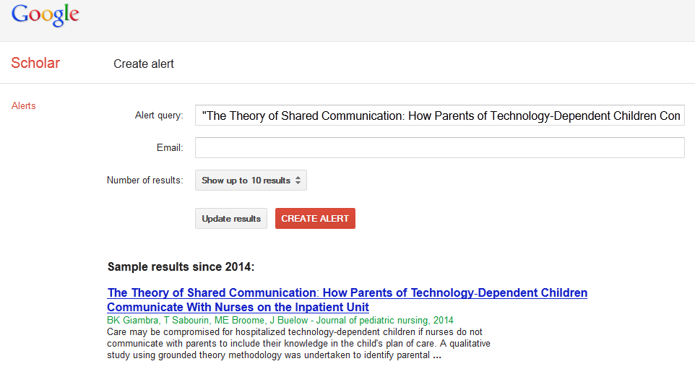
Citation Alerts
Who provide citation alerts?
Journals
Indexing services
Author profiling or social networking sites

Slide 33
Total Impact
There is a trend to calculate an author’s impact beyond academia and include less traditional publications and impact on practitioners & practice.
There is a need to create new algorithms that combine citation counts and include the qualitative analysis of scholarship
Authors should be aware and active participants in the process of research assessment

Slide 34
Learn more about research impact at:
http://libguides.kennesaw.edu/RI

