Slide 1
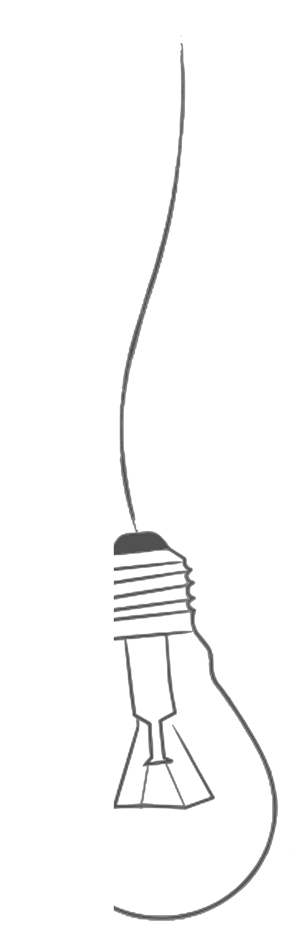


The rise and fall of the virtual community of scholars
Dr. Olga Koz, Graduate Education Librarian okoz@kennesaw.edu

Slide 2
Table of Content
Community
About
Development
Stumbling Blocks
Librarian
Role
Growth
Challenges
Platform

Slide 3
Scholarly communication - “the system through which research and other scholarly writings are created, evaluated for quality, disseminated to the scholarly community, and preserved for future use. The system includes both formal means of communication, such as publication in peer-reviewed journals, and informal channels, such as electronic listservs.” (ARL, “Principles and Strategies for the Reform of Scholarly Communication 1,” 2003)

Slide 4
Scholarly Communication
Formal
Informal
Channels
Publishing
Repositories
Community of Practice
Social media
Formal education
Meetings
Informal Learning, LPN

Slide 5
Community of researchers or Community of Practice (CoP)
Communities of practice (CoP) are groups of people who share a concern or a passion for something they do and learn how to do it better as they interact regularly
(E. Wenger)
CoP are important by themselves but in scholarly communication so their connection to the outside world
Notes:
such as support for members interacting with each other, sharing knowledge, and building a sense of belonging within networks/teams/groups. Interventions that facilitate relationship building among members and that promote knowledge exchange may be useful for optimizing the function of these groups.

Slide 6
Our CoP (Research Consortium)?
“Faculty driven organization dedicated to supporting Bagwell College of Education faculty and graduate students in going through the full research cycle.”
Each college department sends a representative to serve on the committee.
In addition, RC Committee consists of non-voting but hard working members/consultants:
Methodologists (QUAN/QUAL/Research Synthesis)
Grants Support Specialist
Editor- in-Residence

Slide 7
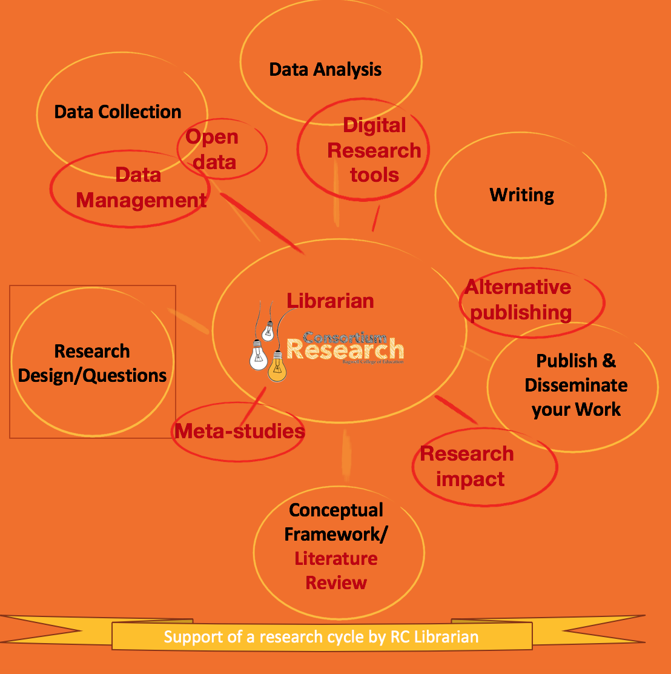
In Red Circles – Librarian’s add-on services for RC
In yellow circles- original model of RC services based on a research cycle, developed by Dr. Jorrin-Abellan (RC Methodologist)

Slide 8
RC Librarian, Intranet Community Manager
Individual Consultations
Workshops & Events
  How to increase your research Impact (together with Dr. Jorrin-Abellan)
  Writing and Publishing in High Impact Journals (03/18/2016) (Drs. Jorrin-Abellan & Wallace)
  Research Synthesis/Scientometrics/Knowledge Maps (Dr. Koz & Romero)
  Lunch with a Librarian (Q&A)
  Meeting with the Digital Common (IR) Manager
  Meeting with the Scholarly Communication Librarian

Slide 9
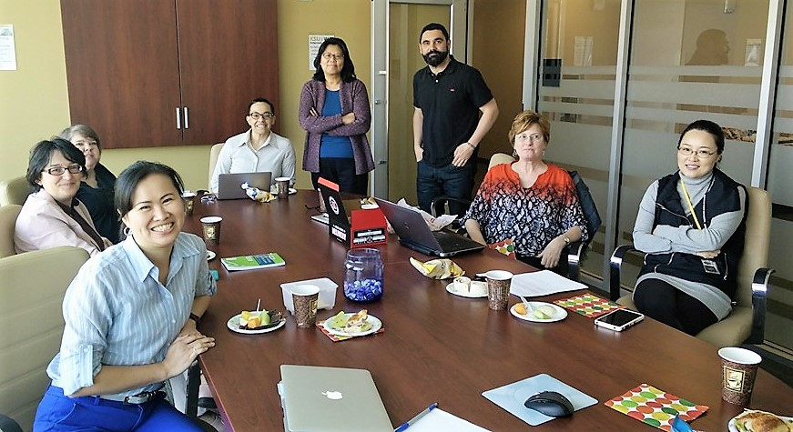
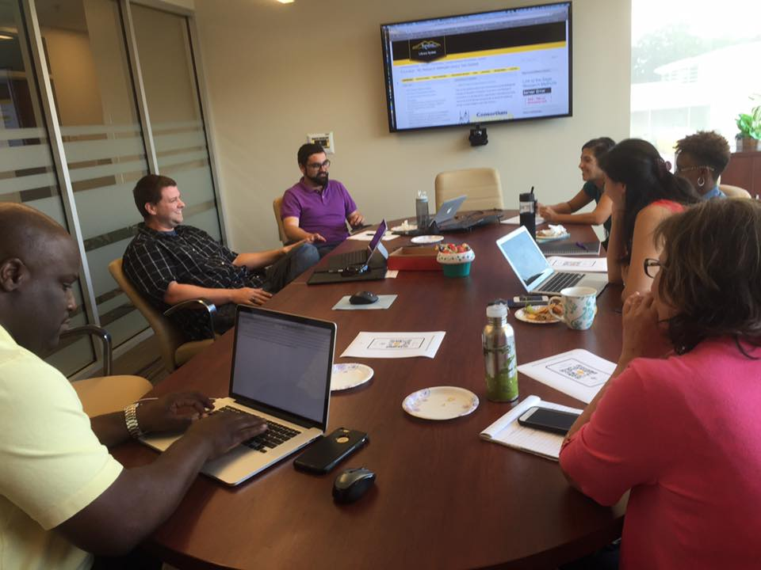
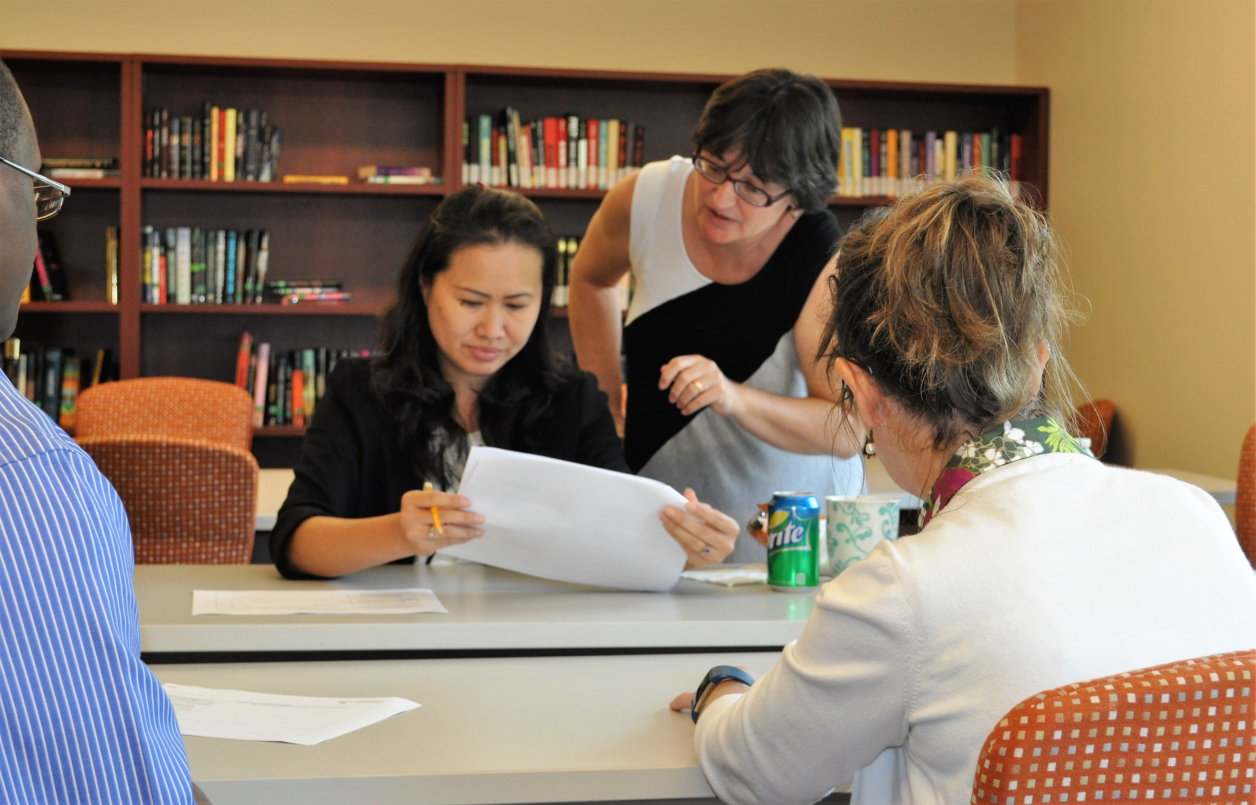
WRITE DAYS
Active Face2Face Community
Stink-eye

Slide 10
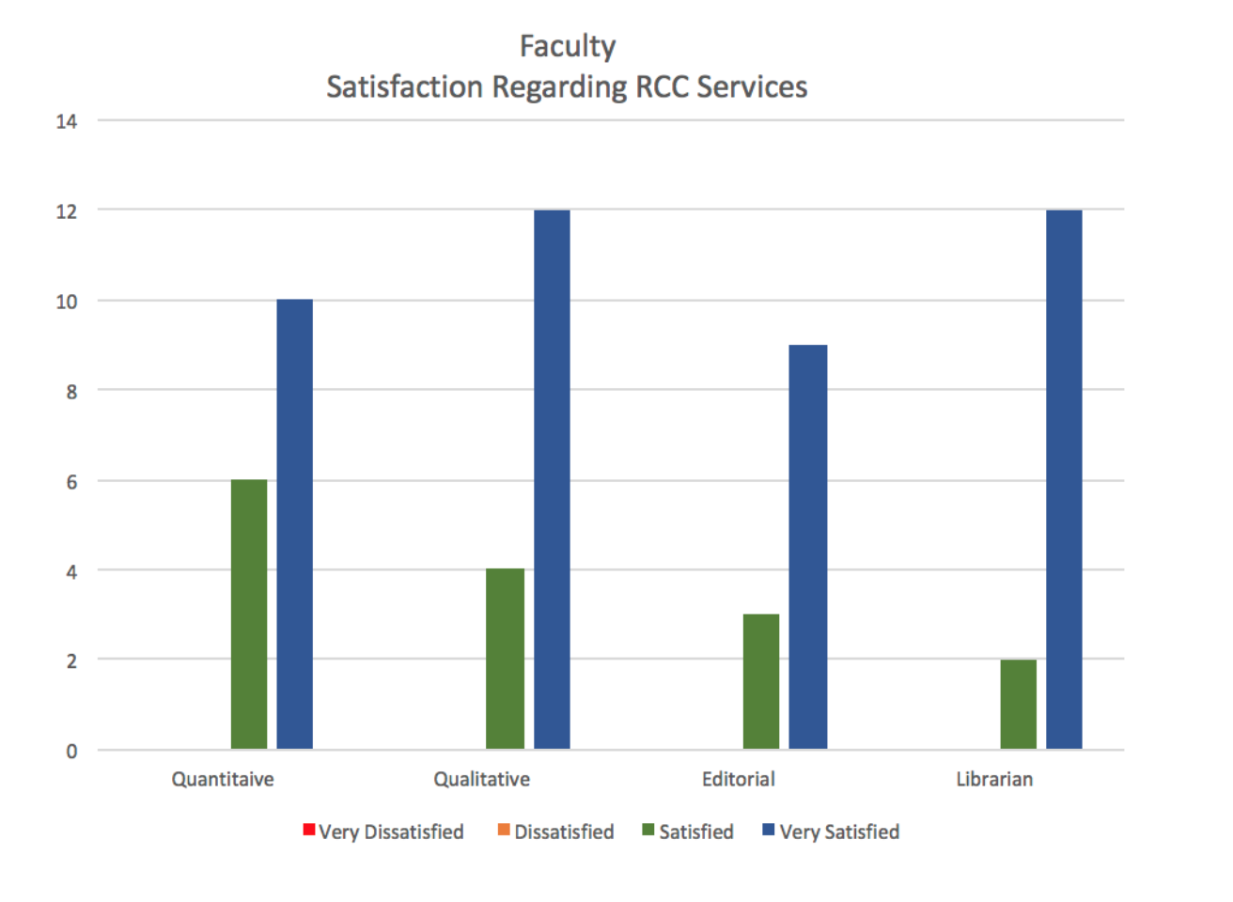
Needs Assessment
User satisfaction survey

Slide 11
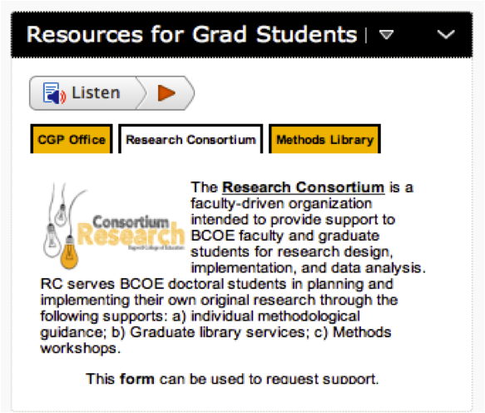
RC Platforms
Static platforms
Website: http://bagwell.kennesaw.edu/research-consortium/index.php
Research Methods Library: http://libguides.kennesaw.edu/edu_rcc
Digital Commons (BePress)
D2L (Learning Management System)
Social-Networking Platforms
Facebook: https://www.facebook.com/groups/RC4BCOE
Office 365 Team and SharePoint site
Failed: Mendeley, Academia.edu, ResearchGate,
Ning,

Slide 12
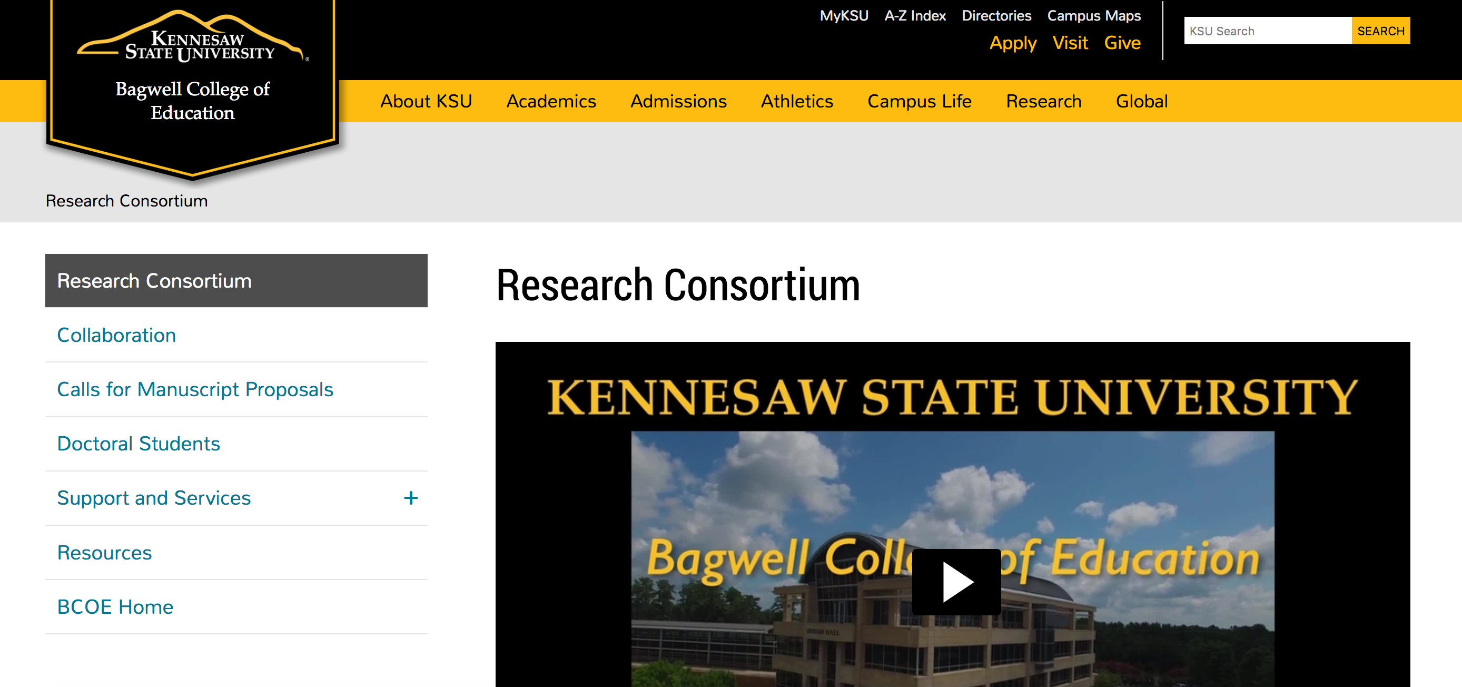
Research consortium website and video

Slide 13
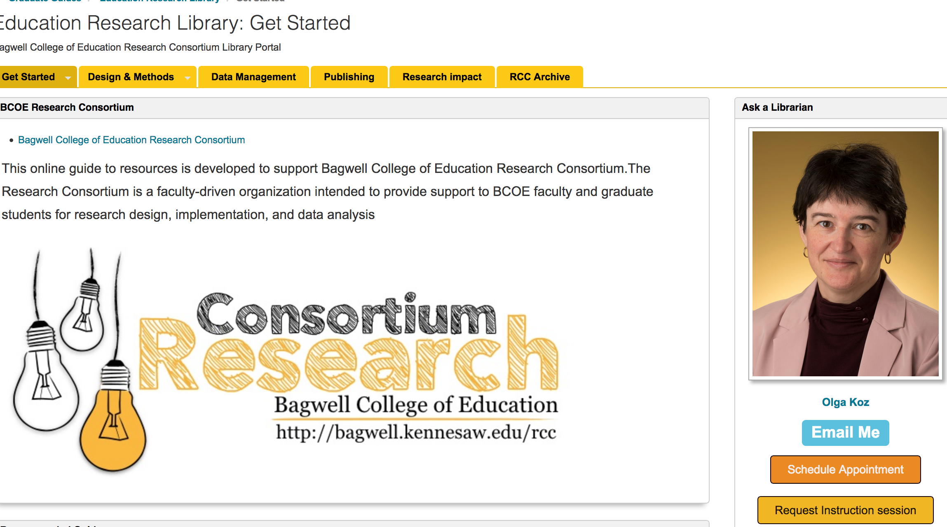
Portal for RC Research Library (LibGuides from Springshare)

Slide 14

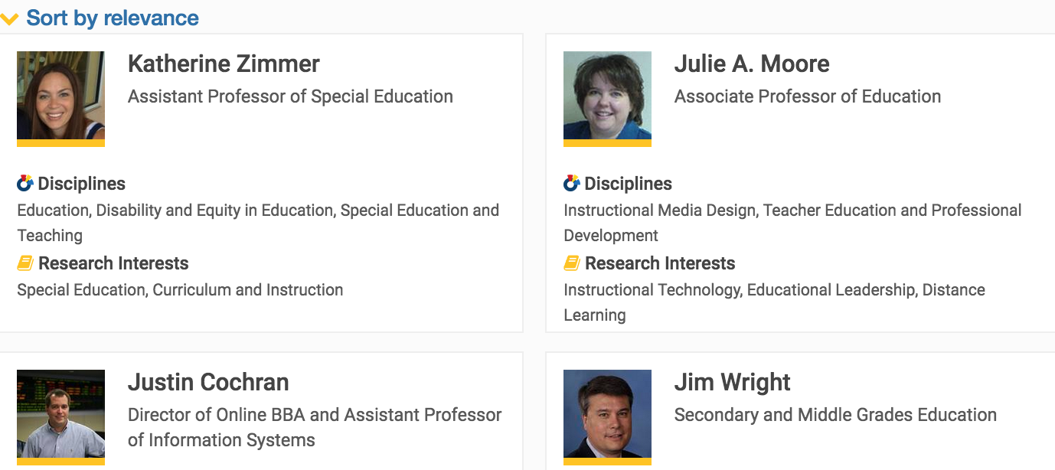

Slide 15
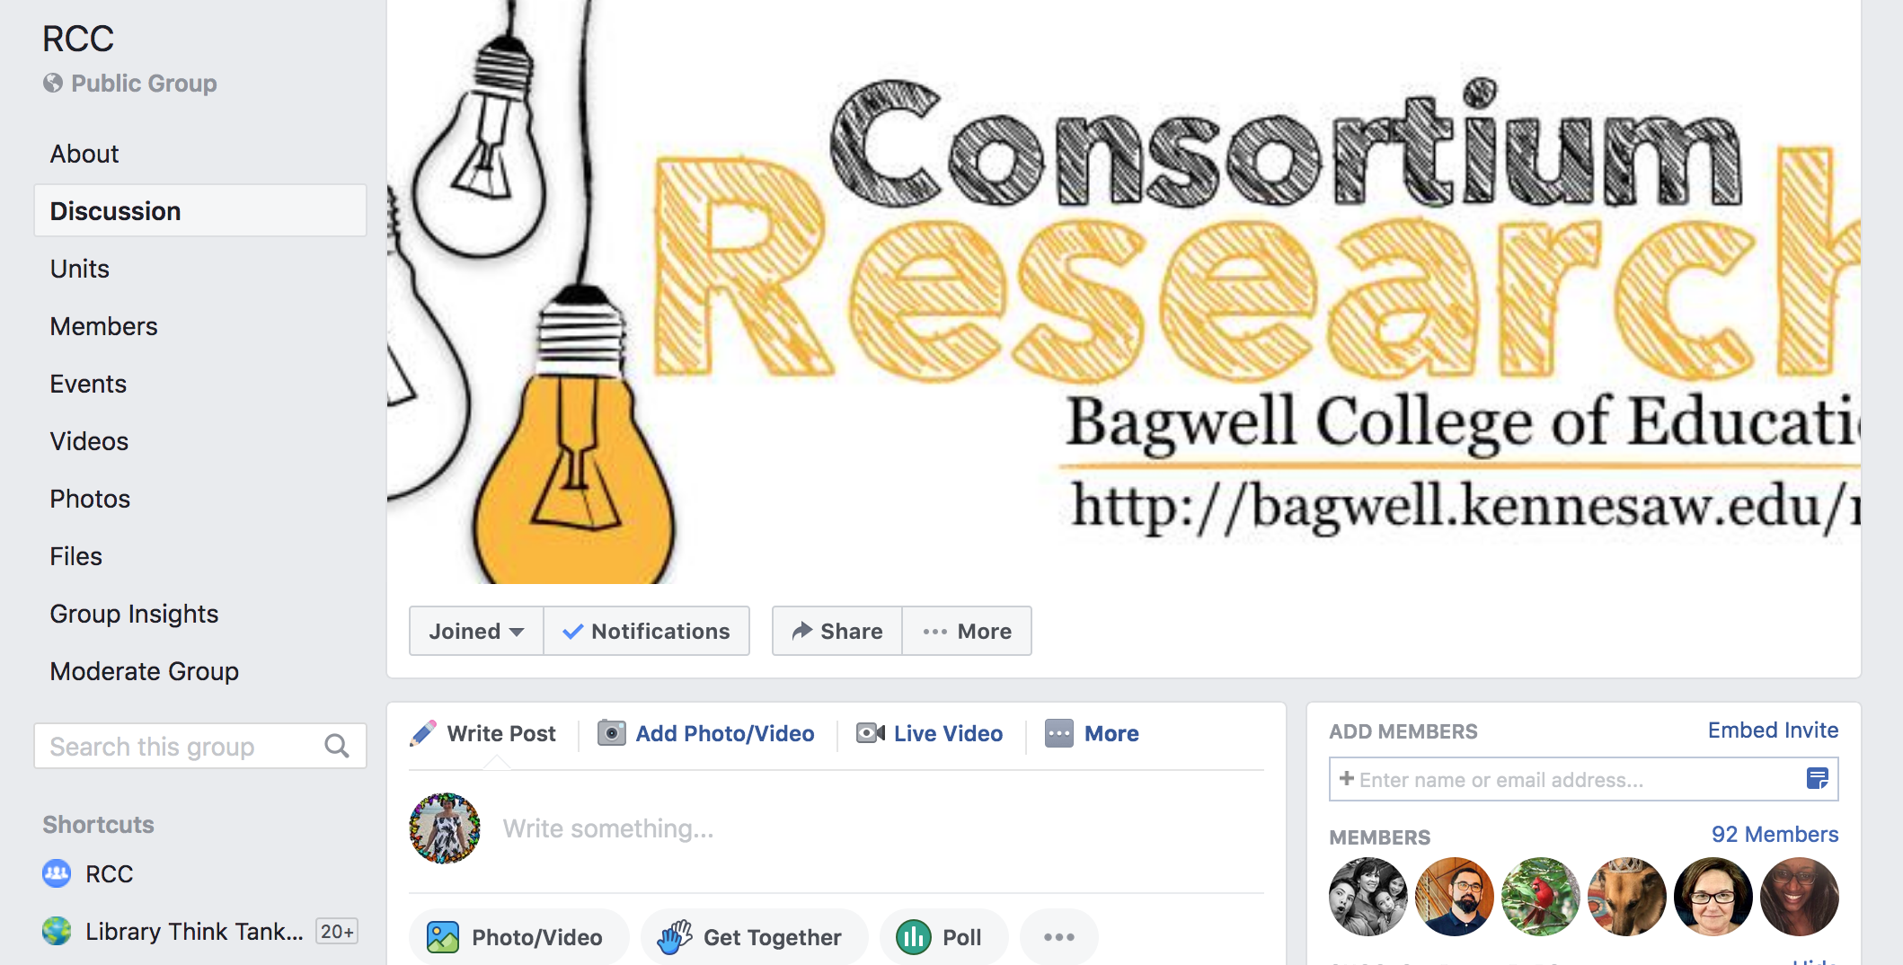
Facebook page/group

Slide 16
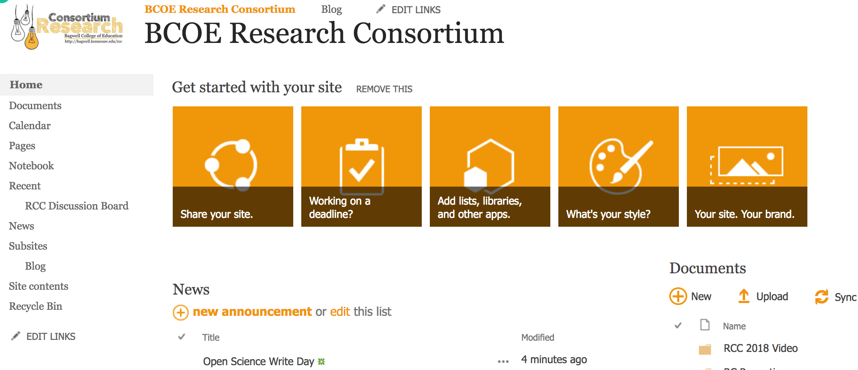
SharePoint Site

Slide 17
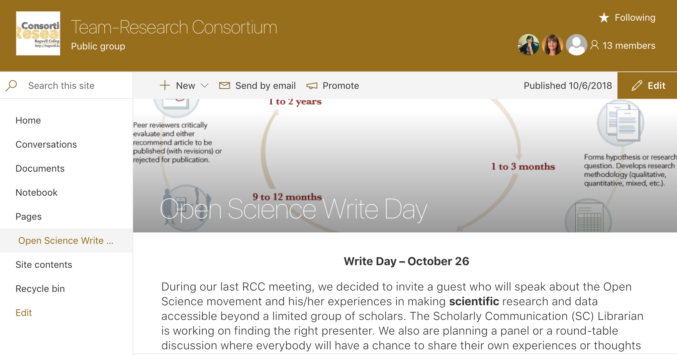
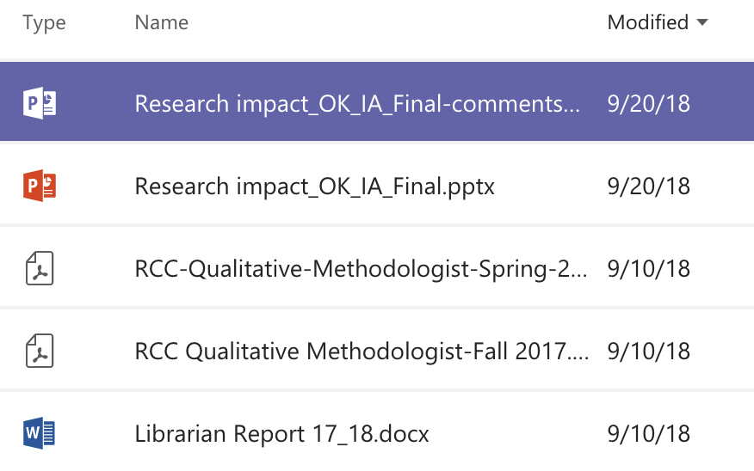
Office 365 Team

Slide 18
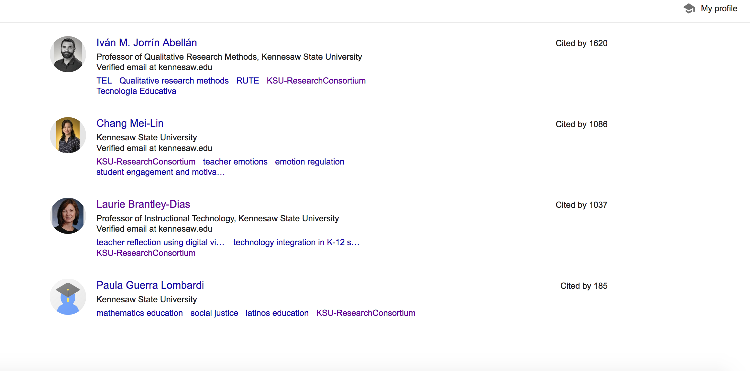
Google Scholar Profiles

Slide 19
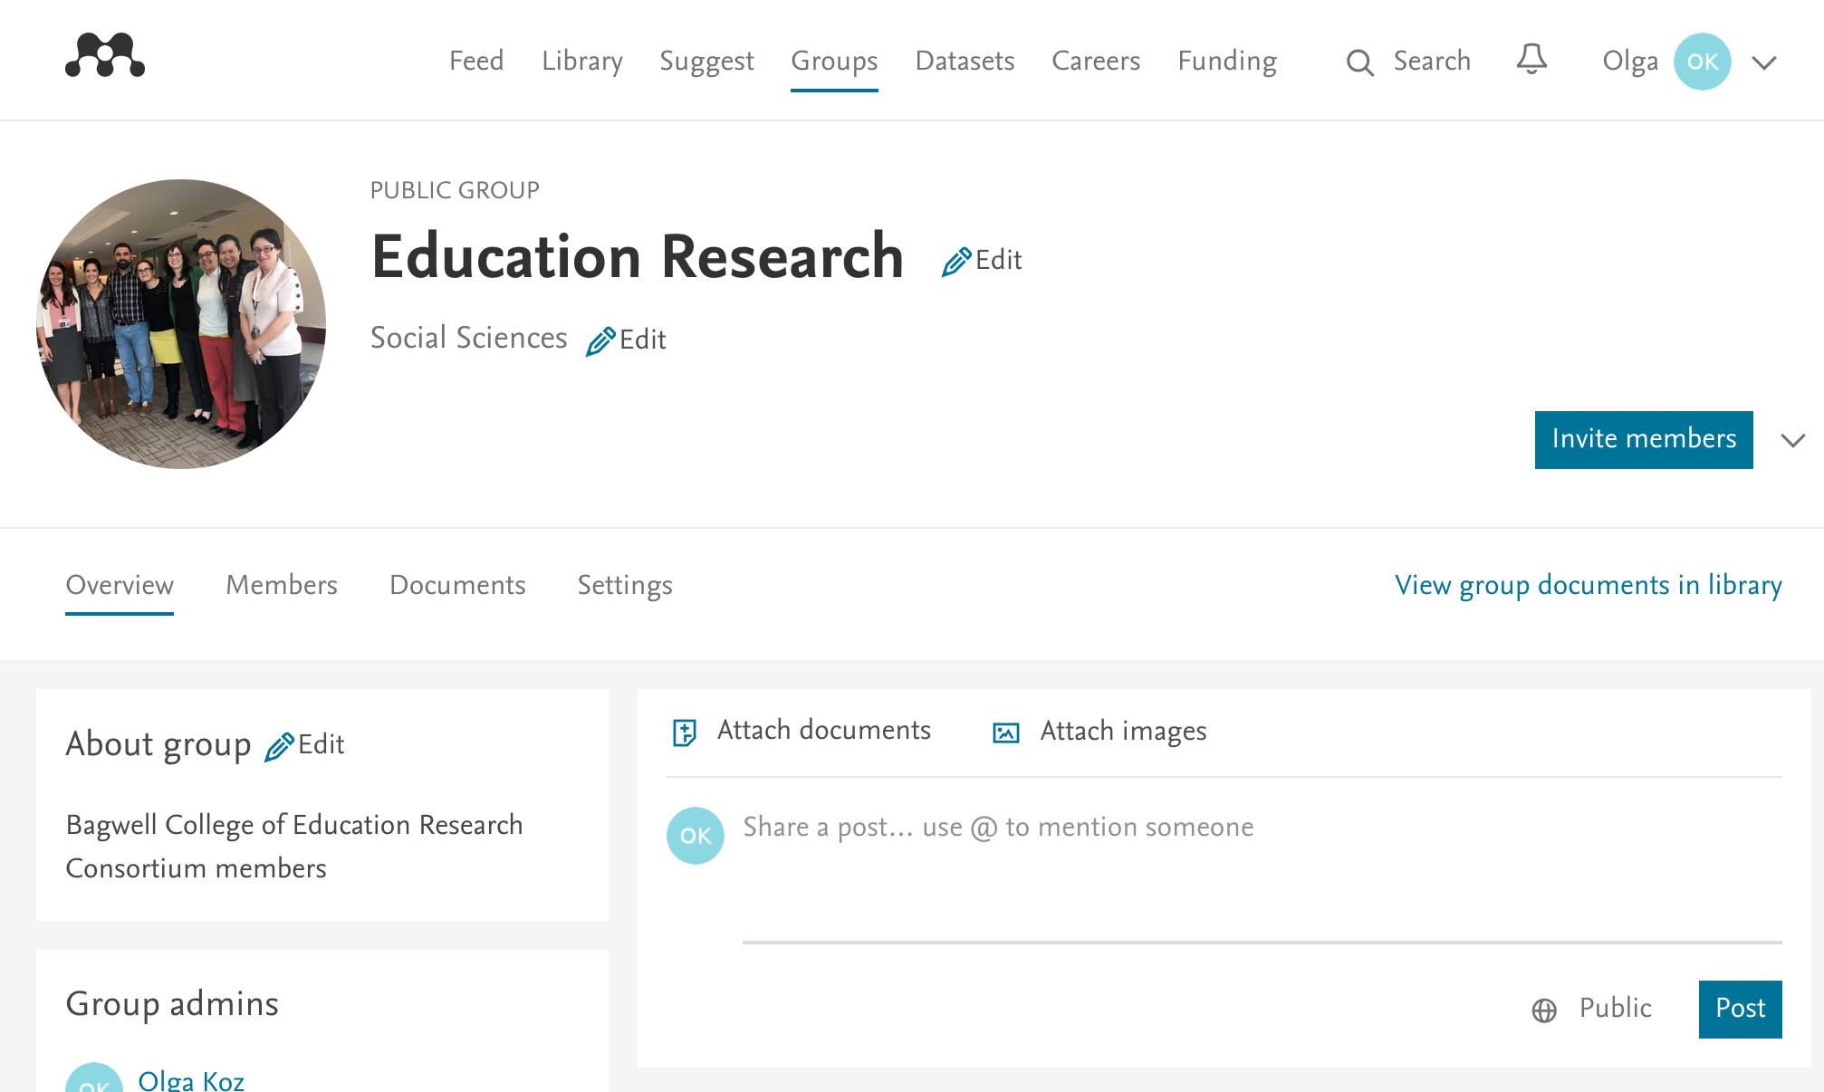
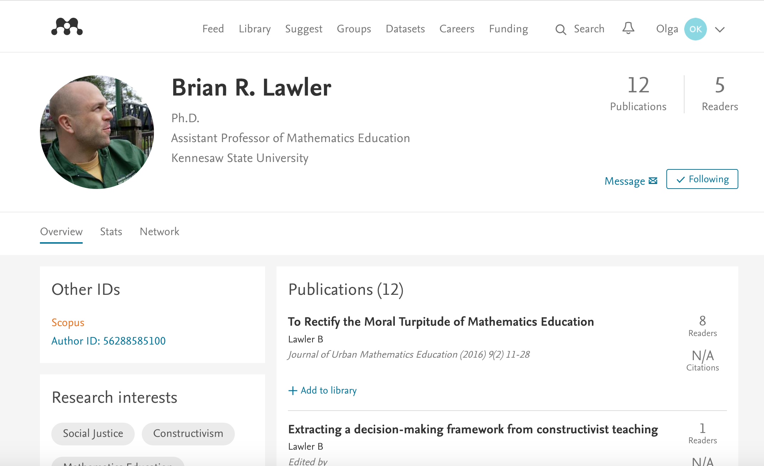
The cold start problem!

Slide 20
Why the online engagement is low?
Scientists are busy and overwhelmed
Need early adaptors
Need popular content (seeding, harvesting, sharing, RSS)
Need a community manager
Platform/Interface issues (trust, privacy, perception, connectivity)
Technology learning curve

Slide 21
References
Association of Research Libraries (2003). Principles and Strategies for the Reform of Scholarly Communication
Wenger E. (1998). Communities of Practice: Learning, Meaning and Identity. Cambridge University Press

