Slide 1
Digitization@Western Libraries
By Nicholas Rapp
April 15, 2014

Slide 2
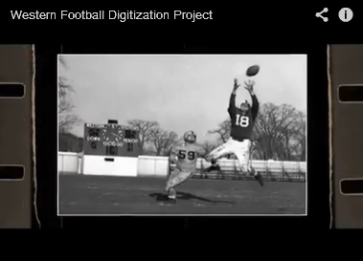
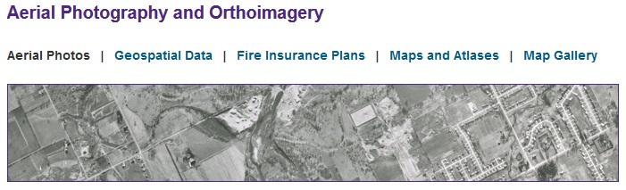
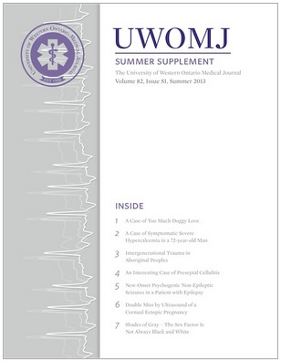
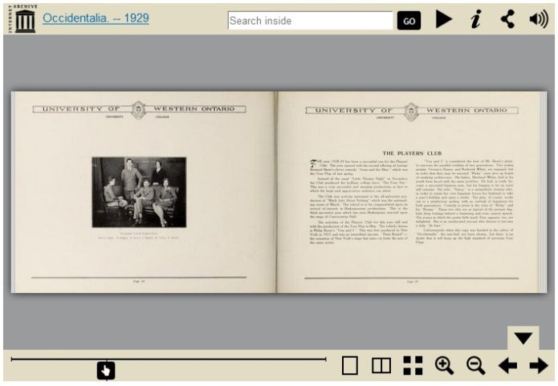
Digitization Projects
lib.uwo.ca, archive.org, uwomj.com

Slide 3
Considerations and Challenges
Types Of Materials and File Formats
Hosting and Displaying Materials
Storage
Infrastructure
Copyright
Metadata
Staffing
Funding

Slide 4
Types of Materials and Formats
Types of Materials
Theses and Dissertations
Photographs
Videos
Geographical Information Systems (GIS) Data and Maps
Musical Scores
Presentations
3D Data Sets
File Formats
PDF/Word/ Other text based documents
TIFF
MPEG, MPEG2
AVI
JPEG, JPEG 2000
.ppt
NetCDF, HDF5, FITS (Scientific data formats)

Slide 5
Hosting and Displaying Materials
– Institutional Repositories

Slide 6
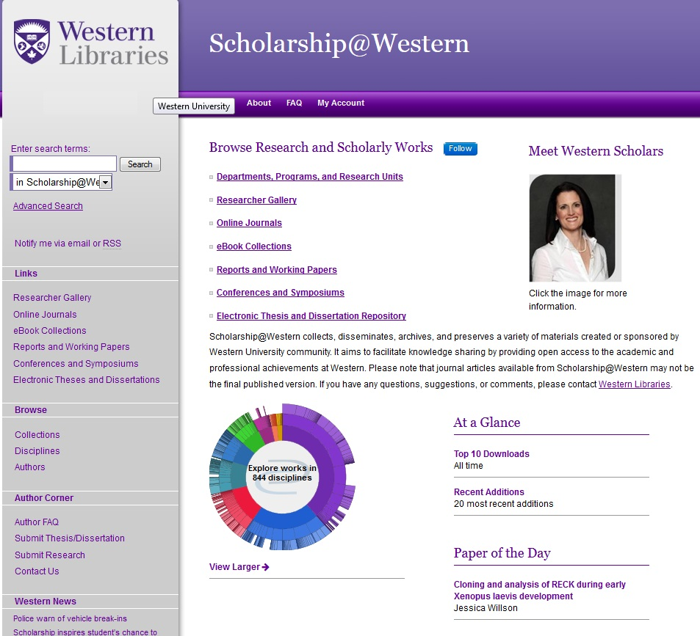
Digital Commons - Western
http://ir.lib.uwo.ca/

Slide 7
Representing Research Data - Metadata
Three ways to represent research Data in Digital Commons
Metadata only submission
Metadata plus descriptive guides
Metadata plus research data
Tamminga

Slide 8
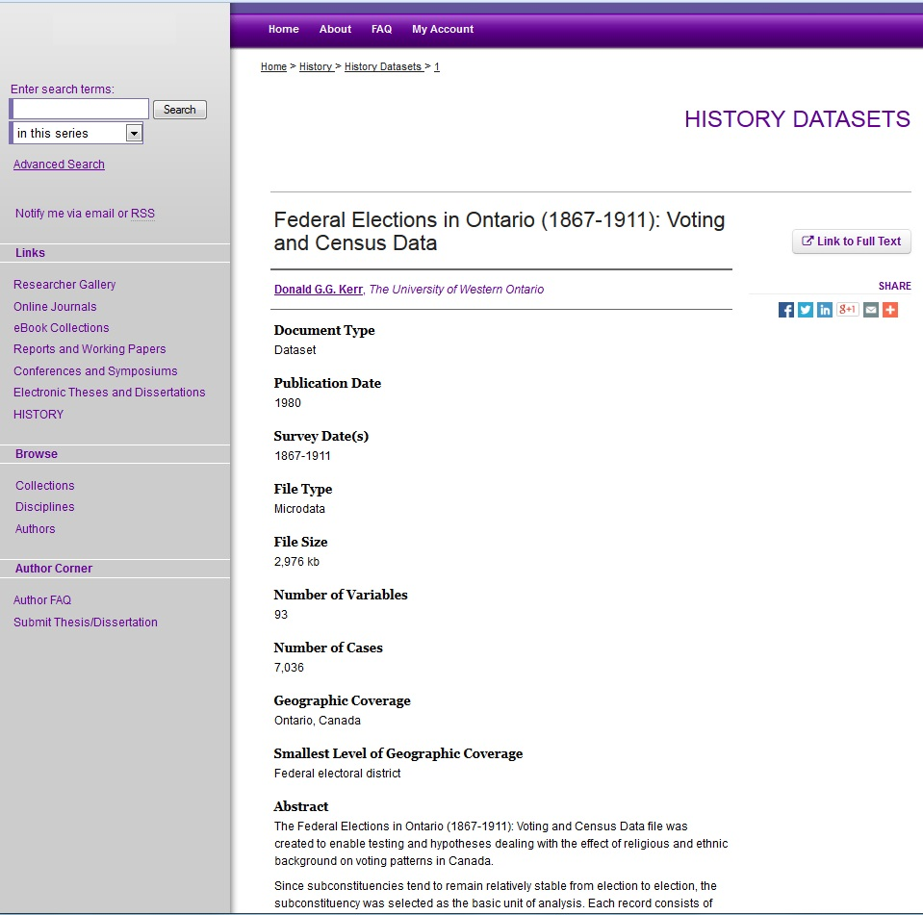
Representing Research Data
Metadata only submission
Provides link to the server where the data is stored and the data delivery system is maintained
Do not have to host various file formats
Tamminga
http://ir.lib.uwo.ca/historydata/1/

Slide 9
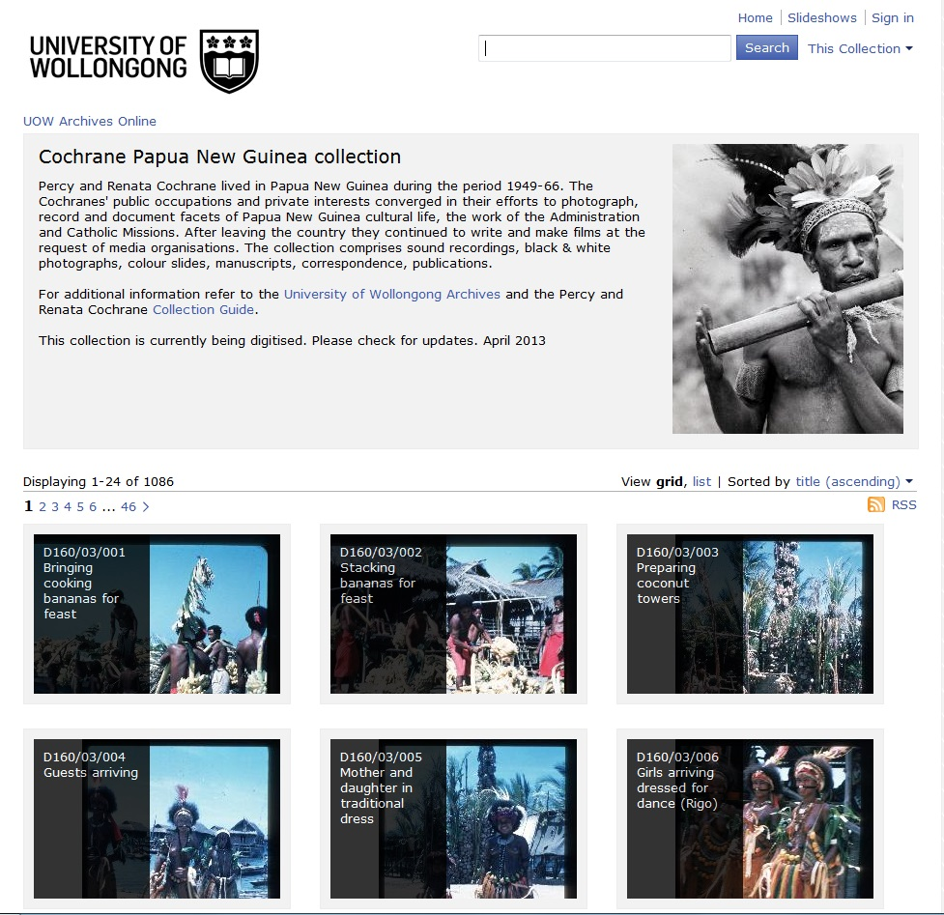
Representing Research Data
Metadata with Descriptive Guides
One location where the datasets are described clearly. The datasets can be stored in that spot or live somewhere else.
Provide valuable information for potential users
Makes data easier to find
The guides are indexed by search engines like Google.
Tamminga
http://encore.library.uow.edu.au/iii/cpro/CollectionViewPage.external?lang=eng&sp=1000012&suite=def

Slide 10
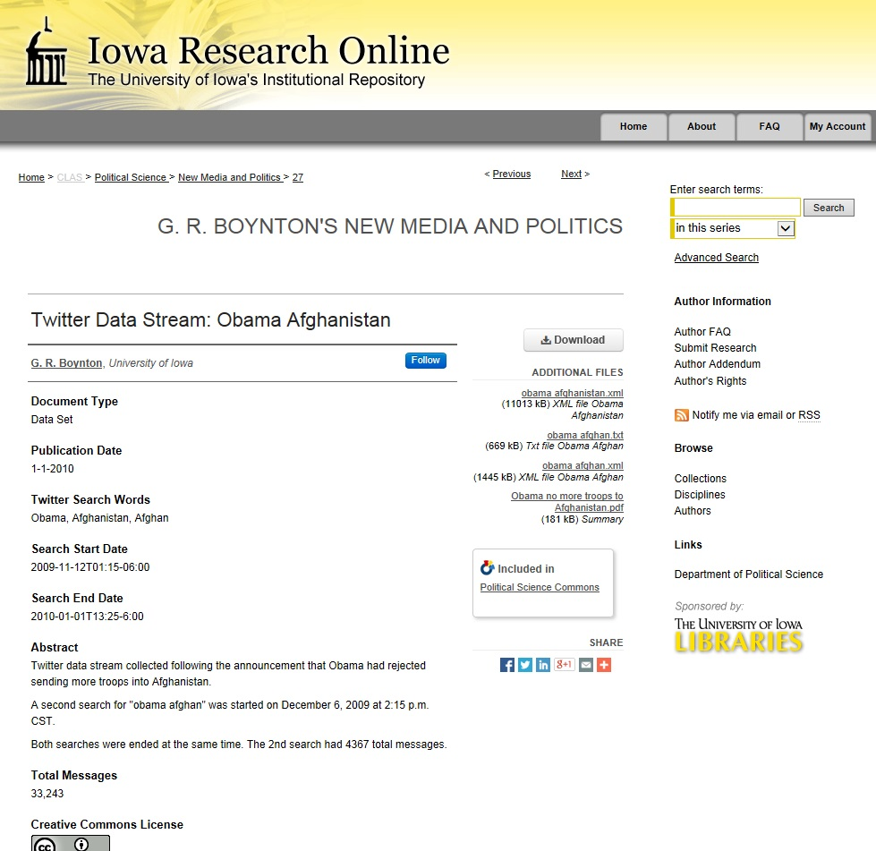
Representing Research Data
Metadata Plus Research Data
Along with metadata they also incorporate research data
Allows for closer examination of the data
This example includes .pdf, .xml and .txt files
Tamminga
http://ir.uiowa.edu/polisci_nmp/27/

Slide 11
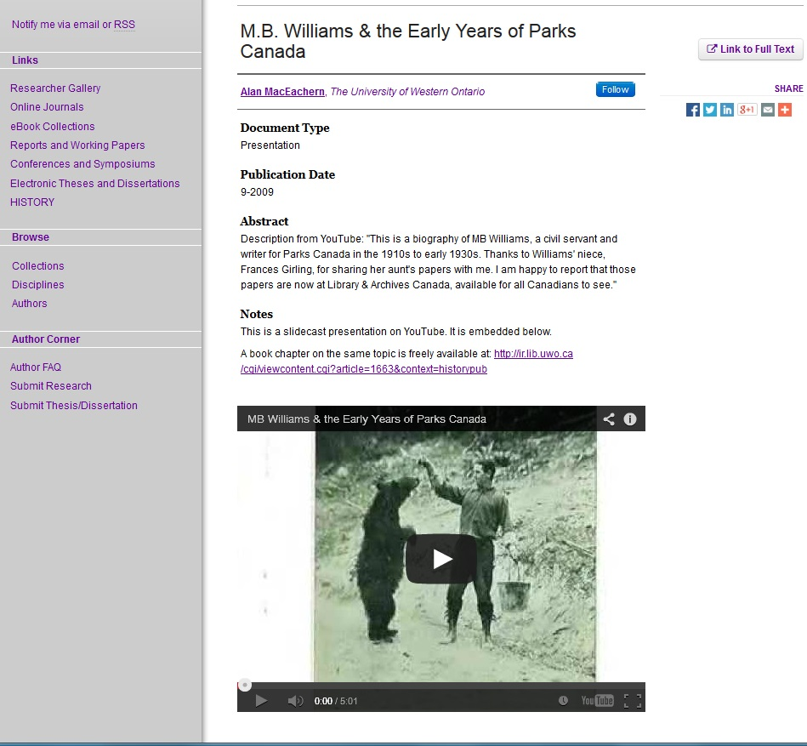
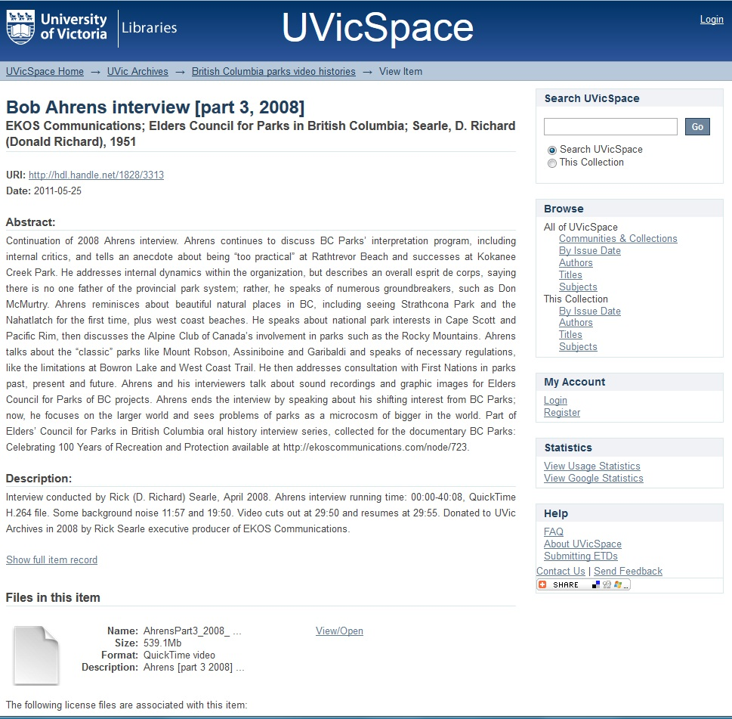
Representing Videos
http://ir.lib.uwo.ca/historypres/2/
http://dspace.library.uvic.ca:8080/handle/1828/3313

Slide 12
Representing Videos
Streaming | Downloading
YouTube or Vimeo | Videos are available in a variety of formats
Much faster and straightforward for viewing | Files can be stored on a server
Reduces the number of file formats | Do not have to rely on an outside source or foreign server
Do not need compatible software | Do not lose file or link if video host crashes or is shut down
Videos can be added onto a server prior to upload | Copyright Concerns
Recommendation: Streaming video

Slide 13
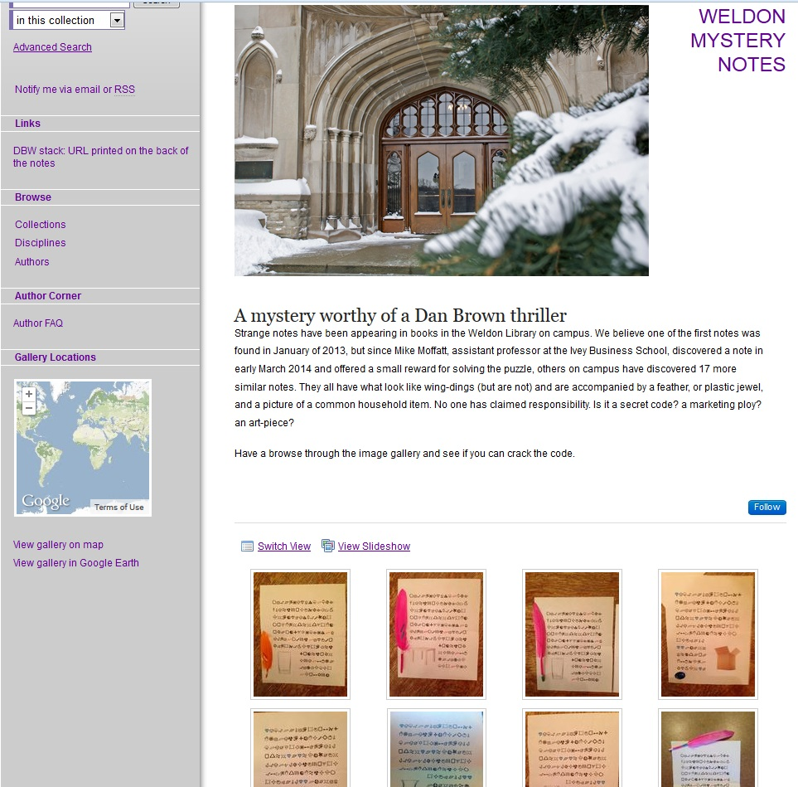
Digitized Special Collections (DISC)
Digitized Special Collections (DISC)
Primarily intended for material not produced at Western.
Could host a variety of materials including:
  Books
  Journals
  Videos
  Photo Galleries
http://ir.lib.uwo.ca/weldon_mystery_notes/

Slide 14
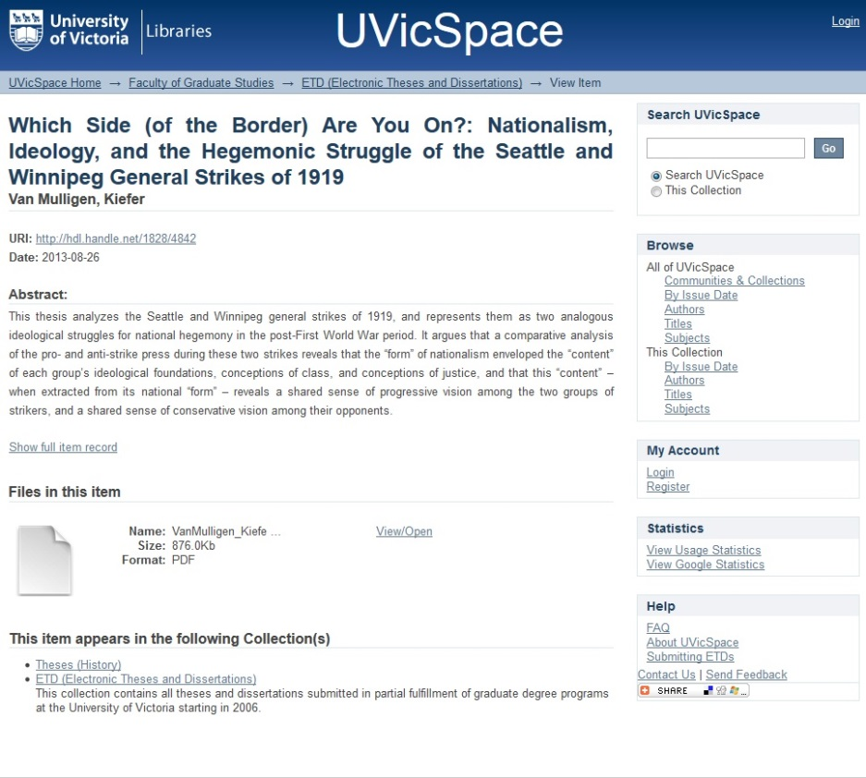
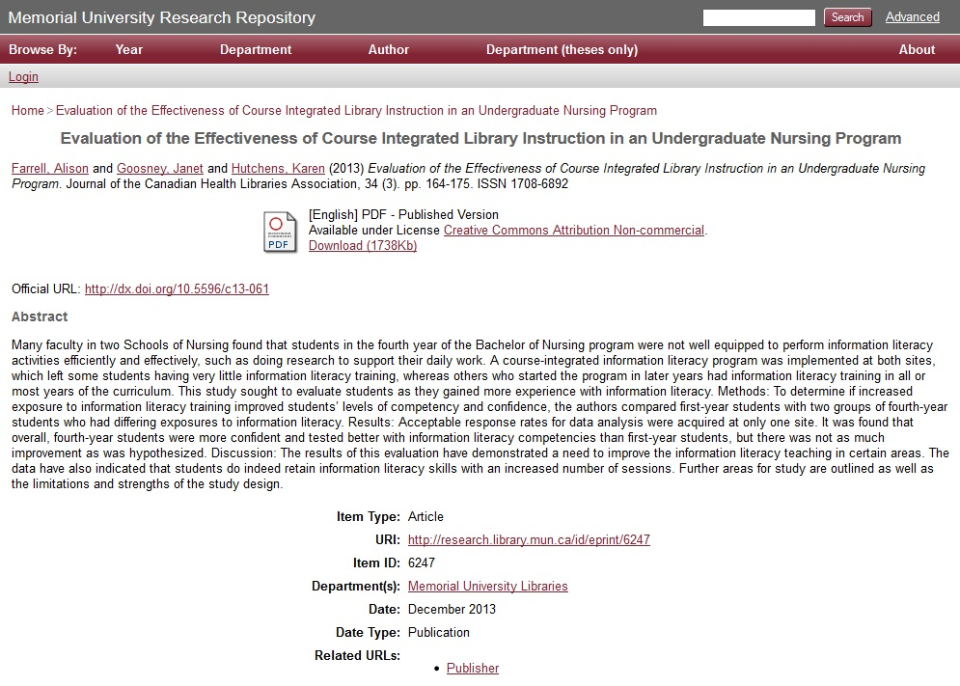
Other Institutional Repositories
DSpace
EPrints
http://research.library.mun.ca/6247/
https://dspace.library.uvic.ca/handle/1828/4842

Slide 15
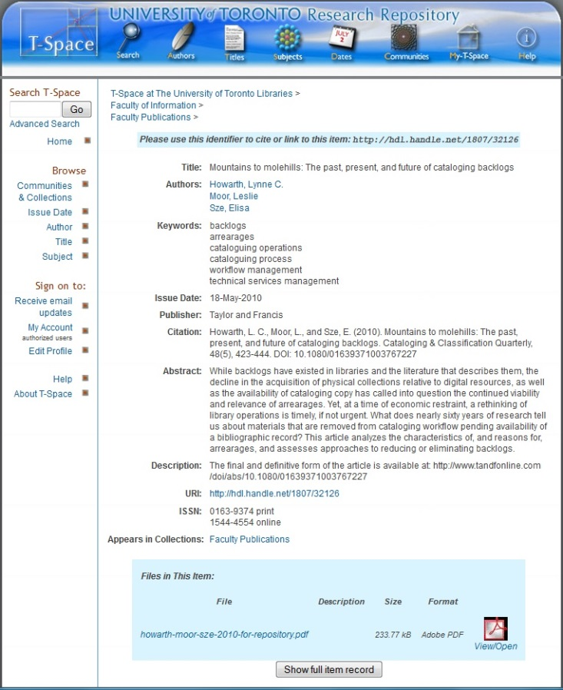
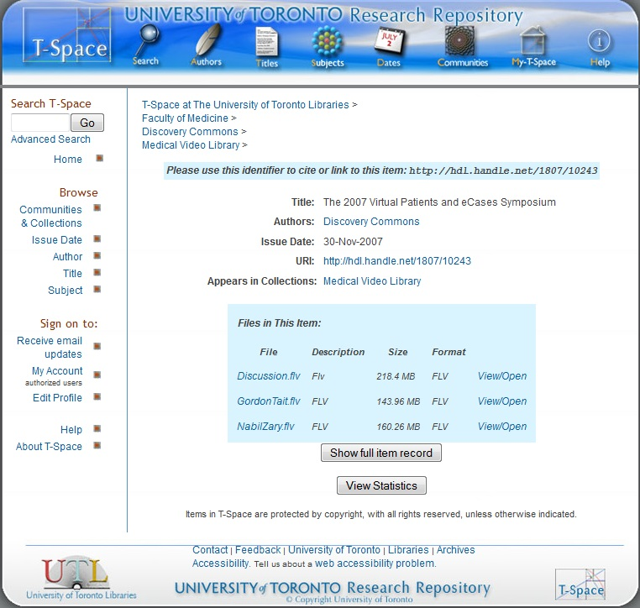
T-Space
https://tspace.library.utoronto.ca/handle/1807/10243
https://tspace.library.utoronto.ca/handle/1807/32126

Slide 16
Other Places To Host Digitization Projects And Digital Collections

Slide 17
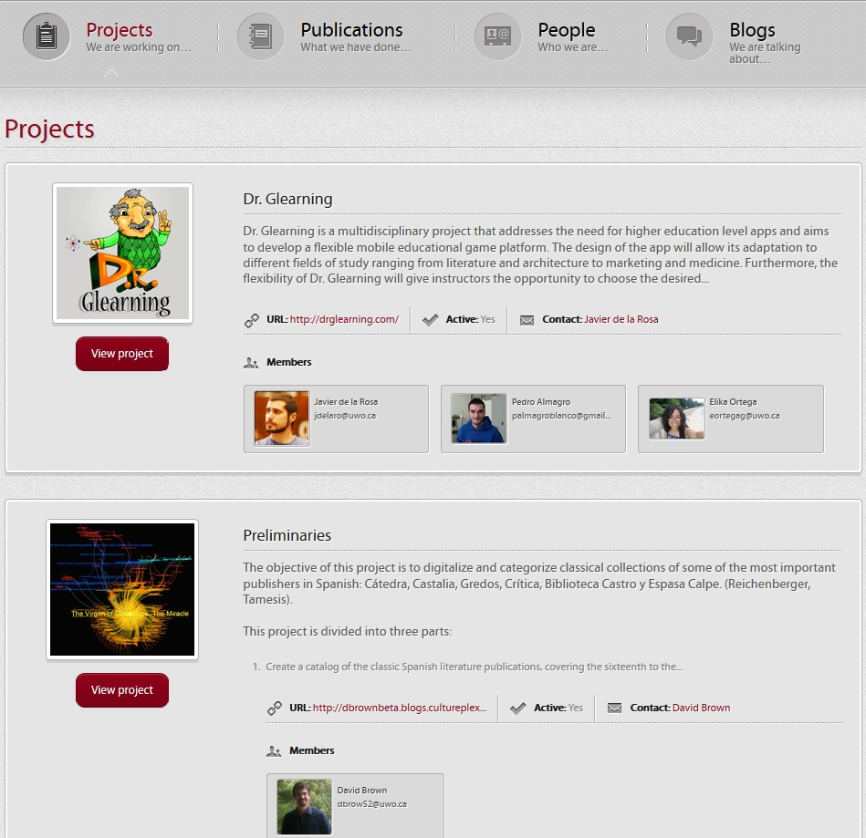
CulturePlex
Cultural Complexity and The Digital Humanities
Provides a host for the projects which are then linked out to external sites
Contains information about the projects
Contact information for those involved with the projects
Could potentially be used to host projects from various libraries and departments at Western
http://www.cultureplex.ca/projects/

Slide 18
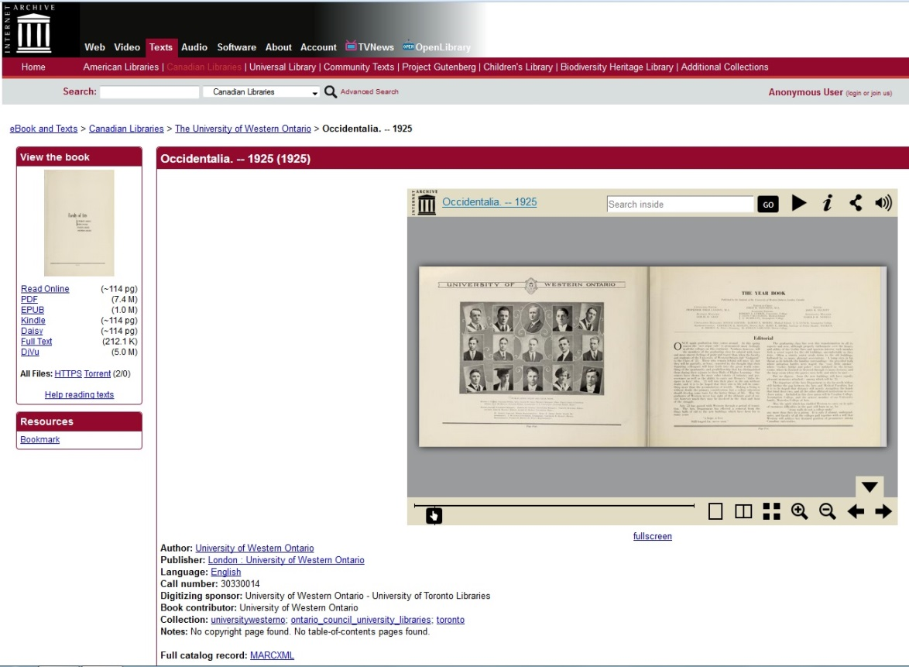
Internet Archive
“Offering permanent access for researchers, historians, scholars, people with disabilities, and the general public in historical collections that exist in digital format”
Currently hosting the Western yearbooks – Occidentalia and other items
Cannot send everything there
Time is a factor
https://archive.org/details/occidentalia25univ
About the Internet Archive

Slide 19

Scholars Portal
OCUL – Ontario Council of University Libraries
Preserves and provides access to information resources
Collection of e-journals, e-books, social science data sets, geo reference data and geospatial sets
Shared by Ontario’s 21 university libraries
Some Western material from various departments is already available here

Slide 20
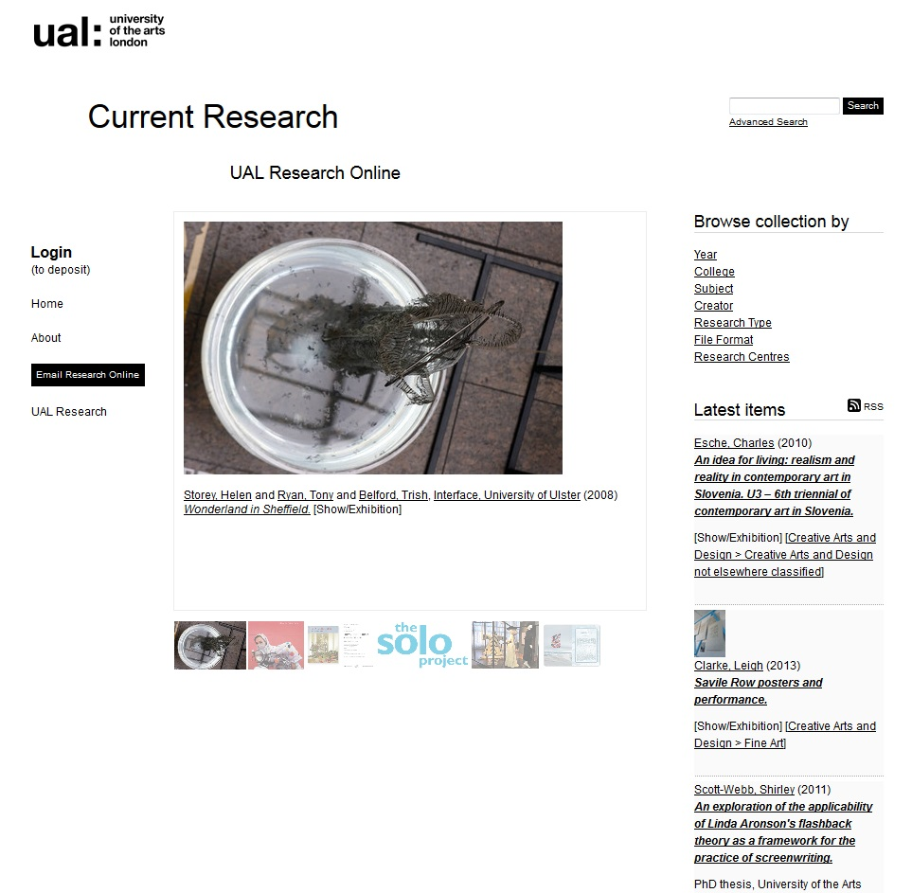
Create A UWO Projects Website
A site dedicated to Western Digitization Projects
University Of The Arts London (UAL) Research Online
  Showcases the research produced at the UAL
  Contains: journal articles, monographs, book chapters, conference papers, conference proceedings, exhibitions, video, audio, images, websites, and selected post-graduate theses
  Able to manage: software, datasets, workshop presentations, patents
  Eprints
http://ualresearchonline.arts.ac.uk/
About UAL Research Online

Slide 21
Recommendation
The libraries and other departments all seem to be going their own way
Have a centralized web page for digitization projects
Scholarship@Western could potentially be this
Even if the page does not host all of the projects they could all link to one another
Creates a focal point for digitization and a common project that can be shared among the various departments

Slide 22
Questions?

Slide 23
In-House Infrastructure
Scanners
56”
Not only for the Map and Data Centre but for other departments within Western as well
  Music Library for score sheets
This could also be used in partnership with other institutions
Would not only raise the status of what is possible at Western but it could also expand what is possible within various fields of work and study
  McMaster
Internet Archives is not fully equipped to handle the type of work that is always required
Rare and fragile materials would not have to be sent off site as often
Materials could still be used by students and faculty at Western while digitization projects were underway

Slide 24
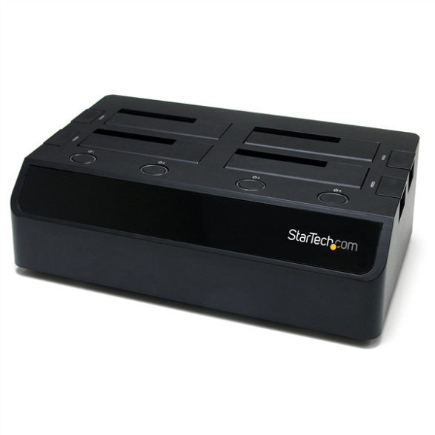
In-House Infrastructure
Docking Stations
Allows multiple SATA Hard Drives to be connected to a computer at the same time through a single connection
Some devices are equipped to handle 4TB drives
Connects through USB
Do not need multiple external hard drives lying around
More cost efficient and requires less technical support than a server
startech.com

Slide 25
Storage

Slide 26
Storage
Number of the files
  London Free Press
    hoping to do up to 10,000 photographs
    Size of Files
      Canadian Tire project
        4TB
  Ariel Photographs
    400 GB
  GIS – Multiple data sets
    500MB per data set
Access
Optimal conditions
Long Term vs. Short Term
Ideally you want retain as much of the original as possible

Slide 27
Storage Options - Microfilm
Advantages | Disadvantages
Preferred method of storage – commonly used | Lack of ability to capture the digital functionality of dynamic web materials
Longevity and sustainability | Levels of complexity and interactivity of born digital objects are likely to increase
Reduces the frequency of interventions that may be required | If microfilm is damaged or destroyed the information will most likely be lost forever
Extremely difficult to alter without detection | Some materials have to be taken apart in order to put them onto microfilm - problem when trying to preserve items
Brown et. al , 2012 and Skinner, 2010

Slide 28
File Servers – Hard Disk Storage
Some Western departments use Equinox
  Limited Capacity
Servers
  Store large amounts of data for many people
  All devices can be stored on one network
  Cannot expand unlimitedly to improve storage ability
  High building costs
  Technical skills required
Ren, 2011

Slide 29
Storage Options
External Hard Drives
  One of the most common forms of storage and transfer
  Can store multiple file formats
  A range of capacities
  Large projects may take up large part of a single external hard drive
  Information should be transferred every 5 years
  They are clunky
CD/DVD
  Common method of storage
  Relatively inexpensive
  How long will this technology be around for?
  Should be considered a short term option
  Physical space

Slide 30
Storage Options - The Cloud
Advantages | Disadvantages
High capacity | Expensive
Mirrored between multiple locations | Network bandwidth issues
Can provide archival storage for large files such as HD Videos and high resolution images | Potential single point of failure
Multiple file formats | Complex
Variety of options available | Must trust service provider and have a clear service agreement in place
 | Susceptible to hackers
Flexible Storage Options and Banach et. Al, 2011

Slide 31
ODLRC
The Ontario Digital Library Research Cloud (ODLRC)
“Collaboration of Ontario’s university libraries to build a high capacity, geographically distributed storage and computing network using proven and scalable open source cloud technology”
OpenStack cloud management software
Will make use of scalable technologies to build large-scale storage services using low-cost disk farms and servers
Lower costs of storage for libraries
Interested in working with large bodies of digital content to explore long- term societal, cultural and economic trends
Marks, 2014

Slide 32
Storage - LOCKSS
Lots Of Copies Keep Stuff Safe
Take content from one place and distribute it through a network of LOCKSS participants
Dozens if not hundreds of copies of the content are mirrored and stored across a wide geographical network
One participant can lose access and the network as a whole remains robust
Private LOCKSS
  Institutions from a mutual aid system to maintain each other’s content
  Bepress/Digital Commons
Nadal, 2011

Slide 33
Storage - Multiple Copies
The Smithsonian Institution Archives
Digitized images are to be stored redundantly on DVD-R/DVD+R with a minimum of two offline copies
  A preservation master and a preservation back up
  The master is to be held offsite
    Contains technical information regarding the creation date of the disks and software used for the creation of the disks
A additional set could be created for reference/public access as long as copyright and internal policy permits it
In total they suggest having a minimum of 3-5 copies in various locations
* The page containing this information has been removed from the Smithsonian Institution Archives website.
Smithsonian Institution Archives

Slide 34
Storage - Multiple Copies
Yale
Maintain a copy of your photo archive off-site
One potential problem of an online copy is that if there is a corruption in your primary copy and you have your system set to automatically clone it to the back up, you may corrupt the backup
Server
  Rescue Repository or Digital Preservation Repository
  Redundant server with tape back up
  Digital Asset Management System – with backup
Physical
  CD/DVD duplicate copies stored in separate locations
  External Hard Drives
    - Should only be used for short term or as a non primary method
  Media and Files should be verified and migrated on a regular basis
Digital Coffee Group, 2010

Slide 35
Migration Schedule
No set standard for migration
University of Massachusetts Amherst
  Check files and refresh storage media on a regular basis
    Create new media copy every five years or when necessary to avoid data loss
  Migrate files to newer formats if needed
    Attempt to stay current with major shifts in standards, software, hardware, platforms, and formats to ensure that files are in a common, readable form
Digital Images, 2012

Slide 36
Recommendation
A combination of online and offline storage would be ideal.
  Online
    Cloud Storage
    Scholar’s Portal OCLRD may become the best option
  Multiple Physical Copies
    One master copy that is not accessed unless it is absolutely necessary. This copy would also contains all the technical information regarding the disk and its contents
    Docking Stations with SATA Drives
    At least 2 copies stored on CDs, DVDs or external hard drives in various locations
  Centralized Server if economically feasible as a back-up
  A minimum of 5 copies over all of these platforms

Slide 37
Questions?

Slide 38
Metadata

Slide 39
Metadata
Designing and documenting a metadata schema for digitization projects
Analyze context, content, and users and determine functional requirements
Select and develop an element set
  General/cross collection metadata schema design
  Collection-specific metadata schema design
  Establish element and database specifications
Establish controlled vocabularies and encoding schemes
Develop content guidelines
Miller, 2011

Slide 40
Metadata
Collection Level Record could include:
Title
Identifier
Resource Type
Date
Creator
Creator (additional authors)
Publisher
Topical Subject
Geographical Subject
Item Level could include:
Title
Identifier
Resource Type
Date
Creator
Topical Subject
Geographical Subject
Part of the collection
Miller, 2011

Slide 41
Metadata
University of Massachusetts Amherst
Required:
Date Created or Published
Identifier
Institution Name
Title
Type of Resource
Required if Applicable:
Creator
Extent
Language of Resource
Related Item
Recommended:
Description
Access or Use Restrictions
Format of Resource
Place of Origin
Rights Information
Subject
Optional:
Citation
Collection Name
Contributor
Genre
Keywords or Tags
Language of Metadata Record
Notes
Publisher
Metadata Working Group, 2013

Slide 42
Metadata
Metadata for other types of research data
GIS Data
  Scale
  Producer
  Various Keywords
  Projection and co-ordinate system are essential
  Limitation of use
  May have a code accompanying the data
Other things to consider
Images could make up a series of multiple views of an item
  Photos of a statue
Multiple authors
  Listed in the same field
  Listed in separate fields

Slide 43
Metadata
Copyright or Rights Holder
This can be a very big challenge, especially when handling materials that are not produced at Western
Collections can include copyright statements and other more complex statement of rights, restrictions, terms and conditions
Some collections also include “separate webpages that state the general intellectual property rights for the resources in the collection as a whole and policies for use for those resources”
Should be included on the listed of required metadata
Encoded Examples
Dublin Core | <dc:rights>
EAD | <accessrestrict>
MODS | <accessCondition type=restriction of access>
VRA | <rightsSet>
Miller, 2011 and Metadata Working Group, 2013

Slide 44
Dublin Core
Dublin Core Elements Used By IRs for ETDs (Out of 10)
Title | 10 | Format | 2
Description.abstract | 8 | Degree.level | 2
Subject | 8 | Degree.grantor | 2
Rights | 5 | Contibutor.role | 1
Degree.name | 4 | Description | 1
Type | 4 | Identifier | 1
Degree.discipline | 3 | Contributor | 0
Language | 3 | Coverage | 0
Publisher | 3 | Description.note | 0
Creator | 2 | Description.release | 0
Date | 2 | Title.alternative | 0
Dublin Core
Elements are broad and generic
Usable for describing a wide range of resources
Qualifiers
Can be limited in describing more complex items and types of research data
Dublin Core Metadata Element Set, 2012 and Park and Richard, 2011

Slide 45
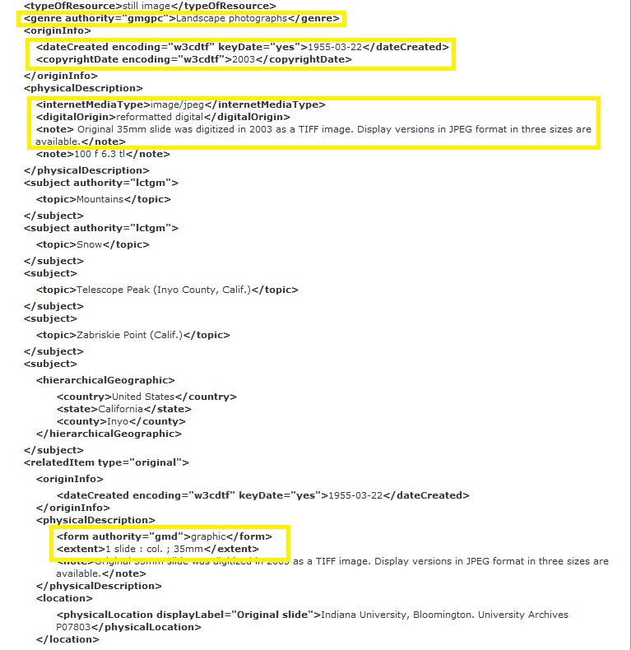
MODS
Metadata Object Description Scheme
Intended for description of a wide range of sources
High compatibility with MARC
Nested hierarchical parent-child elements
  Subelements
Implementers can be as detailed as they want in the use of MODS subelements, attributes and vocabularies
Many institutions have moved away from Dublin Core to MODS
Miller, 2011
http://www.loc.gov/standards/mods/v3/mods-userguide-examples.html

Slide 46
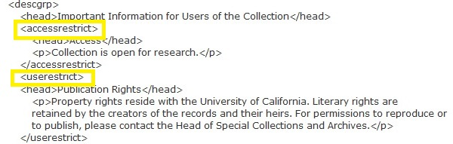
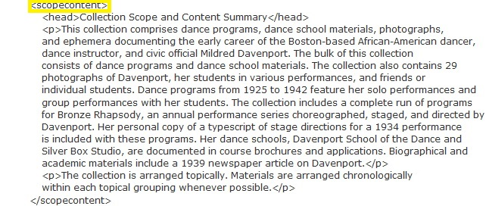
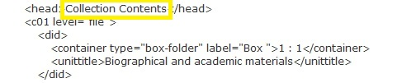
EAD
Encoded Archival Description
Standard for encoding archival finding aids using XML
More large scale projects may require this type of description
About EAD, 2012
http://www.loc.gov/ead/tglib/appendix_c.html

Slide 47
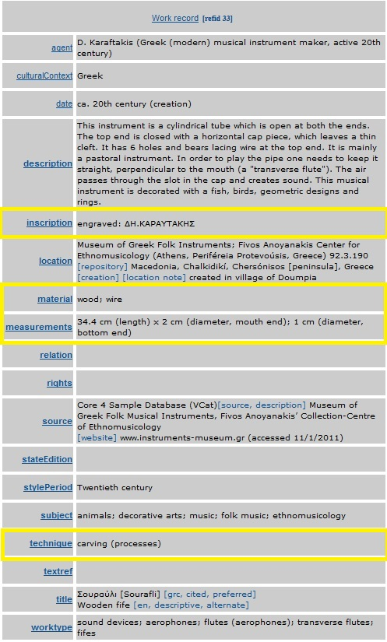

VRA Core
Visual Resource Association’s Core Categories
Most useful in for describing works of visual art and architecture
Demonstrate some of the primary characteristics that art museums consider important for representation and retrieval of works of art and architecture, and of digital collections of images of those works
  Physical material
  Location
  Provenance
  Historical Style
  Techniques used in creating an object
Miller, 2011
http://www.vraweb.org/projects/vracore4/example032.html

Slide 48
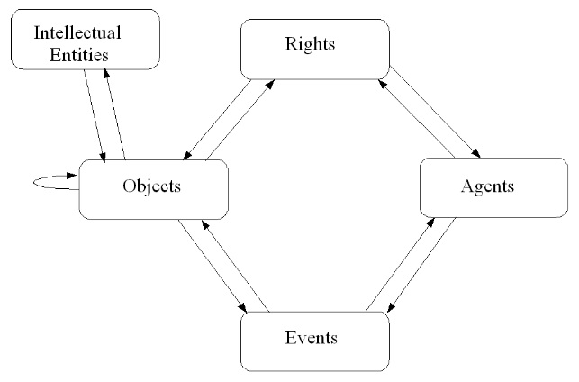
Preservation Metadata
PREMIS – Preservation Metadata: Implementation Strategies
Preservation Metadata - “the information necessary to carry out, document, and evaluate the processes that support the long-term retention and accessibility of digital materials.”
Five entities that were particularly important in regards to digital preservation activities
The PREMIS Data Model
PREMIS, UMASS
PREMIS Editorial Committee, pg. 5, 2012

Slide 49
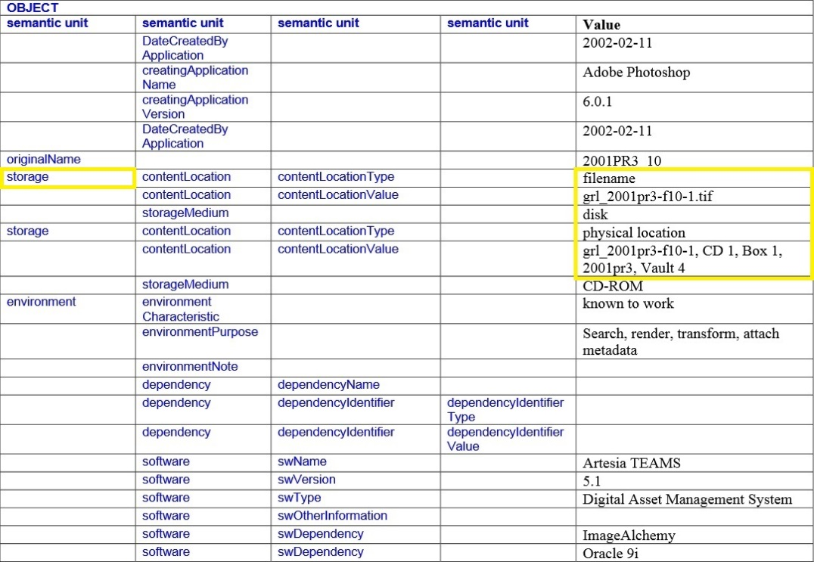
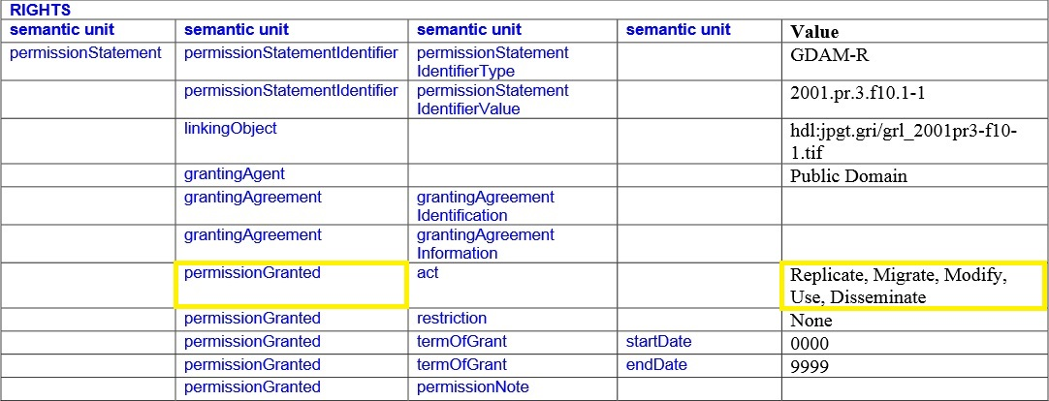
Preservation Metadata
http://www.oclc.org/content/dam/research/activities/pmwg/premis-examples.pdf?urlm=161393

Slide 50
Questions?

Slide 51
Work Cited
1. “About EAD,” The Library Of Congress, July 11, 2012, http://www.loc.gov/ead/eadabout.html.
2. “About the Internet Archive,” Internet Archive, https://archive.org/about/.
3. “About UAL Research Online,” UAL: University of Arts London, http://ualresearchonline.arts.ac.uk/information.html.
4. Banach, Meghan, Brian Shelburne, Kelcy Shepherd and Aaron Rubenstein, “Guidelines For Digitization,” UMass Amherst Libraries, May 2011.
5. Brown, Heather, John Baker, Walter Cybulski, Andy Fenton, John Glover, Paul Negus and Jonas Palm, “The Role of Microfilm in Digital Preservation,” Microform and Digitization Review, Volume 41 (2), July 2012.
6. Digital Coffee Group, “Digitization Shared Practices – Still Images Version 1.0,” Yale University, August 2010.
7. “Digital Images,” UMass Amherst Libraries, May 8, 2012, http://www.library.umass.edu/services/services-for-faculty/preserving-your-digital-materials/digital-images/.
8. “Dublin Core Metadata Element Set, Version 1.1,” Dublin Core Metadata Initiative, June 14, 2012, http://dublincore.org/documents/dces/#DCTERMS.
9. “Flexible Storage Options,” USC Digital Repository, http://repository.usc.edu/storage/.

Slide 52
Work Cited Continued
10. Marks, Stephen, “About The ODLRC,” OCUL, last edited by Jacqueline Whyte Appleby, April 8, 2014, https://spotdocs.scholarsportal.info/display/ODLRC/About+the+ODLRC
11. Metadata Working Group, “Metadata Guidelines,” UMass Amherst Libraries, May 2013.
12. Nadal, Jacob, Digital Preservation: Storing and Managing Digital Collections, Webinar, February 7, 2011, http://vimeo.com/67141895.
13. Miller, Steven J., Metadata for digital collections: a how-to-do-it manual, (London : Facet Pub., 2011).
14. Park, Eun G. and Marc Richard, “Metadata assessment in e-these and dissertations of Canadian institutional repositories,” The Electronic Library, 29:3, 2011.
15. PREMIS Editorial Committee, PREMIS Data Dictionary for Preservation Metadata, version 2.2, July 2012.
16. Ren, Yazhong, “Data Storage in Digital Library using Multi-Storage Technology,” IEEE, 2011.
17. Skinner, Julia, “Learning From The Past: Digitization and Information Loss,” B Sides: UofI SLIS Journal, May 14, 2010.

Slide 53
Interviews
Information was also collected through interviews with the following individuals:
Tom Belton
Bev Brereton
Alyssa Evetts
Christine Homuth
Elizabeth Mantz
Cheryl Woods

Slide 54
Acknowledgments
I would like to thank the following individuals for their assistance and guidance on this project
Tom Belton | Elizabeth Mantz
Bev Brereton | Cheryl Martin
Alyssa Evetts | Joanne Paterson
Christine Homuth | Cheryl Woods
Joan Kammerer

