Slide 1
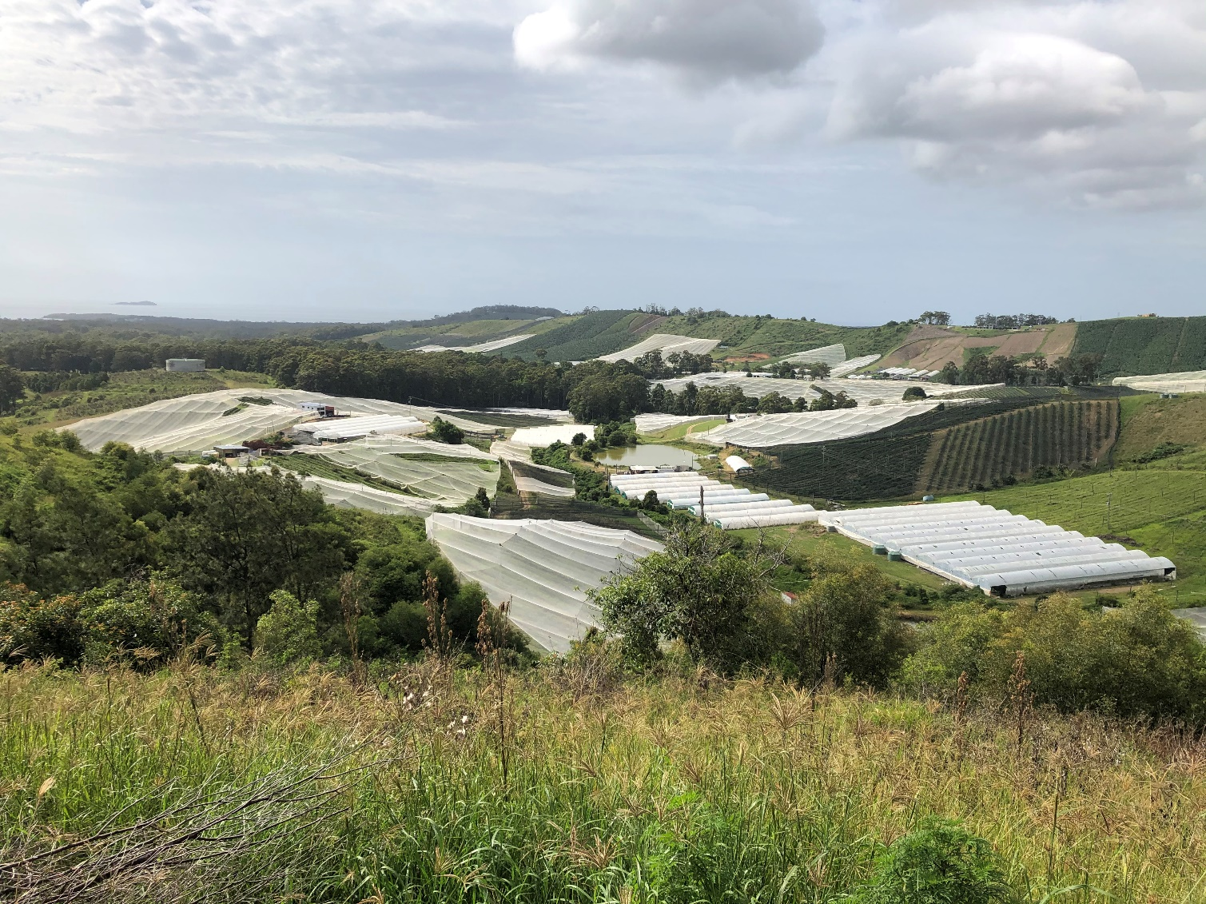



Outside the (Fruit) Box:
A Case Study in Big Picture Coastal Thinking
Neil Dufty – Molino Stewart
Chris Beadle – Water Technology
Notes:
Our talk today provide a case study in how we can use Big Picture thinking in coastal management.
Our case study is an example of working collaboratively government and industry to address major issues facing the coastal zone
We developed an environmental program for Intense Plant Agriculture – to improve downstream estuary health benefits
Acknowledge Council, and DPIE etc

Slide 2
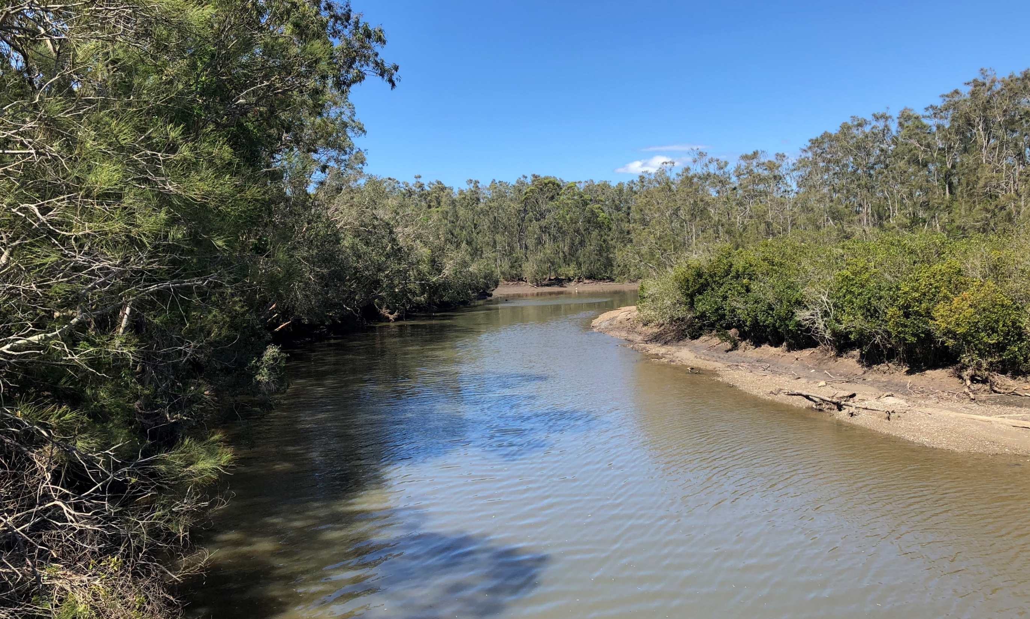
Presentation Outline
Why?
Background into the project and how it fits with coastal management
How?
Developing the CHIEP and the negotiation process
What?
A brief summary of the program
Next?
Where to from here?
Notes:
Just giving an outline of the presentation contents. I always like to do this, but feel free to delete this slide if you want

Slide 3
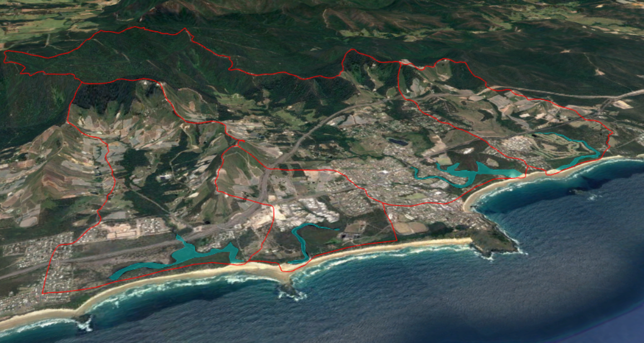
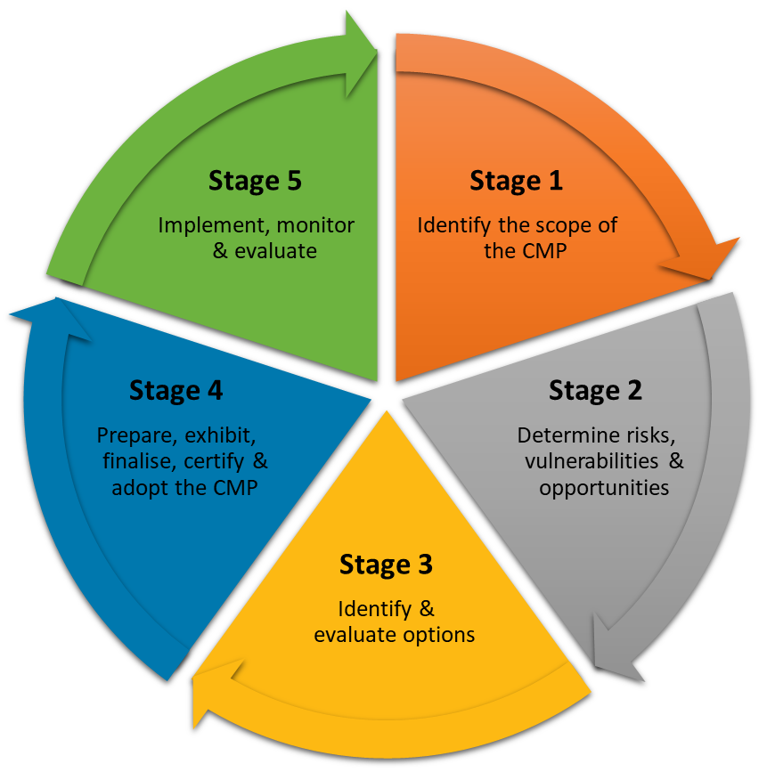
It started with a CMP…..
The Woolgoolga Region Estuaries CMP
Darkum Creek
Woolgoolga Lake
Willis Creek
Hearnes Lake
Notes:
The project was initiated through a CMP for four ICOLLs in the Coffs Harbour LGA.
Engagement with the community and key stakeholders in Stage 1 identified a range of issue for the CMP to address… (cut to next slide)

Slide 4
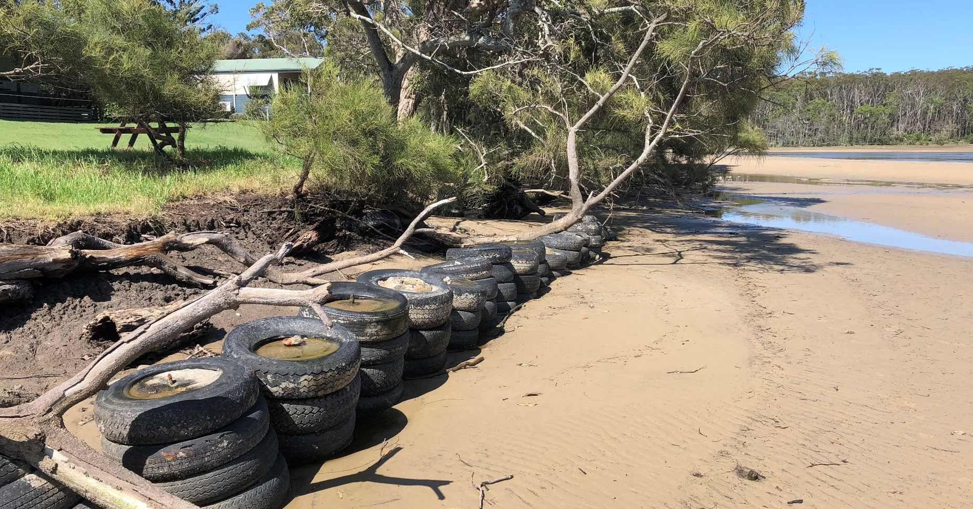
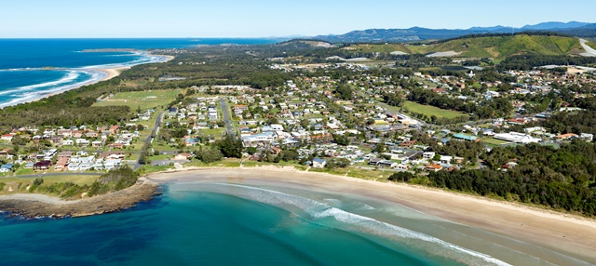
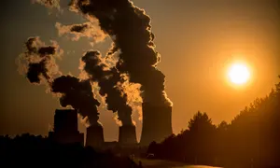
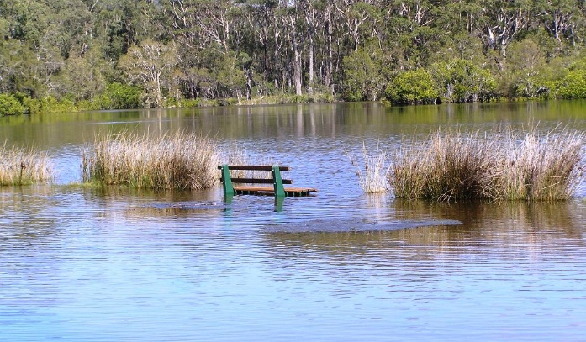
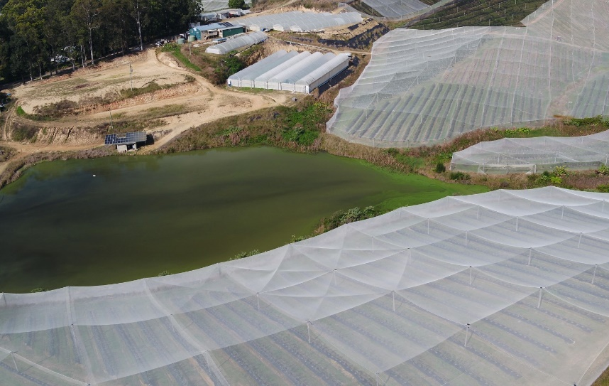
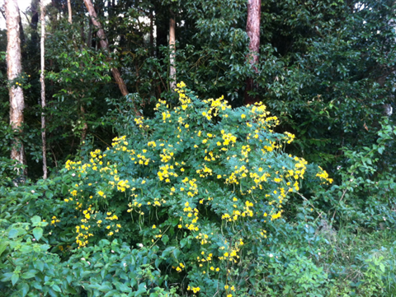
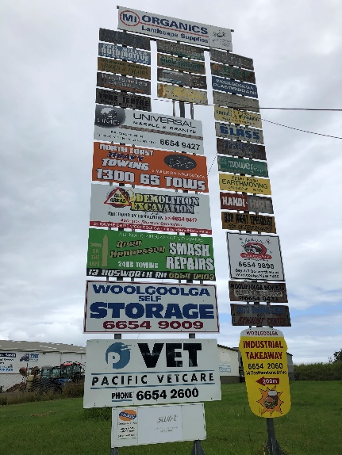
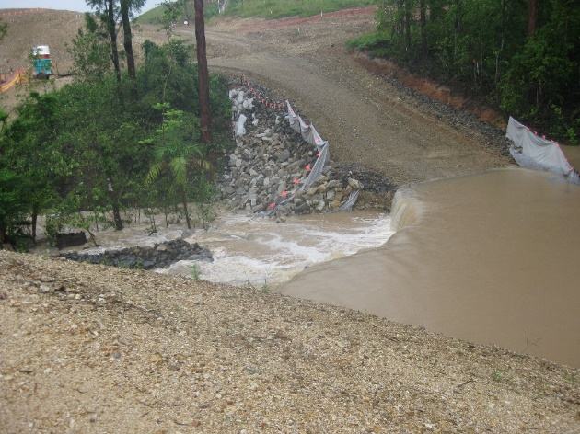
The Various Stressors Affecting the Estuaries
Climate change impacts
Bank erosion
Urban stormwater
Agricultural Land Usage
Invasive flora and fauna
Inundation & Flooding
Industrial runoff
Sedimentation
Notes:
The issues facing these estuaries are typical of many ICOLLs
However, the unique issue facing estuaries on the Coffs Coast, is the extremely high density of horticulture in their catchments. In particular, there is a high density of Intense Plant Agriculture (known as IPA) >> mostly blueberry horticulture. This has boomed over the last 20 years. Coffs Harbour now grows 80% of the nations blueberries!
The impacts on the downstream waterways include from runoff, water extraction, and riparian zone management. Huge amounts of research from Southern Cross Uni to identify and quantify this issue – but no coordinated management approach had yet been developed.

Slide 5
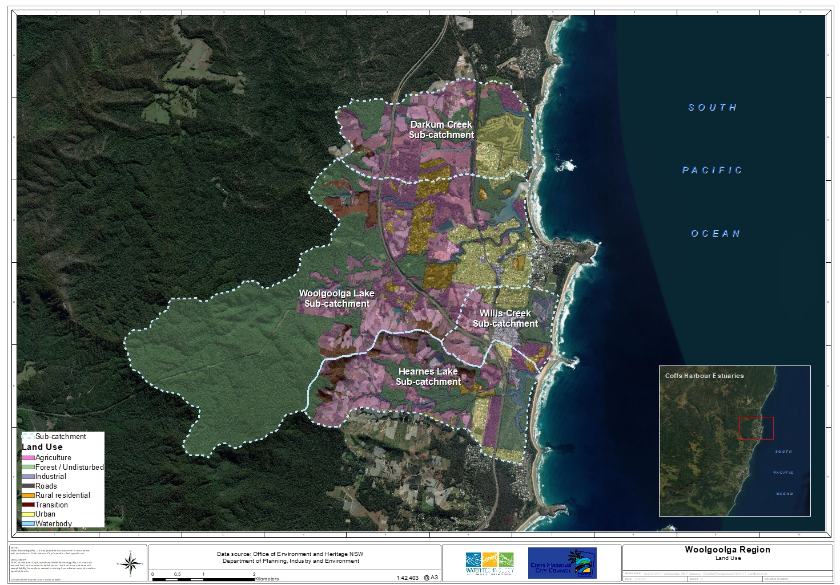
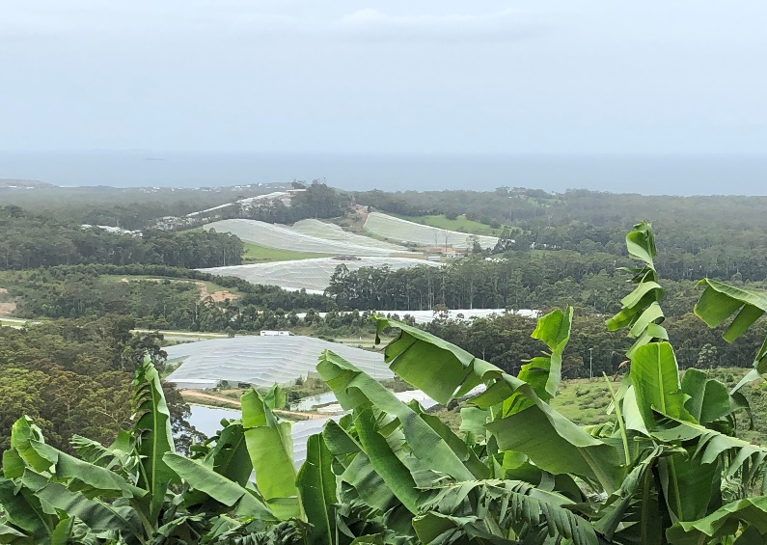
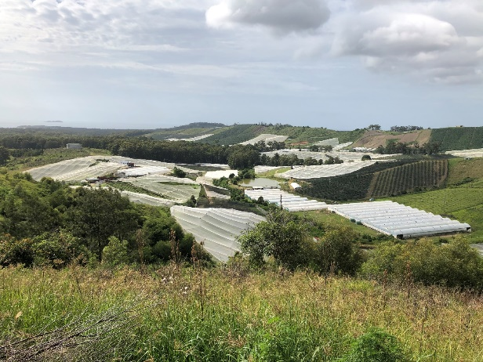
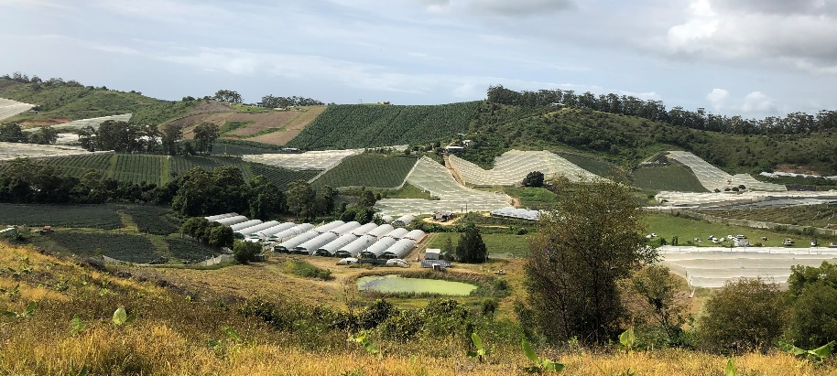
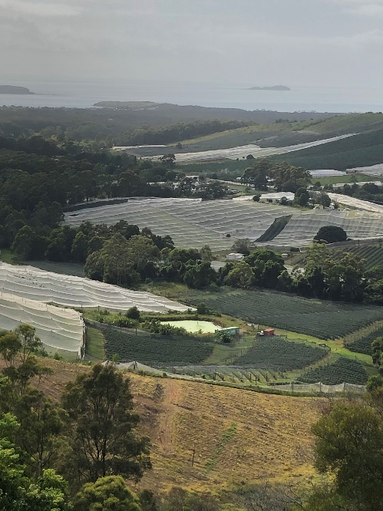
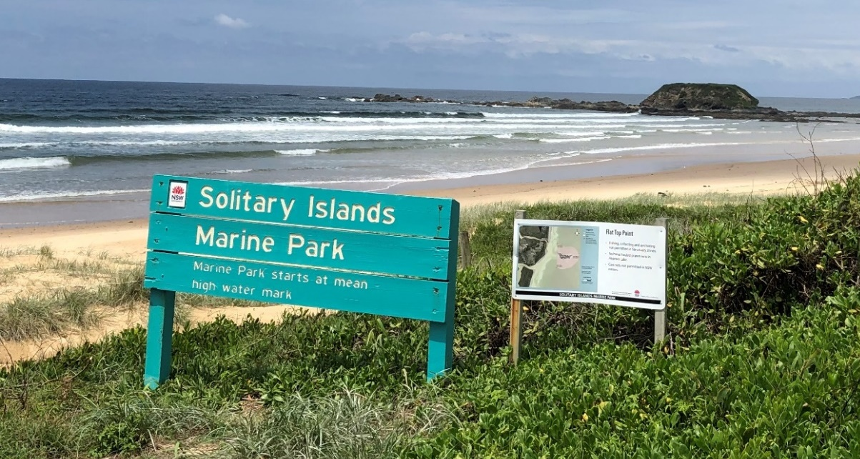
Pink areas show the extent of IPA in the 4 x ICOLL catchments.
IPA = 25-50% of the catchments
Downstream estuary waterways are within SIMP
Notes:
The pink here shows the extent of IPA across these catchments. If you’ve ever flown over Coffs Harbour and seen all the blueberry netting you'll know how ubiquitous it is
Whats so pressing about this is that the estuaries and coastal waters are part of Solitary Islands Marine Park

Slide 6
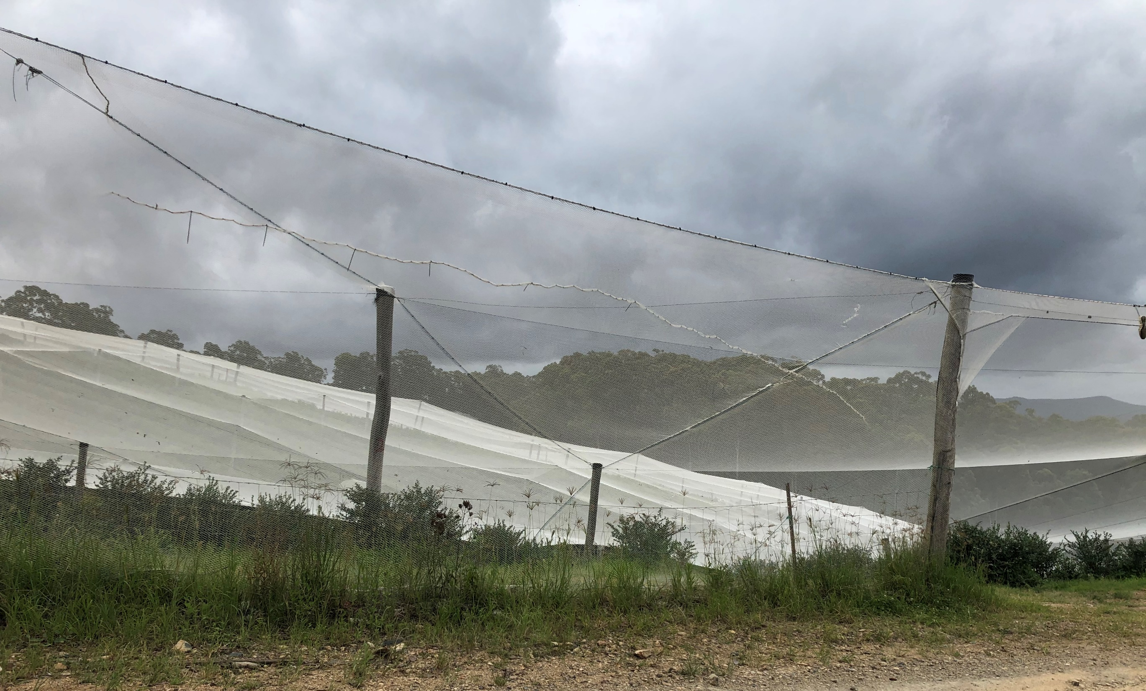






The negotiation and design process
Coffs Intensive Horticulture Environmental Program (CHIEP)
Initial discussions and project scoping
Facilitated workshops to co-design the program
Include additional stakeholders and negotiate content & funding
Clean
Coastal Catchments
Notes:
Initial discussion held with industry groups to establish trust and determine the way forward. Determined that the best way forward was to develop an LGA wide program of environmental improvement for growers. The best chance of uptake and success would be to include industry in the design process.
In terms of design, we started with a select stakeholder group, and then gradually broadened the tent with each step in the design/negotiation process
In the next step, we brought DPI-Ag into the tent to “co-design” the program with the industry groups. Key to this was leveraging off the existing clean coastal catchments program, which is funded through MEMA. Here we can take all the great research and technical work by CCC and design a program to put it into practice in the real world.
Then, we broadened discussions to include Council and DPIE, to negotiate the contents of the program, and identify funding sources

Slide 7









Broader stakeholder engagement
Once a draft plan was developed, additional stakeholders were provided opportunities for review and comment engagement, which was facilitated through the Stage 3 of the CMP…
✓
✓
Traditional Owners
Coffs Harbour Coast and Estuary Management Committee
DPI-Fisheries
✓
Crown Lands
The Local Community
Solitary Islands Marine Park
Community drop-ins
Online engagement
Notes:
Once a draft plan was developed, the draft plan was put before a three major stakeholder groups for review and input..
CEMAC was unanimous in its support
LALC provided positive feedback.
Community feedback graph is on next slide

Slide 8
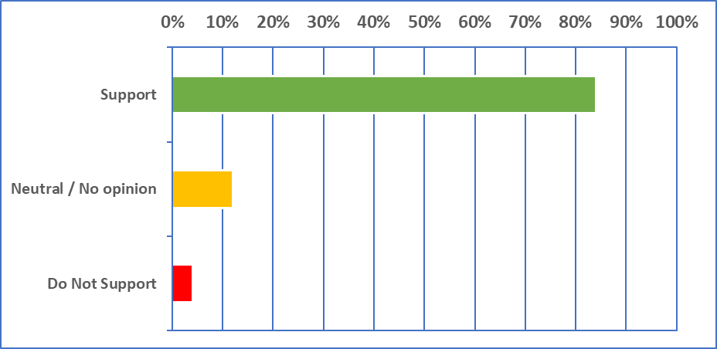
Community Response
84%
12%
4%
Notes:
Overwhelming community support.

Slide 9
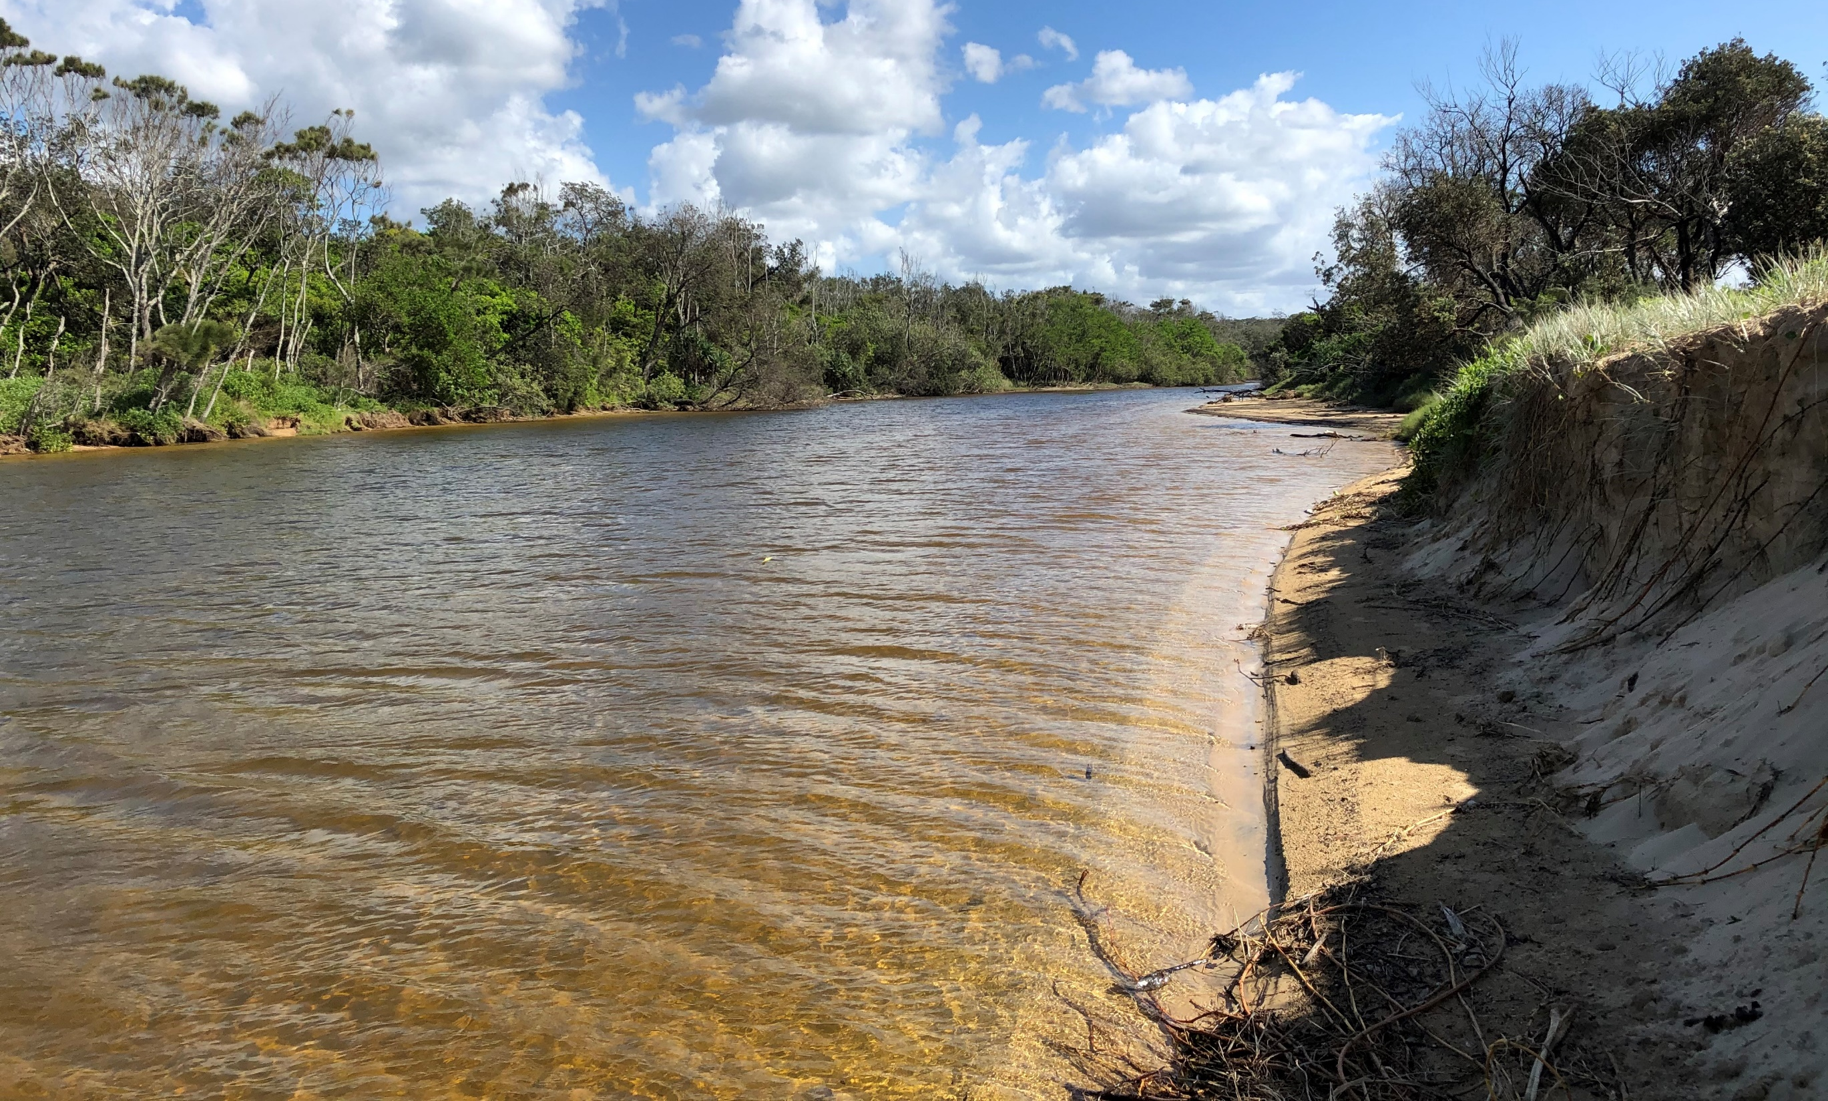
The components of the CHIEP
Dedicated Project Officer
Locally based
Competitive Incentives Program
Improve Practices
Monitoring & Reporting
Stakeholder engagement
Manage the program
Innovation
Practice change
Work with growers
Benchmark & Improve Practices
Hort360
Best
Practice
Management

Slide 10
The CHIEP in Action
Assess current practices using Hort360
Determine if Grower is “Below”, “At” or “Above” Industry standard
Identify & facilitate opportunities for practice change & improvement
Recognition for Growers who demonstrate best practice
Managed by CHIEP Project Officer
Monitoring, Evaluation and Reporting
June 2007 Flood (East Gippsland Catchment Management Authority)

Slide 11
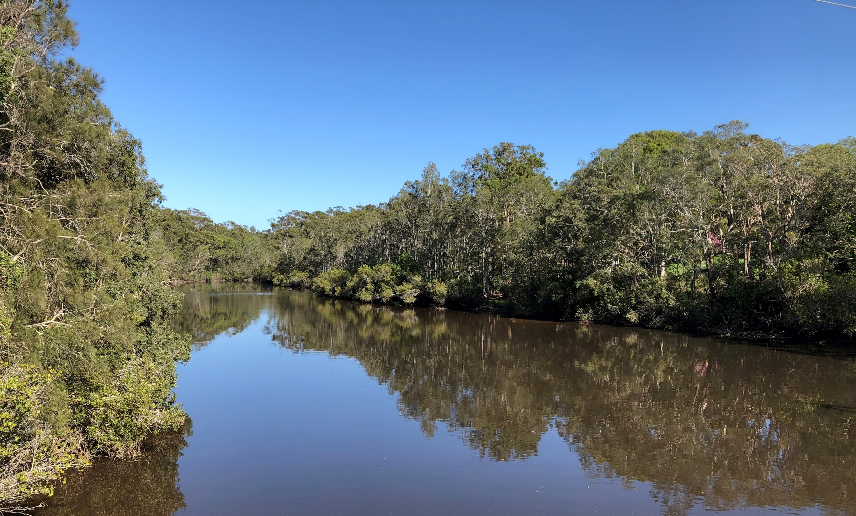
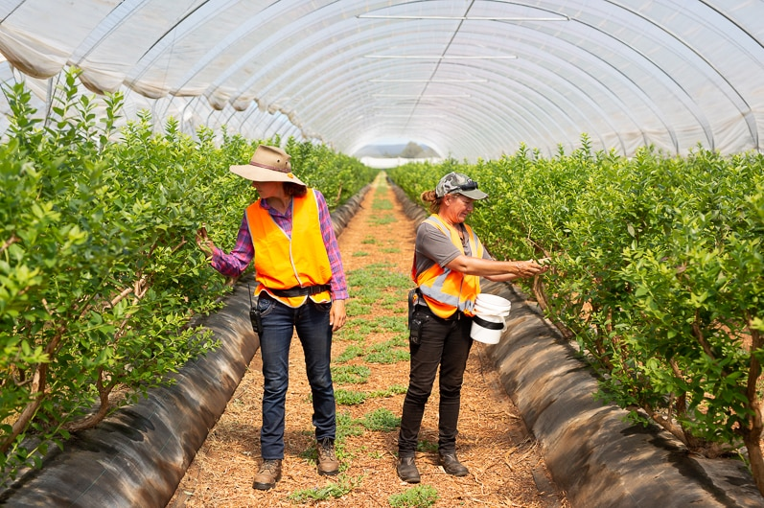
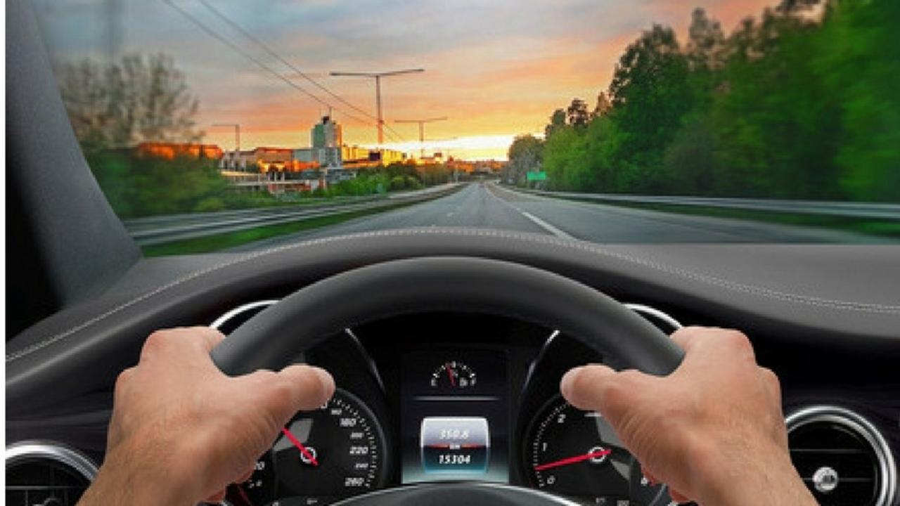
Where to from here?
Being championed by DPI-Agriculture
Marine Estate Management Strategy funding application
Opportunities for industry funding…

Slide 12
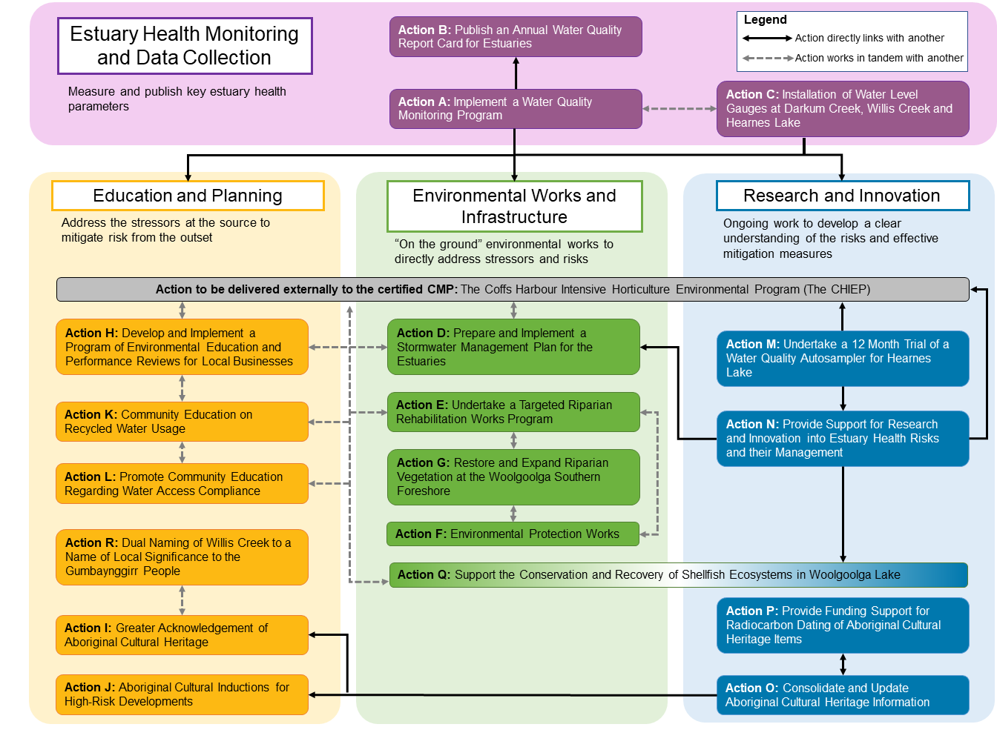
Integration with the CMP
Notes:
Note that delivered, externally to the CMP.
But still linked with man of the actions in the certified CMP

Slide 13
Key Learnings
Really take the time to identify and understand all of your stakeholders
Be prepared to think big and take risks (nothing ventured, nothing gained!)
From little things, big things grow
Understand how to best work within the playing field (legislation, planning & funding)

Slide 14



Recognition…
Notes:
Id give some kudos to:
> Rachael @ BA for being so willing to come to the table and work collaboratively
Mel @ DPI, for her technical expertise and willingness to cross-fertalize (excuse the pun), with the clean coastal catchments program
Council and DPE for engaging in good faith and genuinely wanting to progressing things towards the best outcomes

Slide 15


Questions
Neil Dufty
  Principal at Molino Stewart
  ndufty@molinostewart.com.au
Chris Beadle
  Coastal Engineer at Water Technology
  chris.beadle@watertech.com.au

