Slide 1

The Nelson Slade Bond
Collection
At Marshall University
MARAC, April 18 2009

Slide 2

Today’s Presenters
(in order of appearance)
Nat DeBruin – Archivist and Manuscripts Librarian
Lisle Brown – Curator, Special Collections and Archives
Andrew Earles – Video Operations Specialist
The Nelson Slade Bond
Collection

Slide 3
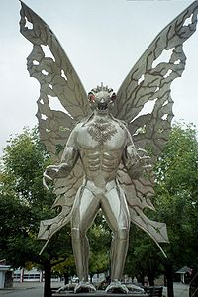
Before Mothman…

Slide 4
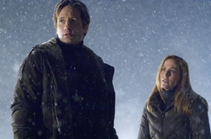
Before “The X-Files”…
“Scully… I don’t think we’re in West Virginia anymore.”
The X-Files; I Want to Believe. Twentieth-Century Fox Film Corporation, Crying Box Productions, 2008

Slide 5
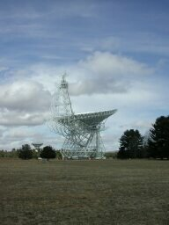
Before S.E.T.I.*…
Green Bank Telescope,
National Radio Astronomy Observatory,
Green Bank, West Virginia
* Search for Extra-Terrestrial Intelligence

Slide 6
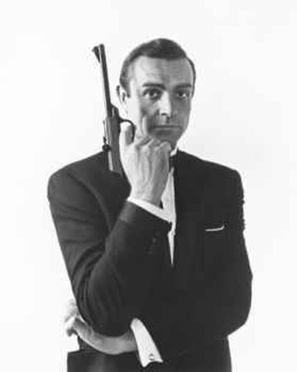
Before 007…

Slide 7
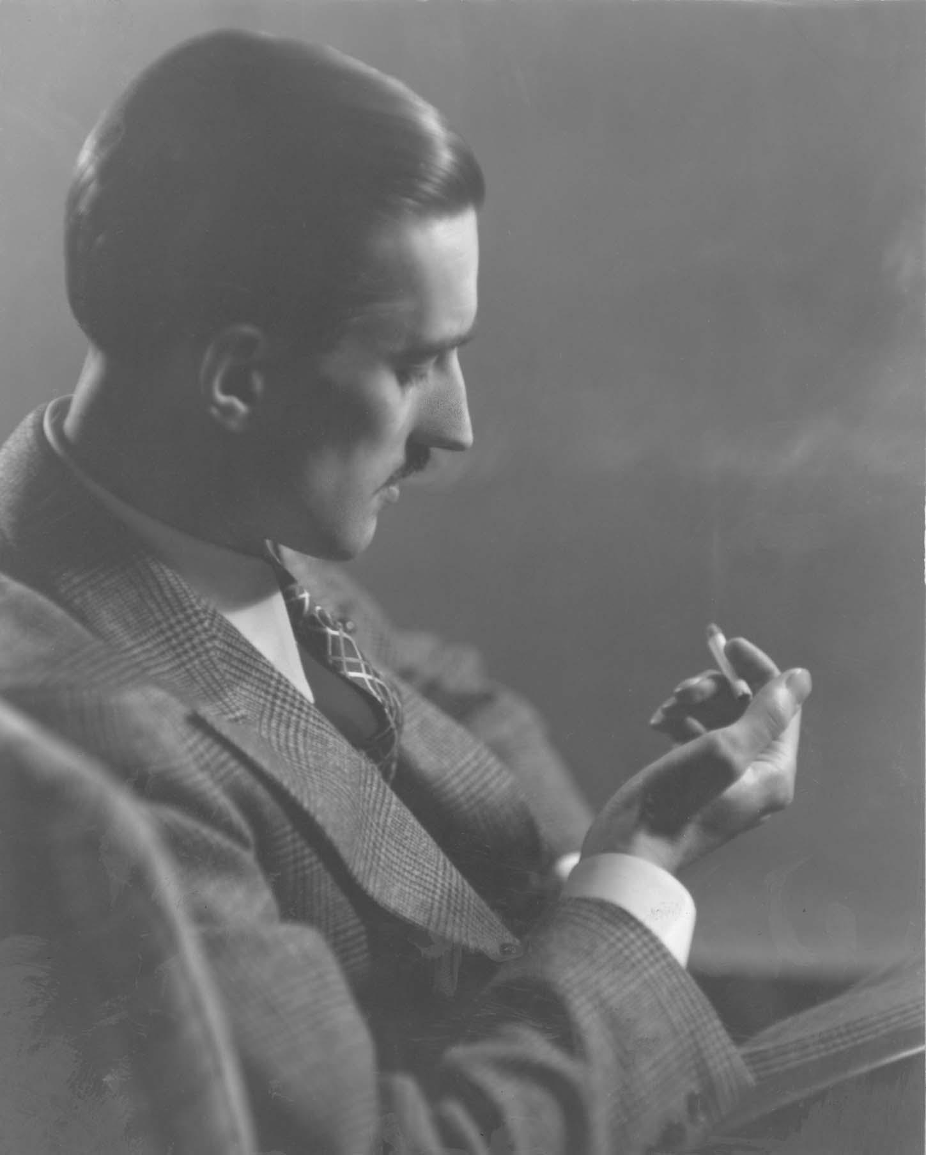
There was Bond…
1908-2006
Nelson Bond…

Slide 8
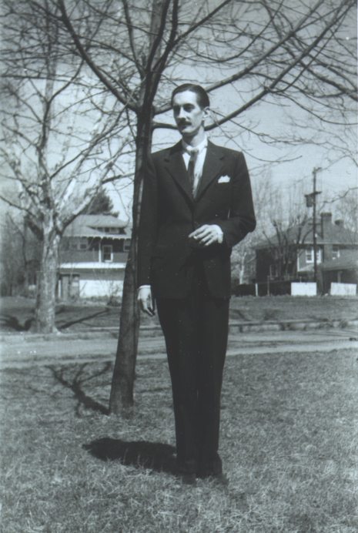
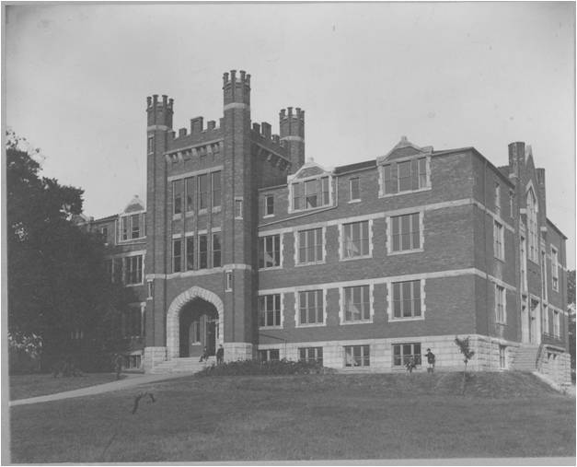
Nelson Bond comes to Marshall College, 1932
“I think I was among the first to see him when he arrived on campus. He looked kind of like Lord Baden-Powell, founder of the Boy Scouts. He was most debonair and dashing and he was given to reciting long passages of Chaucer.”
Retired Charleston Daily Mail editor Jack Maurice
In 1932…
Huntington has a population of 80,000
Tuition at Marshall College = $28.75/semester, books $10.00
July, 1932 Dow-Jones Industrial Average = 41.22
Johnny Cash is born…John Philip Sousa dies
The Nelson Slade Bond
Collection

Slide 9
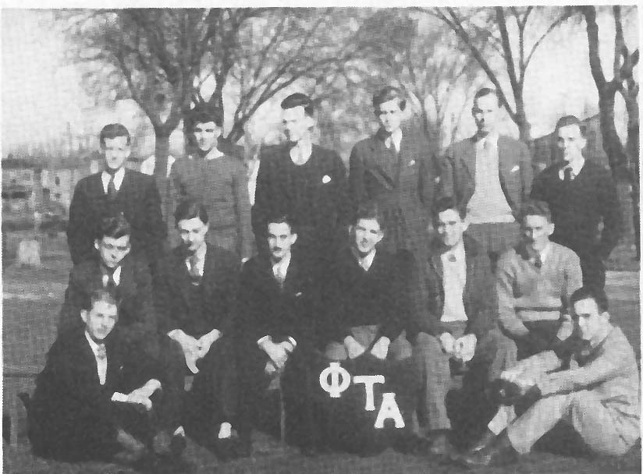
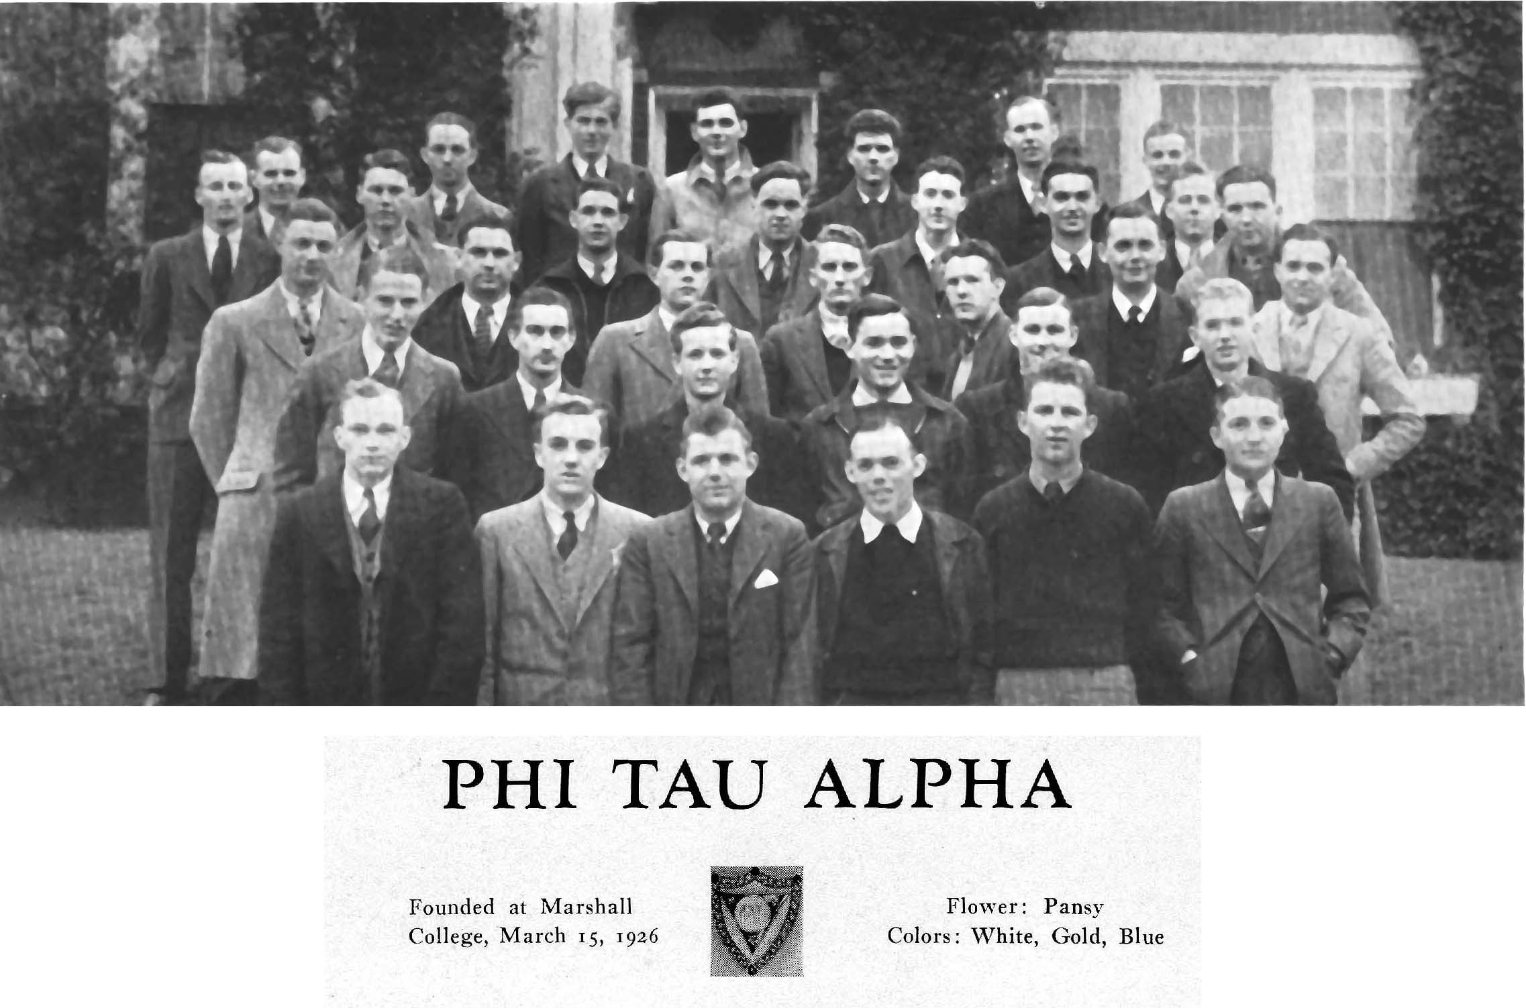
In college life morale is of the highest importance. Listlessness and loafing are educational sins. Intense interest and hard work are essential to success. A dominant purpose tends to develop a strong personality which is itself one of the desiderata of a general education.
Marshall College Catalog, 1932-1933
1933 Intramural Volleyball Champions
“…Because I had no desire to earn a degree! I was simply sitting out the Depression, taking whatever courses appealed to me.”
The Nelson Slade Bond
Collection

Slide 10
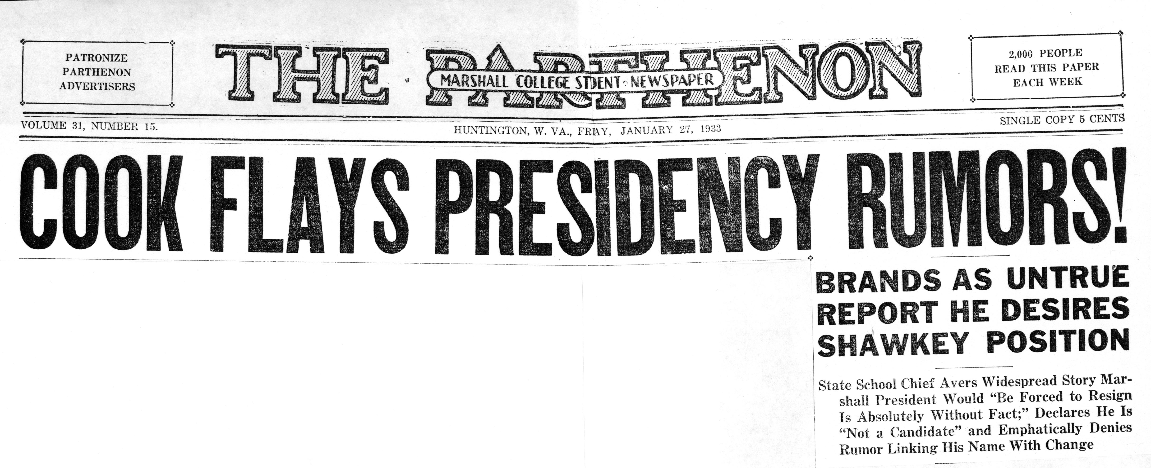
When there’s no news…. Well, just make something up!
Nelson’s first foray into fiction…?
The Nelson Slade Bond
Collection

Slide 11
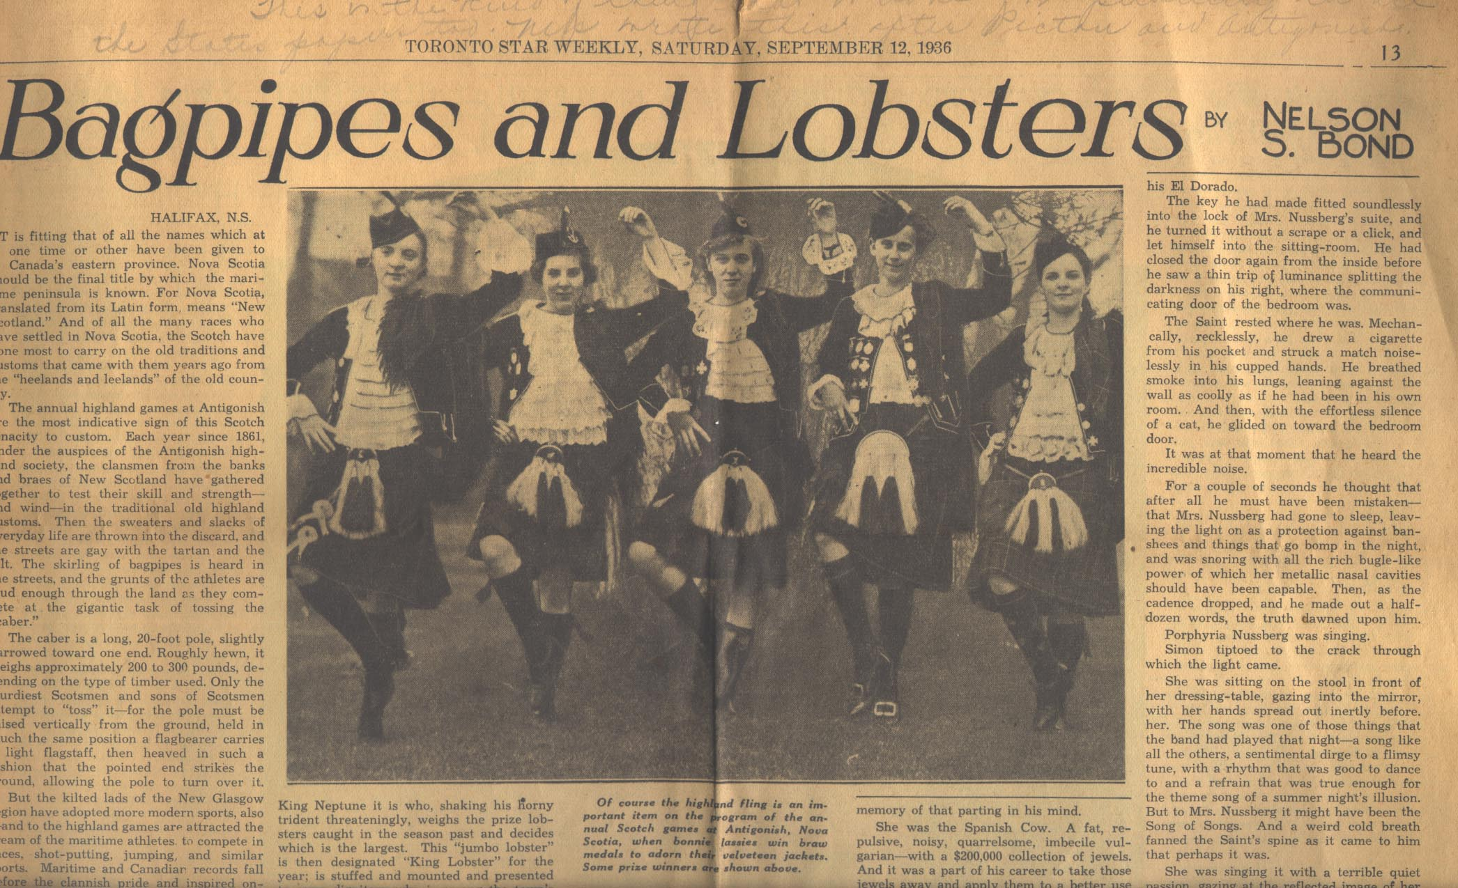
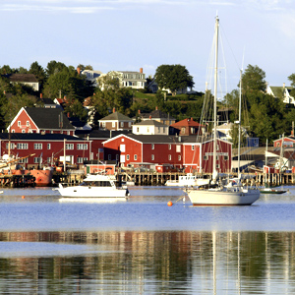
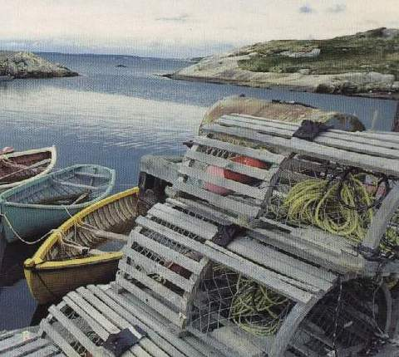
Newlyweds have
to eat too, don’t
they?!
Nelson marries Betty Folsom
in 1934, leaves Marshall
and moves to Nova Scotia in
1936
The Nelson Slade Bond
Collection

Slide 12
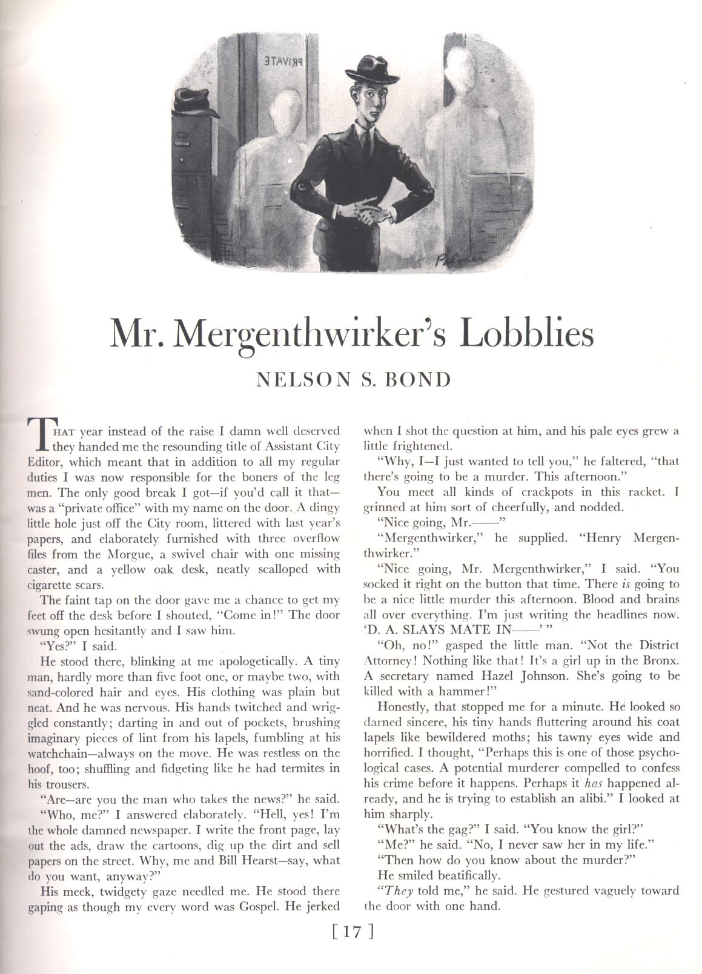
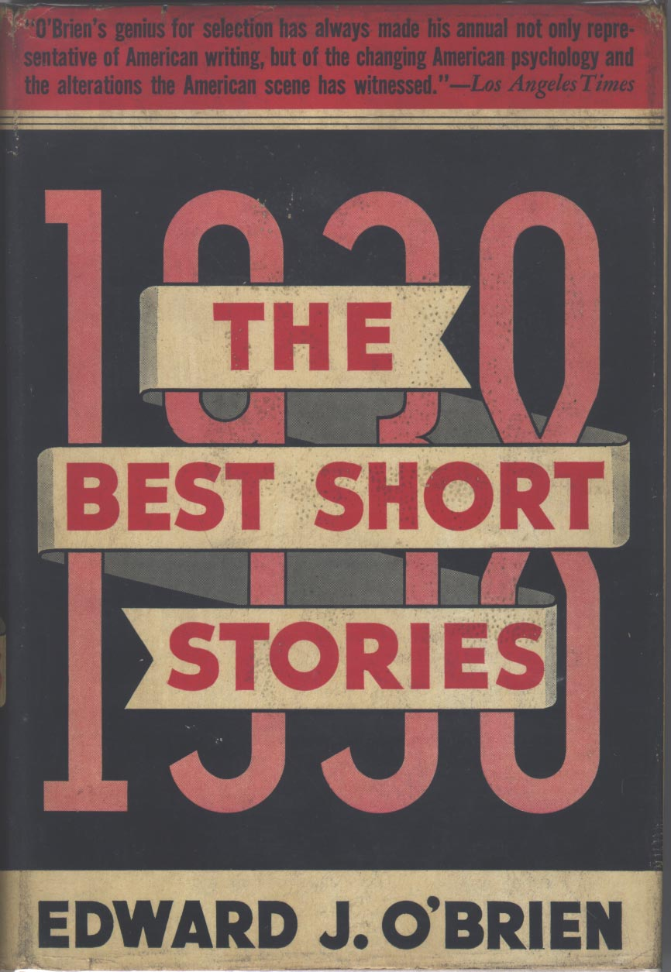
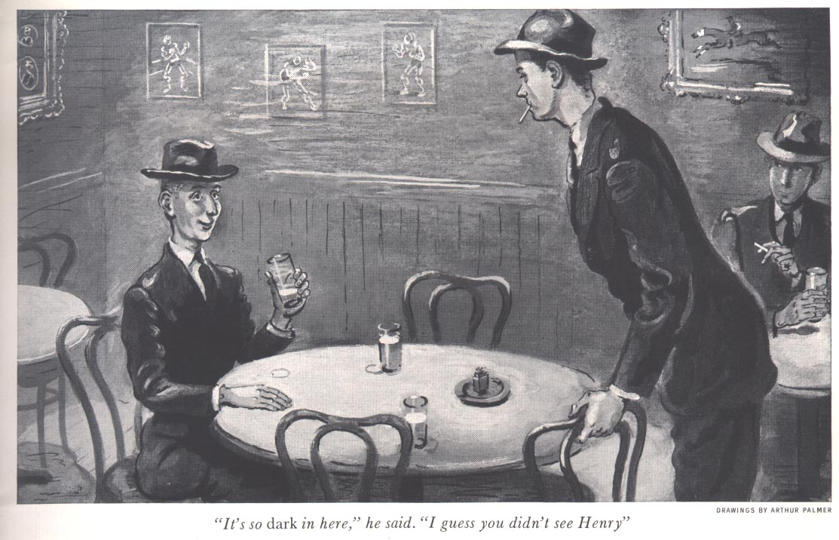

Literary Success –
Scribner’s Magazine, November 1937
The Nelson Slade Bond
Collection

Slide 13
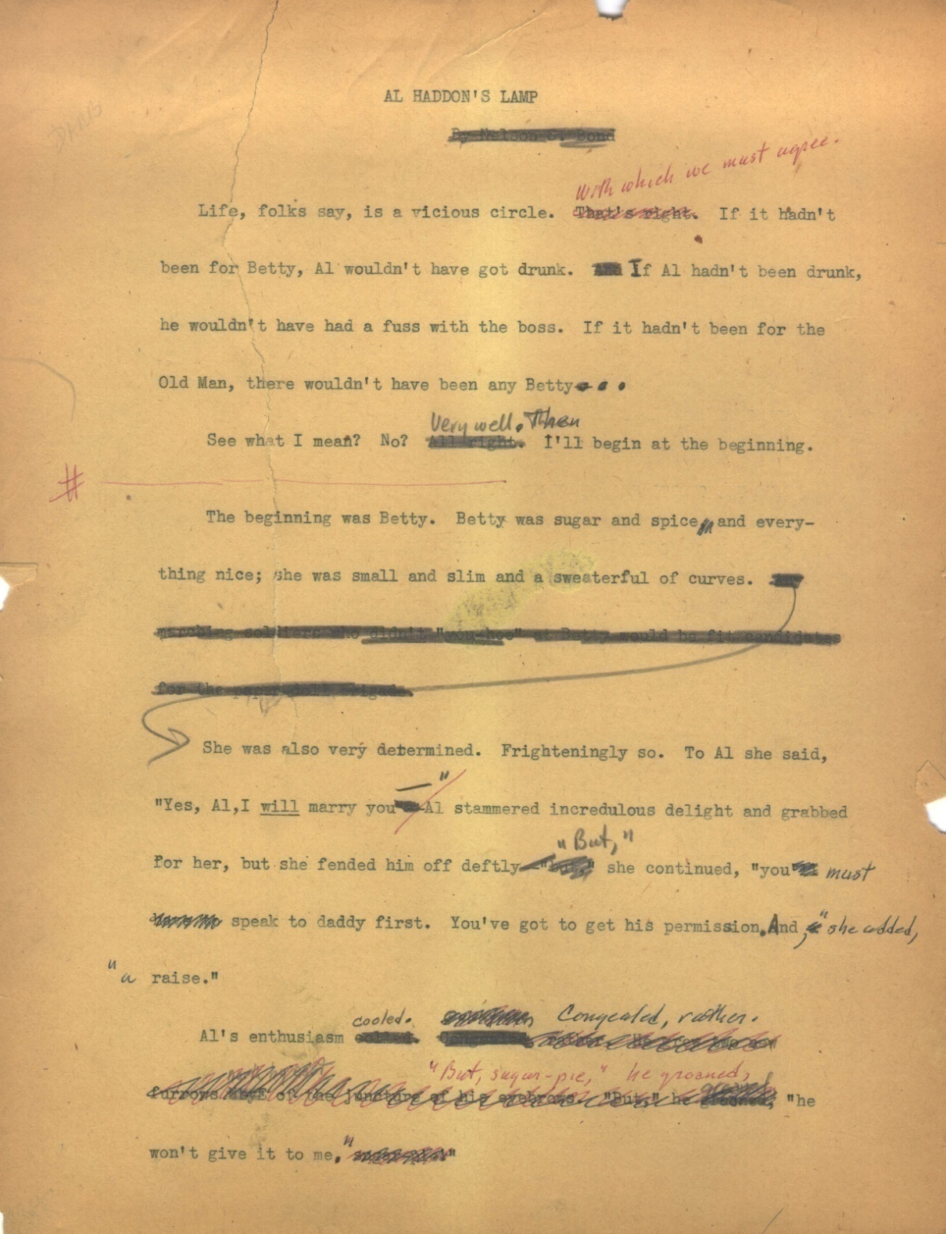
The richness of the Bond
Collection. A journey with…
AL HADDON’S
LAMP
Original MSS materials…
The Nelson Slade Bond
Collection

Slide 14
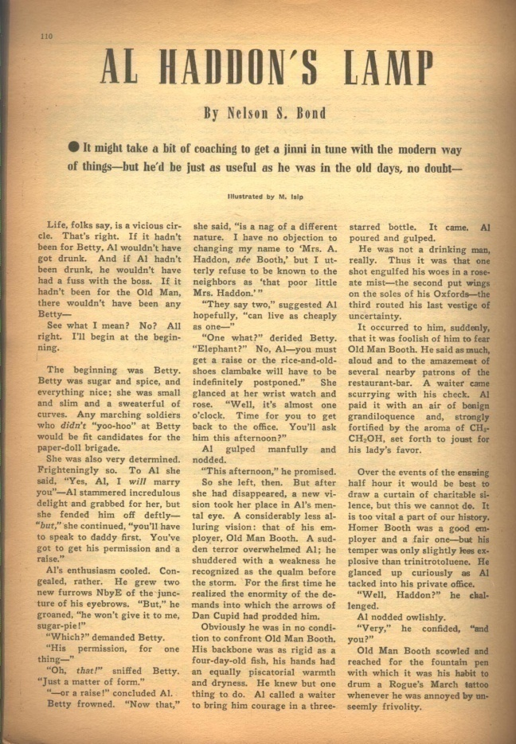
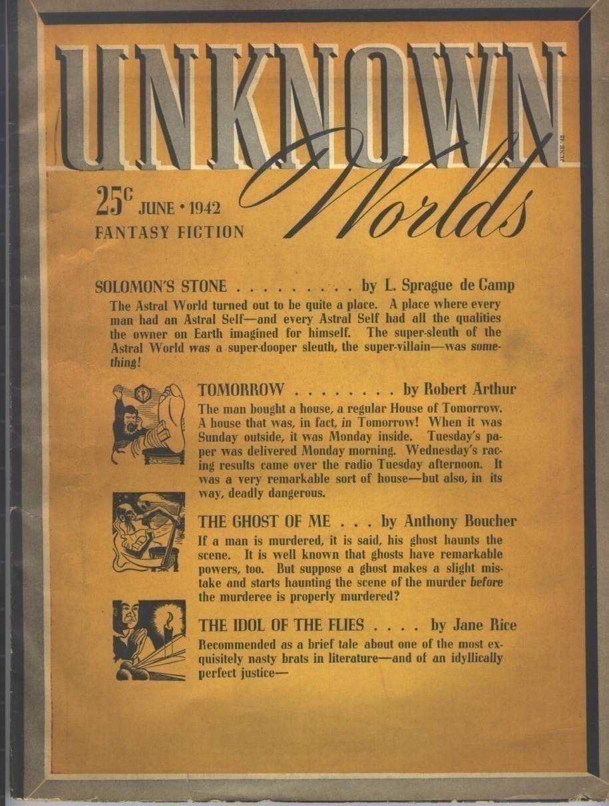
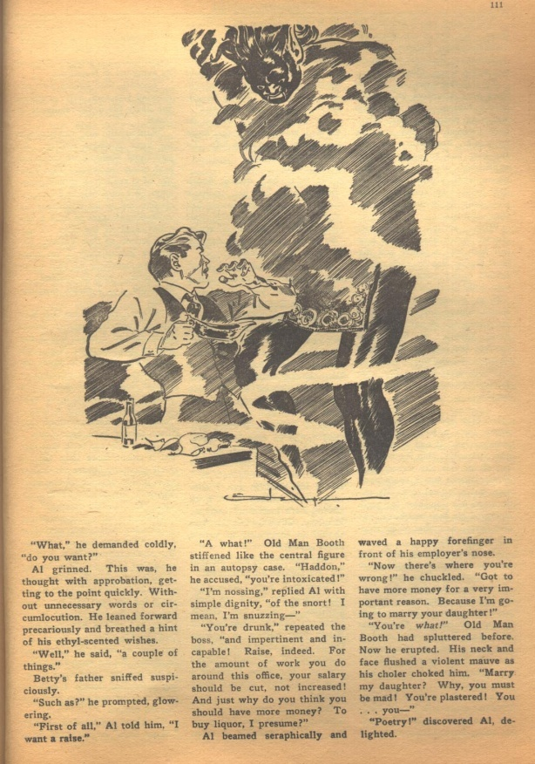
AL HADDON’S
LAMP
The Nelson Slade Bond
Collection

Slide 15
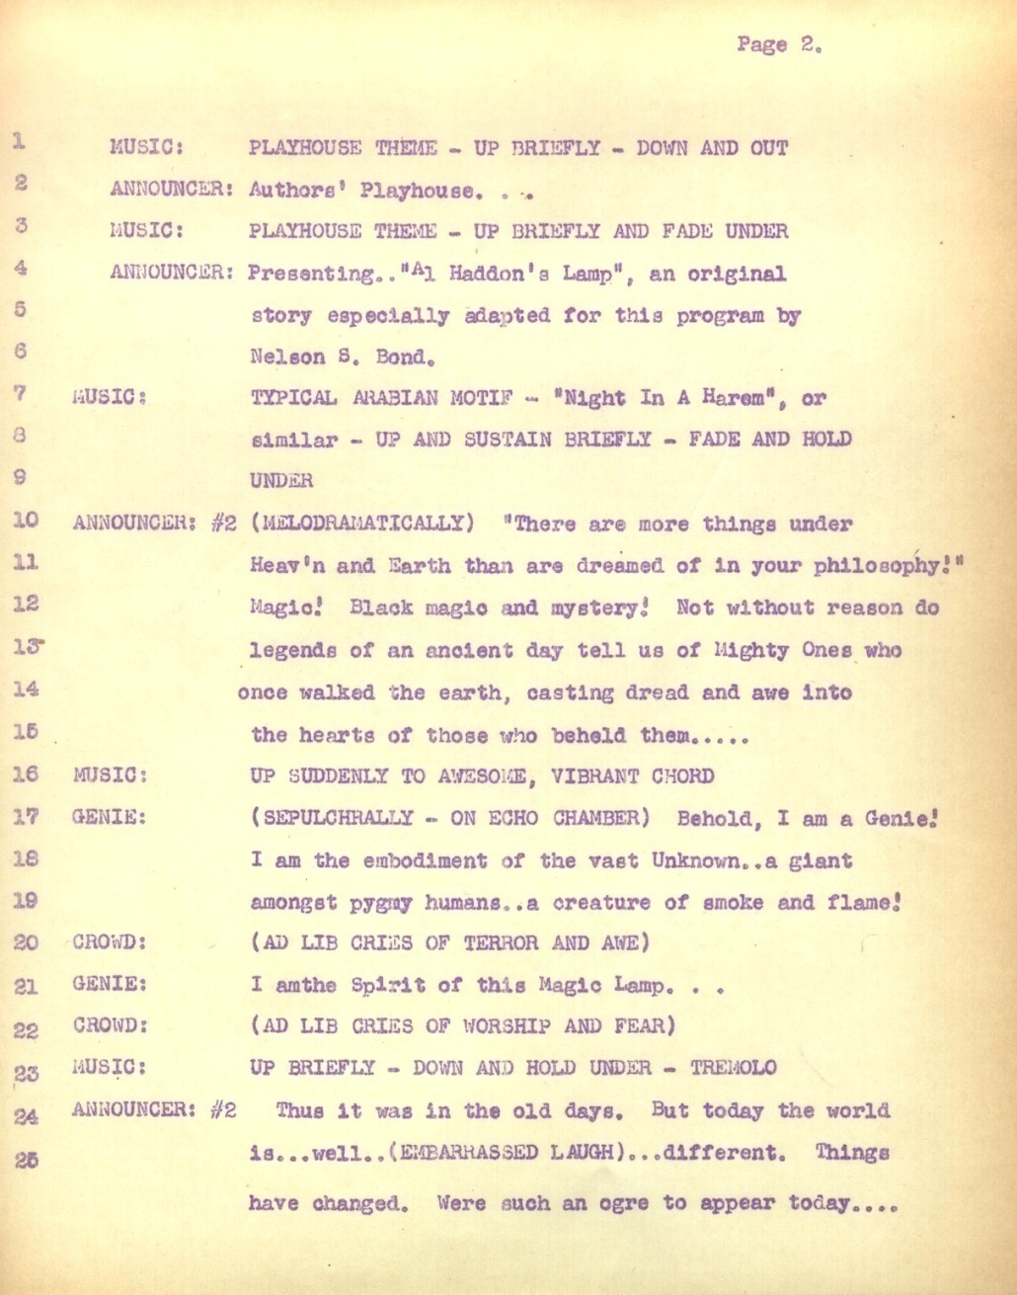
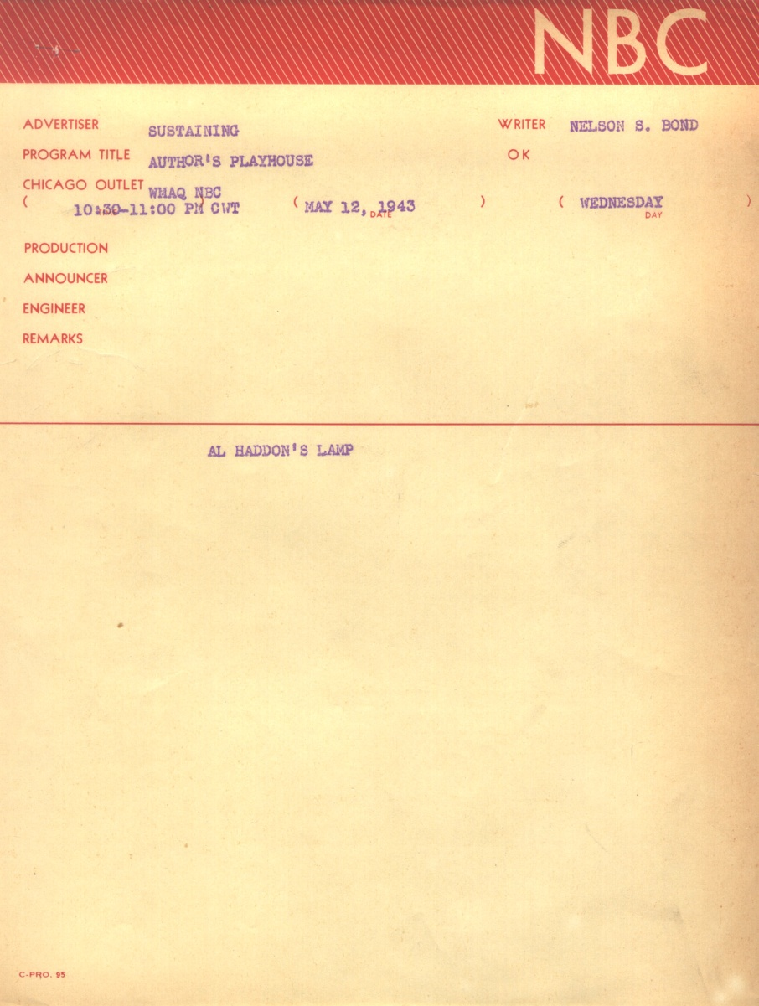

AL HADDON’S
LAMP
The Nelson Slade Bond
Collection

Slide 16
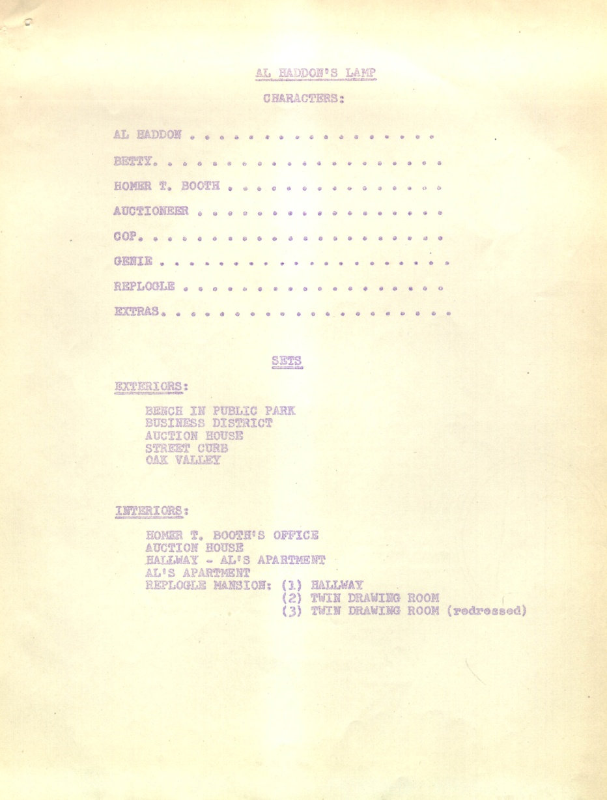
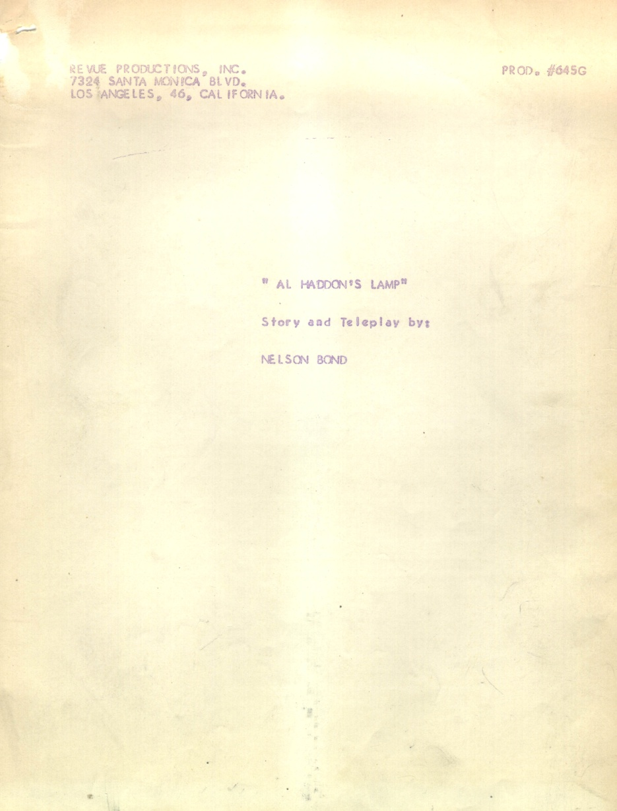
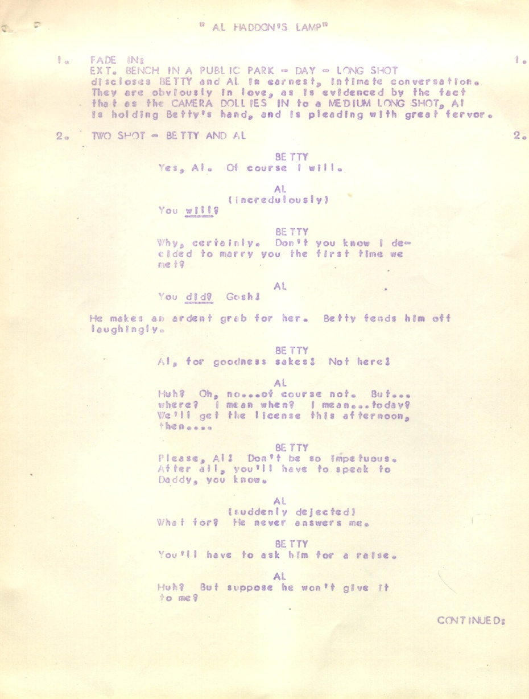
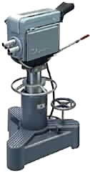

AL HADDON’S
LAMP
The Nelson Slade Bond
Collection

Slide 17
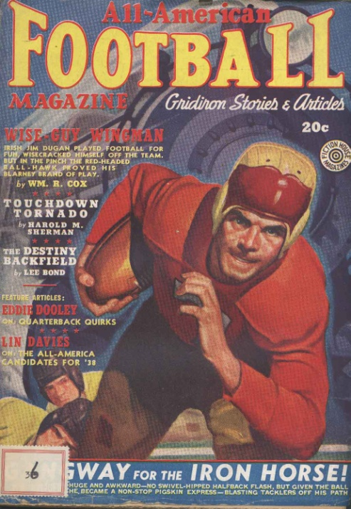
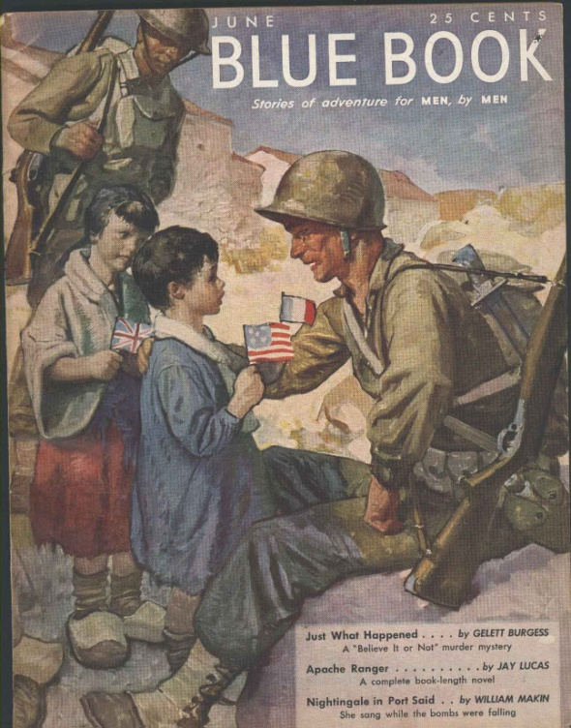
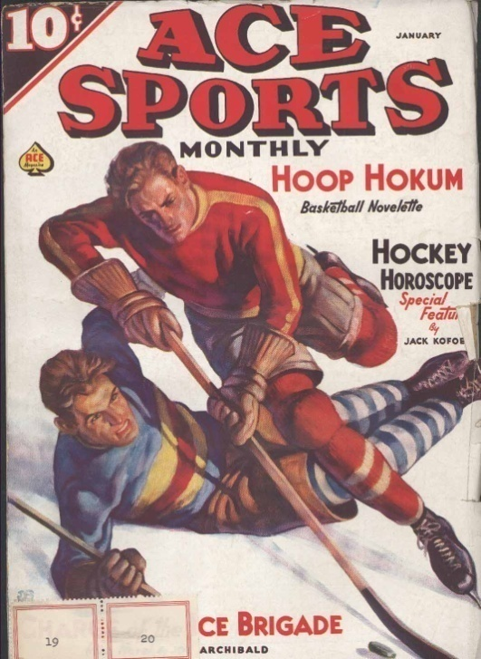
It was not all science fiction and fantasy…
Nelson wrote under several pseudonyms, especially early in his career…
Ralph Powers, Cliff Campbell, Lee Bond, Simon Fitch
The Nelson Slade Bond
Collection

Slide 18
It was not all science fiction and fantasy…
“Mask of Medusa”
Mystery in the Air – Sept. 4, 1947
“Murder on the Half-Shell”
Hot Copy - April 23, 1944
“The Housekeeper”
Lights Out - August 23, 1949
“Rebel Gold”
The Sheriff Show
“Take My Drum to England”
Theatre 5
“The Ring”
Dr. Christian Show – June 16, 1943
The Nelson Slade Bond
Collection

Slide 19

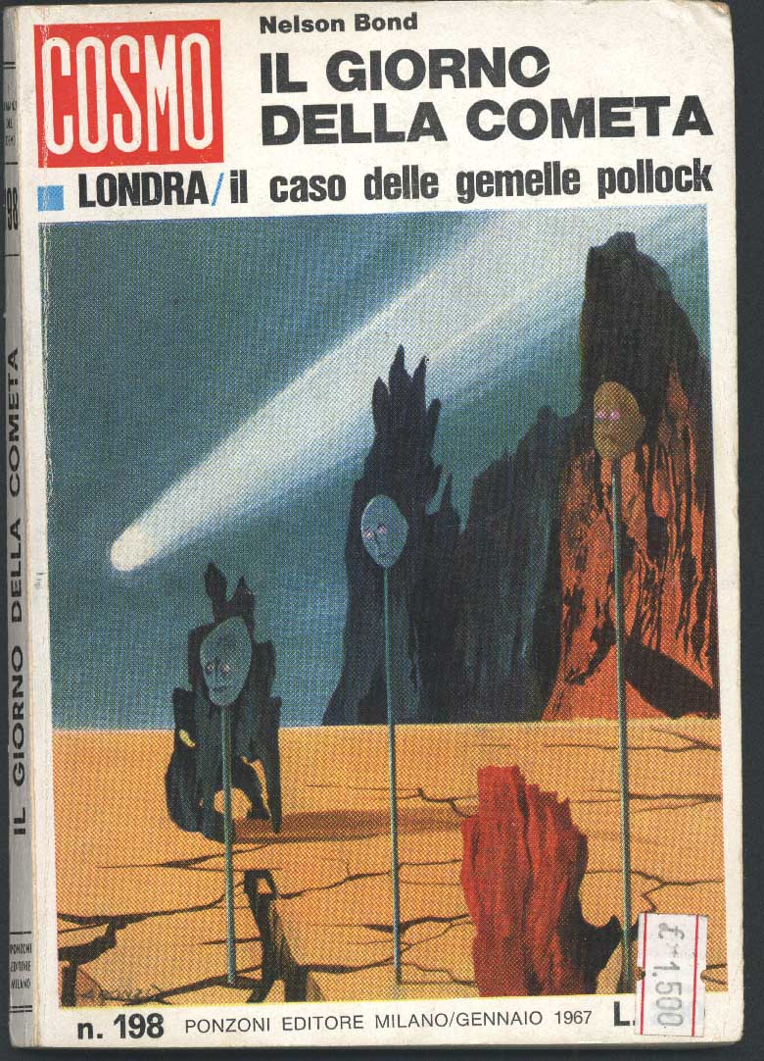
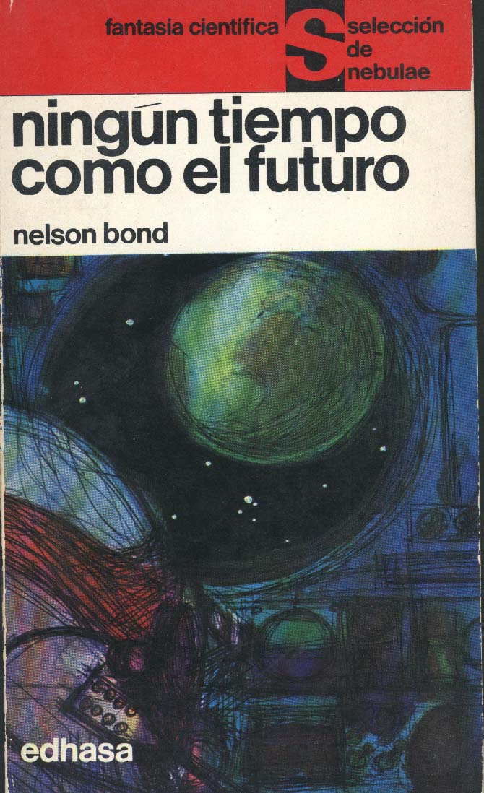
And it wasn’t just in the United States…
The Nelson Slade Bond
Collection

Slide 20
Nelson Bond’s Literary Career…
Published over 200 short stories, novellas, novels,
and articles between 1937 and 1999
Wrote over 200 radio scripts
Wrote 80 television screenplays and stage plays.
In 1998, Nelson Bond was the 4th author
honored by Science Fiction
and Fantasy Writers of America
as Author Emeritus
The Nelson Slade Bond
Collection

Slide 21
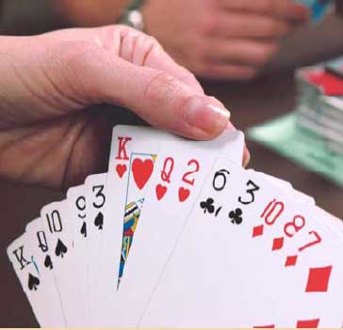
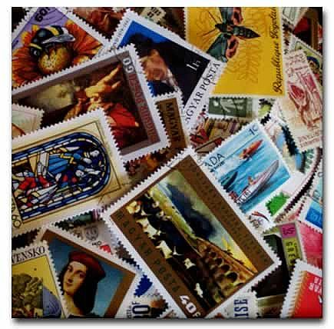
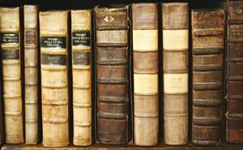
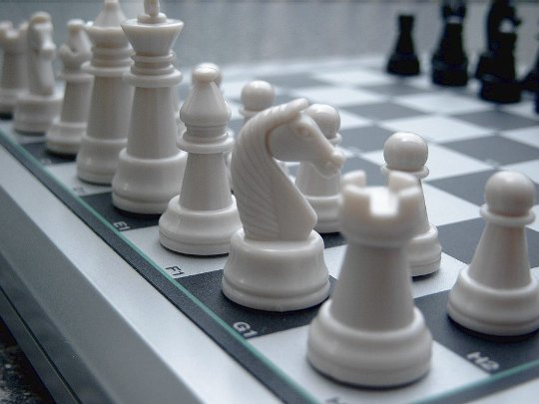
Nelson Bond’s “other life”…
Contract Bridge champion
Stamp Collecting – Wrote The Postal Stationary
of Canada; A Reference Catalog in 1953
Antiquarian Book Dealer
Chess Master
The Nelson Slade Bond
Collection

Slide 22
Nelson Bond Returns to Marshall University
The Nelson Slade Bond
Collection

Slide 23
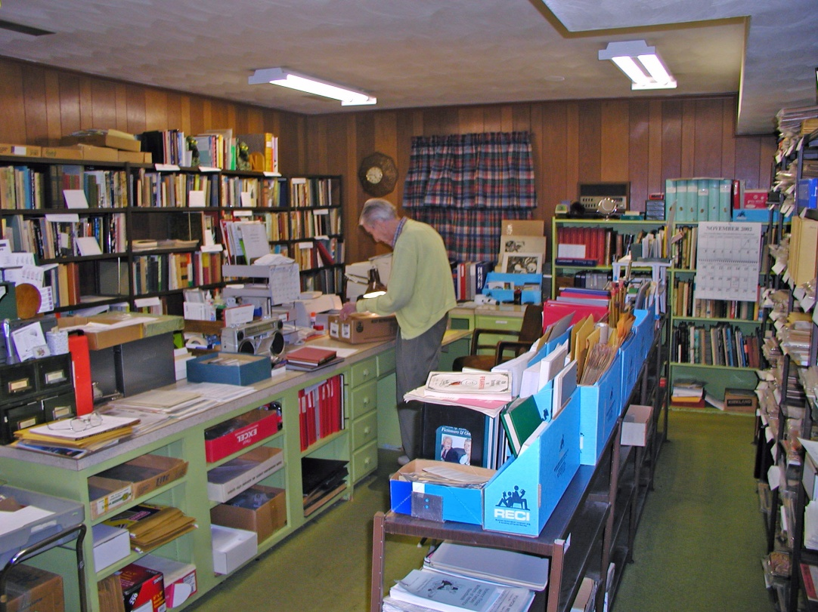
Nelson Bond in his Office in 2002
Beginning in 2003, Nelson Bond began to transfer his papers from his office in Roanoke, Virginia to Marshall University….
….the transfer was completed in 2006
The Nelson Slade Bond
Collection

Slide 24
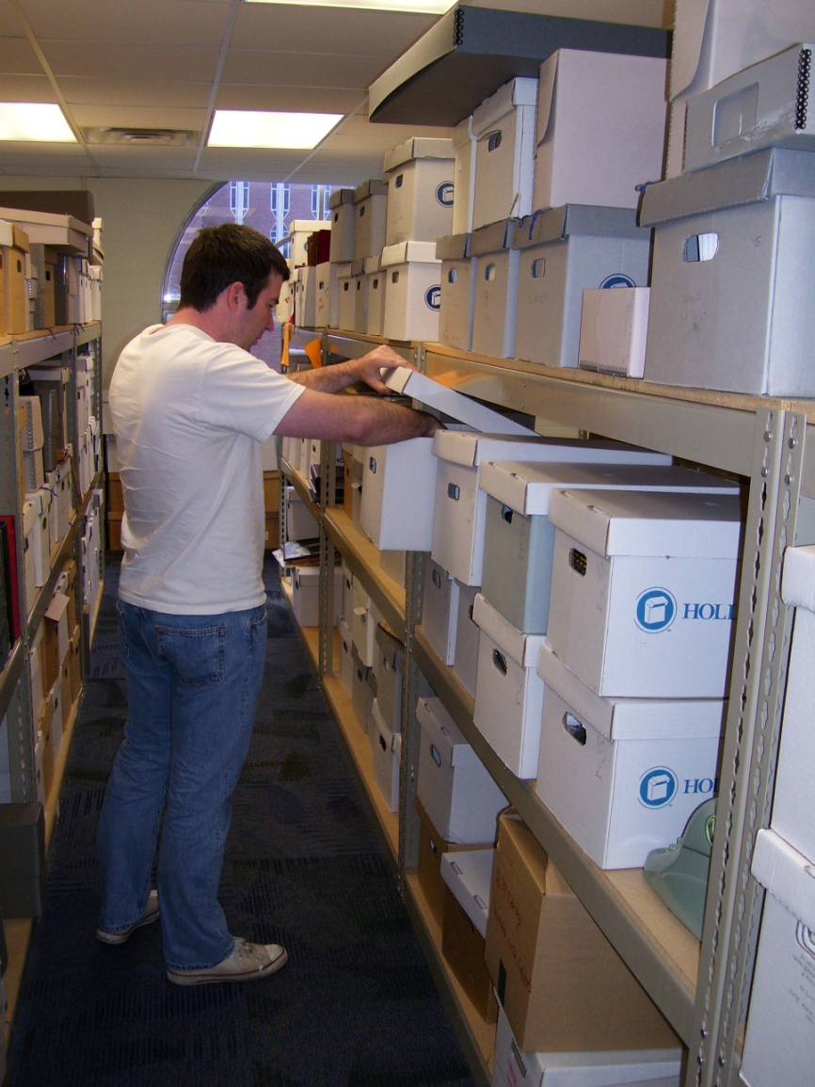
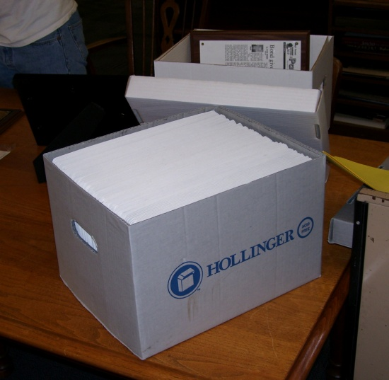
Processing the Bond Collection
Gabe McKee, Marshall University graduate student, was assigned the task of processing the Nelson Bond Collection.
The collection, once Gabe finished, extended over 54 linear feet with all material placed in acid-free folders and containers.
The Nelson Slade Bond
Collection

Slide 25
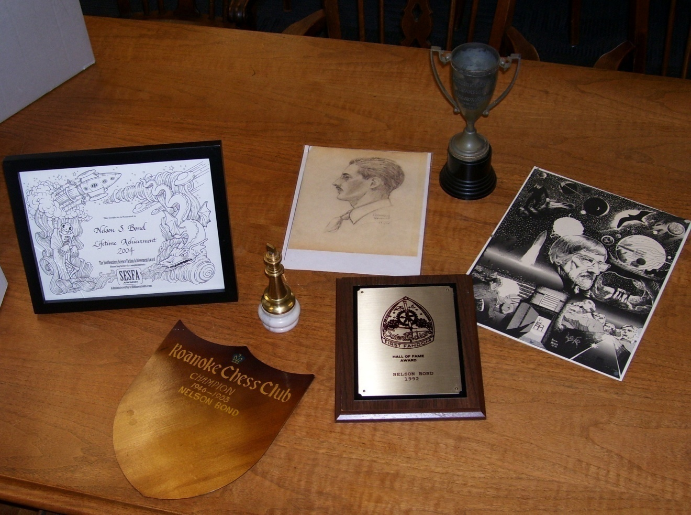
Processing the Bond Collection
Not only does the collection include paper documents, it also has a number of artifacts, including original artwork, plaques, awards, certificates, etc.
The Nelson Slade Bond
Collection

Slide 26
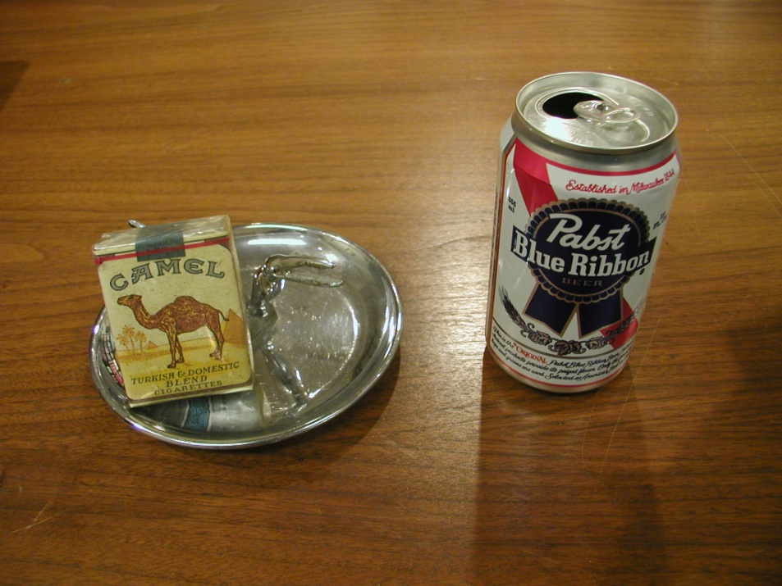
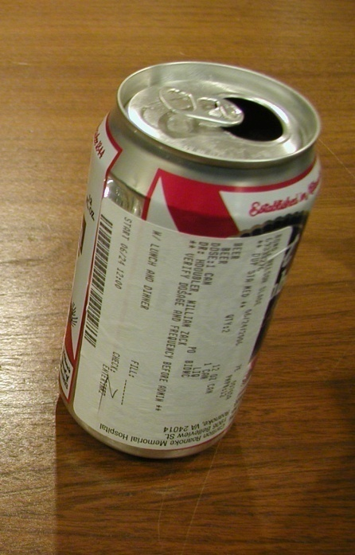
Processing the Bond Collection
Nearly every collection has its unexpected and unique items...
…and Nelson Bond’s collection is no different
The Nelson Slade Bond
Collection

Slide 27
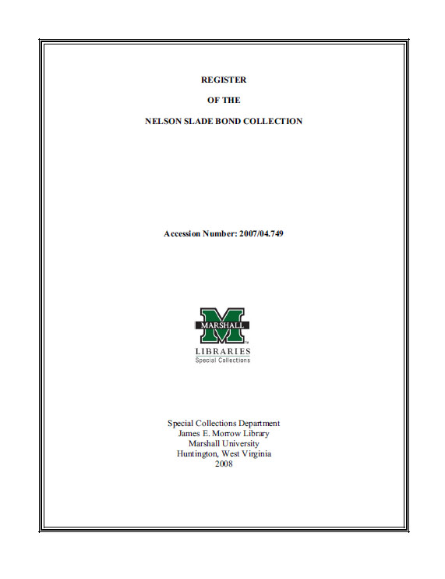
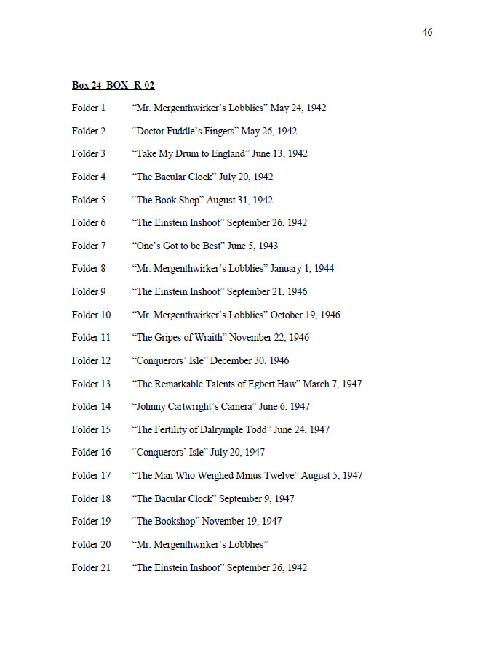
The Register to the Nelson S. Bond Collection
Gabe finished the Register in February 2008
The Nelson Slade Bond
Collection
Available on-line:
http://www.marshall.edu/library/speccoll/mss_guide/pdf/acc-2006-04.0749-bond-n.pdf

Slide 28
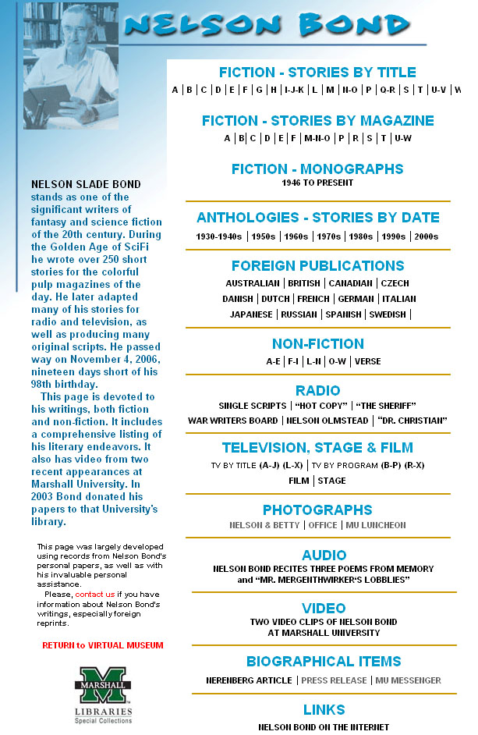
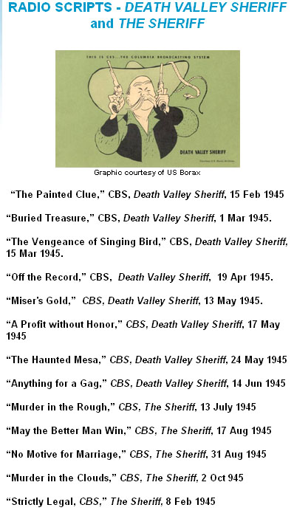
Bond in the Virtual Museum
On-line guide to Bond’s published works, and much more….
The Nelson Slade Bond
Collection
http://www.marshall.edu/library/speccoll/virtual_museum/bond/default.asp

Slide 29
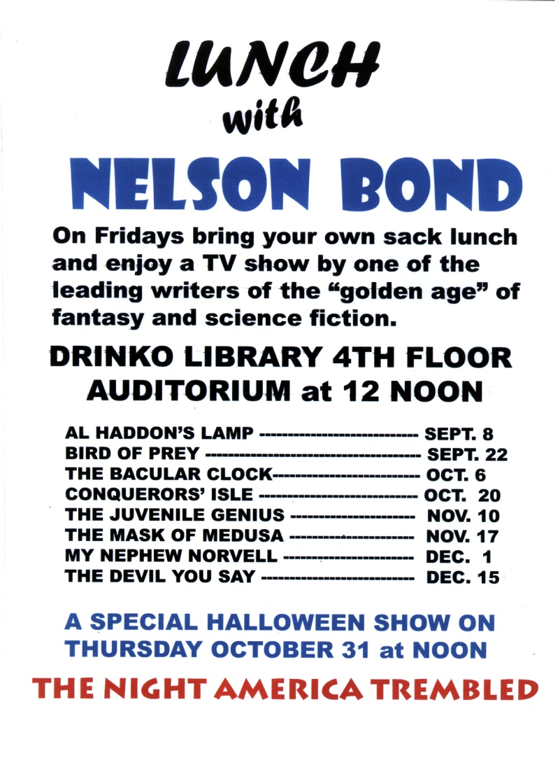
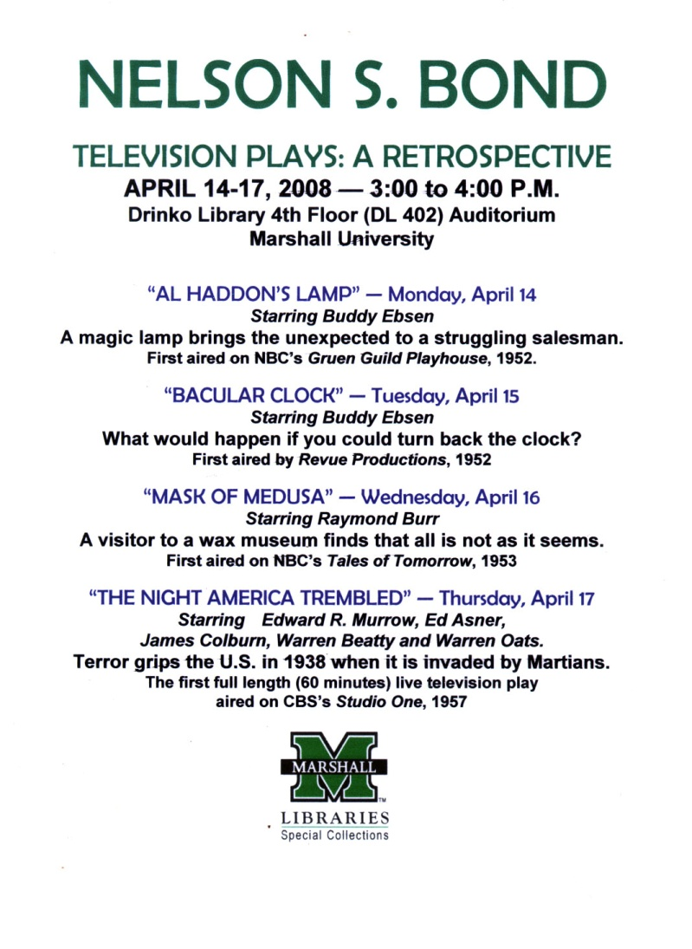
Nelson Bond’s Work Still Remains Popular
The Nelson Slade Bond
Collection
Video used to advertise the Nelson Bond Collection, as well as to promote Special Collections

Slide 30
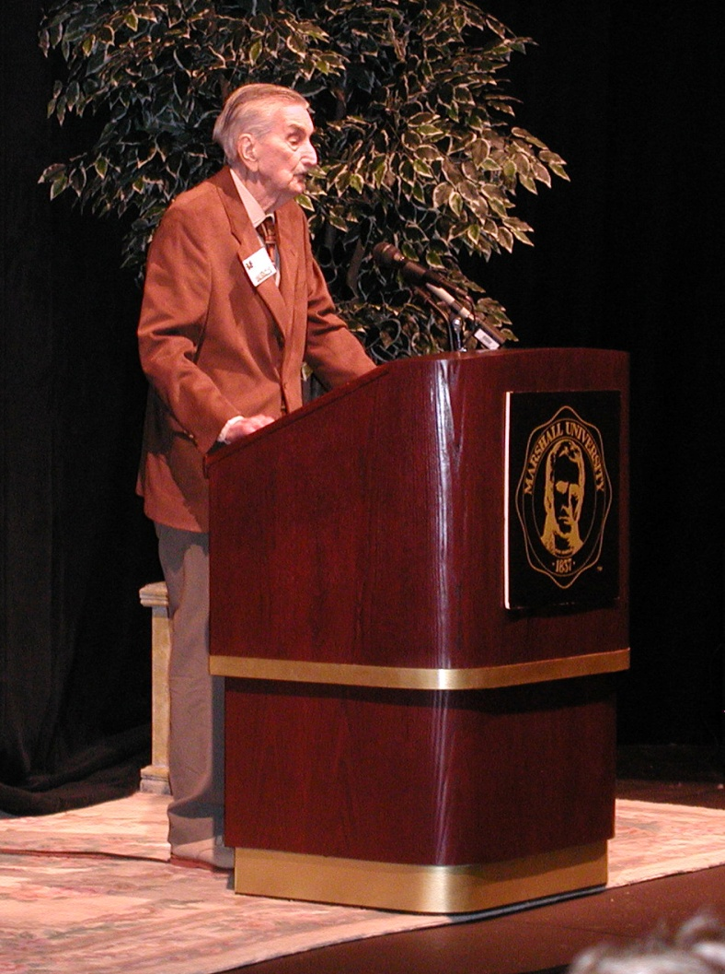
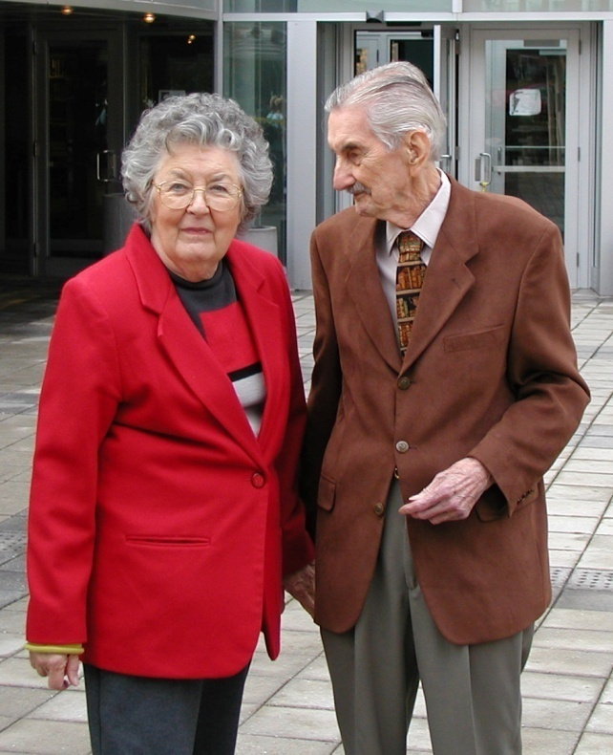
On October 9, 2003, Marshall University honored Nelson Bond and his wife Betty with day-long activities, including a luncheon, where Nelson spoke to journalism faculty and students, and invited guests.
The Nelson Slade Bond
Collection

Slide 31
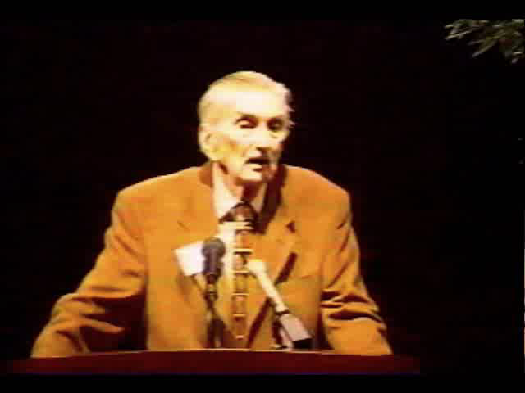
Nelson S. Bond on Videotape
Part of Nelson Bond’s remarks on October 2, 2003
The Nelson Slade Bond
Collection

Slide 32


The Nelson S. Bond Room
Recreation of Nelson Bond’s Office with all items donated by his family.
The Nelson Slade Bond
Collection
Note the “state-of-the-art” wax cylinder recording equipment

Slide 33
The Digital Connection
The Nelson Slade Bond
Collection

Slide 34

The Digital Connection
Original magazine covers were digitally photographed, re-printed on photo paper and mounted on foam board for display to prevent them from being damaged by light exposure
The Nelson Slade Bond
Collection

Slide 35

Audio and Video components of the Collection…
16mm Film of Television Broadcasts
12” 78RPM Records of Radio Broadcasts
16” 33 1/3RPM Records of Radio Broadcasts
Audio Tapes of Radio Broadcasts
The Nelson Slade Bond
Collection

Slide 36


16mm film to digital conversion process…..
The Nelson Slade Bond
Collection

Slide 37


12” 78 rpm records to digital conversion process…..
The Nelson Slade Bond
Collection

Slide 38


16” 33-1/3 rpm records to digital conversion process…..
The Nelson Slade Bond
Collection

Slide 39


Audio Tape to digital conversion process…..
The Nelson Slade Bond
Collection

Slide 40


Audio Tape to digital conversion process…..
The Nelson Slade Bond
Collection

Slide 41





Producing DVD of Television Shows…
The Nelson Slade Bond
Collection

Slide 42

The Nelson Slade Bond
Collection
Original Broadcast on CBS – Studio One
9 September 1957

Slide 43




The Night America Trembled…
Edward R. Morrow
The Nelson Slade Bond
Collection
James Coburn
Edward Asner

Slide 44




The Night America Trembled…
Warren Beatty
Vincent Gardenia
The Nelson Slade Bond
Collection
Warren Oates
John Astin

Slide 45

Still seeking out new careers...
Nelson Slade Bond…
Student, travelogue and sports writer, postage cataloger, fantasy author, publicist, book dealer, galactic explorer.
The Nelson Slade Bond
Collection

