Slide 1

Fictions of Purity:
Puritans, “Native” Americans, and “American” Identity
Nancy Lusignan Schultz, Ph.D.
Pioneer Institute, July 31, 2015

Slide 2
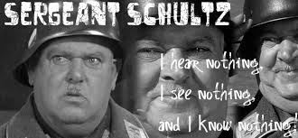
Hogan’s Heroes (1965-1971)

Slide 3
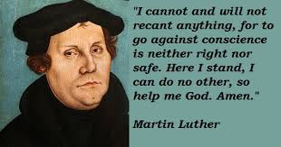
Protestant Reformation

Slide 4
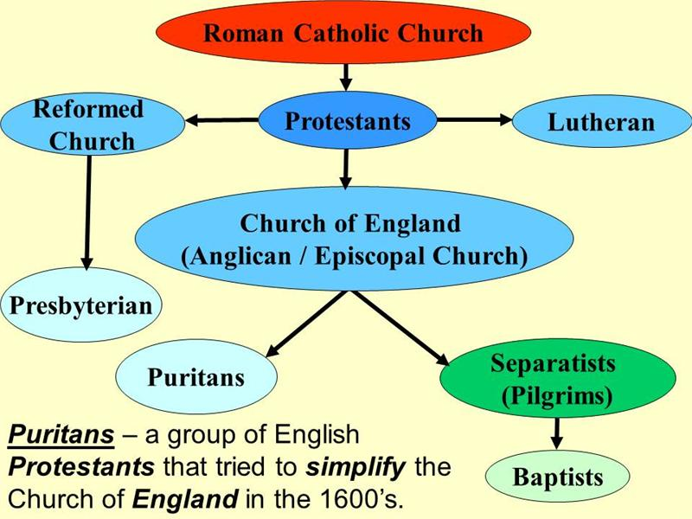

Slide 5
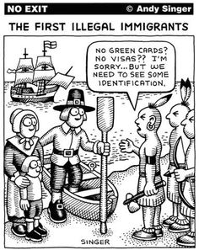
Which are the true “Native Americans” ?

Slide 6
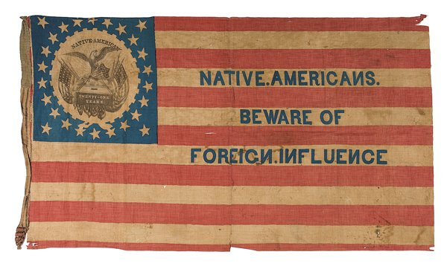
Flag of the “Native American” Party

Slide 7
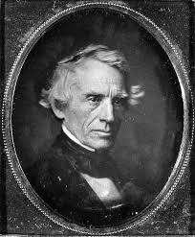
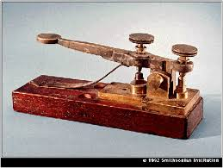
“Morse Code”: Catholics are the “enemy” . -. . -- -.--

Slide 8
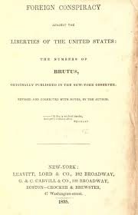
“They will see that Popery is now, what it has ever been, a system of the darkest political intrigue and despotism, cloaking itself to avoid attack under the sacred name of religion."
--"Brutus" (Samuel F. B. Morse)

Slide 9
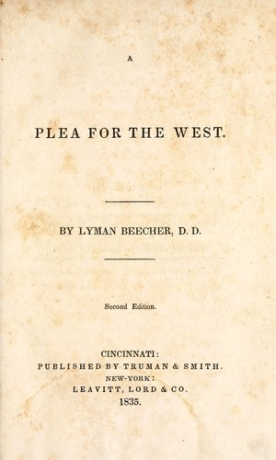
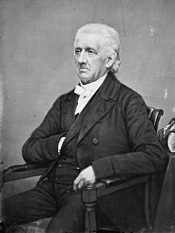
Lyman Beecher, 1775-1863

Slide 10
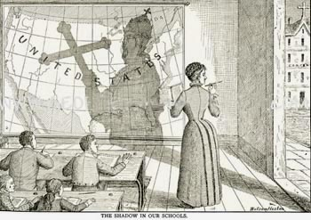
Free-Thinkers Pictorial Textbook, 1890

Slide 11
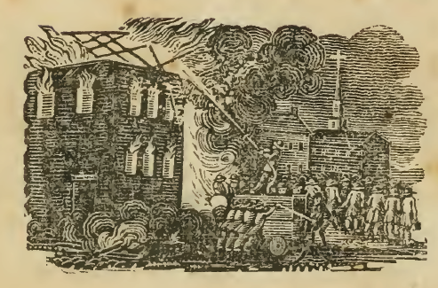
The burning of the Charlestown convent as depicted in An Account of the Conflagration of the Ursuline Convent

Slide 12
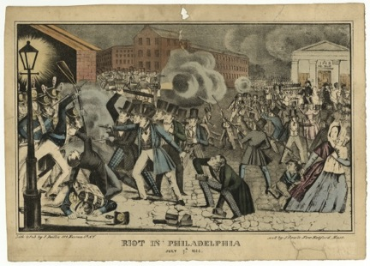
Philadelphia “Bible Riots” 1844

Slide 13
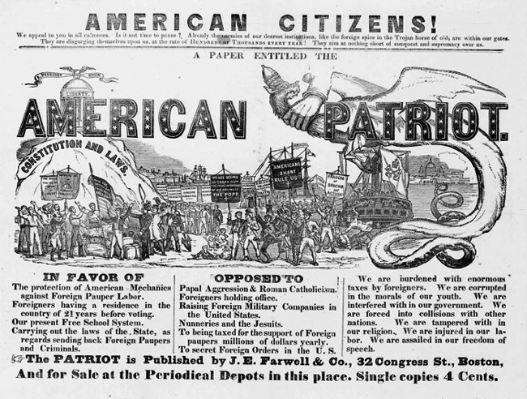
Notes:
https://thatdevilhistory.wordpress.com/2013/10/12/tea-parties-know-nothings-and-klansmen-the-enduring-specter-of-american-nativism/

Slide 14
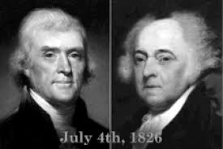
Thomas Jefferson and John Adams both died on July 4, 1826

Slide 15
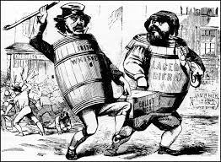
A cartoon from the 1850s by the "Know-Nothings" accusing the Irish and German immigrants of negatively affecting an election.
Notes:
http://www.victoriana.com/history/irish-political-cartoons.html

Slide 16
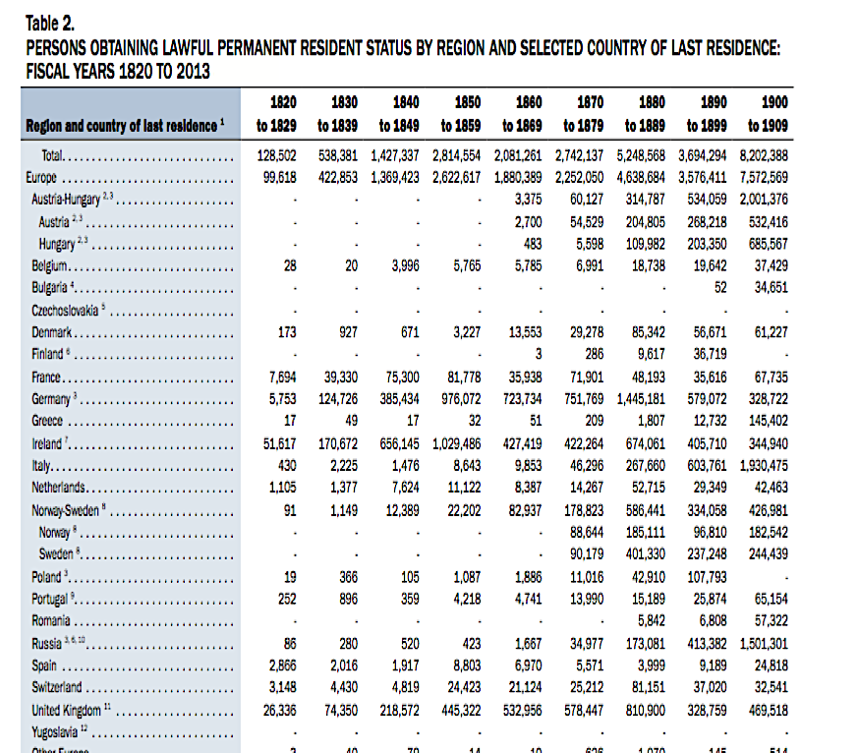

➔
⬅

Slide 17
Ireland
1820-29 | 1830-39 | 1840-49 | 1850-59
51,617 | 170,672 | 656,145 | 1,029,486
Germany
1820-29 | 1830-39 | 1840-49 | 1850-59
5,753 | 124,726 | 385,434 | 976,072
2013 Yearbook of Immigration Statistics, U.S. Department of Homeland Security, http://www.dhs.gov/sites/default/files/publications/ois_yb_2013_0.pdf

Slide 18
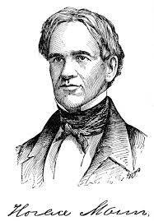
“Only public education can undo the work of the Catholic families and parish schools and.”

Slide 19
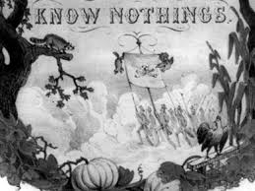
Secretive American political faction that flourished briefly in the 1850s as a result of "nativist" (anti-Catholic and immigrant) concerns. Courtesy of Library of Congress

Slide 20
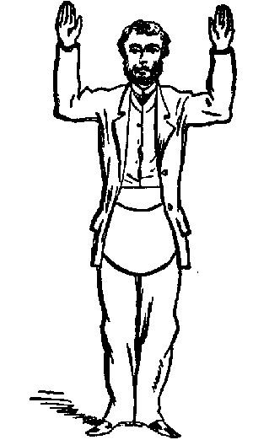
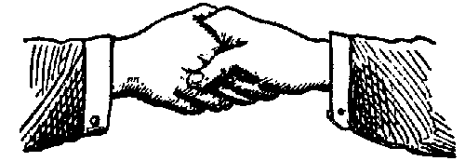
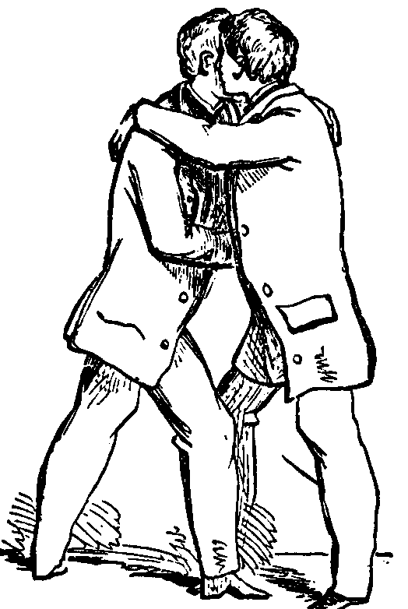
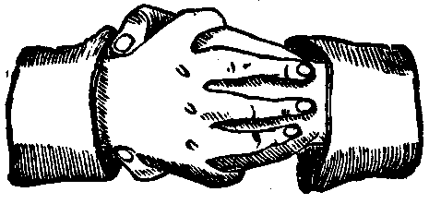
Pass grip
distress
Five points of fellowship
Real grip
Notes:
http://www.ephesians5-11.org/handshakes.htm

Slide 21
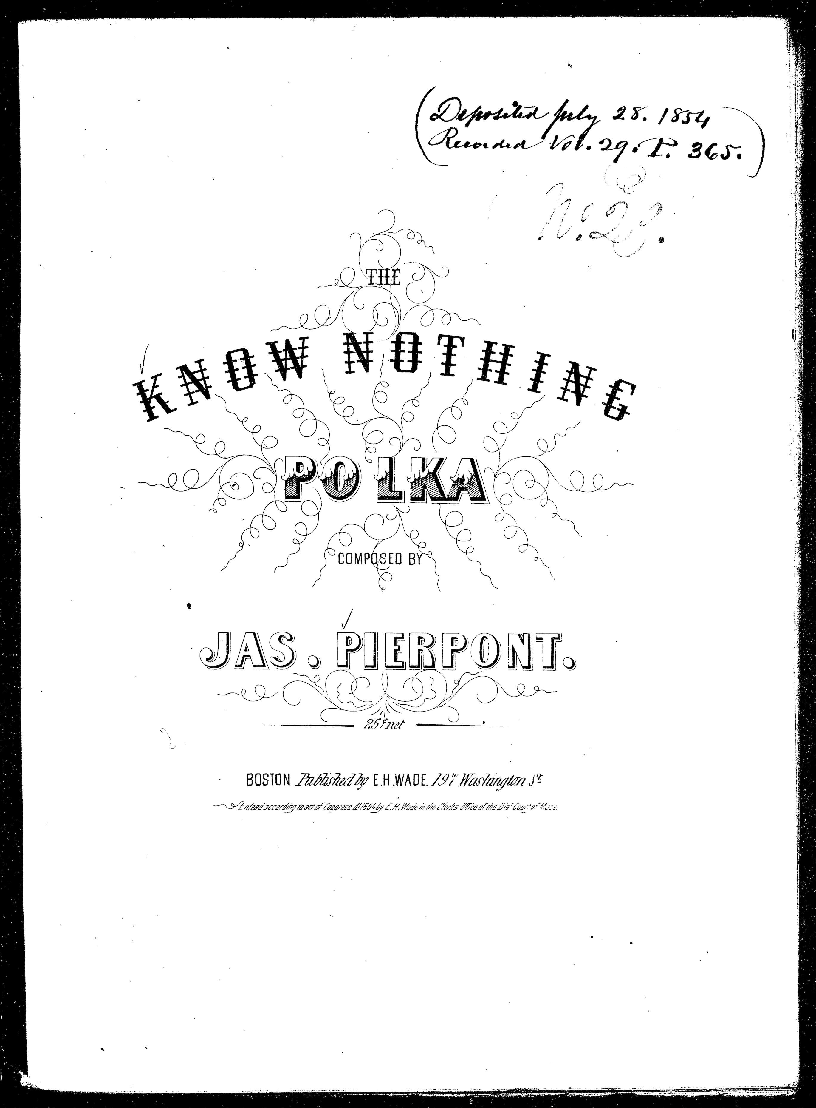
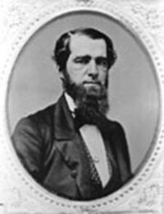

Slide 22
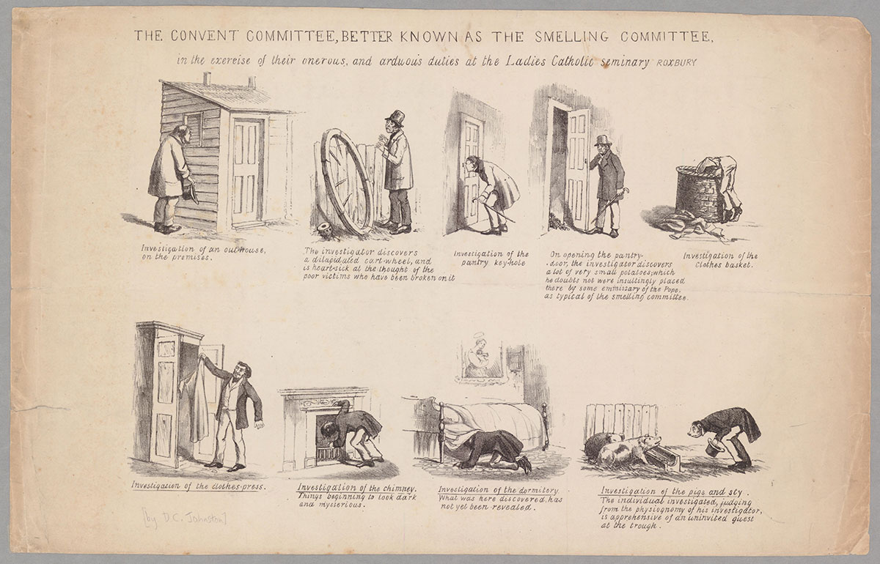
Satiric cartoon by David Claypoole Johnston

Slide 23
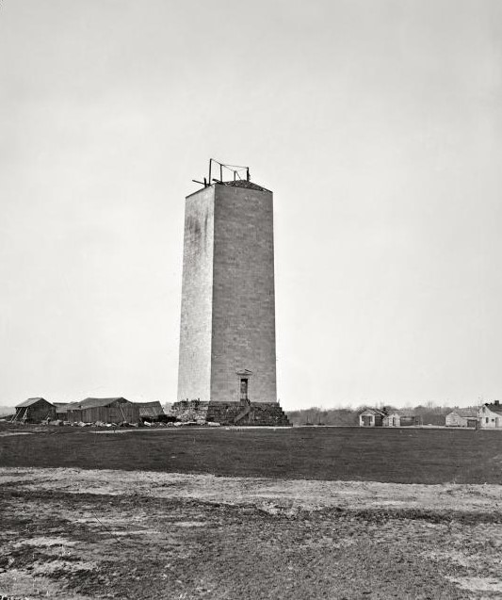
The Washington Monument
was under construction from
1848-1884.

Slide 24
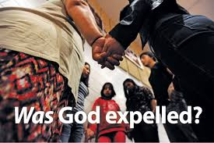
1963

Slide 25
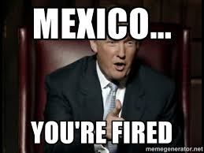

Slide 26
Conclusions

