Slide 1
Development of an Urban Education Initiative to Equip Teacher Candidates for Careers in Urban Schools
Michelle B. Goodwin, EdD
Cindi Spaulding, Ph.D.
Liberty University

Slide 2
Abstract
In January 2016 Liberty University’s School of Education piloted an Urban Education Recognition program to equip teacher candidates to meet the needs of urban K-12 schools with a significant population of students who are economically disadvantaged and/or culturally diverse. In this presentation we share the program characteristics and impact on teacher candidates.

Slide 3
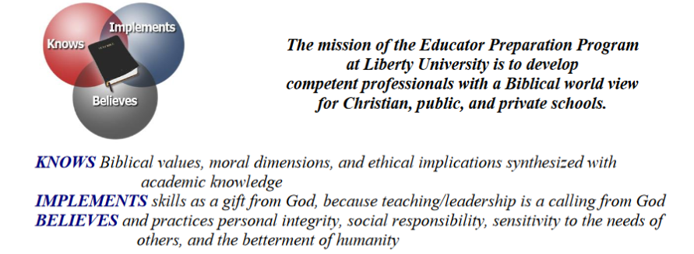
Liberty University’s EPP

Slide 4
The Need
Program Evaluation
Feedback from Community Leaders
A need to better equip candidates for the unique needs of urban schools

Slide 5
Planning
The Team
Associate Dean
Local Elementary Principal
3 Faculty Members

Slide 6
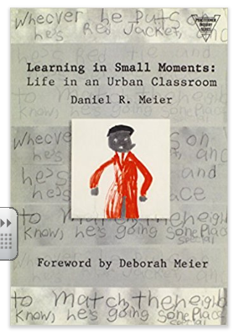

Implementation: Initial Components
Spring & Fall 2016
40 hours of field experience in an urban school or education center
Monthly meetings
  Ongoing Book study
  Poverty Simulation
  Panel Discussion
  Pre/Post Assessment & Reflection

Slide 7
Current Components: Spring 2017
20 hours of field experience
Bi-weekly chapter meetings
  Guest speakers
  Panel discussion
Trip to Washington DC
  1 elementary school
  1 middle school
. Culmination Activity
  club members will share their experiences and insight with the Teachers of Tomorrow students at Heritage High School in Lynchburg.
Pre/Post Assessment & Reflection
Field Experience Hours
Chapter Meetings
2016/2017 academic year activities funded by a university grant called ILLUMINATE:
“Grants for the improvement of teaching”

Slide 8
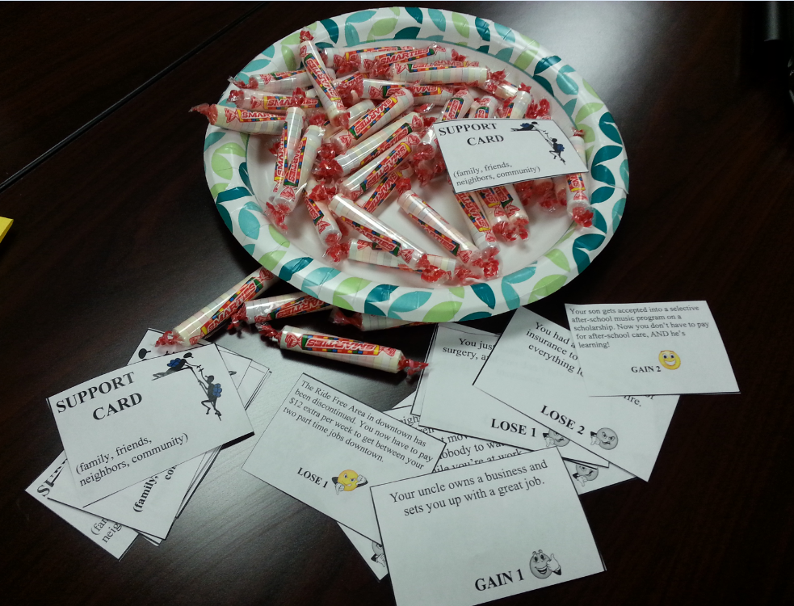
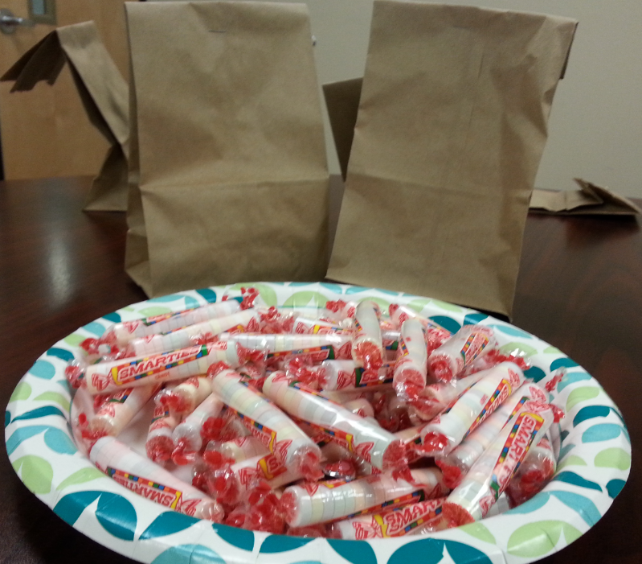
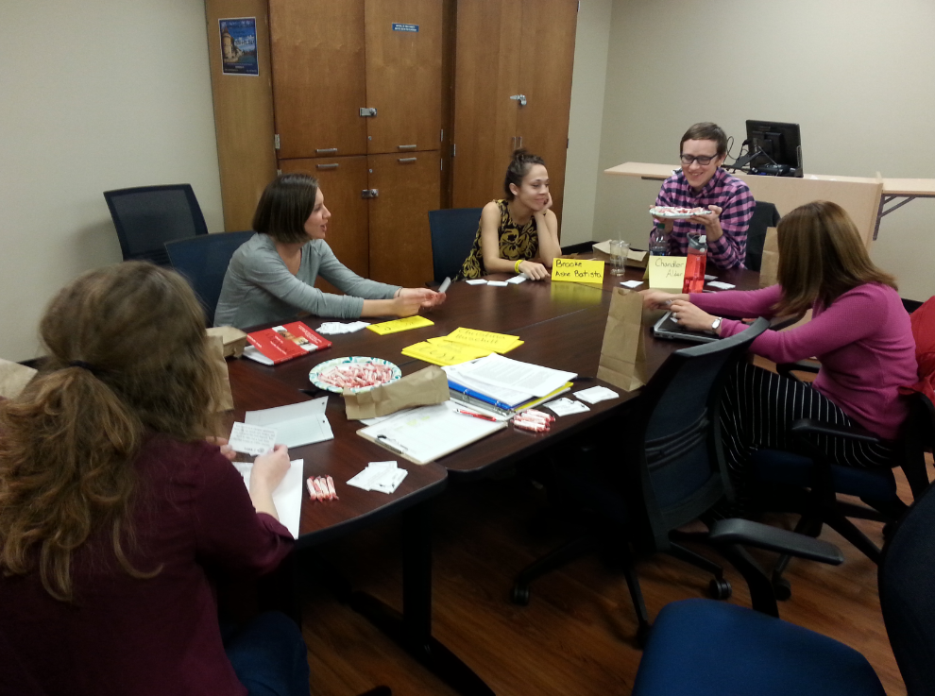
Sample “Club” Night – Poverty Simulation

Slide 9
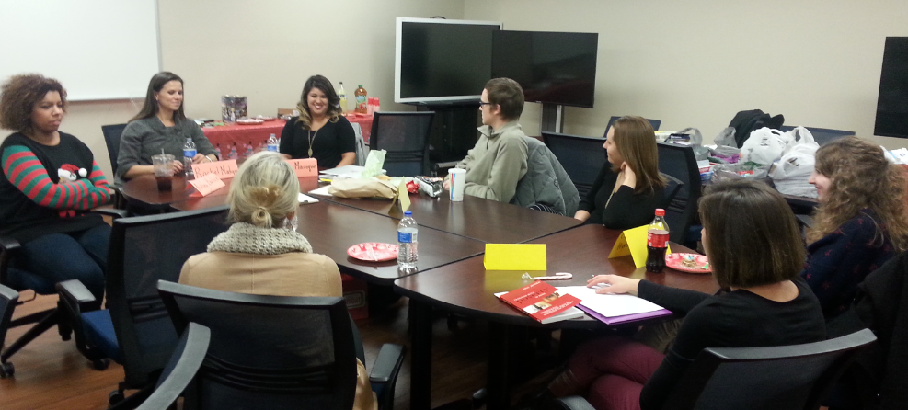
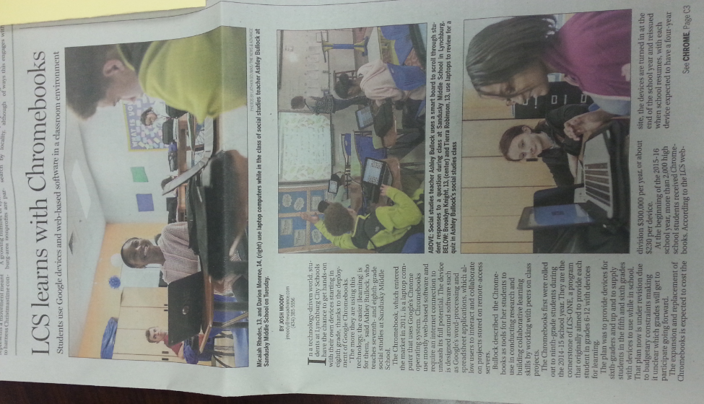
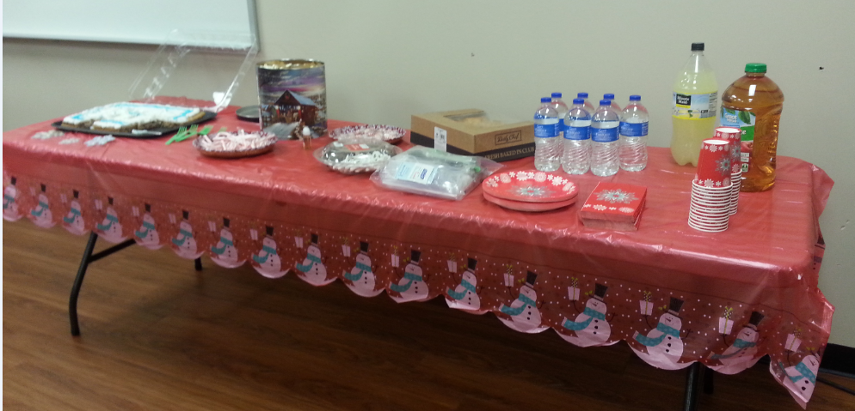
Club Night – Christmas ‘N Colleagues Round Table

Slide 10
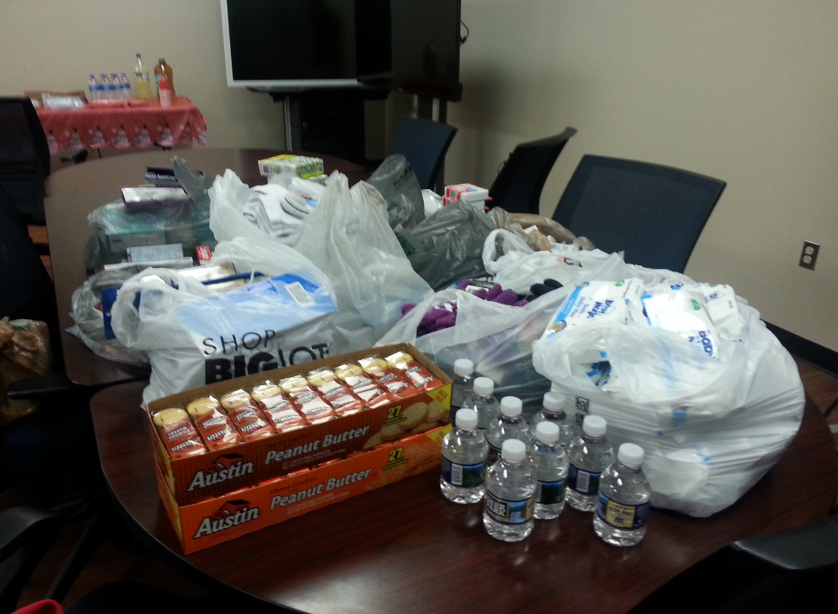
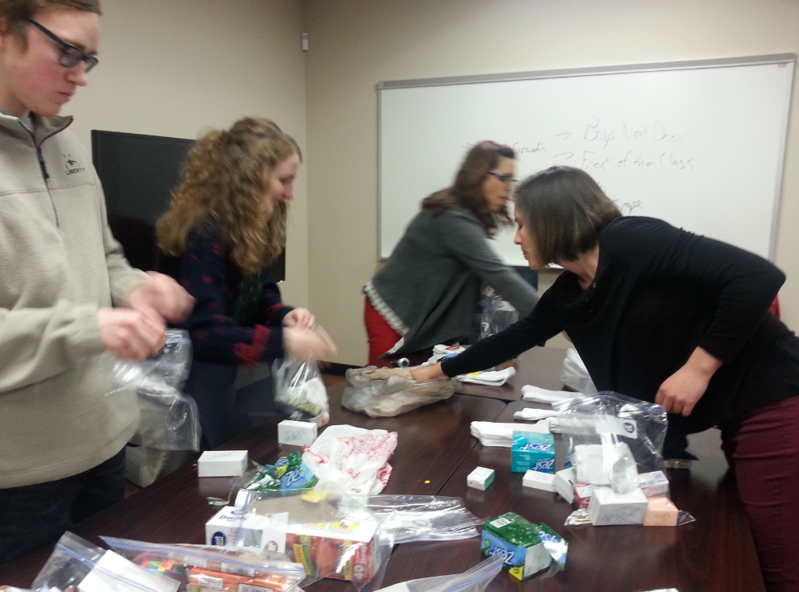
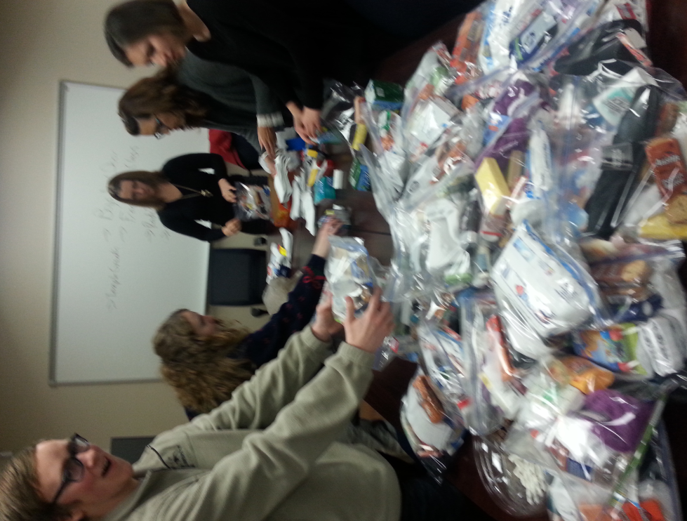
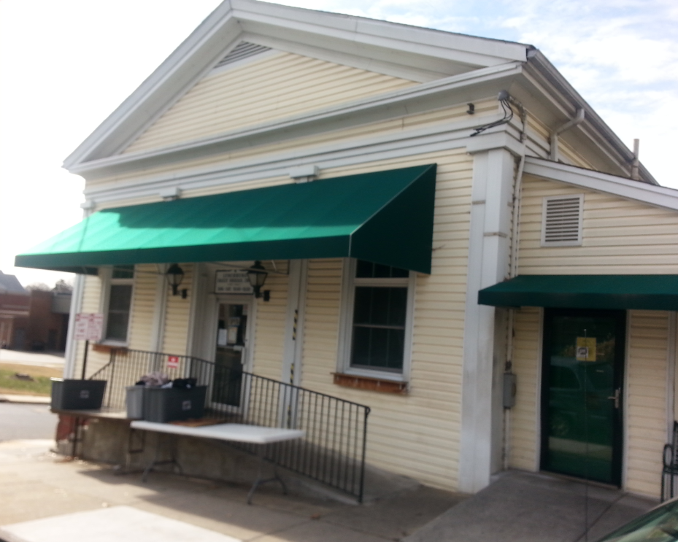
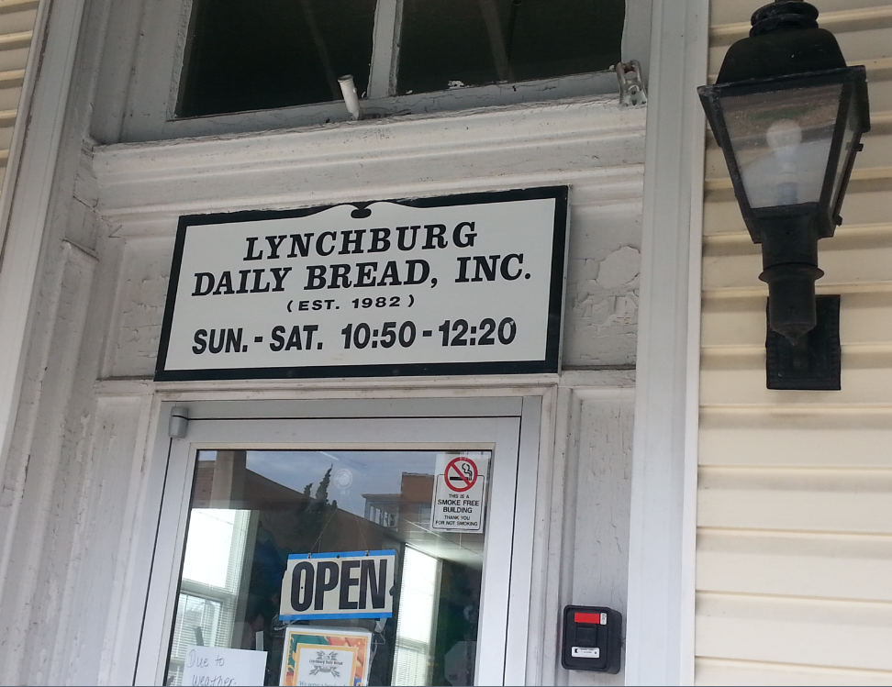
Service in the Community

Slide 11
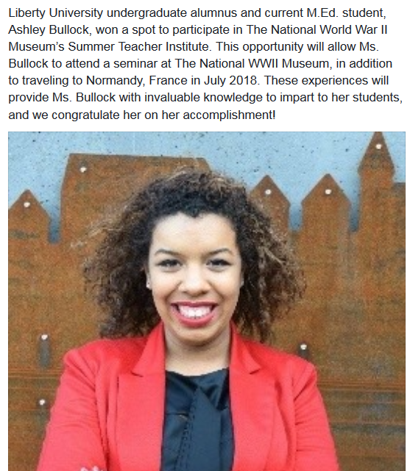
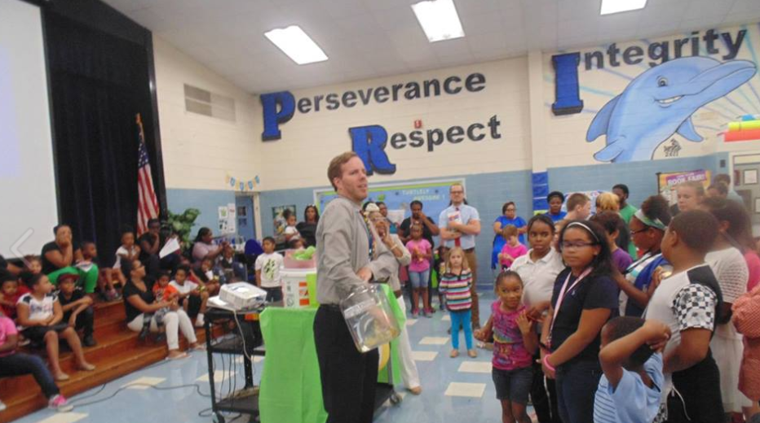
Strong Supports and Cheerleaders have been a huge key in this success!
Prize Patrol Event

Slide 12

Washington Fellowship

Slide 13
Teacher Candidate
Reflections
Impact on Skills, Knowledge, & Dispositions
“It is sad to say that I was told to beware of urban schools but now I know that there are just differences that the teacher should be aware of and good teachers can handle well. I have learned tons on classroom management and teacher enthusiasm. The more enthusiastic I am the more enthusiastic my kids will be. I have also deepened my ideals behind expectation. If I start to expect the very best from my students then they will work harder than they ever thought possible to achieve their best work.”
“My placement grew my classroom management skills because there were so many behavioral issues. I got to tutor a lot of different students so I feel like I improved at articulating and differentiating concepts.”
“The experience gave me a much stronger positive outlook on the urban school setting. Being able to observe teachers in this setting, and see the different classroom and behavior management has been a blessing. It has definitely changed the way I look at behavior management. My knowledge of the urban school setting increased greatly as well. The children in this setting have such wonderful hearts, and after they know you’re there to help you have a buddy for life.”

Slide 14
Future Extensions
Summer “Urban Education Institute”
Additional Urban Student Teaching Cluster Centers (similar to Washington Fellowship)
Coursework / Cognate / academic track for Urban Education

Slide 15
Questions?
Michelle B. Goodwin, EdD
Email: mbgoodwin@liberty.edu

