Slide 1

The HARD Knocks of a SOFTware Field Placement and Assessment System
Michelle B. Goodwin, Ed.D.
Esther Alcindor, Ph.D.
Miranda Arnold, Ed.S.
Rachel McCormick, Ed.S.

Slide 2


Context – Liberty University
Established in 1971
Over 14,500 residential students
Over 110,000 students including residential and online students
Located on 7,000 beautiful acres in the Blue Ridge Mountains
Liberty University is the largest private, nonprofit university in the nation, the largest university in Virginia, and the largest Christian university in the world.
http://www.liberty.edu/aboutliberty/

Slide 3

What’s your context?

Slide 4

Begin with a pilot!
Start on a small scale
Use a “base site”
Have one main point of contact
  Create an easy email alias

Slide 5

Be patient and perseverant!
Be willing to pilot until you feel confident about full implementation
Don’t give up too easily
  You will encounter obstacles
Have a back up plan

Slide 6

Provide training!
Training for candidates
Training for Host Teachers (K-12 teachers)
Training for College Faculty Members
http://www.liberty.edu/index.cfm?PID=26514

Slide 7
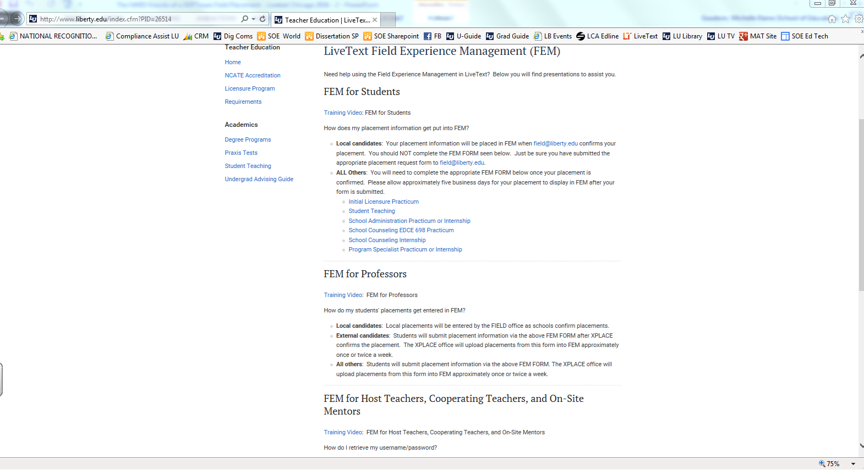
Sample Online Training Page

Slide 8

Anticipate challenges!
Be ready to problem solve
Again, have a back up plan!

Slide 9

Provide accountability!
Spot check
Communication between all individuals

Slide 10
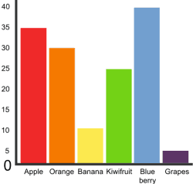
Consider assessment needs!
Think ahead
  What data collection is needed?
    Demographics (SES, ethnicity, exceptionalities, etc.)
    Critical assessment reports (SPA, CAEP, etc.)

Slide 11
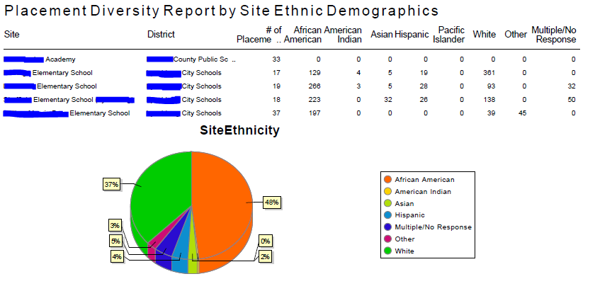
Data reports!

Slide 12
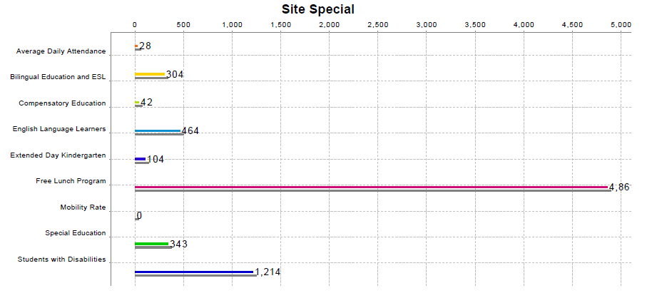
Data reports!

Slide 13
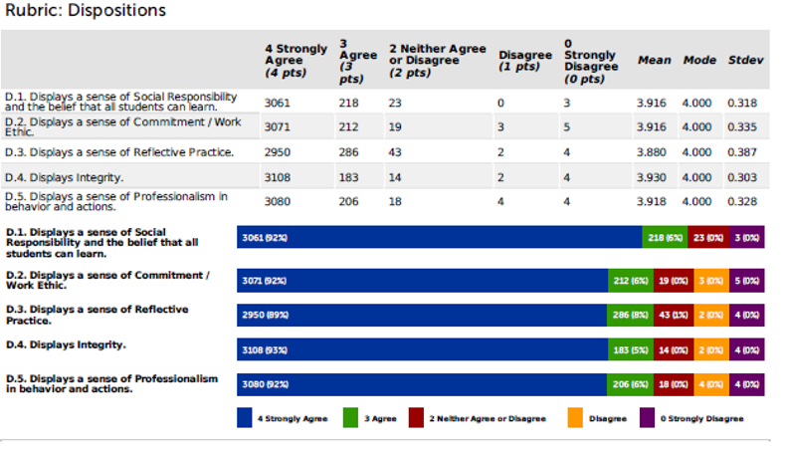
Data reports!

Slide 14
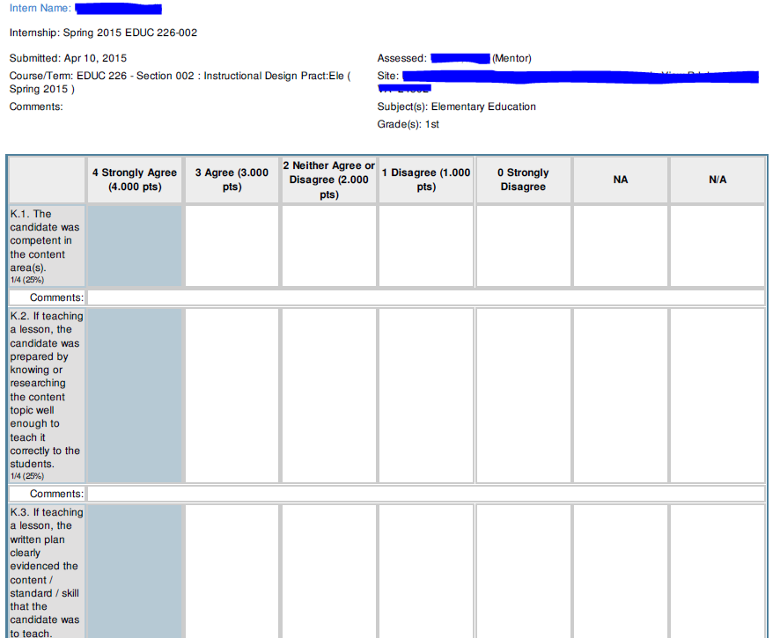
Data reports!

Slide 15
Helpful resources!
LU Training Page for LiveText FEM
  www.liberty.edu/index.cfm?PID=26514
Contact Information
  http://works.bepress.com/michelle_goodwin

