Slide 1

The HARD Knocks of a SOFTware Field Placement and Assessment System
Michelle B. Goodwin, Ed.D.
Miranda Arnold, Ed.S.

Slide 2

Begin with a pilot!
Start on a small scale
Use a “base site”
Have one main point of contact
  Create an easy email alias

Slide 3

Be patient and perseverant!
Be willing to pilot until you feel confident about full implementation
Don’t give up too easily
  You will encounter obstacles
Have a back up plan

Slide 4

Provide training!
Training for candidates
Training for Host Teachers (K-12 teachers)
Training for College Faculty Members

Slide 5

Anticipate challenges!
Be ready to problem solve
Again, have a back up plan!

Slide 6

Provide accountability!
Spot check
Communication between all individuals

Slide 7
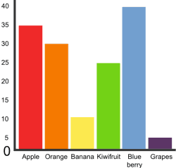
Consider assessment needs!
Think ahead
  What data collection is needed?
    Demographics (SES, ethnicity, exceptionalities, etc.)
    Critical assessment reports (SPA, CAEP, etc.)

Slide 8
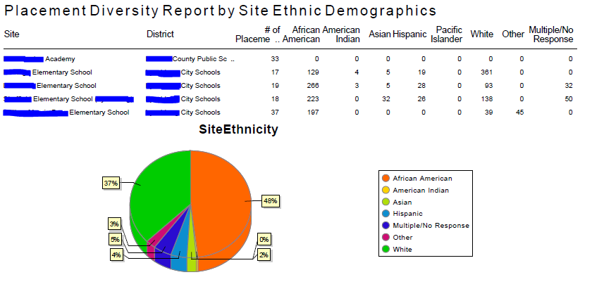
Data reports!

Slide 9
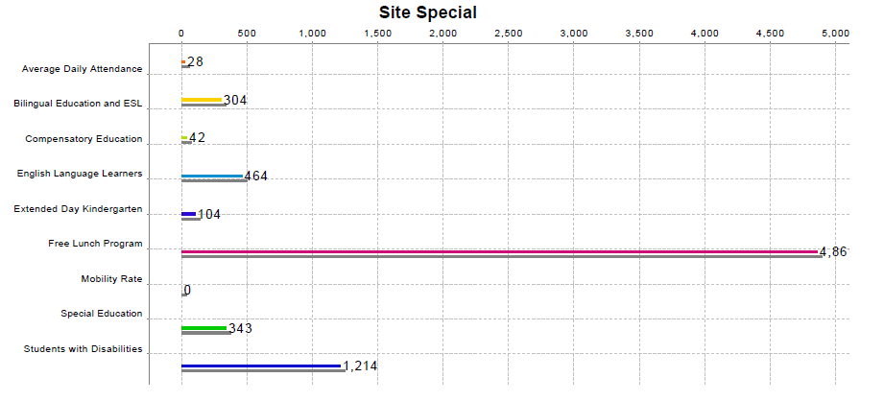
Data reports!

Slide 10
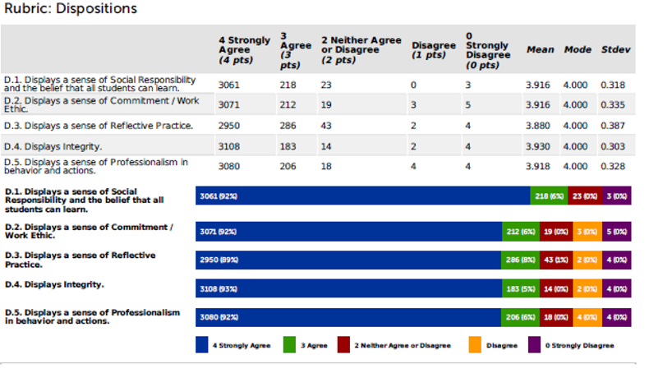
Data reports!

Slide 11
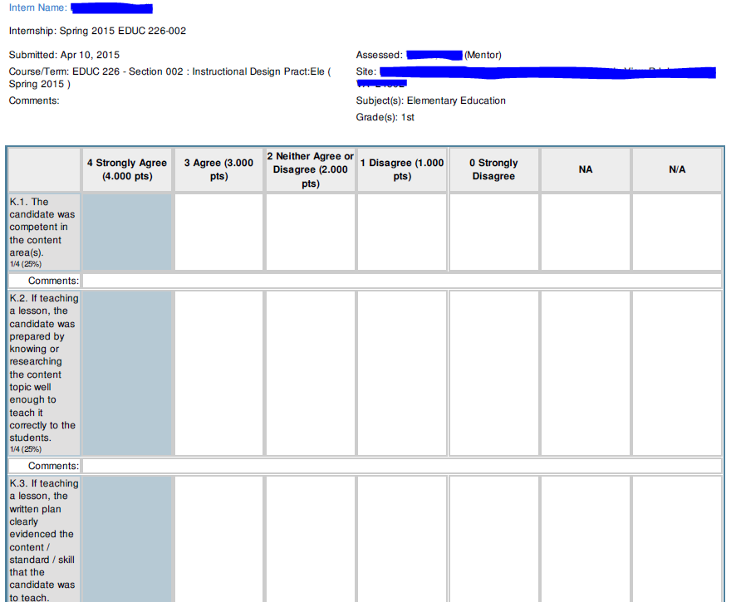
Data reports!

Slide 12
Helpful resources!
LU Training Page for LiveText FEM
  www.liberty.edu/index.cfm?PID=26514
Contact Information
  http://works.bepress.com/michelle_goodwin

