Slide 1
Stats Don’t Tell the Whole Story
Using Qualitative Data Analysis of Chat Reference Transcripts to Assess and Improve Services
Michael Mungin
James Madison University
URL: http://guides.lib.jmu.edu/ChatResearch

Slide 2
Introductions
Me
James Madison University (JMU)
JMU Libraries

Slide 3
Major Points
Know What You’re Getting Into
Preparation and Planning
The Richness of Data is Astounding
This is Research in Progress

Slide 4
Background
History of Chat at JMU Libraries
Current State of Chat
Literature Review
Opportunity

Slide 5

Research Methodology
Grounded Theory Techniques
Dedoose
  Dedoose Pros and Cons
Descriptors and Code Book
Labor Intensity
Limitations
(lies)

Slide 6
Descriptors
Affiliation (Student, Faculty, Alum, etc.)
Length of Chat
Semester (Spring, Fall, Summer)
Time of Day (by hour)
Answered or Unanswered?
Nature of Question (Reference, Directional/Policy, Known Item, Technology Problem, etc.)
Week of Semester (1-16, Spring Break, Finals, etc.)
Responder (Librarian, Student Worker, Library Paraprofessional, etc.)
Year
Day of the Week

Slide 7
Some Preliminary Results
Who’s Engaging With Us?
Mostly Students (55% identified but almost certainly much more)– No Surprises here
Unknowns Present Another Research Limitation

Slide 8
Some Preliminary Results
What Are We Being Asked?
Missing from LibraryH3LP Stats, but not Springshare
Reference Questions Represent a Clear Plurality of Questions
    Despite Some Internal Perceptions
    Useful Data Internally Considering Directions JMU is considering (more on that later)

Slide 9
Some Preliminary Results
Service Interruptions: The “Delay” Problem
 | Chats | Delays | Delays Per Chat
Librarian | 895 | 72 | 0.08045
Non-Librarian Staff | 323 | 63 | 0.19505
Reference Desk | 511 | 215 | 0.42074
Answering Chats While Simultaneously on the Reference Desk Can Have Measurable Effects on Quality of Service and Disruption Rate
    Sort of Obvious, but Here’s Some Data on the Severity

Slide 10
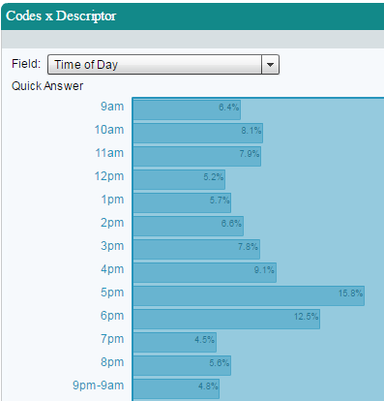
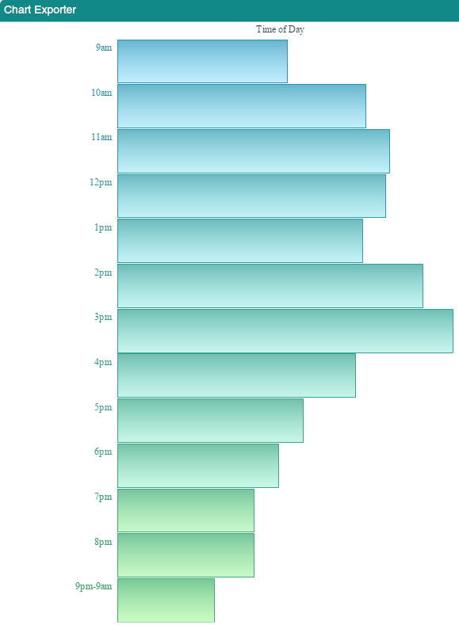
Some Preliminary Results
Lazy, Lax Librarians!?!?: The “Quick Answer” Conundrum
  What is a “Quick Answer?”
Why Do Quick Answers Occur More Between 4-6pm, Even When Controlling for Average Chats Per Hour?
  Are Librarians Fatigued? Do They Want to Go Home? More Research Required
  Training Opportunity

Slide 11
Some Preliminary Results
Citation Questions are a Mess
  A Total Mess
  Roughly 18% of Reference Questions Analyzed Had a Citation Element
    No Standardized Response Exists
      41.3% - Referred to Library Resource
      58.7% - Given a Template or Provided a Complete Citation
      17.3% - Directed to Non-Library Resource (e.g. Purdue OWL)
      Only 2.9% Directed to Writing Center
      Differing Comfort Levels with Citation Help Are Apparent
      Consequence: Total Crapshoot for Students Seeking Help with Citations
        An Organization-wide Policy May Be Worth Exploring

Slide 12
Some Preliminary Results
User Experience Considerations
  Library Hours Example
  Questions about library hours represented 16.3% (63/385) of directional/policy questions during the first three semesters examined.
    Why are students so often clicking past the Hours link on the website and entering library chat instead?
    This will be interesting to our UX Librarian

Slide 13
Some Preliminary Results
Alumni
70% of alumni questions concerned which resources they retained access to.
  The sample size is not large yet, but I would expect this trend to continue.
  This, combined with external feedback, suggest that this is an area well-suited for improvement.

Slide 14
Future Directions
Help Is On The Way
Changing Reference Model at JMU
  This project will allow for meaningful pre-/post-change comparison, which is a bit of a gap in the literature.

Slide 15
Thank You!
Questions?
Please contact me at:
Michael Mungin
munginmj@jmu.edu
http://guides.lib.jmu.edu/ChatResearch

