Slide 1
Developing Principles For Dei-informed Research In Or/analytics Through An Analysis Of Published Journal Articles
Michael P. Johnson University of Massachusetts Boston michael.johnson@umb.edu | Tayo Fabusuyi University of Michigan fabusuyi@umich.edu | Jamie Lannon University of Massachusetts Boston jamie.lannon001@umb.edu
INFORMS Fall National Conference
Anaheim, CA
October 24 – 27, 2021

Slide 2
Project Motivation
Many different disciplines and domains have expanded their focus to address the needs and concerns of traditionally marginalized or disadvantaged groups:
  Feminist economics
  Critical race theory
  Disability studies
Such efforts are less common in STEM domains
Diversity, equity and inclusion (DEI) has an increasing profile in OR/analytics:
  Communities: Minority Issues Forum, Women in OR/MS
  Initiatives: Diversity, Equity and Inclusion Committee, Diversity Ambassadors Program
  Research: Editor’s Cut: Diversity and Inclusion (2019); Management Science Virtual Special Issue on Diversity (2020)
Overall, the emphasis has more often been on the profession than on the discipline
As a research topic, DEI is often as a lens through which to understand
organizations as opposed to policies, products and services more generally

Slide 3
This project: How can we deepen our understanding of DEI within OR/analytics?
Goal: Develop principles by which researchers in OR/analytics may integrate ideas about diversity, equity and inclusion into research ideas that span application areas and analytic methods
Purpose: Provide guidance for researchers who wish to produce rigorous research that speaks to contemporary desires for social impact through giving voice to underrepresented and marginalized groups
Strategy:
  Review published papers in INFORMS journals to assess level of engagement with DEI principles
  Interview authors to understand motivations and understandings of DEI

Slide 4
Research program: DEI in OR/analytics practice and research
Our larger goal is to deepen our understanding of diversity, equity and inclusion across OR/analytics
  What is the composition of the profession?
  What is the presence of DEI in scholarship?
  What role does DEI play in OR/analytics education?
  What are principles for DEI-informed research and practice?
What would OR/analytics look like if it were aligned with principles of social and racial justice and anti-racism?

Slide 5
Literature review: Evaluating presence of DEI-themed research
Purpose: Assess efforts to assess frequency, underlying meaning, and opportunities for engaging DEI in a variety of disciplines
  OR/analytics
  Engineering, science and mathematics
  Professional disciplines (business, policy, planning)
  Social sciences (sociology, economics)
Methods:
  Resources: PubsOnLine, SpringerOpen, JSTOR, IEEE Xplore, EBSCO, ProQuest, ScienceDirect, Web of Science
  Keywords: diversity, equity, inclusion; engaged research; research approach(es); critical: approach, perspective, lens; field; industry; discipline
Results: 14 papers, in addition to Johnson and Chichirau’s 2020 TutORials piece

Slide 6
Literature review key results
Infuse DEI concepts at the research training level (Cano, 2020; Poole et al., 2021; Stachl et al., 2021)
  Support research that explores DEI-related questions
  Train students in applying DEI principles
  Increase diversity in mentoring programs
  Examine educational materials for presence of DEI themes
Adapt perspectives from other disciplines (Reinholz et al. 2021; Núñez et al. 2020; Rogers 2020; Fabusuyi and Johnson 2021)
  Change theory
  Intersectionality
  Feminist epistemology
  Critical race theory
  Community engagement
Assess current environment to learn how the discipline understands and implements DEI initiatives (Woodbrook 2020; Burgess et al. 2017; Roberts 2021; Ashley et al. 2021)
  DEI toolkit to improve data science approaches and decisions
  Examine the demographic and social diversity of authors of IS publications
  Collect more data on authors’ experiences, pay diversity and author diversity in publishing
  Inconsistent understanding of DEI principles by arts planners

Slide 7
Research design
Key questions:
  What is the level of engagement of published research with DEI principles?
  What challenges do we infer about connecting DEI principles with research efforts that appear to have little connection with social issues?
  What opportunities to there appear to be in surfacing DEI principles in research efforts that have plausible connection with social issues?
Research tasks:
  Develop a rubric to evaluate papers
  Creating a non-random, purposive sample of papers (2014 Editor’s Cut)
  Evaluate papers both qualitatively and quantitatively
  Interview authors
  Develop principles by which DEI could be infused into OR/analytics
  research

Slide 8
Rubric design
What is the policy or planning topic?
What are the application areas/domains?
What are the analytic methods used?
In what ways are diversity, equity and inclusion involved with (implicated by, implied by) this problem?
  4.1 DEI principles are relevant to the article’s domain or specific research question (Y/N) If Yes:
  4.2 Diversity: Research problem (in)directly impacts racial, gender, sexual orientation, and other variances in identity (Y/N)
  4.3 Equity: Research problem (in)directly impacts favorable access resources for all groups (Y/N)
  4.4 Inclusion: Research problem (in)directly impacts changes in societal practices, policies, and processes of exclusion (Y/N)

Slide 9
Rubric design, cont’d
How do the authors account for DEI in this paper?
  5.1 Authors addressed relevant DEI principles in this paper (Y/N) If Yes:
  5.2 Background/ Discussion: Author's discuss relevant DEI principles intertwined with research question, but methodology does not account for DEI-related inputs (Y/N)
  5.3 Methods/Results: Author's incorporate some level of relevant-DEI principles in methodology (Y/N)
  5.4 Limitations: Authors acknowledge DEI principles’ importance but were limited in applying DEI due to resource limitations (Y/N)
  5.5 Domain Applicability: Authors explain how the DEI-relevant results of their research could be adapted for real-life use (Y/N)

Slide 10
Rubric design, cont’d
What is the quality of the DEI-related analysis in this paper?
  6.1 Empirical DEI-related analysis is salient to the paper’s goals (Y/N) If Yes:
  6.2 Modeling: Research model was built with intention to incorporate relevant DEI principles (Y/N)
  6.3 Analysis: Chosen inputs/stratification addresses relevant DEI principles (Y/N)
  6.4 Results/Discussion: Authors discuss the impact of relevant DEI considerations produced in the results (Y/N)
  6.5 Real-world Applicability: DEI-relevant results support real-world implementation (Y/N)

Slide 11
Rubric design, cont’d
Does the research in this paper have the means to improve DEI?
  7.1 As published, research has the potential to improve DEI (Y/N)
  7.2 Theory: The author’s incorporation of DEI-relevant principles in their research furthers existing approaches to improve DEI (Y/N)
  7.3 Methods: The incorporation of DEI-relevant principles to the research methodology furthers the ability of the research to improve DEI (Y/N)
  7.4 Replicability: Results from this research provide a strong foundation for usability in various contexts (Y/N)
  7.5 Adaptability: The DEI-relevant results of this research have the ability to be applied in practice to improve DEI.
Rubric score components
Question | 4 | 5 | 6 | 7 | Total
Max Score | 4 | 5 | 5 | 5 | 19

Slide 12
Analysis process
Three researchers
Two PIs (MJ, TF) read two papers apiece; RA (JA) read all papers
Inter-coder reliability:
  JL & TF: average score 2.95; average deviation 23.13%
  JL & MPJ: average score 8.25; average deviation 77.82%
Distribution of total scores:
 | Q4 | Q5 | Q6 | Q7 | Total
Average | 2.98 | 0.75 | 0.53 | 1.35 | 5.60
Min | 0 | 0 | 0 | 0 | 0
Max | 4 | 4 | 4.5 | 4 | 16
Std Dev | 1.31 | 1.20 | 1.08 | 1.58 | 4.01

Slide 13
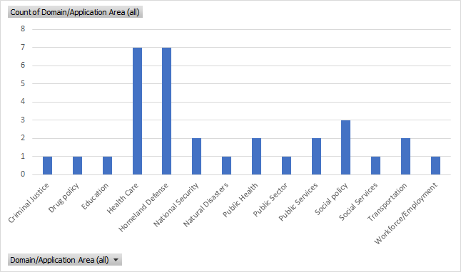
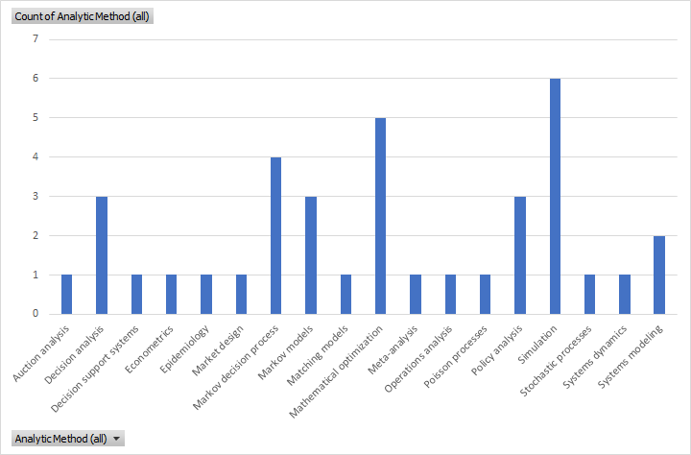
Case study results: Paper characteristics
Collection: Editor’s Cut, Volume 4: Confronting Public Problems With Operations Research (2014)
14 papers, published between 1980 – 2015
Application Areas
Analytic Methods

Slide 14
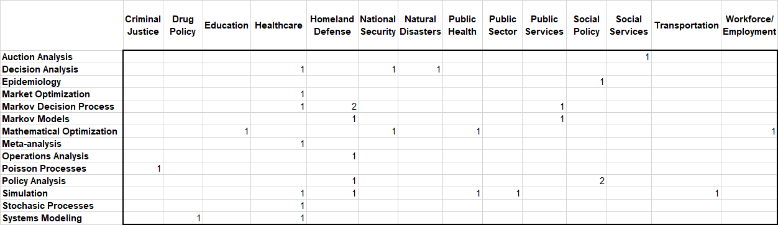
Case study results: prevalence of application areas and analytic methods
For application areas, papers in healthcare and homeland defense occur most often, while analytic methods such as mathematical optimization, simulation and Markov decision models predominate

Slide 15

Case study results: average total scores, by application areas and analytic methods
Across application areas, highest-scoring papers are in education, healthcare, public health and homeland security; highest-scoring papers by analytic method are in mathematical optimization, simulation and systems modeling

Slide 16
Discussion
Inter-coder reliability could be improved
Average scores are low, a consequence in part of contingent nature of questions
Some application areas may be more amenable to DEI-focused approaches, and some analytic methods are easier to adapt to incorporate DEI concerns than others.
Notes:
Last bullet: It may be that some application areas lend themselves in a straightforward way to addressing DEI principles, and that some analytic methods are easier to adapt to incorporate DEI concerns than others. For example, health care focuses on people who are part of groups whose characteristics, such as race or gender, are associated with certain outcomes, whereas transportation may be harder to conceive through a DEI lens. Similarly, one could imagine that certain analytic methods, such as optimization, are easier to adapt DEI principles to via additional objectives or constraints, than, say stochastic modeling.
Still, a core belief that motivates our work is that many more application areas and analytic methods can support a DEI approach than we may understand at present. (A subsequent version of this presentation should do a dive into particular papers, to address specific ways that these papers fell down on the job.)

Slide 17
Reflection
Application of rubric is time-consuming and subjective
We were struck by the number of papers with what seem to be clear DEI implications, but persistent lack of attention paid to diversity in clients, populations and service areas; perceptions of fairness and equity for underrepresented or marginalized populations; reflections on what model results mean for social inclusion
No papers addressing organization design, in contrast to prevalence of this topic in 2019 Editor’s Cut and 2020 Management Science Virtual Issue on Diversity
Notes:
Application of rubric is time-consuming and subjective: we’re not seeing a machine-learning approach to automating this work.
Second bullet: read it. This, as I read it, is the core of our analysis, which we’ve not explored as we should: exactly how did particular papers fail to meet expectations for engaging DEI issues? This might be tricky, since we have not wanted to call out particular researchers.

Slide 18
Project limitations
Single case
Small number of papers
Papers predate recent increase in DEI-related work

Slide 19

Next steps
Apply rubric to a collection of papers in an application area not expected to have substantial connections to DEI
Apply rubric to recent collection of papers with substantial connections to DEI
Interview authors to understand motivations, knowledge, expectations with respect to DEI

Slide 20
References
Ashley, A. J., Loh, C. G., Bubb, K., & Durham, L. (2021). Diversity, equity, and inclusion practices in arts and cultural planning. Journal of Urban Affairs, 1–21. https://doi.org/10.1080/07352166.2020.1834405
Johnson, M.P. and G. Chichirau. 2020. “Diversity, Equity and Inclusion in Operations Research and Analytics: A Research Agenda for Scholarship, Practice and Service”. In (Cheryl Druehl and Wedad Elmaghraby, Eds.) Tutorials in Operations Research 2020: Pushing the Boundaries: Frontiers in Impactful OR/OM Research. Catonsville, MD: INFORMS, pp. 1 – 38.
Johnson, M.P., Khojandi, A. and P. Keskinocak (Eds.) 2019. INFORMS Editor’s Cut: Diversity and Inclusion: Analytics for Social Impact, Volume 13. Catonsville, MD: Institute for Operations Research and the Management Sciences. Available online at https://pubsonline.informs.org/editorscut/diversity.
Kaplan, E.H. 2014. INFORMS Editor’s Cut: Confronting Public Problems with Operations Research. Catonsville, MD: Institute for Operations Research and the Management Sciences. Available online at https://pubsonline.informs.org/editorscut/publicsector.
Núñez, A.-M., Rivera, J., & Hallmark, T. (2020). Applying an intersectionality lens to expand equity in the geosciences. Journal of Geoscience Education, 68(2), 97–114. http://dx.doi.org.ezproxy.lib.umb.edu/10.1080/10899995.2019.1675131.
Rogers, A. M. (2020). Avoiding The Issue: A Critique of Organizational Socialization Research From Feminist and Minority Perspectives. Organization Development Journal, 38(1), 75–88.

