Slide 1
MARCs of Quality
Understanding & Vetting Bibliographic Records
NEO-RLS Webinar
December 8, 2021
Mike Monaco
The University of Akron

Slide 2
Learning objectives
1. Be able to tell if a MARC record is complete enough to be ingested by the catalog and provide meaningful access
2. Be able to identify the most common subject heading systems and whether a record has sufficient headings
3. Understand how series statements are used, and where to find series information

Slide 3
What is cataloging for?
FRBR user tasks:
Find
Identify
Select
Obtain
FRAD (FRSAD) user tasks:
Find
Identify
Contextualize
Justify (Explore)
LRM user tasks
Find
Identify
Select
Obtain
Explore
Notes:
I promise not to get too deep into theory. But if you’ve been following the changes being made to the cataloging rules, the theoretical basis of RDA was originally the FRBR and FRAD/FRSAD “user tasks.” These are being supplanted by the LRM model’s user tasks, which are more or less the same; the “Justify” task is omitted as it is more for librarians than end-users. The FRBR model in turn has roots in the Paris Principles. However you model it, users need to be able FIND resources matching their search criteria, IDENTIFY the nature of the search results and select among them for what fits their inquiry; OBTAIN the resources; and use the characteristics of the resources to find similar or related resources (EXPLORE).

Slide 4
Description and Access
“Descriptive cataloging is the process of representing resources by recording their identifying traits and selecting specific names and titles to serve as access points.”
--Brian Dobreski (2021) Descriptive Cataloging: The History and Practice of Describing Library Resources, Cataloging & Classification Quarterly, 59:2-3, 225-241, DOI: 10.1080/01639374.2020.1864693
Notes:
There’s a tendency to think about description and access as different goals. But they work hand-in-hand. If we accept the definition given here, descriptive cataloging already touches on providing access, as the names and titles associated with the resource will be used to create access points. Only the addition of access points for topics, form, and genre, as well as the addition of call numbers, are not covered.
So accurate description aids identification and selection; access points allow exploring the collection by bringing together similar or related works. Call numbers, internet links, and item and holdings records provide for obtaining the resources.
I mention this to remind you that good cataloging is a service first and foremost to users.

Slide 5
MARC tags
(LDR) Data about the record
00X Control fields (fixed-length fields, etc.)
01x-09x Standard numbers & codes
1xx Main entry / Access point
20x-24x Title(s)
25x-28x Edition, Imprint, & publisher statements
3xx Physical description and attributes
4xx Series statements
5xx Notes
6xx Topical access points, genre/form
70x-75x Access points for entities
76x-78x Linking entries
80x-83x Series access points
Notes:
For this webinar we are focusing on bibliographic records and determining what makes a bib record useful, in particular MARC records. As you know, MARC records use “tags” (numbers) define different parts of the record. The “Leader” is a set of codes preceding the tags, and which contain information about the record itself. The rest of the record is split into fields defined by the numeric tags.

Slide 6
Descriptive fields
00X Control fields (fixed-length fields, etc.)
01x-09x Standard numbers & codes
1xx Main entry / Access point
20x-24x Title(s)
25x-28x Edition, Imprint, & publisher statements
3xx Physical description and attributes
4xx Series statements
5xx Notes
6xx Topical access points, genre/form
70x-75x Access points for entities
76x-78x Linking entries
80x-83x Series access points
Notes:
The first thing to recognize is that some tags are descriptive of the resource being cataloged -- identifying it. These are noted in blue.

Slide 7
Access points
00X Control fields (fixed-length fields, etc.)
01x-09x Standard numbers & codes
1xx Main entry / Access point
20x-24x Title(s)
25x-28x Edition, Imprint, & publisher statements
3xx Physical description and attributes
4xx Series statements
5xx Notes
6xx Topical access points, genre/form
70x-75x Access points for entities
76x-78x Linking entries
80x-83x Series access points
Notes:
Other fields are used to create access points for finding or discovery of the resource. These are noted in red.

Slide 8
Descriptive fields Access points
(Both)
00X Control fields (fixed-length fields, etc.)
01x-09x Standard numbers & codes
1xx Main entry / Access point
20x-24x Title(s)
25x-28x Edition, Imprint, & publisher statements
3xx Physical description and attributes
4xx Series statements
5xx Notes
6xx Topical access points, genre/form
70x-75x Access points for entities
76x-78x Linking entries
80x-83x Series access points
Notes:
You will have noticed some of these fields serve dual purposes, and so they are appearing in purple.

Slide 9
Transcribed fields
00X Control fields (fixed-length fields, etc.)
01x-09x Standard numbers & codes
1xx Main entry / Access point
20x-24x Title(s) (245 is transcribed)
25x-28x Edition, Imprint, & publisher statements
3xx Physical description and attributes
4xx Series statements
5xx Notes (Quoted notes)
6xx Topical access points, genre/form
70x-75x Access points for entities
76x-78x Linking entries
80x-83x Series access points
Notes:
It’s also very important to understand that some fields have content created according to rules & standards, and some are transcribed directly from the resource. The transcribed fields are noted in italics, because they come more or less verbatim from the resource. Sometimes they need to be supplied by the cataloger, in which case their source should be noted in the record.

Slide 10
Descriptive fields Access points
(Both)
(Transcribed)
00X Control fields (fixed-length fields, etc.)
01x-09x Standard numbers & codes
1xx Main entry / Access point
20x-24x Title(s) (245)
25x-28x Edition, Imprint, & publisher statements
3xx Physical description and attributes
4xx Series statements
5xx Notes (Quoted notes)
6xx Topical access points, genre/form
70x-75x Access points for entities
76x-78x Linking entries
80x-83x Series access points
Notes:
Here’s the overlay of all the broad MARC tags and how they are coded per cataloging rules. But note that your local system (ILS, discovery layer, etc.) may handle different tags differently. For example it is very common for ILS’s to index other fields and use them for access via keyword searching. Some will index contents notes and use them as name and title access points alongside the authorized access points in your catalog.

Slide 11
MARC “ingestion” & your ILS
Key questions:
How are incoming records matched to existing records?
What happens when records match?
Which fields/tags are indexed?
Notes:
And this raises the point that one of the key questions when vetting or evaluating a MARC record will be: what will my system do with it? [read]

Slide 12
Playing with matches
Incoming records are usually compared to records already in the system by:
001 Control number (LC, OCLC, SkyRiver, or vendors)
010 LCCN
020 ISBN (CLEVNET)
022 ISSN
Less commonly:
Record number (accession number in local system)
019 / 035 Additional control numbers
Other match points (title, etc.)
Notes:
These are the common “match points” for records, determining when an incoming record will be added as a new record, overwrite an existing record, or be rejected.

Slide 13
Incoming!
A match might trigger an overlay, a “duplicate” record inserted, or rejection of the record
No match might trigger insertion or rejection of the record
An overlay might replace all or some fields, or mark it for deletion
Items, orders, and holdings records may also be created in the process (typically by 9xx tags)
Notes:
This is locally controlled. Talk to your systems folks. This is your homework.

Slide 14
What is a good MARC record?
Description matches your item
Access points provide appropriate access
Coding will be successfully ingested into your ILS/discovery
Notes:
What is a GOOD MARC record? There is no single criterion or set of criteria that you can apply universally; good cataloging is situational, and depends on what you are trying to accomplish. However three minimal standards will work in most situations: [read bullets] Which of the three is most crucial depends on what you are doing.

Slide 15
The ideal record : copy cataloging with item in hand
Transcribed fields match item
Access points are sufficient and appropriate
Match points will allow your system to ingest as expected
Notes:
For copy-cataloging resources, you might already have some kind of in-house documentation that you used for training. If not, constructing such a document will be a useful exercise and I would encourage you to do so if possible. It will likely go into a lot more detail than this slide, of course. But of course you look first at the bibliographic description, then at the MARC coding. The transcribed fields need to match your item. [read 2, 3]

Slide 16
The ideal record : batch loads
Match points will allow the record to overlay or insert as appropriate
Leader & fixed fields will let your ILS ingest the record correctly
Bibliographic description is specific
Access points will be index/searchable in your ILS and are sufficient for discovery/access
Notes:
. For batch-loaded records, such as something being provided by a vendor for PDA, e-resources, etc., I’d look most closely at these points. 1, Matchpoints. 2, LDR and fixed fields will assign correct template/material types to the record. For example, is this an electronic resource? Continuing resource? Etc. 3. Title, imprint, etc. point to a unique edition, so user will know what they will get. 4. Access points will be used correctly by your system and seem appropriate.
1 & 2 mainly require you to know how your ILS works. 3 & 4 are more dependent on the quality of the cataloging. As you can't compare the resources to the records in batch processes, you need to look for marks of quality in the record.

Slide 17

Things to look for
Notes:
Clothing labels were introduced in the 19th century to distinguish the maker of garments and protect consumers from shoddy knock-offs. MARC records have certain markers that can also tell you who made them, and from that you can often get a sense of the care that went into the record.

Slide 18
Record source
001 __ ocm12345678 [with 003]
035 __ (DGPO)12345678
040 __ DLC |c DLC |d DLC
042 __ nsdp
Notes:
The source of a record can be indicated in various places in a MARC record. Per MARC21, the 001 “Contains the control number assigned by the organization creating, using, or distributing the record. … The MARC code identifying whose system control number is present in field 001 is contained in field 003 (Control Number Identifier). An organization receiving a record may move the incoming control number from field 001 (and the control number identifier from field 003) to field 035 (System Control Number), 010 (Library of Congress Control Number), or 016 (National Bibliographic Agency Control Number), as appropriate, and place its own system control number in field 001 (and its control number identifier in field 003).”
The 035 has “Control number of a system other than the one whose control number is contained in field 001 (Control Number), field 010 (Library of Congress Control Number) or field 016 (National Bibliographic Agency Control Number).”
The 040 will have MARC codes for cataloging source, transcribing agency, and modifying agencies. I’ve depicted the “best case” scenario when using LC copy. |a indicates the record is sourced from LC, and |c indicated LC provided the MARC transcription. Any record from LC’s database will have these, including CIP. But most importantly the |d indicates that LC modified the record once the item was in hand. If there is no |dDLC, some other agency modified the CIP and there is no guarantee of LC quality.
042 is for authentication codes. These indicate some type of review by the national cataloging agency whose database the record comes from. The presence of an 042 by itself does NOT guarantee record quality either.

Slide 19
040 a closer look
LoC MARC code list for organizations
https://www.loc.gov/marc/organizations/
OCLC directory of member libraries
https://www.oclc.org/en/contacts/libraries.html
Notes:
The agencies are identified by MARC codes from lists established by various countries. You’ll presumably be looking mostly at codes from the US list maintained by LoC. In OCLC, the codes will be OCLC institution codes. I strongly recommend checking out these lists. You probably already know some codes as good signs and some are red flags.

Slide 20
Is this a Library of Congress record?
040 DLC ǂb eng ǂe rda ǂc DLC ǂd YDX ǂd BAKER ǂd IEF ǂd BTCTA ǂd YDXCP ǂd LCS
Notes:
This record for example has DLC in a & c but not d. D’s are: YDX (GOBI), BAKER (Baker & Taylor), IEF (PALS Shorewood Service Center), BTCTA (B&T tech services), YDXCP (Yankee Book Peddler /B&T cataloging project), LCS (Lincoln County Public Library). Note that most vendor codes in 040 just indicate that they have added their 9xx tags, product codes, etc. to a record and not that they've verified headings or transcriptions. SOME libraries verify and improve CiP and some just add holdings.

Slide 21
CIP: verify, verify, verify!
Cataloging in publication
040 -- NO $d DLC
263 -- MMYYYY prospective publication date
Based entirely on Publisher’s survey. ANYTHING could change
But: with 042 pcc, generally trustworthy.
Notes:
CIP records are notoriously unreliable. The Absence of a $d DLC, as I mentioned, is bad sign for CiP records. They also tend to have a tag 263 for prospective publication date. LC -- and anyone with the item in hand -- would remove 263; if it's still there you should suspect the record was not verified against the item. CIP data is just what the publisher provided ahead of publication. The title may vary; edition may or may not appear in final item; the publication date may or may not be accurate. Imprint might vary. Verify, verify, verify. $d institutions may or may not have done due diligence. They may have added fields. Maybe they changed SH incorrectly. If in doubt, check LoC’s online catalog for the LCCN. Good PCC cataloging agencies will add an 042 when completing CiP.

Slide 22
042 a closer look
http://www.loc.gov/standards/valuelist/marcauthen.html
PCC & national libraries
anuc -- Australian National Union Catalog
lac -- Libraries & Archives Canada
lccopycat -- LC copy cataloging
pcc -- Program for Cooperative Cataloging
ukblsr -- British Library Standard Record
Other codes
dc -- Dublin Core
dlr -- Digital Library Registry
scipio -- Scipio Art and Rare Book Sales Catalog
Notes:
There are a lot of possible codes. These are some to look out for. On the left, codes that generally guarantee that headings are verified against an authority file and follow certain minimal standards; on the right, codes indicating the record is intended to follow a different standard than your typical monograph cataloging (not ISBN, AACR2, or RDA) and probably should NOT be used.

Slide 23
Checklist: What to look out for in a record
001 / 035 / 020 / 010 / 022
LDR & 008
040 / 042
245 (& appropriate 246)
505 / 520
6xx
8xx
Notes:
You’ll want the 0XX to be something that will import as expected into your catalog.
LDR & 008 fixed fields should be present. If you’re using a bibliographic utility like OCLC or SkyRiver this is not usually an issue.
040 -- CiP?
042 can offer some assurance of quality. “Trust but verify”
245 and 246s should obviously match your item and make it findable.
The next items on the checklist we'll cover in a bit.
505/520 -- Are there contents and summaries? Are they garbage?
6xx -- Are they from the thesaurus/thesauri you use?
8xx -- is the series present and correct?

Slide 24
But do I use this record?
Everything matches, except …
Notes:
So assuming you have a good record, for copy cataloging there is still the question of whether the record is the right one to use.
Why? You need to be aware of how the record will interact with other library systems, especially for ILL. Bib records in principle should be unique to a given edition of a work. Users, especially researchers, care about this. The control numbers in your record will tell other libraries you have a particular edition.
Let’s look at some common situations copy catalogers ask about when everything ALMOST matches.

Slide 25
But do I use this record?
Everything matches, except …
The ISBN is different -- Sure.
Notes:
ISBNs are NOT bibliographically distinctive. New printings might use new ISBNs, or there might be distinct ISBNs for hardcover versus paperback, etc. On the other hand, be aware that publishers sometimes reuse ISBNs for different editions or even different works. They are not supposed to, but ISBNs cost money. ISBNs can help you find the right record but are no substitute for verifying the rest of the record.

Slide 26
But do I use this record?
Everything matches, except …
The year is different -- Maybe
Notes:
Year. This can be a serious deal-breaker. But bear in mind that there are printing dates, copyright dates, and publication dates.
Publication dates, as expressed by a year next to the publisher’s name or the edition statement, takes priority over copyright date, from which publication date is inferred (and placed in brackets).
Copyright date takes precedence over printing date.
This can be confusing, I know. I have examples on the next slide and a handy chart at then of the slides.

Slide 27
264 _1 $a New York : $b Random House, $c [2020]
Matches:
©2020.
©2020. Random House. Sixth printing, 2021.
No date given
(Optionally, second 264 for copyright date, and third for printing date. Note for source in third case)
264 _1 $a New York : $b Random House, $c 2020.
Matches:
First edition, 2020.
Random House, 2020. ©2021 the author.
Random House, 2020. Sixth printing, 2021.
(Optionally, additional 264s for copyright or printing dates)
Notes:
Here are two examples of imprints and what they actually match

Slide 28
But do I use this record?
Everything matches, except …
The edition statement is different -- No.
The record says “First edition” but my item has no edition statement -- Maybe.
Notes:
Edition. A difference in edition statements is a dealbreaker. But the absence or presence of certain edition statements (“Book club edition” or “First edition” or “Paperback edition”) is ok if everything else matches. Sometimes CiP has "First edition" but nothing appears on the item. That is fine, CiP is unverified. Sometimes pinting or binding is used with "edition" to mean version or printing. Those can be ignored too.

Slide 29
But do I use this record?
Everything matches, except …
The publisher is different -- Maybe
Notes:
Imprint. Different places are generally OK when within same country. The publisher name should match, but sometimes there are several firms listed. The record might reflect only different choices when prominence on the item is ambiguous.

Slide 30
But do I use this record?
Everything matches, except …
The page count is different -- Maybe
Or it has “discussion questions” -- Usually no
Notes:
A difference of 3 pages or less is ok (unless the total is 10 pages or less). A difference when numbering is present or absent from preliminaries & post-paging. Differences in how paging is recorded is ok. These are typically differences that reflect catalogers’ judgement or very minor changes in layouts. If the discussion group section is more than a few pages, and continues the paging of the main text, no.

Slide 31
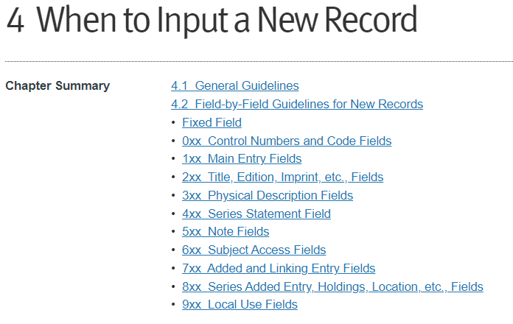
Notes:
It would take a few hours to cover everything -- I would refer you to the OCLC Bibliographic Formats & Standards document (linked in my handout). This is partly to tell you when to create a new record.
But I recognize not everyone is authorized to create new records, and may not be able to have a colleague do this for them. What if you are a solo copy cataloger and have to use … something? I’d export the record, but make sure not to update your holdings in OCLC (or SkyRiver etc.). If possible, edit your record locally and REMOVE control numbers like OCLC# and LCCN that would identify it with the other edition. Should you ever retrospectively update your holdings in the bib utility, they should add a new record based on your local record as it will not, per their algorithms, match their master record.

Slide 32
Subject headings
“Everything should be made as simple as possible, but no simpler.”
--attributed to Albert Einstein by Roger Sessions in the New York times, 8 Jan 1950.
Notes:
Let’s shift gears and look at access points -- in particular, subject headings..

Slide 33
The thesauri
LCSH (6xx _0)
MeSH (6xx _2 or 6xx _7 $2 mesh)
Sears (6xx _7 $2 sears)
FAST (6xx _7 $2 fast
LC Children’s (6xx _1)
Local, others, … (6xx _4, 6xx _7 $2 local, etc.)
Notes:
Obviously you will want to see that the SH are from a thesaurus or thesauri used by your system. The second indicator and/or subfield 2 will tell you this. So that should be one of the first things you look at.

Slide 34
The Use and Abuse of LCSH
How many SH are too many? Too few?
The official answers are in LC’s Subject Headings Manual.
https://www.loc.gov/aba/publications/FreeSHM/freeshm.html
Notes:
Because MOST libraries use LCSH, and because LCSH raise many questions, we'll focus on those.

Slide 35
The 20% rule
General rule. Assign to the work being cataloged one or more subject headings that best summarize the overall contents of the work and provide access to its most important topics.
LC practice: Assign headings only for topics that comprise at least 20% of the work.
--SHM 180.1

Slide 36
Exception: No SH
Note: There are certain works to which the Library of Congress assigns no subject headings because of their very general or amorphous nature, for example, a general periodical or a collection of essays with no discernable theme. In addition, it is Library of Congress practice not to assign subject headings to texts of sacred works or to individual works of belles lettres with no identifiable theme or specific form.
--SHM 180.1 (note)

Slide 37
How many?
The number of headings that are required varies with the work being cataloged. Sometimes one heading is sufficient. Generally a maximum of six is appropriate. In special situations more headings may be required.
LC practice: Do not assign more than ten headings to a work.
If more than one heading is present, Library of Congress catalogers assign them in order of predominance.
--SHM 180.3 (emphasis added)
Notes:
Soft limit of six headings, but LC also has a hard limit of 10

Slide 38

Respect my hierarchy
A given heading, depending upon its place in a hierarchy, may subsume several subtopics that are also represented by headings in the subject authority file. Assign to a work only the headings that most closely correspond to the overall coverage of the work. Do not assign headings that represent the subtopics normally considered to be included in an assigned heading's coverage.
-- SHM 108.5
Notes:
Respect he hierarchy of SH. Don’t use a narrow term along with a broader term that subsumes it. This is further refined in the following sections. Headings should be as specific as the work, and no more.

Slide 39
Example: Beginning gymnastics
Gymnastics
NOT
Gymnastics
Balance beam
Parallel beams
Pommel horse
Tumbling

Slide 40
The Rule of Three
If a general topic includes in its scope more than three subtopics, but the work being cataloged discusses only two or three of these subtopics, assign the appropriate two or three headings rather than the broader heading.
If more than three of the subtopics are discussed in the work, assign the broad heading instead, unless the rule of four, described below, applies.
--SHM 180.8
Notes:
Rule of three -- if only 3 of fewer sub-topics apply, use them rather than the BT

Slide 41
Example of the Rule of Three applied
American sports part one: Football and baseball
Football--United States
Baseball--United State
Sports in the United States, a comprehensive guide
Sports--United States

Slide 42
The Rule of Four
In certain circumstances it may be preferable to assign headings for four subtopics of a broad concept. If a heading covers a broad range and each subtopic forms only a small portion of that whole range, assign the four subtopics instead. For example, for a discussion of the works of four American literary authors, a heading for each author may be assigned since the heading American literature--History and criticism covers the works of all American authors.
LC practice: Do not exceed four subtopics under any circumstances.
--SHM 180.9
Notes:
Rule of four -- OK, sometimes four NTs make sense. But never more than four.

Slide 43
The Rule of Four Applied
Masters of Horror: From Lovecraft to Barker
Use
Lovecraft, H. P. (Howard Phillips),
1890-1937
Merrit, Abraham
King, Stephen, 1947-
Barker, Clive, 1952-
NOT
Horror tales -- History and criticism
Five Inventors Who Changed the World
Use
Inventors--Biography
NOT
[the five individual names]

Slide 44
How many subject headings?
Generally, six or fewer
As specific as the work
Think about
20% rule,
and whether the SH respect the hierarchy of broader and narrower terms (the rules of three & four)
Notes:
My point here is that there are rules but they allow for judgement. Too many SH can be as bad as too few, as it will clutter your search results. Complex subjects or those with multiple elements can have more, but you want them to be specific to the work

Slide 45
Summaries notes
Subject headings’ little helpers?
What saith LC?
Notes:
.
Of course there are limits to what we can communicate with SH. So summaries were introduced to aid users in selecting resources.
Most commonly used for fiction, children’s literature, and audio-visual materials in the early days.
Now it is very common to see publisher’s descriptions in summaries.

Slide 46
LC on Summaries notes
Guidelines for publishers submitting CIP info:
Brief (one sentence to 50 words)
Unbiased / not the opinion of author or publisher
Specific terms, names, places, time periods as appropriate
Avoid verbiage about currency (latest, state-of-the-art, etc.)
Standard English / correct grammar
No obscenity / profanity
Summaries will be rejected or accepted, not edited, by LC
For juvenile works:
As above, 25-30 words + possibly a single sentence about special features
Mention name and age of character(s), setting, time period, major themes/plot elements
Notes:
Note that this is NOT transcribing the back of the book or publisher’s blurb. But this policy is not always enforced.

Slide 47

Notes:
Does this follow LC guidelines?

Slide 48
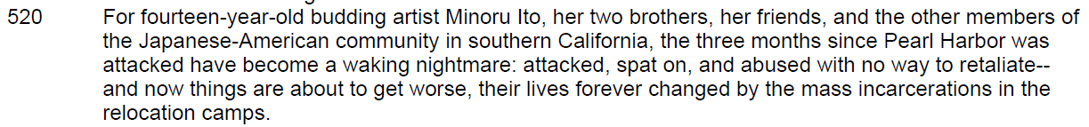
Notes:
Better. (YA novel)

Slide 49
Contents notes
LC policy: Show the relationship of works in a compilation to the compilation itself via the 505 contents note “unless burdensome.”
CIP often accepts Tables of contents of non-compilations.
Notes:
Contents on the other hand serve to add access points for works within a compilation. Really LC policy is to use contents notes only for compilations of works, but in practice tables of contents of other works are often passed through CIP, and many catalogers feel that chapter titles help their users too.
Some systems index titles and authors from contents notes, so keep that in mind too.

Slide 50
100 1 Olson, S. Douglas, ǂe author.
245 1 0 Aristophanes' Clouds : ǂb a commentary / ǂc S. Douglas Olson.
505 0 0 Machine generated contents note: ǂt ARISTOPHANES' CLOUDS -- ǂt Text -- ǂt Commentary.
Notes:
Here's an example of an unhelpful contents note. At least we are warned it was "machine generated" -- that is, harvested from publisher metadata, most likely.

Slide 51
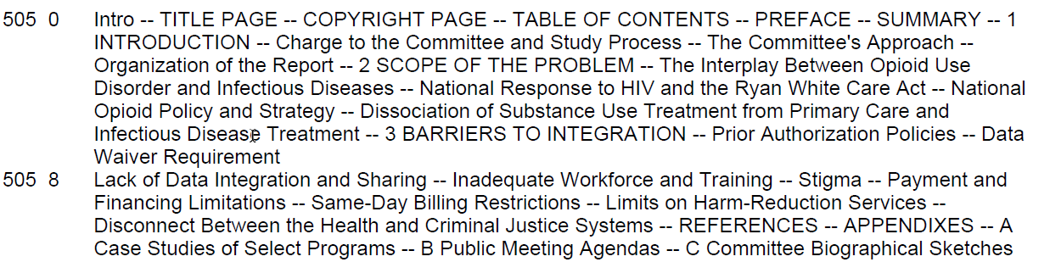
Notes:
This one was almost certain machine generated too. But apart from some formatting issues and the inclusion of unhelpful entries like "Preface", it may give more of a sense of the contents than the title proper and SH would alone. So maybe keep it.

Slide 52
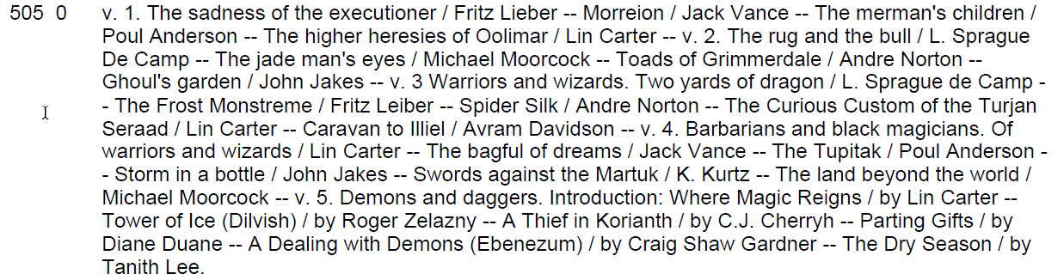
Notes:
This is more clearly a contents note as intended -- works in a compilation.

Slide 53
Everything you wanted to know about series*
*but were afraid to ask
Series in MARC and LC policy
Notes:
Another group of questions regarded series. We'll briefly look at the history of series cataloging ; 4xx and 8xx fields; When is a series not a series?; What series is this anyway?

Slide 54
Some history
Pre-AACR2 -- 400, 410, 411, 440, 490, 8xx used
1981 -- LC implements AACR2; 440 and 490 redefined, other 4xx no longer used
1989 -- LC begins to “trace” all series
2008 -- 440 becomes obsolete, 490 redefined
Notes:
Earlier versions of MARC included additional 4xx fields to cover different situations. 400-440 used when the series' authorized form was the same as the transcribed statement; 490 used when series was not given an added entry; 8xx used for authorized forms if different from 4xx.
The tags in red were retired and those fields converted to 440s or 490s + 8xx combinations.
In 1989, LC began systematically creating series authorities records for all cataloging, and "tracing" them by adding variant "Use for" entries.
In 2008, tag 440 was also retired, so now all series information is given in a transcribed 490 and an 8xx for AAPs

Slide 55
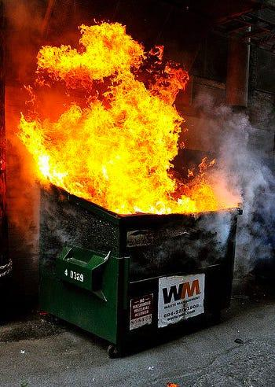
June 1, 2006
Notes:
I left out one major event though. June 1, 2006: A day that will live in infamy among catalogers. This was the Library of Congress’ implementation date of their decision not to create/update series authority records and not provide series controlled access points (AAPs).
However, NACO participants have continued creating series authorities and many BIBCO participants and other catalogers provide AAPs. In some cases the the APs are not fully controlled, however. So we often see 8xx in records with no supporting SAR. This creates a lot of confusion.

Slide 56
When is a series not a series?
The “Series-like phrase”
LC-PCC practice (not in AACR2 or RDA)
A matter of judgement
May be in a note, or imprint, or omitted
Notes:
It's not helped by the fact that sometimes a series is not a series. LC introduced the concept of a "series-like phrase" for terms that have some appearance similar to a series but which don't really fit the concept of series as given in cataloging rules.
Cataloger's judgement is required, and typically recorded in a SAR. The phrase might be given in a note, or in the imprint, or ignored entirely.

Slide 57
Types of series-like phrases
Unnumbered statement of emanating body
A Stoval Museum publication
Statement of the commercial publisher of sub-imprint/subsidiary name
An Interscience Publication
Published by JOHN WILEY & Sons
Phrase includes name of in-house editor or other official of the firm
Michael di Capua Books
Number that cannot be associated with a series title
UC-10
Notes:
NACO identifies a variety of categories of series-like phrases. These are some of them; the list is not exhaustive. (1) Unnumbered statement of emanating body. Critically, unnumbered. Given in a note if not already in imprint or elsewhere in record. (2) Statement of the commercial publisher of sub-imprint/subsidiary name. This would normally go in imprint or quoted note (3) Phrase includes name of in-house editor or other official of the firm. Again, goes in a note (4) Number that cannot be associated with a series title. Maybe in a note

Slide 58
Types of series-like phrases
5. Slogan, motto, prize, etc.
Workers of the world, unite!
A Caldecott honors book
6. Unnumbered genre or characterizing word
Essai
Mystery
Graphic novel
7. Broad category or subject or publisher’s category/listing NOT using “series,” “library,” “collection,” etc.
Educational software
Romans et nouvelles
Notes:
(5) Slogans or mottos would go in a note or “At head of title” added entry. Prizes should go in 586. (6) Unnumbered genre or characterizing word. Typically on cover/cover flaps, container. Generally not noted. (7) Also on the cover or container, a broad category or subject or publisher’s category/listing NOT using “series,” “library,” “collection,” etc. This category has exceptions, if it appears elsewhere in the resource, like a series title page.

Slide 59
Some series-like phrases
Ace fantasy book
Aladin books
Avon pocket-sized books
Dragonfly books
Plume book
Puffin Books
Yearling book
Fodor’s travel publications
Golden easy reader
Penguin mystery original
Prima’s official strategy guide
Schuster reprint
Signet classic
Notes:
Here's a selection of series-like phrases, mostly falling in caterogy 1 or 7. NONE would be given in a 490 or 8xx, but they might be in the imprint area of the reocrd or a quoted note.

Slide 60
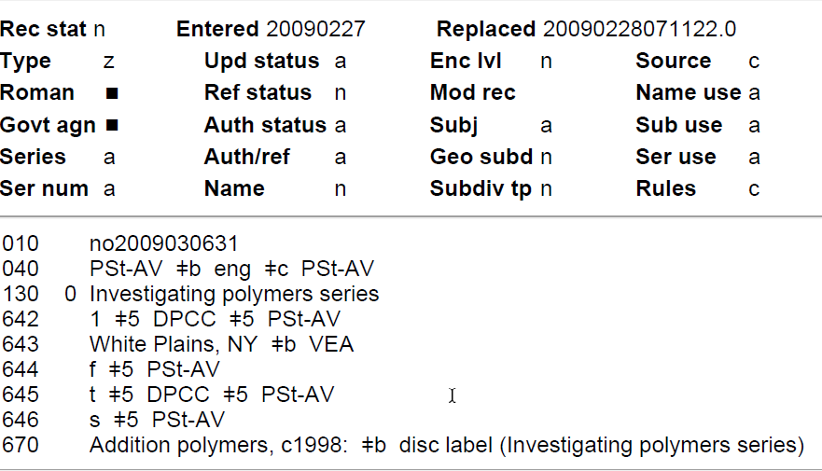
Series authority record
008 090227n| acaaaaaan |n ana c
Notes:
Let's look at a couple of series authority records to see what's going on. This is a record for a bona fide series, as displayed in OCLC. The type of series code, position 008/12 or labeled "Series" fixed field in OCLC, has “a” -- it is OK to use as added entry. Note that I added the 008 tag off to the side to show the position of the code for non-OCLC displays.
I also wanted to mention the 6xx notes. Note 642, which gives an example of how to give numbering in 8xx $v -- an arabic numeral in this case, with no “number” or “no.” The subfield 5's in these notes point out the institutions to which the note applies.

Slide 61
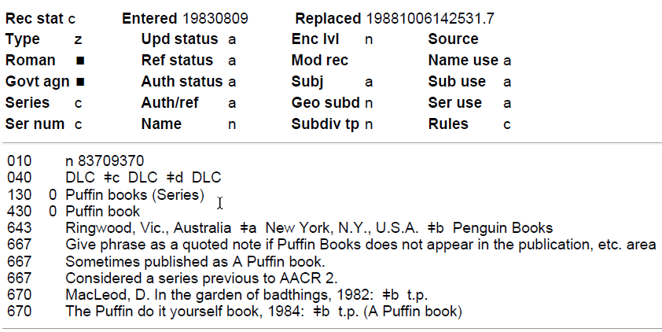
Series-like phrase
008 830809n| acaccaaa |a ana
Notes:
Here's a SAR for a series-like phrase. It might seem contradictory to crear an AR for a phrase that is NOT to be used as an access point, but the logic is that this SAR reocrds the decision not to use it as an AAP or trreat it as a series. Again the series type code is critical: here it is “c” -- which means series-like phrase. Note again the 6xx Notes to catalogers. 667 instructs us to use a quoted note if we did not already put Puffin Books in the imprint area.

Slide 62
Series in cataloging
490 for transcribed series statement(s)
8xx for series authorized access point(s)
Check the NAF (LC’s catalog or within your bibliographic utility such as OCLC)
Browse your bibliographic utility and/or catalog for the series
Notes:
Always ok to use 490 for bona fide series statement (NOT series-like phrase). Use
8xx for AAP. Again, note that your local system might index 490 as well as 8xx.
You can tell if there is a SAR by searching for the series as a title in the NAF -- either in LoC's web site or OCLC. You should also browse your local system to confirm local practice.

Slide 63


The old standbys
Notes:
Another common question is when a novel or similar is known to be part of a real series but the numbering/sequence is not given. Wikipedia and Goodreads are pretty good places check “known” titles to see where they fall in a series.

Slide 64



Blogs & Websites
Notes:
I dug a little deeper and found these three very literally-named web sites utilize publisher data and ISBN databases. They list fiction series, and often provide both publication order and in-world chronological order, since some series are published out of chronological order. “Book Series in Order” is probably the parent/source for the other two, which are more ad-heavy and exist mainly to provide Amazon Affiliate links. So with caveats I'd recommend that over the other two.

Slide 65
Questions?
monaco@uakron.edu

Slide 66
Useful links
Does this record match my item? Close enough?
OCLC’s When to input a new record https://www.oclc.org/bibformats/en/input.html
Subject headings
LC SHM https://www.loc.gov/aba/publications/FreeSHM/freeshm.html
SHM 180 https://www.loc.gov/aba/publications/FreeSHM/H0180.pdf
Basic Subject Cataloging Using LCSH https://www.loc.gov/catworkshop/courses/basicsubject/

Slide 67
Useful links
LC guidelines on summary notes: https://www.loc.gov/publish/cip/techinfo/summary_guidelines.html
https://www.loc.gov/publish/cip/techinfo/cyac_summary.html
History of series tracings and authorities
https://ac.bslw.com/community/blog/2010/03/brief-history-of-series-authority-work/

Slide 68
Identifying series
Library of Congress Authorities https://authorities.loc.gov/
GoodReads list: https://www.goodreads.com/list/tag/series
Book Series in Order blog: https://www.bookseriesinorder.com/

Slide 69
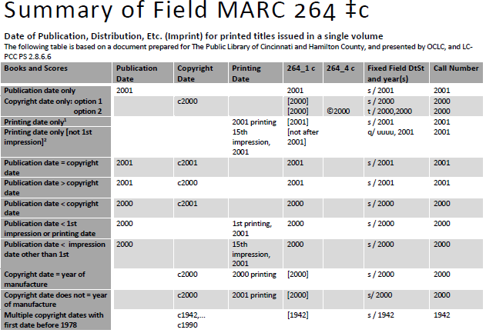

Slide 70
