Slide 1
Adventures in ETD metadata wrangling:
Metadata workflows for a mass retrospective dissertation & Thesis digitization project
at the University of Massachusetts Amherst
Meghan Banach Bergin
ALA Midwinter 2016
Notes:
recently started project to digitize our entire collection of print theses and dissertations going all the back to the late 1800s.
24,00 ten years to digitize all of them.
first a brief overview of the overall project workflow
Then more detail about our metadata workflows.

Slide 2
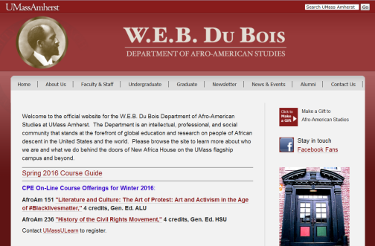
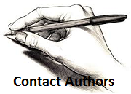
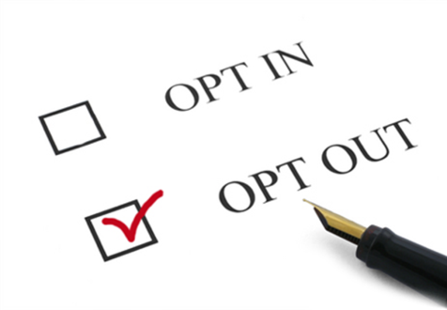

Dissertation and Thesis Digitization Project Workflow
Pre-scanning steps
Notes:
first phase of the project Pre-scanning steps:
Selecting an academic department to digitize
Notify the department chair
mail a letter to the authors and notify them of our intent to scan their dissertations.
Authors can opt-out of having their dissertation made publicly available online
send back a form with the “opt-out” box checked off
restrict their dissertation to campus only access and by ILL request only for off campus users.
(basically the same availability if it was still in print format on the library’s shelves.)
When we hear back from authors that they would like to opt-out we record their responses in a spreadsheet

Slide 3

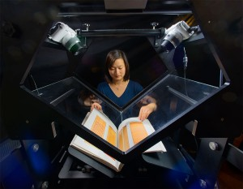
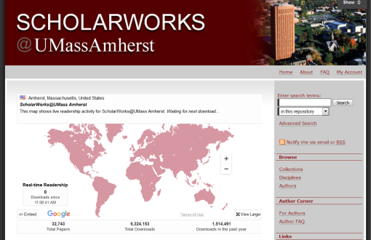

Dissertation and Thesis Digitization Project Workflow
to IR
Scanning and post-scanning steps
Notes:
pull and ship the dissertations to the Internet Archive’s scanning center at the Boston Public Library.
digitized
print copies are shipped back to us.
upload the metadata and PDF files to our IR ScholarWorks@Umass Amherst which is a Bepress Digital Commons repository

Slide 4
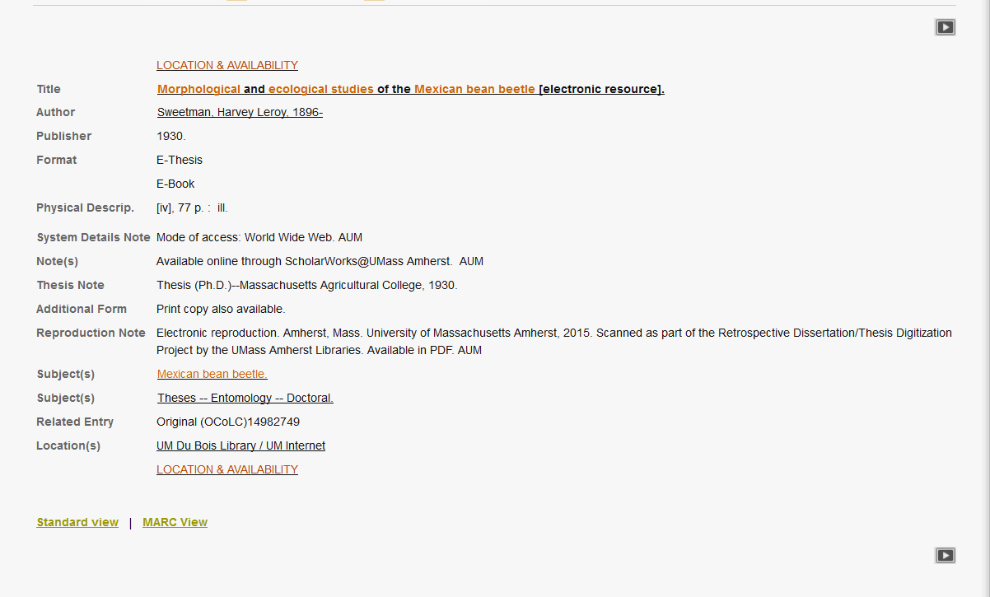
MARC Records
Notes:
begin our metadata and batch uploading workflows.
Derive MARC records for the digital versions of the dissertations from the MARC records for the print versions using a MARC Edit Task List

Slide 5


Metadata Conversion
Notes:
transform MARC metadata to Dublin Core using a PERL script written by our Digital Archivist.

Slide 6
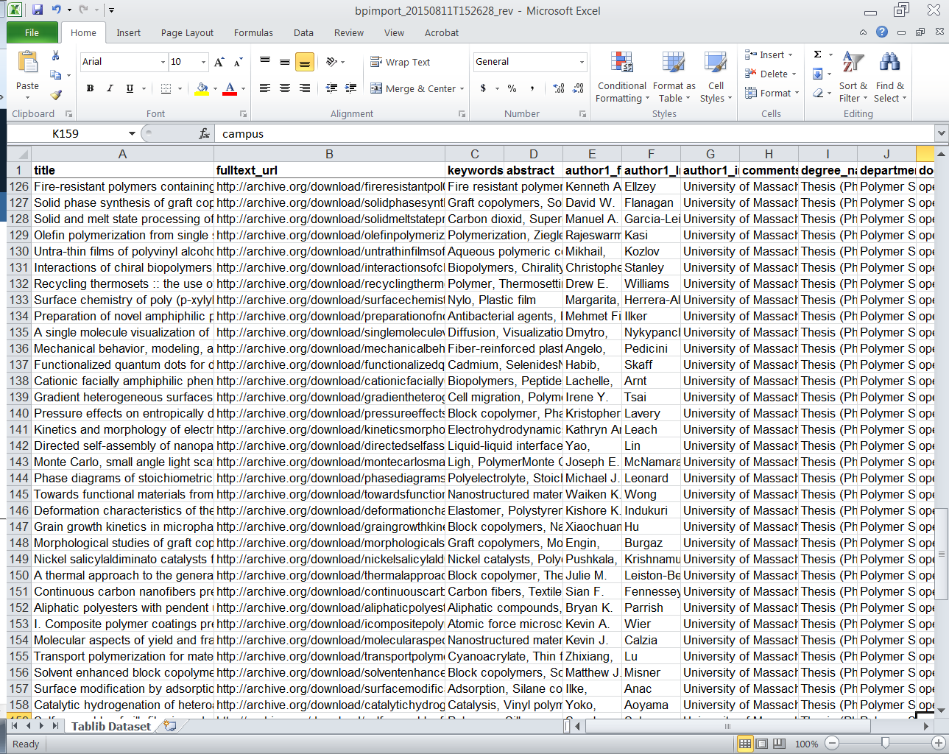
Batch Uploading to IR
Notes:
script generates an Excel spreadsheet we can use to batch upload the metadata and PDF files to our IR

Slide 7

Batch Set Access Controls
Notes:
add the opt out information to the Dublin Core metadata spreadsheet.
put the word campus in the document type column of the Dublin Core metadata spreadsheet.
tells the system to set campus only access controls on these titles.

Slide 8
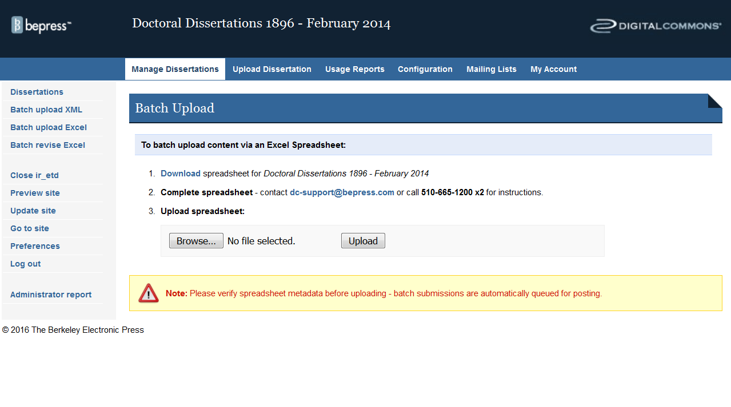
Batch Upload to Digital Commons
Notes:
batch upload the spreadsheet to ScholarWorks
very easy…IF it works
system is very picky about the metadata it will accept.
Troubleshooting
go back and try uploading it again a couple of times before the system is happy with it and accepts it.

Slide 9
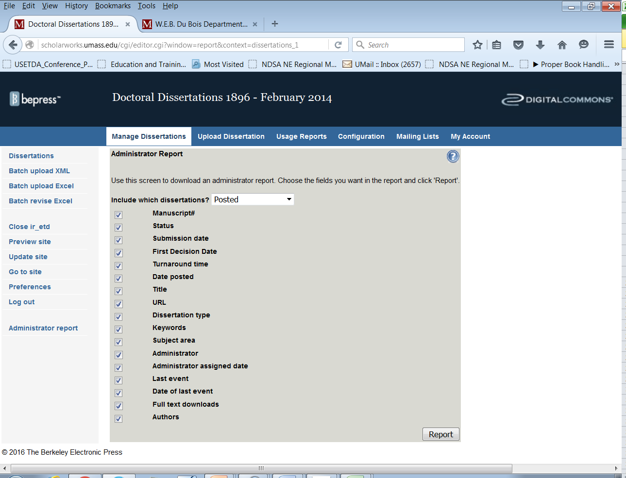
Batch Export URLs from Digital Commons
Notes:
export another spreadsheet of the ETD metadata back out of Digital Commons which contains the URLs for each title

Slide 10
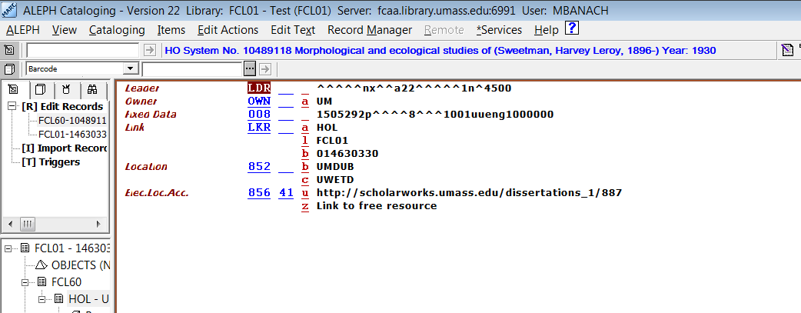
Batch Add URLs to MARC Records
Notes:
match up the URLs in this spreadsheet to our file of MARC records and
insert the URLs into the MARC records.
process is complete!

