Slide 1
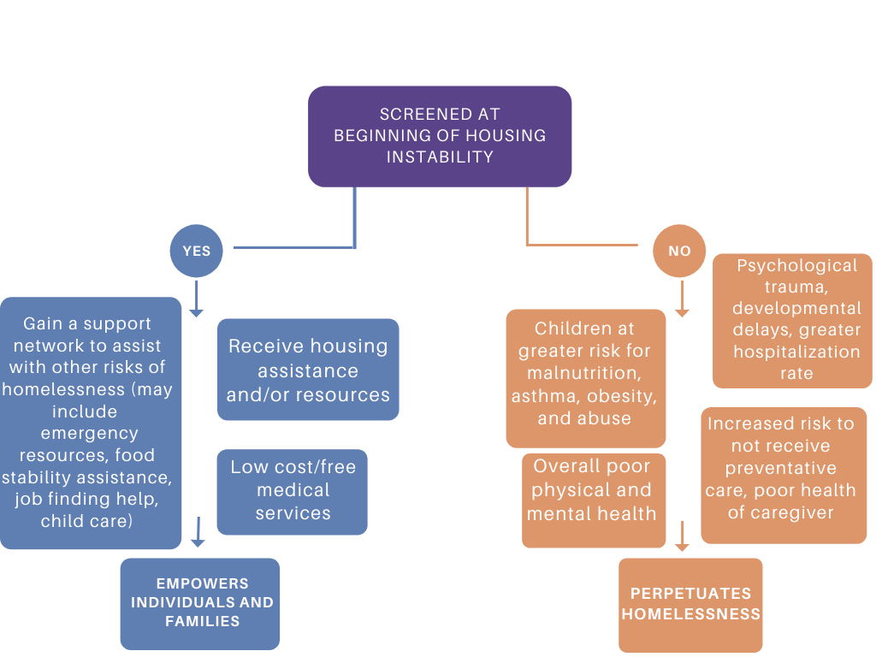
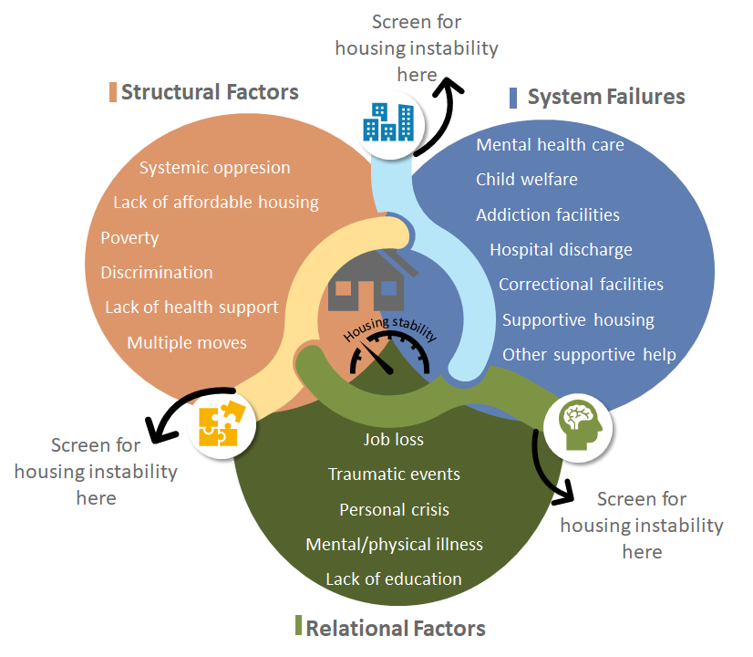

How Do Healthcare Providers Screen Children and Families for Housing Instability?
Grace Anne Ludvik and Meghan R. Mason, PhD, MPH
Introduction
What is Housing Instability?
Figure 3.
In 2018, 34% of families in urban settings experienced housing instability (Sandel et al., 2018)
Effects of housing instability include:
  Poor physical and mental health
  Delays in seeking medical care
  Higher incidences of child hospitalizations
  Higher odds of poor health in children
  Higher odds of poor health for caregivers, typically mothers
Currently, there lacks a recommended screening protocols for housing status
Housing instability refers to many different situations that have overlapping needs and barriers in health and wellbeing associated with housing status. Housing instability covers a wide range of situations, which include:
At risk for losing housing
Marginally housed
Literal homelessness
Low income and high expenses of living (medical bills, lack of affordable housing, ect.) (Kushel, 2006)
Spending at east one night in a rented room or in someone else’s home (Arriola, 2015)
Living in a shelter or on the streets
(Asgary, 2014)
Objectives
Create a data-driven universal screening tool and fact sheet
Figure 1.
hhhhhHousing Instabilityhhhhhh
Methods
Benefits of Early and Frequent Screening
Using the databases listed below, 8,199 articles were extracted and uploaded into team literature review tool, Covidence.
Reviewed by two people in two stages
  First stage reviewed abstracts for key words/concepts
  Second stage more in-depth text review
Collect definitions and current promising housing instability screening practices
Databases: PubMed, PsychInfo, SocIndex, CINAHL, Google Scholar
Recommendations
Develop a universal tool to identify people on the spectrum of housing instability
  Fact sheet
  Screening protocol
Limitations
There is no standard definition for homelessness or housing instability, which may lead to underreported data.
There is social stigma against homelessness and housing instability; For this reason, people may be hesitant about admitting to having concerns about their housing situation.
Inclusion | Exclusion
Mentions homelessness or similar phrase listed in abstract Suggests some type of screening for homelessness occurred in conducting the study Study based on US population Written in English Published between 2008-2020 | Does not mention homelessness or a similar term in the abstract The study takes place outside of US Not written in English Study not published between 2008-2020 Nonhuman studies
Next Steps
Complete literature review
Conduct additional interviews
Further develop fact sheet based on findings
Develop screening protocol.
Figure 1.0
Outcomes
Figure 2.
Housing status is impacted by a variety of factors. Figure 2. demonstrates what leads to housing instability and how early and frequent screening can reduce the negative health outcomes of housing instability.
Notes:
Arriola, K. J., Spaulding, A. C., Booker, C. A., Williams, C., Avery, A., Porter, N. J., . . . Frew, P. M. (2013). Understanding the
relationship between social support and physical and mental well-being among jail detainees living with HIV. Journal of
Health Psychology, 20(1), 3-12. doi:10.1177/1359105313496447
Asgary, R., Garland, V., Jakubowski, A., & Sckell, B. (2014). Colorectal Cancer Screening Among the Homeless Population of
New York City Shelter-Based Clinics. American Journal of Public Health, 104(7), 1307-1313. doi:10.2105/ajph.2013.301792
Kushel, M. B., Gupta, R., Gee, L., & Haas, J. S. (2006). Housing instability and food insecurity as barriers to health care among
low-income americans. Journal of General Internal Medicine, 21(1), 71-77. doi:10.1111/j.1525-1497.2005.00278.x

