Slide 1

Proving Your Value: The Librarian’s Contribution to the Promotion and Tenure Process
ACRL 2013

Slide 2
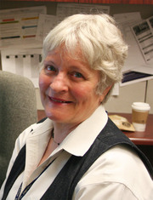
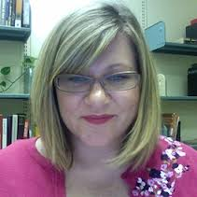
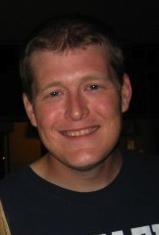
Contact Information
Susan Ariew
sariew@usf.edu
Twitter: @EdLib
Vera Lux
vlux@bgsu.edu
Twitter: @thetruelight
Matt Torrence
torrence@usf.edu
Twitter: @torrence42
Notes:
Welcome and panelists each introduce themselves

Slide 3

Check out our LibGuide for additional resources
Join the Discussion on Twitter
#acrlimpact
http://guides.lib.usf.edu/acrl2013

Slide 4

The Value of the Academic Librarian to the Promotion/Tenure Process
Offers expertise and information in using bibliometric tools
Helps researchers decide where to submit manuscripts for publication
Provides direct support to faculty in preparing promotion/tenure portfolios
Keeps abreast of new trends
Notes:
Matt

Slide 5

The Importance of Understanding Impact
Scholarly Impact
The value of faculty research for purposes of retention, promotion, tenure decisions.
“Research visibility that enhances institutional stature among peers.” (Alpert, 1985)
Notes:
Vera--Introductory content before we move into specifics. The first and most important point to be made along the way here is the fact that librarians need to understand impact and why it is such an important part of faculty survival at higher education institutions. Becoming an expert in the tools and measures related to impact is key to “proving your value” to faculty.
Susie
I would like to talk out the key points of this and the following slide. I just want to make sure I know everything we want to get across here. Thanks for the notes Susie! --Vera
Vera will add to this to further emphasize the value of librarians (Matt 03082013)

Slide 6
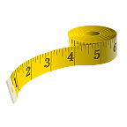
Understanding Impact
Bibliometrics
A set of methods used to study or measure texts and information, often toward to goal of assessing scholarly impact.
“Impact Factor is not a perfect tool to measure the quality of articles but there is nothing better… and is, therefore, a good technique for scientific evaluation.” (Garfield, 2007)
Notes:
More introductory content before we move into specifics. Vera

Slide 7

Common Impact Measures
Cited references to an author’s work
  Who is citing that author as an authority
  How much or how often an author is cited
Journal rankings
  Quantitative data about journals, including impact factors
Reviews of an author’s work
  Qualitative information on the quality of more extensive works, such as books and portfolios.
Notes:
Matt

Slide 8
Measuring Impact Across the Disciplines
Traditional bibliometric tools remain essential for faculty, despite flaws and disciplinary variance.
Alternative bibliometric tools become a widely acceptable means of capturing impact, particularly in the social sciences and humanities.
Altmetrics are a fast-emerging area with high potential for digitally savvy faculty, but are still imperfect and untested in most tenure cases.
Notes:
Topic: thoughts on the value of metrics, the future of metrics, disciplines & metrics. Matt

Slide 9
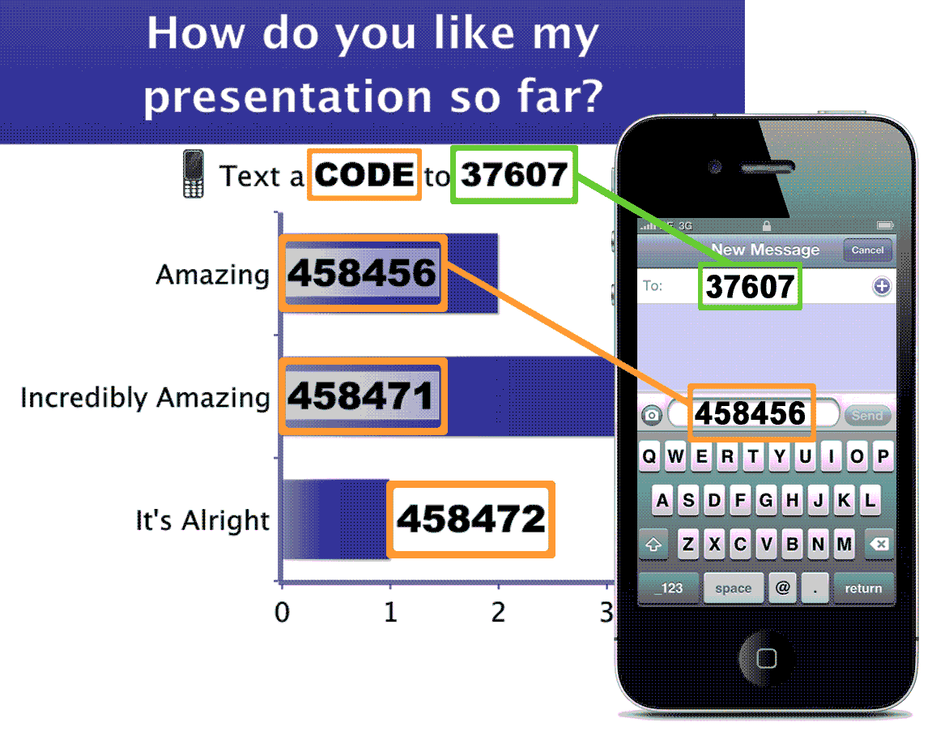
How To Vote via Texting
EXAMPLE
Notes:
This slide is for display to the audience to show them how they will vote on your polls in your presentation. You can remove this slide if you like or if the audience is already comfortable with texting and/or voting with Poll Everywhere.
Sample Oral Instructions:
Ladies and gentlemen, throughout today’s meeting we’re going to engage in some audience polling to find out what you’re thinking, what you’re up to and what you know. Now I’m going to ask for your opinion. We’re going to use your phones to do some audience voting just like on American Idol.
So please take out your cell phones, but remember to leave them on silent. You can participate by sending a text message.
This is a just standard rate text message, so it may be free for you, or up to twenty cents on some carriers if you do not have a text messaging plan. The service we are using is serious about privacy. I cannot see your phone numbers, and you’ll never receive follow-up text messages outside this presentation. There’s only one thing worse than email spam – and that’s text message spam because you have to pay to receive it!

Slide 10
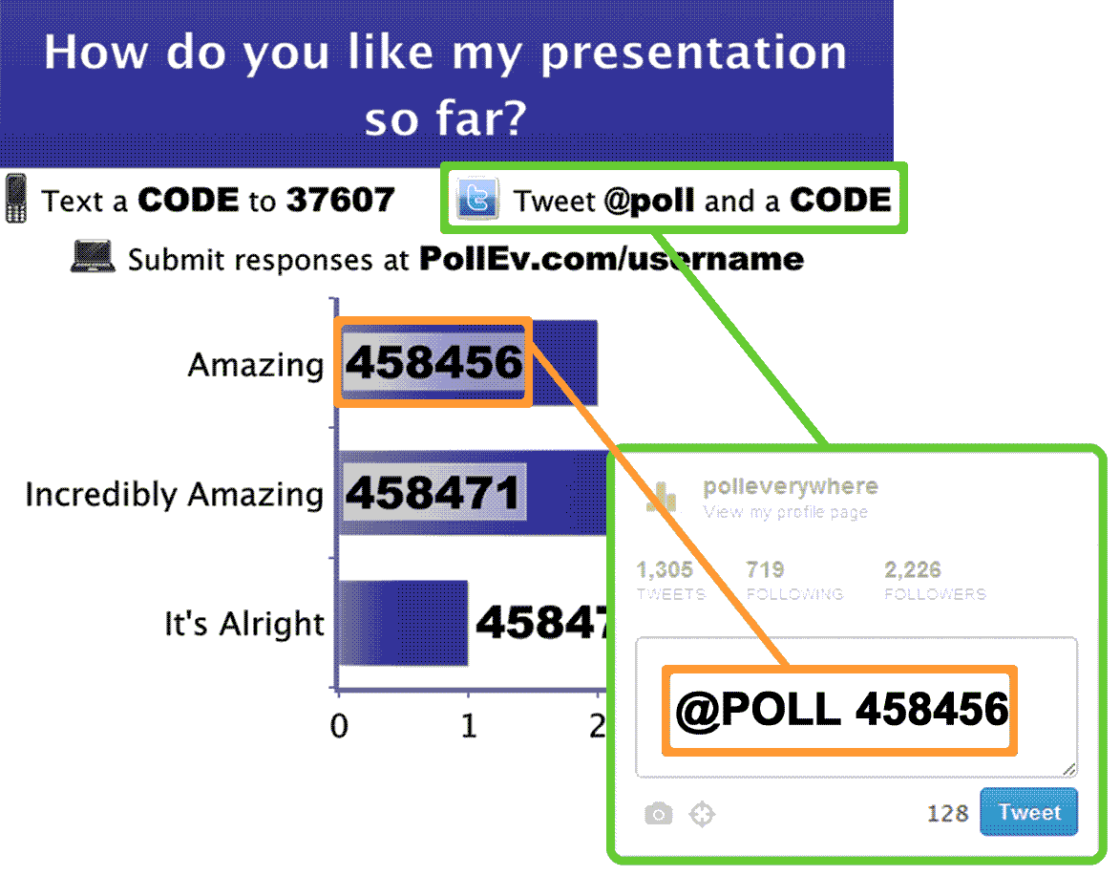
How To Vote via Twitter
EXAMPLE
Notes:
This slide is for display to the audience to show them how they will vote on your polls in your presentation. You can remove this slide if you like or if the audience is already comfortable with texting and/or voting with Poll Everywhere.
Sample Oral Instructions:
Ladies and gentlemen, throughout today’s meeting we’re going to engage in some audience polling to find out what you’re thinking, what you’re up to and what you know. Now I’m going to ask for your opinion. We’re going to use Twitter to do some audience voting.
So please take out your cell phones or laptops, but remember to leave them on silent. The way you will be able to participate is by tweeting a response to @poll. Your followers won’t be bothered by this message.

Slide 11
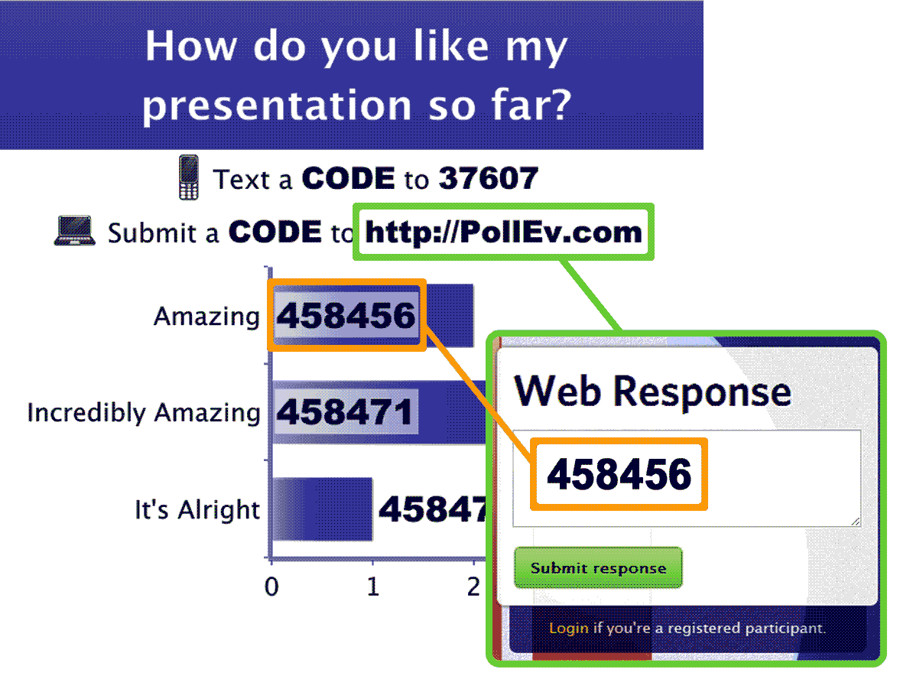
How To Vote via PollEv.com
EXAMPLE
Notes:
This slide is for display to the audience to show them how they will vote on your polls in your presentation. You can remove this slide if you like or if the audience is already comfortable with texting and/or voting with Poll Everywhere.
Sample Oral Instructions:
Ladies and gentlemen, throughout today’s meeting we’re going to engage in some audience polling to find out what you’re thinking, what you’re up to and what you know. Now I’m going to ask for your opinion. We’re going to use your phones or laptops to do some audience voting just like on American Idol.
So please take out your mobilephones or laptops, but remember to leave them on silent. You can participate by submitting an answer at PollEv.com on your laptop or a mobile phone.
The service we are using is serious about privacy. I cannot see who you are or who voted.

Slide 12
Which of the following disciplines places the most importance on publishing in books/monographs?
  Medical & Biological Sciences
  Physical Sciences & Maths
  Engineering & Computing
  Social Sciences, Business & Economics
  Humanities
  Education & Sport
  Interdisciplinary
Notes:
<?xml version="1.0" encoding="ISO-8859-1" ?>
<poll url="http://www.polleverywhere.com/multiple_choice_polls/irXtcvU3814sKph">
<!-- This snippet was inserted via the Poll Everywhere Mac Presenter -->
<!-- The presence of this snippet is used to indicate that a poll will be shown during the slideshow -->
<!-- TIP: You can draw a solid, filled rectangle on your slide and the Mac Presenter will automatically display your poll in that area. -->
<!-- The Mac Presenter application must also be running and logged in for this to work. -->
<!-- To remove this, simply delete it from the notes yourself or use the Mac Presenter to remove it for you. -->
<title>Which of the following disciplines places the most importance on publishing in books/monographs?</title>
</poll>

Slide 13
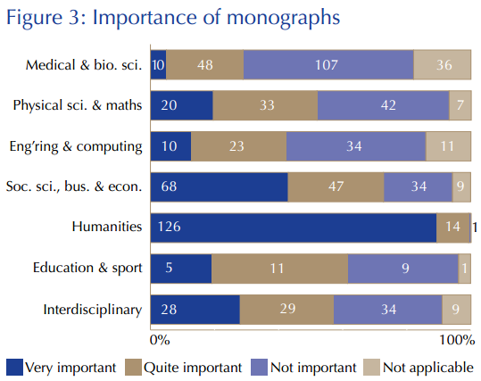
The Importance of Monographs and
Conference Presentations/Posters
From Research Information Network, “Communicating Knowledge” (2009)
Notes:
Susie
Visual example of the differences in the value of certain scholarly outputs by discipline. The point to librarians is that you need to know the impact measures most important to the disciplines you serve in order to be able to assist faculty.

Slide 14
Traditional Bibliometric Tools and Citation Counts
Here's a sample from an ISI-based data set for citations of Canadian-authored articles published between 1981 and 2000. The number for each discipline is the average number of citations per published article (both article and citations in ISI-listed journals).
Philosophy: 1.11
Literature: 0.33
Oncology: 26.73
Economics: 6.74
Biochemistry: 23.54
Art and Architecture: 0.35
Neuroscience: 21.41
Posted by: Tom Hurka, December 06, 2007 from the Leiter Report
Notes:
Susie
How each discipline is unique in number of cites that occur and how faculty publish—the variations particularly with ISI

Slide 15
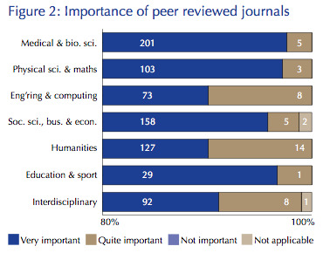
The Importance of Journal Articles
From Research Information Network, “Communicating Knowledge” (2009)
Notes:
Added slide (Matt 03082013)
Susie can continue with this slide

Slide 16

Traditional Bibliometric Tools that
Favor the Sciences
Web of Science, aka Web of Knowledge
  A combination of resources and resource types
  A database that does more than just “find” articles
  Tracking the articles that cite other articles…
  Links to articles contained in these bibliographies (some are outside the ISI “universe”)
Journal Citation Reports (JCR)
Notes:
Matt:
Topic: Traditional bibliometric tools – Web of Science/Knowledge & Journal Citation Reports
General discussion of how this product combines databases with bibliometric tools and citation information

Slide 17


Traditional Bibliometric Tools – Web of Science
Journal Citation Reports
Presents quantifiable, statistical data that provides a systematic way to evaluate the world’s leading journals.
Covers more than 10,000 from more than 25 million cited references indexed every year
No Arts and Humanities edition
Journal Impact Factor
Computed by calculating the average number of citations to articles in the journal during the preceding two years from all articles published that given year
See http://www.mathunion.org/fileadmin/ IMU/Report/CitationStatistics.pdf
Notes:
Matt Traditional bibliometric tools – Web of Science/Knowledge & Journal Citation Reports (also mention Book Citation Index)
Intro about ISI’s JCR. Don’t need to go into detail because some schools have these tools and some don’t, but do want to talk about ISI’s role as the first and the most prestigious, especially at the beginning when metrics creeped into the promotion/tenure process.
Susie: Caveats about SSCI and JCR--criteria and reasons for inclusion/exclusion of journals in SSCI and the JCR. Currently there are now 1181 journals indexed in ERIC and the percentage in SSCI and ISI coverage is only about 20-25%. 206 r “Education and Educational Research” another 37 under “Education, Special” and another 51 under “Psychology, Educational.” 304 total.

Slide 18
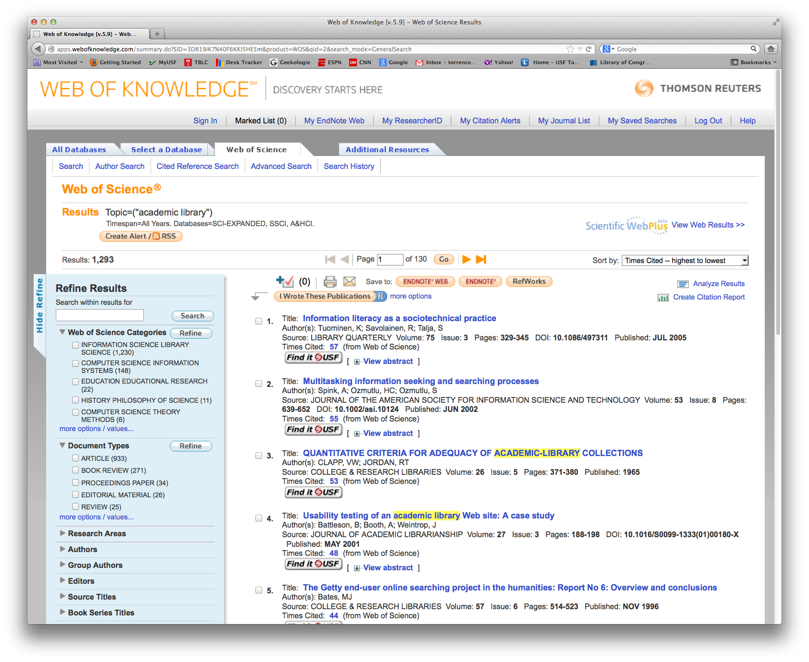
Traditional Bibliometric Tools – Web of Science
Notes:
Per our discussion, I removed the image of the Book Citation Index. Matt will put in new images, etc. I also moved this to follow the intro slide (Matt 03082013)

Slide 19

Traditional Bibliometric Tools - SCOPUS
Scopus & SciVerse
  A database known as an alternative to Web of Knowledge
  Offers similar metrics, but uses slightly different algorithms
    SCImago Journal Rankings (SJR)
    Source Normalized Impact per Paper (SNIP)
  Offers a much wider range of journals, but still fairly limited for humanities scholars
Notes:
Topics: Traditional bibliometric tools extended – Scopus, Book Citation Index, Data Citation Index
Vera: Scopus, SJR, Move Web of Knowledge points to another slide Matt

Slide 20
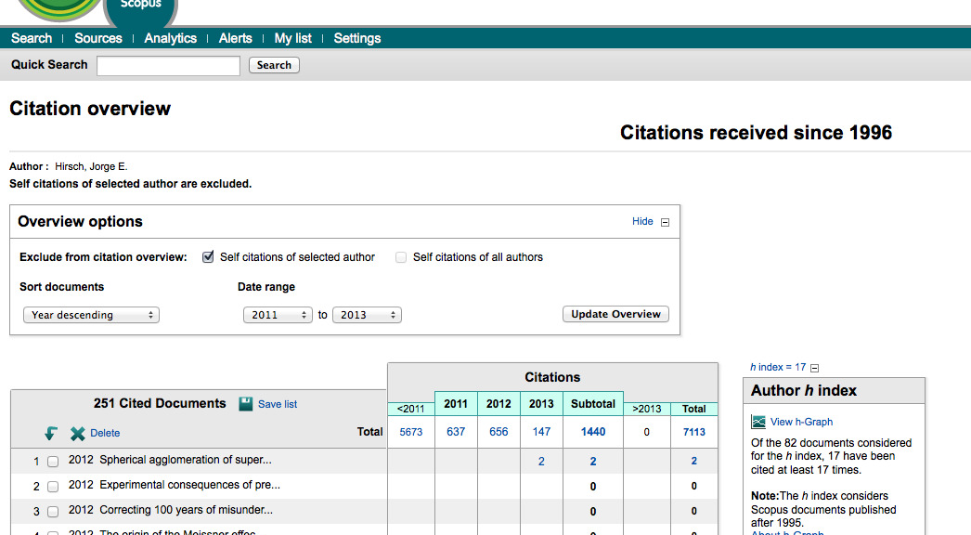
Traditional Bibliometric Tools - SCOPUS
Scopus Author Evaluator
Notes:
Topics: Traditional bibliometric tools extended – Scopus, Book Citation Index*, Data Citation Index,
Vera
Needs images screen shot from Vera (Matt 03082013)

Slide 21

Alternative Bibliometric Tools
Books & Book Chapters
  Google Books
  Google Scholar Citations
  WorldCat Identities
  Anne Harzing’s Publish or Perish
Notes:
Susie
Topics: Shift from traditional bibliometrics to alternative bibliometrics based on scholarly needs.
These are tools mostly used with monographs more than with book chapters which present unique challenges for authors in terms of demonstrating impact.

Slide 22
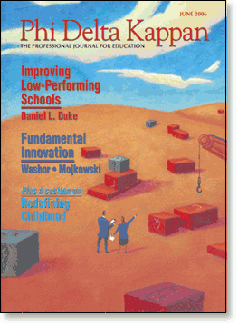
Alternative Bibliometric Tools
Other Tools for Non-Ranked Journals
  Cabell’s or Ulrich’s Journal Profiles
    Journal acceptance rates
    Publication type (e.g. scholarly, trade)
    Abstracting & indexing
    Readership information
  WorldCat
    Journal holdings
Notes:
Other tools used to profile publications. Here I can show journal profiles table. --SAA

Slide 23
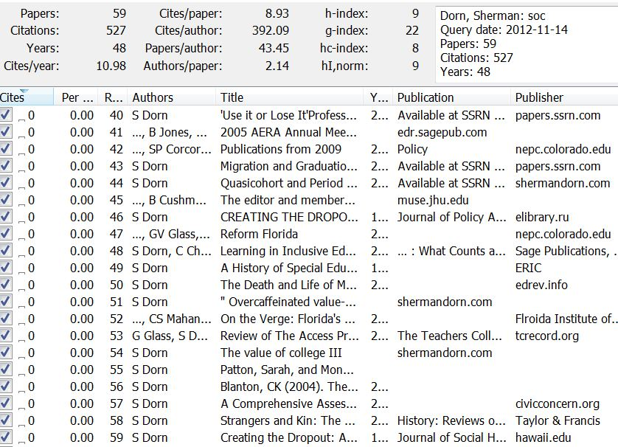
Alternative Bibliometric Tools
Harzing’s Publish or Perish
Notes:
Susie Topic: Google Scholar Profiles, Harzing’s Publish or Perish
Harzing example. I can’t show the software live on my computer. This slide is hard to read, though.

Slide 24
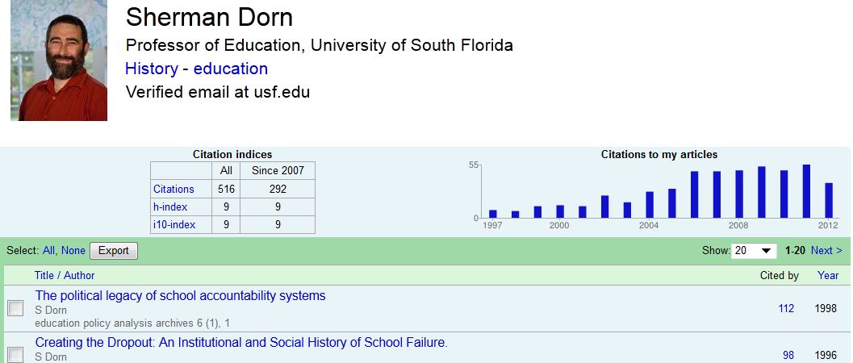
Alternative Bibliometric Tools Friendlier to Social Sciences & Humanities
Google Scholar Profiles
Notes:
Susie
Topic: Google Scholar Citations, Harzing’s Publish or Perish
Google Scholar Citations feature is proving to be very popular with faculty in all fields, but particularly education, humanities, social sciences.
The h-index is an index that attempts to measure both the productivity and impact of the published work of a scientist or scholar. The index is based on the set of the scholar’s most cited papers and the number of citations that they have received in other publications. The index can also be applied to the productivity and impact of a group of scientists, such as a department or university or country, as well as a scholarly journal. The index was suggested by Jorge E. Hirsch, a physicist at UCSD, as a tool for determining theoretical physicists' relative quality^{[1]} and is sometimes called the Hirsch index or Hirsch number.

Slide 25

Emerging Altmetrics Tools
Altmetrics
The creation and study of new metrics based on the Social Web for analyzing, and informing scholarship
“We rely on filters to make sense of the scholarly literature, but the narrow, traditional filters are being swamped. However, the growth of new, online scholarly tools allows us to make new filters; these altmetrics reflect the broad, rapid impact of scholarship in this burgeoning ecosystem.” (Altmetrics.org)
Notes:
Vera
Not sure how much of this material we actually want to cover in depth.

Slide 26
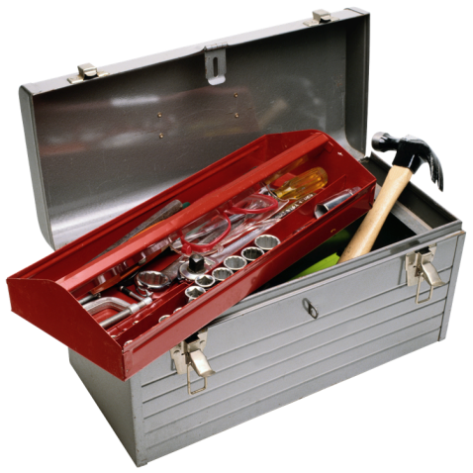
Emerging Altmetric Tools
Article-Level Metrics
  PLoS Article-Level Metrics (Views & Downloads)
  SSRN (Views & Downloads)
  Altmetric It Bookmarklet
Social Media Metrics
  Twitter API
  Impact Story (aka Total Impact)
Readership Metrics
  Mendeley API
Notes:
Again, look at this and decide what we might include and revise accordingly. Matt? Vera?
Based on our discussion, I removed the two slides (Impact Story and Altmetric It Bookmarklet). Vera can do both slides on Altmetrics here, and/or add more. If not, I’m happy to talk about some elements, or just Mendeley (Matt 03082013)

Slide 27
Would altmetrics be acceptable measures of impact for the tenure and promotion process at your institution?
  Yes
  No
  Depends on the department/discipline
  Maybe in the future
Notes:
version="1.0" encoding="ISO-8859-1" ?>
<poll url="http://www.polleverywhere.com/multiple_choice_polls/SGKqCmTpaWkZFJi">
<!-- This snippet was inserted via the Poll Everywhere Mac Presenter -->
<!-- The presence of this snippet is used to indicate that a poll will be shown during the slideshow -->
<!-- TIP: You can draw a solid, filled rectangle on your slide and the Mac Presenter will automatically display your poll in that area. -->
<!-- The Mac Presenter application must also be running and logged in for this to work. -->
<!-- To remove this, simply delete it from the notes yourself or use the Mac Presenter to remove it for you. -->
<title>Would altmetrics be acceptable measures of impact for the tenure and promotion process at your institution?</title>
</poll>

Slide 28

Outreach
Promoting Professional Expertise on Campus through LibGuides
Library and Information Resources Related to Promotion and Tenure (USF)
Who’s Citing Me? (Bowling Green)
Notes:
Vera

Slide 29
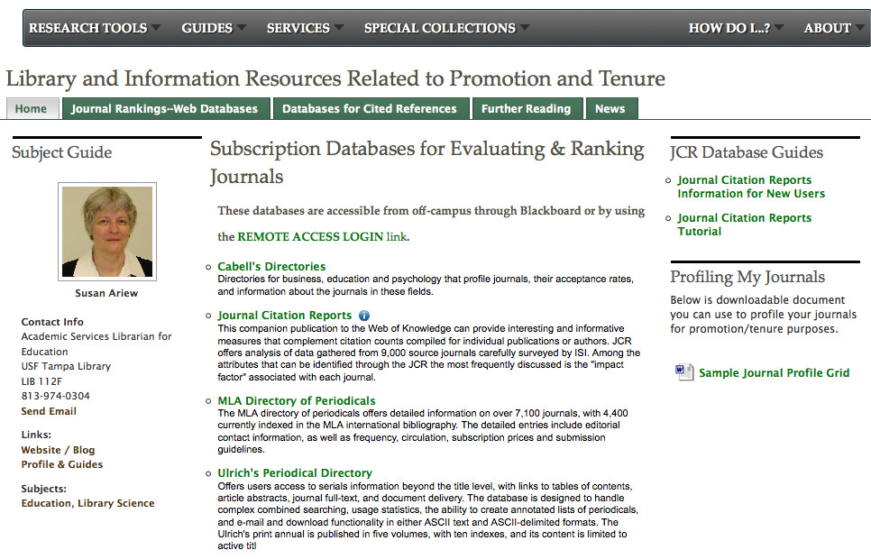
LibGuide Example USF
Notes:
SAA

Slide 30
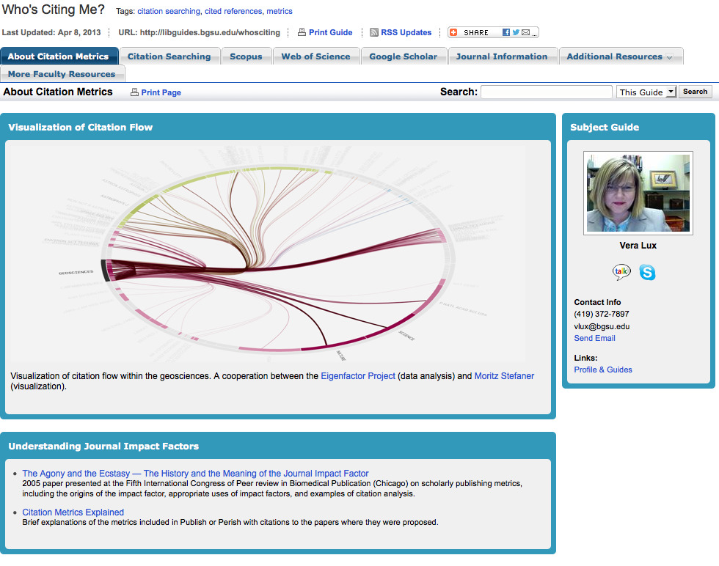
LibGuide Example BGSU
Notes:
Vera

Slide 31

Workshops/Orientations
Orientations for New Faculty
Workshops for upper level graduate students and junior faculty members.
USF’s “Beyond the Basics” series, “Documenting Scholarly Impact with Cited References, Journal Rankings, and Bibliometrics.”
Notes:
Susie
“This Webinar is for faculty and graduate students interested in how scholars can profile the impact of their work through cited references and journal rankings. The session will cover bibliometric tools that assist researchers in deciding where to submit their manuscripts, how to determine the impact of their journal publications, and finally how to build a strong tenure/promotion portfolio in documenting their cited references.” Matt and Susie

Slide 32

Consultations
One-on-One meetings with faculty who need support looking up journal rankings and using bibliometric tools to document (and target) their citations.
Notes:
Might want to talk about the number of consults we do and the purpose of those consults. Susie, Vera

Slide 33

Providing Services--Challenges
Available resources
Gaining a reputation on campus as the impact “expert”
Scale and size of outreach
Faculty expectations

Slide 34
How do librarians at your institution support faculty with the promotion tenure process?
  LibGuides
  Workshops
  Consultations
  Tutorials
  Nothing currently
  Other
Notes:
<?xml version="1.0" encoding="ISO-8859-1" ?>
<poll url="http://www.polleverywhere.com/multiple_choice_polls/lFxw4yYdDPoubSx">
<!-- This snippet was inserted via the Poll Everywhere Mac Presenter -->
<!-- The presence of this snippet is used to indicate that a poll will be shown during the slideshow -->
<!-- TIP: You can draw a solid, filled rectangle on your slide and the Mac Presenter will automatically display your poll in that area. -->
<!-- The Mac Presenter application must also be running and logged in for this to work. -->
<!-- To remove this, simply delete it from the notes yourself or use the Mac Presenter to remove it for you. -->
<title>How do librarians at your institution support faculty with the promotion tenure process?</title>
</poll>

Slide 35
Works Cited
Alpert, D. (1985). Performance and paralysis: the organizational context of the American research university. Journal of Higher Education, 56, 241-281.
Garfield E. (2007). Journal impact factor: A brief overview. Canadian Medical Association Journal, 161(8), 979–80. Retrieved August 21, 2012, from www.cmaj.ca/content/161/8/979
Hurka, T. (6 December 2007). ISI Philosophy journals and promotion decisions. Leither Reports: A Philsophy Blog. Retrieved December 3, 2012 from http://leiterreports.typepad.com/blog/2007/12/isi-philosophy.html
Research Information Network (19 September 2009). Communicating knowledge: How and why UK researchers publish & disseminate their findings. JISC. Retrieved December 1, 2012 from http://www.jisc.ac.uk/publications/research/2009/communicatingknowledgereport.aspx
Notes:
Do we want to create a LibGuide? A handout? Where do we want to highlight more resources?

Slide 36

http://guides.lib.usf.edu/acrl2013

Slide 37
Questions?

