Slide 1
Wasted Words?
Current Trends in CD Policies
Matt Torrence / Audrey Powers / Megan Sheffield
University of South Florida
Charleston Conference 2012

Slide 2
Purpose of Survey
To determine the administrative structure of collection development and technical services in academic ARL libraries
To find out if ARL libraries continue to follow more traditional policies and procedures for Technical Services and Collection Development
To see if and how ARL libraries are experimenting with new collection development services
  This includes services and technology

Slide 3
Purpose of Survey
To measure and compare the amount of time available to librarians to review and select new materials
To determine if print materials are being reviewed in new and innovative ways or if they receive the same assessment as electronically formatted materials
To measure the employment of data or patron-driven acquisition methods

Slide 4
About the Libraries at the University of South Florida
2,100,000 volumes at USF Tampa Library
2,250,000 volumes USF Library System
53,000 E-Journal Titles
1,500 P-Journal Titles
1,175,000 Expended on Monographs
4,800,000 Expended on Serials
190,000 Total Circulations

Slide 5
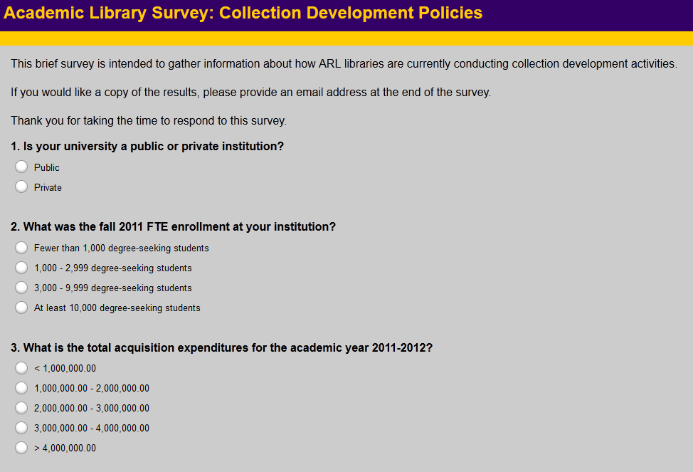
The Survey Instrument

Slide 6
The Survey Instrument
Surveys emailed to 112 academic ARL Libraries
The 27 items that form the survey are roughly broken up into six basic question types:
  Demographic & Quantitative – (questions 1-11)
  Organizational – (questions 12-13)
  Collection Policies & Management – (questions 14-23)
  Assessment Inquiries – (questions 24-26)
  Qualitative Response – (question 27)
53 ARL Libraries responded
47 % response rate
Notes:
The general setup of collection development at these universities seems to use subject specialists (Q7, 86.5%) with a general CD policy (Q5, 84.6%) that each spend a minority of their time on development activities (Q8, 32.1% spend 1-20% of their time on CD; 35.8% spend 20-40% of their time on CD). They generally do not have consortia CD policies (Q6, 69.2%). Of their general-use CD policies, most review it every 1-5 years (Q9, 20.8%) or every 5-10 years (13.2%). About half (Q11, 54.7%) of these policies are available to the public online, with the other half being split between internal use only, available on request, or only partial CD policies available to the public.
The percentage of time allotted for cd activities varies greatly (Q8) from 0 – 70% for most library respondents’ with one library having two dedicated librarians conducting collection development 80 – 100% of their time.

Slide 7
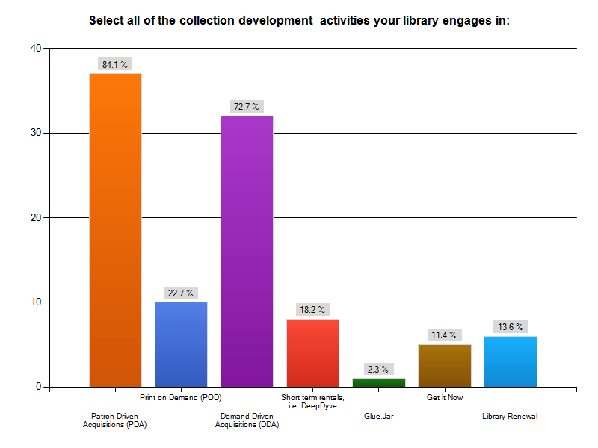
The Results: Collection Development Activities
Notes:
the comments indicated that the libraries preferred the use of traditional collection development methodologies such as using approval plans and direct ordering from YBP. This clearly indicates that we are in a transition between using standard methodologies (not willing to let go, yet) and experimenting with new methodologies (PDA, DDA), but not willing or able to truly experiment with everything that is available (Glue.Jar, Get It Now, etc.)

Slide 8
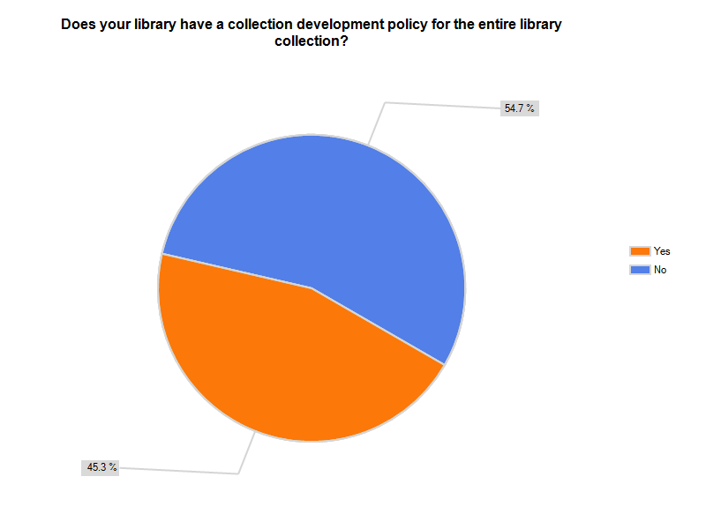
The Results: General vs Specialized Policies
Notes:
ARL members were also split down the middle when it came to having separate policies for each discipline: 48.1% said yes and 51.9% said no (Q16). The numbers go up, however, for policies related to specific collections. A large majority (76.5%) have subject and collection specific policies (Q17). A large majority of respondents indicated they did not have a separate policy for electronically formatted materials (78.0%, Q19) or for all electronic resources (92.2%, Q20).

Slide 9
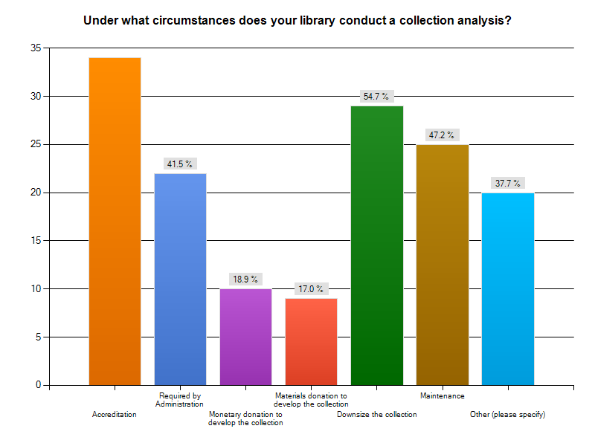
The Results: Collection Analysis & Assessment
Notes:
When performing an analysis of the collection, most libraries rely on reports (83.0%) and the librarians’ knowledge of their subject areas (86.8%). About a third of respondents (39.6%) rely on WorldCat Collection Analysis reports specifically (Q25). In the comments section, 22 responses of which 5 libraries indicated they conducted a collection analysis to enhance and improve the collection, 5 libraries indicated it was used for decision making; 2 indicated it was for budget constraints, 2 indicated the librarians choose to do it to increase their knowledge of the collection, 3 indicated they did it when it was perceived as needed and 3 other responses included scholarly statistics, grant proposals and user communication in general (motivation).

Slide 10
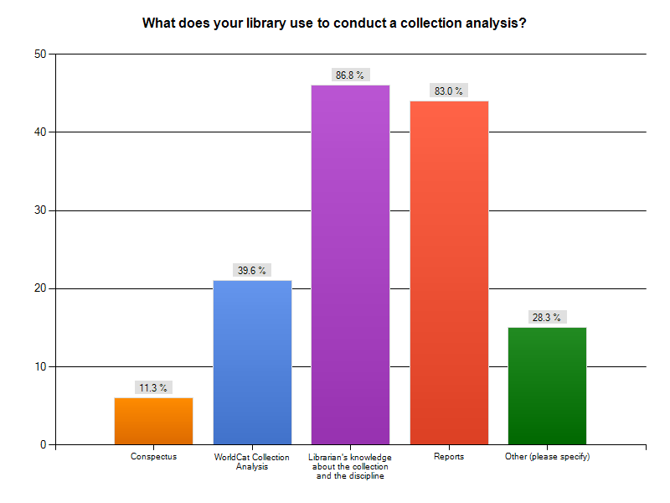
And Even More Results

Slide 11
Are CD Policies Being Used?
Although the answer to this question might seem very straightforward from the responses to Q5 (Does your library use CD policies, 84.6% yes, 15.4% no), further responses paint a different picture
Although most of the libraries surveyed do have collection development policies, they appear to use them for a wide range of activities, such as accreditation and communication and the policies themselves vary widely in their scope and currency.
When asked about the availability of CD policies (Q11), the respondents were split evenly; some of the policies, or parts of a specific policy, are available externally (on the web) and some are not available externally (discipline specific policies)

Slide 12
Are CD Policies Being Maintained?
It is not as clear whether or not CD policies are being maintained
Certainly there were some survey respondents who indicated their policies were updated (or at least reviewed) annually, and some had specific policies for different subject areas or formats
The majority indicated that CD policies were only revisited about once every 5 years, and a majority of the respondents did not have CD policies dedicated to specific formats (e-journals, databases, e-books, etc.)
Notes:
this may not be indicative of a lack of maintenance to the CD policies, but rather that libraries are taking a more holistic view of collection development and trying to move beyond format-specific issues. In other words, they are trying to focus on what makes an item suitable for the collection content-wise rather than format-wise.

Slide 13
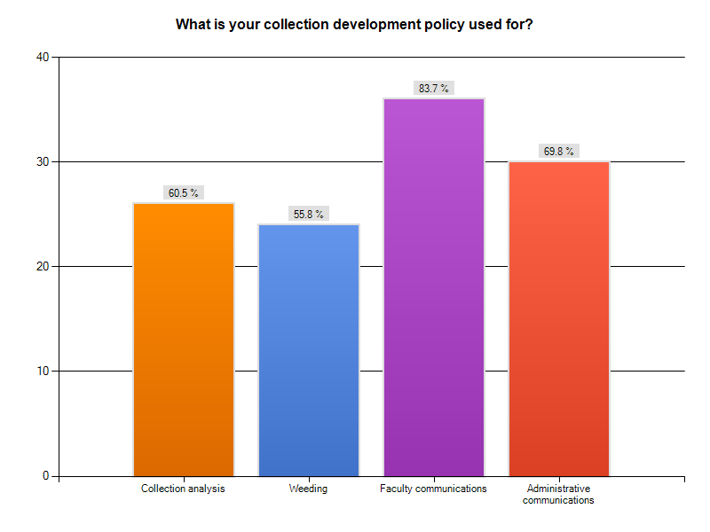
What are the Motivations for Using CD Policies?
Notes:
There seem to be two different ways that CD policies are being used as seen in the responses to Q26 (histogram of results shown below). The first category, which got more responses, is for faculty and administrative communications. This would include such activities as explaining library purchasing decisions to those outside the library. The second use is more internal – policies can be used for collection analysis and weeding. The internal/external split in these uses indicates that CD policies lead a double life: their obvious purpose (guiding the development of the collection) is sometimes secondary to their usefulness as marketing tools.

Slide 14
Conclusions and Future Plans
A good deal of baseline information has been established on the current use and creation of collection development policies in academic libraries.
A majority of the respondents are still utilizing these documents to guide the collections and to market to faculty, satisfy accreditation and reporting requirements, and other standard functions
Many ARL libraries are transitioning toward newer models of collection development
As the cost for print and electronic formats continue to rise, library budgets stay the same or decrease, and technology continues to change the collection development landscape, the authors believe that the collection development “philosophy” may be a more holistic response to the changing nature of the collection development environment.
Notes:
In order to expand and continue this project, the authors intend to produce a more detailed and thorough study of the findings, including an updated and comprehensive literature review. Also in place are plans for follow-up communication with participant libraries that wish to know more about the data gathered, as well as opportunities for their collaboration and contribution. In addition, the research team will use the further analysis to develop another survey for future distribution and evaluation.

Slide 15
Thanks for Your Time
(Questions at the end of the following presentation)
For a copy of this presentation, please contact any of the researchers:
  Matt Torrence, torrence@usf.edu
  Audrey Powers, apowers@usf.edu
  Megan Sheffield, kmsheffield@usf.edu
Or go to the conference website for the PowerPoint presentation and the conference proceedings

