Slide 1
Learning from our students through learning assessments
Megan Klein Hattori (Sociology)
Mary Moser (Library)
2015 Annual University Conference on Teaching, Learning, and Technology

Slide 2
Welcome and introductions

Slide 3
how do you assess learning in your courses?
(think-pair-share)

Slide 4
Pedagogy assessed

Slide 5
Courses
Senior seminar
Graduate seminar (with some seniors)
Learning goals on the syllabus:
By the end of the semester you should be able to:
…
…
Design, conduct, and analyze a research project or proposal related to the sociology of gender and sexuality.

Slide 6
Pedagogical enhancements
Library instruction
iPads in the classroom
Writing worksheets
Grading rubrics
Parallel writing
Peer-review and revisions

Slide 7
Pedagogical enhancements
Library instruction
iPads in the classroom
Writing worksheets
Grading rubrics
Parallel writing
Peer-review and revisions
Wildly popular with students
(who were stressed about their papers)

Slide 8
Library instruction
Students will be able to…
  Describe the research process
  Articulate the value of a literature review
  Differentiate between empirical research and review articles
  Identify keywords, synonyms, and search terms
  Search a variety of databases and resources
  Locate related resources through forward and backward citation tracking
Knowledge-Based
Skills-Based

Slide 9
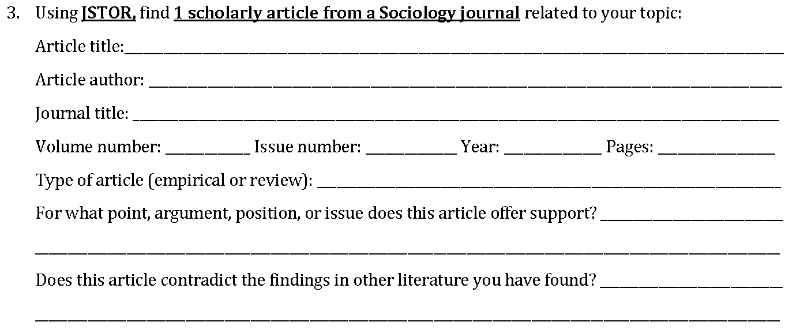
Library instruction
Scaffold, scaffold, scaffold

Slide 10
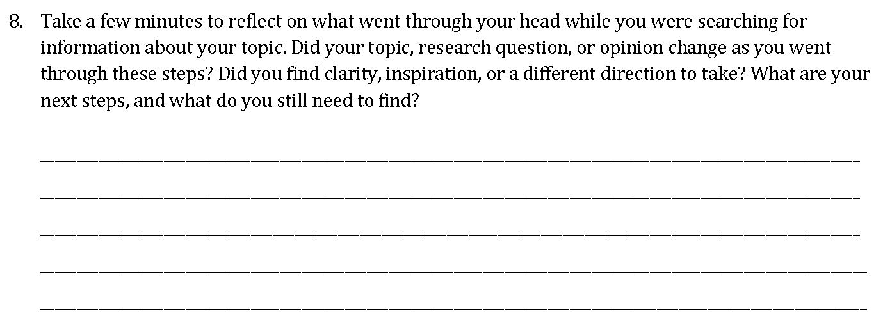
Library instruction
Reflect, reflect, reflect

Slide 11
iPads in the classroom
Bringing sociology into the classroom
  Finding peer-reviewed resources before the literature reviews
  Finding peer-reviewed resources during the peer-reviews
  Finding images for an example of content analysis

Slide 12
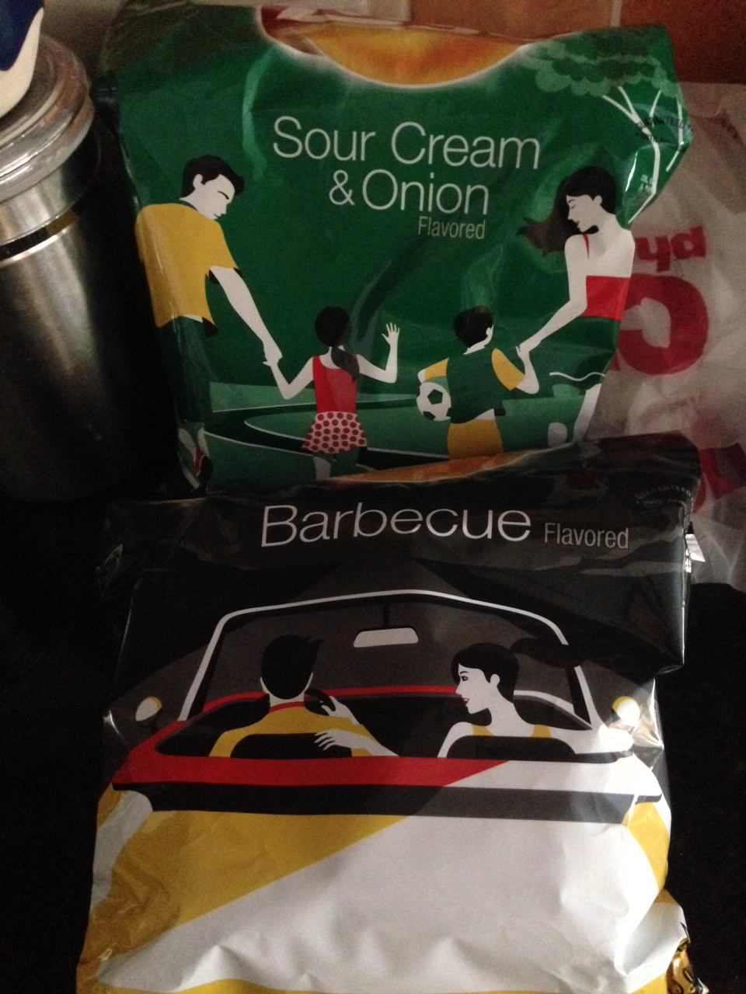
iPads in the classroom
Content analysis:
Each student finds one advertisement (for any product) that has humans in it
Describe 5 things you see in the ad
Write “field notes” on the board
Reflect on things we see in multiple ads
Fill out an “Analysis” worksheet

Slide 13
Analysis worksheet
This worksheet will help you outline your paragraphs. Each paragraph in your Analysis review will consist of one main point from your research. Your paragraph will start with the first sentence identifying one main idea you learned from your research, with the remaining sentences in your paragraph providing evidence or support for this main point by explaining two pieces of evidence.
*******First Main Point*******
(bold this sentence) During my fieldwork, something of sociological interest that I saw a couple times was…
______________________________________________________________________________________________________________________
Two examples from fieldwork that supports point 1:
1) For example, this one time… (give a specific example)
2) For a second example, this one time… (give a specific example)

Slide 14
Writing Worksheets and Grading Rubrics
Literature Review
************ First main point (1st paragraph)************
*** first main point should be why your topic is important WITHIN THE FIELD OF SOCIOLOGY**
(bold the sentence that completes this statement) I read a bunch of readings and many of them talk about how my topic is central to sociology in that…
___________________________________________________________________________
___________________________________________________________________________
Two examples from the peer-reviewed literature you’ve read that support point 1:
1) In one reading, the authors (all authors’ last names and the year of publication in parentheses. If you use quotes, add the page # too) explained…
2) In another reading, those authors (all authors’ last names and the year of publication in parentheses. If you use quotes, add the page # too) explained…

Slide 15
Writing Worksheets and Grading Rubrics
1st main point from your review of the literature is clearly written in first sentence of paragraph and support for it is convincing (__/5 pts)
*** first main point should be why your topic is important WITHIN THE FIELD OF SOCIOLOGY***
First example from your review of the literature that supports point 1 ( ____/ 5 points)
  Clearly and sufficiently described; does provide support for main point of paragraph.
Second example from your review of the literature that supports point 1 ( ____/ 5 points)
  Clearly and sufficiently described; does provide support for main point of paragraph.

Slide 16
Parallel writing
A week before students had sections of their papers due I would follow the worksheet and write the section for a paper I was drafting
Use the worksheet and the write-up as an example (typos and all in the first draft)
Talked about the experience (and pain) of writing on a deadline, getting lost in a literature review, and competing demands on my time

Slide 17
Peer review and revisions
Used the grading rubrics that were tied to the writing worksheets
Students struggled with providing constructive criticism instead of simply editing

Slide 18
Layers of assessment
First paper/last paper
Sociology department learning assessment
Students’ self-evaluations

Slide 19
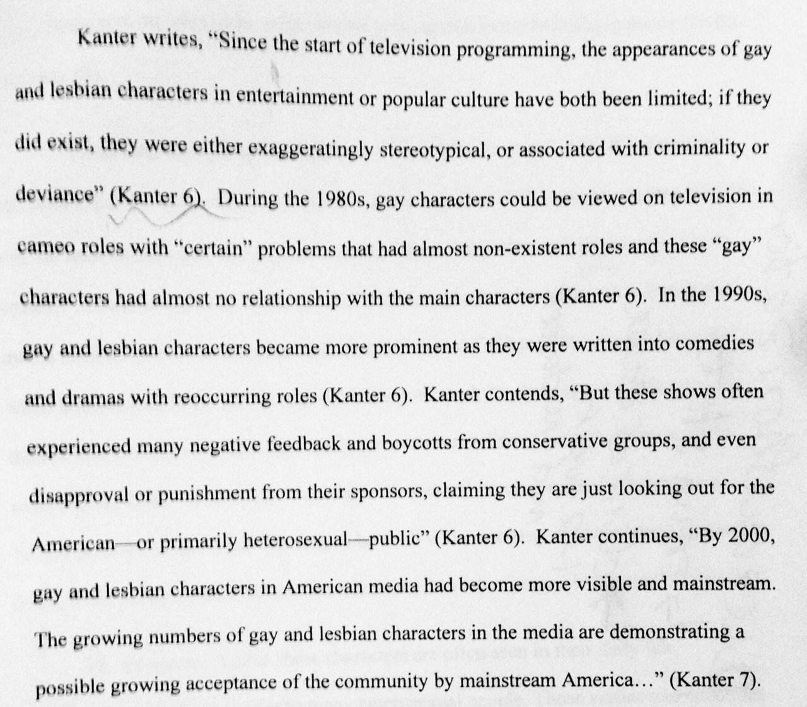
A look at first paper/last paper

Slide 20
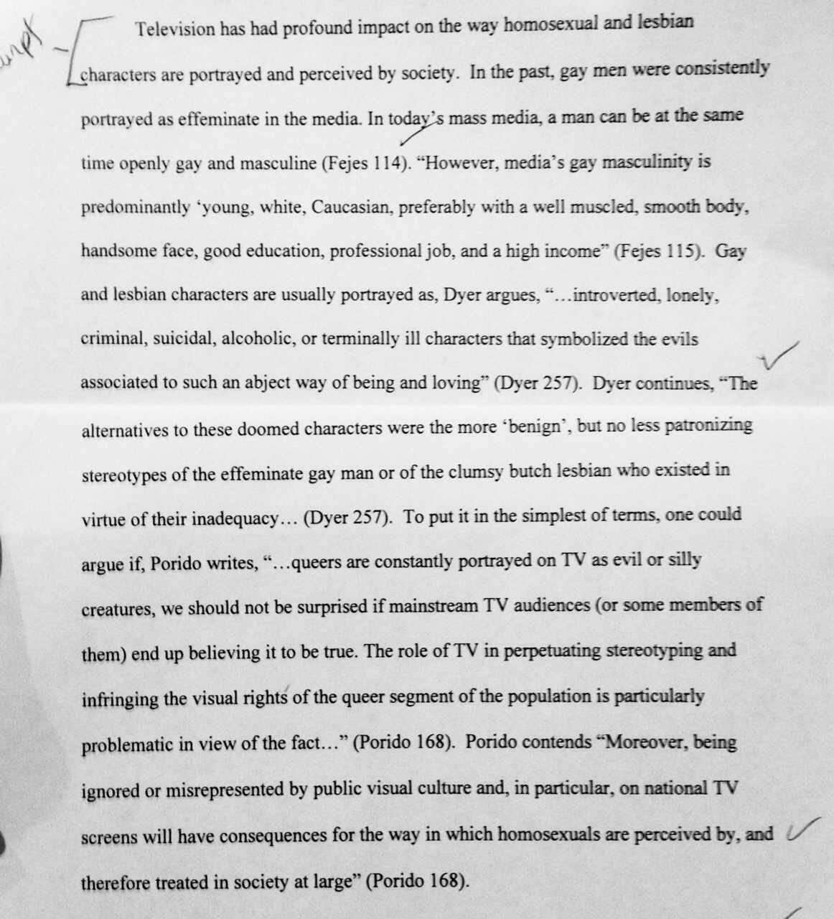
A look at first paper/last paper

Slide 21
Findings from Sociology Department’s assessment
(for 470)

Slide 22
Findings from Sociology department’s assessments
15-question pre- and post-test
Given at the beginning and end of semester
Concepts measured:
  Reading citations
  Identifying scholarly/popular sources
  Citing sources quoted in another source
  Efficient research strategies
  Identifying when a citation is needed
  Identifying appropriate paraphrasing

Slide 23
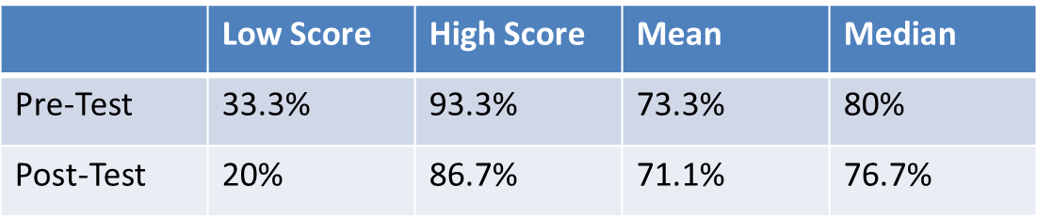
Findings from Sociology department’s assessments
Sociology Learning Assessment Results (SOCIOL 470)

Slide 24
Findings from Sociology department’s assessments
What students can do easily:
  Define paraphrase and plagiarism
  Identify when citations are needed
  Determine what types of sources are appropriate to use for research (e.g. Google vs. databases)
  Select effective keywords for a database search
  Explain the value of peer-reviewed sources

Slide 25
Findings from Sociology department’s assessments
What challenges students:
  Identifying peer-reviewed sources from a citation
  Citing sources quoted in another source
  Writing and identifying complete citations

Slide 26
Findings from Sociology department’s assessments
Some caveats:
  Students were graded on completion of the post-test, but not on their actual score. End-of-semester brain melt may be at play here.
  The library instruction sessions were more closely aligned with the goals of the research paper assignment than they were with the Sociology Learning Assessment instruments
  Were improvements noticed by the professor in the overall quality of sources used in the research papers and consistency of citation formatting?

Slide 27
Findings from students’ self-evaluations

Slide 28
Data
Participation voluntary, during class
Graduate course (11)
  Beginning of semester self-evaluation of sociological skills
  End of semester self-evaluation of sociological skills
  End of semester reflection of where skills were at beginning of semester
Senior seminar (19)
  Beginning of semester self-evaluation of sociological skills (reviewed but data not entered)
  End of semester self-evaluation of sociological skills
  End of semester reflection of where skills were at beginning of semester
  *issues with inconsistencies on 4 assessments
3 measures for grad students, 2 for undergrads
All analysis conducted in SPSS

Slide 29
Questionnaire
Please circle the extent to which you agree or disagree with the following statements: (5-pt scale)
I can find appropriate peer-reviewed resources.
I can communicate ideas effectively in writing.
I do not know how to write a literature review. (R)
I can cite sources using a standard format (examples: APA, MLA).
I can design the methods of a research project.
I cannot analyze data for a research project. (R)
I can draw conclusions based on data from a research project.
I am not always 100% certain how to avoid plagiarism. (R)
I can provide constructive feedback to a classmate on his or her paper.

Slide 30
Questionnaire
Now I would like for you to think about the process for writing your final paper. Please tell me the extent to which you agree or disagree with the following statements:
Sessions with the librarians improved my final paper.
Having access to the iPads to work on papers in class improved my final paper.
I learned from the worksheets on how to write each section of the paper.
Parallel writing improved my final paper.
I did not learn from making revisions to my final paper. (R)
In-class peer review of my paper did not improve my final paper. (R)
I learned from having the grading rubric in advance.
Professor’s comments on drafts of my paper did not improve my final paper. (R)

Slide 31
How did students feel their skills changed? (at post-test)

Slide 32
Self-assessment improvements for skills explicitly targeted: reflection vs final

Slide 33
Self-assessment improvements for skills not explicitly targeted: reflection vs final

Slide 34
Overestimation or underestimation?
Data from grad students suggests that students either:
  Overestimated their skills at the beginning of the semester or
  Overestimated the amount of change in their skills when reflecting on their pre-course skills.
    Papers suggest that they overestimated their skills
    But: “While on the other side it seems like I was at the same level as I came in at, I am not. At the beginning of the semester I thought I knew, but after taking this class I realize that I did not know at the beginning. Thank you” -Grad student

Slide 35
There were improvements. What helped?

Slide 36
What students say improved their final paper

Slide 37
What students say improved their final paper

Slide 38
What students say improved their final paper

Slide 39
What students say improved their final paper

Slide 40
What students say improved their final paper

Slide 41
What students say improved their final paper

Slide 42
What students say improved their final paper

Slide 43
What students say improved their final paper

Slide 44
which of these do students feel helped the most in terms of producing a high quality final paper?
Items ranked the highest:
58.6% said worksheets
34.5% said professor’s comments on drafts
24.1% said revisions
* Students were allowed to rank ties at all levels

Slide 45
Conclusions
Students’ skills improved in all areas, with dramatic improvements in literature reviews
All enhancements had at least 15% of students agreeing that it improved their final paper
Value of enhancements from earlier in the semester, such as library sessions and analysis example with the iPads, may be forgotten later in the semester
Many enhancements worked together
  iPads with a worksheet to learn how to do content analysis
  Worksheets with parallel writing as example of how I filled them out
Suspect that the value of the iPads differs on student income– many brought laptops in the classroom

Slide 46
Conclusions, Continued
Don’t make major program changes based on only one source of data
Think about what type of data is going to give you the best measure for what you’re trying to learn about your students
Try using multiple assessment methods to triangulate your findings
A “library visit” alone is not enough to help students reach higher levels of Bloom’s taxonomy in the research arena. How can we do “information literacy across the curriculum” and embed low-stakes practice opportunities in courses?

Slide 47
Discussion
  What assumptions do we make about student knowledge and skills, especially in upper-level courses?
  How do student confidence levels in their ability to complete a task affect their ability to complete that task?
  What is our role as educators in teaching self-confidence, empowerment, and autonomy in addition to teaching course content?
  What can different types of assessment (formative, summative, qualitative, quantitative, direct, indirect, etc.) tell us about what and how our students learn? Is one type or form of assessment better than another?

Slide 48
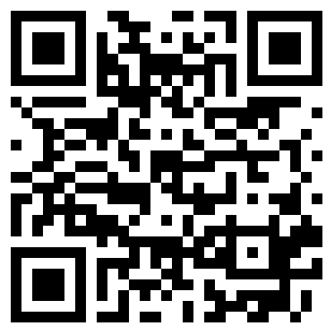
Give us Feedback
about this Session!
http://umb.li/UCTLT feedback
Are you excited about what you learned today?
Do you have ideas
for improvements?
Share your thoughts about this session with conference organizers and help
us understand what works best
for the future!

