Slide 1
RE-IMAGINING TRADITIONAL LIBRARY INSTRUCTION
STEVE BAUER, DIRECTOR OF THE RHETORIC PROGRAM
MARY MOSER, LEAD INSTRUCTIONAL SERVICES LIBRARIAN
KERRY ROURKE, RHETORIC FACULTY MEMBER AND DIRECTOR OF THE WRITING CENTER

Slide 2
Why change?
What words or images come to your mind when you hear the words “Library” or “Librarian”?
Libraries are changing dramatically!
Harvard’s Labrary (no, that’s not a typo)
Notes:
Steve: set context as Rhet admin. Why this presentation at this moment.
We should be open to ideas that come from others—faculty, librarians. This idea came from “below.”
Students used to think of library instruction as critical; students now may think they know how to search and don’t need librarians.
Change in libraries/library instruction--Images of past and present libraries
Harvard’s “Labrary”

Slide 3
We all need to improve and embrace opportunity
Faculty
Students
Librarians
All of us may think we have separate domains, but we need to re-imagine our domains as we think about knowledge production.
Notes:
Faculty—traditional view is of librarians as service people who come in and “do their thing”
Students– (sorry, Steve, I didn’t write what you said about students here)
Librarians—need to be teachers
Okay and even healthy to be dissatisfied with the status quo

Slide 4
What WORKED FOR US
Recognizing and expressing dissatisfaction with the status quo
Establishing and communicating that the Library matters
Collaborating
Modeling professionalism
Being brave! Embracing chaos and messiness
Empowering students to be scholars
Revealing our authentic selves
Recognizing that it takes work and maintenance
Continuously assessing!
PUT MAIN IDEAS HERE: BRAVERY, COMFORT WITH CHAOS, ETC. Need to make these parallel.
SLIDES THAT FOLLOW CAN EACH ADDRESS THESE WITH AN IMAGE
THIS SLIDE IS PREVIEW SLIDE
Notes:
Mary and I collaborate—show student responses to “new way” of doing this.
What were Mary and I’s objectives?
Did we achieve them?
Use images of Mary and students and screen shots from student assessment letters (may want to use some as handouts, too)
Our collaboration from both perspectives—narratives
Bullet points—map out

Slide 5
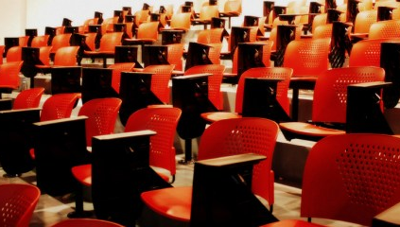
Dissatisfaction with the status quo

Slide 6
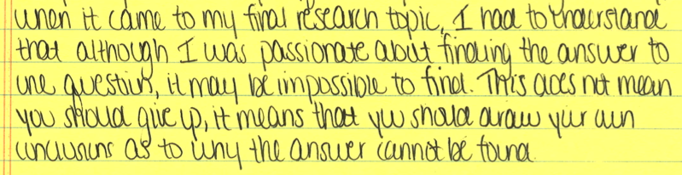
ESTABLISHING THAT THE LIBRARY MATTERS
Notes:
Library as more than a physical space. Harken back to slide about dynamic nature of libraries. Emphasizing to students that google isn’t everything—librarians are professionals with skills that faculty and students do not have.

Slide 7
COLLABORATION!
Mary and Kerry emailed and met throughout the process:
Kerry to Mary before we met: “What has not worked in past library sessions: lots of talking at students, low student involvement, prefab modes of instruction, too much time on scholarly vs. non-scholarly (I can cover that in class)”;
Kerry to Mary in our first face-to-face meeting: ““Are you okay if I jump in and ask a question? What about if I have to correct you in front of students?” “
Mary to Kerry after first meeting, before in-class session with students: “Here’s a blog post (written by a librarian) that talks through concept mapping (sometimes called knowledge mapping or mind mapping) as a process for knowledge management. It gives some examples and links to some resources. We can talk more about this at our meeting. This is just a bit of additional reading…for all your free time, and only if you’re interested!!!
Notes:
Other related words: partnership, communication.
This slide should actually have some of the emails that mary and I sent before working together. Save this photo for another slide.

Slide 8
More collaboration
Mary to Kerry after in-class session: “I’ve attached their feedback from today’s session. I always think it’s interesting to see what resonated with them, what didn’t, and what questions they still have. I’ll follow up individually with the ones who indicated they’d like additional help. In the meantime, however, if there’s anything else I can help with, don’t hesitate to ask! With other sections, I’ve started to work with them on the nuts and bolts of actually integrating sources into a paper, so I’m happy to do that for you and your students (or anything else about citing sources)—though I have a feeling you have that well in hand!”
Kerry to Mary after in-class session: “Thanks for teaching me a few tricks yesterday! Just when I think I have that library thing down...but it is so important for the students to see me learning, too, so it worked out well. As I said, I really want them to understand that librarians are professionals with valuable information to teach them, and I think you modelled that exquisitely yesterday.”

Slide 9
Modeling professionalism
I think we could cut this slide—I feel like it is covered elsewhere and doesn’t need its own slide

Slide 10
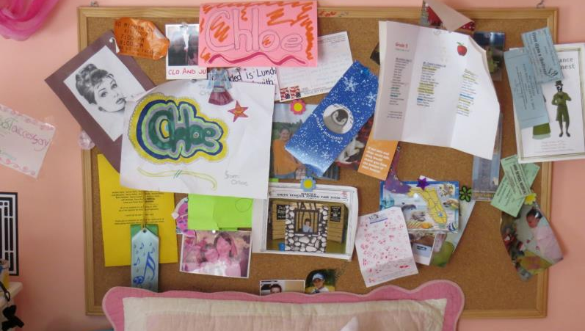
Bravery/Chaos/messiness
Notes:
Making mistakes in front of students
Willingness to allow multitasking in class
No need to “own” the conversation

Slide 11
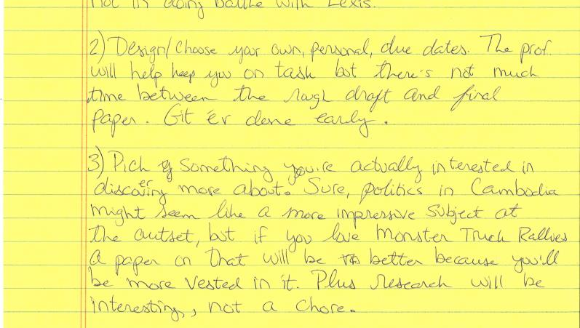
Empowering students

Slide 12
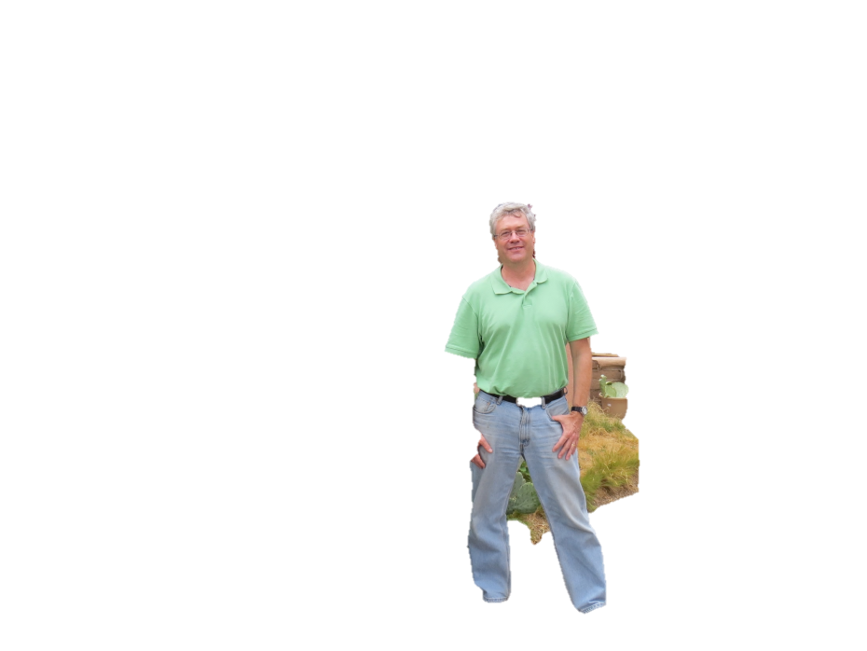
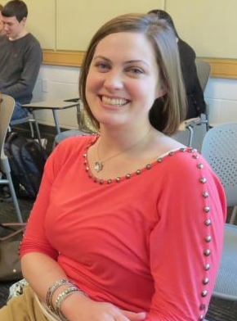
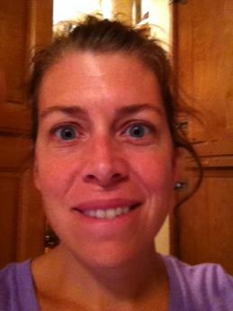
Revealing our authentic selves

Slide 13
Break the cycle!
This is what we do.
Wait, this isn’t working…
I’ve got an idea—let’s try it!
Hey, this works!
Notes:
This is a model of library instruction—want to caution audience members to never become complacent. A reminder that this takes work and maintenance.

Slide 14
LET’S SEE WHAT IT MIGHT LOOK LIKE
TELL US A TOPIC THAT YOU ARE INTERESTED IN RIGHT NOW
FRAME IT AS A QUESTION

Slide 15
The library survey—finding out what we need
We surveyed our Rhet faculty (3 of us collaborated)
All faculty think that it is critical to do library sessions
All faculty ranked “what is important to teach” differently
Excerpts/screen shots—need to decide which ones.
Faculty think current library instruction is effective—we disagree; it can be better (note that Ellen Argyros’ response rated the session as very effective but also conceded that students, when quizzed, didn’t understand what WorldCat was)
Having time to correct papers in the back of the classroom doesn’t make it an effective session (free work day!)

Slide 16
Steve sets up Q&A
Conclusion—proposal questions
What fresh possibilities do you see in how faculty, students and librarians can disturb preconceived ideas about research, libraries, and the work of knowledge creation?
How do you talk about the librarian to your students? Is he/she a “guest lecturer”? Applause (implies “other”). Queering the language.
We should be open to ideas that come from others—faculty, librarians. This idea came from “below.” What great ideas are there that we don’t even know about? What great ideas can we get from our students (surveying, assessing)?
How do we identify our domains and responsibilities. Challenge the “that’s the librarian’s job.” Giving up control of teaching.

Slide 17
Workbook
What it is and how to use it.

