Slide 1

What Makes Strong Communities in Digital Humanities Projects
Margaret Heller | Loyola University Chicago | @margaret_heller
Chicago Colloquium on Digital Humanities and Computer Science
November 9, 2019
Notes:
-Work with DH projects hosted by the library/others
-Teach in the DH MA program
-will present my research, and then a short description of how this works in a DH project I currently support

Slide 2
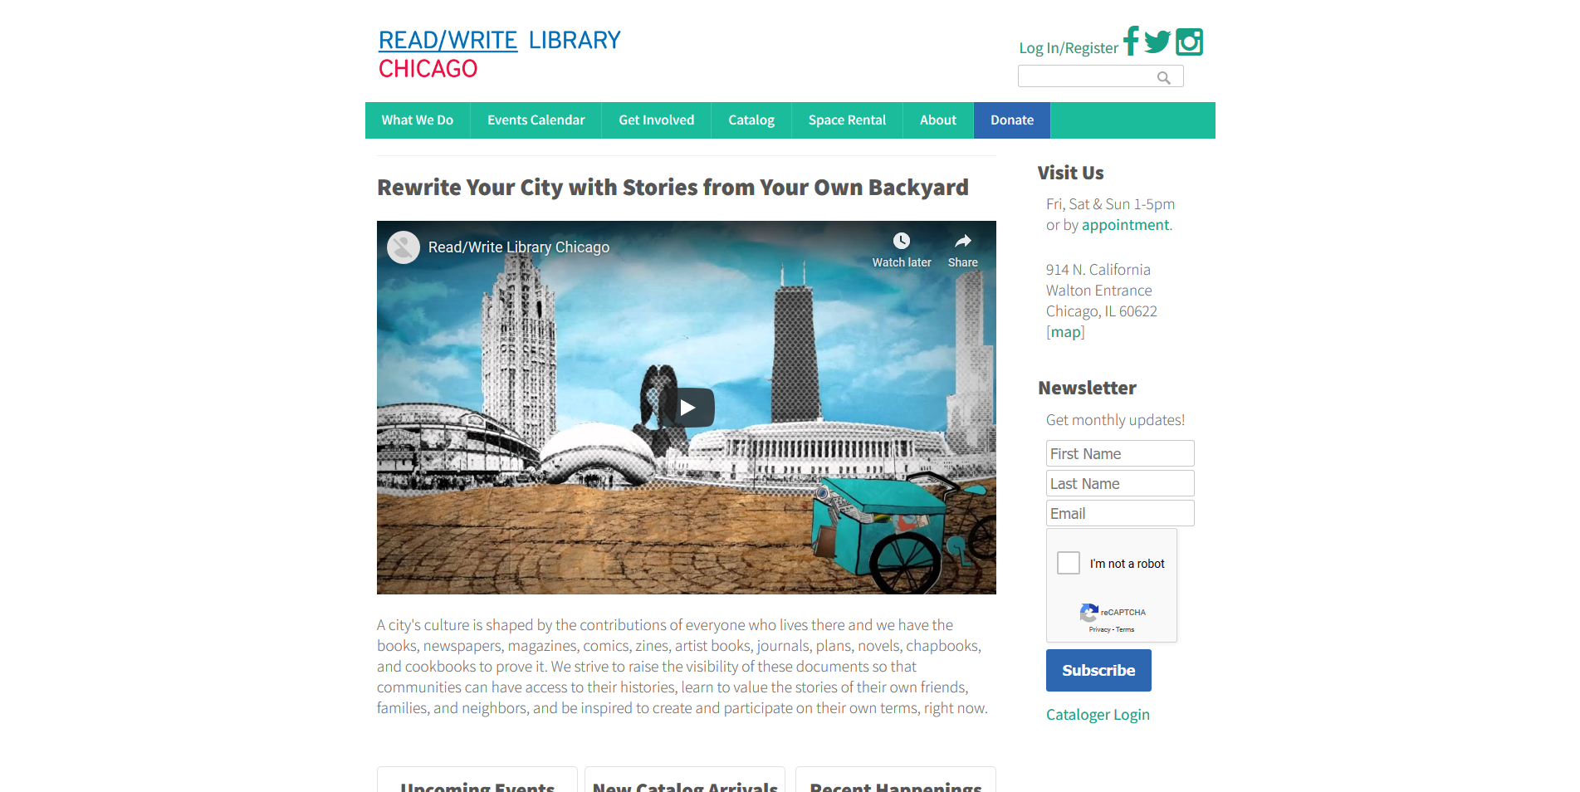
Notes:
I first became introduced to community projects and digital humanities through my work with the Read/Write Library Chicago. If you happened to attend this conference in 2010 you might have seen the poster that I presented with Nell Taylor, the founder of the library, which was known as the Chicago Underground Library at that time. The experience of helping to build a successful grassroots community library that helped to link disparate artistic communities in Chicago has helped me throughout my career as I have become involved with more technical communities. I have always paid attention to what makes communities work.

Slide 3
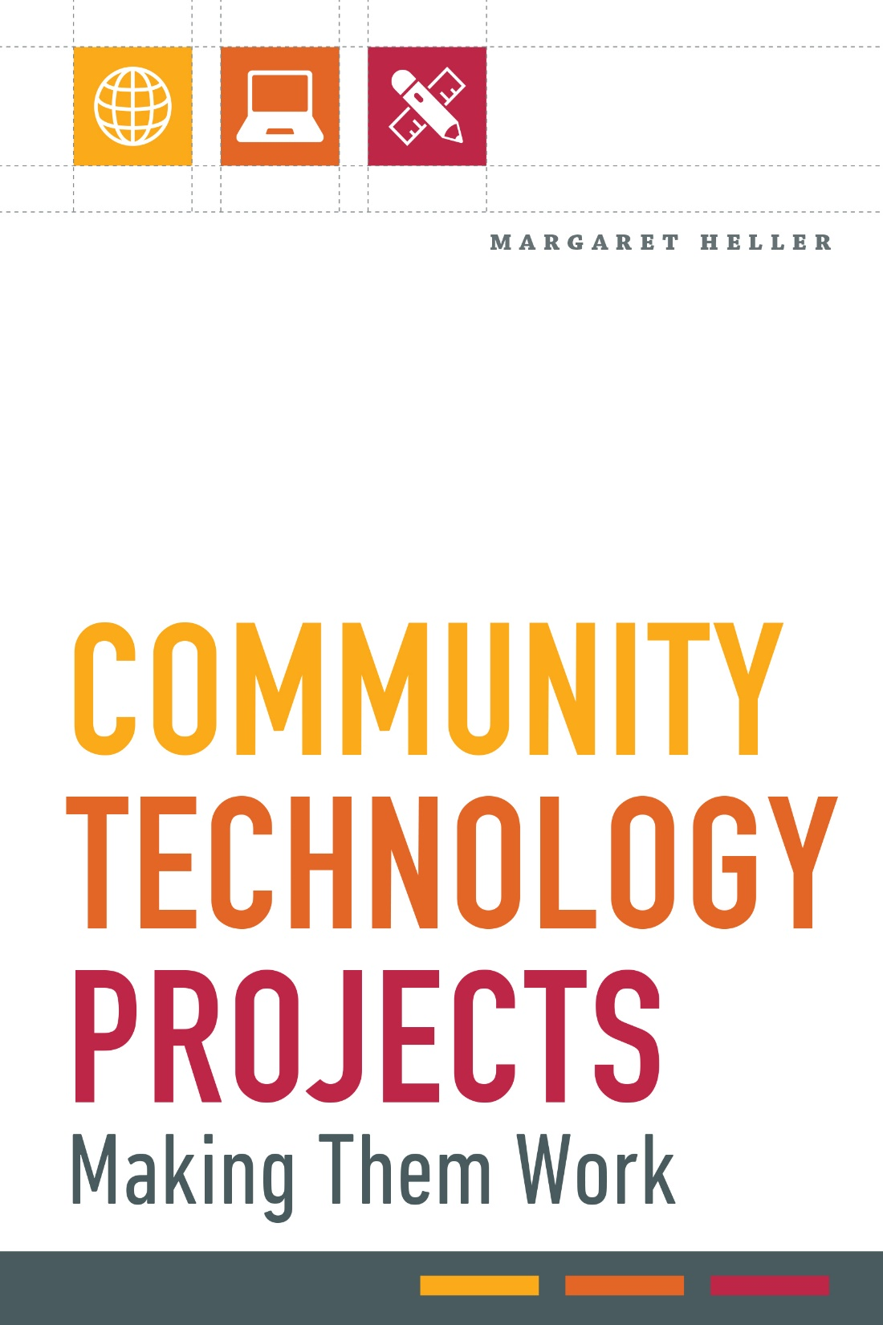
Research Background
Notes:
A few years ago, I started wondering if there were specific traits in library software development communities that would help predict whether the project would eventually go commercial or stay open source. In trying to figure out that, I realized that a lot of assumptions I had about what makes successful projects weren’t necessarily true. I assumed that you had to have lots of funding, a lot of strong development expertise, and a fancy institution. It turned out that this wasn’t true. These were neither sufficient nor necessary for success. So I started looking at a number of library technology and digital humanities projects. I found that projects that were more successful worked hard at building communities and understanding their communities. I then researched what makes strong technology communities. All of this ended up in a book I published last year that is meant for practitioners, managers, and funders in the library technology area. I think DH projects are a really important part of this.

Slide 4
Landscape of DH Communities
Notes:
What are community projects? I use the word community somewhat loosely to refer to any project that involves groups of people from multiple areas working on a shared goal. There are a variety of ways you could break this down, but I am going to give three overarching categories that I think make sense for digital humanities.

Slide 5


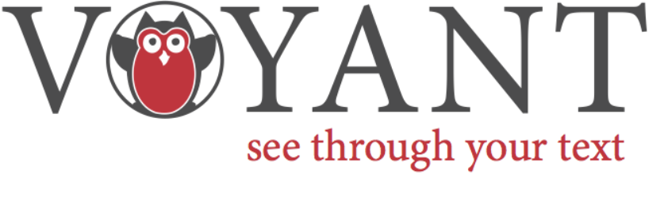

Distributed Development/Open Source Software
Notes:
This is the type of project that most people think of most likely when they think of community projects, and they certainly are that, though only part of the story. These are the tools we use to make our projects. I want to emphasize that this is about the community model, not the software license a particular tool uses. Projects can range from large communities that have some sort of financial infrastructure and formal governance, to small tools that help people do a job but probably have a very small developer base. The large tools are perhaps more likely to stay active because so many people rely on them, but this makes managing the community and bringing in new talent more challenging. Such tools are likely to be able to monetize themselves in some way. Small tools may face the same problem, and if too much of the knowledge belongs to one or two people, the tool will likely wither without a community, but it might be easier to recruit a stron small user base.

Slide 6
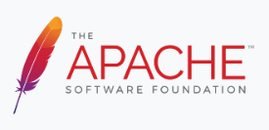

Associations and Consortiums
Notes:
Associations and consortiums form to formalize technical partnerships or discussions. They are instrumental to digital humanities work because they allow institutions to share resources, and have the potential to solve larger problems. The challenge with these groups is that while they are often founded with a specific problem in mind, as needs shift they have to be able to shift with it. Note the merger between Lyrasis and Duraspace—these associations formed for completely different historical reasons, but shifting needs over time brought them close enough it finally made sense to merge, though on the second try.

Slide 7
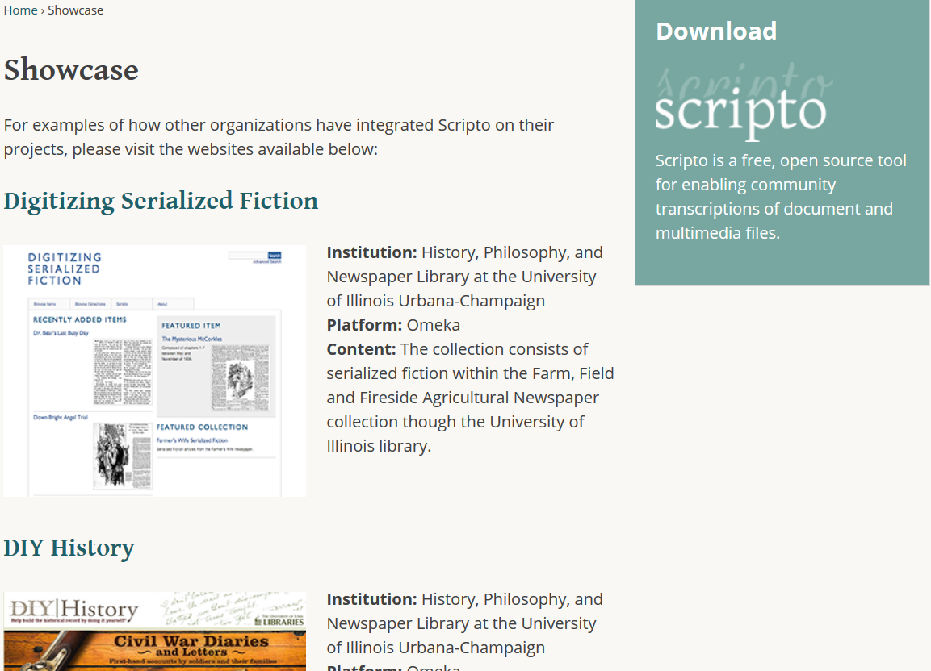
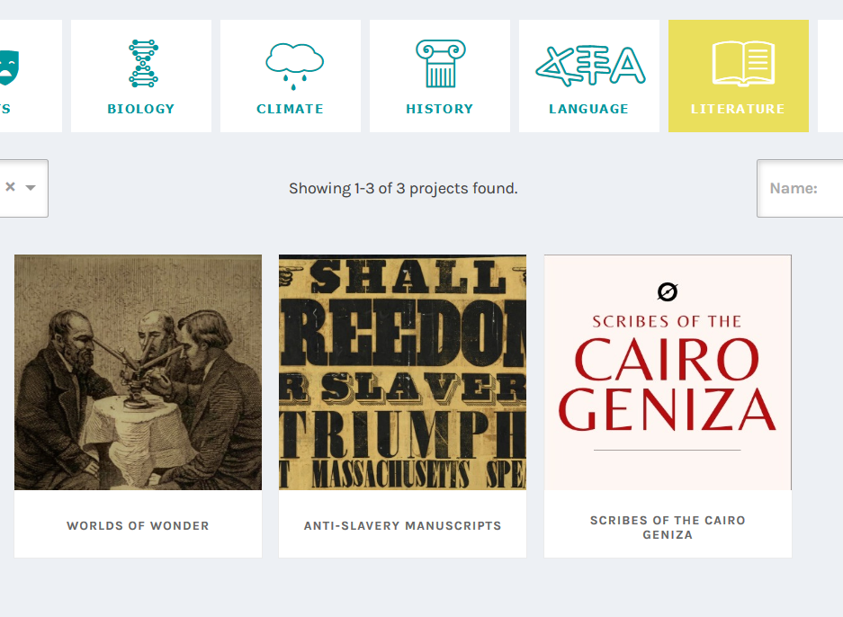
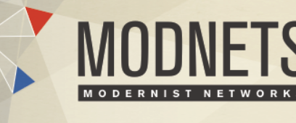
Collaborative Research Projects
Notes:
Digital humanities research projects often start from an individual or a center, but making a digital humanities research project sustainable requires building networks of help, expertise, and users. Projects that rely on crowdsourcing or volunteers must keep community management the highest priority. Even if the actual work remains with an individual institution, if no one uses the research and expands upon it, the work is less likely to survive. (Describe the projects)

Slide 8
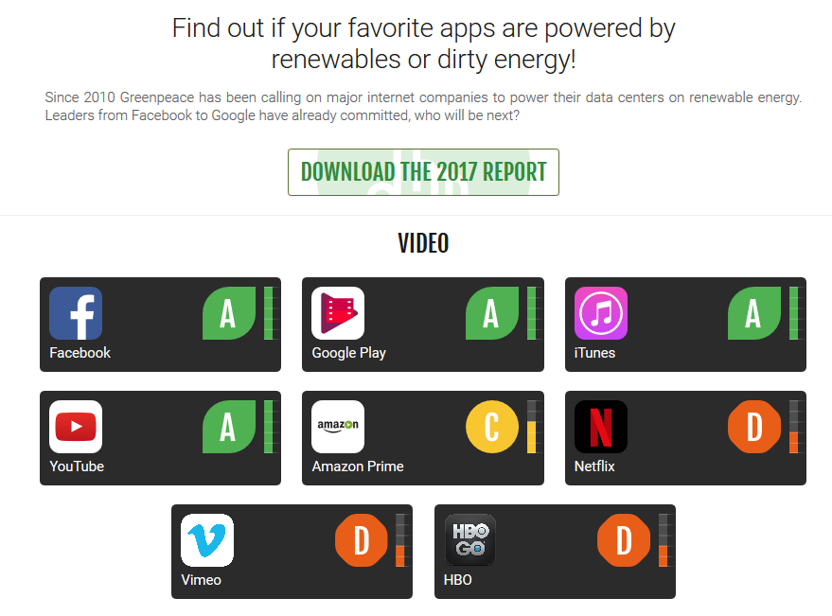

Sustainability
Financial
  Hosted Services
  Memberships
  Byproducts (like DOIs)
Environmental
Labor
Notes:
Many DH projects do start out with funding from grants or institutions, “the overarching achievement of successful projects is that they benefit their members enough to secure funding past the initial start-up phase. The benefits mean that participating institutions or individuals receive infrastructure or a new tool they could never have developed on their own, or for a lower cost than a commercial service.” This does not necessarily help out research projects that rely on on-going funding for infrastructure and will never charge access fees. Funding models exist for spinning off part of the work to be commercially viable (for instance, Omeka and Zotero offer hosting services), or for membership models. And the costs to the environment and the workers on the project cannot be ignored.

Slide 9
Making Strong Communities
Notes:
The people in communities are its most important asset. How can they be supported, particularly if they are unpaid?

Slide 10

Be Wary of Hacker Ideology
Notes:
Open source software development provides a model for volunteer technical engagement, but it’s important to approach this with historical context and caution, though a lot of good comes out of open source culture.
The hacker ideology is a concept described by Eric Raymond in his 1999 book The Cathedral and the Bazaar. He argues that open source developers, or hackers, operate in a gift economy. In this economy, your individual reputation is your reward. You are invited into greater participation in a community as recognition of what you have given to that community. There are some good and important outcomes of this ideology. It encourages individuals to share their own half-finished solutions to a problem they experienced to get help from the community. It invites respect for thanking people and noting their work. But I do not find the hacker ideology a good basis for creating strong communities. There is exclusivity built into the process by design. Culture, too, is a problem. I often point out that the only pronoun Raymond ever uses is “he”. This situation has improved only slightly in the past 20 years, with a 2017 GitHub survey finding that 95% of contributors identify as men.
Star institutions and developers are not a panacea. We know that the people and institutions we have admired are often hiding predators in plain sight. MIT is certainly the most notable recent example: the scandal of Jeffrey Epstein anonymously funding the Media lab, among other smaller scandals, and the resignation of Free Software Foundation founder Richard Stallman. I think this is yet more proof of what I suggest in my book about what makes strong communities.
“Having star members or institutions may be helpful in securing funding but can hurt the project in the long term if this causes the community to lean too much on these for institutional memory and identity. Developing community means shaping the perception that everyone can contribute by facilitating that ability. This includes recruiting new voices and perspectives by helping people who do not see themselves as capable of participating in technology communities to feel comfortable.”

Slide 11
Volunteer Motivations
Values. Expressing altruistic feelings
Understanding. Learning new skills that cannot be acquired elsewhere
Social. Spending time with others
Career. Believing that skills gained by volunteering will help with career
aspirations
Protective. Shielding the ego from negative self-perception or alleviating
guilt about privilege
Enhancement. Building on positive self-perceptions.
(Clary et al. 1998, 1518)
Notes:
I find a more positive place to look for how to motivate participants in communities is in business psychology, where researchers have tried to understand what motivates volunteers to begin and continue volunteering. Starting in the mid-90s a research team headed by Gil Clary and Mark Snyder developed a functional model called the Volunteer Functional Inventory, which groups the psychological motivations for volunteerism. They are:
People whose volunteering fulfills these motivations will keep doing the work. Other research groups have expanded or contracted the number of motivations, but the essential finding is the same: if you can discern the motivations of your community and meet those needs, you will have more engaged participants.

Slide 12

Understanding Motivation
Notes:
What does motivation look like in DH communities? It’s not always easy to know what your community needs and to provide it to them. Having a person or group dedicated to community management is the critical component in making strong communities. The community manager is the one who understands how the community works, what it wants, and how to get them what it needs. They can use research methods such as focus groups, surveys, or ethnographies, and communicate findings through tools such as personas. HathiTrust is one example of a project with personas for their community that other projects have adapted.
One caveat that is particularly important to digital humanities is that participants are likely to feel pressure to participate for career motivations, and therefore are doing unpaid labor with the hope of future employment from it. This pressure comes in equal measure from open source culture and academic culture. In addition, “Crowdsourcing projects give the veneer of gamification to what is essentially unpaid digital labor.” The problem here is that this means that people who would have wanted to participate but couldn’t work for free are excluded. Thinking about ways to include, and recognize, this community is important to understanding the whole picture.
One way to think about this is in Bethany Nowviskie’s contextualization of the phrase “less yack, more hack.” While it smacks of hacker ideology, she points out that the real origin of this phrase came from THATCamp and was a commentary on the nature of academic conferences, which tended to reinforce norms rather than allow for new forms of scholarly engagement promised by digital humanities. But she also points out that it illuminates a divide that can make some people feel second-class in a DH project—the people doing the work, and the people who get public accolades for directing the project—are not always the same people.

Slide 13


Volunteer Engagement
Task Support
Emotion-Oriented Support
Help with installing the tool or product
Help with getting involved in the development
Getting unstuck technically
Help with understanding the problem the tool solves
Help getting involved with the community
Social interactions
Getting unstuck politically/socially
Notes:
I like the model for volunteer engagement proposed by Kerstin Alfes, Amanda Shantz, and Catherine Bailey in their 2016 paper. They emphasize that you can support volunteers by providing task support and emotion-oriented support. Volunteers who get support in both areas will feel more engaged, and this support can also fulfill their motivations.

Slide 14
Engagement Techniques for DH Projects
 | Task Support | Emotional Support
What is happening with the project | Detailed documentation and/or a wiki | Blog with news about the project
What kinds of work/conversations are happening | Open code on GitHub or another repository | Social media channels or other forum
Cultural expectations | Clear expectations for process | Code of conduct
Ability to have conversations | Technical mailing list or chat/Slack | General mailing list/Slack
Decision-making opportunities | Technical development calls or meetings | User groups or conferences
Notes:
In my research, I found that the more of the types of supports offered in both areas, the more successful the project. Projects that look like they have the elements of success, but don’t have an easy way to get in and stay in aren’t going to be as successful. In Quinn Dombrowski’s “Whatever Happened to Project Bamboo?” she points out that one of the issues that could be seen as minor, but was illustrative of larger problems, what that no one updated the Project Bamboo blog for 18 months. Coupled with unclear expectations and non-transparent project progress, this made it difficult for people to feel part of a whole among disparate groups in Project Bamboo.

Slide 15
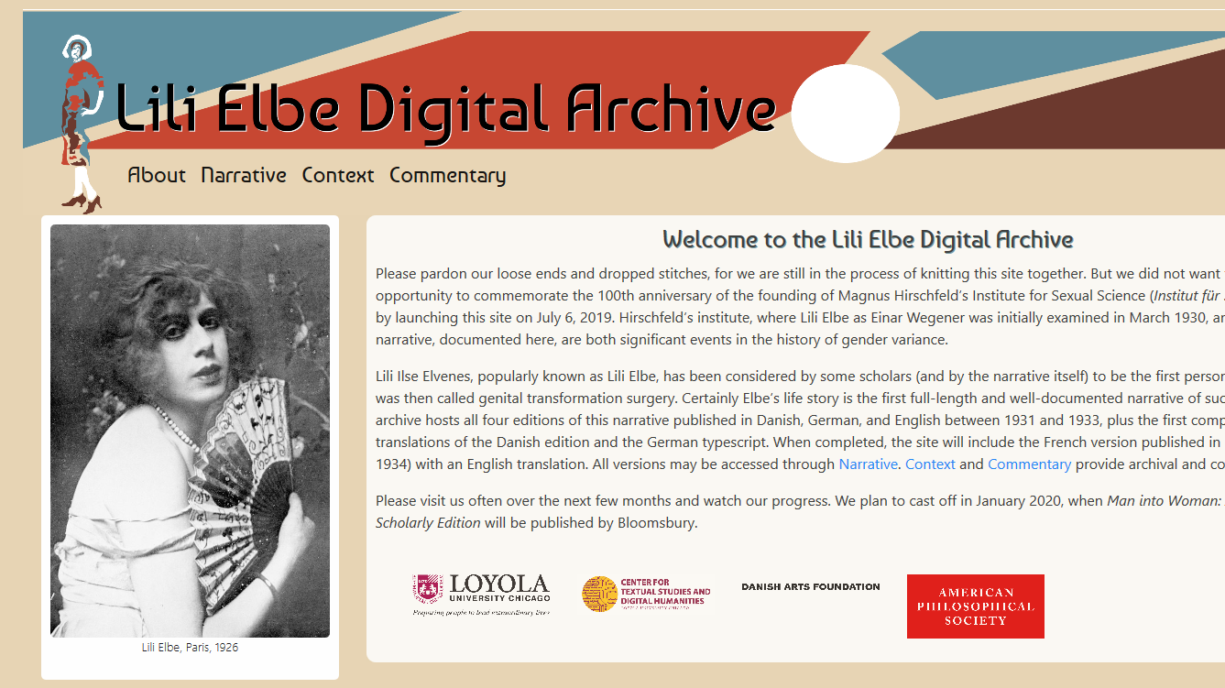
Case Study
lilielbe.org
Notes:
I will now give a current example, based on the Lili Elbe Digital Archive is the first digital edition of the four editions of Lili Elbe’s story of her life, as well as useful contextual material and commentary. I have worked with this project for a number of years now, right now in a technical capacity maintaining the site on the LUC library servers. This project has very limited funding, and is really a labor of love for the many people who work on it.
Thanks to Emily Datskou for these statistics:
Directors, Dr. Pamela Caughie and Dr. Sabine Meyer
Digital Editors, Dr. Nick Wasmoen, University at Buffalo and Rebecca J. Parker
Project Manager, Emily Datskou
Undergrad Volunteers
11 undergraduates from Loyola and other schools in the Chicago area like University of Chicago and DePaul
Graduate Volunteers
9 graduate students from Loyola
Faculty and Staff
11 faculty and staff
LUC library staff
Faculty members in Copenhagen and Berlin
Staff from international archives
Engagement of undergraduate students in particular is key to this project. The project is structured to work with engaged learning classes, as well as volunteers, and their work is truly part of the project. They are invited to make it their own, and to be partners in the work.
However, such a complex project with such a limited staff, spread across the US and the world, does fall into disarray from time to time. For example, it is absolutely critical for people to scrupulously use the Git repository while they are working, and problems have occurred when that doesn’t happen. Documentation could use some work. The library has agreed to maintain the project long term, but we haven’t always understood all the technical infrastructure or agreed with the choices. Despite this, people feel a desire to ensure Lili’s story is available, and this motivation is enough to keep the team engaged.

Slide 16
Selected Bibliography
Alfes, Kerstin, Amanda Shantz, and Catherine Bailey. 2016. “Enhancing Volunteer Engagement to Achieve Desirable Outcomes: What Can Non-Profit Employers Do?” VOLUNTAS: International Journal of Voluntary and Nonprofit Organizations 27 (2): 595–617. https://doi.org/10.1007/s11266-015-9601-3.
Clary, E. Gil, Mark Snyder, Robert D. Ridge, John Copeland, Arthur A. Stukas, Julie Haugen, and Peter Miene. 1998. “Understanding and Assessing the Motivations of Volunteers: A Functional Approach.” Journal of Personality and Social Psychology 74 (6): 1516–30. https://doi.org/10.1037/0022-3514.74.6.1516.
Datskou, Emily. 2018. “The Evolution of Digitizing Lili Elbe's Man Into Woman.” From Evidence to Scholarship: Collaborating to Transform Undergraduate Research, March 2018, Reed College, OR.
Dombrowski, Quinn. 2014. “What Ever Happened to Project Bamboo?” Literary and Linguistic Computing 29 (3): 326–39. https://doi.org/10.1093/llc/fqu026.
Lee, Timothy. 2019. ArsTechnica. https://arstechnica.com/tech-policy/2019/09/richard-stallman-leaves-mit-after-controversial-remarks-on-rape/
Nowviskie, Bethany. 2014. http://nowviskie.org/2014/on-the-origin-of-hack-and-yack/

