Slide 1
LibQUAL+ 2019
Internal Presentation of Findings

Slide 2
LibQUAL+ Crash Course

Slide 3
The LibQUAL (LQ) survey measures user expectations and how well the library is fulfilling them.​
​
The survey instrument hasn’t changed in years, allow us to track user satisfaction over time.​

Slide 4
3 Dimensions studied
Affect of Service (AS), the people element​
  Attentiveness​
  Helpfulness​
  Dependability​
Information Control (IC), the “stuff” of the library​
  Print and electronic resources​
  Website​
  Equipment (printers, scanners, etc.)​
Library as Place (LP), the environment itself​
  Individual and Group Study Space​
  Noise​
  Comfort​

Slide 5
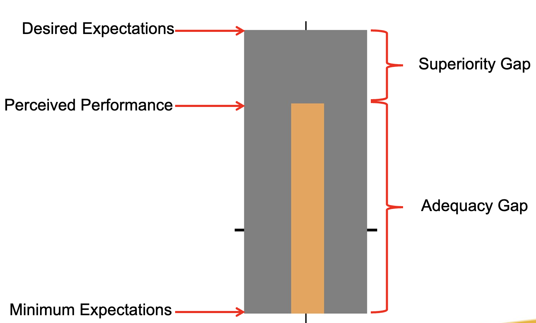
What is a thermometer chart?

Slide 6
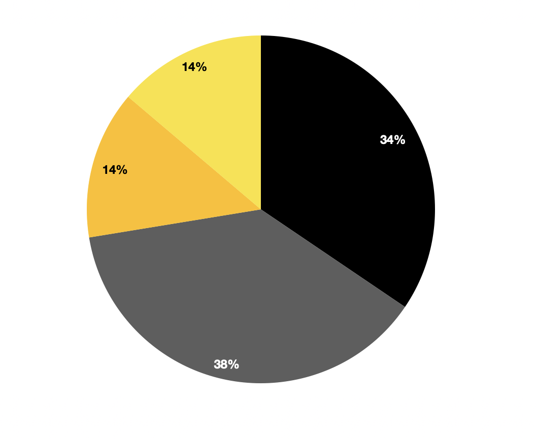
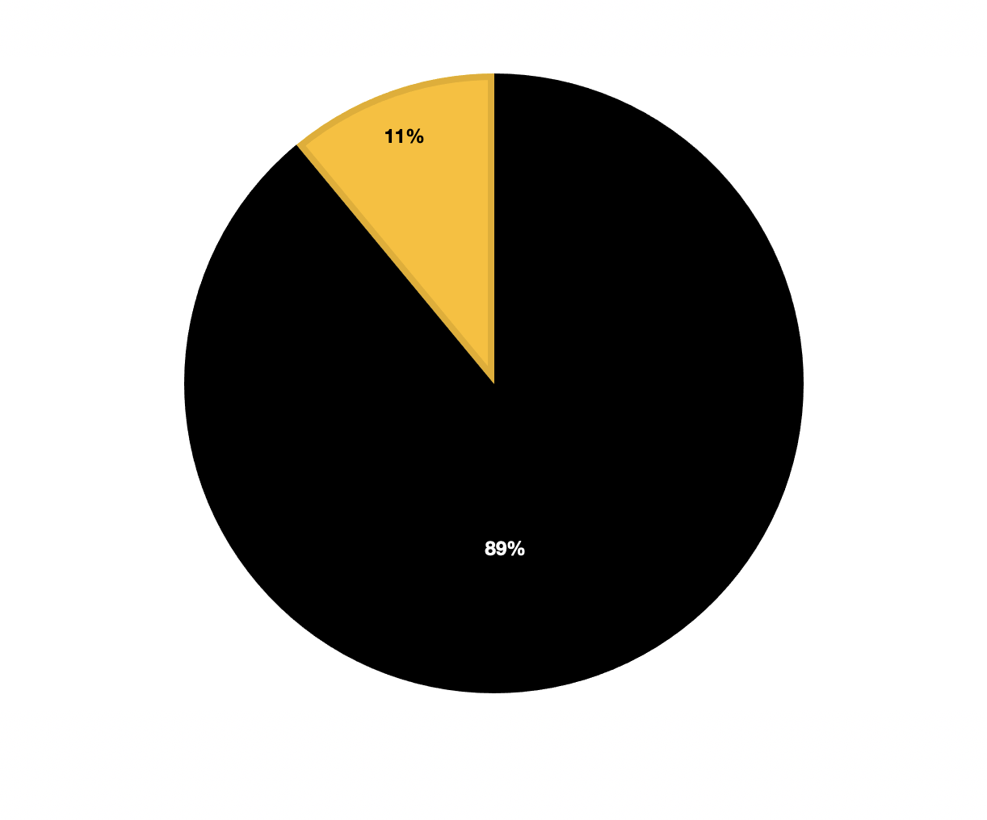
Who Responded?
We had 474 total respondents to the survey this year
Library Staff
89% of responders were undergraduate students
Faculty
Staff
Other
Of the 11% other, most responders were graduate students followed closely by faculty then staff and library staff.
Graduate Students
Undergraduate Students

Slide 7
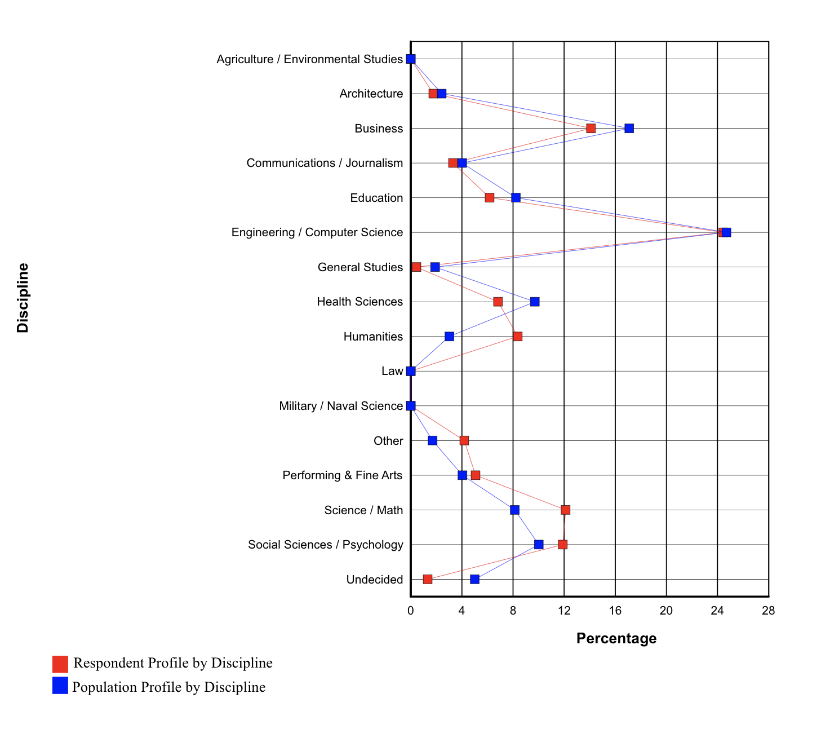
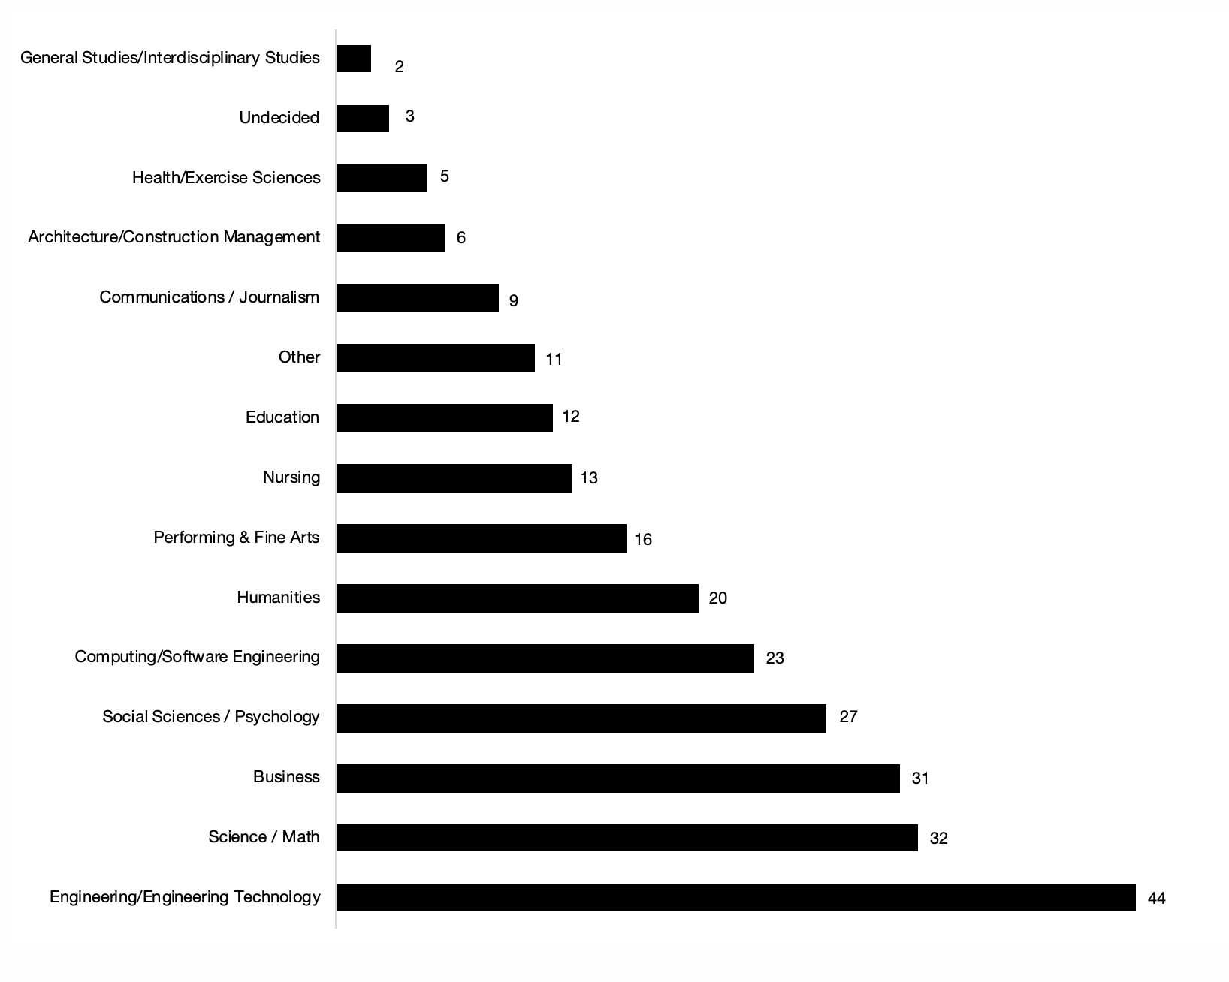
Who Responded?
A large number of respondents came from the Engineering field, in line with the discipline percentages of the university.

Slide 8
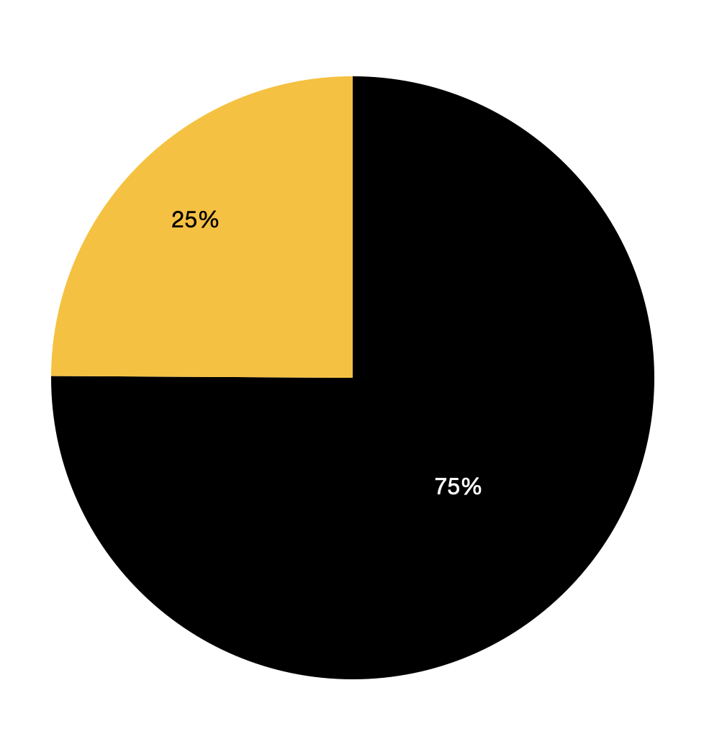
Who Responded
Johnson Library
The respondents split exactly 25% from the Johnson Library on the Marietta campus and 75% from the Sturgis Library on the Kennesaw Campus.
Sturgis Library

Slide 9
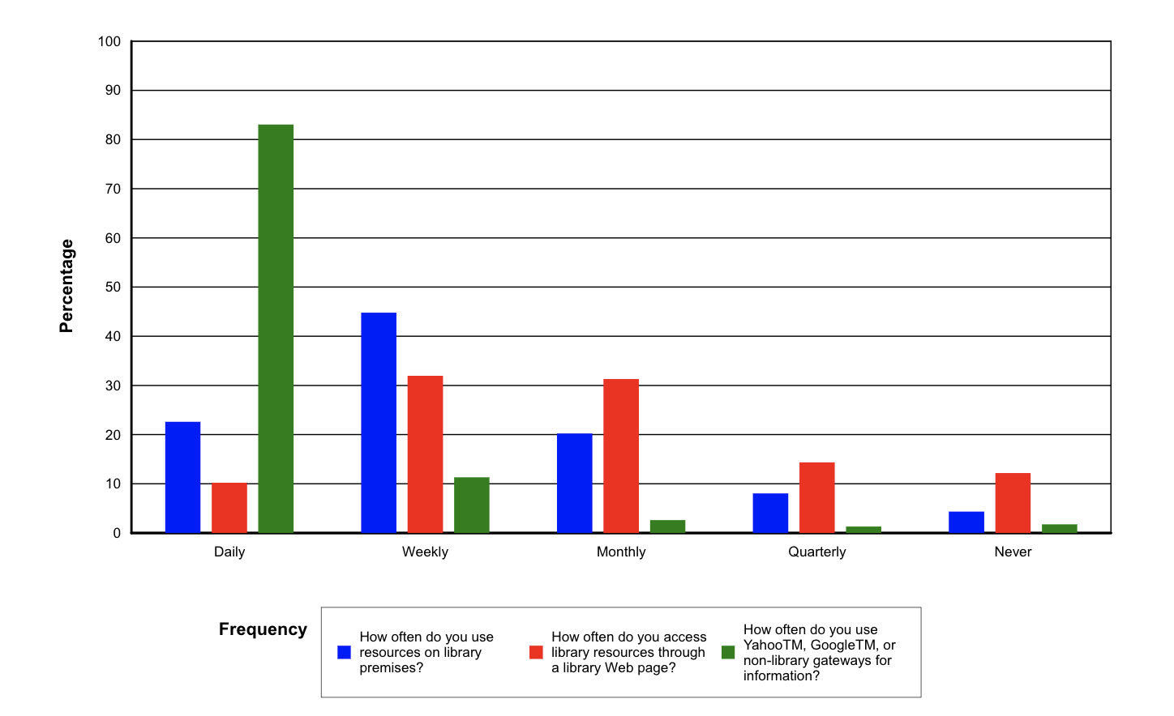
Library Usage in General
Generally, the library website is used monthly while the libraries are used physically weekly

Slide 10
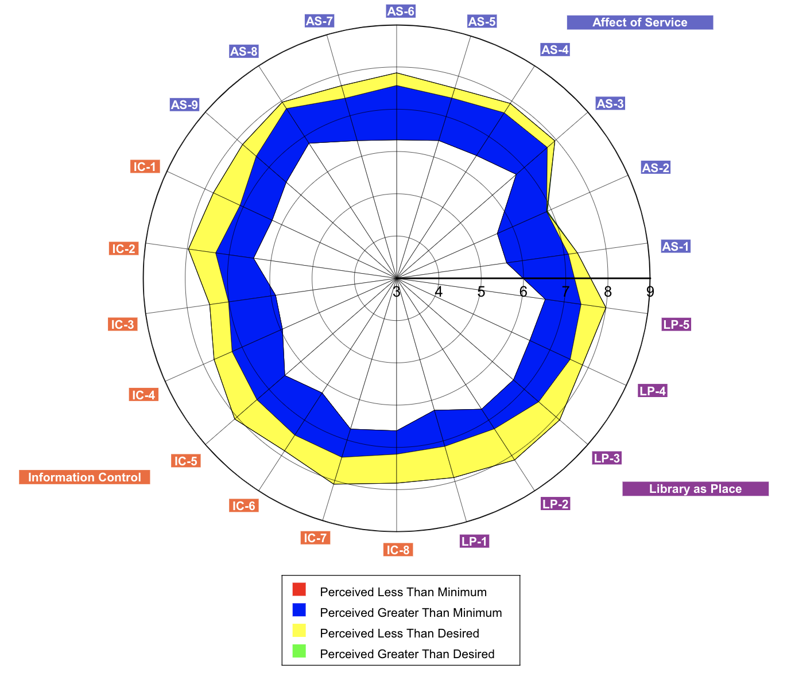
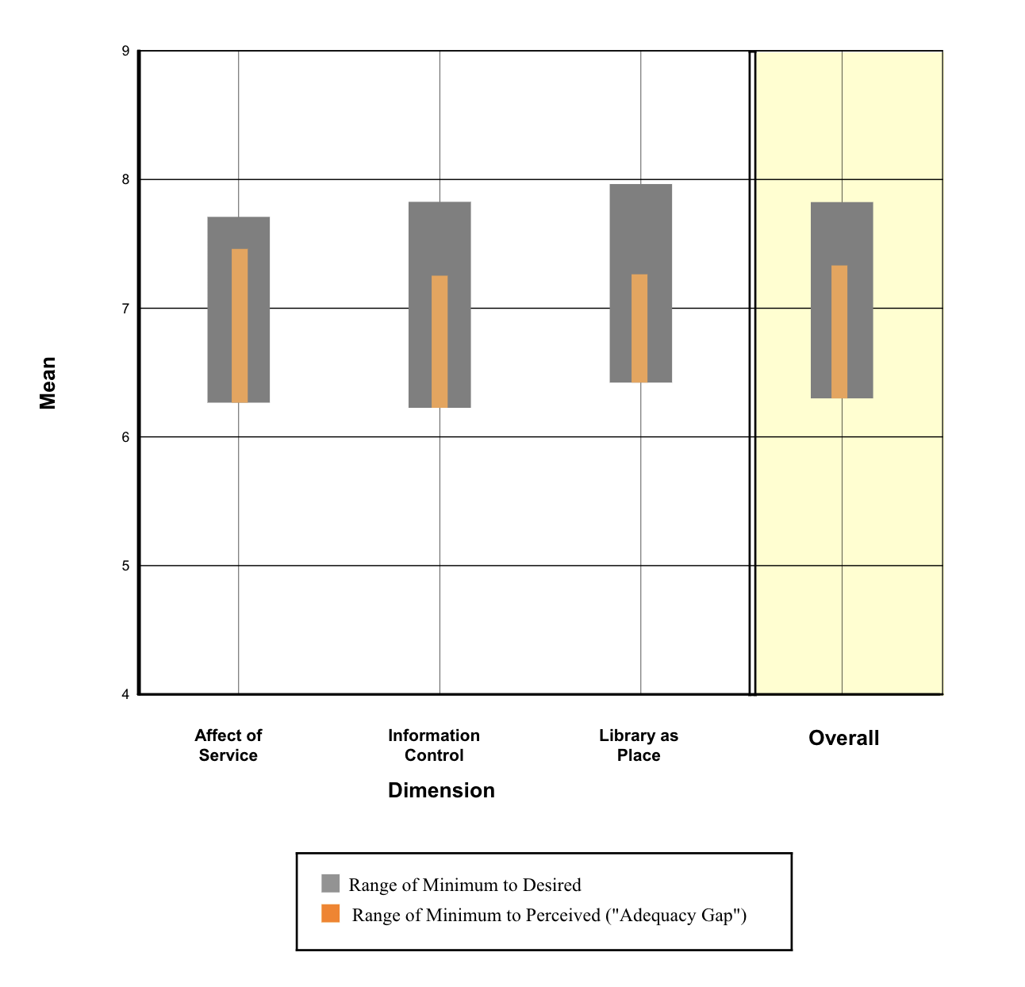
Core Question Summary
Generally, the libraries performed favorably in nearly all areas: Information control, Service, and Library as a Place

Slide 11
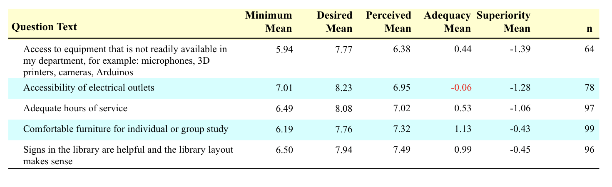
Optional Questions Summary
The KSU Libraries were allowed 5 optional questions
Accessibility to electrical outlets showed the most desired for improvement, followed by equipment not available in departments
Comfortable furniture and library signage scored the highest
Note of interest: The adequate hours of service had an adequacy mean of .53

Slide 12
Undergraduate Students

Slide 13
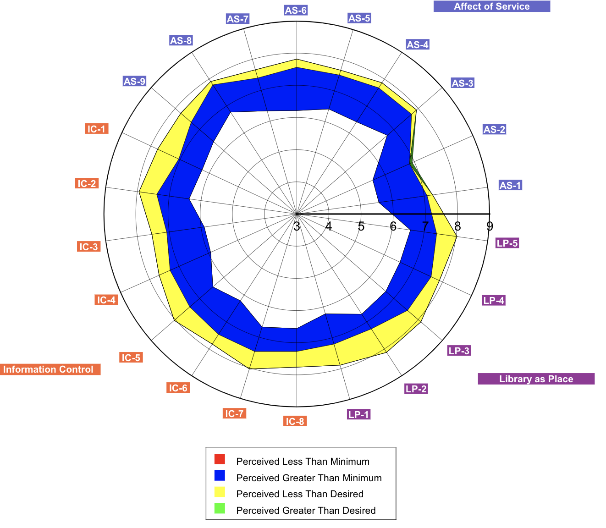
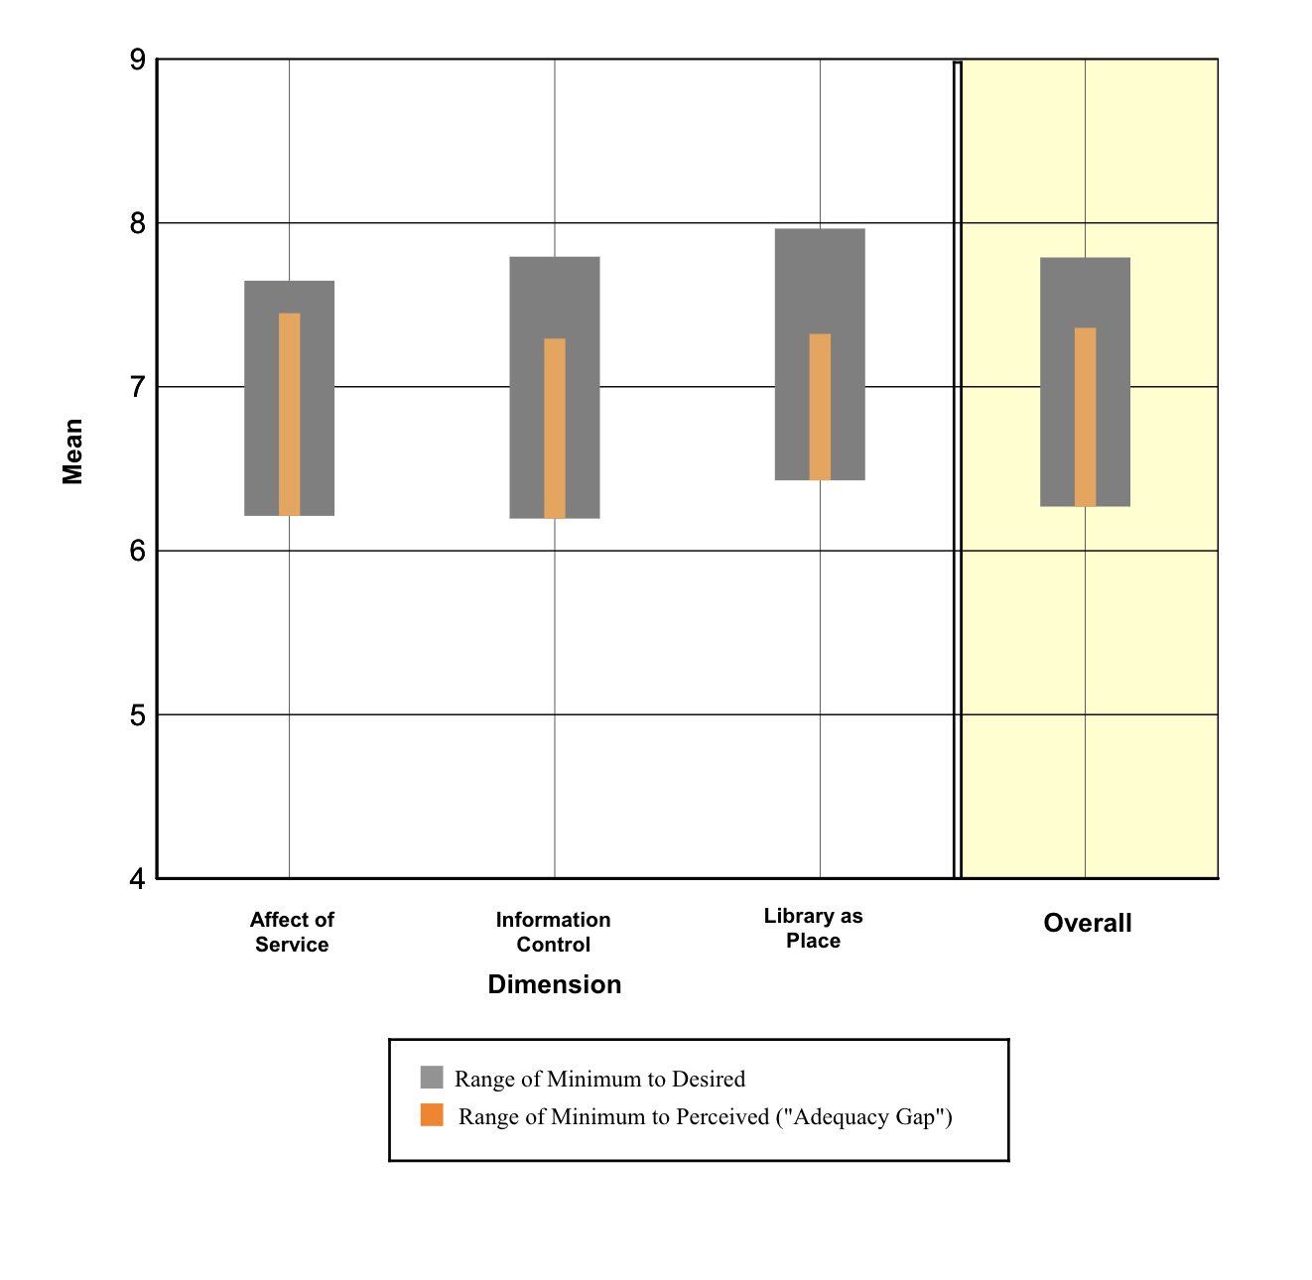
Satisfaction
The undergraduate respondents were highly satisfied with the work of the KSU library system

Slide 14
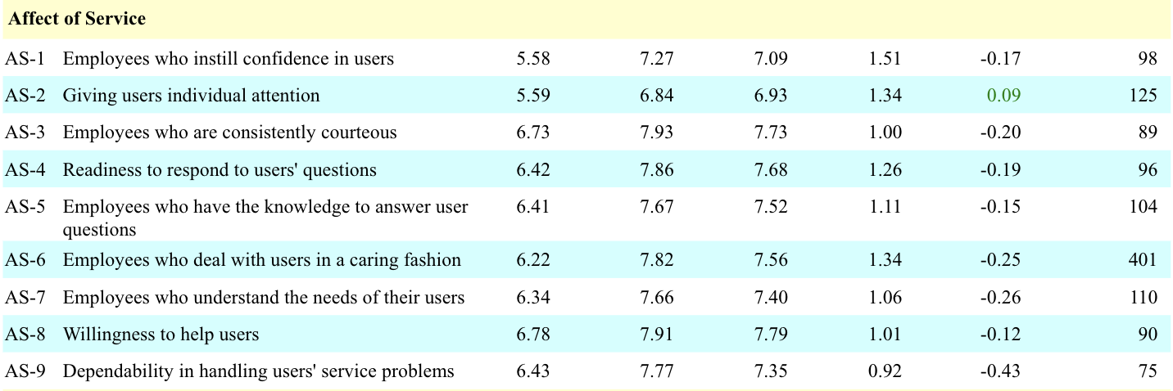
What do we do well?
Undergraduate students were impressed mostly with our service and the ability to give individual attention
They also responded far greater than minimum to the prompts:
  The printed library materials I need for my work
  The electronic information resources I need
“I really love you guys and appreciate the work you do.”
“I would not be passing my courses with out the library!”
“I always have great experiences with my trips to the library.”

Slide 15
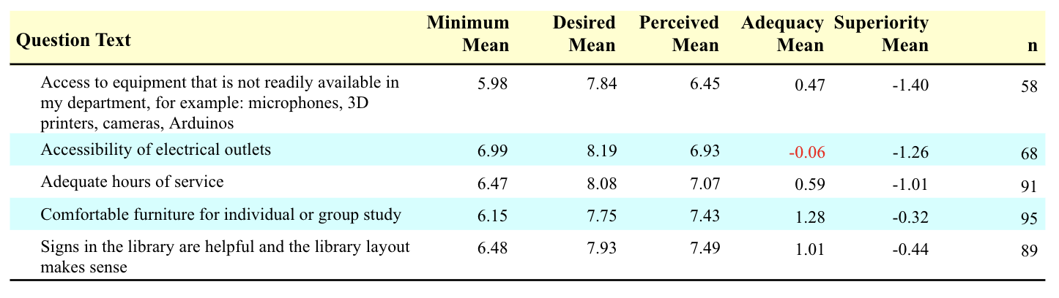
Where can improvement lie?
The most desired improvements were in the realm of facilities. Undergraduates noted a need for more electrical outlets and a desire for more quiet study space
“People who talk loud, eat loud, or are disruptive of others should receive the death penalty.”

Slide 16
Graduate Students

Slide 17
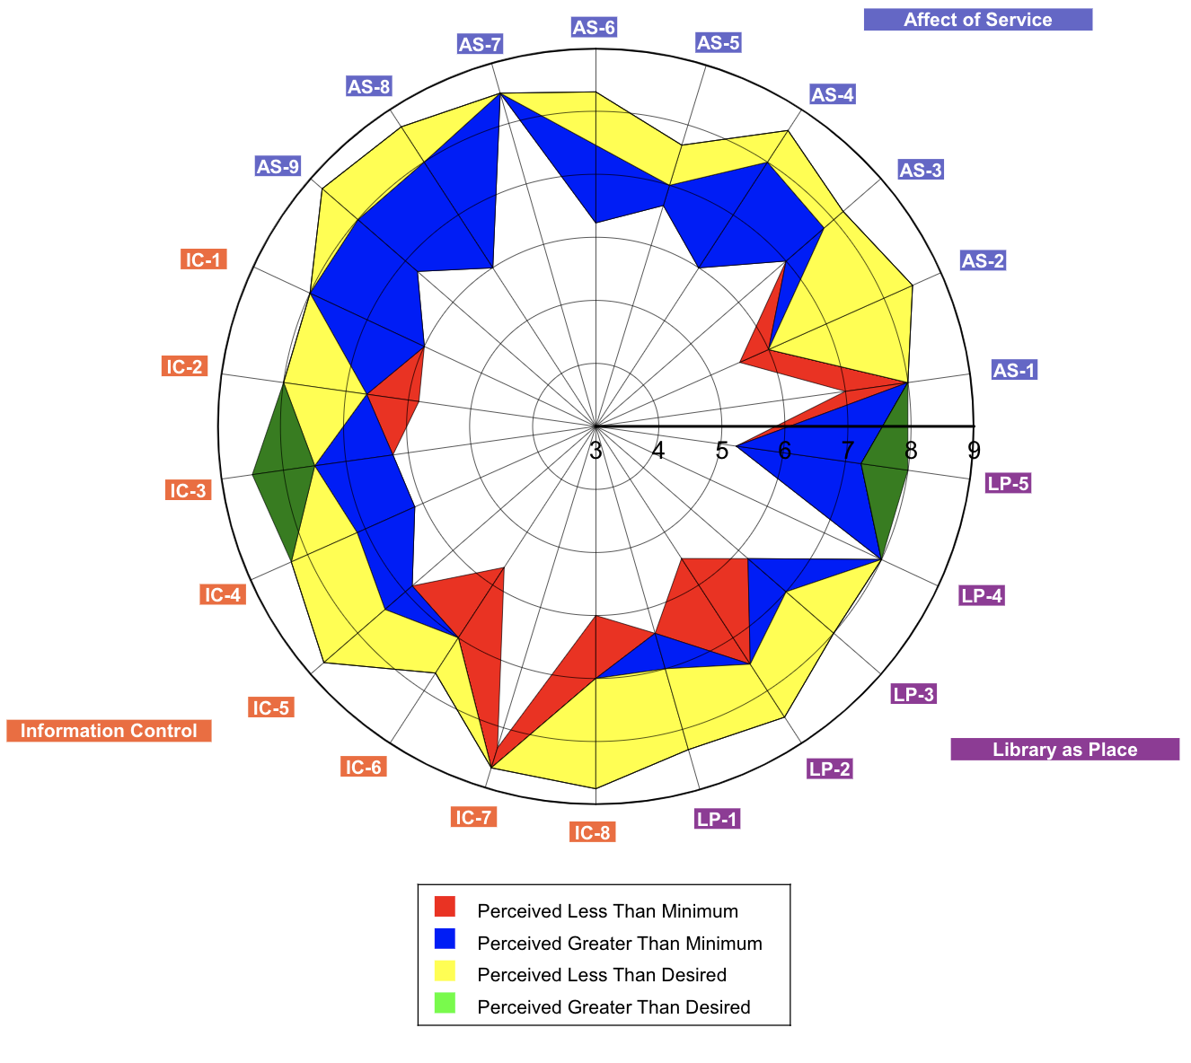
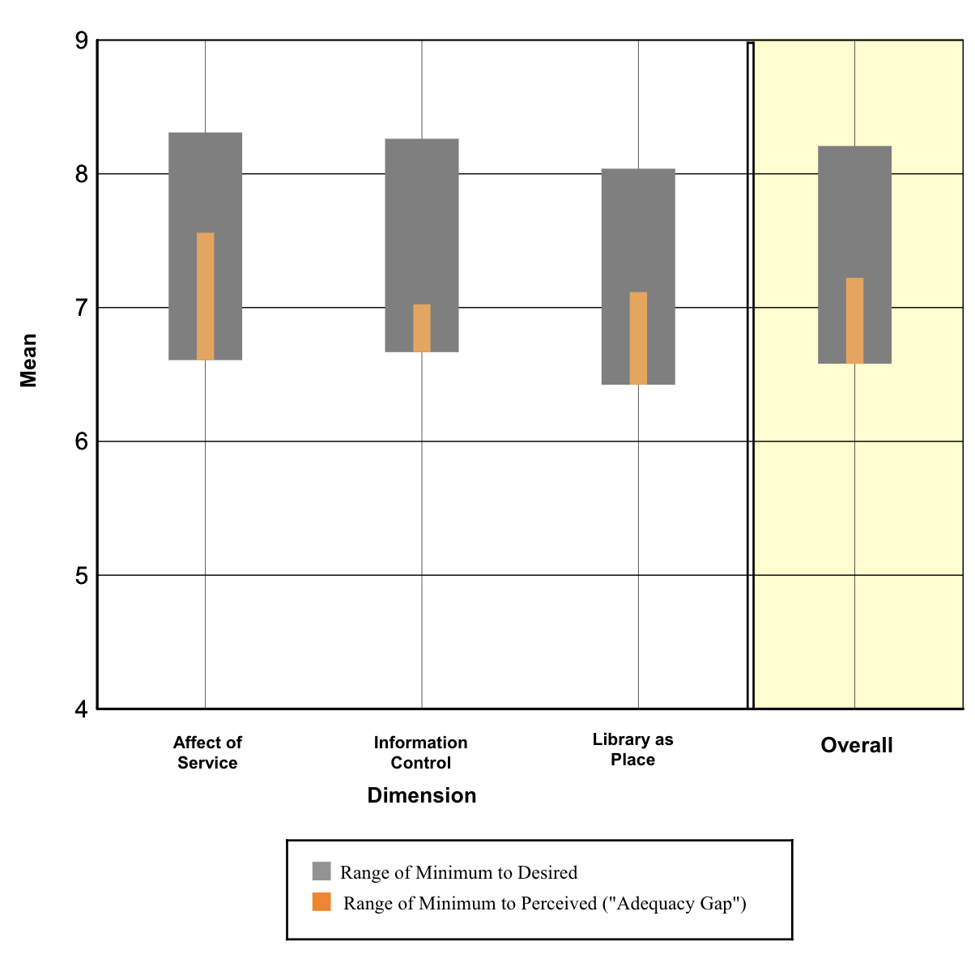
Satisfaction
The graduate students indicated both room for improvements and areas where we excel

Slide 18
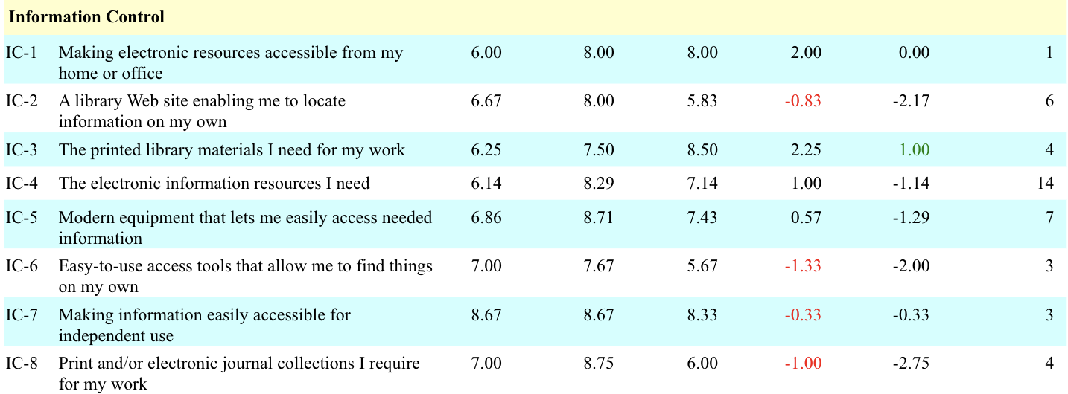
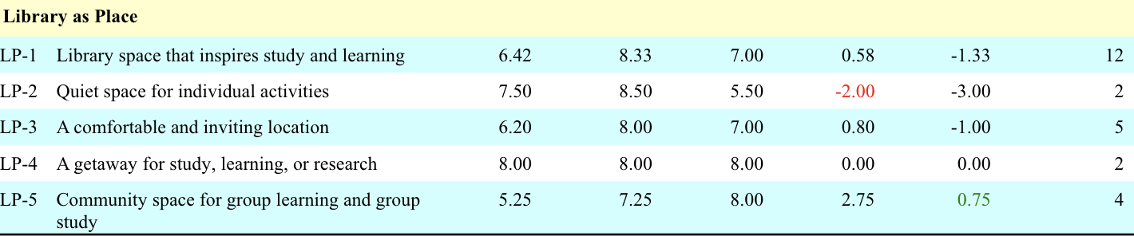
What do we do well?
We exceeded our desired expectations for Graduate Students in printed materials and community space for group learning
“I am very impressed with the renovations to the Kennesaw campus library”
“Our graduate librarian for the MSW social work department has helped our cohort and professors so much!”

Slide 19
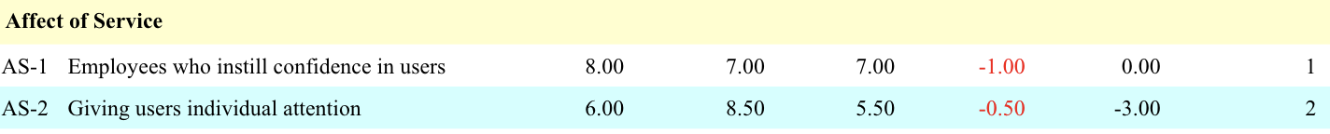
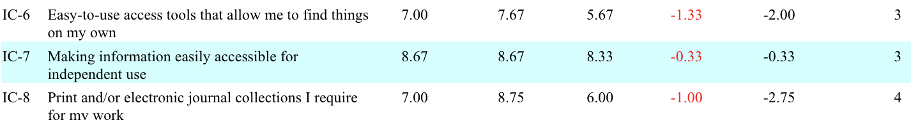
Where can improvement lie?
The graduate students shared a number of areas where the KSU library system was perceived under the desired minimum including individual attention, the ease of use of the website and tools, collections, and the space for quiet studies.

Slide 20
Faculty & Staff

Slide 21
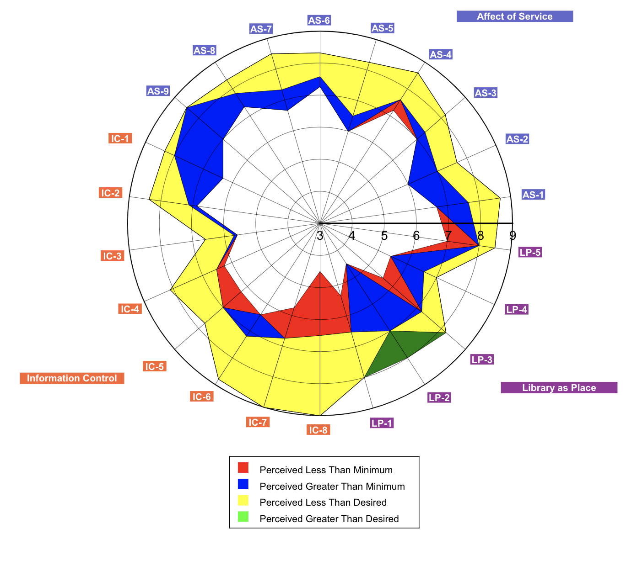
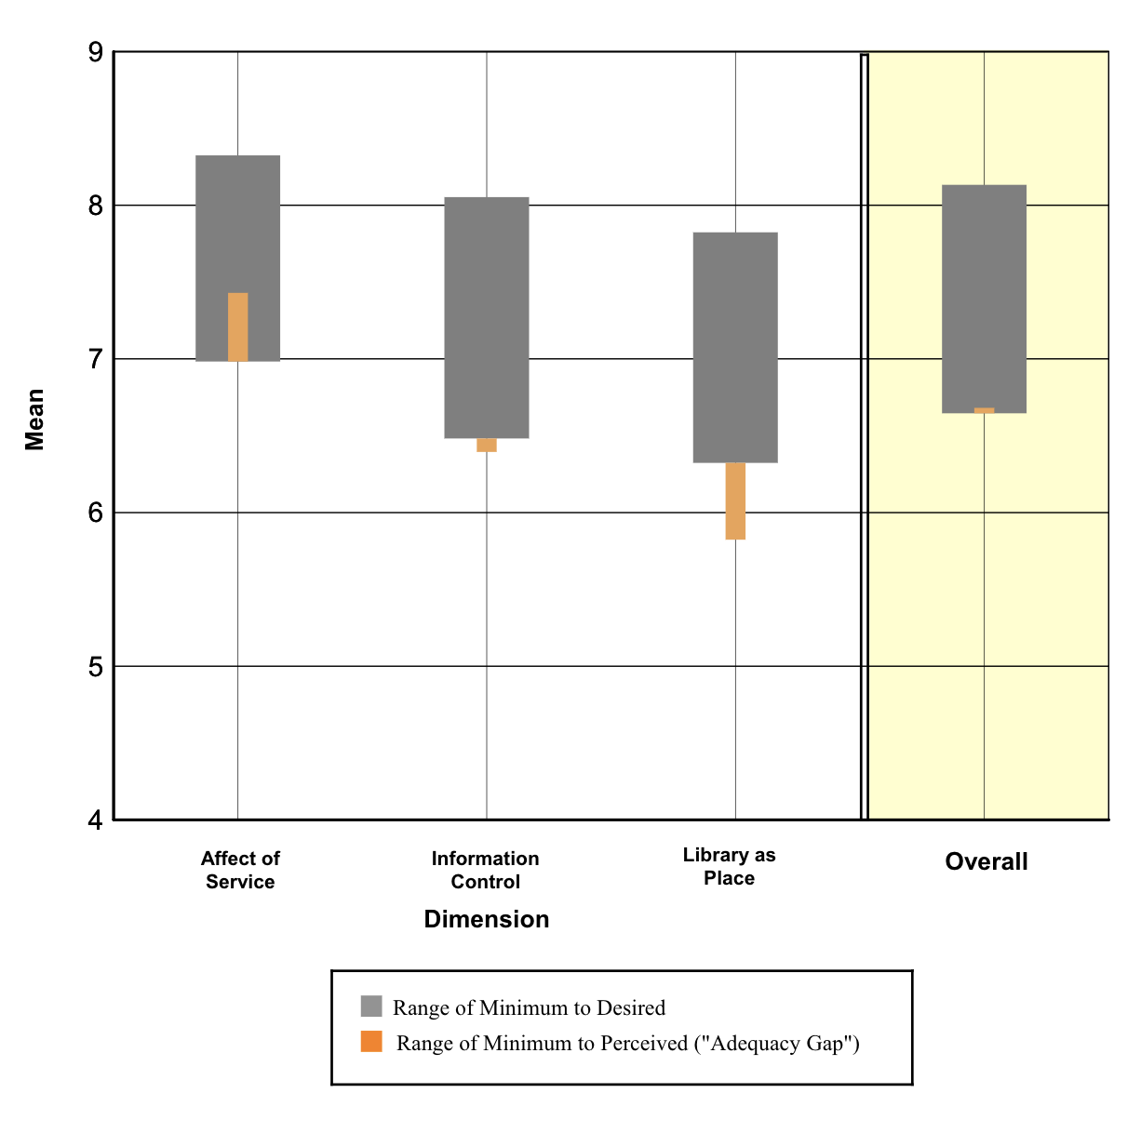
Satisfaction
The faculty indicated several areas where they would like to see improvements in the KSU Library System

Slide 22
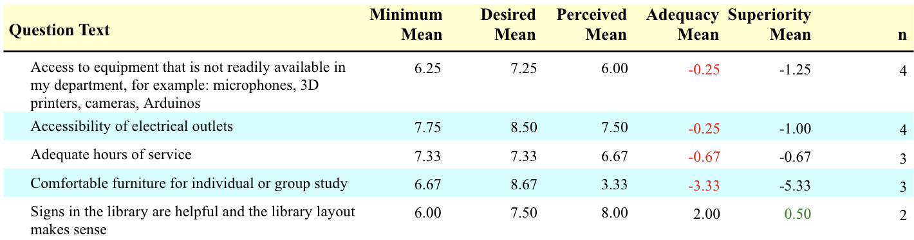
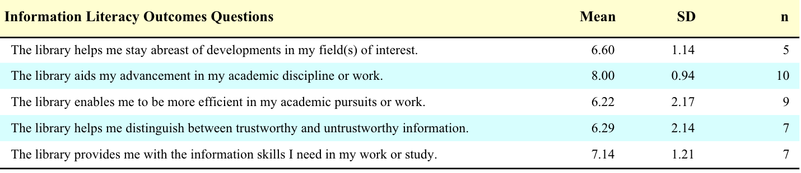
What do we do well?
We exceeded our desired expectations for Faculty in library signage and the library layout for both campuses
The faculty also generally believe the library system help in their academic work and information literacy skills

Slide 23
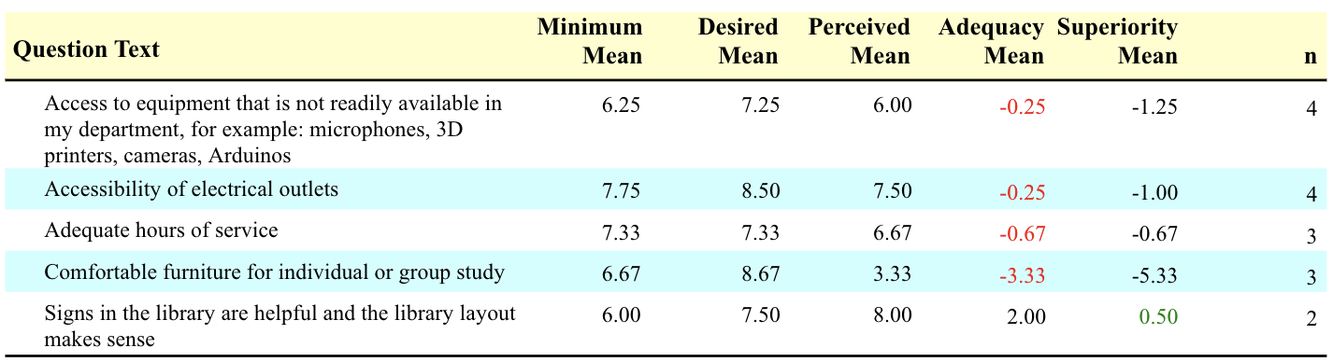
Where can improvement lie?
The adequacy mean for faculty answers were below the minimum in multiple areas including electrical outlets, hours of service, and equipment available.

Slide 24
Johnson and Sturgis
General Branch Analysis

Slide 25
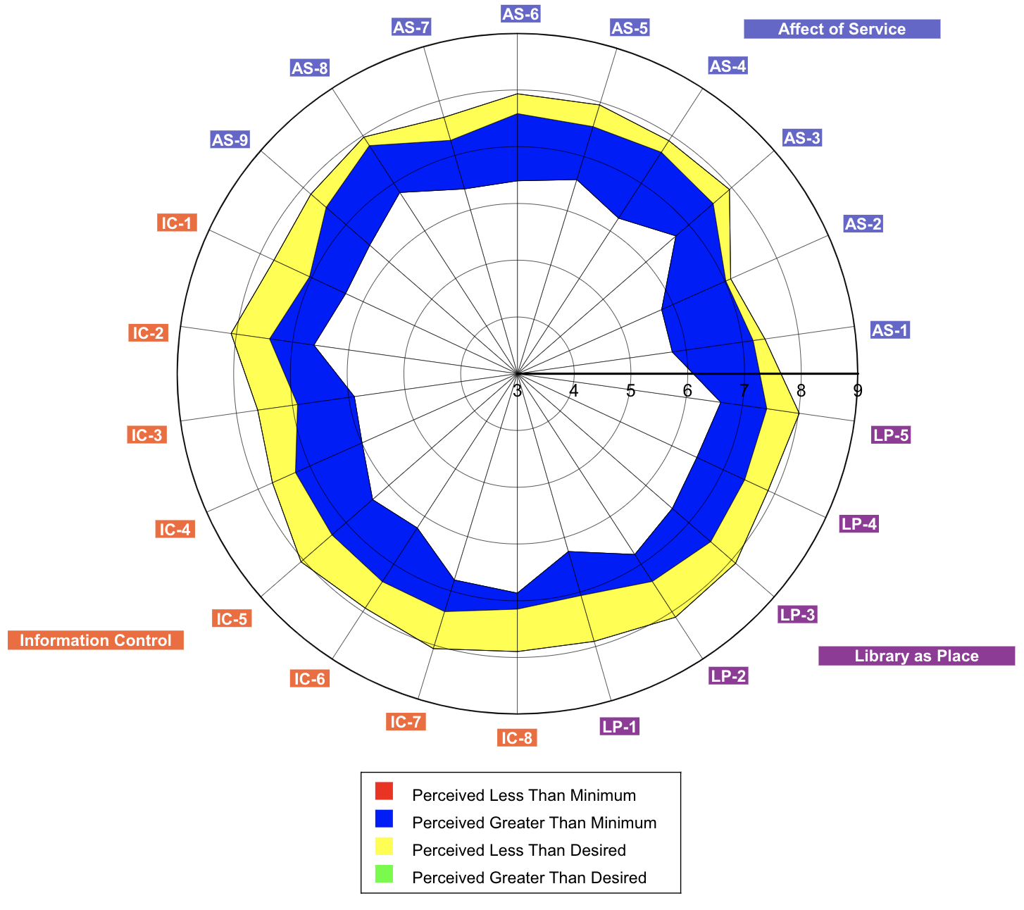
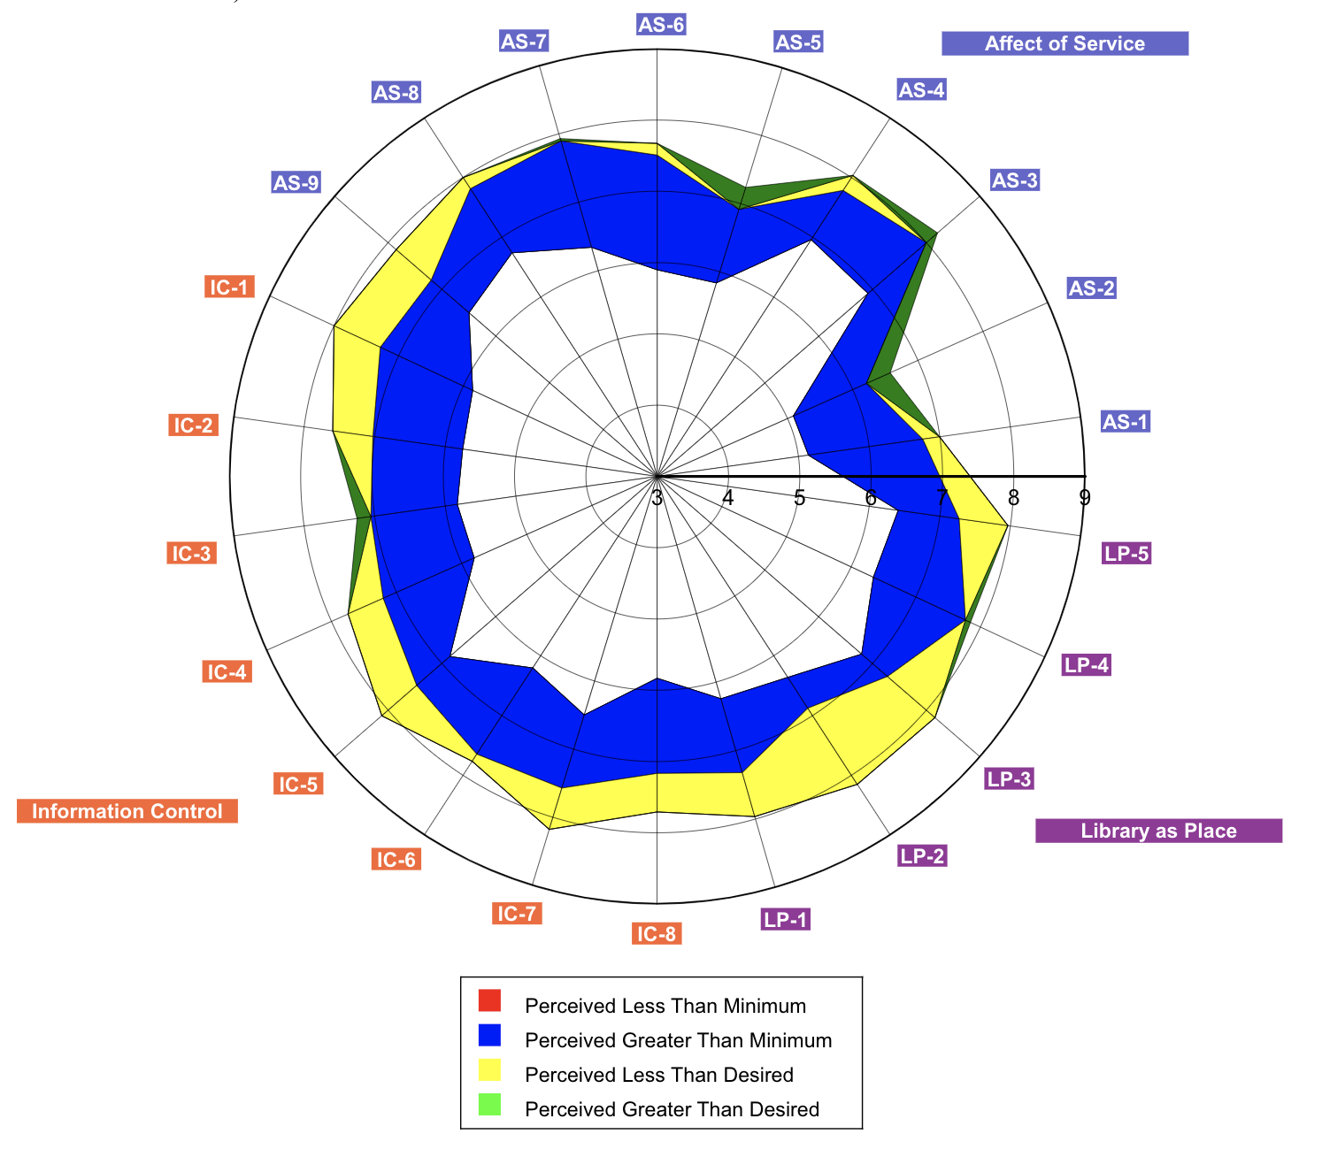
Satisfaction
Sturgis
Johnson

Slide 26
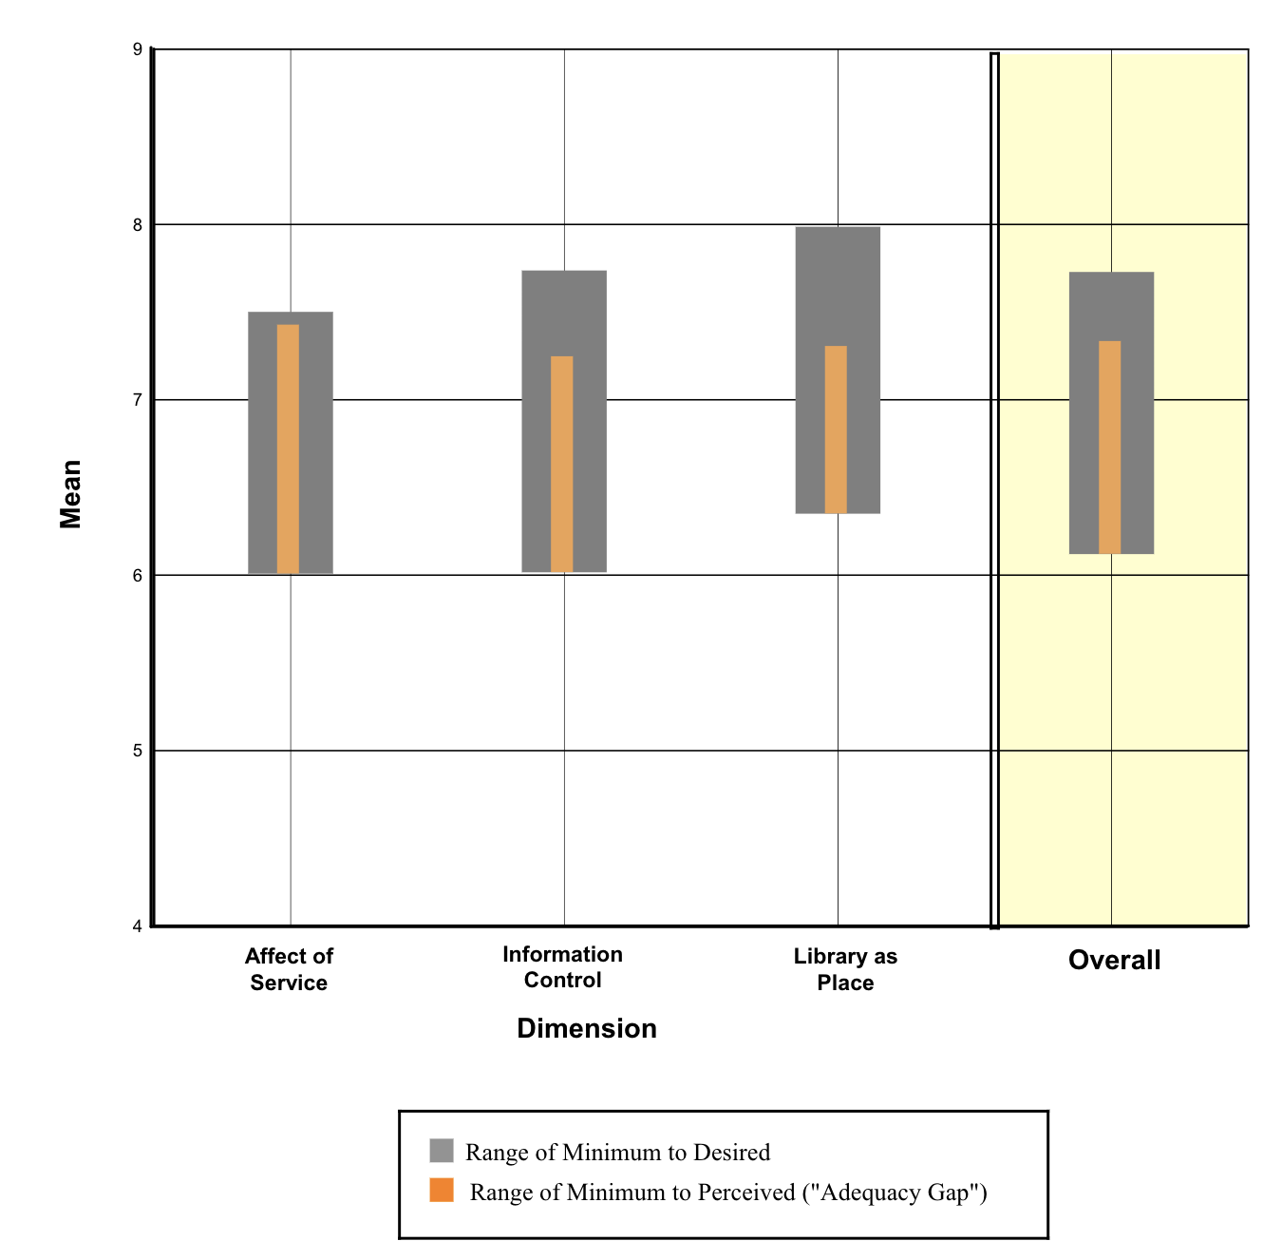
Johnson
Johnson exceled over desired expectations in…
  Giving individual attention
  Courtesy
  Knowledge
  Understanding needs
  Printed materials
  A getaway for study, learning, or research

Slide 27
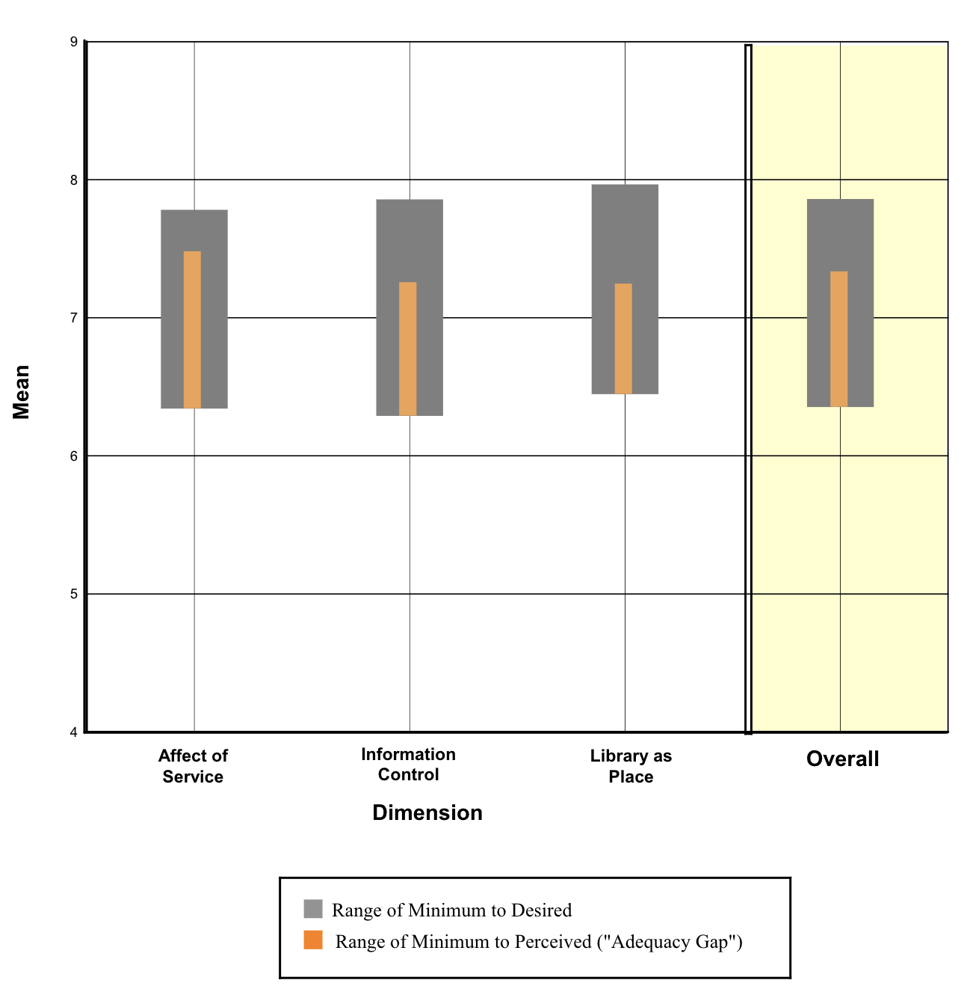
Sturgis
Sturgis met all expectations and did very well at…
  Instilling confidence
  Giving individual attention
  Readiness to respond to questions

Slide 28
Let’s look long-term
More closely

Slide 29
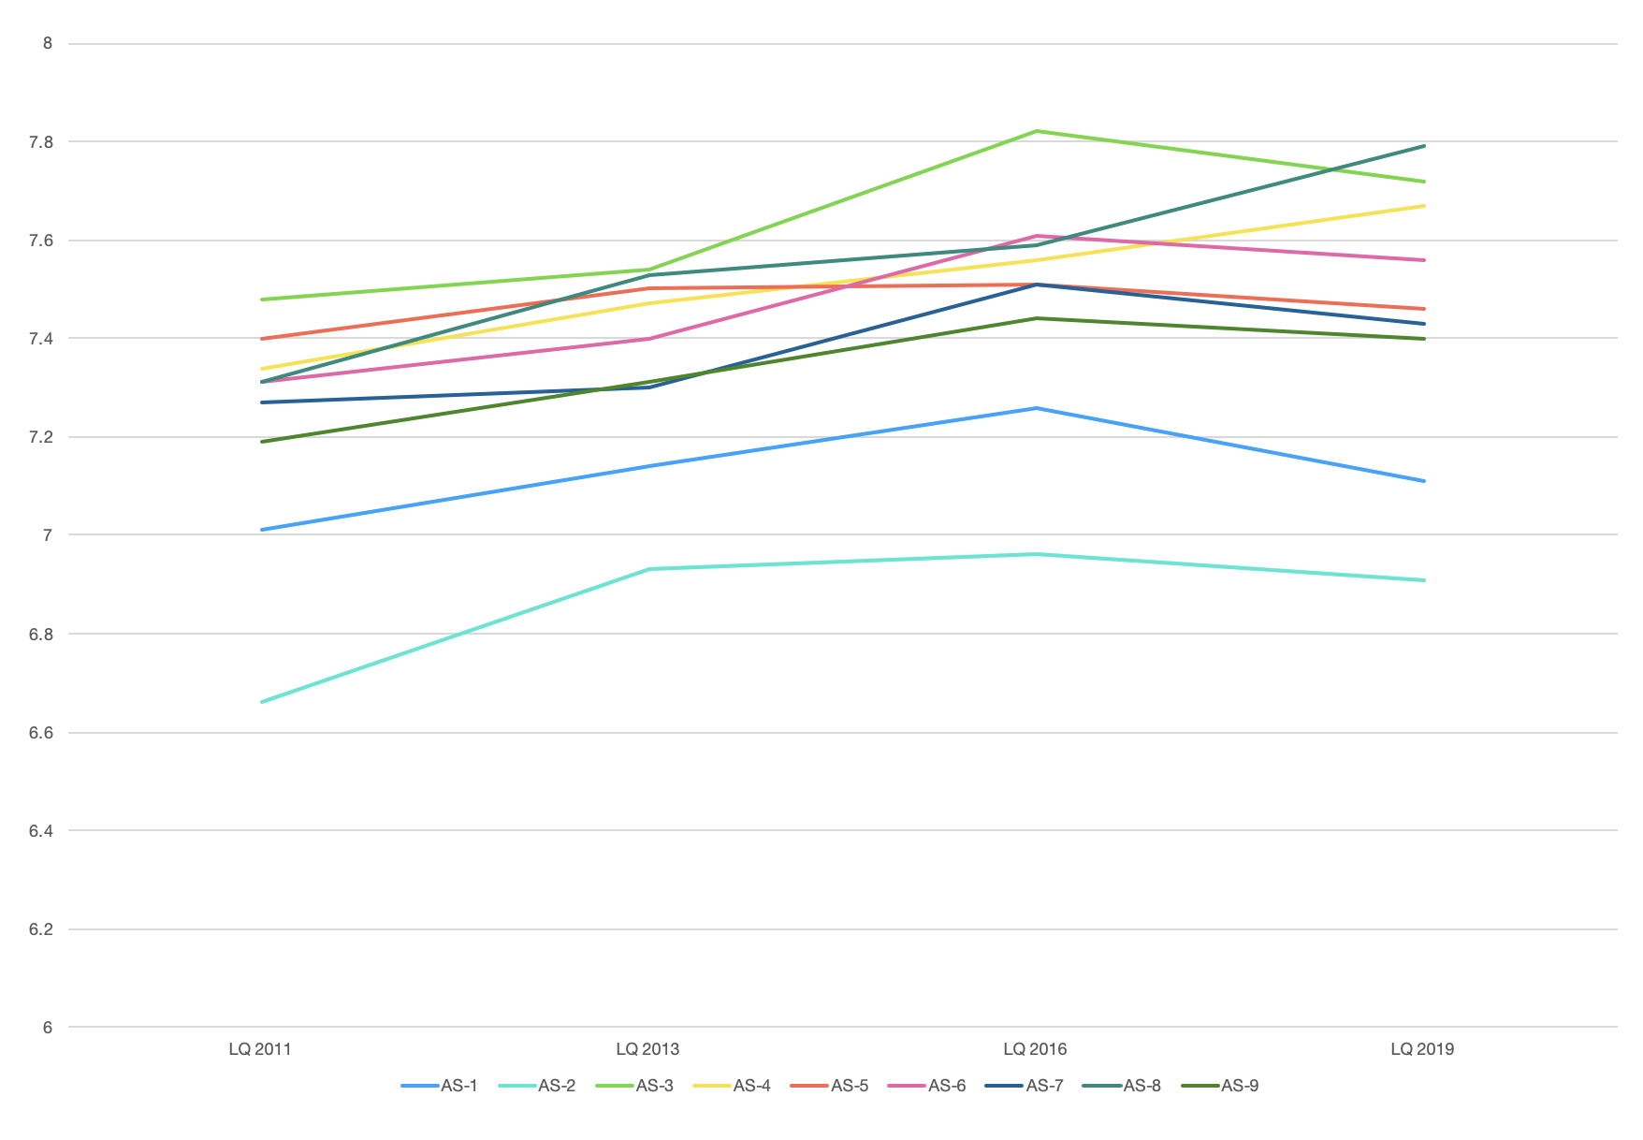
Area of Service
All around, perceived mean of service has gone down only slightly

Slide 30
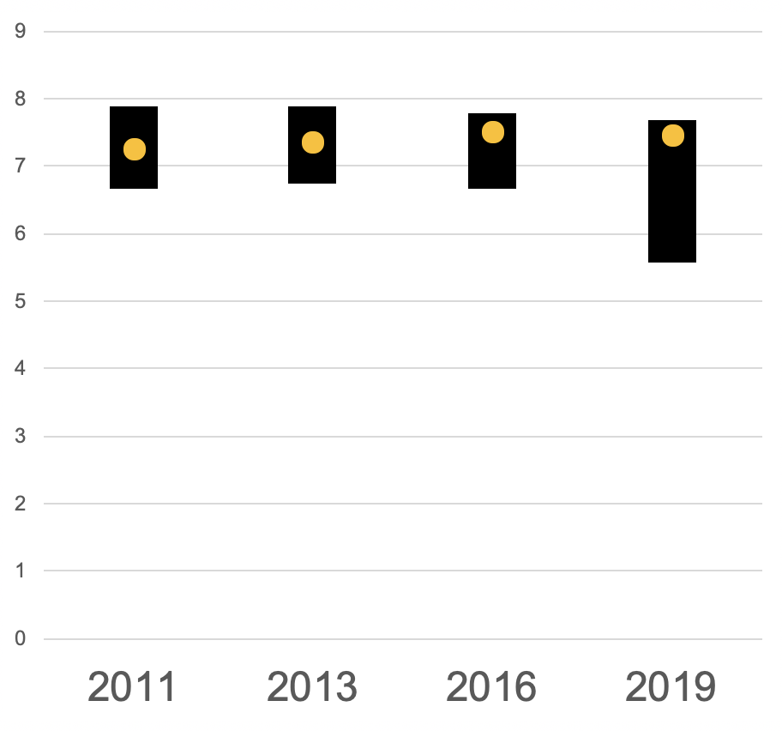
Area of Service
However, the desired and minimum means have decreased as well.

Slide 31
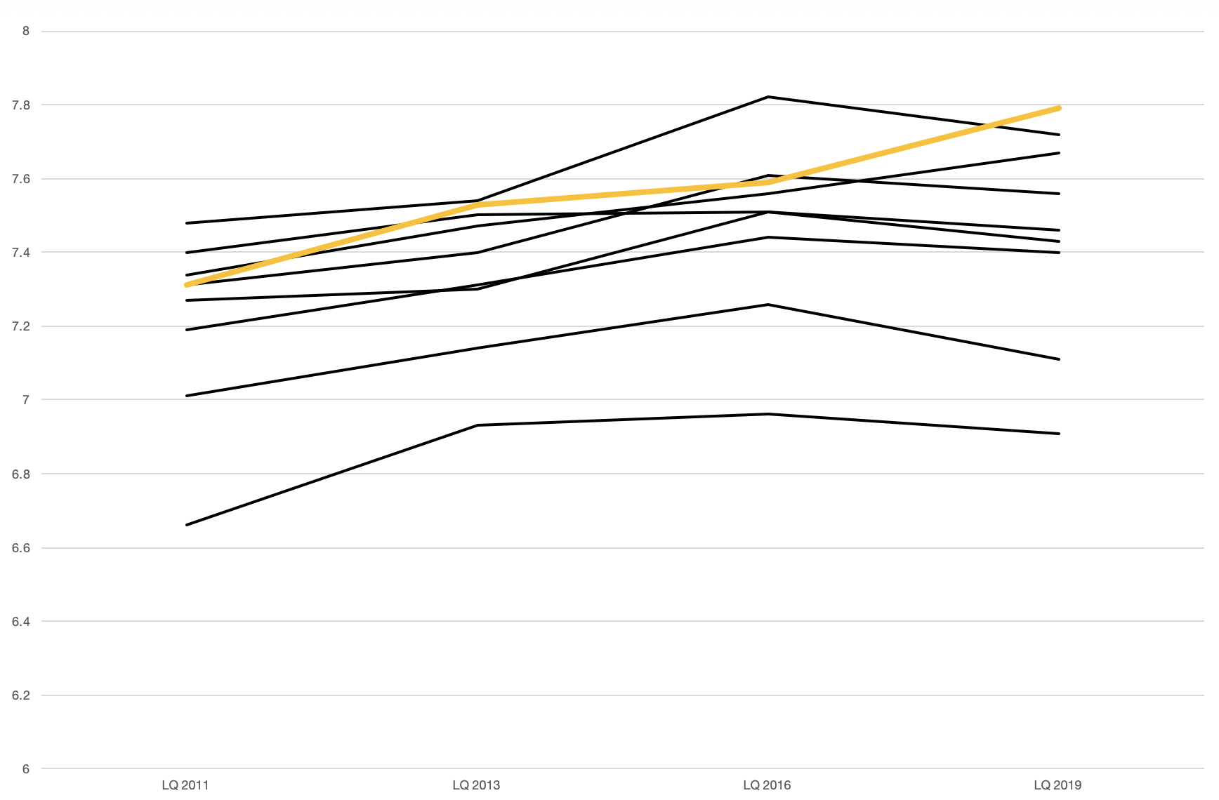
Area of Service
Willingness to help users has also gone up in the last three years.

Slide 32
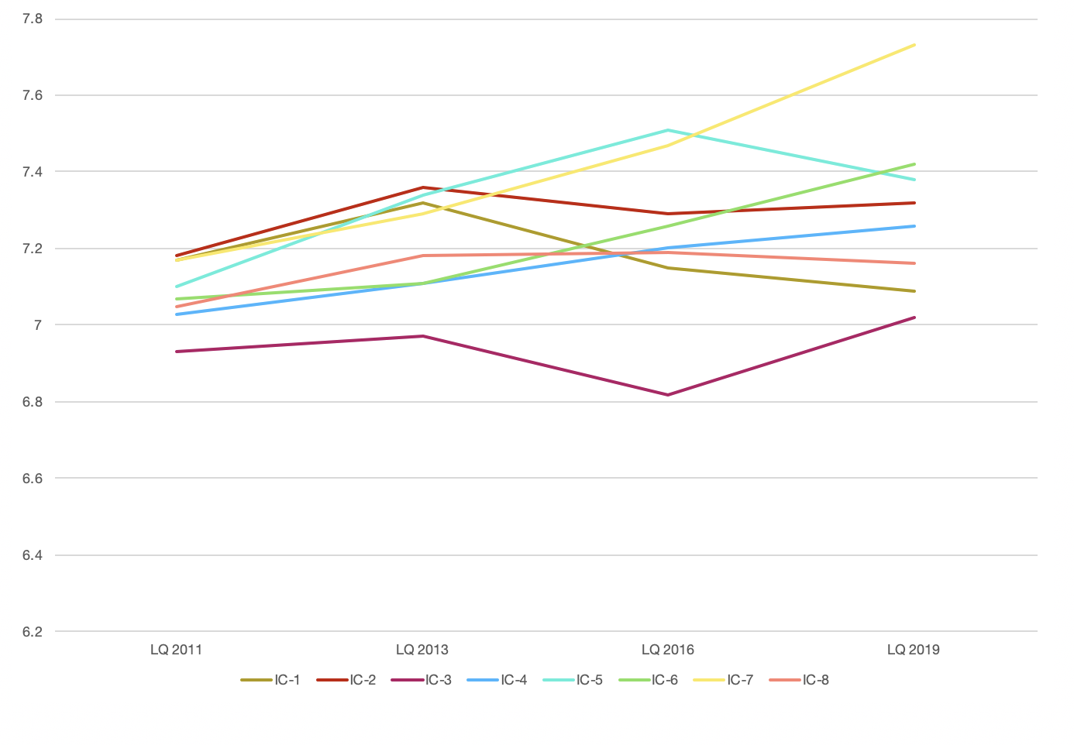
Information Control
Information Control has improved in most all areas

Slide 33
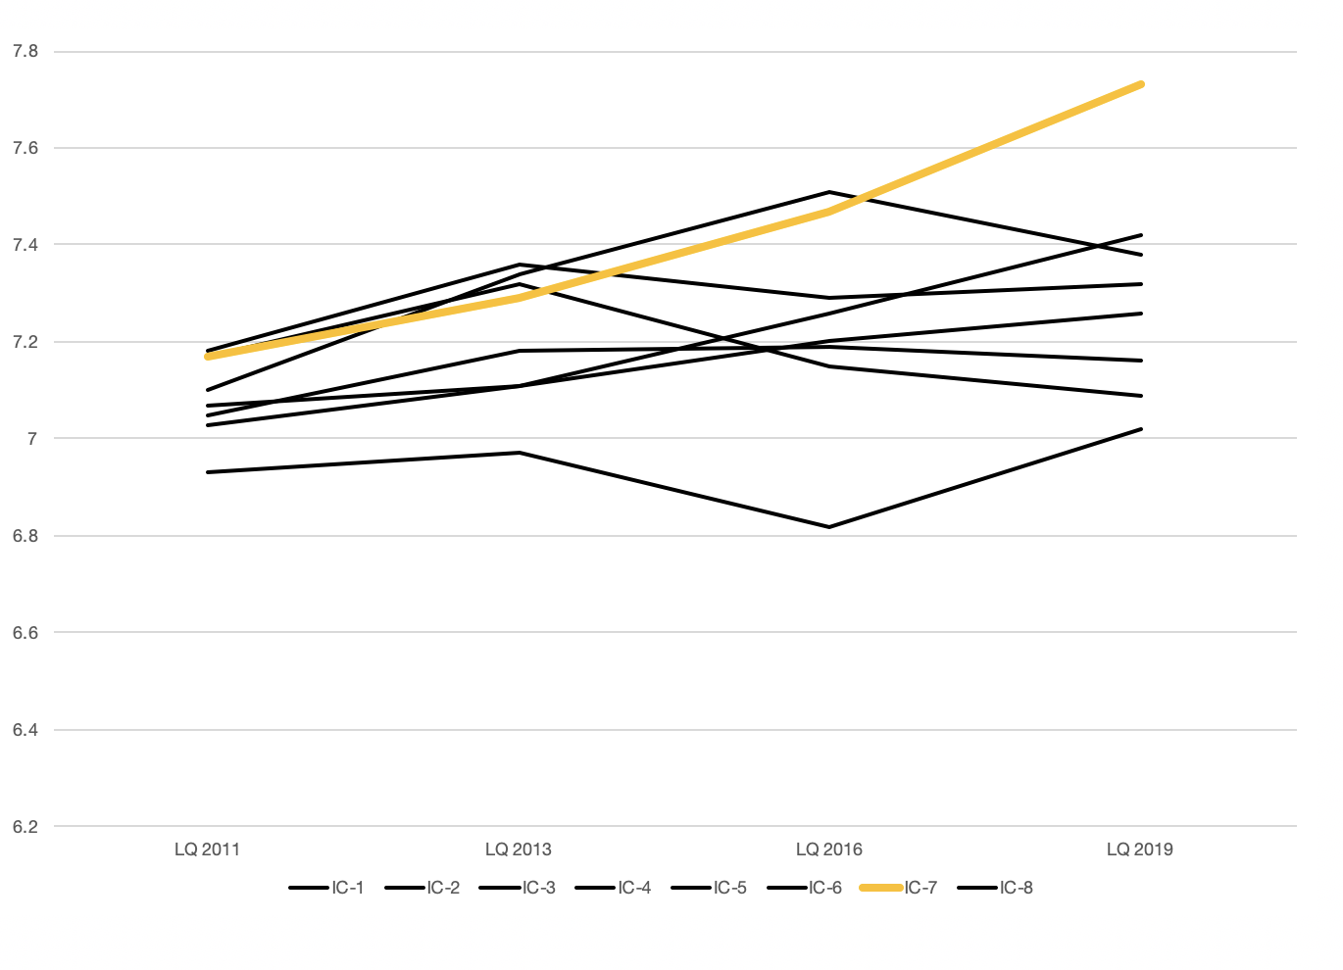
Information Control
There has been a dramatic increase in satisfaction of making information easily accessible for
independent use

Slide 34
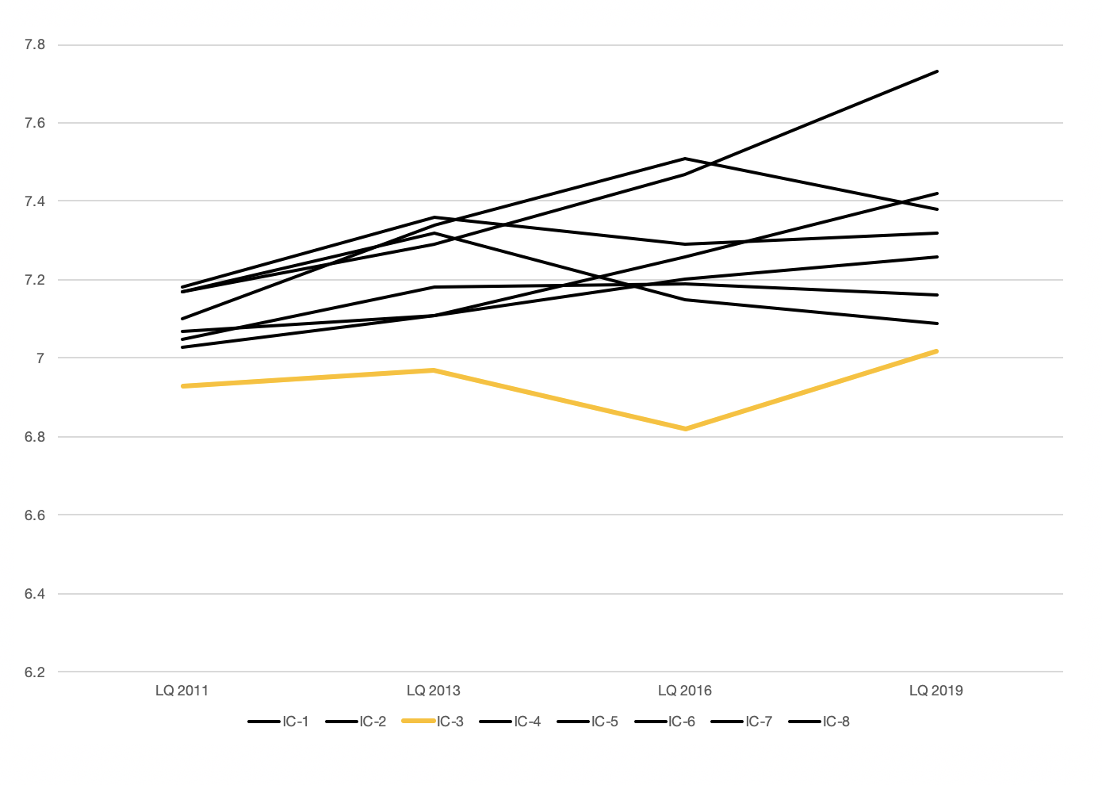
Information Control
And an increase in satisfaction of the printed materials needed for the user’s work

Slide 35
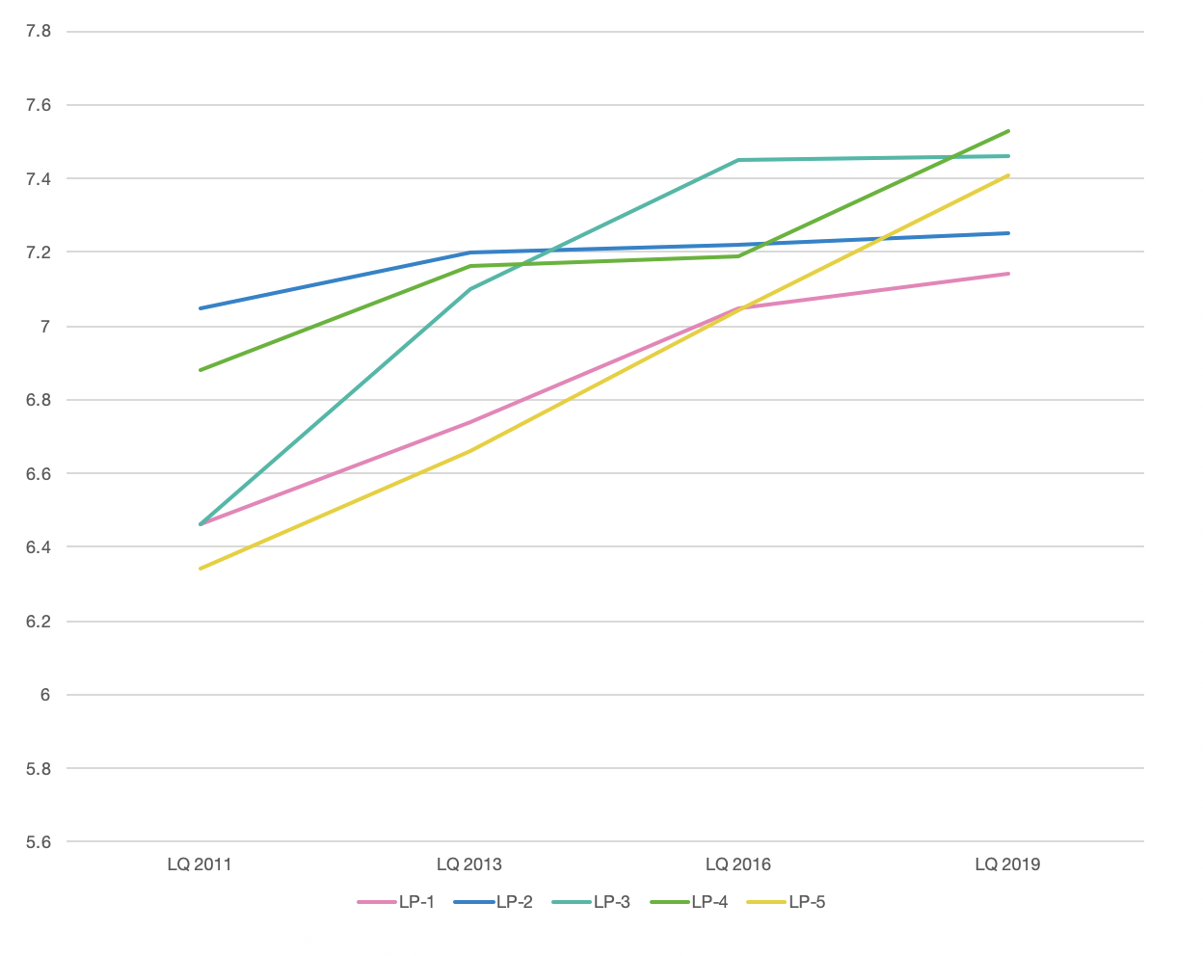
Library as a Place
The library as a place has seen a sharp increase in satisfaction across the board

Slide 36
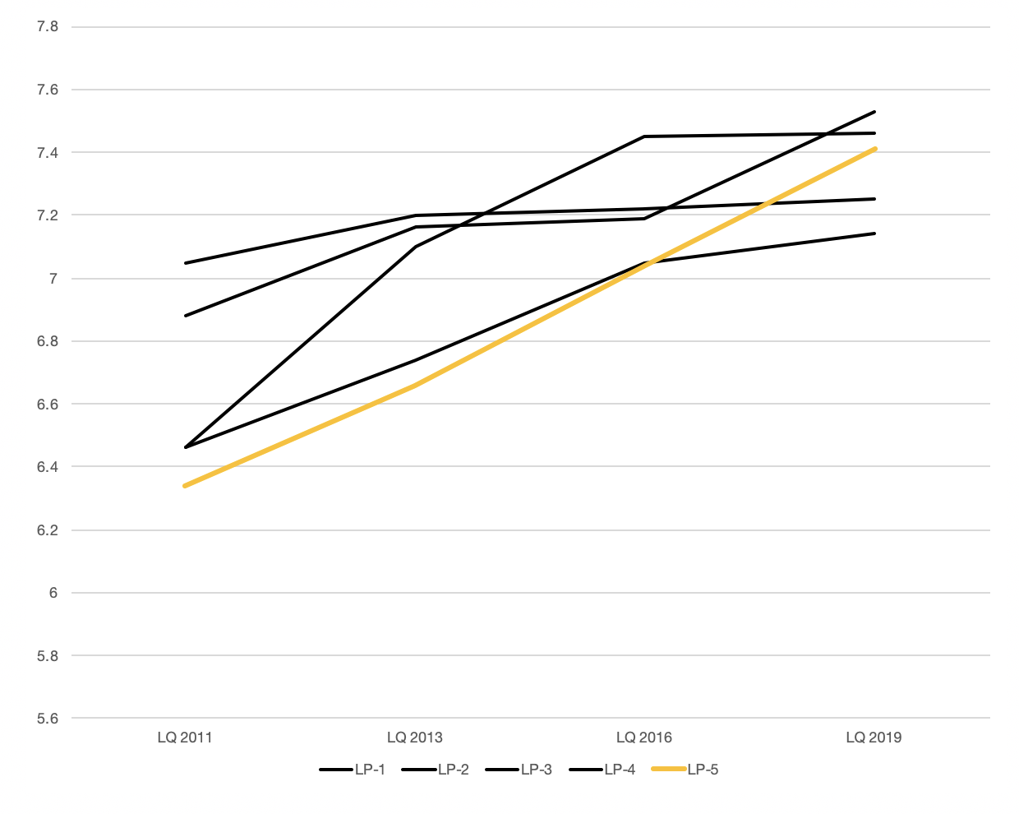
Library as a Place
The largest increase across the survey from 2011-2019 was the satisfaction in community spaces for group learning and group
study

Slide 37
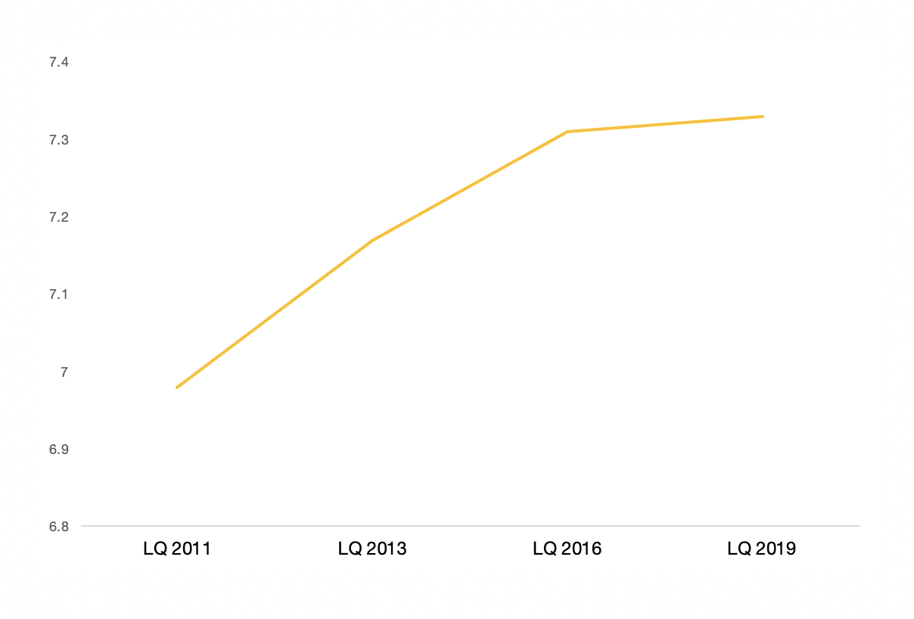
Overall Perceived Mean
Overall, our perceived mean increased from 6.98 in 2011 to 7.33 in 2019.
7.33
7.31
7.17
6.98

Slide 38
Where do we go from here?
Short Term Goals
Long Term Goals
More FAQ’s to address some of the gaps in knowledge
Utilizing student technology money for some requested software such as GarageBand
Reassessing quiet spaces for silent vs quiet
More space for individual and group study
More study rooms for student use
Water fountains at the Johnson Library
Bathroom renovations

