Slide 1


Latvian Community Libraries Adapting to Generational Changes
Maira Bundza
Western Michigan University
Association for the Advancement of Baltic Studies
Conference at Stanford University
June 3, 2018

Slide 2
Generations of Latvian community libraries
First wave
  1889 – Boston Latvian Benefits Society Library
  1892 – Philadelphia Society of Free Letts
  1898 - Socialistic Latvian Worker’s Association Library in Boston
  Socialistic Latvian Worker’s Association Library in Chicago
  1908 – Latvian Relief Association in Chicago Library
  1927 – American Latvian National League Library - Boston

Slide 3
Generations of Latvian community libraries
Second Wave
  1949 – Latvian National Association of Canada Library*
  1950 – Latvian Ev. Luth. Church of New York Libary – Brooklyn*
  1957 – Boston Daugavas Vanagi Library*
  1958 – Chicago Latvian Association Library
  1965 – Latvian Ev. Luth. Church of New York Libary – Yonkers
  1966 – Garezers Library – Three Rivers, MI
  1980 – Latvian Canadian Cultural Centre Library
  1983 – Latvian Studies Center Library – Kalamazoo, MI*
  Others in Chicago, Cleveland, Freehold NJ, Grand Rapids MI, Iowa*, Kalamazoo MI, Los Angeles, Minneapolis, Portland OR, San Francisco*, Seattle WA, St. Petersburg FL, Washington DC and more
  Continued:
    American Latvian National League Library - Boston
    Philadelphia Society of Free Letts
  * no longer exist

Slide 4
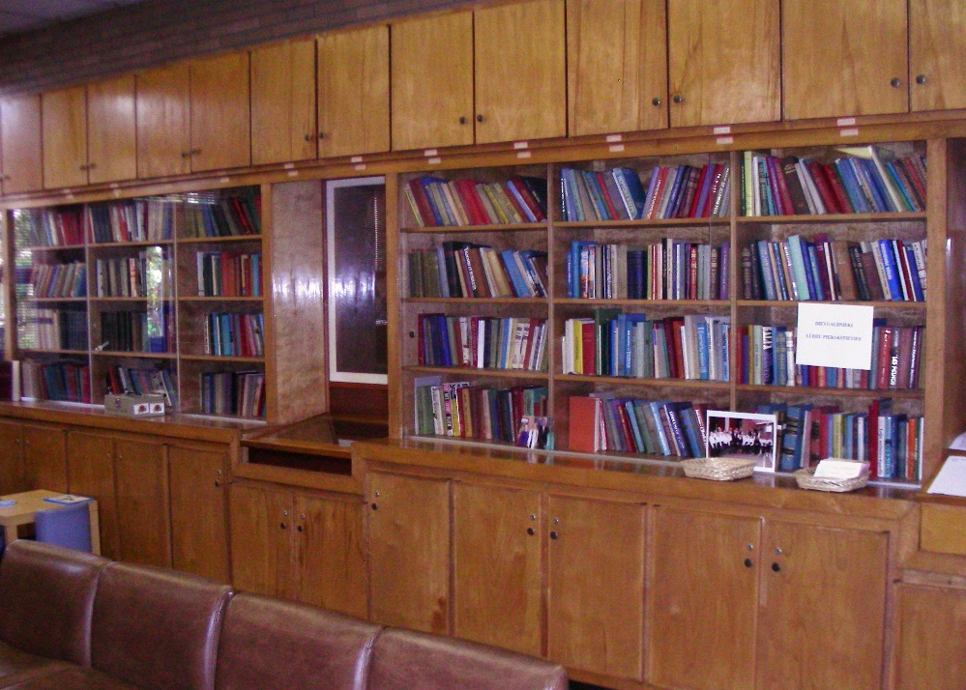
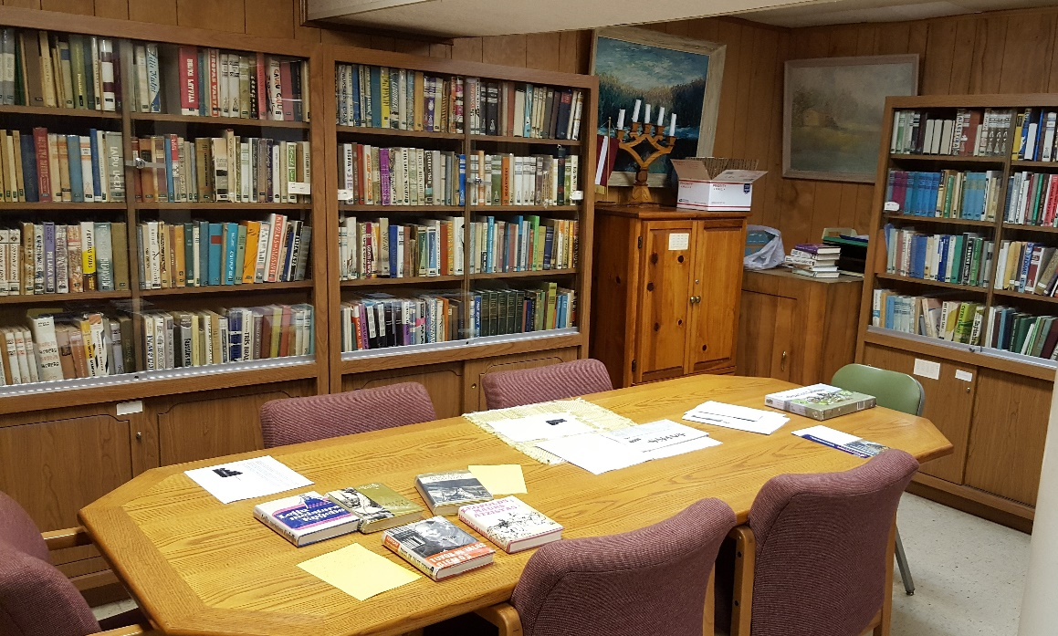
Church Library in Chicago -not active
School Library in same building - active
Cleveland Latvian Library – recently reorganized

Slide 5
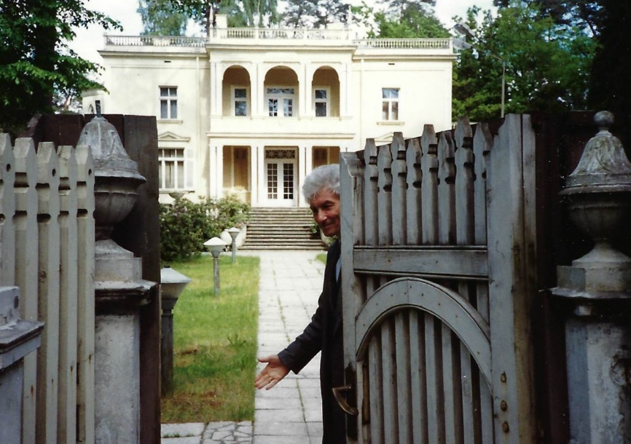
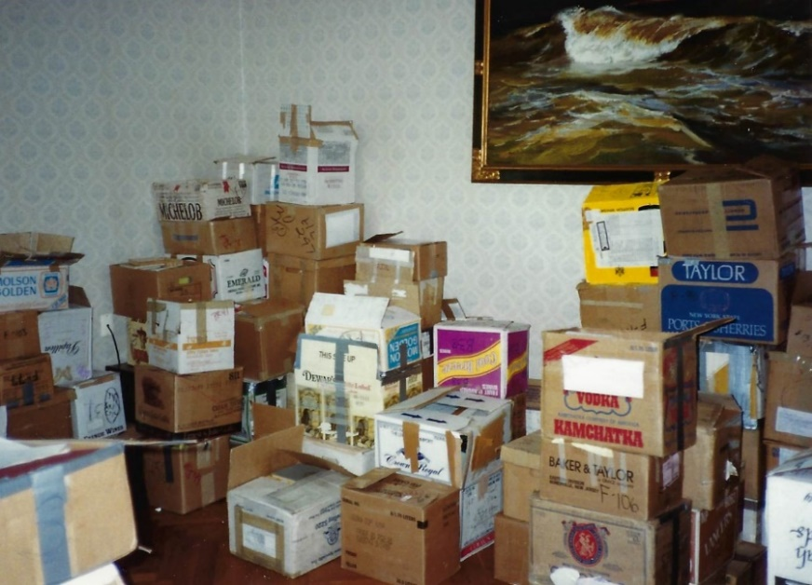
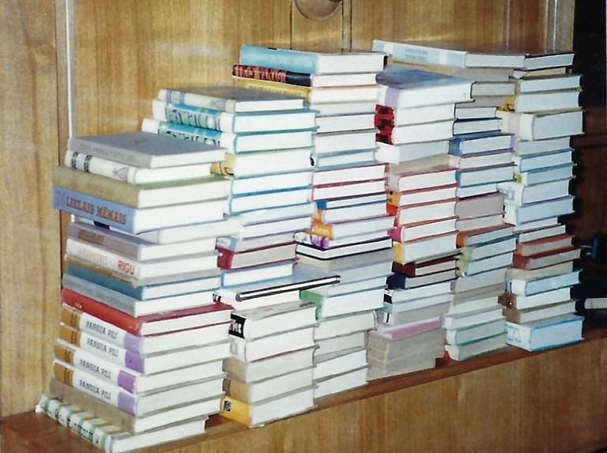
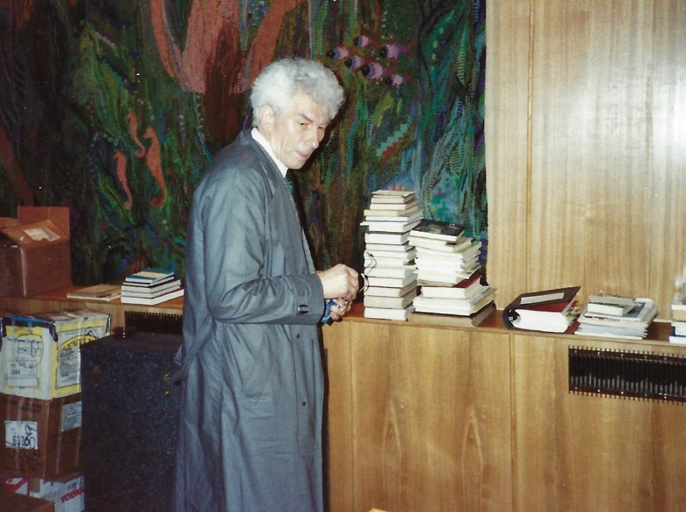
Cultural Fund (and Imants Ziedonis) receives Latvian exile books and distributes to district libraries 1990

Slide 6
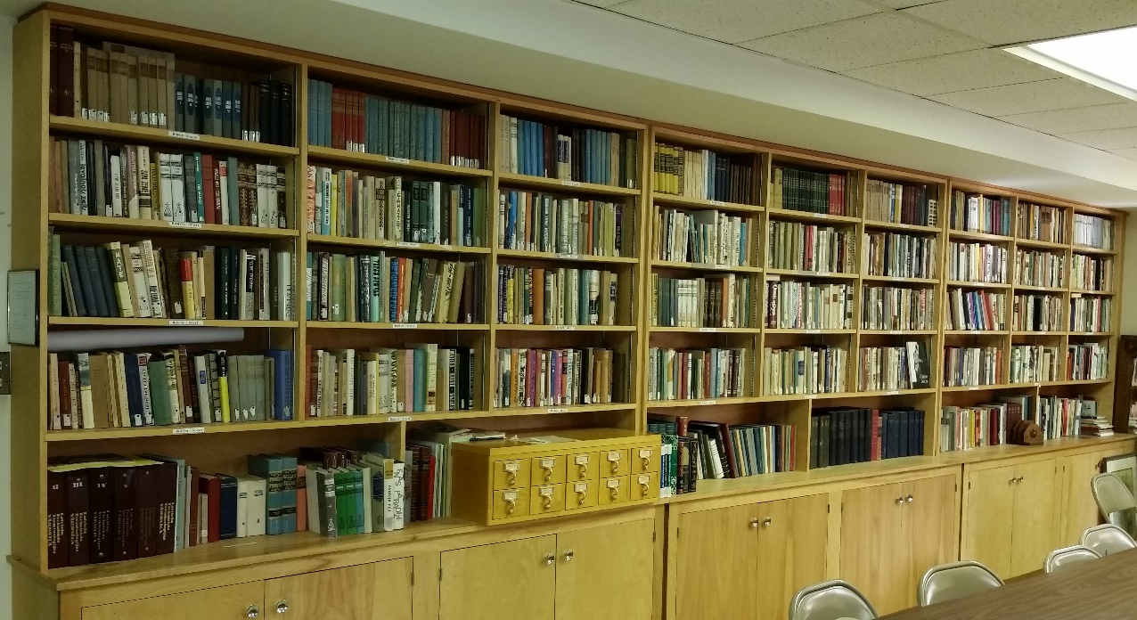
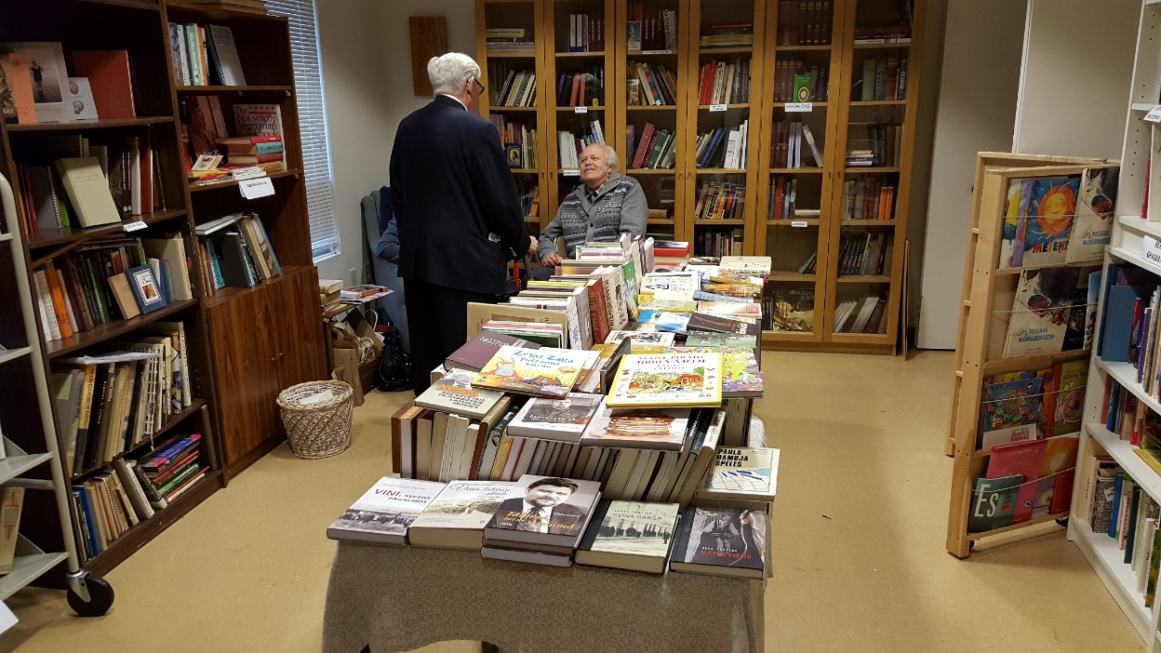
Washington DC (actually Rockvill, MD)
Library and Bookstore

Slide 7
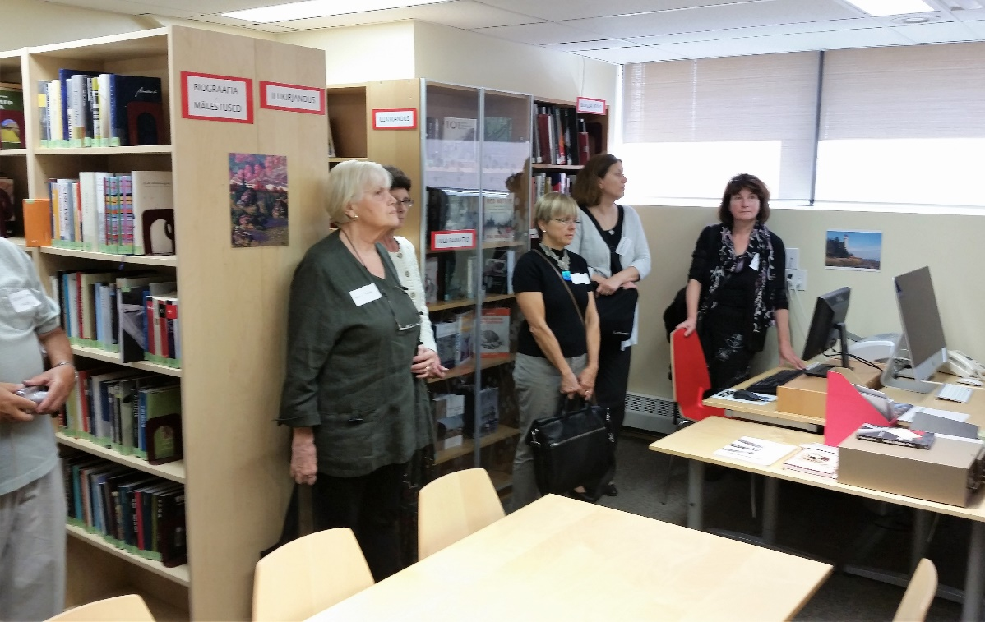
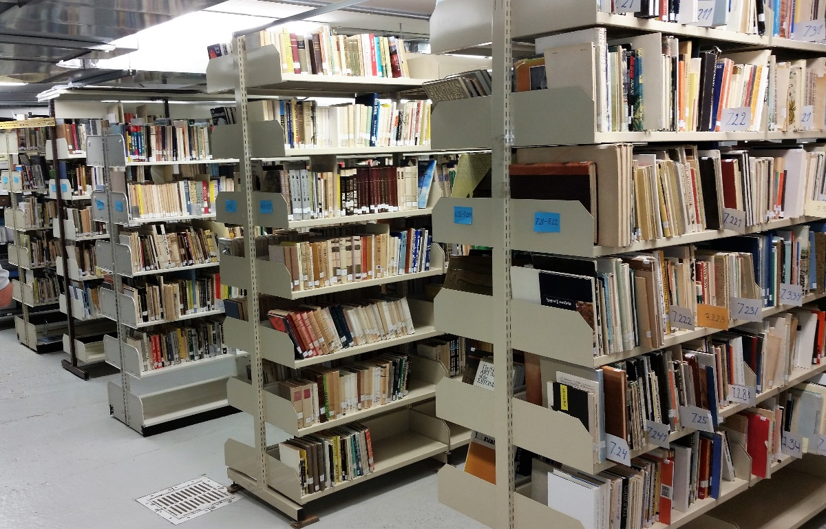
Tartu Institute Library & Archives, Toronto

Slide 8
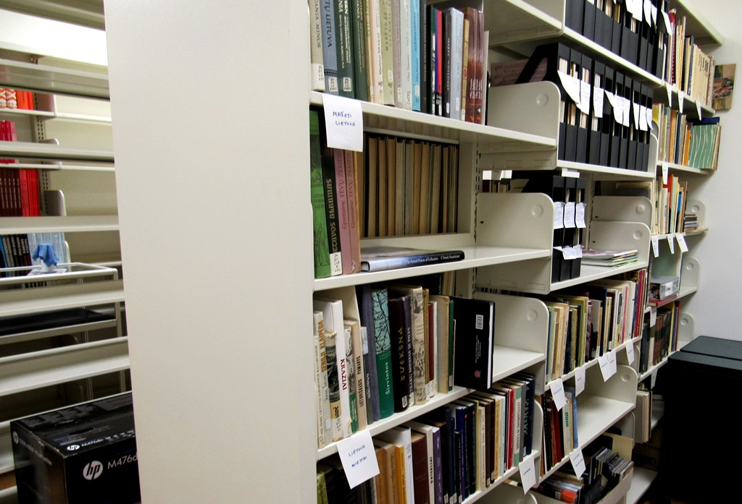
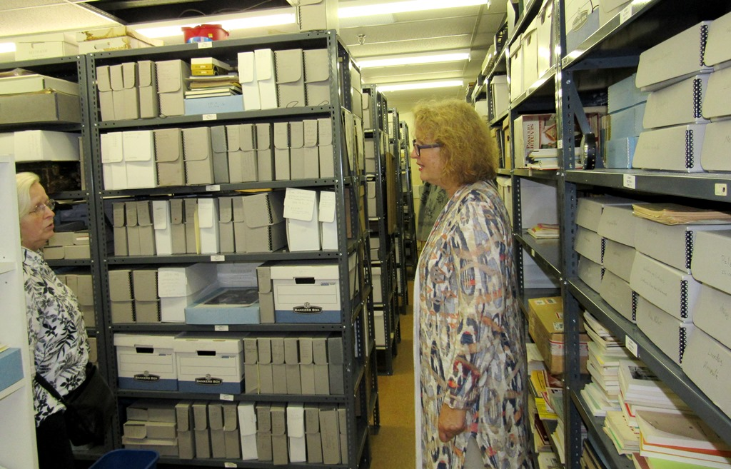
Lithuanian Canadian Museum Archives

Slide 9
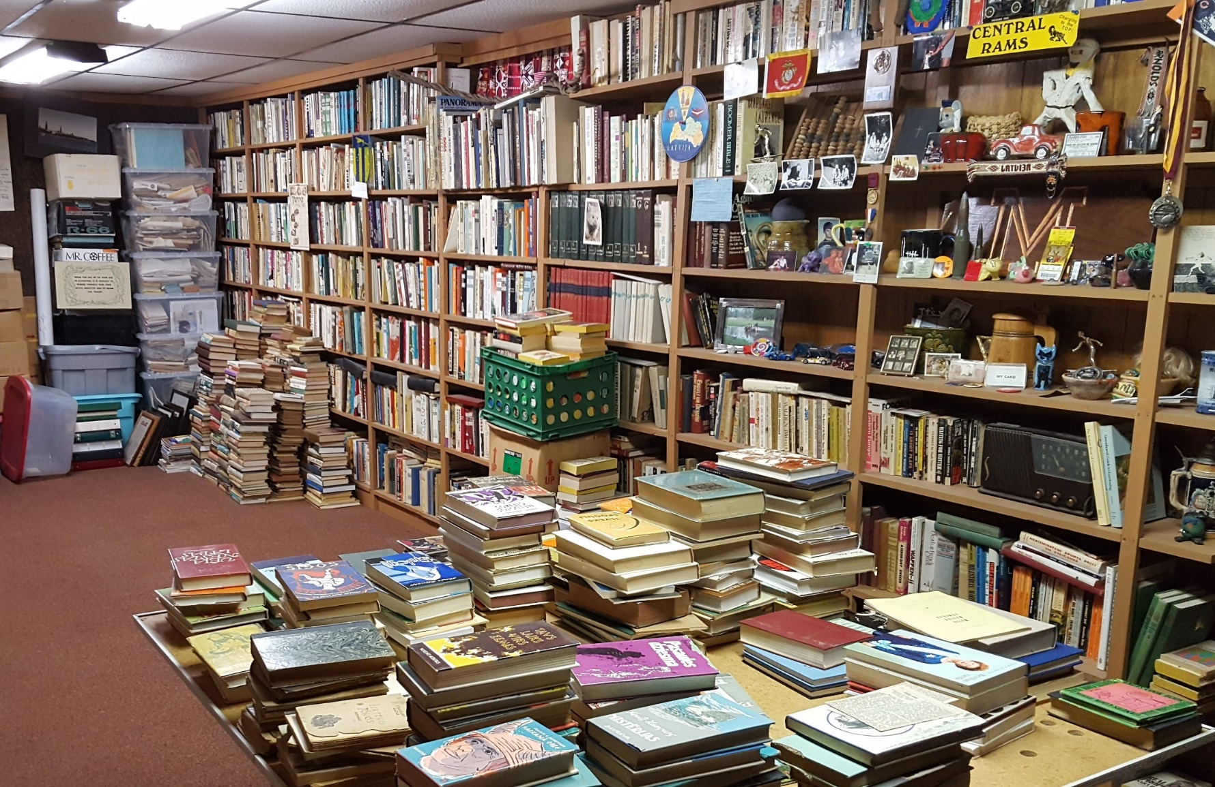
Private collection needing some organization

Slide 10
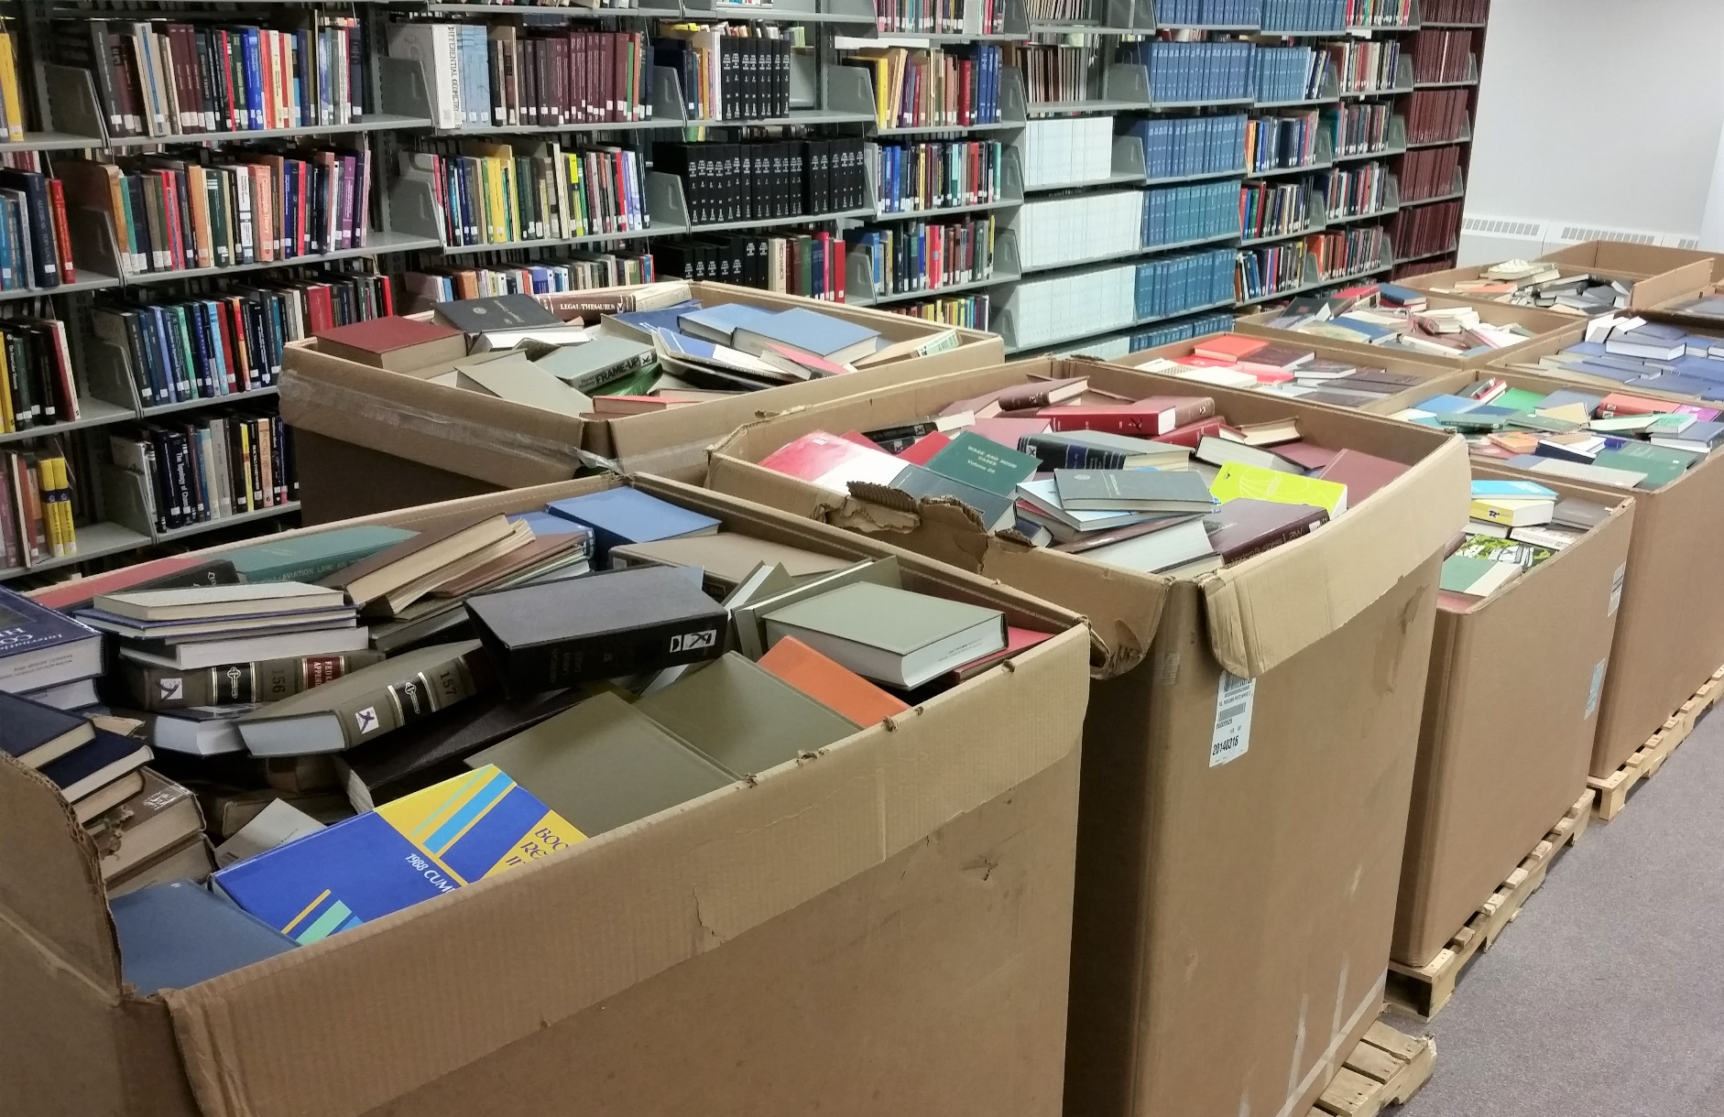
Academic libraries weeding

Slide 11
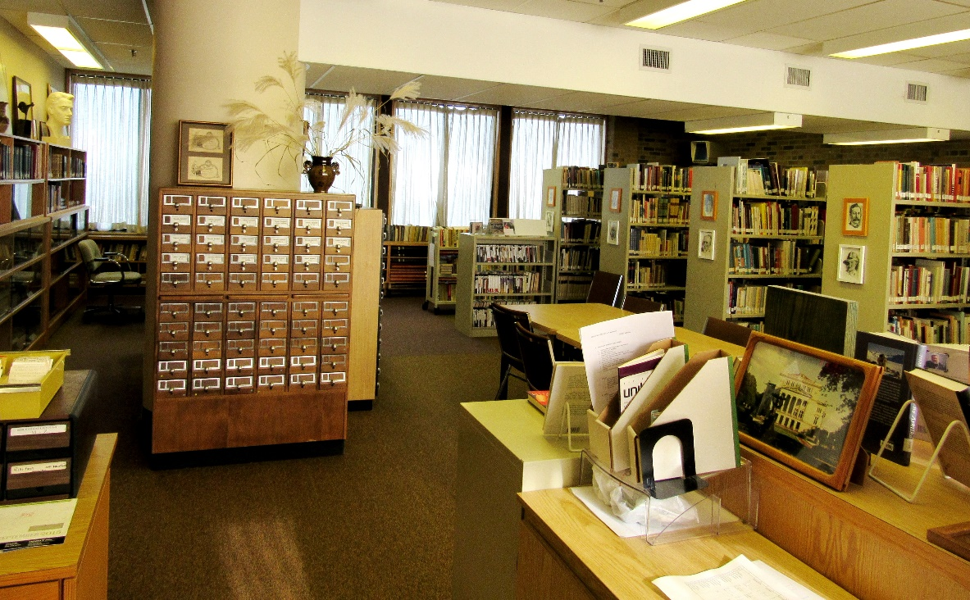
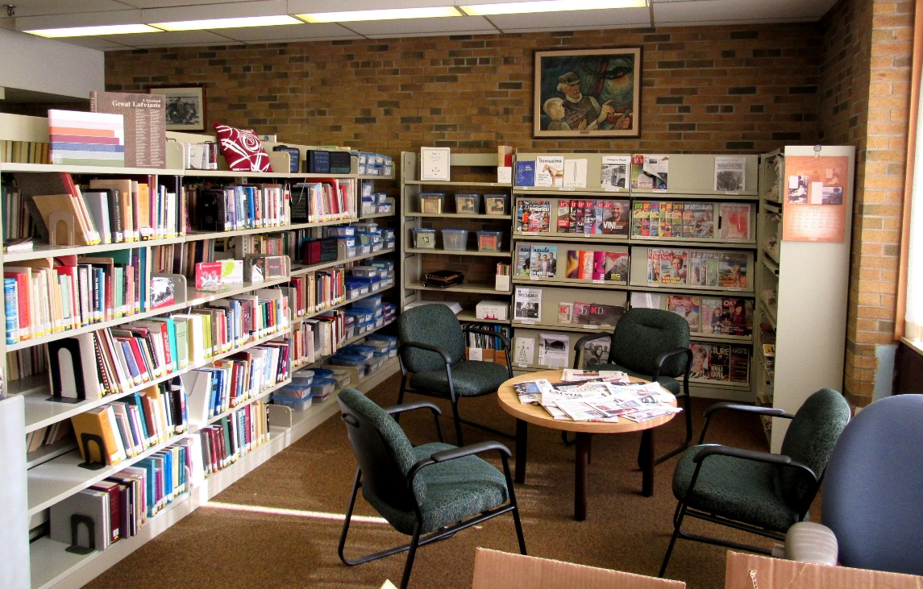
Latvian Canadian Cultural Centre Library

Slide 12
Generations of Latvian community libraries
Third wave
  2000’s – Philadelphia Society of Free Letts Library revival
  Minneapolis Library
  2010 – Garezers Library (Three Rivers, MI) - moved
  2014 – Karlis Ķezbers Latvian Library (Chicago) revival
  2016 – Boston Latvian Library
  2018 – Latvian Library in Yonkers revival

Slide 13
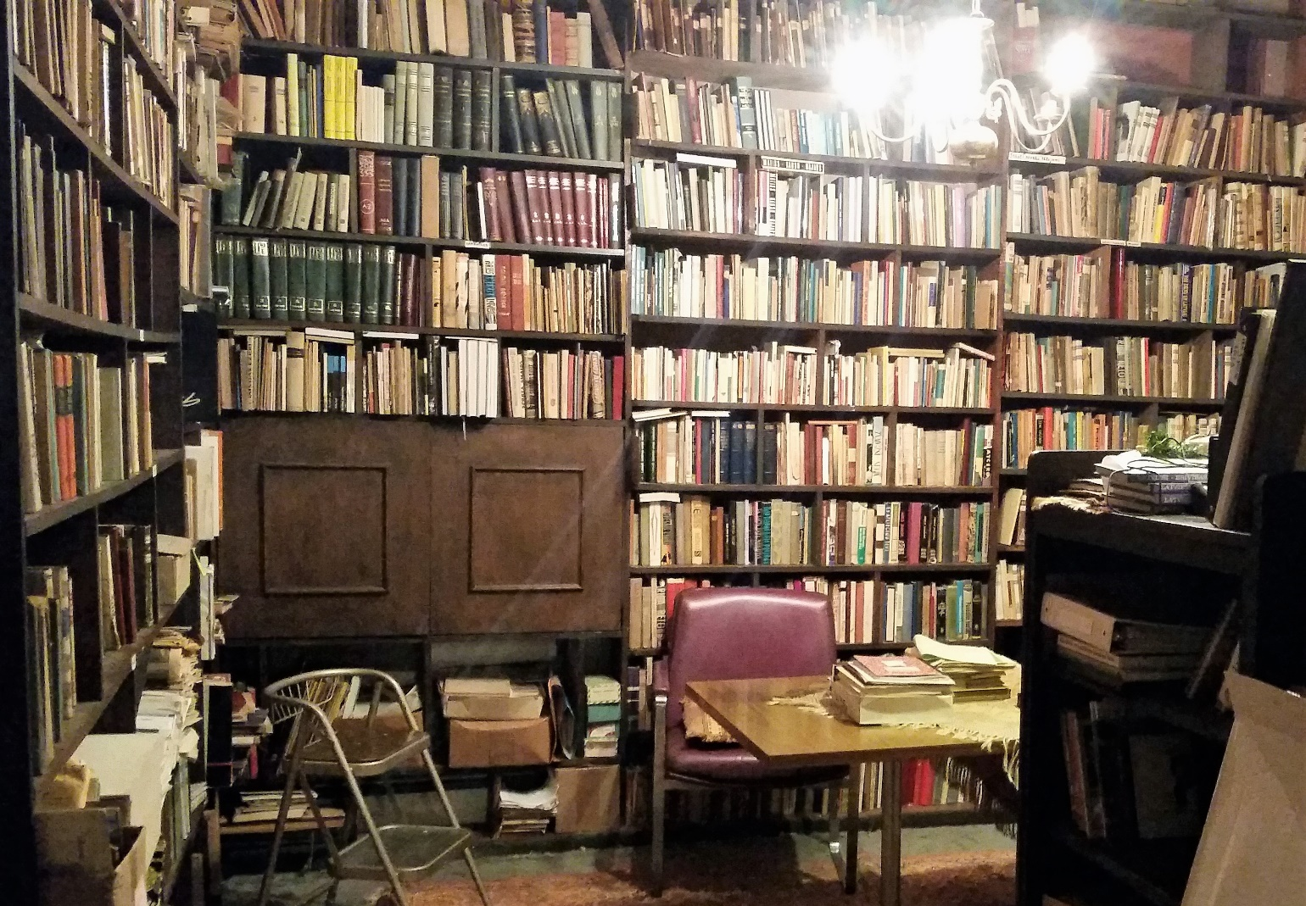
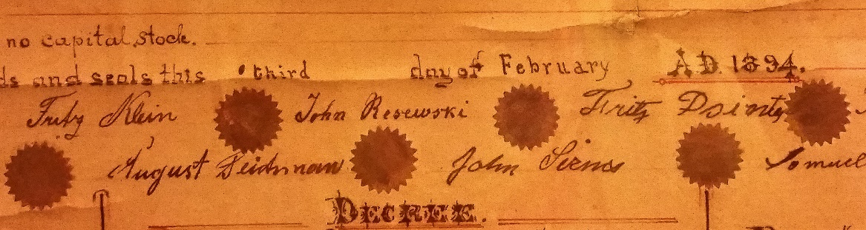
Philadelphia Society of Free Letts Library

Slide 14
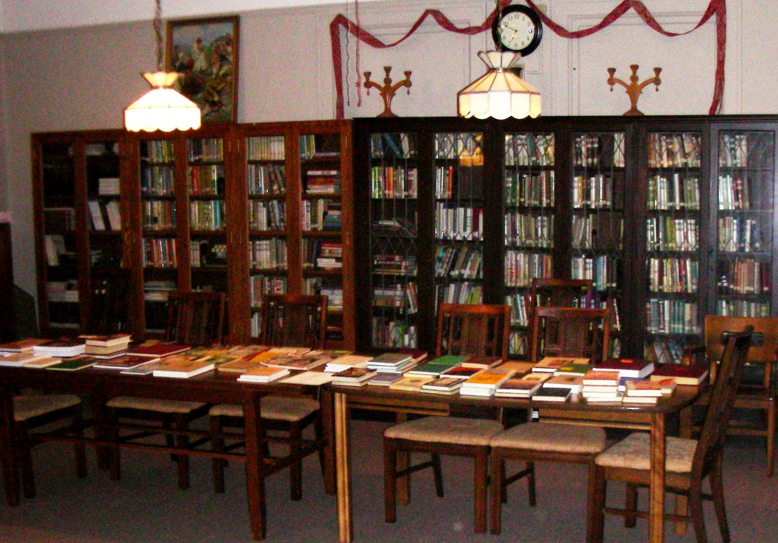
Minneapolis Library

Slide 15
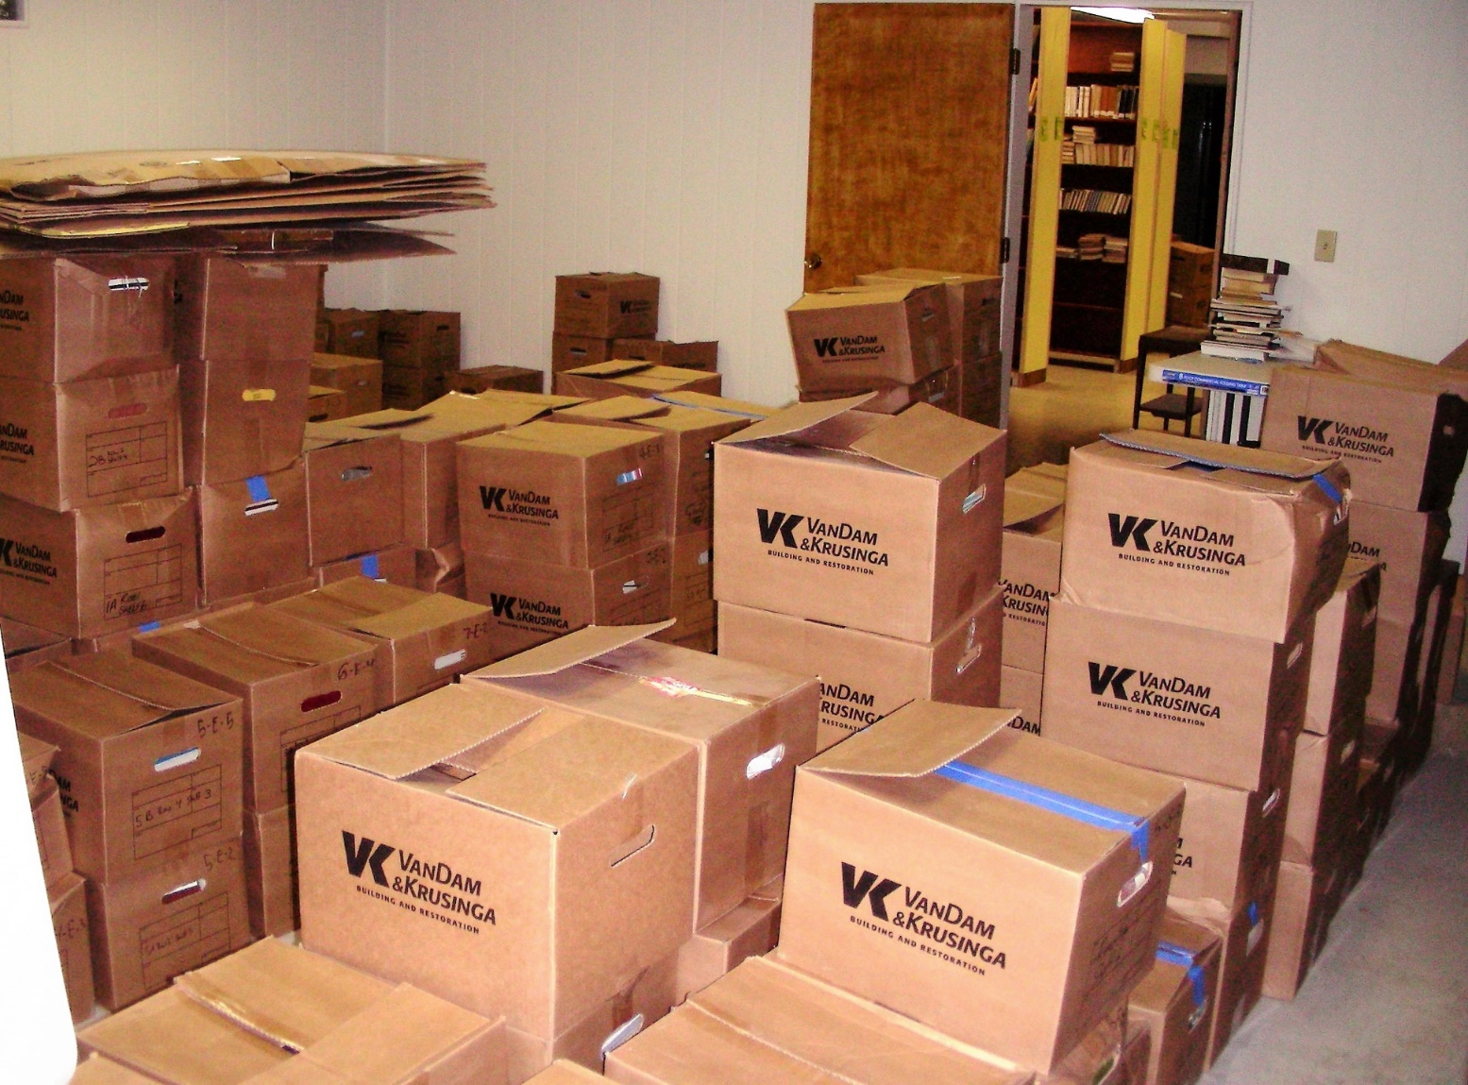
Latvian Center Garezers Library
(Three Rivers, MI)

Slide 16
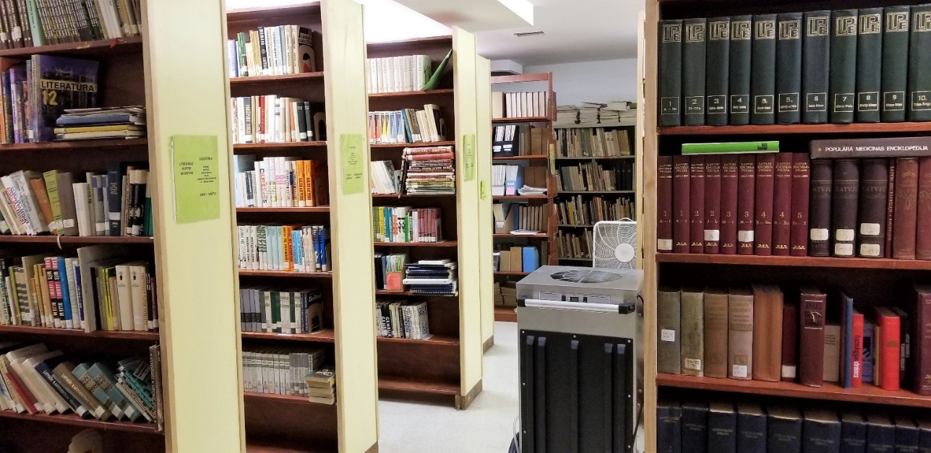
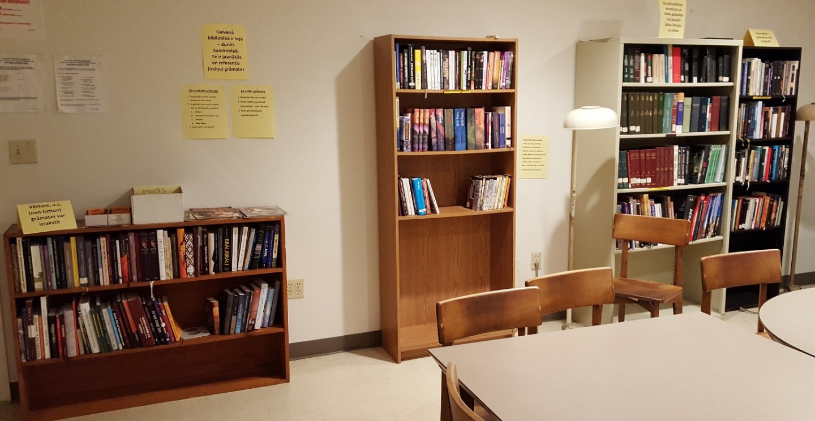
Latvian Center Garezers Library
(Three Rivers, MI)

Slide 17
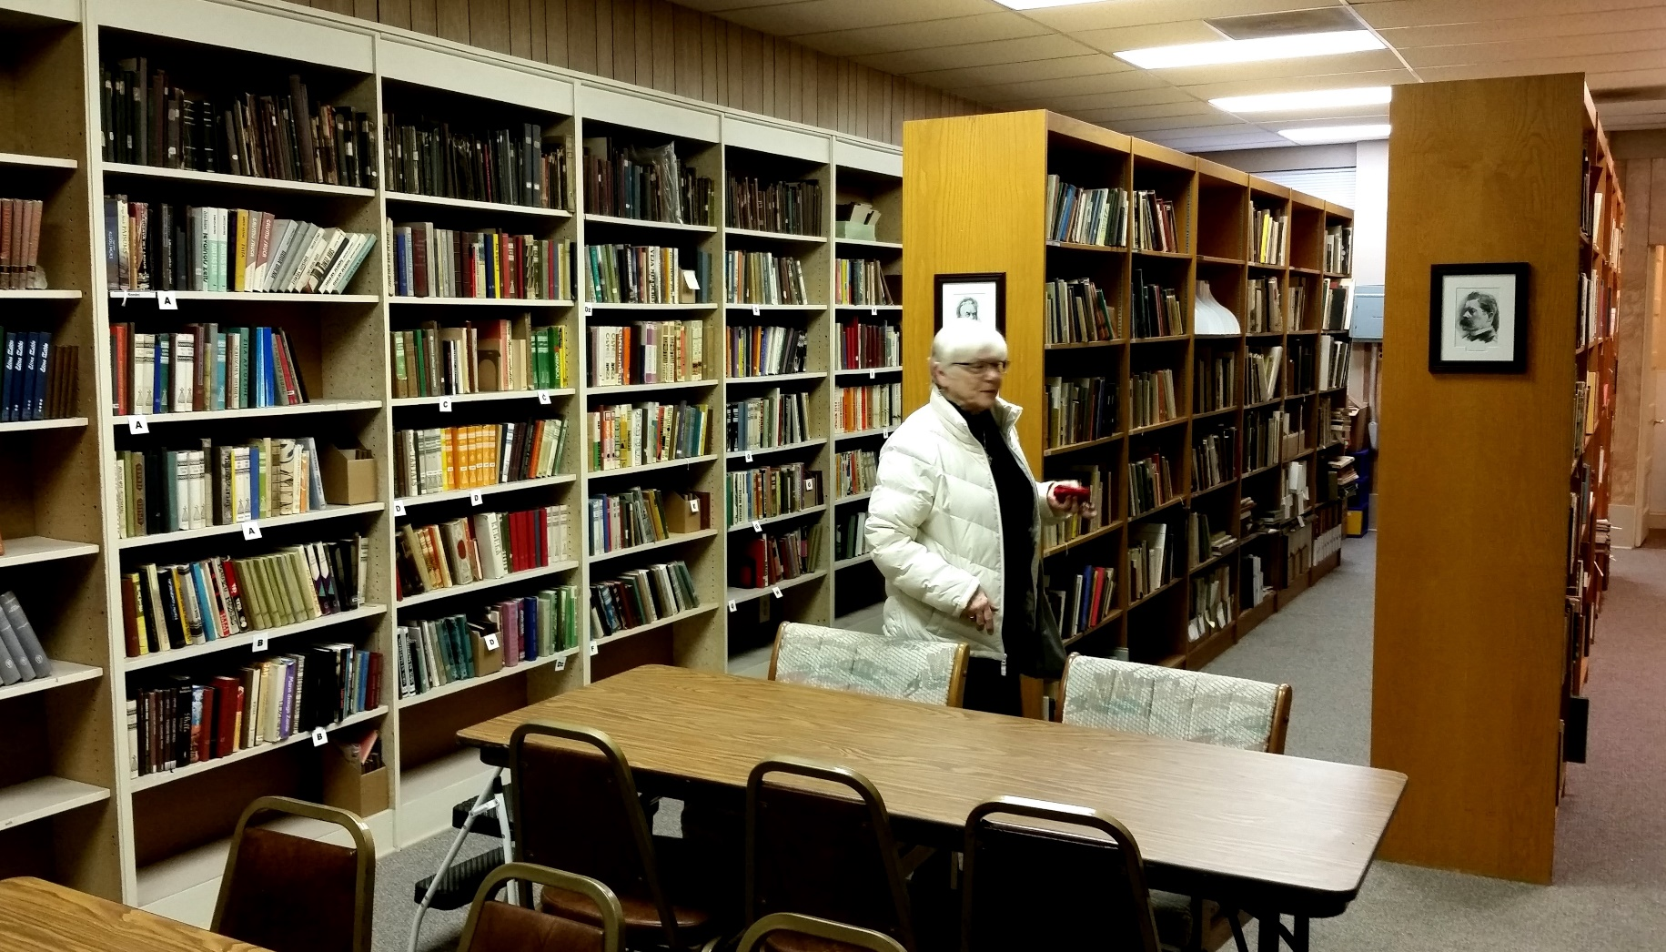
Karlis Ķezbers Latvian Library (Chicago)

Slide 18
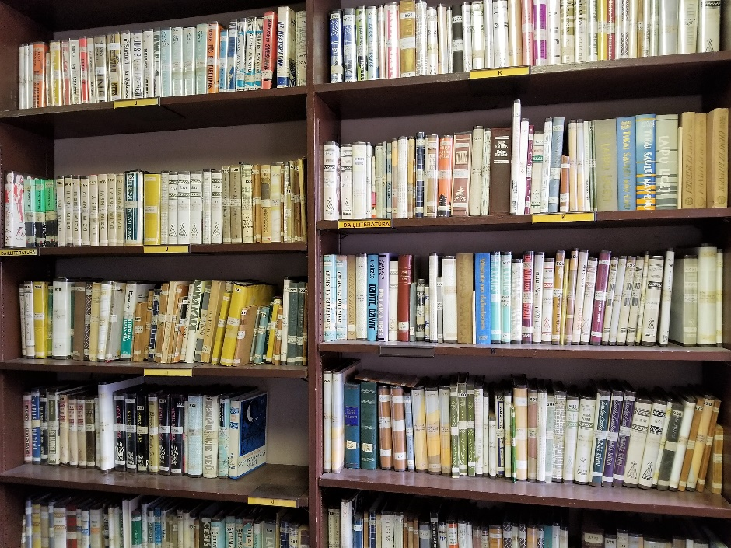
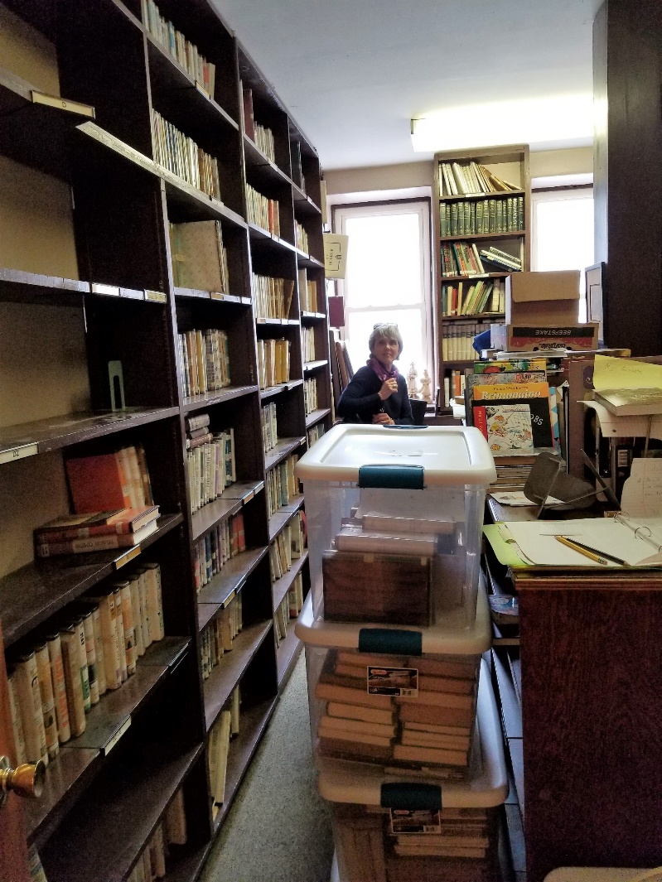
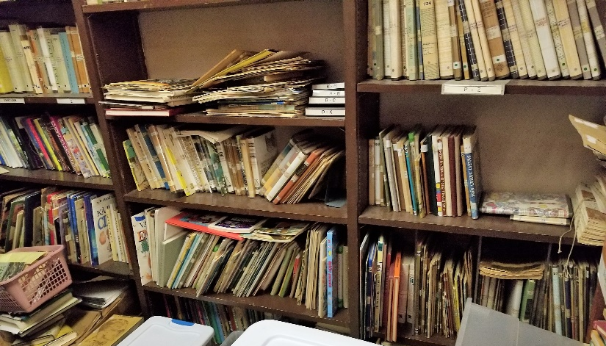
NY Latv. Ev Luth. Church Library - Yonkers

Slide 19
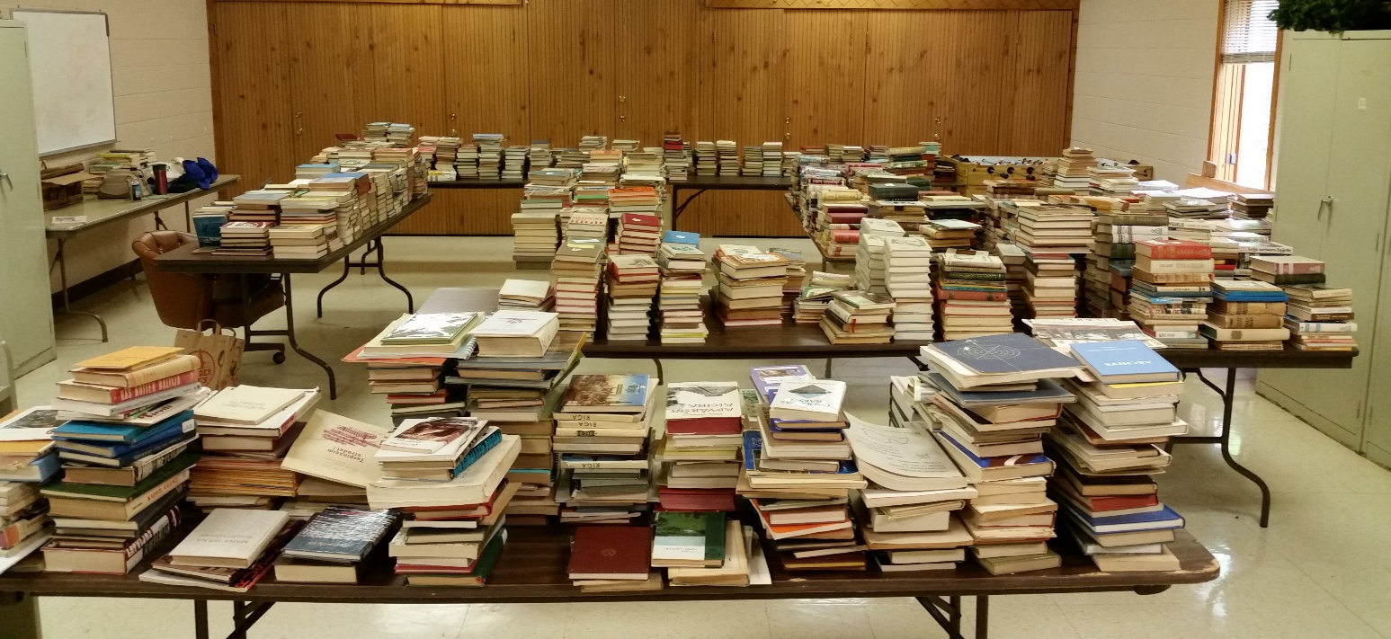
Kalamazoo library sorting

Slide 20
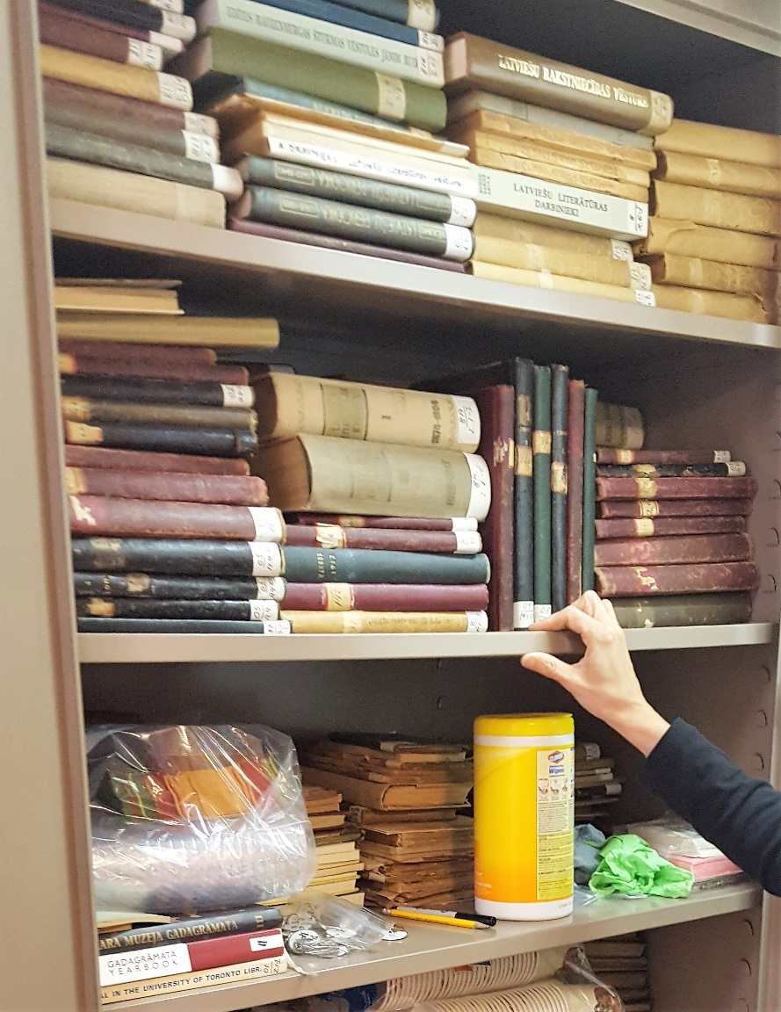
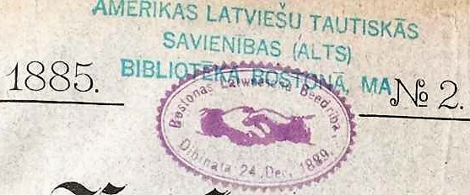
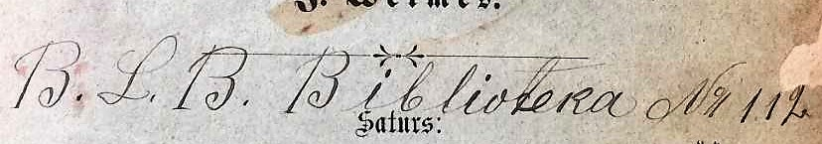
American Latvian National League Library/Archive in Boston

Slide 21
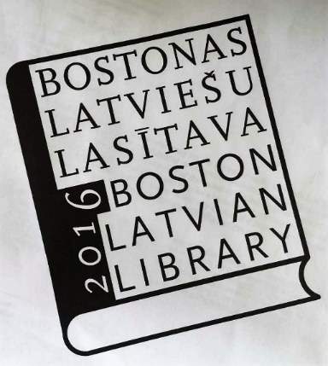
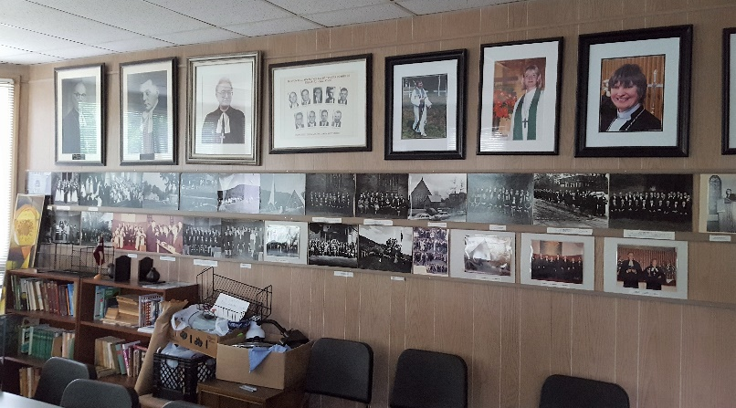
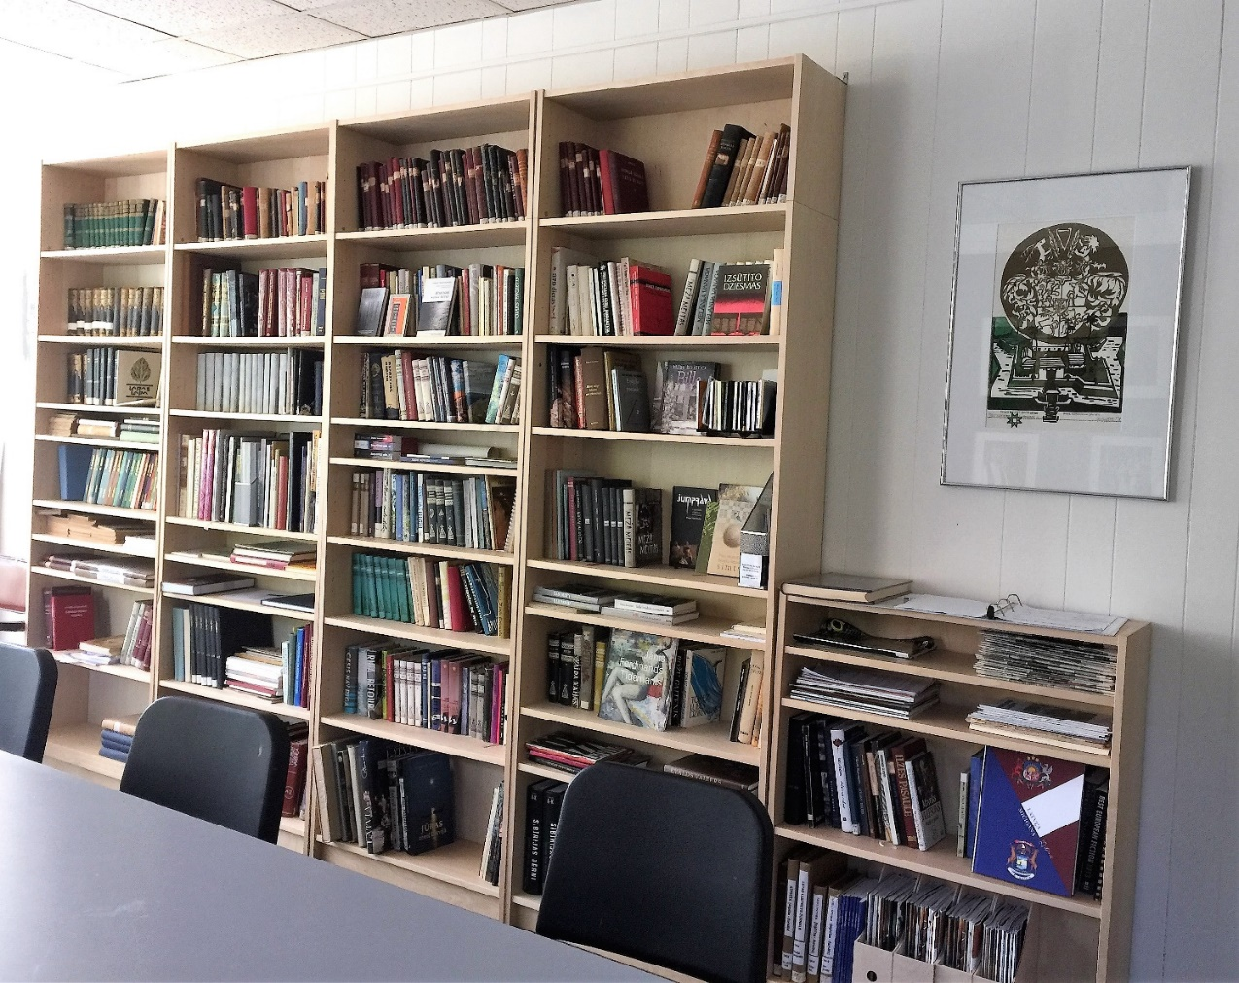
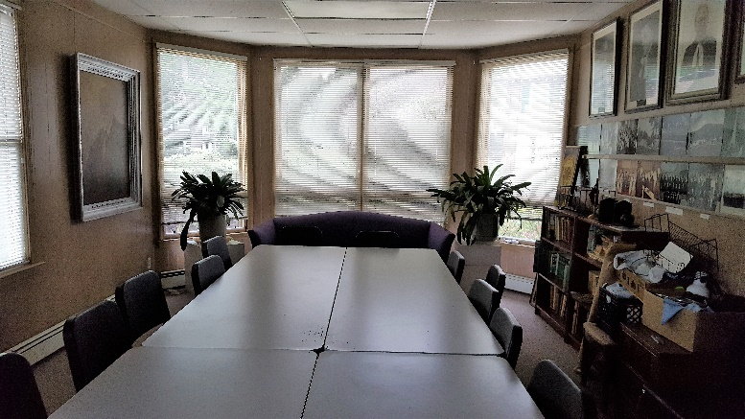
Boston Latvian Library
Before
and after

Slide 22
Conclusion - suggestions
Realize what you have that is unique and needs to be preserved for historical purposes as an archive.
Who are your readers or potential readers and what do they need?
Make the collection live by acquiring new materials
Keep some of the old
Check if Latvia still needs any of your publications.
Find a good home for what you don’t need
Don’t be afraid to recycle.

