Slide 1


Re-Inventing Reference
Lynn Sheehan
Head of Liberal Arts Programs
ACRL 2011
A Declaration of Interdependence
Philadelphia, PA ~ April 1, 2011

Slide 2
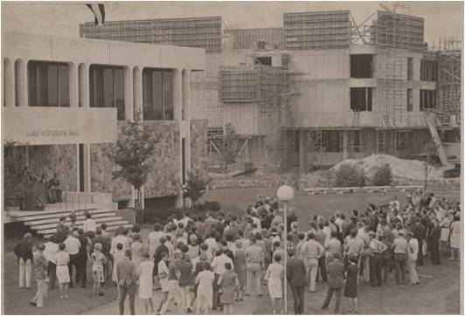
Grand Valley State University
Comprehensive, public university
Three plus campuses
800 plus faculty
24,000 plus undergraduate and graduate students
18 liaison librarians

Slide 3
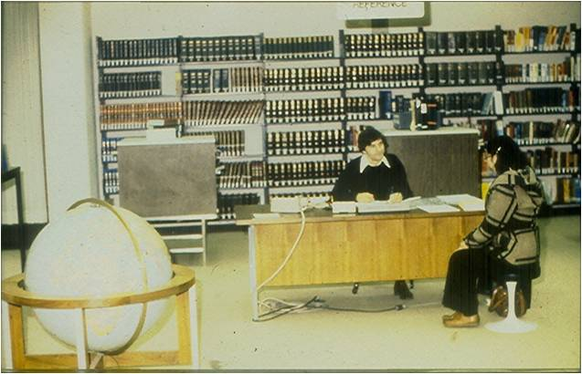
Reference @ GVSU: Then
Three locations with different environments, patrons, and staffing
Hybrid staffing—Reference Desk Assistant (RDA) program
Informative statistics (LibStats) beginning Fall 2008
  Number of questions
  Type of questions

Slide 4

Competing priorities
New responsibilities for
liaison librarians
  + Instruction
  + Outreach
  + Scholarly communications and institutional repository
  + Planning for new building and services

Slide 5

Process
Review of overall library services and trends
Analysis of LibStats evidence
Examination of print reference collection usage
Shift in attitudes toward reference

Slide 6
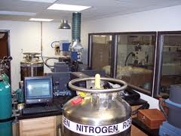
Analysis of LibStats evidence
Reference Effort Assessment Data (READ) Scale from Dominican University http://www.dom.edu/library/READ/index.html
Modified four-point READ scale:
  1-directional, technical, policy (student worker)
  2-ready reference (paraprofessional)
  3-reference (may require librarian)
  4-request for citation information

Slide 7
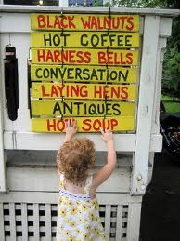
Conversations and changing attitudes
Increased reliance on RDA staffing
Changes in Reference Education
(“What’s your favorite Reference book?” discussion was telling.)
“Is Print Reference Dead?”
Polanka, S. (2008, January 29) Gale online session .

Slide 8

Led to …
A vision of blended services and single- service point to better
serve patrons
An experiment

Slide 9

Reference @ GVSU: Now
One desk at Zumberge Library
Staffed by full-time support staff and students
Librarians available for callout via Wimba Pronto in BlackBoard
Other locations in flux due to local environmental factors

Slide 10
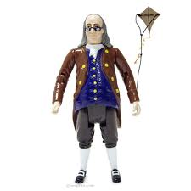
Now what?
Building relationships with other departments in library
Dealing with loss of traditional librarian role
Investigating reasons for decline
in the number of reference transactions
Assessing ourselves: student workers, staff, and librarians
Energy and persistence conquer all things ~ Benjamin Franklin

Slide 11
References
Allegri, F. & Bedard, M. (2006). Lessons learned from single service point implementations. Medical Reference Services Quarterly, 25(2), 3147.
Arndt, T. S. (2010). Reference service without the desk. Reference Services Review, 38(1), 71-80.
McDermott, M. (2001). Staffing the reference desk: Improving service through cross-training and other programs. Legal Services Quarterly, 19(1/2), 207-219.
Moore, M.E., McGraw, K.A., & Shaw-Kokot, J. (2001). Preparing staff to work at a single service desk. Medical Reference Services Quarterly, 20(1), 79-86.
Naismith, R. (2004). Combining circulation and reference functions at one desk. Journal of Access Services, 2(3), 15-20.
Powell, J., Bryan, L., Michelson-Thiery, M., Koltay, Z., & Patterson, M. (2007). Integrating an engineering library's public service desk: Multiple perspectives. Issues in Science and Technology Librarianship, 49(Winter).

Slide 12
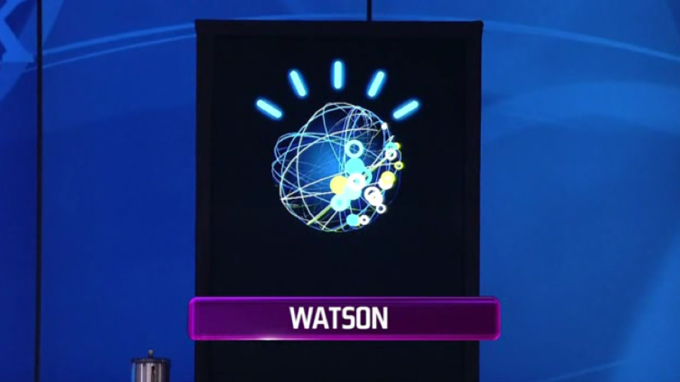
Questions? sheehanl@gvsu.edu

