Slide 1

Student Success and Learning through Critical Thinking Development
Presented By:
Dr. Lynell Hodge
March 24, 2017

Slide 2
Outline
Introductions
Background information
What’s at stake?
Discuss student learning

Slide 3
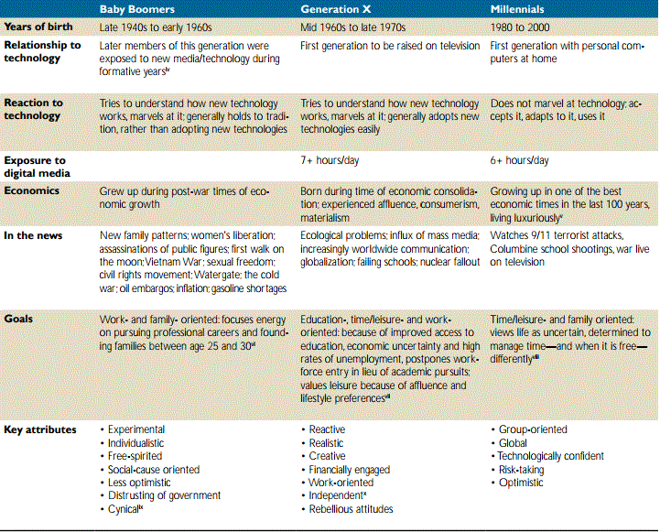
Student Demographics
International Education Advisory Board (n.d.) Learning in the 21st Century: Teaching today’s students on their terms.
Notes:
https://www.certiport.com/Portal/Common/DocumentLibrary/IEAB_Whitepaper040808.pdf

Slide 4
What’s at stake?
The National Education Association (Towler, 2014) reported memorization was a teaching strategy.
Memorization focuses on recall and application, but lacks
  Student engagement
  Student preparedness

Slide 5
Student Learning
Why is it important to discuss student learning?
  Cognitive engagement
    Learning more deeply
  Critical thinking
    Problem solving
Notes:
http://neatoday.org/2014/11/25/deeper-learning-moving-students-beyond-memorization-2/

Slide 6
Teaching Strategies
Content delivery approach
Teacher led
  Ex: lectures, webinars, etc.
Student-focused
  Ex: discussions, group work, etc.
Pros and cons of each
Notes:
https://www.scribd.com/document/98174770/Strategies-of-Teaching list of teaching strategies

Slide 7
Strategies for engagement and critical thinking
Reflection- process of making meaning
Role immersion- a form of role play
Simulation- imitate a real-world process or system
Debates- oral presentation of knowledge
Engagement Critical Thinking

Slide 8
Recommendations
Depending on the subject combining the teaching strategies maybe the most effective
  i.e. lecture followed by role immersion
Provide guidelines/rubrics
  Association of American College and Universities
Provide detailed feedback to students prior, during, and after experiences to support their learning

Slide 9
Student Feedback
“I feel the simulations and experiences were most effective. Whatever she does, she should never stop giving feedback in general or on papers/assignments because she is a great resource when it comes to reviewing our work.”
“I was glad she made us do so many hands on experiences in a way that was inclusive to all students.”
“I loved every project as it was a good way to learn the material and reinforce it.”
“I think she should try to get rid of so many papers and focus on simulation, discussion, and immersive experiences whether it be a class trip to downtown or to a food bank or something.”
  Evaluation comments
“I will be applying to medical school this summer and you are a part of the main reason why I still volunteer with hunger and homelessness.”
  Student email

Slide 10
On Campus Resources
Faculty Center for Teaching and Learning
  http://www.fctl.ucf.edu/
  Faculty Success
Office of Faculty Excellence
  http://facultyexcellence.ucf.edu/
UCF Library
  http://library.ucf.edu/services/instruction/

Slide 11
Contact information
  lynell@ucf.edu

