Slide 1


A Research Agenda on the Persuasive Effects of Social Media Influencers
Louisa Ha, Ph.D.
Professor
and
Yang Yang
Doctoral Candidate

Slide 2
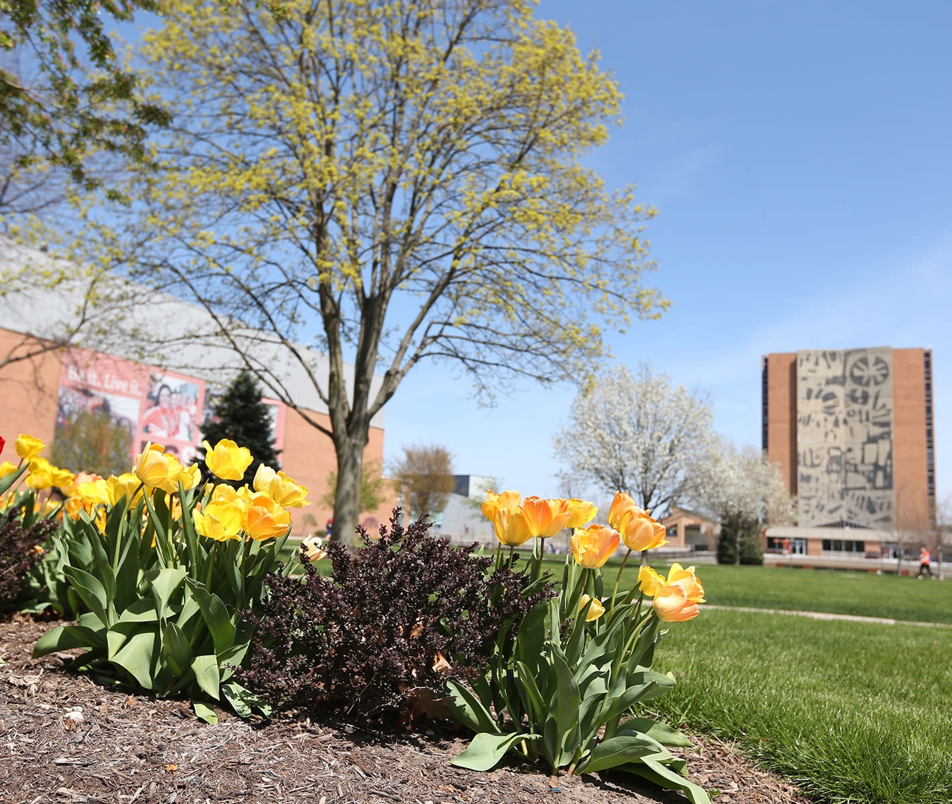
Academic interest in social media influencer marketing
2019 special issue on it in the International Journal of Strategic Communication
upcoming special issues in:
International Journal of Advertising
Journal of Advertising

Slide 3
Characteristics of Opinion Leaders
Group of people who create or disseminate the information from the media
Willing to speak out and be different from others
Uniqueness and originality
Not every individual has the same perceived opinion leader
have high influence on consumers’ product adoption processes as well as their decision making

Slide 4
4 Common Types of Opinion Leaders
1. Peers
2. Experts
3. Celebrities
4. Social Media Influencers (combination of 1,2,3)

Slide 5
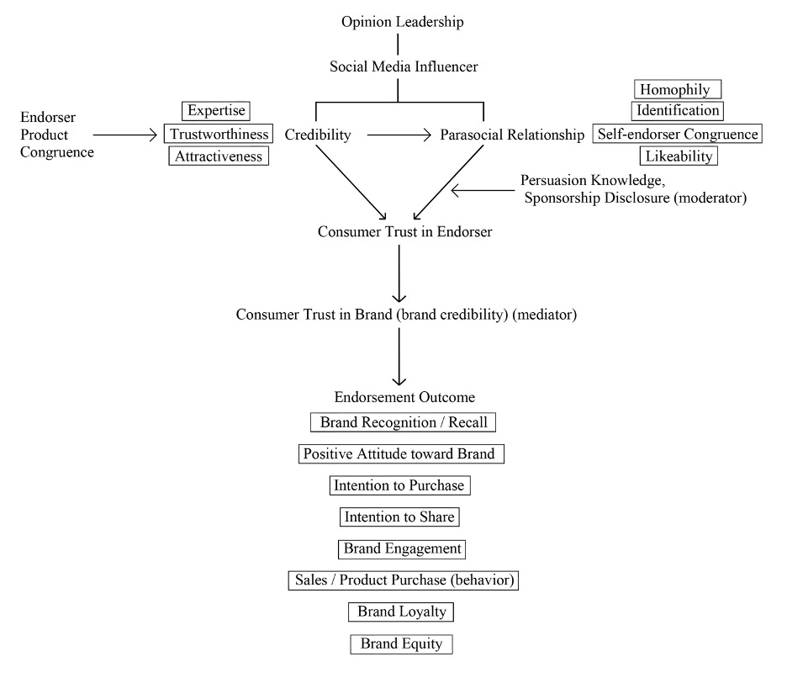
The Social Media Influencer Brand Persuasion Process

Slide 6
Future Research Agenda
Product Category, User Difference and Content Development in Social Media Influence Marketing
Scope of Influence of the Influencers
Cross-national Comparison to Test Social Media Influencer Persuasion Models
Platform Comparison and How Social Media Influencers Use the Platform’s Technology Affordances to Build Relationship
Type of Influencers and the Strength of Influence
Longevity of Influence of SMIs
How Trust in SMI Developed over Time
Influencer Risk Assessment and Controversiality Index Development
Ethics of Influencer Marketing Beyond Disclosure

Slide 7
Product Category, User Difference and Content Development in Social Media Influence Marketing
Difference in influencer effectiveness in new brands vs established brands, high and low involvement products, Digital goods (e.g., mobile apps, mobile games) vs. non-digital goods
How do subscribers/followers differ from ad hoc viewers/users in the persuasiveness of the social media influencers?
Consumers’ prior knowledge: the existing knowledge towards the endorsed product based on consumers’ life experiences and their prior experience with the product. Consumers may have already an attitude toward the endorsed product regarding its good or bad. Then how much the influencer can change them has not been studied.
How to define product-influencer congruency?
Need more research on brand endorsement strategies used by social media influencers
more content analysis and big data analysis research on the topic should be conducted as the current research is dominated by surveys and experiments.

Slide 8
Scope of Influence of the Influencers
Compare a range of influence from:
directly related products matching the expertise of the influencer,
closely related products that the influencer probably has some expertise in it,
unrelated products that the influencer should have no knowledge in them
social issues, to advocacy and activism that the influencer as a citizen of the society can be vocal about it.

Slide 9
Cross-national Comparison to Test Social Media Influencer Persuasion Models
Severe lack of cross-national comparison studies to validate the influencer persuasion models across markets
Pay attention to global south markets (Africa and Latin America)
Cultural impact of social media influencers on domestic and international followers should be examined
Need more international collaboration

Slide 10
Platform Comparison and How Social Media Influencers Use the Platform’s Technology Affordances to Build Relationship
how social media influencers develop parasocial relationship with their followers in each platform and their relationship management with different affordances/audience expectations
the synergy of the platforms which influencers have presence for the benefit of the advertisers

Slide 11
Type of Influencers and the Strength of Influence
Different types of influencers on social media with different fan base and source of fame.
Offline celebrity turned social media influencers vs. the native social media influencers such as PieDiePie.
The effect of the gender of the influencer (opposite sex versus same sex influencer) and gender-congruity expectation on the parasocial relationship strength, perceived homophily and credibility with their followers.

Slide 12
Longevity of Influence of SMIs
compare long time successful influencers such as PewDiePie with influencers that decline in influence over time to identify longevity attributes of influencers and how to maintain a career as a social media influencer.

Slide 13
How Trust in SMI Developed Over Time
How social media users found out the influencers and became their followers.
Current follower research had not examined the characteristics of the followers for different types of influencers.
The relationship can change over time. The reasons of the user following the influencer (e.g., share the same values and opinion, or want to learn from the influencer or just follow others because of the fame and popularity) may predict their loyalty and trust in the influencer.

Slide 14
Influencer Risk Assessment and Controversiality Index Development
Avoid risks and damages caused by negative influencers and celebrities real-life behaviors including scandals and their controversial and unethical behaviors
Create a controversality index of influencers based on their content and personal life-style
Systematic measurement of spontaneity, sincerity and authenticity of influencers

Slide 15
Ethics of Influencer Marketing Beyond Disclosure
How much the influencer may alter and bias their product reviews and haul videos of other competing brands after they received sponsorship of one brand
Analyzing the changes in impartiality and opinion of other competitor brands after the influencer was sponsored by a particular brand.
To what degree influencers follow the Federal Trade Commission’s (FTC) disclosure guideline and regulations in different countries

