Slide 1
Using a Mindfulness Based Art Technique That Promotes Emotion Regulation and Self Compassion
Lisa S. Sosin, PhD, LPC, LLP, BACS

Slide 2
Rationale for Using The Creative Exposure Technique
(1). Learn about a simple approach to teaching clients of all ages and backgrounds about emotion regulation and dysregulation and how they relate to their presenting concerns
(2). Learn the theoretical underpinnings of Creative Exposure
(3). Learn the steps to Creative Exposure
(4). Practice Creative Exposure

Slide 3
Rationale for Using The Creative Exposure Technique
Creativity supports adaptability and problem solving skills (Lawrence, Foster, & Tieso, 2015)
The importance of creativity has been demonstrated in both counseling and counselor education (Duffey, Haberstroh, & Trepal, 2009; Whitelock, Faulkner, & Miell, 2008).
Creative, mindfulness approaches are effective in supporting integration of disassociated, un-integrated aspects of the self and intolerable affect states (Siegel, 2010).
Exposure treatment is effective for trauma symptoms (Barlowe, D., Ellard, K., Fairhome, C. Farchione, T. & Boisseau, C., 2011)
Creative Exposure is a gentle, creative, and powerful method of compassionately exposing counselees to avoided affect (Sosin, 2015; 2016; Rappaport, 2009).
These methods have been profoundly effective in my practice with children, adults, couples, and families (Sosin, 1985-2016)

Slide 4
KEY TERMS USED IN THIS PRESENTATION
Emotional Development: The process by which we learn to know, experience, and represent in words the full spectrum of emotions with awareness and compassion toward the self and others (Greenspan, 1997).
Emotion Regulation: Our ability to experience and label our emotional experiences and respond to them in keeping with our values and authentic personhood, even when we feel significant distress (i.e., intense fear, guilt, and/or shame); the developmental capacity of monitoring and modifying the flow of energy and attention of the mind. Rigid or chaotic mind states reflect strong neural networks that are tenacious and require a tremendous amount of energy to learn how to regulate (Siegel, 2010).
Attunement: The ability for the counselor to be empathically present and sensitive to the affective and cognitive state of the counselee. This state of shared being promotes internal integration and the ability for blocked states of consciousness to emerge so that self-regulatory capacities can develop (Gottman, Gottman, & Siegel, 2014).
Exposure Treatment: An evidence based cognitive-behavioral therapy treatment that promotes habituation to avoided/distressing/intolerable/dissociated affective and cognitive content (Barlow et al., 2011; Gabbard, 2014).
Mindfulness Practice: Purposeful attention to the present moment while non-judgmentally and objectively observing cognitive and affective content (Siegel, 2007).
Self Compassion: The ability to respond to ourselves with gentleness, tenderness, patience, and kindness; knowing and accepting ourselves as we are in the moment (Neff, 2015).
Art Focusing: an evidence-based counseling skill based on Eugene Gendlin’s Focusing Technique (1996) and developed by Laurie Rappaport (2009).

Slide 5
THEORETICAL FRAMEWORK
The Creative Exposure Tool draws from several empirically based models.

Slide 6
It is Grounded on an Emotion Development Model: Six Core Developmental Capacities
1. Regulation and Shared Attention (FELT SECURITY) (0-3 months)
2. Engagement with warmth, trust, intimacy (ATTACHMENT) (3+ months)
3. Two-way purposeful, GESTURAL communication (DIFFERENTIATION ENABLED VIA SECURE BASE) (3+ months). Interactive problem-solving/use of gestures in continuous flow.
4. Functional use of ideas (REPRESENTATION WITH WORDS) (12 MONTHS+)
5. Building bridges between ideas (GREATER AND GREATER REPRESENTATION ACROSS THE VARIETY OF AFFECTIVE-SELF THEMES)
6. MATURITY= LOVE (including the ability to speak the truth in love) AND WORK (individuated yet interdependent, authentic expression of the self)
(Greenspan, 1997)

Slide 7
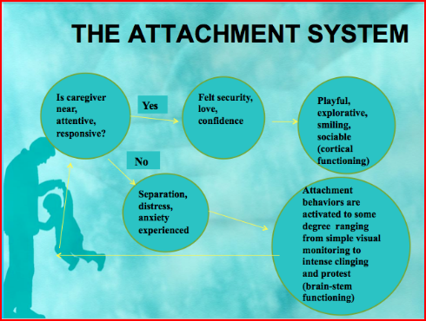
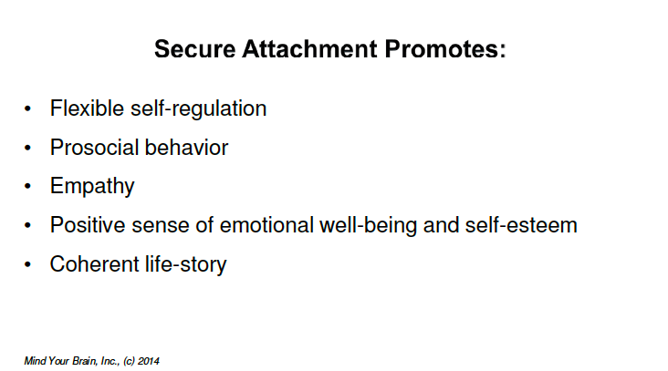
It includes an interpersonal neurobiology perspective on emotion development.
Where is the counselee in terms of monitoring, experiencing, representing in words, and regulating primary feelings:
Sadness, Disappointment, Anger, Pleasure, Excitement, Delight, Happiness,
Pride, Competition, Self-Esteem, Positive Self-Regard, Jealousy, Envy,
Curiosity, Sad, Angry, Helpless, Excited, Humiliated…
(Bowlby, 1988)
(Bowlby, 1998; Siegel, 2014)

Slide 8
Date/Time | Situation | Automatic Thought/s Images with Belief Level (1-10) | Feeling/s with Significant Units of Disturbance (1-10) | Bio-Psycho-Social-Spiritual Tools | Results (1-10)
It draws on SF-CBT and Art Therapy methods to promote secure attachment and emotion development
(Bowlby, 1988)

Slide 9
Introduction to Creative Exposure
Art as process/expression of authentic self vs. product
Supplies: Paper, colors, and between session logging sheet

Slide 10
Steps of the Creative Exposure Method
What We are Going to Do Together Today
Anchor/Safe Place-Person
Depiction at center of paper
Selection of Trigger
Depict the thoughts, feelings, and behaviors related to trigger using the downward arrow technique to get to schema level
Re-establish anchor and address thoughts, feelings and behaviors from peaceful, safe place with self-soothing and loving kindness toward self
Share experience with a partner
The Full Creative Exposure Method
Full BPSS assessment
Psychoeducation (neuro-empathy)
Counselee consent to the case conceptualization and treatment plan
Anchor: Relaxation and establishment of safe place/safe person
Depiction of Anchor
Selection of Trigger
Imaginal Exposure
Depiction of thoughts, feelings and behaviors related to trigger with SUDS and BL
Compassionate, soothing process of engagement from Anchor until felt security is ascertained
Closure
Use of Logging Sheet between sessions

Slide 11
Barlowe, D., Ellard, K., Fairhome, C. Farchione, T. & Boisseau, C. (2011). Unified protocol for transdiagnostic treatment of emotional disorders. NY: Oxford University Press.
Duffey, T., Haberstroh, S., & Trepal, H. (2009). A grounded theory of relational competencies and creativity in counseling: Beginning the dialogue. Journal of Creativity in Mental Health, 4, 89-112.
Gottman, J., Gottman, J., & Siegel, D. (2014). The Siegel-Gottman Summit Two day Clinical Training: Neuroscience Meets Family Science: Mindfulness in Relationships. WI: PESI.
Greenspan, S. (1997). Developmentally based psychotherapy. International University Press.
Lawrence, C., Foster, V., & Tieso, C. (2015). Creating creative clinicians: Incorporating creativity into counselor education. Journal of Creativity in Mental Health, 10:166-180.
Neff , Karen. Self Compassion Meditations: http://self-compassion.org/category/exercises/#guided-meditations
Rappaport, L. (2009). Focusing-oriented art therapy: Accessing the body’s wisdom and creative intelligence. PA: Jessica Kingsley Publications.
Siegel, D. (2010). The Mindful Therapist. NY: Norton.
Sosin, L. & Rockinson-Szapskiw, A. (2016, Under Review). Creative Exposure Intervention as part of clinical treatment for adolescents exposed to bullying and experiencing Post Traumatic Stress Disorder symptoms. Journal of Creativity in Counseling.
Sosin, L. (2016, Summer). Mindfully discovering one’s authentic self. Association of Creativity in Counseling Newsletter.
Sosin, L. (2016, August). The Creative Balance Tool: Teaching students’ how to maintain a healthy mind for optimal academic performance and overall wellbeing. Center for Teaching Excellence, Liberty University Faculty Orientation Workshop.
Sosin, L. (2015, November). Creative Exposure Treatment: Using Art Focusing to promote emotional development, emotion regulation, and self-compassion. Hot springs VA:Virginia Counselor Association Annual Conference.
Sosin, L. (2015, August). How Great Thou Art: Using creative focusing skills to promote stillness, sanity, and scholarship for teaching and learning. Lynchburg, VA: Liberty University Faculty Orientation.
Sosin, L. (1985-2016) Connections Psychological Services Single Case Studies.
Whitelock, D. Faulker, D., & Miell, D. (2008). Promoting creativity in Ph.D. supervision: Tensions and dilemmas. Thinking Skills and Creativity, 3, 143-153.

Slide 12
CE QUESTIONS
The creative exposure intervention log can be used to track triggers, belief and SUDS levels, and the outcome of using the intervention. True or False
One fundamental aspect of the creative exposure intervention is to develop an internal safe person and safe place. True or False
People who use the creative exposure intervention must be “good” at art to use it effectively. True or False
The creative exposure intervention includes the following steps: psychoeducation about and client consent, pre-logging, establishing and creatively depicting the safe person and safe place, selecting an active trigger, imaginal exposure and creative depiction, engaging in a compassionate, soothing process and creative depiction, and post-logging. True or False

