Slide 1
Creative Exposure Treatment: Using Art Focusing to Promote Emotional Development, Emotion Regulation, and Self-Compassion.
Lisa S. Sosin, PhD, LPC, LLP, BACS
Virginia Counseling Association Conference, November, 2015

Slide 2
What We are Doing for the Next Two Hours
1. Learn to assess and conceptualize your own and your counselee's emotional development
2. Apply this learning to case conceptualization and treatment planning
3. Learn how to utilize Art Focusing (Rappaport, 2009) and practice it yourself to promote attunement with self and others, emotional development, mind organization, affect regulation, and self-compassion
Learn how to utilize Art Focusing in keeping with a CBT exposure model that does not require art
Obtain information about further training and resources

Slide 3
Rationale for Using Creative Approaches
Research indicates that creativity supports adaptability and problem solving skills (Lawrence, Foster, & Tieso, 2015)
The importance of creativity has been demonstrated in both counseling and counselor education (Duffey, Haberstroh, & Trepal, 2009; Whitelock, Faulkner, & Miell, 2008).
Creative, mindfulness approaches are effective in supporting integration of disassociated, un-integrated aspects of the self and intolerable affect states (Siegel, 2010).
Exposure treatment is effective for trauma symptoms (Barlow, 2014).
Art focusing is a gentle, creative, and powerful method of compassionately exposing counselees to avoided affect (Rappaport, 2009).
These methods have been profoundly effective in my practice with children, adults, couples, and families (Sosin, 1985-2015)

Slide 4
KEY TERMS USED IN THIS PRESENTATION
Emotional Development: The process by which we learn to know, experience, and represent in words the full spectrum of emotions with awareness and compassion toward the self and others (Greenspan, 1997).
Emotion Regulation: Our ability to experience and label our emotional experiences and respond to them in keeping with our values and authentic personhood, even when we feel significant distress (i.e., intense fear, guilt, and/or shame); the developmental capacity of monitoring and modifying the flow of energy and attention of the mind. Rigid or chaotic mind states reflect strong neural networks that are tenacious and require a tremendous amount of energy to learn how to regulate. “Wimbledon/”10,000 hours. We can tell counselees about this (Siegel, 2010).
Attunement: The ability for the counselor to be empathically present and sensitive to the affective and cognitive state of the counselee. This state of shared being promotes internal integration and the ability for blocked states of consciousness to emerge so that self-regulatory capacities can develop (Gottman, Gottman, & Siegel, 2014).
Exposure Treatment: An evidence based cognitive-behavioral therapy treatment that promotes habituation to avoided/distressing/intolerable/dissociated affective and cognitive content (Barlow et al., 2011; Gabbard, 2014).
Mindfulness Practice: Purposeful attention to the present moment while non-judgmentally and objectively observing cognitive and affective content (Siegel, 2007).
Self Compassion: The ability to respond to ourselves with gentleness, tenderness, patience, and kindness; knowing and accepting ourselves as we are in the moment (Neff, 2015).
Art Focusing: an evidence-based counseling skill based on Eugene Gendlin’s Focusing Technique (1996) and developed by Laurie Rappaport (2009).

Slide 5
I. Learn to Assess and Conceptualize Your Own and Your Counselee’s Emotional Development
To provide a foundation and understanding for ethically and effectively applying Art Focusing in counseling, we will first review case conceptualization from an attachment and emotional development perspective.
In this section of the presentation we will:
Review an Emotion-Development Model
Consider your own development

Slide 6
Developmental Model I: Six Core Developmental Capacities
1. Regulation and Shared Attention (FELT SECURITY) (0-3 months)
2. Engagement with warmth, trust, intimacy (ATTACHMENT) (3+ months)
3. Two-way purposeful, GESTURAL communication (DIFFERENTIATION ENABLED VIA SECURE BASE) (3+ months). Interactive problem-solving/use of gestures in continuous flow.
4. Functional use of ideas (REPRESENTATION WITH WORDS) (12 MONTHS+)
5. Building bridges between ideas (GREATER AND GREATER REPRESENTATION ACROSS THE VARIETY OF AFFECTIVE-SELF THEMES)
6. MATURITY= LOVE (including the ability to speak the truth in love) AND WORK (individuated yet interdependent, authentic expression of the self)
(Greenspan, 1997)

Slide 7
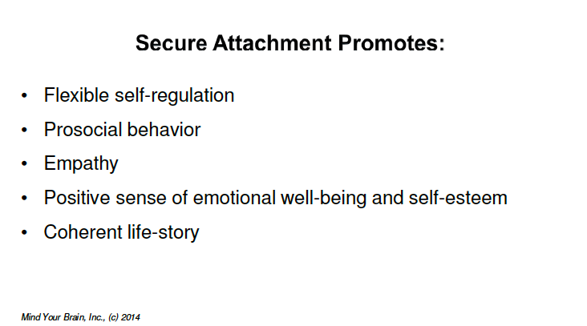
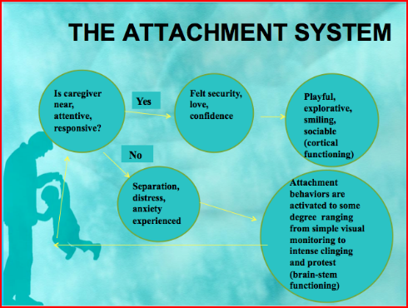
(Bowlby, 1988)
(Bowlby, 1998; Siegel, 2014)

Slide 8
Developmental Model II: Emotional Themes that Need “Scaffolding” to Come Up the Developmental Ladder without Constriction or Full Deficit
Dependency, intimacy and closeness (including separation anxiety)
Pleasure, excitement, and sexuality
Assertiveness, curiosity, competition, anger, aggression (incudes fears and worries about aggression)
Self-limit setting
Empathy and mature forms of love
Think of each of these capacities as existing on a continuum. A ladder helps conceptualize this and counselees understand this readily.

Slide 9
Important Note: Optimal development of these capacities involves a complex interplay of intrapersonal, interpersonal, and extra-personal factors (i.e., sensory uniqueness, generational/parental attachment/trauma history, crisis/trauma, systems family is embedded in, etc.).
We all have limitations in some of these areas and will go “down” the developmental ladder given enough brain stem activation.

Slide 10
II. Apply This Learning to Effective Case Conceptualization and Treatment Planning Prior to Using Art Focusing
In this section of the presentation we will:
Determine where art focusing fits into the treatment process
Discuss the foundational task of case conceptualization
Explore a form of CBT exposure treatment

Slide 11
Pre-Assessment
Comprehensive Bio-Psycho-Social-Cultural Assessment (including DSM based interview)
Written Report with Case Conceptualization and DSM Diagnosis
Treatment Plan with Goals and Measurable Outcomes
Assessment Throughout the Treatment Process
Termination
After Care Plan
Assessment Throughout the Treatment Process
Termination
After Care Plan
Where Art Focusing Exposure Treatment Fits Into the COLLABORATIVE Treatment Process

Slide 12
The key to case conceptualization is collaboratively determining what needs to happen in treatment for the counselee to reach his/her goals as quickly and effectively as possible before starting formal treatment. Where is the counselee stuck (emotional themes) at what level (developmental capacities).
Treatment provides a safe haven for counselees to come up the developmental ladder as they create a bio-psycho-social-spiritual toolbox to effectively address triggers (bring down SUDS levels).
You may find this Exposure Logging sheet, that my counselees and I often utilize, helpful for processing out of session triggers (clock metaphor) that counselees could not sufficiently down regulate (Meichenbaum, 2014).
Art focusing becomes one of the tools folks use to bring SUDS levels down. Many of my counselees learn to effectively use this method without using art. They develop skill in other tools that are more congruent for them.

Slide 13
III. Learn How to Utilize Art Focusing (Rappaport, 2009) and Practice it Yourself to Promote Attunement with Self and Others, Emotional Development, Mind Organization, Affect Regulation, and Self-Compassion
In this section of the presentation we will:
Introduce Art Focusing
Learn the steps to Art Focusing
Practice Art Focusing

Slide 14
Introduction to Art Focusing
Art as process/expression of authentic self vs. product
Supplies

Slide 15
Steps of the Method
Clearing a space (*provide more structure for those who are more dysregulated: secure attachment/organized: less structure; insecurely attached/dismissing/avoidant organization; disorganized attachment: more structure). Stop here and create art from Step One
Choosing an issue and a felt sense
Finding a handle/symbol
Resonating with artistic expression. Stop here and create artistic expression of your felt sense image.
Asking the Felt Sense
(Rappaport, 2010, p. 105)

Slide 16
IV. Learn how to utilize Art Focusing in keeping with a CBT exposure model that does not require art
PRACTICE…

Slide 17
V. Obtain information about further training and resources
Duffey, T., Haberstroh, S., & Trepal, H. (2009). A grounded theory of relational competencies and creativity in counseling: Beginning the dialogue. Journal of Creativity in Mental Health, 4, 89-112.
Gabbard, G. O. (2014). Gabbard’s Treatments of Psychiatric Disorders: DSM V Edition. Arlington: APA.ISBN- 13: 78-1585624423 | Edition: 5
Gendlin, E. (1996). Focusing-oriented psychotherapy: A manual of the experiential method. NY: Guildford.
Gottman, J., Gottman, J., & Siegel, D. (2014). The Siegel-Gottman Summit Two day Clinical Training: Neuroscience Meets Family Science: Mindfulness in Relationships. WI: PESI.
Greenspan, S. (1997). Developmentally based psychotherapy. International University Press.
http://focusingarts.com
Lawrence, C., Foster, V., & Tieso, C. (2015). Creating creative clinicians: Incorporating creativity into counselor education. Journal of Creativity in Mental Health, 10:166-180.
Neff http://self-compassion.org/category/exercises/#guided-meditations
Rappaport, L. (2009). Focusing-oriented art therapy: Accessing the body’s wisdom and creative intelligence. PA: Jessica Kingsley Publications.
Siegel, D. (2010). The Mindful Therapist. NY: Norton.
Whitelock, D. Faulker, D., & Miell, D. (2008). Promoting creativity in Ph.D. supervision: Tensions and dilemmas. Thinking Skills and Creativity, 3, 143-153.

