Slide 1
Under Pressure: Work-related stress in academic libraries
Fayth Parks, Ph.D, Licensed Psychologist
Lori Gwinett, M.L.I.S.
Lisa P. Smith, M.L.S
Georgia Southern University
Statesboro, GA
Notes:
Welcome audience, introductions

Slide 2
Today’s goals:
Discover issues and problems that academic librarians find stressful about their jobs
Review how stress affects the mind and body
Identify signs of stress overload
Discover how work-related stress can affect job performance
Discover measures that will help ameliorate the effects of stress
Notes:
Review goals for the session. Explain that it will be an interactive session.

Slide 3
What is stress?
“A person’s psychological and physiological response to the perception of a demand or challenge”
Dependent upon the meaning an individual gives to the challenge
AND
Dependent upon the individual’s assessment of resources available to meet the demand
Bunge, C. (1987). Stress in the library. Library Journal, 112(15), 47.
Notes:
basic definition of stress, which is essential.
Stress is something that is within a person. This is why something that is stressful to one person may not be at all stressful to another.

Slide 4
Is librarianship a stressful profession?
Kniffel, L. (1999). Survey says librarians rank low in stress. Hel-lo? American Libraries, 30(5), 38. Retrieved from http://search.ebscohost.com/login.aspx?direct=true&db=lxh& AN=1834915&site=ehost-live
Notes:
Not everyone agree that libraries are stressful places to work. According to this editorial, written shortly after the Jobs Rated Almanac (St. Martin’s Griffin) was published. This book ranked 250 careers by 6 factors: environment, income, outlook, physical demands, security, and stress. Librarian ranked at the bottom of the unstressed, along with florist and piano tuner. It ranked the 9th lowest in stress.
As Kniffel puts it, it could be that we as librarians make it all look easy. The editor of the almanac, Les Krantz, apparently knows little or nothing about the job of a librarian, especially when it come to role ambiguity, which Kniffel states is a leading cause of stress for librarians.

Slide 5

A typical day at the desk?
Notes:
Most library users (hopefully) do not see librarians or library staff interact or react in such a way as Mary in the movie, Party Girl.
Let’s watch.

Slide 6
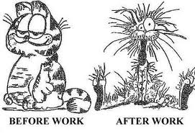
What are some of the things that cause stress for you on the job?
Notes:
Here is an opportunity for you to tell us what specific things cause stress for you at work. MOVE TO NEXT SLIDE

Slide 7
What do you find stressful at work?
Notes:
Have audience members provide info orally and make notes on either PPT slide or flip chart
Input from the audience (try to categorize)

Slide 8
Leading causes of stress in Academic Libraries:
Work Overload/Work Under-load
Interpersonal Relationships
  Patrons
  Other librarians & staff
Physical Environment
Career Stages
  Early, Mid-career, & Approaching Retirement
Bunge, C. (1987). Stress in the library. Library Journal, 112(15), 47.

Slide 9
Recent data on stress in libraries
British Psychological Society Conference (2006)
  Researchers shared project results: Being a librarian more stressful than fighting a fire, driving at a fast speed, or teaching a class of misbehaving children.
Topper, E. F. (2007). Stress in the library workplace. New Library World, 108(11), 561-564.
Notes:
Topper is a public librarian in Illinois at the time of the writing of this article.
interviewed 300 people in five occupations, and was surprised to find that the most stressful work
environment was the calm library setting, with many of those responding saying that
they were dull and boring places in which to pursue a career. Librarians complained
that there was not enough variety in their work, that they did not have enough control
over their careers, and they were not allowed to put their skills to full use.
Study mention lack of training in stress management for librarians both in the curriculum of library school and on the job.

Slide 10
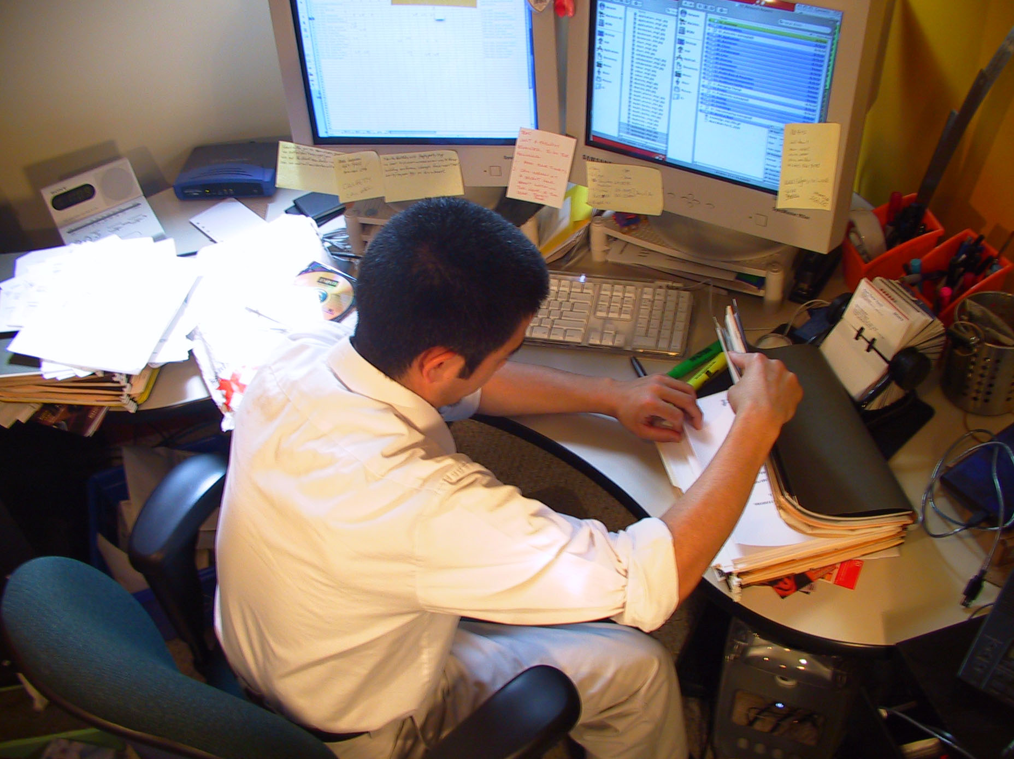
Additional causes of stress
Notes:
Knibbe-Haanstra cites a lack of gratitude from clients/patrons throughout the public service sector, including librarianship, and adds that sometimes hostile and unappreciative environments arise at public service desks. Other factors included poor leadership, lack of staff (and faculty) autonomy, incongruent vision of job objectives, excessive workloads, lack of support from administration, inadequate resources, a degree of disconnect between themselves and their supervisors, and “technostress” first termed by Craig Brod in the book: Technostress: The Human Cost of the Computer Revolution Reading: Mass: Addison-Wesley 1984. These various stressors can cumulate and potentially lead to unhappy and unhealthy public service professionals, including librarians.

Slide 11
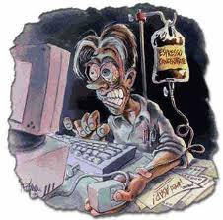
Technostress
Information overload
Performance anxiety
Role conflicts of professional identity
Burnout
Knibbe-Haanstra, M. (2008). Reference desk dilemmas: The impact of new demands on librarianship. Reference & User Services Quarterly, 48(1), 20-25. Retrieved from http://search.ebscohost.com/login.aspx?direct=true&db=lxh&AN=34514466&site=ehost-live
Notes:
A category into itself, and one that permeates many already discussed causes of stress in the field of librarianship, technostress can be caused by phenomenon such as “too much, too soon” expectations from users who expect reference service to be like ordering fast food, which “can seriously upset a librarian’s self-assurance of resource awareness.” The lack of common database interfaces and continuity means more professional development is needed at a time when less is available. From the same article, the author concludes that “the overwhelming nature of technology can, at times leave librarians feeling frustrated and helpless in the face of constant change and therefore generate a high level of stress.” Even those who embrace technology can find themselves short of time to adequately learn new databases and software necessary to perform their jobs.

Slide 12
How does stress affects us?
Our body | ... Our mood | ... Our behavior
Headache Muscle tension or pain Chest pain or heart attack Fatigue Change in sex drive Stomach upset Sleep problems | Anxiety Restlessness Lack of motivation or focus Irritability or anger Sadness or depression | Overeating or under eating Angry outbursts Drug or alcohol abuse Tobacco use Social withdrawal Relationship frustration
American Psychological Association. (2010). Stress in America. Retrieved September 15, 2012, from http://www.apa.org.libez.lib.georgiasouthern.edu/news/press/releases/stress/national-report.pdf
Notes:
http://www.apa.org/news/press/releases/stress/national-report.pdf
You may feel: angry, undervalued, underpaid, and exhausted
The unrelenting stress of a high-pressure job (which the literature and many in this room can attest that librarianship is) can lead to numerous health problems including addiction to drugs or alcohol, either as a way to try to stay energized and "up" to complete excessive workloads, or as a self-medicating attempt to relax when you finally have some time for yourself.

Slide 13

When you feel like this….
Notes:
When you feel like this more often than not at work, it probably comes as no surprise that these feelings and responses to them can impact your job performance.

Slide 14
How stress affects job performance
Dissatisfaction with job
Negative physical & emotional health
Declining efficiency, initiative, & interest in work
Uncooperativeness
Negative behavior
Proclamation that one’s contributions go unnoticed or unappreciated
Blame
Disorientation & signs of mental or physical breakdown during crisis periods
Tardiness
Absenteeism
Unsatisfactory library service
Turnover
Complete burnout
Knibbe-Haanstra, M. (2008). Reference desk dilemmas: The impact of new demands on librarianship. Reference & User Services Quarterly, 48(1), 20-25. Retrieved from http://search.ebscohost.com/login.aspx?direct=true&db=lxh&AN=34514466&site=ehost-live
Topper, E. F. (2007). Stress in the library workplace. New Library World, 108(11), 561-564.
Notes:
There is a correlation between chronic stress and burnout, although the two are not synonymous.
Individual stress can be detrimental to healthy functioning of an organization.
Dr. Parks will share with you ways to keep chronic stress from leading to burnout.

Slide 15
Self-Care in the Midst of It All
A STEP BY STEP GUIDE

Slide 16
Yerkes-Dodson Law
Empirical relationship between arousal and performance
The law dictates that performance increases with physiological or mental arousal, but only to a point. When levels of arousal become too high, performance decreases.
Notes:
The Yerkes-Dodson law is an empirical relationship between arousal and performance, originally developed by psychologists, Robert M. Yerkes and John Dillingham Dodson in 1908. The law dictates that performance increases with physiological or mental arousal, but only up to a point. When levels of arousal become too high, performance decreases.

Slide 17
Five basic sources of STRESS
SOCIAL
PSYCHOLOGICAL
PSYCHOSOCIAL
PHYSIOLOGICAL
YOUR THOUGHTS

Slide 18
POSITIVE SELF-TALK
“I deserve good things to happen in my life.”
“I’m OK just the way I am.”
“I can handle this.”

Slide 19


Pace of Your Life
Increased stimulation ----------- Reduced stimulation

Slide 20
Holistic Model
MIND - BODY- SPIRIT

Slide 21
KEYS TO SELF-CARE
SOCIAL SUPPORT
(connectedness and quality relationships)
EMOTIONAL EXPRESSION
SOLITUDE

Slide 23
Self-Care Practices
PROGRESSIVE RELAXATION
MEDITATION & PRAYER
GUIDED IMAGERY
TOUCH & MASSAGE
MUSIC & AROMA THERAPY
EXERCISE
HUMOR

Slide 24
References
American Psychological Association. (2010). Stress in America. Retrieved September 15, 2012, from http://www.apa.org/news/press/releases/stress/national-report.pdf
Bunge, C. (1987). Stress in the library. Library Journal, 112(15), 47. Retrieved from http://search.ebscohost.com/login.aspx?direct=true&db=lxh& AN=7469142&site=ehost-live
Knibbe-Haanstra, M. (2008). Reference desk dilemmas: The impact of new demands on librarianship. Reference & User Services Quarterly, 4 8(1), 20-25. Retrieved from http://search.ebscohost.com/login.aspx?direct=true&db=lxh& AN=34514466&site=ehost-live
Kniffel, L. (1999). Survey says librarians rank low in stress. hel-lo? American Libraries, 30(5), 38. Retrieved from http://search.ebscohost.com/login.aspx?direct=true&db=lxh& AN=1834915&site=ehost-live
Topper, E. F. (2007). Stress in the library workplace. New Library World, 108(11), 561-564.
Harry Birckmayer (Producer), & von Scherler Mayer, D. (Director). (1995). Party girl. [Video/DVD] Sony Pictures.

Slide 25
Questions? fparks@georgiasouthern.edu lsmith@georgiasouthern.edu lgwinett@georgiasouthern.edu

