Slide 1
Sleuthing in the Academy
Dorothy Sayers’ Gaudy Night as a reflection of the
Oxford Women's experience
Lisa Rose-Wiles
Seton hall University Libraries

Slide 2
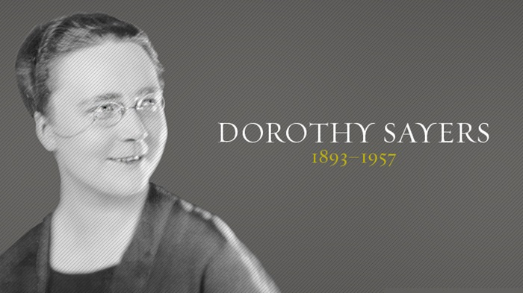
Christianity Today
Dorothy Leigh Sayers (13 June 1893 –17 December 1957) was a renowned English crime writer, poet, playwright, essayist, translator, and Christian humanist. She was also a student of classical and modern languages. https://www.sayers.org.uk/biography

Slide 3
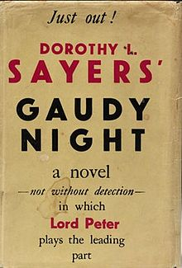
Gaudy Night (1936)
Lord Peter Wimsey Novels
Whose Body? (1923)
Clouds of Witness (1926)
Unnatural Death (1927)
The Unpleasantness at the Bellona Club (1928)
Strong Poison (1930)
The Five Red Herrings (1931)
Have His Carcase (1932)
Murder Must Advertise (1933)
The Nine Tailors (1934)
Gaudy Night (1935)
Busman's Honeymoon (1937)
Translations of Latin in Gaudy Night

Slide 4
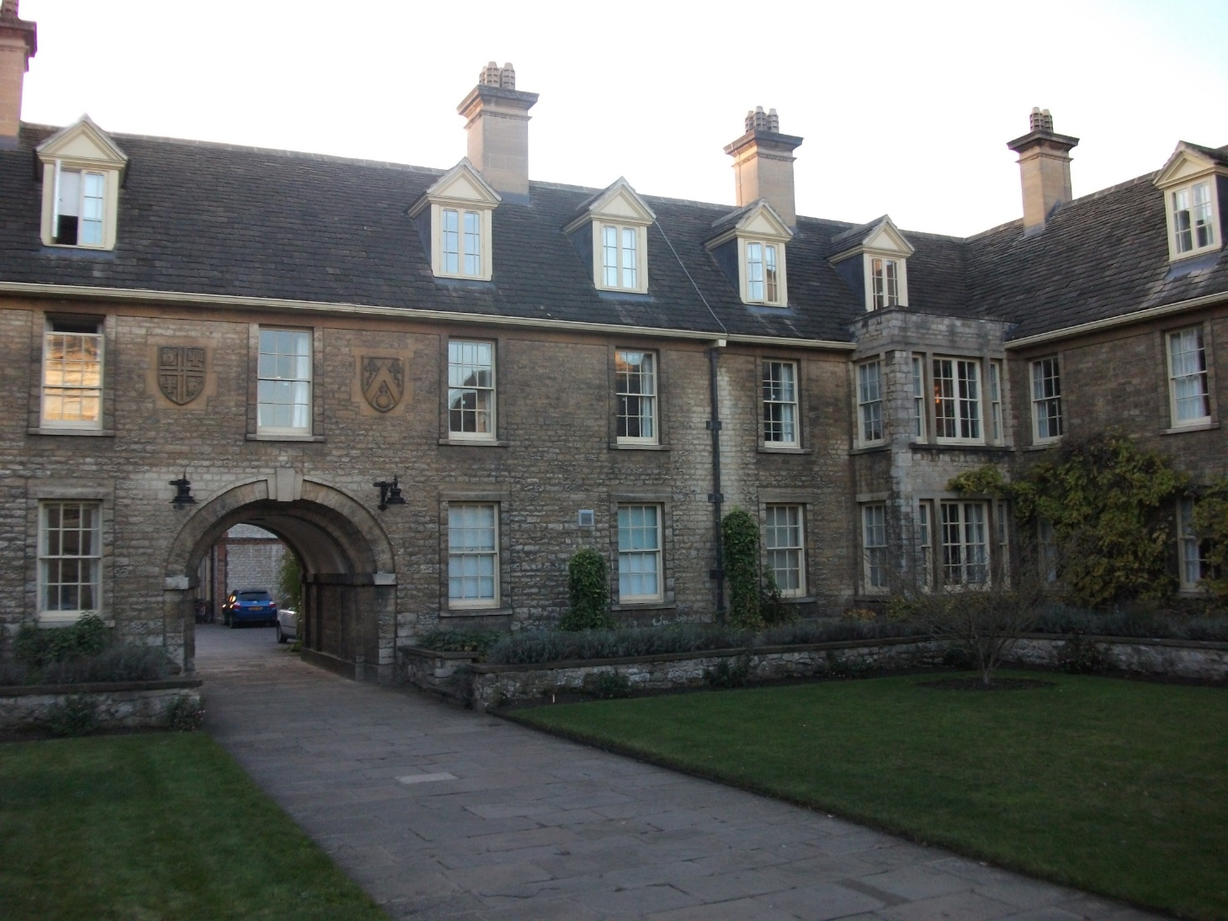
Sommerville Women’s College, Oxford, est. 1879

Slide 5
Key themes in Gaudy Night
Idealizing the Academy
Women and Education
Brains vs Heart (academic profession vs marriage and family)
Academic Integrity

Slide 6
Idealizing the Academy
“if only one could come back to this quiet place, where only intellectual achievement counted; if one could work here steadily and obscurely … undisturbed and uncorrupted by … personal spites, personal jealousies”
“that one had loved and sinned and suffered and escaped death was of far less ultimate moment than a single footnote in a dim academic journal establishing the priority of a manuscript or restoring a lost iota subscript. “
(Gaudy Night, p. 18-19)

Slide 7
Women and Education
I think it’s perfectly noble of [men] to let us come trampling over their university, bless their hearts. They’ve been used to being lords and masters for hundreds of years and they want a bit of time to get used to the change. Why, it takes a man months and months to reconcile himself to a new hat” (p. 56)
Wimsey on “the question of women’s education”: Is it still a question? I hope you are not going to ask me whether I approve of women’s doing this or that … you should not imply that I have any right to either approve or disapprove” (p. 335).

Slide 8
Brains vs Heart
“intellectual women should marry and reproduce their kind … but [the English husband] had something to say in the matter, and very often, he did not care for an intellectual wife” (p. 46)
“if one takes on personal responsibilities one owes a duty in that direction. I one’s job interferes with them, perhaps one should give up the job” (p 346).
And what of those folk cursed with both brains and hearts?

Slide 9
Academic integrity
“He told a lie about somebody else who was dead and dust hundreds of years ago. Was a dirty bit of paper more important than all our lives and happiness?”
“…that one had loved and sinned and suffered and escaped death was of far less ultimate moment than a single footnote in a dim academic journal establishing the priority of a manuscript or restoring a lost iota subscript.”

Slide 10
Thank you!

