Slide 1
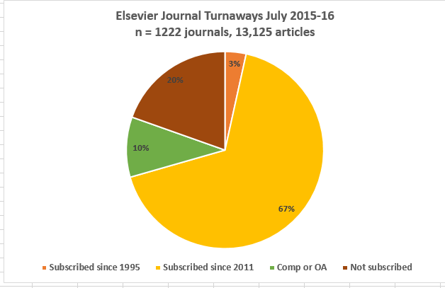
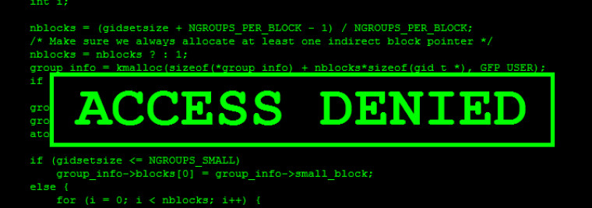

Turnaways or Denials: a sales pitch by any other name?
Access denied: COUNTER Report JR2 “User is denied access to a content item because the user or his/her institution does not have access rights under an agreement with the vendor”
JR2 was introduced in 2012, Release 4 of the Counter Code of Practice
If you do not have access to a particular article, a turnaway is recorded when the user lands on the abstract ….
Sulekha Kalyan & Lisa Rose-Wiles
Seton Hall University Libraries
Why denials for journals available on ScienceDirect?
A demand for older content? (the majority of denials were for articles published prior to our coverage dates)
So why so few interlibrary loan requests (only 4 journals had ILL)
Are students only reading the abstracts of articles?
______________________________
Why JSTOR denials for content available in other databases?
Users think JSTOR “has everything” vs. mostly historical material?
Why don’t they look at other databases or check the A-Z list?
_____________________________
Questions to reflect on …
Should we limit database search results to full text by default?
What about hybrid open access?
How do we encourage students to search multiple databases as well as using a Discovery Service?
How do we encourage students to read articles not just abstracts?
How do we respond to vendors who want to sell journals or packages based on denial data?
Our analyses: a tale of two databases.
.
The Pitch …
“We call it a turnaway. It’s when a researcher locates a title they want, only to discover your library doesn’t carry it” (Elsevier, July 2015)
“Knowing what your patrons want empowers you to make better acquisition decisions. The “turnaway” information shows how many times patrons tried to access a particular title and were turned away because you don't subscribe to it” (Elsevier, November 2015).
“We have noticed that [your patrons] have been trying to access research …but were turned away after hitting an access wall since you don't subscribe to this content. Interested in gaining access to this package? Contact us today” (Sage, Feb. 2016).
We thank Access Services librarian John P Irwin
for providing the interlibrary loan statistics.
Analysis of denials for ScienceDirect subscribed journals
Only 20 denials from 6 journals were articles published 2011-2016
69% were for articles published 2000-2010
31% were for articles prior to 2000
    Analysis of denials from JSTOR databases (8 collections)
    N = 572 journals, 2,716 articles
    Denials were almost all from journals that we do NOT subscribe to. There were NO interlibrary loan requests for these journals.
    Of the 68 journals (1,324 articles) with more than 10 denials,
    52 (76%) available through other databases with no embargo
    10 (15%) available with an embargo (typically one year)
    We do not know if users found the articles in these databases
.

