Slide 1
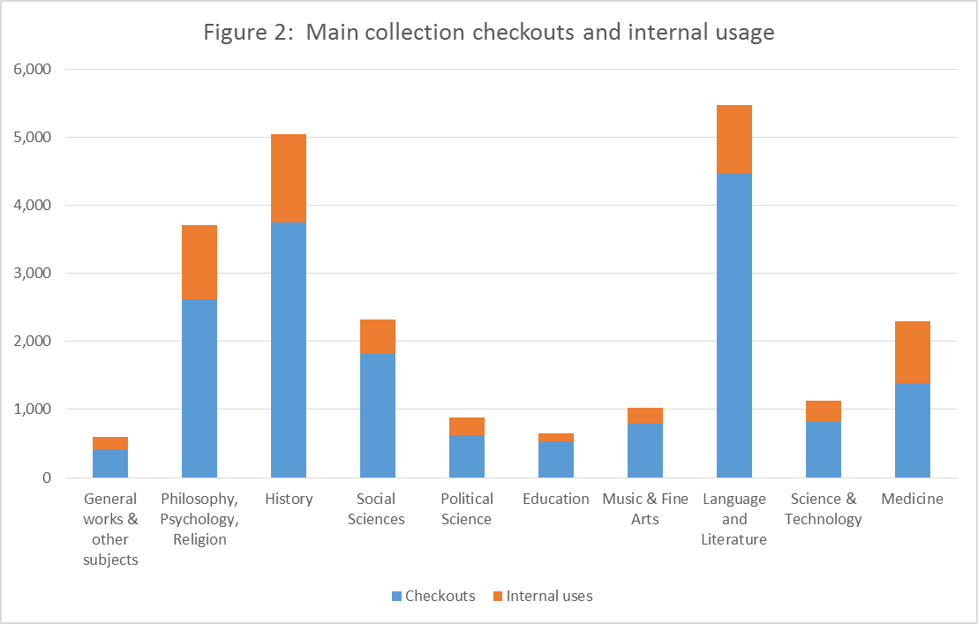
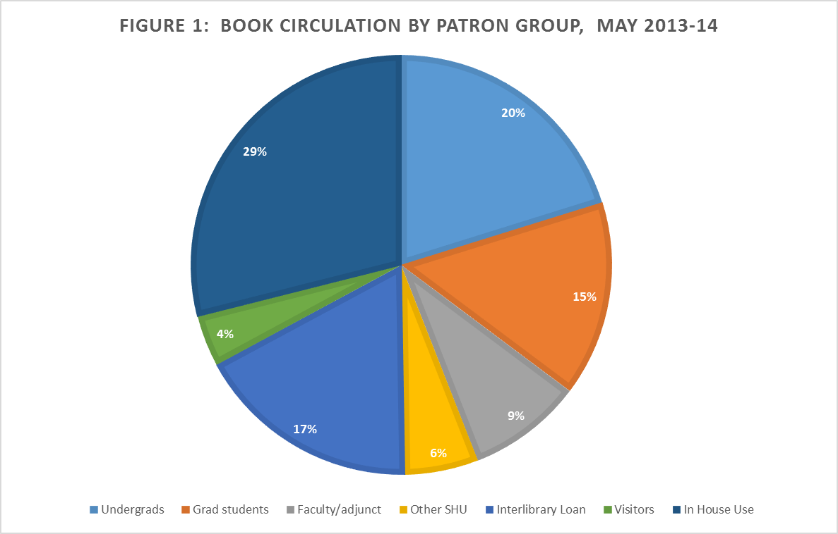
In-house print book use at Seton Hall University Libraries
Dr. Lisa Rose-Wiles, John Irwin & Katie Wissel
Seton Hall University Libraries
Introduction
In 2013 we analyzed print book circulation at Seton Hall University Libraries. Circulation was relatively low, but our data took no account of in-house circulation (books that were removed from the shelf but not checked out). In our continuing efforts to assess use of library resources and collection development practices, we examined in-house use of print books and compared it with statistics for books checked out for May 2013-14..
Table 1: In house use of Reference Collection by Subject
Methods
We used the circulation module of our Voyager system to track books that were removed from the shelves in all areas of Walsh Library. Stacks workers used a hand-held device to scan book records under the patron group “non-circ”. We restricted analyses of the subsequent Voyager report to format ‘book’.
Note high use of medical (and nursing) books, low use of “traditional” reference books
.
  Conclusions
  Adding “in house use” to existing circulation data provides improves assessment of the use of library collections and expressions of library value.
  The question: who is using books “in house” and what are they doing with them?
      Results: Book circulation
      29% of book use was “in house”, 71% checked out
.
Main Collection in house use vs. checkouts
.
Acknowledgments
We thank SHU Systems Librarian Xue-Ming Bao for his assistance with Voyager data.
© Lisa Rose-Wiles, 2015. Lisa.rose-wiles@shu.edu
.

