Slide 1

An Ethnographic Study of eBook use: a Library-Anthropology Collaboration
Lisa Rose-Wiles & Sulekha Kalyan
Seton Hall University
16th annual VALE / NJ ACRL / NJLA CUS Users' Conference, Friday, January 9, 2015, Rutgers University, Piscataway, NJ.

Slide 2
Background: History of eBooks at SHU
Old Net Library collection (rarely used)
Added small ebrary collection of selected titles in science & nursing and leased ebrary business collection in 2009
Began ebrary PDA in 2011; expanded to 24 subject areas
Added ebrary Academic Complete & EBSCO eBook Academic Collection in 2012
SHU University Research Council (URC) 2013 summer research grant – quantitative usage data, comparison by collection & discipline, some informal interview data.
Notes:
Initial usage statistics for the individually-purchased books were promising, with almost 50% of titles being used at least once. Use of the much larger business collection was lower at about 7%, but in both cases usage was higher than checkout rates for print books in their respective subjects and date ranges (Rose-Wiles & Stern, 2010).

Slide 3
Summary statistics | ebrary PDA | ebrary Academic Complete | EBSCO eBook collection
Dates available | Oct 2011-June 2014 | Jan 2012-June 2014 | October 2012-June 2014
Titles in collection | 4,595 | 116,478 | 133,705
# viewed | 982 | 8,995 | 18,439
% viewed | 20.0% | 7.7% | 13.8%
Average titles viewed per month | 22 | 300 | 878
average pages viewed | 24 | 27 | n/a
average pages printed | 1.0 | 1.1 | n/a
% viewed books with chapter downloads | 43% | 21% | n/a
% viewed books downloaded | n/a | 8.0% | 9.3%
Average cost per book viewed | $25.14 | $1.26 | $0.55
Average purchased/ downloaded | $82.56 | $15.95 | $5.64
Notes:
PDA most heavily used, especially chapter downloads (full book downloads not permitted) but expensive – full hard back price when triggered.
EBSCO most viewed but few downloaded (does not allow chapter downloads)
Chapter downloads – treating chapters like articles?

Slide 4
eBook usage has not increased over time
(sample data from PDA trigger reports)
subject area | Triggered @ June 2012 | Triggered July-Dec 2012 | Triggered Jan-June 2013 | Triggered June-Dec 2013 | Triggered Jan-June 2014 | total
Anthropology | 23 | 13 | 7 | 7 | 8 | 58
Biology | 3 | 1 | 3 | 1 | 0 | 8
Chemistry | 5 | 3 | 2 | 1 | 3 | 14
Environmental studies | 3 | 1 | 0 | 0 | 3 | 7
Math | 0 | 1 | 1 | 0 | 0 | 2
Physics | 1 | 0 | 1 | 0 | 1 | 3
Health sciences | 15 | 15 | 20 | 11 | 11 | 72
Nursing | 2 | 16 | 6 | 5 | 3 | 32
Sociology |  |  |  | 2 | 9 | 11
Total | 52 | 50 | 40 | 27 | 38 | 207
Total for all subject profiles | 96 | 75 | 44 | 40 | 44 | 299
Notes:
Initial interest, then decline …. Even though the number of available titles increased substantially.

Slide 5
Subject areas with highest eBook usage
Gender Studies
Race Studies
Autism
Anthropology
Ecology
Nursing
Health Management
Why might this be?
Specific assignments
Faculty member assigns eBooks
Recent areas of study / fewer print books available.
Students use eBooks in the absence of print books?
Notes:
The most likely explication is that there were assignments around these areas. What is interesting, is that that the first three on the list (in no particular order) are all topics that have been written about more widely in the past 10-15 years. Suggestion that students will use e-books in the absence of a breadth of print books in the subject area

Slide 6
What’s going on with eBooks?
We asked our anthropology colleagues to help us find out.
Partnered with Dr. Cherubim Quizon to offer a research question for students taking Qualitative Methods (Anth 2912)
Group project designed and carried out by four students during fall semester 2014
Chosen methods were an online survey and structured interviews.
Online survey yielded 26 responses but our anthropologists recorded an impressive 80 individual student interviews.
Notes:
The power of students talking to students … and qualitative data informing quantitative data.

Slide 7
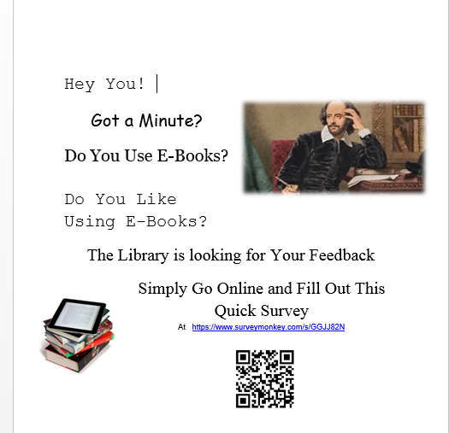
Invitation to
online survey!

Slide 8
Online Survey Results
About half (53%) reported using eBooks
Over 60% did not enjoy using eBooks
58% used eBooks only for academics
Most common advantages of eBooks: less clutter / easy to carry, easy to access, easy to search keywords
Most common disadvantages: unable to access (62%) and unreliable (68%).
    Hmm, WHAT DOES THAT MEAN???

Slide 9
Semi-structured Interview Data

Slide 12
Notes:
Other probably means no preference?

Slide 13
Notes:
We know nursing students are required to use eBooks but they were only 8% of respondents ..

Slide 15
Some key eBook dislikes from interviews
headaches, eye strain, staring at screen, can’t read in the sun
Distractions; can’t focus, hard to read
remember more when read physical book
death of computer, battery life, “dependent on electricity”, internet connection, disconnection, “computer technicalities”, technology, freezing, imaging problems, loading time, problems with interface
    Here is the … “UNRELIABLE”
Can’t make notes, can’t be marked or held, problem finding pages,
“not very user friendly”; “not tangible”; “not physical pages”, “can’t hold and flip pages” .. NOT A REAL BOOK.
Notes:
We tend to assume the “younger generation” are techy, but clearly many have issues with eBook technology and viewing them as a substitute for print.

Slide 16
Our anthropology students’ suggestions
Have another interview of the student body next semester
  Train Student Workers
Perform more s interviews over a period of different days/times
  With incentives!
Look at the possibility for incoming Freshmen to take a course in how to use eBooks
  We plan to have vendors come and do presentations, hold workshops (with students, faculty AND librarians); create tutorials and research guide
Notes:
The interview process next semester could be online or in person or both, but needs to have an incentive, if there is another in person interview, it needs to be separated from the library by location and have student doing the interview rather than librarians.
We believe that a course on ebook usage could help in boost the amount of individuals who use ebooks and a lot of the problems mentioned about ebooks could be resolved with a course.

Slide 17
Food for thought …
[We] might think that young adults are adaptable to the change in technology [but many students at] College today grew up with print books and are more comfortable reading print than an eBook.
The best way to fix this problem on campus would be to start teaching individuals about how to use eBooks in the library. This would inform students and staff how to use eBooks and make them more comfortable to the new technology.
Anthropology 2912 eBooks final report

Slide 18
Our thanks to
Dr. Cherubim Quizon, Associate Professor
Department of Sociology, Anthropology & Social Work
Brianna Galvin, Julie Lipyanka,
Sarah Pinsky, Margaret Schriber
(Anthropology 2912 – Qualitative Methods)
Katie Wissel (SHU libraries intern / Rutgers MLIS candidate)
SHU University Research Council

Slide 19
Questions --- Discussion
Our future plans ….
Notes:
The young and techy generation find eBooks “unreliable” but seem constantly “reading” on their cell phones. What’s the difference? why? Do you have the same experience?
Should we see eBooks as “digital versions of print books”? (or more like chapters = articles)
How can persuade publishers / aggregators to improve eBook platforms
What about online students?

Slide 20
Some points for discussion ..
The young and techy generation find eBooks “unreliable” but seem constantly “reading” on their cell phones. What’s the difference? why? Do you have the same experience?
Should we see eBooks as “digital versions of print books” or “something different”; more like chapters = articles?
Are students using eBooks without realizing it (e.g. discovery service results combine source types).
How can we persuade publishers / aggregators to improve eBook platforms and features?
What about online students?

