Slide 1
Weeding print book collections at Seton Hall University.
Lisa Rose-Wiles, Science Librarian
Seton Hall University

Slide 2
Well, librarians don’t like to weed!
There is a general reluctance among librarians to remove any books from library collections (Dubicki 2008, p. 132)
But: I like weeding, and it’s easier in my areas (sciences and health sciences) than in the humanities.
And: It’s good to do. Frees up space, helps inform collection development, makes the collection more attractive and easier to locate items.
So .. I started weeding (small scale) soon after I arrived at SHU in mid 2008.

Slide 3
Pushes to expand my weeding.
My 2011 study - low circulation of science & health science books, especially older books.
Inventory project: an opportunity to weed R’s and Q’s.
Early 2012, we signed on with Better World Books “library discards and donations program”
Several large sets donated to chemistry and physics; both agreed to have low-use older sets and volumes moved to main or discarded.
Notes:
Details of the inventory project can be found at: Martha Fallahay Loesch. "Inventory redux: a twenty-first century adaptation" Technical Services Quarterly 28.3 (2011).
http://works.bepress.com/martha_loesch/1

Slide 4
My (largely subjective!) weeding criteria
Discard old editions of textbooks, treatment guides, drug books etc.; ‘popular’ books; damaged books.
  Selectively replace/update old editions, damaged books.
Consider fit with our curricular areas and faculty research interests.
Check other library holdings (WorldCat), availability and price on Alibris/Amazon.
Circulation history
Consult with science faculty, university archivist.

Slide 5
The Big Weed of 2012
The goal: shrink reference by 35% (move books to circulating collection or discard them)
Why?
  Accommodate curriculum library books displaced by Dunkin Donuts
  Expand student commons space
  Improve the look and use of our reference section.
Also remove old indexes and abstracts from the 3rd floor Main (circulating) collection …
And I (with our Associate Dean) will co-ordinate!

Slide 6
The plan
Subject librarians tag books in their subject areas
  Red=discard, green=move to main
Stacks staff move tagged volumes to 3rd floor staging area (space freed by discarding abstracts and indexes)
One volume of multi-volume sets moved upstairs; the rest disposed of (dumpster en route)
… Volumes are magically removed from Voyager and seamlessly discarded, sent to Better World books or re-labeled and re-shelved in Main.
!

Slide 7
The results
over 10,000 reference volumes (1,776 linear feet of shelf space) discarded or relocated to Main.
About 4,000 volumes of indexes and abstracts freed up 600 linear feet on the third floor
I weeded over 3,000 books from the main collection in my subject areas and the Z’s.
Weeding government documents and print journals brought the total space reclaimed to 5,586 linear feet (about 31,445 volumes).
But --- nearly 7,000 volumes remained “in transition” from reference on the 3rd floor
Notes:
800 to be moved to main, 1920 to be discarded and the rest waiting to be reviewed.

Slide 8
The aftermath
Our systems librarian produced a master list of reference books to be marked X (delete) or Y (relocate), periodically batch processed to change Voyager record.
Over 1,600 records removed, 2,000 changed to main = 21% reduction in reference records
  Many were multi-volume sets
Remaining books and ‘problem records’ taken to and processed in cataloging (an endless procession of book carts)
  Students and a volunteer assisted

Slide 9
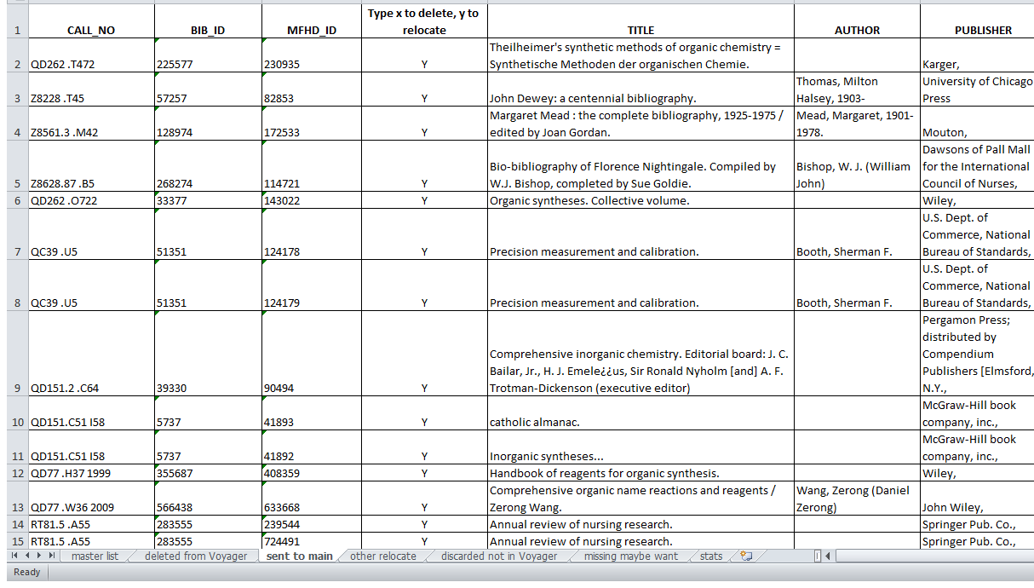
Notes:
Sample of our batch move and delete spreadsheet

Slide 10
How did we do?
We achieved about a 30% reduction of reference, gained space for curriculum books and planned expansion of student workspace.
  A follow-up inventory will give more accurate figures, check missing or miscataloged books
Several thousand books moving to main await processing and re-locating. More weeding in Main is needed to accommodate them.
  1,200+ books sent to BBW in 2013 (~38% sold so far).
May 8th, cataloging finished the last cart of discards

Slide 11
Lessons learned
--- or “too much too soon”
We needed better weeding guidelines
Lack of buy-in by some librarians created difficulties (and a lot of extra work for me).
We needed a better way/place to keep volumes ‘in transition’ (and in call number order)**
We needed more help (and space) to move the glut of books through cataloging.
  **Next time, we will change Voyager records in situ, THEN remove and process volumes.

Slide 12

Thank you, and Questions?

