Slide 1


Spatial Literacy with PolicyMap
Lisa DeLuca, MLIS, MPA Candidate
Seton Hall University
South Orange, NJ
7th Annual MPA Capstone Panel
March 9, 2018

Slide 2
Introduction
Use of spatial analysis for assessment of situations in political science and to understand public policy
POLS 2110 Contemporary Issues in US Public Policy with Professor Michael Taylor
PolicyMap Assignment evolved over two academic years
Data Visualization Track in Seton Hall MPA Program
Implications for Public Administration

Slide 3
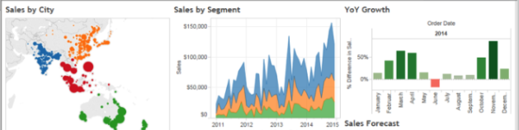
Why mapping?
Data Visualization as part of the research process; create different outputs to complement your research.
Use free tools available including:
  PolicyMap (public version)
  Tableau Public
  Excel Power Map
  Google Fusion Tables and Maps
Mapping allows you to visualize data. Shows relationships that cannot be expressed as effectively in a table.
Notes:
Socioeconomic factors
Access to resources – broadband
Urban/Rural
Other Demographics
Health Behaviors
Climate

Slide 4

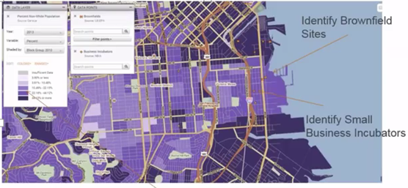
Why PolicyMap?
GIS-light mapping tool where students can map and create tables and Excel files for economic, demographic and social indicators
Cost effective/relevant for undergraduates; also relevant for graduate students with advanced analytical data literacy skills.
Free version can be used post-graduation
For each category of indicators, you can choose from two types of data:
  Data layers (thematic) heat maps
  Data points (addresses) or point level dataset

Slide 5
Student Learning Outcomes:
PolicyMap Assignment
20 students in POLS 2110 Contemporary Issues in US Public Policy
Create and use a map for illustrative purposes.
Utilize social and economic drivers to illustrate public policy issues
Demonstrate understanding of public policy issues by creating a table or shaded map (choropleth).
Download publically available data for analysis.
Analyze data to show trends/relationships between social/economic variables.
Share teaching experience with Political Science faculty, other departments

Slide 6
2016 Rubric Scores
Area of focus

Slide 7
Assignment modifications – 2016 & 2017
First Year
Too general – students were not giving starting point for assignment
Open ended assignment - students overwhelmed variable choices
Lightbulb did go off when they were researching their hometowns
Based on rubric scores, more time was planned to explain analysis component
Second Year
Narrowed focus to student’s home Congressional District at same website
More time explaining the analysis of variables to students
Researched key issues in their home district
Students selected demographic, social or economic indicator that was relevant to their Congressional Representative

Slide 8
Grades Fall 2016 and Fall 2017

Slide 9
Implications for Public Administration
Use data visualization for reporting for more accurate storytelling
See patterns in maps or clusters that cannot be seen in a table or spreadsheet
Identify unknown relationships, new research questions, or new policy ideas
Demonstrate relationship between variables
Utilize free tools
Solidifies student data and spatial literacy skills for future success
Use different physical outputs to display data – message boards, Rasberry Pi, interactive monitors
References:
Chen, H. M. (2017). Real-world uses for information visualization in libraries. Library Technology Reports, 53(3), 21-25.
Finch, J. L., & Flenner, A. R. (2016). Using Data Visualization to Examine an Academic Library Collection. College & Research Libraries, 77(6), 765-778.
Knaflic, C. N. (2015). Storytelling with data: a data visualization guide for business professionals. Hoboken, NJ: John Wiley and Sons, Inc.

Slide 10
Two Broad Categories - “Civic Tech and Big Data”
Public Information
Digital Government
One way information provision from government to residents.
Done in the most interesting way possible.
“Better” presentation of web sites, meeting minutes, video access, mobile information access
“Better” marketing, outreach to people
Two-way communication between government and residents.
Done in the most interesting way possible.
“Better” interaction and use of government data, statistics, and information.
“Better” understanding of a people
Source: Matt Hale, “So What is Big Data” 2/4/18

Slide 11
Thank you to:
PolicyMap
Seton Hall College of Arts & Sciences
Seton Hall MPA faculty
Dr. Matt Hale (Program Director), Dr. Rosanne Mirabella,
Dr. Michael Taylor, Dr. Terrence Teo, Dr. Naomi Wish,
Dr. Rob Pallitto (Department Chair)
  Seton Hall University Libraries: Dr. John Buschman

Slide 12
Questions? lisa.deluca@shu.edu or ldeluca1101 (Twitter)
Research Guides
PolicyMap https://library.shu.edu/policymapgs
Public Administration https://library.shu.edu/pubadmin
Non-Profit Management https://library.shu.edu/npm
US Politics https://library.shu.edu/uspolitics

