Slide 1
policymap
Teach your students mapping
Lisa DeLuca, Social Sciences Librarian
Digital Humanities Summer Seminar
May 24, 2016

Slide 2
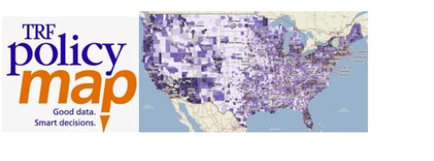
What is policymap?
Cloud-based data and mapping platform that enables students and faculty to access data about communities and markets across the U.S.

Slide 3
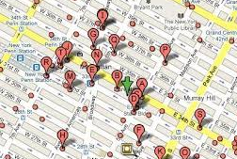
Data types
Data layers (thematic) heat maps
Data points (addresses) or point level datasets
Notes:
Socioeconomic factors
Access to resources – broadband
Urban/Rural
Other Demographics
Health Behaviors
Climate

Slide 4
Improved data and spatial literacy
Example: Public Health
Teach students how to create maps
Perform descriptive epidemiological studies
Use GIS as a tool for assessment, advocacy, planning, evaluation
Use zip code as a predictor of health status
Geographic description of health
Notes:
Socioeconomic factors
Access to resources – broadband
Urban/Rural
Other Demographics
Health Behaviors
Climate

Slide 5
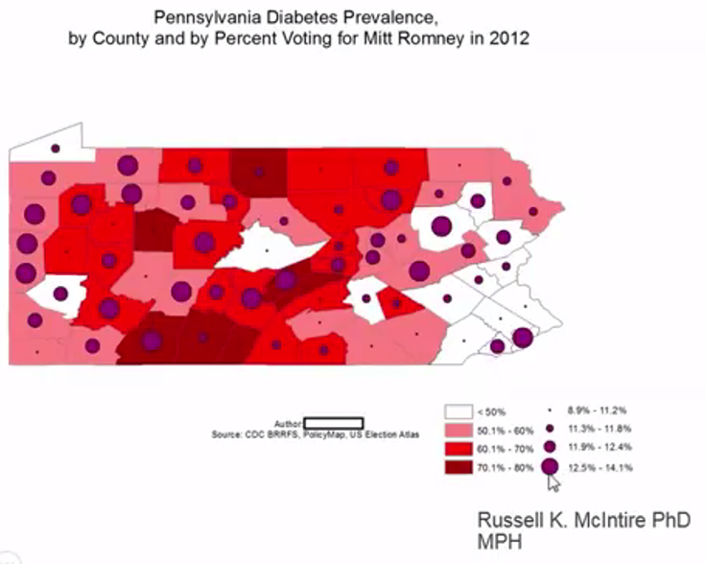

Slide 6
Improved data and spatial literacy
Example: Urban Planning
View geographic relationships
Explore multiple units of analysis
Geographic scales (census tracts, counties)
Download data
Geographic description of health
Notes:
Socioeconomic factors
Access to resources – broadband
Urban/Rural
Other Demographics
Health Behaviors
Climate

Slide 7
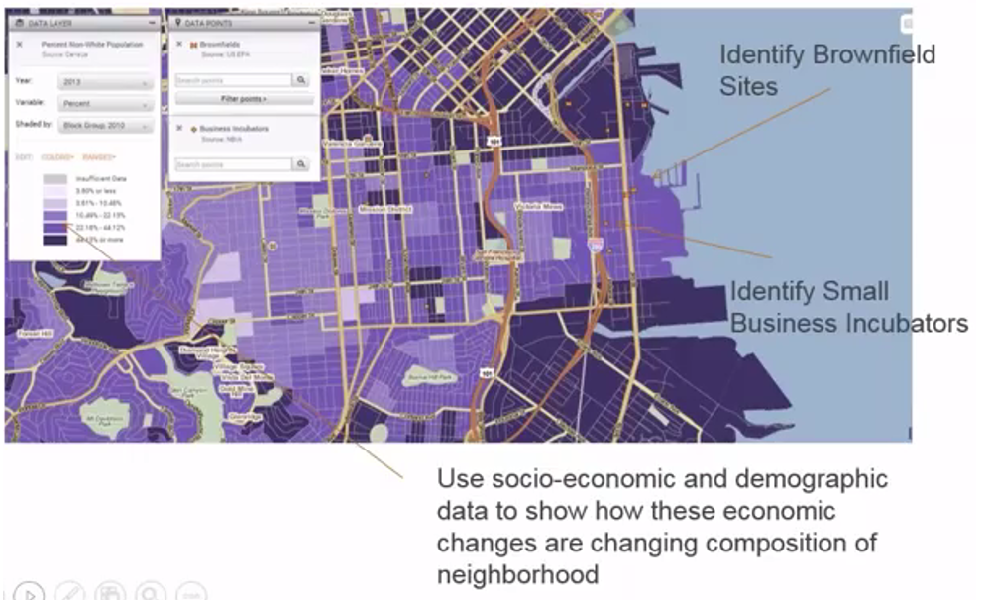

Slide 8
Improved data and spatial literacy
IMPORTANT FOR ALL DISCIPLINES
Design maps and understand components
Understand types of maps and symbols
Edit, format data from Excel
Geocode
Download data from U.S. Census
Proximity Analysis, Correlations
Notes:
Chloropleth
Heat Maps
Geocoding – plot as point on map with x,y coordinates
Proximity analysis - technique used to determine the relationship between a selected point and its neighbors.
Bivariate correlations - tests whether the relationship between two variables is linear (as one variable increases, the other also increases or as one variable increases, the other variable decreases)

Slide 9

your research process
Geocoded
Photographs
Addresses
Agency Data
Research Data
INPUT
OUTPUT
Theses, Disser-tations
Arc GIS
Reports, Tables
Course Assign-ments
JournalArticles

Slide 10
Builds STUDENT confidence
Can reduce barriers to working with data
Consumers of qualitative vs. quantitative evidence
PolicyMap: library.shu.edu/policymap
Research Guide: library.shu.edu/policymap
This presentation was adapted from the webinar: Using PolicyMap in the Classroom, October 20, 2015

