Slide 1
Lily Conference – 2010
Star Swift, Linda Masselink, Anne Merkle
Grand Valley State University

Slide 2
“Don’t Blink or You’ll Miss it!”
The Power of Telepresence in Education

Slide 3

Don’t Blink!

Slide 4
What Was Done in MGT 432…
ooVoo video chat with graduate student
ooVoo sent web cameras for our students
Students began using ooVoo
Chat with professor, mediators and arbitrators for bargaining of labor contracts

Slide 5

A Growing Use in the Classroom
First Year……
Collective Bargaining Only
Wage Comparables
Contract Language
Economic Data
Insurance Date
Pension Data
Cost Out Entire 2 Year CBA
Draft entire CBA
Four years later……
Discipline Process
Grievance Process
Pre -Arbitration Meeting with Arbitrators
Meetings before, during and after class
Virtual office hours
Other Classes

Slide 6
Real Life For Students and Professor
Grand Rapids
Allendale
Holland
28.60 Miles
15.40 Miles
21.21 Miles

Slide 7
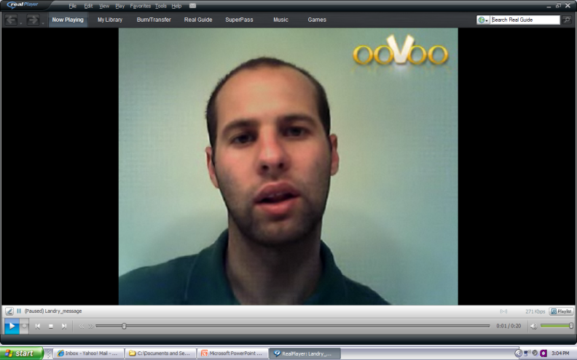
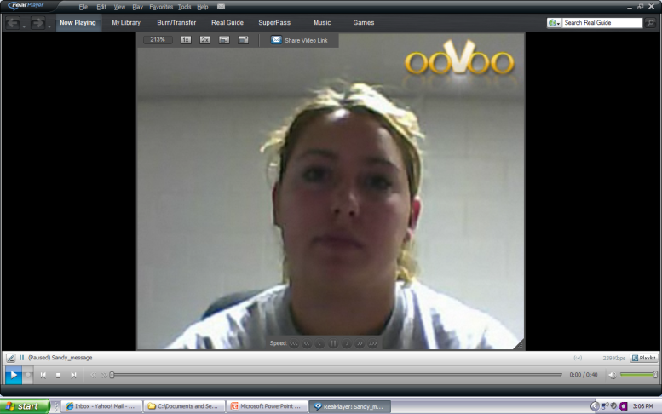
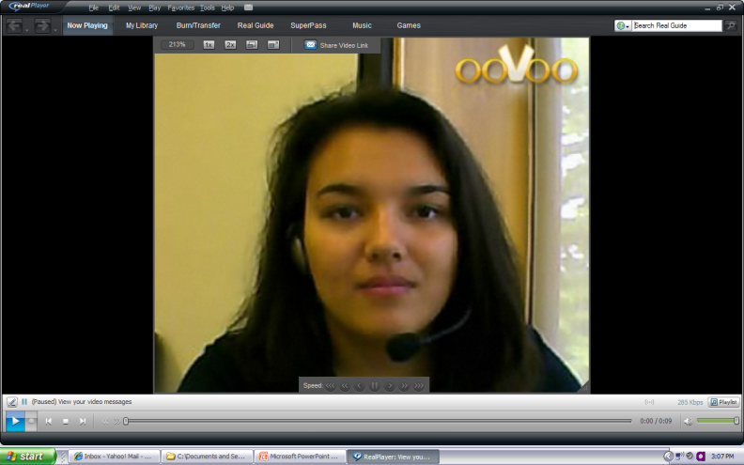
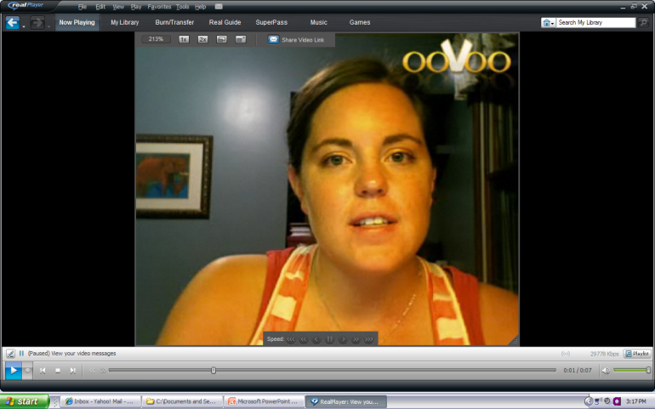
Online Collective Bargaining
GV Holland Campus
Home
Union
vs.
Employer
GV Pew Campus
Home

Slide 8
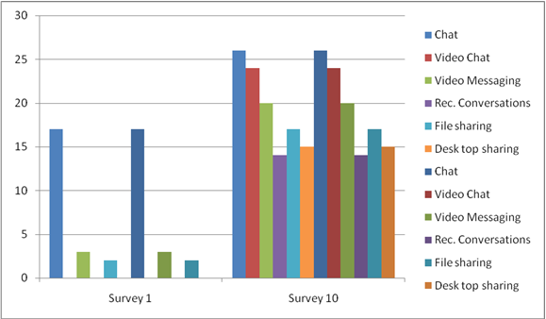
Skills Grow with Use

Slide 9

ooVoo

Slide 10

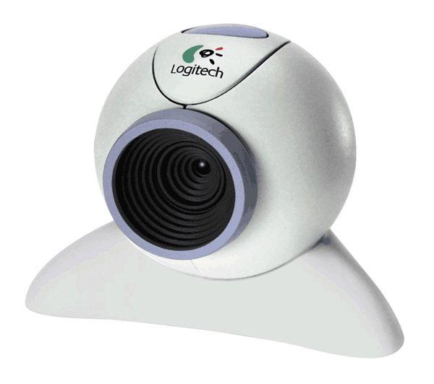

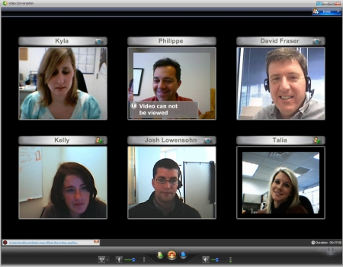
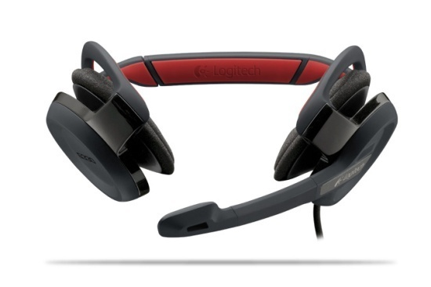
What You Need For Video Chat…
Computer with broadband –plug in!
Video chat software
Web camera
Headphone

Slide 11
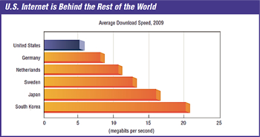
“The Medium U.S. Broadband Speed? South Korea’s Divided by Four.”

Slide 12
Telepresence at GVSU
ooVoo Business Plan
- $40.00 now $13.95 @
GVSU
- 6 Person Windows
- Desk Top Sharing
- Record Conversations
- YouTube Lectures
- Video E-Mail
- Quick Chat
GVSU
- New Business School Building
- New Library
- Telepresence in both
- Undergrad Use
- Graduate Use
- Staff and Faculty Use

Slide 13
Other Uses Already in Place Around the World

Slide 14
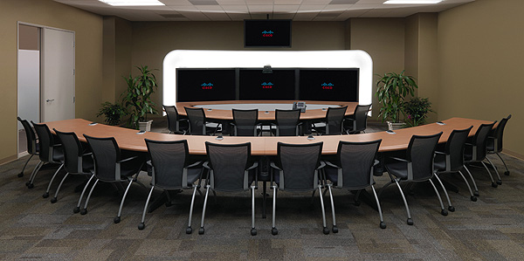
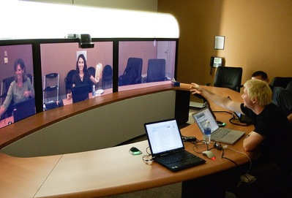
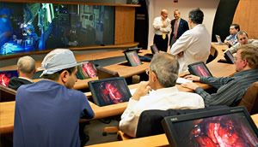
Parallel Uses of Video Chat
Businesses/ Hotels
Medicine
Libraries/Education
Sports

Slide 15
Why Telepresence in Education?
It is green
It saves time
It saves money
It allows a solid personal connection
It is the future

Slide 16
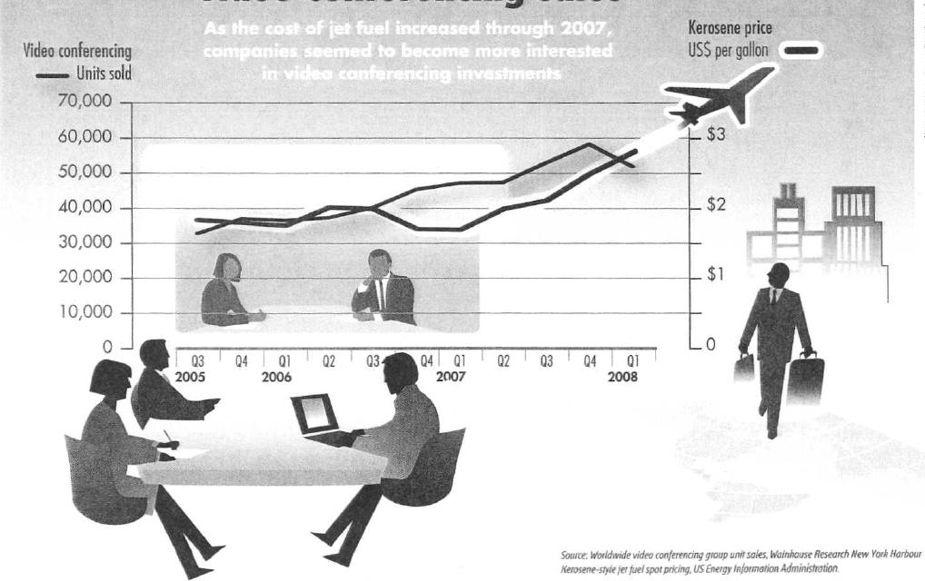
Jet Fuel Prices vs. Videoconferencing Sales

Slide 17
Do it Right and Be Prepared!

Slide 18

Getting Ready…
Preparation - Have an organizational session
Establish ground rules
Create an agenda
Share documents needed for meeting
Establish communication
Leader explains purpose of meeting

Slide 19




Tips For A Better Meeting
Appearance – dress appropriately
Be mindful of body language
Test Equipment
Be aware of background
Adjust lighting

Slide 20

More Tips…
Share materials (visuals) slowly due to natural lag time of camera
Keep visuals simple
Need to leave? Let everyone know before leaving.
End the Meeting - Summarize issues and recap action items, Set next meeting date
Write up summary/minutes to send via e-mail or ooVoo

Slide 21
Presented By:
Linda Masselink
Anne Merkle
Maris Stella Swift
Special Thanks to Nisreen Anani for her assistance.

Slide 22
http://www.gvsu.edu/e-hr/
E-HR Website

