Slide 1

Linda Masselink
Steelcase Library
Notes:
LIBRARY RESEARCH IS CRITICAL TO GRADUATE STUDIES. WE CAN HELP YOU SUCCEED.
ALL LIBRARY RESEARCH DOES NOT HAVE TO TAKE PLACE IN THE LIBRARY. MANY LIBRARY RESOURCES ARE AVAILABLE ONLINE – YOU MAY ACCESS THEM FROM YOUR HOME OR OFFICE 24 HOURS A DAY.

Slide 2
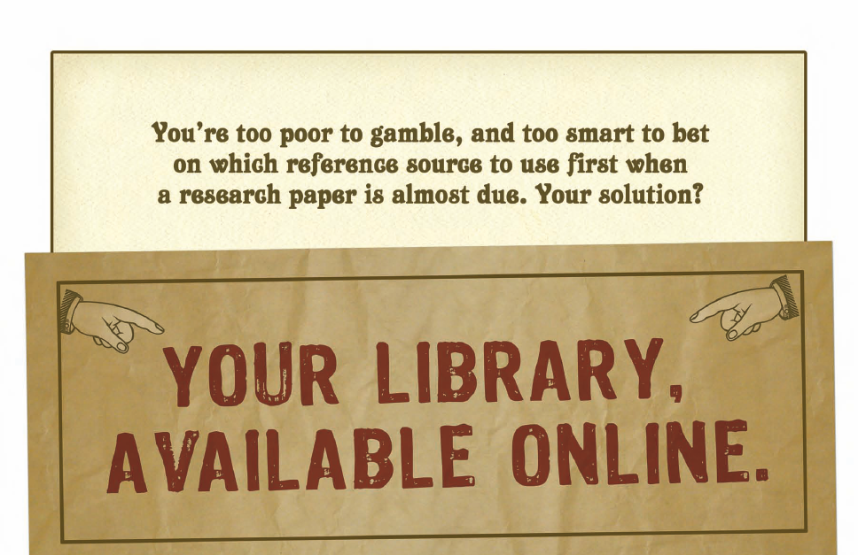

Slide 3
Library Home Page
Get to the Library from the University home page
www.gvsu.edu
Notes:
START WITH THE LIBRARY WEB SITE.
CATALOG: BOOKS, AND MAGAZINES OWNED BY GVSU.
MAIN, STEEL, FREY, CML
MAKE A REQUEST – COURIER SERVICE TWICE A DAY
SUBJECT RESOURCES: DIRECTS YOU TO SPECIFIC RESOURCES FOR YOUR AREA OF INTEREST
WE SUBSCRIBE TO OVER 200 DATABASES. WE HAVE ACCESS TO OVER 70,000 PERIODICALS ONLINE.
AOL CAUTION
OFF CAMPUS LOGIN = COMPUTER LOGIN
$$$ BUDGET FOR SUBSCRIPTIONS
RESOURCES FOR: STUDENTS – ACCESS COURSE RESERVE (MAY BE ONLINE OR HELD AT THE CHECKOUT DESK)
UNDER: TOOLS AND SERVICES
REFWORKS: SOFTWARE CITATION MANAGEMENT TOOL
HOURS, LOCATIONS – WHERE ARE THESE LIBRARIES LOCATED?
COLLECTIONS AT STEELCASE: 6 DICIPLINES
AUTOMATED RETRIEVAL SYSTEM – UNIQUE TO STEELCASE LIBRARY – ACCESSIBLE THROUGH THE ONLINE CATALOG
POSSIBLE TO REQUEST A BOOK FROM ALLENDALE AND HAVE IT DELIVERED TO STEELCASE OR ANOTHER LIBRARY
COMPUTER ACCESS FAQ’S: IF YOU CAN’T ACCESS DATABASES THIS TELLS YOU HOW TO TROUBLESHOOT
UNDER RESEARCH SKILLS
CITING SOURCES – WE HAVE SEVERAL STYLE MANUALS AT THE REFERENCE DESK: MLA, APA, CHICAGO MANUAL OF STYLE, TURABIAN. FIND OUT WHAT YOUR INSTRUCTOR WANTS YOU TO USE.

Slide 4
On the Library Home Page
Search box
  Search the catalog and some databases
  Subject Guides
  - Discipline specific help

Slide 5
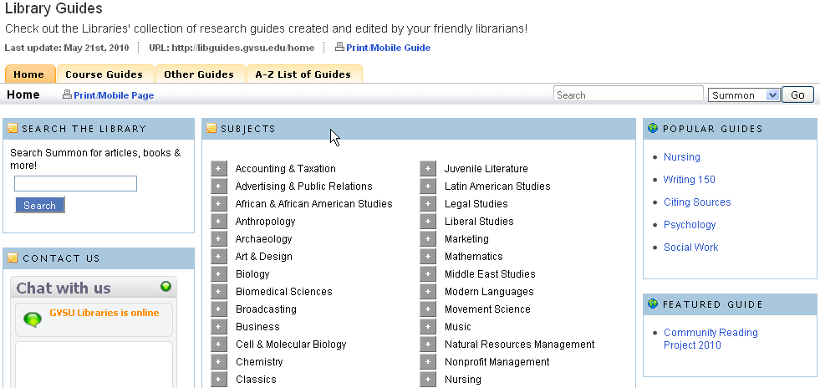
Subject Guides

Slide 6
Subject Guides

Slide 7
Check it out!
30 books at one time
10 week check out – 5 week renewal
Renew online
CAN’T renew if overdue!
Notes:
MY LIBRARY ACCOUNT(FOUND UNDER RESOURCES FOR STUDENTS)
WHAT IS CHECKED OUT; FINES; ITEMS ON HOLD

Slide 8
Available for you to check out
Laptops
  May be checked out for 4 hours at a time
iPads
  May be checked out for 3 days at a time
  Use student ID to check out

Slide 9
What if we don’t have the resource you need?
Document Delivery
No charge!
20 requests allowed at one time
Notes:
HOW DO YOU GET ALL OF THESE WONDERFUL SERVICES? STUDENT ID CARD. THE BARCODE ON THE BACK IS YOUR LIBRARY IDENTIFICATION.
YOU MAY EVEN CHECK OUT A LAPTOP TO BE USED IN THE LIBRARY IF YOU NEED ONE.

Slide 10
Skills for Conducting Research
1. Focus on the topic (narrow the topic/broaden the scope)
2. Work in reverse chronological order, searching the newest information first.

Slide 11
Skills
3. Understand the significance of terminology and determine correct search terms
4. Vary the sources (use books, periodicals, databases, websites)

Slide 12
Skills
5. Use search operators (and, or, not) in database searches.
6. Multiply sources by 3 (identify 3 times as many references as needed for the research).

Slide 13
Skills
7. Evaluate critically the material retrieved; be especially suspicious of sources from the web.
8. Assimilate the information; don’t plagiarize. Incorporate your own ideas based on the research topic.

Slide 14
Skills
9. Cite all sources. Seidman College uses APA style manual
(Skills list adapted from U of Arkansas)
10. “Just Ask” when you have a question! Online, by phone or in person.

Slide 15
Please know…
Librarians can simplify the research process for you.
The online Library (catalog, databases, eBooks) is available 24/7.
BIG difference between the Internet & subscription databases.

Slide 16
Peer Consultants
New service!
Peer research consultants are available to assist with research.
Available Sunday – Thursday evenings.

Slide 17

Maximize your time.
Improve your research.
JUST Ask!

Slide 18
Help is available
www.gvsu.edu/library

Slide 19
Let’s get started
www.gvsu.edu/library
Harvard Business Review
May 2003

Slide 20

Questions

