Slide 1




Slide 2
It’s Not About the Coffee:
Customer Service Lessons Learned from
Starbucks

Slide 3
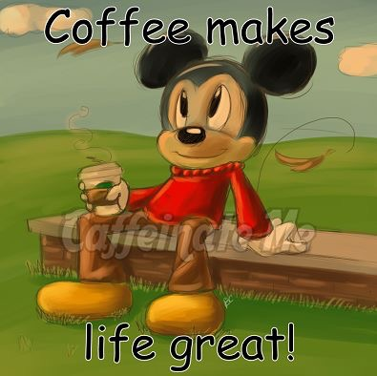

Thursday, October 13, 2016
2:15-3:00 pm

Slide 4

Presented by:
Dr. Linda Marie Golian- Lui,
Associate Dean of Library Services
Kennesaw State University
lgolianl@kennesaw.edu
1-470-578-6168

Slide 5
Today’s Outline
Introduction
Know Who You Are
Know Why You are Here
Think Independently
Build Trust
Listen for the Truth
Be Accountable
Take Action
Face Challenge
Practice Leadership
Dare to Dream
Conclusion

Slide 6

1. Introduction

Slide 7

Utilizing Ideas From

Slide 8
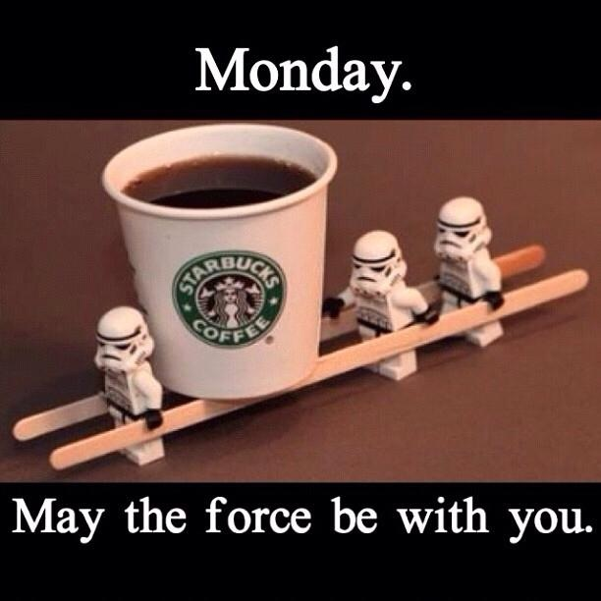
1.) Putting People First.
2.) Embracing the Human Condition.
3.) Respecting People for who they Are.
4.) Identify and develop values, skills, and goals.

Slide 9
Key Concepts
We are all in this together.
Are you listening and basing your actions on the best information available – including the unacceptable truths?
Are you clear about your role , purpose and Contributions?
Are you Doing the right things for the right reasons?
Is the right person making the right decision?
Are your decisions and actions building trust and showing you care?
Are you taking responsibility and not blaming other?
Are you letting truth be your guide?

Slide 10

2. Know Who You Are
We all wear many hats, but what is your primary hats?
Have you seriously thought about, and codified:
Who you are in the organization,
Who you are not in the organization,
What part you play in moving your organization forward
When people and their organizations are clear about their values, purpose, and goals, they find the energy and passion to do great things.

Slide 11

3. Know Why You are Here
Path to success comes from doing things for the RIGHT reasons.
You cannot succeed if you do not know what you are trying to accomplish.
You cannot succeed if everyone in your group is not aligned with the same goals.
Find your passion.
Help others find their passion.

Slide 12
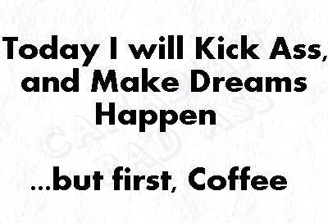
4. Think Independently
People are not “assets”
They are human beings who have the capacity to achieve results beyond what is thought possible.
Get ride of rigid rules and encourage independent thinking towards the goals.

Slide 13

5. Build Trust
Care, like you Really Mean it! You cannot fake caring.
As a leader, caring is not a weakness but a sign of strength.
Caring is the biggest ingredient needed in building trust in the workplace.
Without freedom from fear, we can’t dream, and we can’t reach our potential.

Slide 14
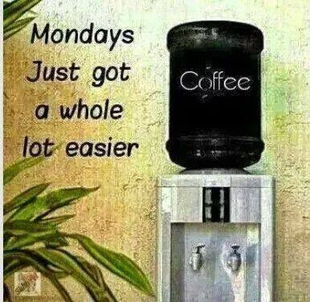
6. Listen for the Truth: The Walls Talk
Listen for the truth
More importantly WALK the TALK.
Put time into what is said, but more importantly, what is NOT being said.
You will quickly learn what your clients want
You will quickly learn what your team can do
Quickly learns / implement solutions to problems

Slide 15

Listening Habits
Open your ears and close your mouth
There is no substitute for human exchange (email)
Listen for the meaning below the surface
Let silence fill the conversation
Ask, especially for those who would not normally come forward
Make it safe
Be responsive, especially with emails
Give feedback
Clean up your communication mistakes with face-to-face listening

Slide 16

7. Be Accountable: Only the Truth Sounds Like the Truth
Transparency is important.
No secrets,
no lies of omission,
no hedging and
no dodging.
Take responsibility and say what needs to be said with CARE and RESPECT.

Slide 17

8. Take Action
Find the sweet spot of passion, purpose and persistence.
Remember, it is all about the people, your coworkers / staff and your customers. This is your first action priority.
Feel, do, think.
Think like a person of action, and act like a person of thought.

Slide 18

9. Face Challenge
Remember, we are all human beings first.
Use your values and principles to guide you during your hardest times.
If a challenge is too big, or if you are stuck, break it down into smaller chunks.
Put people first and ask your staff for help and you will face and conquer your challenge.

Slide 19

10. Practice Leadership
Leadership is about giving your time to the people you work with.
Leadership can be filled with “I need your attention now” moments.
Leaders are everyday people who try to get things done with the cooperation of others.
Don’t let the NOISE of leadership drown out the mission / vision or the truth.

Slide 20

11. Dare to Dream
Say Yes to yourself and others who have ideas that align with the organizational goals.
The MOST powerful word in an organization is YES. Then figure out how to make it happen.
Say yes, and enjoy all that you are doing, and help others to do the same.

Slide 21
12. Conclusions
An organization must develop trust among leadership, workers, and customers in order to flourish.
An organization needs to continually develop and try new things.
An organization needs to develop leaders among all ranks of workers
It’s all about the coffee is really IT’S ALL ABOUT THE PEOPLE. It is not all about me, IT’S ABOUT WE.

Slide 22
Source Consulted:
Behar, Howard (2007). It’s Not About the Coffee: Lessons on Putting People First from a Life at Starbucks. Penguin Group, New York, New York.

Slide 23
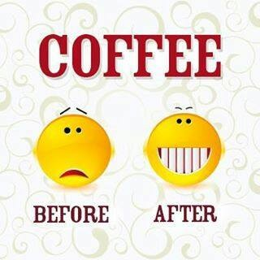
Comments?

Slide 24
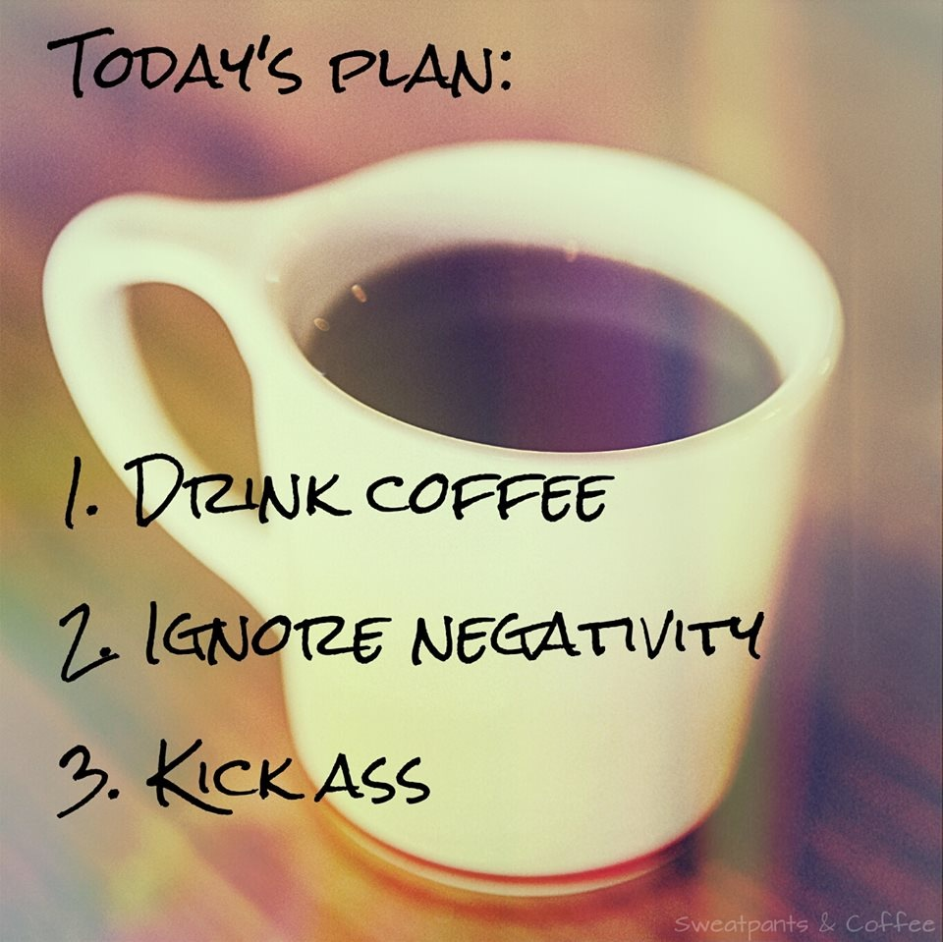
Thank You

