Slide 1






Slide 2



Using De Bono’s Six Thinking Hats for Creative Thinking, Effective Decision Making, Engaged Meetings, and Faster Problem Solving
FLA Annual Conference Orlando, FL May 7-9, 2014
Dr. Linda Golian-Lui Kennesaw State University
Diane Kachmar, Florida Atlantic University
Katherine Jana Lui-Golian

Slide 3

Welcome

Slide 4
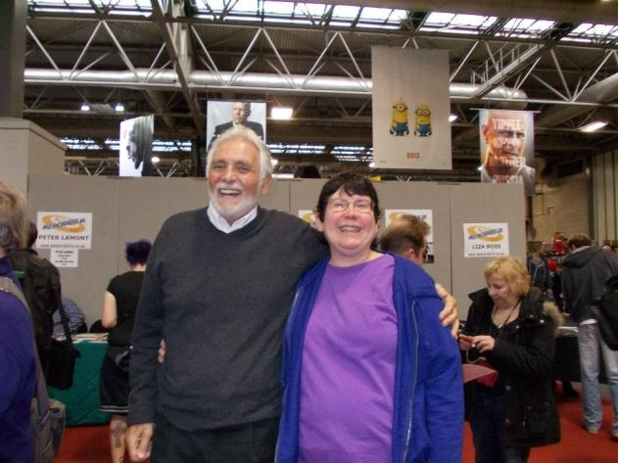
Welcome

Slide 5
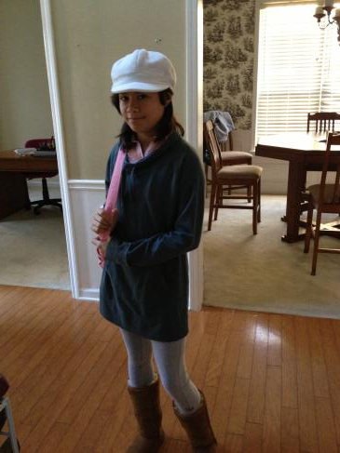
Welcome

Slide 6
Today’s Materials
I. PowerPoint Handout
II. QR Catalog Cards
III. Visit the LibGuide for Bibliography
IV. My Business Card

Slide 7






Six Thinking Hats In The Library
Blue Process | White Objective | Red Intuitive
Green Creative | Yellow Positive | Black Cautious
Notes:
Slide 4

Slide 8
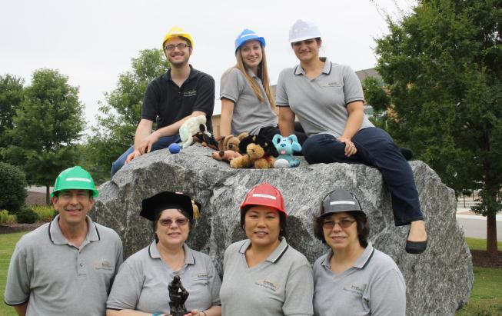
Sturgis Library Before
6 Thinking Hats
Before 6 Thinking Hats

Slide 9
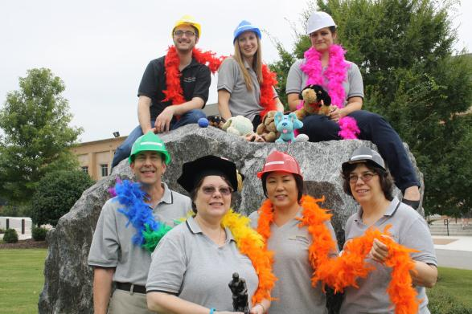
Sturgis Library After
6 Thinking Hats

Slide 10
Today’s Outline
I. Why Thinking Matters
II. De Bono
III. 6 Thinking Hats
IV. Tutu Example
V. Group Exercise
V. In Conclusion

Slide 11
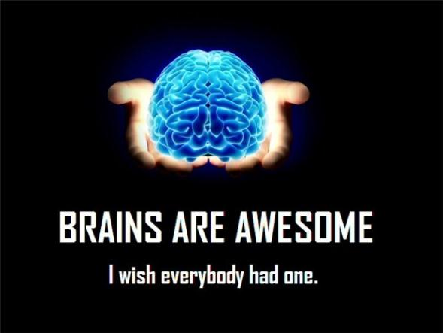
I. Why Thinking Matters

Slide 12
Thinking about Thinking
Thinking is like breathing – we take it for granted. But how we think is just as vital to our lives as leaders as breathing is to live. (Thinking about Thinking, 1993, p.70).

Slide 13
We ALL Think we are “Right”
All of us assume that the way we think is the “right” way
Thinking often proceeds as waffle and reaction to what turns up from moment to moment
How we think dictates our approach and therefore our behaviors
When we fail at something, we ascribe it to be bad luck, we seldom take the view that the way we thought about it was part of the problem

Slide 14
Thinking Causes Confusion
We involve too much in the thinking process
We inappropriately get our emotions, ethics, values, ruts, friendships, intelligences, gender issues, experiences, creativity, flexibility, learning styles, opinions, and thinking styles involved in decision making and problem solving situations

Slide 15
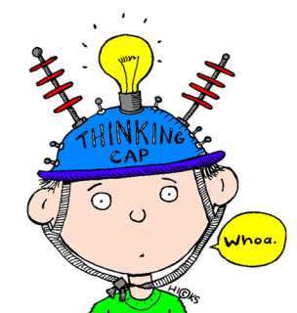
Thinking Stew
Suggestions, judgment, criticism, information, and plain emotion become all mixed together in a sort of thinking stew

Slide 16
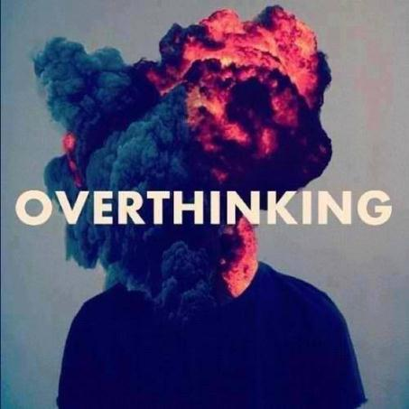
Classic Overthinking

Slide 17
II. Edward De Bono
Considered the father of lateral thinking
Concluded that the only people satisfied with their thinking skills were POOR THINKERS who believed that the purpose of thinking was to prove yourself right
Believed that people needed to embrace the concept of thinking ONE THING at a time
This allows thinkers to separate emotion and other baggage from logic

Slide 18
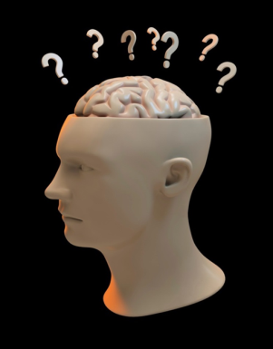
Lateral Thinking
Thinking to resolve problems with an indirect and creative approach, using reasoning that is not immediately obvious

Slide 19
III. 6 Thinking Hats
Technique for effective meeting and / or problem solving.
Ability to switch one’s view / vision and attitude.
A tool for individual and team thinking development.
A tool that supports a healthy learning organization.

Slide 20
Why Six Thinking Hats?
Helps us to communicate more effectively
Promotes creative problem solving
Supports dealing with new situations
Allows us to deal with limited information
Takes away emotions and baggage
A way to avoid arguments
Can be fun
Allows brain to do one thing at a time – less confusing, more focus

Slide 21
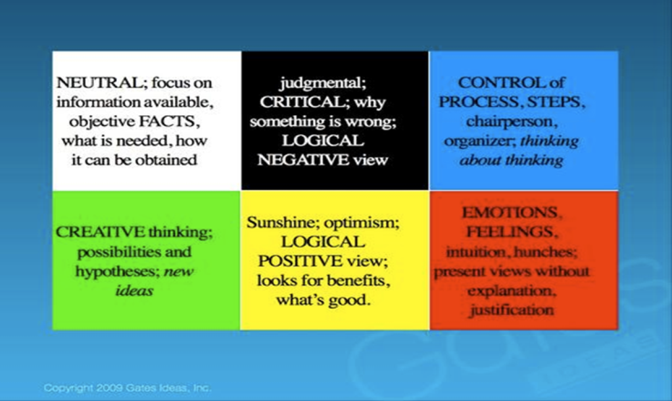
STH Summary

Slide 22
Guiding Principles
Use hats to focus the thinking … one at a time
Don’t have to use all the hats
Can use some hats more than once
No debates or arguments … brainstorm
Begin with blue
End with blue
Keep red brief
Keep time brisk (3-4 minutes per hat) – prevents rambling
If you need to stimulate ideas consider a ‘Random Word’

Slide 23
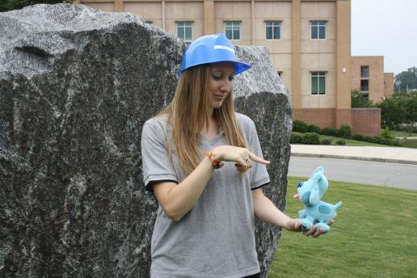
Blue Hat:
Controls the process

Slide 24
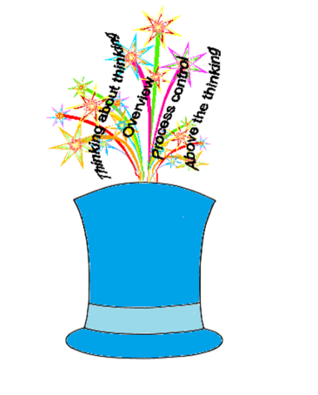
Manages the process
Keeps people focus
Makes the agenda
Provides summary
Helps communicate the conclusion
Helps finalize the next step
Manages the time limits

Slide 25
Blue Hat Key Points
Plays the role of the discussion leader
Could be any participant, but usually the scribe
Used for directing when switching hats
Takes practice to use this hat skillfully and with tact

Slide 26
Blue Hat Prompts
Why are we here?
What are we dealing with?
What do we want to achieve?
Where do we want to end up?

Slide 27
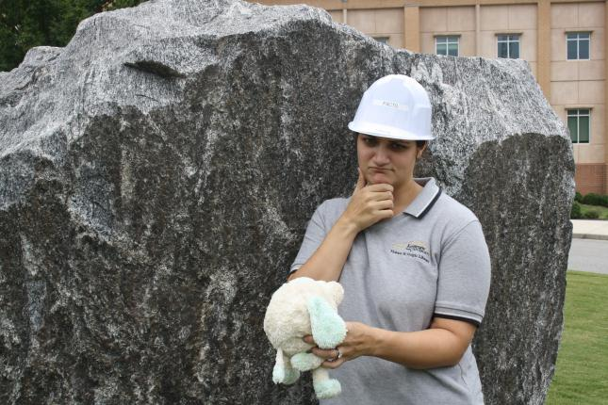
White Hat:
Factual, describes what is there

Slide 28

White Hat: Information Collector
What information is available?
What information would we like to have?
What information do we need?
What information is missing?
How can we obtain the missing information?

Slide 29
White Hat Key Points
Reports AND listens
Assesses the accuracy
Assesses the relevance
Deals with conflicting information
Does not do the thinking for others
Helps to separate the facts from speculation

Slide 30
White Hat Prompts
What do we know?
Do we really know what we think we know?
What do we need to find out?

Slide 31
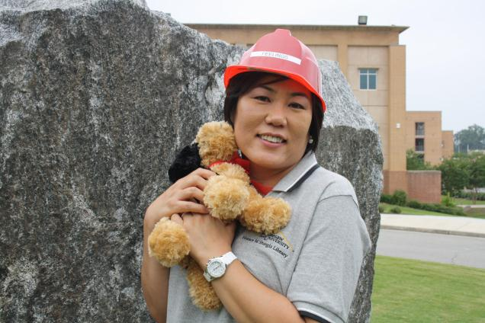
Red Hat:
Intuitive, expresses how one feels

Slide 32
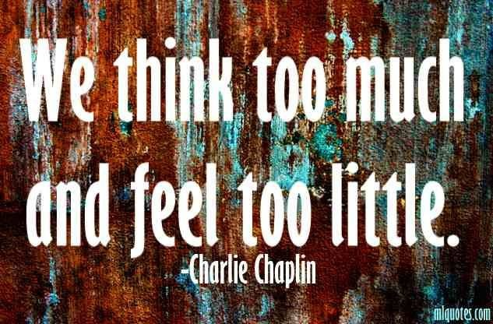
Feeling is Important in the Workplace

Slide 33

Red Hat: Focus on Feelings
Intuition
Feelings
Hunches
Justification not needed
No Whining

Slide 34
Red Hat Key Points
Full permission to express feelings and intuition
Ok to express ‘right now’ feelings
Ok to express ‘how I felt’ feelings
Ok to express ‘how I think” I might feel
Ok to express fears
Ok to change feelings
Not supposed to be correct or logical
Not supposed to be reliable

Slide 35
Red Hat Prompts
How do you feel about this?
How did you feel about this?

Slide 36
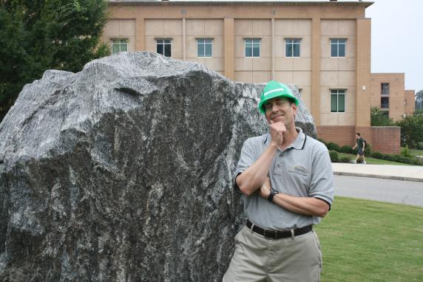
Green Hat:
Creative, comes up with ideas

Slide 37

True Strength

Slide 38

Green Hat: Creativity
Cannot expect people to be creative but can expect people to make a creative effort
A willingness to:
Look for alternatives
Challenge current thinking
Consider new possibilities

Slide 39
Green Hat Key Points
A deliberate search for alternatives
Ok to be illogical
Ok to suggest something that has failed before
Ok to suggest something that will cost $$
Ok to be outrageous
OK to modify an idea
A deliberate search for alternatives
Don’t be satisfied with the obvious
Pregnant pauses are OK

Slide 40
Green Hat Prompts
What are some alternatives?
Think outside of the box?
If we had $1 million dollars what could we do?
If we had unlimited time what could we do?

Slide 41
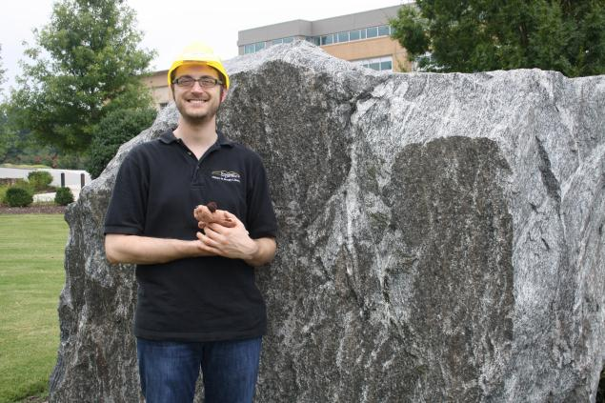
Yellow Hat:
Sees what is good in EVERYTHING

Slide 42

Yellow Hat: Focus on Benefits
What is good about the situation?
Who might benefit & how?
How is this valuable?
Why is this logical?

Slide 43
Yellow Hat Key Points
Value sensitive
Concept sensitive
Why is this of interest to people / organization?
How does this showcase organizational ROI?
How does this give our organization a competitive edge?

Slide 44
Yellow Hat Prompts
How can we make this work?
What value is there in this idea?
What opportunities were there in the past?
What opportunities are there in the future if we stay the course?
Under what circumstances would this work?

Slide 45
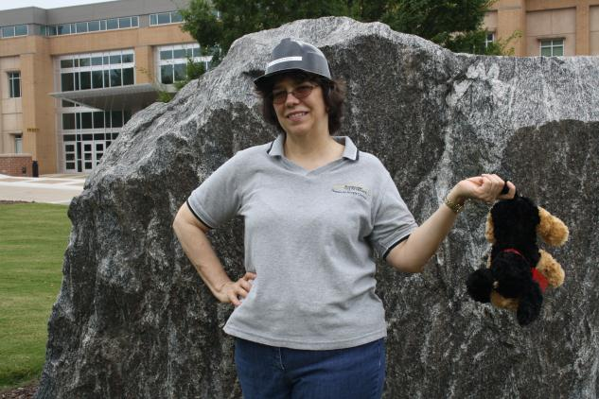
Black Hat:
Sees the wrong with EVERYTHING

Slide 46
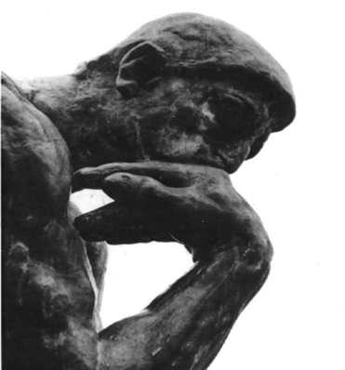
Black Hat: Focus on Cautions
What are the possible problems?
Where might there be difficulties?
What are the risks?
Where do we need to proceed with caution?
Where are we weak?

Slide 47
Black Hat Key Points
It is OK if some of the same information also comes up under white hat
This is NOT the time to solve the problems raised by the black hat
This is a valuable and necessary step – be thorough and ruthless
However, do not overuse this step

Slide 48
Black Hat Prompts
How could this backfire?
What’s the risk?
Why would someone object?
Will this expose us to liability?
Do we have the resources?
Will it cost too much?
Has it failed before?

Slide 49
IV. Example:
Applying the Six Hats
Blue Process | White Objective | Red Intuitive
Green Creative | Yellow Positive | Black Cautious

Slide 50

Should librarians wear tutus in the library on Fridays?

Slide 51
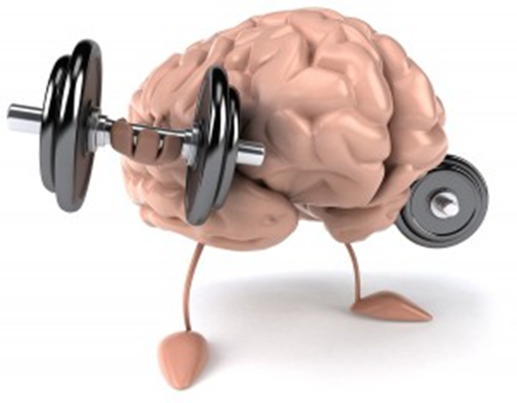
V. Group Exercise

Slide 52
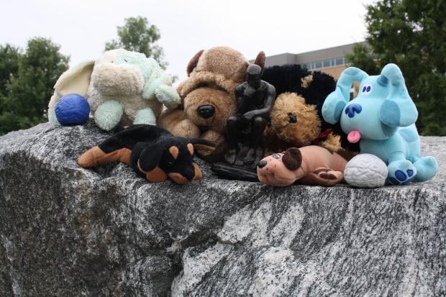
Should the library bring in stress dogs during final exams?

Slide 53

VI. In Conclusion …..

Slide 54
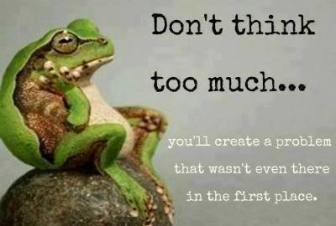
Don’t Think Too Much

