Slide 1
Sprawl and the law
Michael Lewyn Touro Law Center

Slide 2
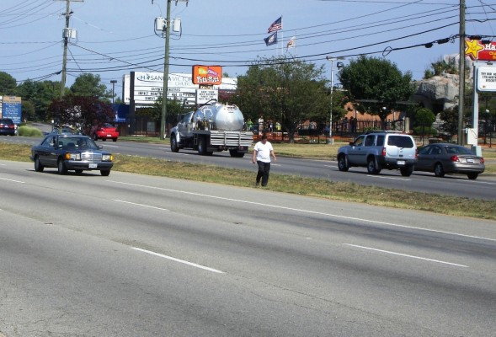
What is sprawl?
Two meanings-
HOW WE GROW- automobile-dependent development is sprawl, pedestrian-friendly development is not

Slide 3

Defining sprawl, part 2
WHERE WE GROW- suburban development is sprawl, urban development is not
Development can be sprawl in one sense but not the other

Slide 4
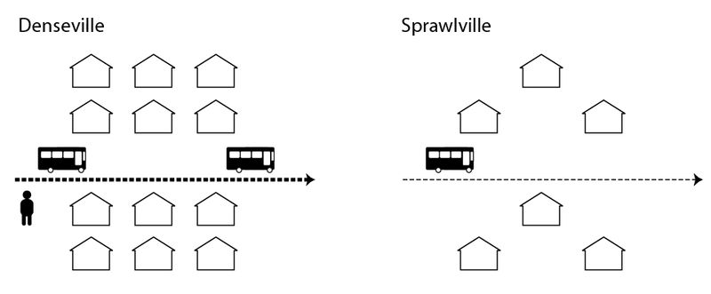
How we grow- zoning rules encouraging or forcing auto-centric development
single use zoning- keeps housing and commerce far apart (sometimes not within walking distance)
Anti-density regulation- reduces number of residences within walking distance of shops

Slide 5
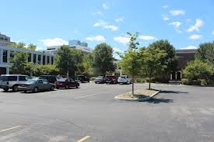
Pro-sprawl zoning: not just use and density regulation
Setbacks and parking requirements- pedestrians have to walk through parking lots to reach shops and apartments and offices

Slide 6
Also….
Minimum parking requirements subsidize driving- parking usually free, but paid for by all of society (since landowners pass costs on to all of us
And reduce density, thus reducing walkability

Slide 7
What to do about pro-sprawl zoning?
Deregulation- but how far do we go?
Constitutional challenges to zoning- usually unsuccessful
New urbanism- anti-sprawl codes, more permissive in some ways, less so in others
Parking reform- not just abolishing minimum parking requirements, but also market pricing to keep on-street parking spaces available

Slide 8
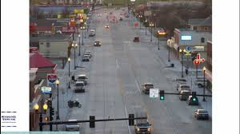
Pro-sprawl street design
Subdivision regulations create…
Wide streets- making it easy to drive too fast

Slide 9
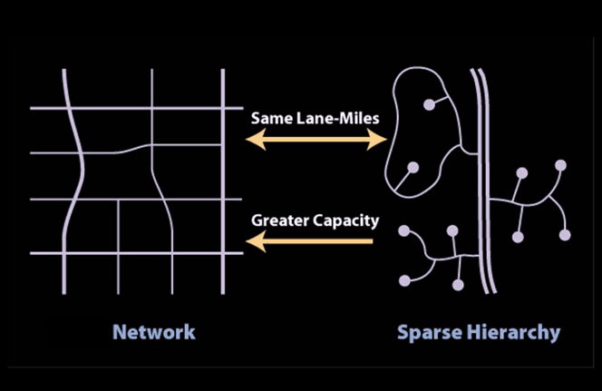
More pro-sprawl street design
Long blocks- too few intersections means you have to go out of your way to walk to side streets
Cul-de-sacs- another way of forcing pedestrians to go out of their way

Slide 10
Where we grow: pro-sprawl transportation and land use policies
The problem: Highways open up suburbs for development, while public transit not funded well enough to catch up
Is land use regulation that keeps development out of suburbs a viable remedy? Constitutional constraints weak, but do growth boundaries increase housing costs?

Slide 11
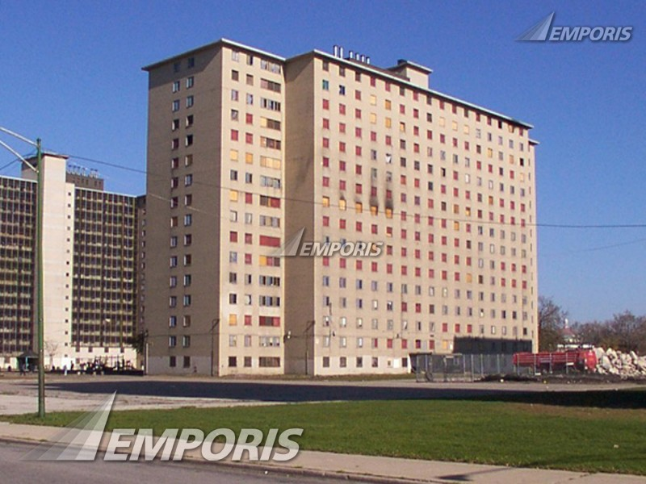
Where we grow: housing policy
Govt. discourages city life by putting public housing in cities but not in suburbs
Was HOPE VI a remedy?

Slide 12
Where we grow: pro-sprawl education policy
The problem: urban schools have lots of poor children, keeping out middle-class parents
Why did this happen?
Residency requirements mean where you live = where you go to school, so poverty in cities means poverty in schools
Desegregation case law- cities had to integrate every school, while suburbs with 100% white-middle class students did not

Slide 13
Education policy- solutions
School finance equalization? Maybe worth trying, but “equalized” public schools still can’t attract urban middle class
Vouchers a solution? Maybe in theory but existing voucher programs only for poor, so don’t do anything to keep middle class in cities

Slide 14
Taxes and sprawl
Mortgage interest deduction?
Gas tax?
Land value tax?

