Slide 1

How I taught a mini-course about Orthodox Judaism and Land Use
Michael Lewyn Touro Law Center

Slide 2

Background: Why the Course?
In 2021, one of the Law Center’s faculty decided to create a university-wide online course on equity issues, entitled “Structural Barriers and the Pursuit of Equity.” Faculty from throughout the university were asked to contribute a week’s worth of material.
Because my scholarship is mostly about land use and I know more about Orthodox Jews than about other marginalized groups, I chose to create a segment on the relationship between land use regulation and Orthodox Jews.

Slide 3

How I organized the course
Intentional discrimination – cases involving intentional discrimination against Orthodox Jews (usually Hasidic sects).
Other constitutional issues- facially neutral local rules that nevertheless might violate the First Amendment.
RLUIPA- a federal statute expanding on constitutional rights of religious institutions. In keeping with the rest of the subject matter, I focused on cases involving Orthodox Jewish groups.

Slide 4

Part 1: Intentional discrimination – why?
An introductory note- why might municipalities be especially tempted to exclude Orthodox Jews?
Orthodox Jews believe that using cars and public transportation violates the Sabbath. Thus, they need to walk to services on Sabbath, which means that they tend to have lots of small synagogues. However, more synagogues means more tax-exempt property, conflicting with municipal desire to maximize revenue-producing property.
Orthodox Jews rarely attend public schools- because a) Jewish holidays often fall on weekdays, making school attendance difficult and b) they prefer their children to spend more time on Torah study (as opposed to secular courses) . As a result, municipal leaders perceive that Orthodox Jews are less likely to support generous funding for public schools.

Slide 5

Example of discriminatory intent
Bloomingburg Jewish Educ. v. Vill. of Bloomingburg, 111 F. Supp.3d 459 (2015)
Facts- Hasidim expanding from nearby towns. City allegedly tried to curb Hasidic-oriented real estate development.
Ruling- Courts found that town intended to exclude Hasidim, based on discriminatory statements.
This violated equal protection clause (because intentional discrimination based on religion a violation) and Fair Housing Act, as well as substantive due process (because arbitrary laws violate due process).
Bottom line: zoning decision motivated by desire to exclude Hasidim (or by analogy, other religious group) unconstitutional.

Slide 6

Part 2: the Eruv problem- or, how to violate the Constitution without clear discriminatory intent
Background- A. Jewish law forbids carrying on Sabbath within a
public domain
• But there’s a limit to the rule: if you carry in a
private domain, such as indoors, that’s OK.
• As early as 5th c. or so, rabbis allowed creation of a
private domain through wires or walls; this artificial “house” is
called an “eruv.”- usually wires tied to utility poles. Typical American eruv just covers a neighborhood or two (though larger in
Manhattan and DC).
•Why litigation? Because streets are government-
owned, which means govt permission required for eruv. So
when govt rejects eruv, litigation sometimes results. Almost
never controversial in big cities, but sometimes controversial
in small suburbs.

Slide 7

Key eruv case: Tenafly Eruv Ass'n v. Borough of Tenafly, 309 F.3d 144 (3d Cir. 2002),
Facts: local govt refuses to allow Eruv because signs not allowed on street policies and eruv treated as sign; local Jews file suit.
Governing 1st amendment principle- laws restricting signage generally OK if neutral. When law not neutrally applied, strict scrutiny applies (which means law unconstitutional absent compelling state interest).
Ruling: Courts says law not neutrally applied. Court says lots of stuff gets put on utility poles and city doesn’t complain. So strict
scrutiny applies, and city must allow eruv.
By contrast, in other cases where law applied neutrally, city allowed to exclude eruv.

Slide 8
A note on disparate impact
Fair Housing Act prohibits rules that have disparate impact based on race, religion or other suspect categories, unless a good reason for rule and no less discriminatory rule.
Disparate impact claims based on religion rarely, if ever, succeed in court.
BUT students should be aware of extent to which neutral laws negatively effect Orthodox Jews.
In particular: zoning laws that limit housing density generally disfavor walkability, and thus negatively effect Orthodox Jews by limiting the number of places where people can walk to synagogue.

Slide 9

Part 3: RLUIPA (Religious Land Use and Institutionalized Persons Act) – statutory protection for religious minorities
Two key concepts:
“Substantial burden” – land use regulation violates RLUIPA if it substantially burdens religion, unless govt shows compelling state interest.
“Equal terms”- govt must
treat religious institutions
on equal terms with
comparable secular land
uses.

Slide 10
Westchester v. Mamaroneck, 504 F.3d 338 (2d Cir. 2007),
What plaintiff wants to do: expand religious
school. Town refuses based on concerns
about inadequate parking etc
Ruling: court finds substantial burden because 1) city’s reasons for decision unpersuasive 2) P had no practical alternative to proposal, couldn’t expand on existing site 3) city did not try to meet P halfway by suggesting conditions for approval
Substantial burden test involves balancing interests.

Slide 11
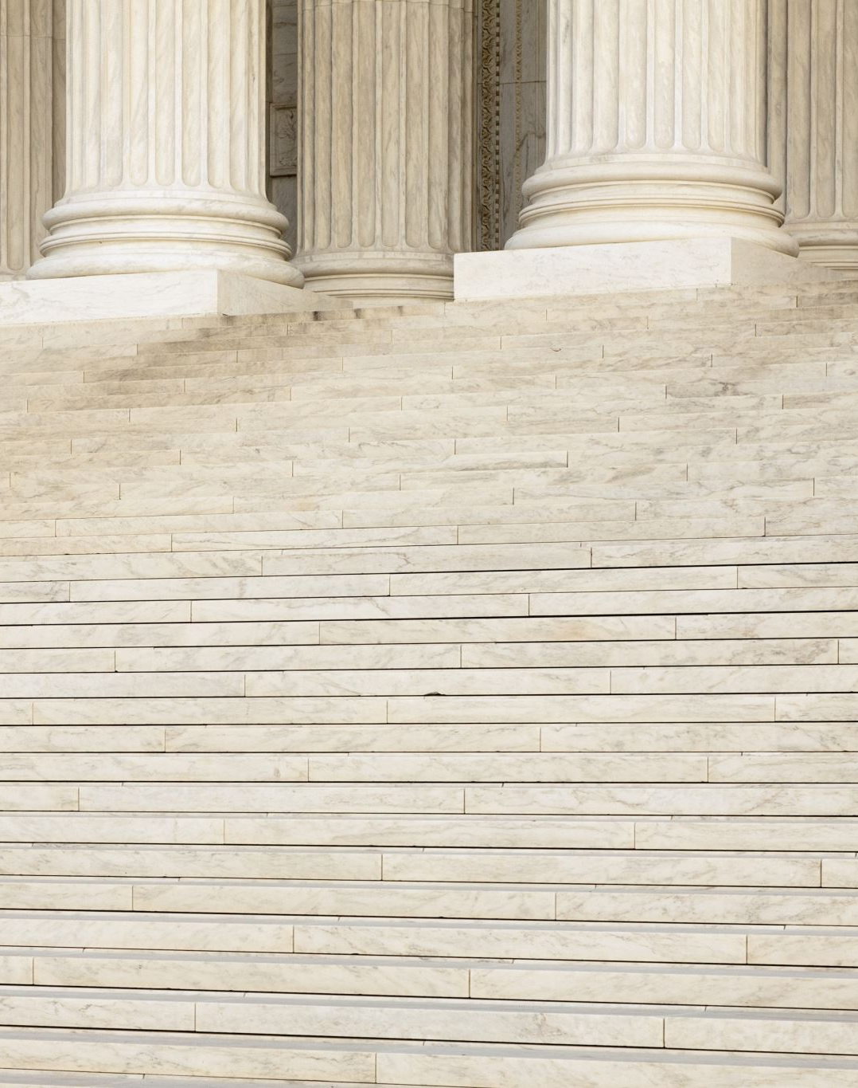
Chabad Lubavitch v. Litchfield Historic Dist., 768 F.3d 183 (2014)
What plaintiff wanted to do: alter a house in a historic district to build a clock tower. City says no because of historic preservation law.
P’s equal terms claim: P’s claim: secular library allowed to make major changes and we weren’t, hence we weren’t treated on equal terms
Ruling: court rejects claim, because library renovations were made 50 years ago, and historic preservation laws have become stricter.
Bottom line: equal terms provision does not prevent changes in law.

Slide 12
Assessment
A few short essays.
1) I gave students some local zoning ordinances, and asked them how they would lobby to change laws if they were lobbying for Orthodox interests.
2) gave students a hypothetical in which small town zoning code limited religious institutions to one of five zones in the town, and asked students whether code violated RLUIPA.

