Slide 1
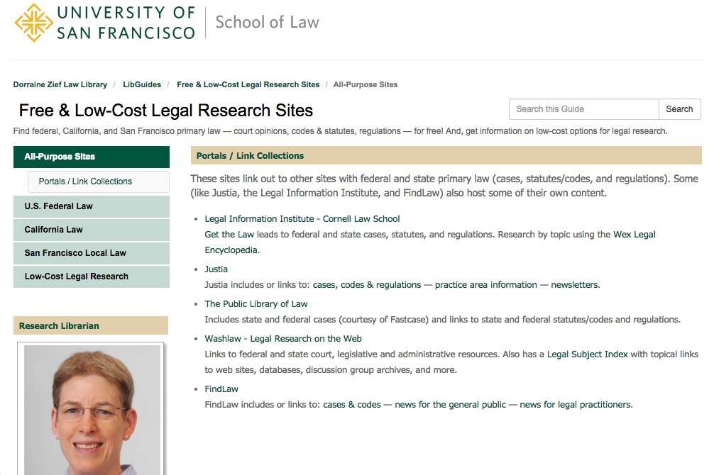
Free & Low-Cost
Legal Research Options
Lee Ryan, J.D., M.L.I.S.
Research Librarian, USF School of Law, Dorraine Zief Law Library
[Slides and outline available on TWEN and at: http://works.bepress.com/lee_ryan/. Last updated on April 5, 2017]
[Based on the National Business Institute Seminar “Find it Fast and Free on the Net: Strategies for Legal Research on the Web,” Oakland, California, June 5, 2012.]
Notes:
1
Now that you’re coming to the end of the year — and getting close to summer jobs, or 2nd year intern- or externships, Prof. Mikulak and I thought this would be a good time to do 2 things:
FIRST, we thought it would be good for me to demo some free and low cost options for legal research.
As you know, you may not always have access to Lexis or Westlaw — or they may be too expensive for some projects.
So I’ll introduce you to some alternatives.
SECOND, we thought you should at least SEE Bloomberg Law. It’s not at all “low cost” but …
— it has a very predictable pricing structure for practitioners;
— and it’s free to you while you’re in law school.
Overall, my GOALS for this session are fairly modest. All I really want is for you to be AWARE of the many alternative online research options out there.
If you leave today thinking, “Wow, there are a lot of good free or inexpensive online research tools out there” —
and “I also have to take a look at this ‘Bloomberg Law’” —
then I’ll be satisfied.

Slide 2
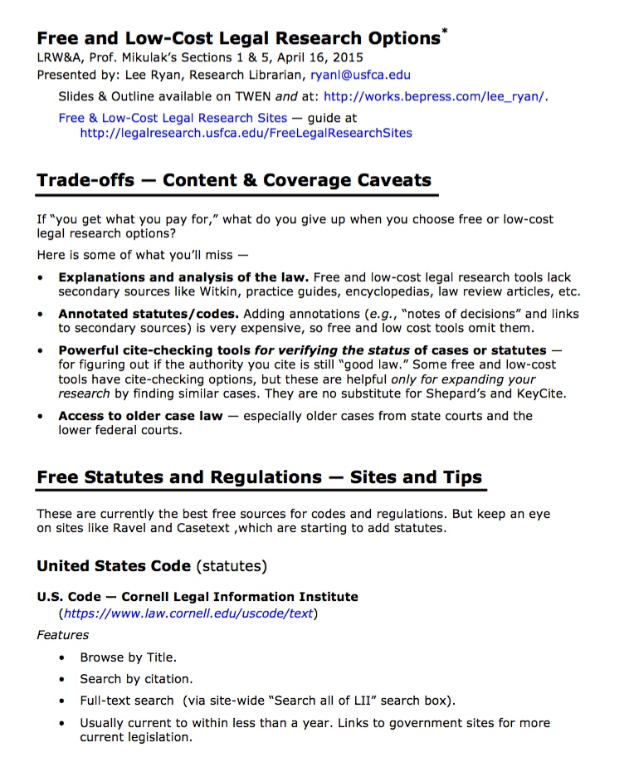
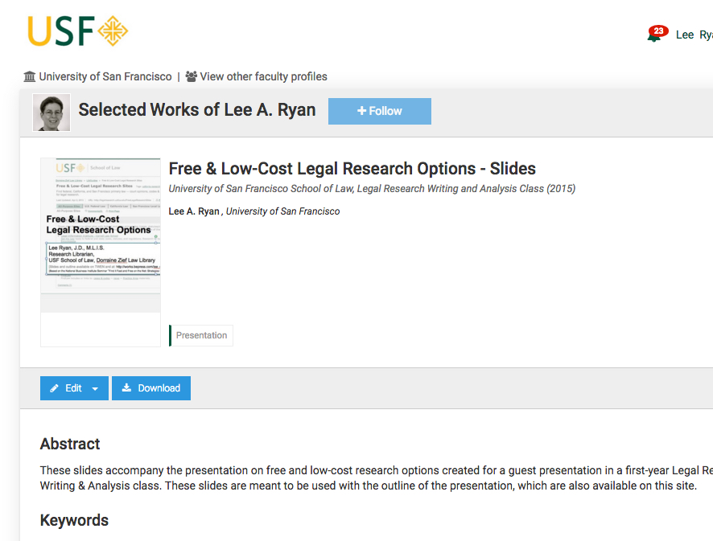
On TWEN
(Download Word version for live links.)
http://works.bepress.com/lee_ryan/
Details! Live Links!
Slides and outline via TWEN and bepress “Selected Works.”
Notes:
I’ll be zipping through all of this —
So I want you to have ways to look back at what I covered.
First, these slides plus an outline (with live links to all the sites) are on TWEN — and both are also on my “Selected Works” site, which, unlike TWEN, doesn’t need any password.

Slide 3
Zief Research Guide
http://legalresearch.usfca.edu/FreeLegalResearchSites
Notes:
Second, the library has a research guide (also without any password) where we gather links to the best free and low-cost sites.

Slide 4
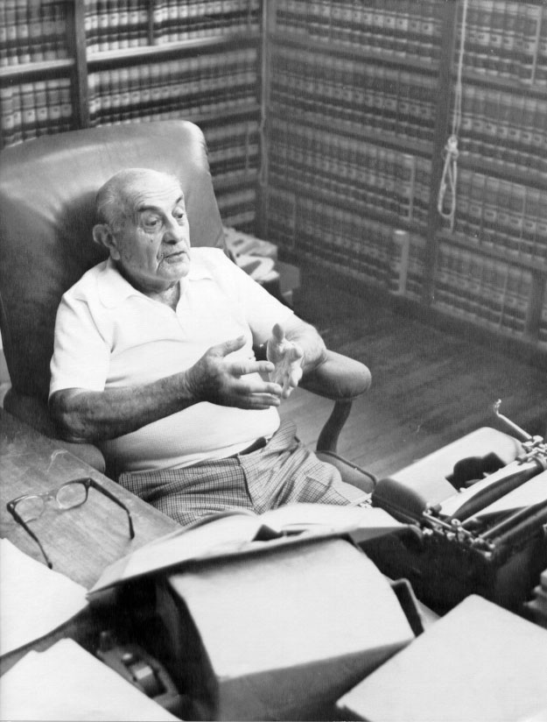
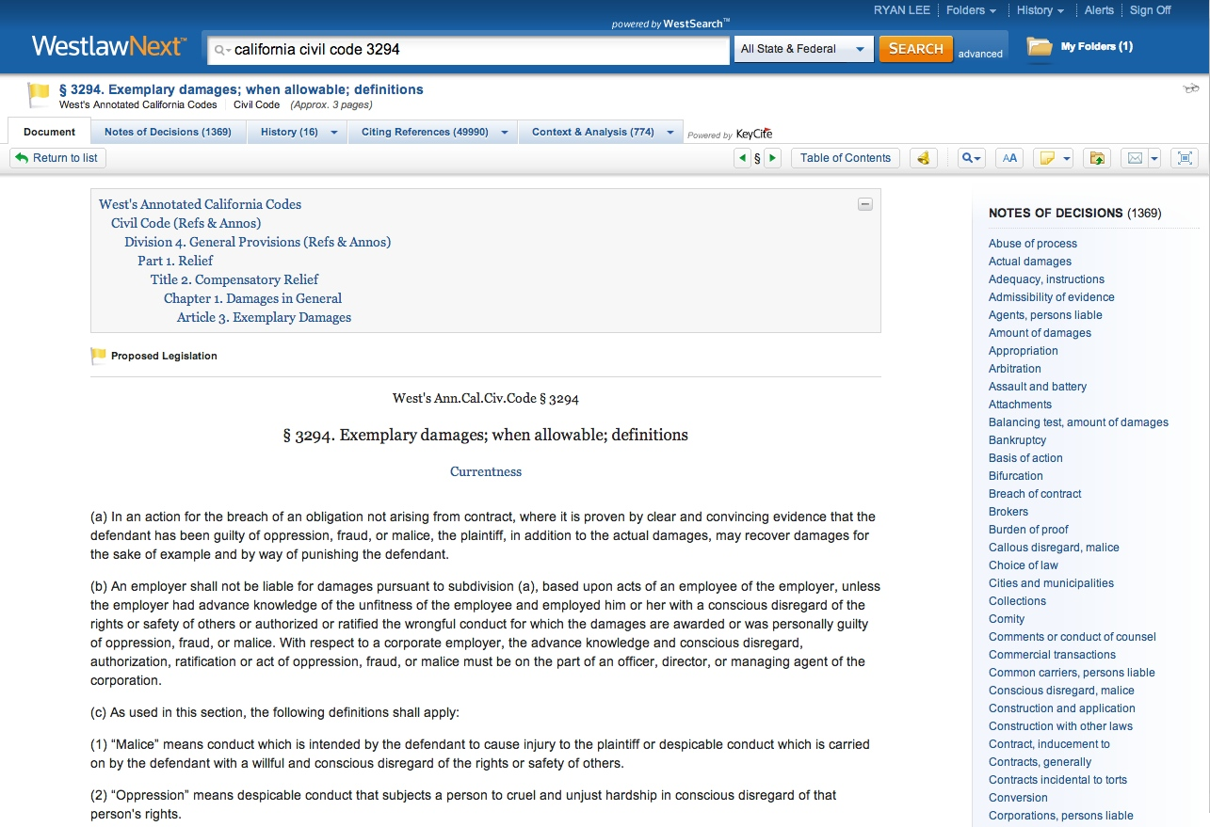
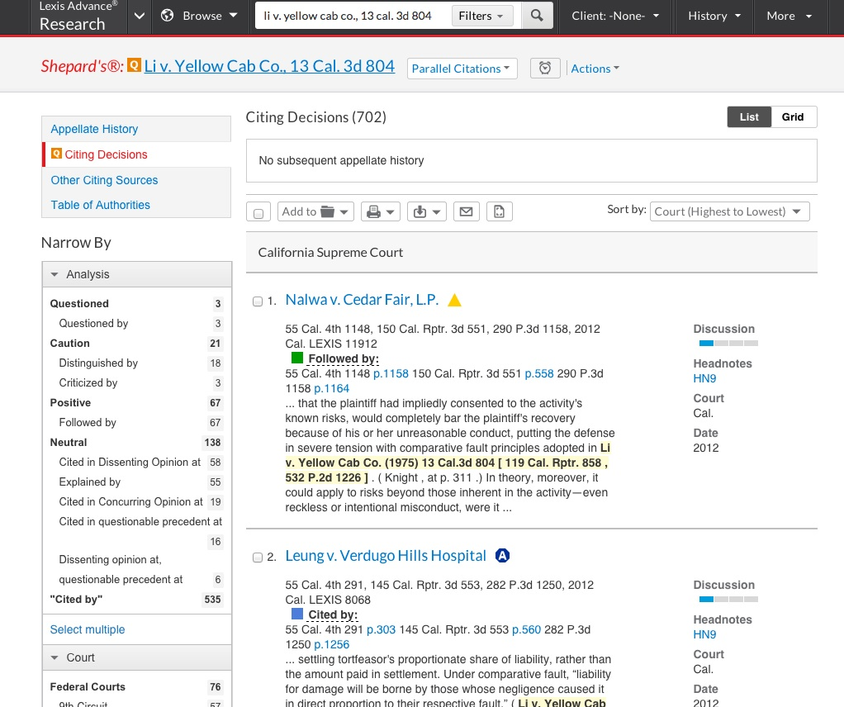
No secondary!
No anno. Codes!
No Shepard’s / KeyCite!
Caveats — Content & Coverage
Notes:
4
Before I demo any free sites … a general warning.
You give up a LOT when you pay nothing or only a small amount.
Some of the main things you give up include the following —
For CONTENT…
[ANIMATE at bullets]
- you give up — explanations and analysis (there are no free “Witkins”);
- you give up — annotated statutes, meaning you don’t get the interpreting cases
and helpful secondary sources; and
- you give up — full-featured citators (like KeyCite and Shepard’s) for verifying the status of your case.
And…
For COVERAGE, you give up (often):
- older state court cases;
- older federal court cases.
So you DO get what you pay for.

Slide 5
Free Statutes & Regulations
Notes:
5
There’s not much to say about free statutes and regulations.
They tend to be pretty bare-bones.
Even if I didn’t have Westlaw or Lexis, I’d STILL find a way to start my statutory research with a practice guide,
OR to hunt down an annotated code in print first.
But there are some sites that are fine, particularly for looking up known code or regulation sections.
These include….

Slide 6
Best Free Statute / Reg. Options
U.S. Code — Cornell Legal Info. Institute
(http://www.law.cornell.edu/uscode/text/)
Code of Federal Regulations (C.F.R.) — Cornell LII
(http://www.law.cornell.edu/cfr/text/)
California Codes — Cal. Legislative Info. Service
(http://leginfo.legislature.ca.gov/faces/codes.xhtml)
California Code of Regs. — Cal. Office of Admin. Law
(http://ccr.oal.ca.gov/) — powered by Westlaw!
Notes:
… my favorites — and there’s ….
One site each for federal statutes and regulations — and
One site each for California statutes and regulations.
(As an aside, the Cal Code of Regs site is particularly powerful because it’s got some Westlaw searching features.)

Slide 7
Free Case Law
Notes:
7
For case law, there are some pretty impressive free options. These include…

Slide 8
Best Free Case Law Options
Google Scholar - Legal Documents
(http://scholar.google.com/) — Select “Legal Documents” before searching
California Official Reports — public access web site
(http://www.lexisnexis.com/clients/CACourts)
Ravel (free “Open” accounts)
(https://www.ravellaw.com/)
Fastcase iPad / iPhone / Android App
http://www.fastcase.com/ipad/ — iPad
http://www.fastcase.com/iphone/ — iPhone
http://www.fastcase.com/android/ — Android
Notes:
…. These 4, which I consider to be among the best established sites.
Note that there’s a phone or tablet APP on the list.
And it’s not just the app DOWNLOAD that’s free. The app gives free access to basic Fastcase CONTENT.

Slide 9
Best of the Best
Google Scholar &
California Official Reports
Notes:
9
Of those 4 options, I think these 2 are the most noteworthy, so I’ll show a little more detail for both.
Google Scholar has super (although not 100%) coverage —
it’s good for cases from any state, or for federal cases.
The California Official Reports free service is noteworthy for its inclusion of ALL published California cases, regardless of age,
AND for its powerful search options.

Slide 10
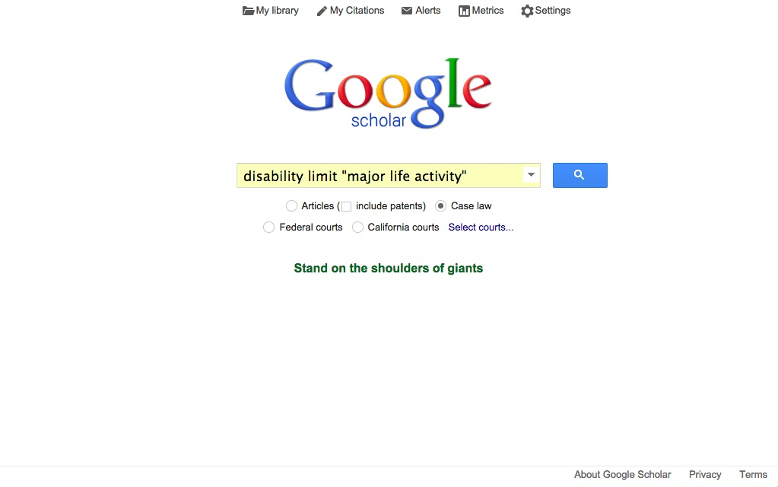
Select “Case Law” before searching.
Google Scholar — Case Law
http://scholar.google.com/
Notes:
Google Scholar’s familiar look-and-feel make it comfortable to use.
Just be sure that you select the “Case law” option before you search.
In my various test searches, I’ve been very impressed with the relevance of the results I’ve gotten from Google Scholar.
(Basically, for each case law tool I tried, I ran a search looking for cases on the California definition of “disability” as a condition that limits a “major life activity.”)

Slide 11
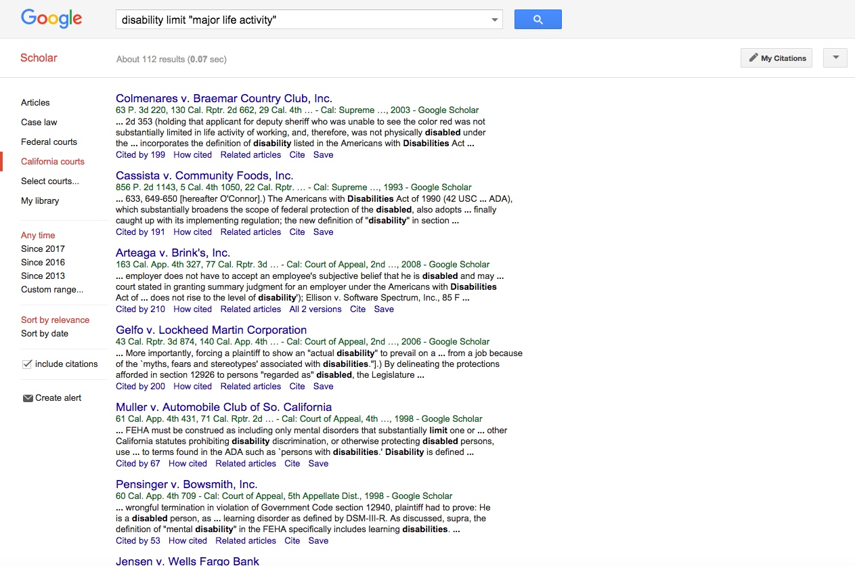
Filters — for court and date
Google Scholar – results (Cal. Courts filter)
Notes:
These Google Scholar results for my test search were good, in that they include a lot of the cases that other sources
(like practice guides and annotated codes) suggest are relevant to my issue.

Slide 12
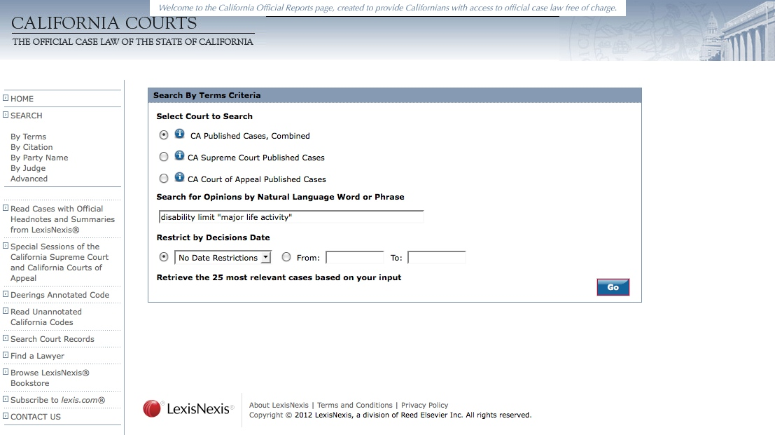
Default search —
natural language
Other search options — including
full LexisNexis terms & connectors
Calif. Official Reports — public access site
http://www.lexisnexis.com/clients/CACourts/
Notes:
The second of my “best of the best” free sites is this California-specific site.
It’s distinctive because
- it has all official PUBLISHED California cases going back as far as possible
AND
- it’s powered by Lexis’s search engine.
The only downside is that new cases are added only 4 times a year.
I tested it using my “disability” search …

Slide 13
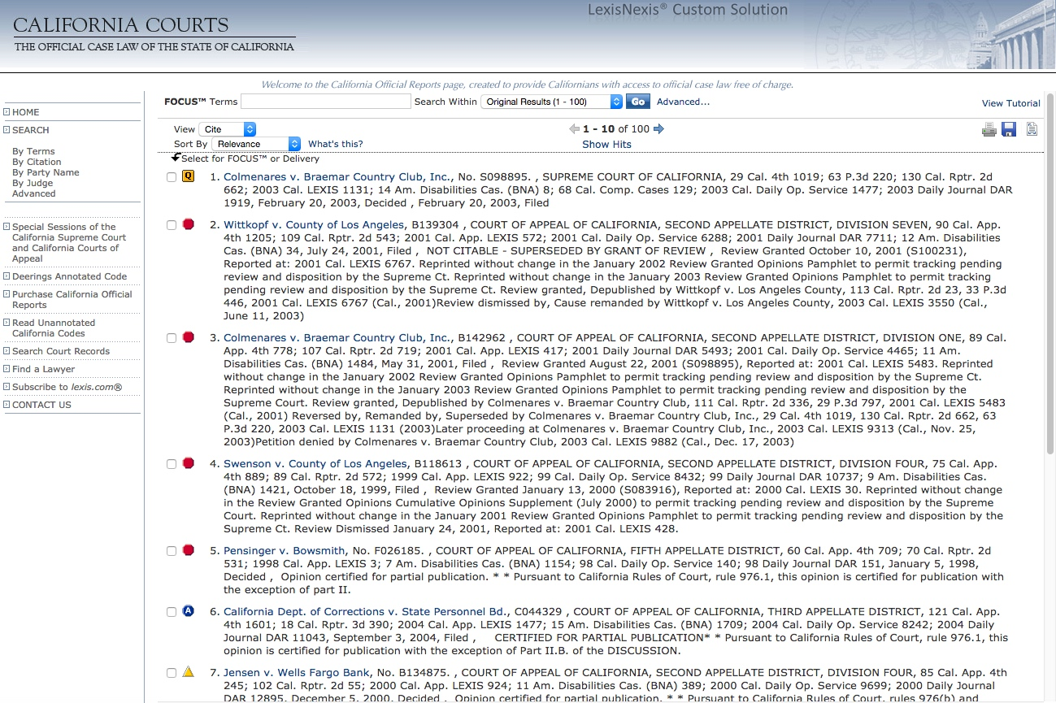
Up to 100 results
(for natural language search)
Calif. Official Reports — results (nat. lang.)
Notes:
… and I got very good results.
By the way, you might notice that you can see the Shepard’s SIGNALS next to the case citations...
BUT!.. You can’t get a full Shepard’s REPORT from this site without subscribing to (and paying for) Lexis.
As I’ve said before and will say again…
There is no free substitute for Shepard’s or KeyCite, particularly when you need to VERIFY the STATUS of a case.

Slide 14
Intriguing Newcomers
Ravel & Casetext
Notes:
14
Before I leave the free sites, I’d like to introduce Ravel and Casetext, which have appeared in the last couple of years.
Both are very promising — and might displace my two free favorites —
if I weren’t afraid their venture capital might dry up & they’d disappear.

Slide 15
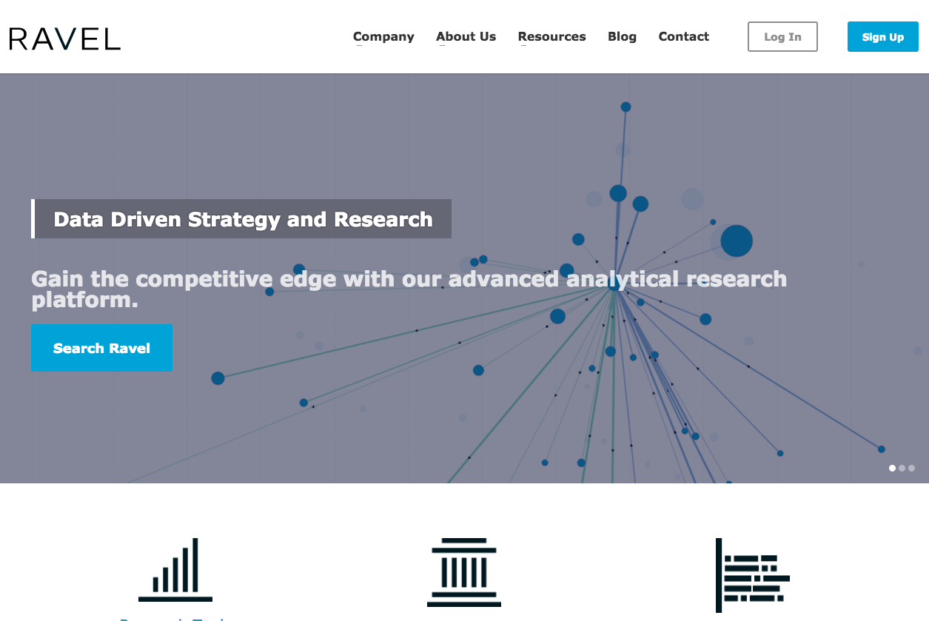
(“Advanced” plans are free for users with “.edu” email addresses
… at least for now.)
Ravel (“data driven research”)
http://www.ravellaw.com/
Notes:
Ravel has several plans, each with different content and features.
I’m kind of cheating in including it with the “Free” sites — But its “Open” plan IS free to anyone.
AND its “Advanced Plan” (with more case law and more features) is available to USF.
Advanced Plan includes Ravel’s distinctive visualization tools.

Slide 16
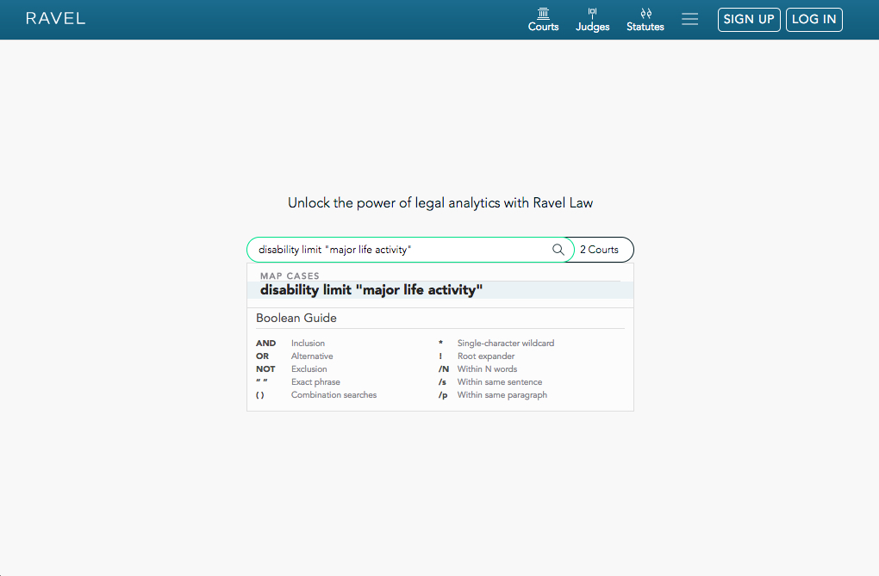
Ravel — Searching
Notes:
I ran my “disability” search in California cases using Ravel’s free “Open” plan…

Slide 17
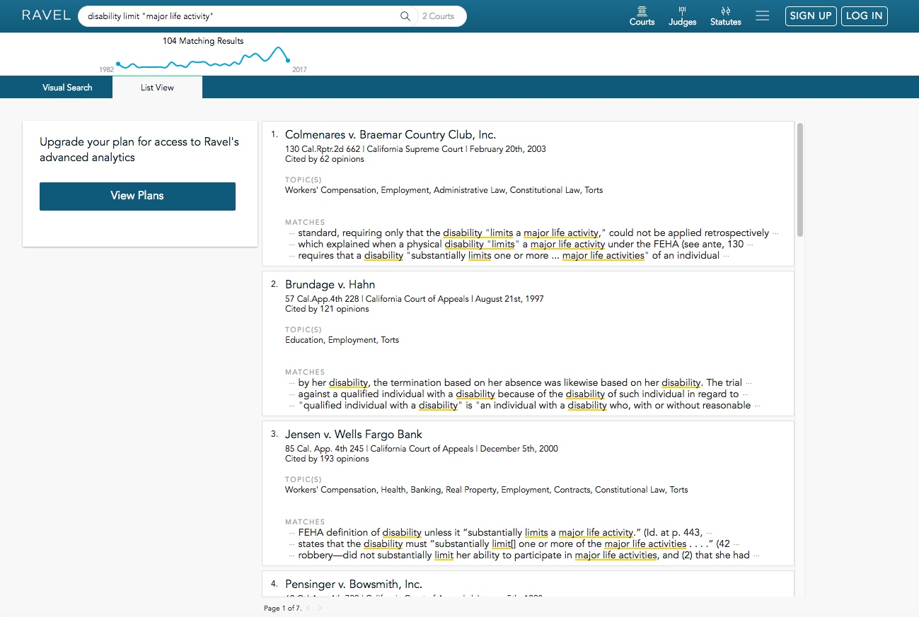
Ravel — results in free “list view”
Notes:
The results were quite good in terms of relevance.
In the free “Open” plan interface, Ravel displays my results in “List View”

Slide 18
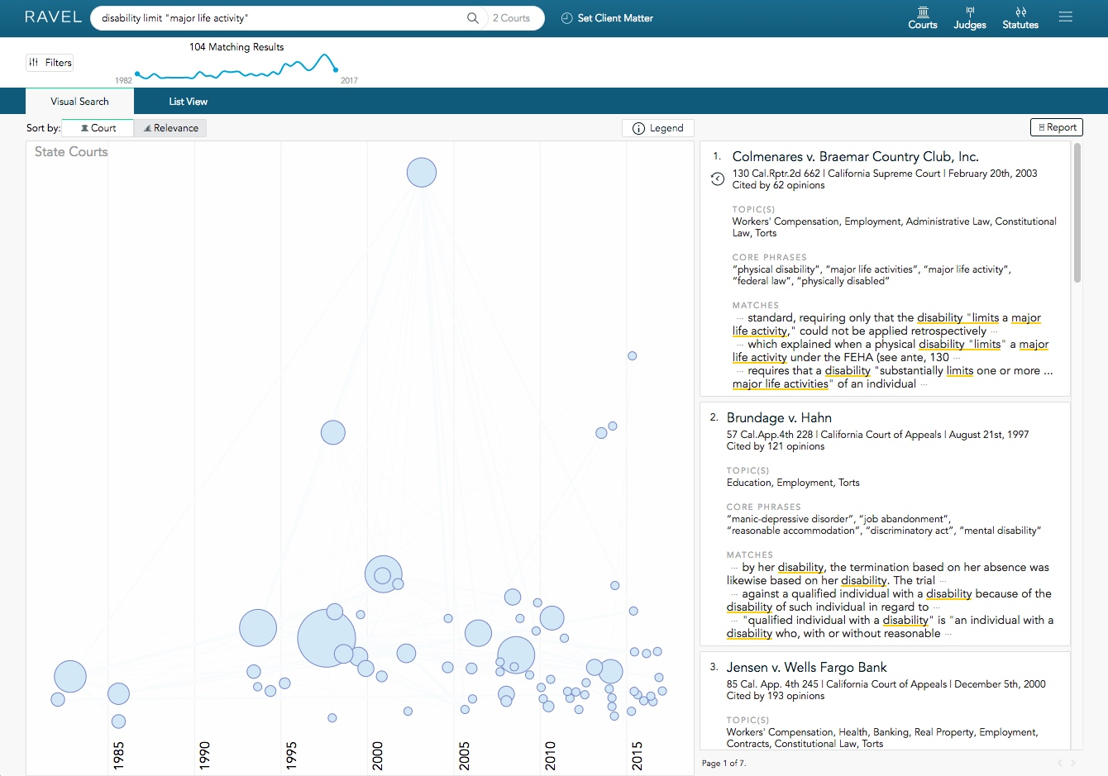
Ravel — results in “visual search” (not free)
Notes:
Then I signed on to my “Advanced” plan (available to us here at USF)…
(Which is kind of cheating for this “free” section of the presentation!)
This gave me access to the “Visual Search” display of my results.
Ravel uses the size of the circles to show how often cases have been cited.
And it uses lines to show the citation relationships between cases — who cites to whom.
[There’s a lot more to Ravel than this — but it can’t be shown in a screenshot; you need to see it live.]

Slide 19
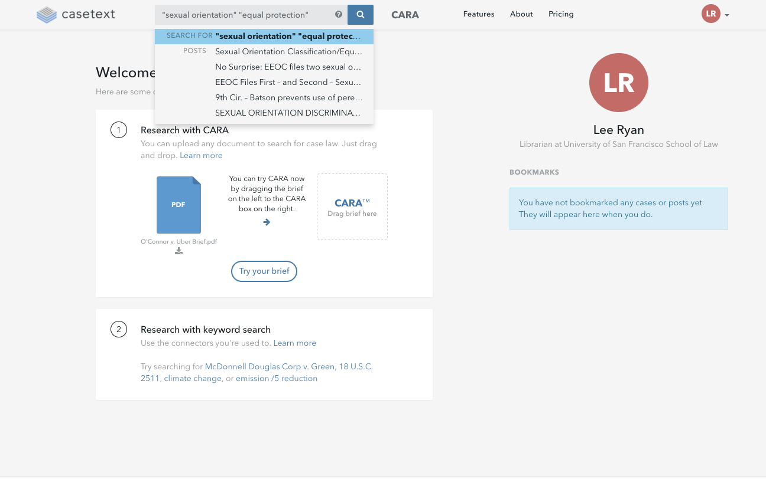
Casetext
http://www.casetext.com/
Notes:
Here’s Casetext, where I also tried my “disability” search — with good results.
BUT, to highlight Casetext’s unique features, I did a different search:
a broad search for
“sexual orientation” and “equal protection”

Slide 20
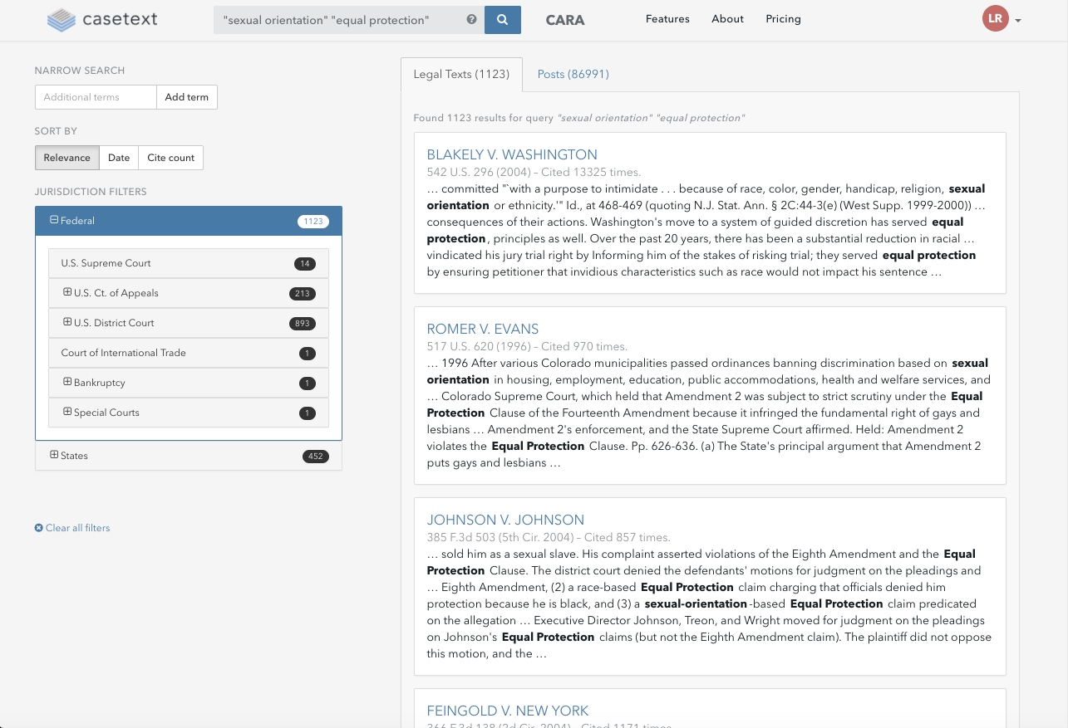
Topical posts added by users
Casetext — results list (filtered to Federal cases)
Notes:
One distinctive Casetext feature is that it “crowdsources” by letting registered users add content in the form of posts — and even basic cite-checking information.
In my search results here, in the Supreme Court cases, you can see the link to posts users have added.

Slide 21
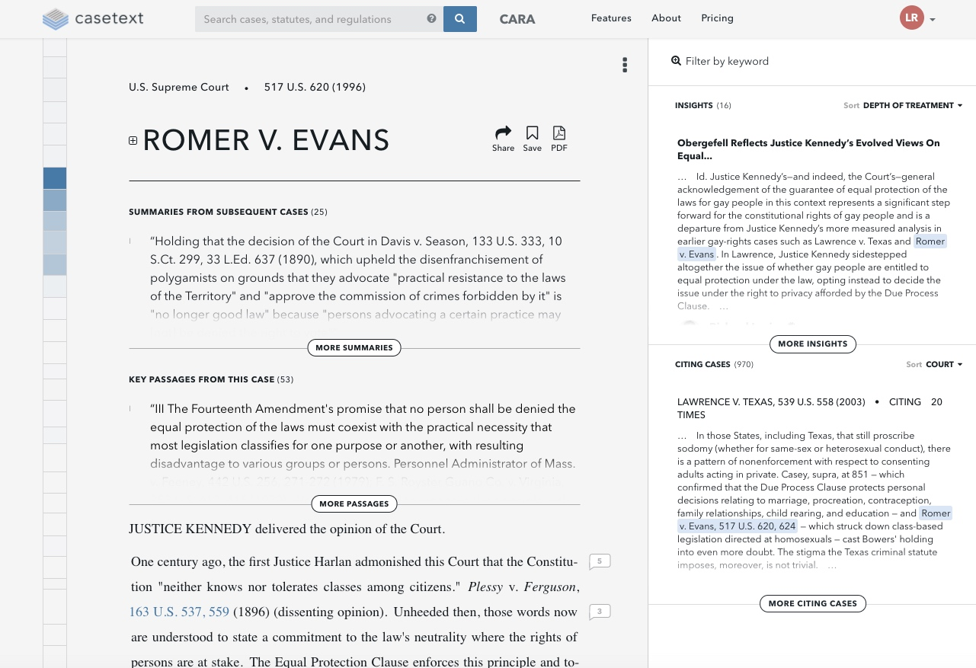
Summaries of Romer from later cases
“Heat Map” at margin
showing
most-cited parts of case
Posts (“insights”)
written by users
Key passages (often-cited passages) of Romer
Later cases that cite to Romer
Casetext — case display
Notes:
And in this CASE display of Romer v. Evans, you can see several of Casetext’s distinctive features:
[ANIMATE at bullet points]
- summaries of Romer from later cases
- key passages (often-cited passages) from Romer
- the user-edited posts (called “insights”)
- later cases that cite to Romer
AND
- the “heat map” on the left, showing which parts of Romer are most often cited by other cases

Slide 22
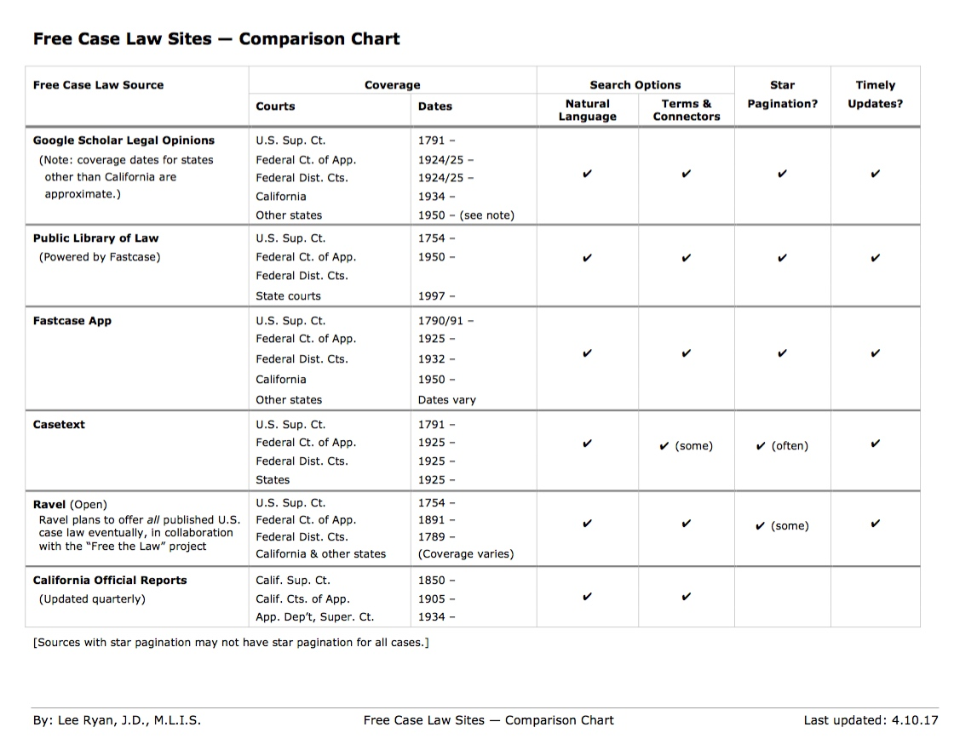
Free sites — summary of features
Notes:
22
As a wrap-up on the free sites, here’s a comparison chart of their features,
which you can consult at your leisure if you download the slides or the chart from TWEN.

Slide 23
Low-Cost Options
Notes:
23
If you’re willing and able to pay a bit, there are some very good options available.

Slide 24
Best Low-Cost Options
Fastcase “premium” — $65 to $95 per month
(http://www.fastcase.com/) (free to USF law students)
Casemaker — $60 to $90 per month
(http://www.casemakerlegal.com/) (Casemaker X is free to USF law students)
Versuslaw — $14 to $40 per month
(http://www.versuslaw.com) (free to USF law students — “Premium” Plan)
AccessLaw — Calif. law only — $46 per month
(http://www.accesslaw.com/)
Notes:
These 4 have particularly impressed me.
The prices vary, but aren’t shockingly high.
And for the price, you generally get (as compared to free sites):
- more search options;
- more display options;
- some options for organizing your work (like folders or histories);
- some slightly more sophisticated “citators” (for EXPANDING your research); and
- more content besides just cases (For example, you might get statutes, regulations, court rules, etc.…)
As law students, you now have free access to Fastcase, Casemaker and Versuslaw. Details are in the Outline on TWEN.)
Of these 4 really good products, Fastcase and Casemaker are, for me, the standouts.
[If you’re curious about the other 2, I’ve got some extra screenshots on the slides as posted on TWEN.]

Slide 25
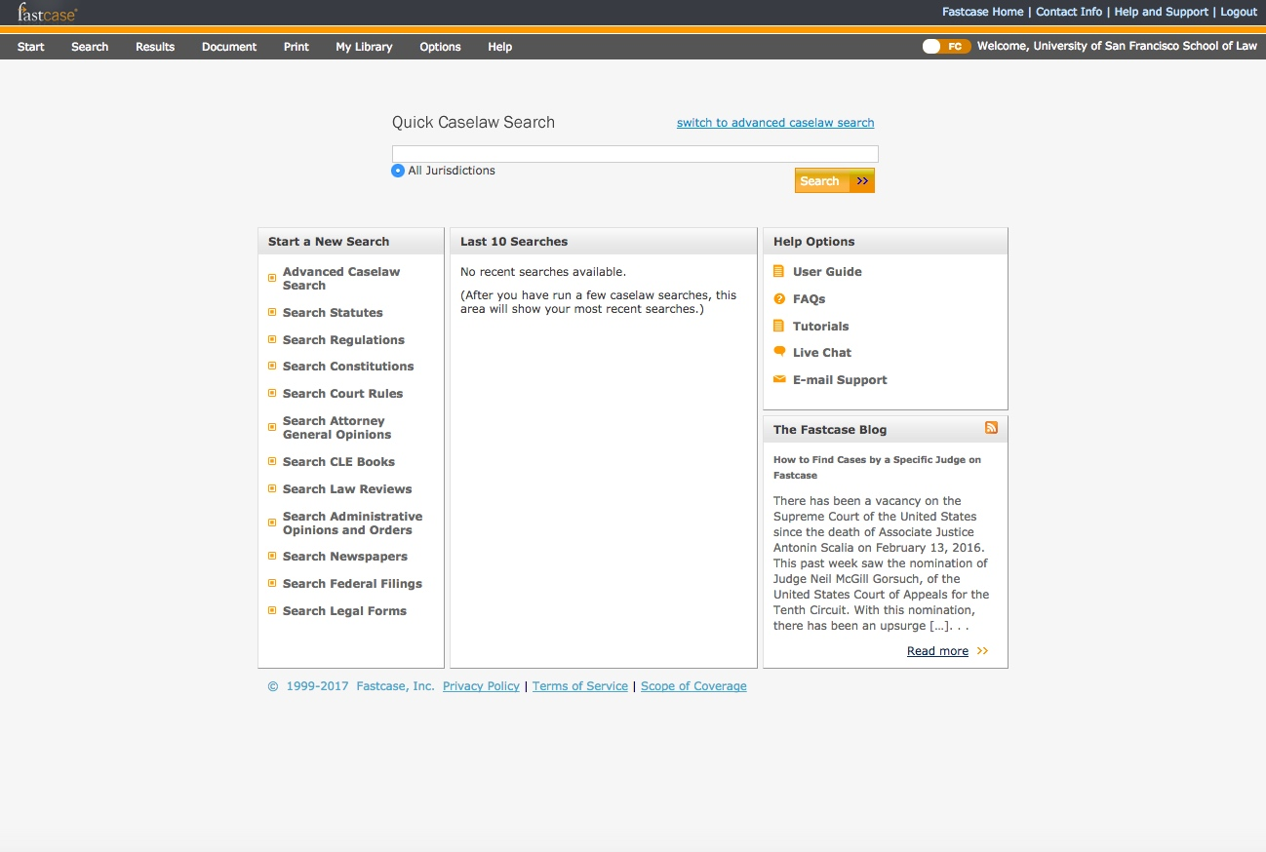
Fastcase — v. 6 interface
http://www.fastcase.com/
Notes:
Fastcase is moving from one interface to a new one.
This is the old (and still default) interface.
You can use this little slider
[ANIMATE ARROW]
in the top-right-hand part of the screen…
To switch to the new Fastcase 7 interface, which looks like this:
[NEXT SCREEN]

Slide 26
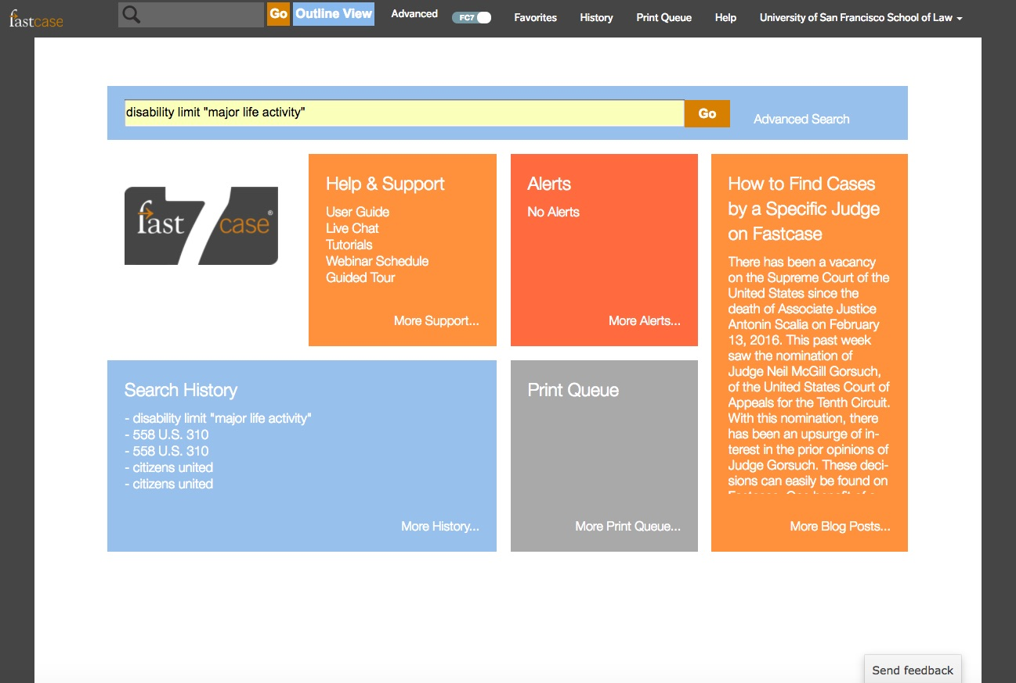
Multiple search options
Fastcase 7
http://www.fastcase.com/
Notes:
This is the Fastcase 7 landing screen, and I’ll continue my demo in the new Fastcase 7 interface.
I did try my “disability search” as a natural language search from the search bar here (and it went well), but
I was also curious about what “advanced search” would offer

Slide 27
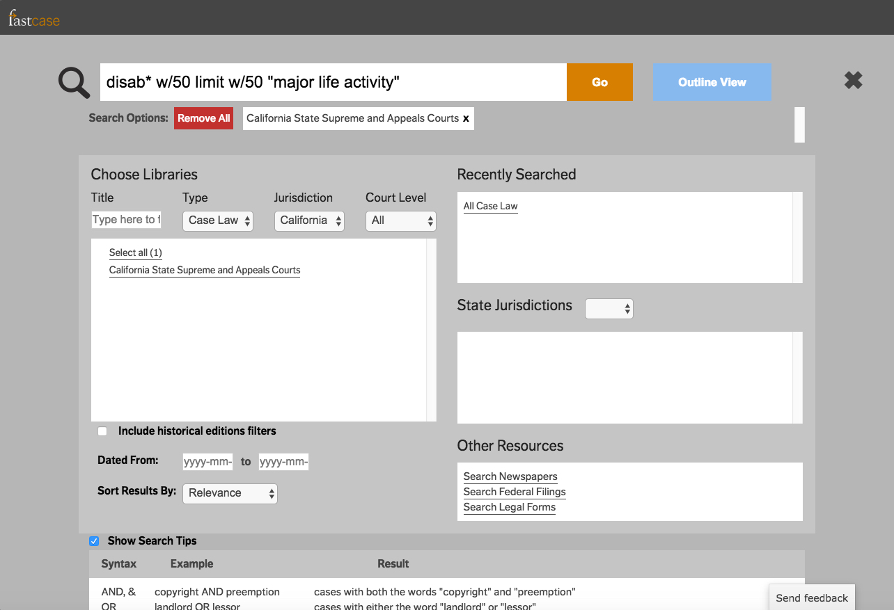
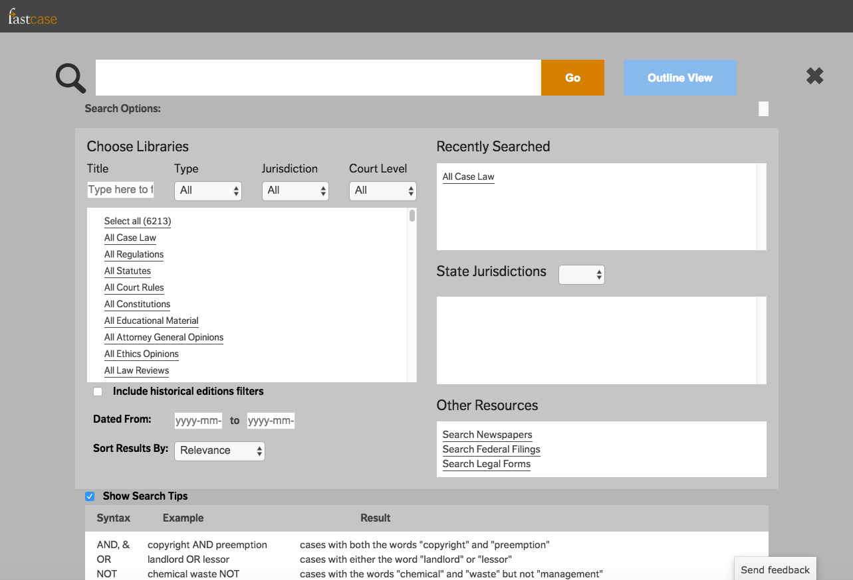
Terms & Connectors
or Natural Language
Fastcase — advanced search screen
Notes:
The advanced search screen walks you through the options,
and the form lets you “show search tips”
so that you can see what connectors you can use if you choose terms and connectors.
Using the form…
[ANIMATE to advanced search with cal chosen & search in place]
I selected California case law, and ran my search as terms and connectors.

Slide 28
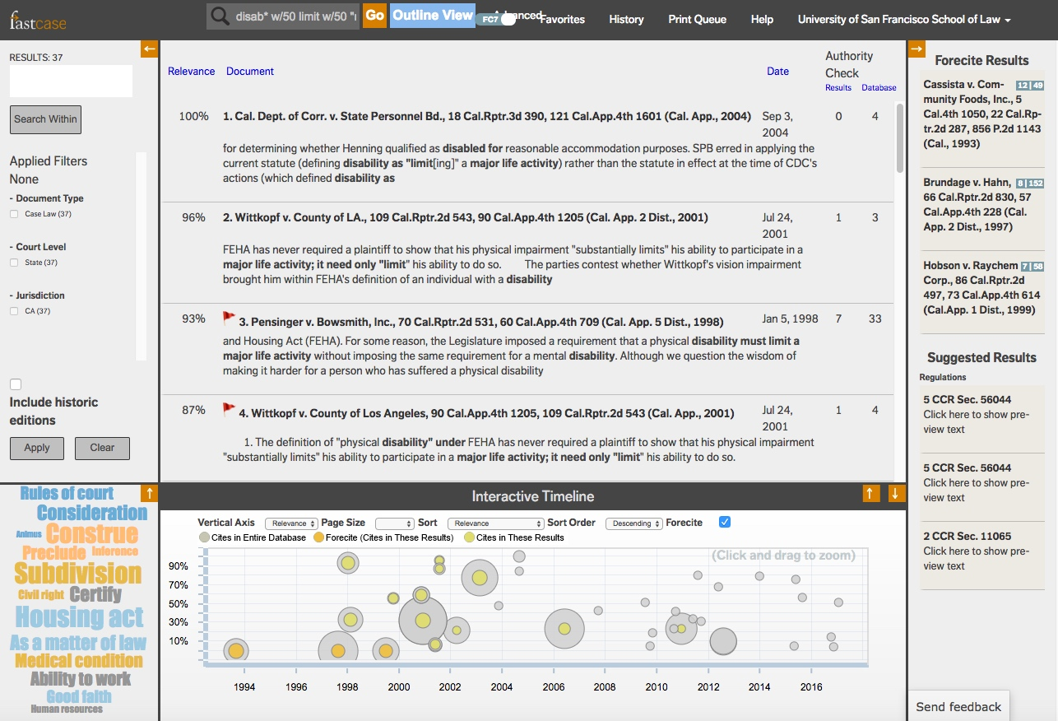
Forecite
Filters & “Search Within”
Interactive Timeline option
Interactive Timeline option
“Bad Law Bot”
(flags potentially problematic precedent)
“Bad Law Bot”
(flags potentially problematic precedent)
Word cloud
Fastcase — results (default view)
Notes:
My search results were good — for both terms & connectors and natural language—.
The default results display includes several helpful features:
[ANIMATE at Bullet Points as needed]
The “Bad Law Bot” flag (more on that in a second)
Forecite, which suggests other possibly-relevant cases that your search terms didn’t retrieve
Filtering and “search within results” options
A word cloud, AND
A visual “interactive timeline”
As to “Bad Law Bot,”
[ANIMATE]
… it is a computer algorithm that tries to flag POTENTIALLY bad law.
No human judgment is involved (except yours, when you read Pensinger and its citing cases!)
And even Fastcase says that “Bad Law Bot” is no substitute for KeyCite or Shepard’s.)
And as to the “Interactive Timeline” display,
[ANIMATE]
… which you can maximize…

Slide 29
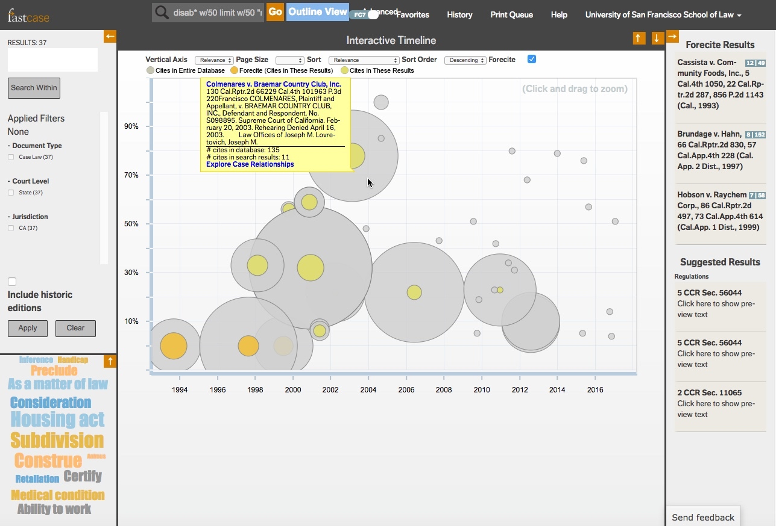
Fastcase results — Interactive Timeline
Notes:
This is the interactive timeline display for MYsearch results.
It shows the results spread over time, with the circles indicating by size how often the cases have been cited.

Slide 30
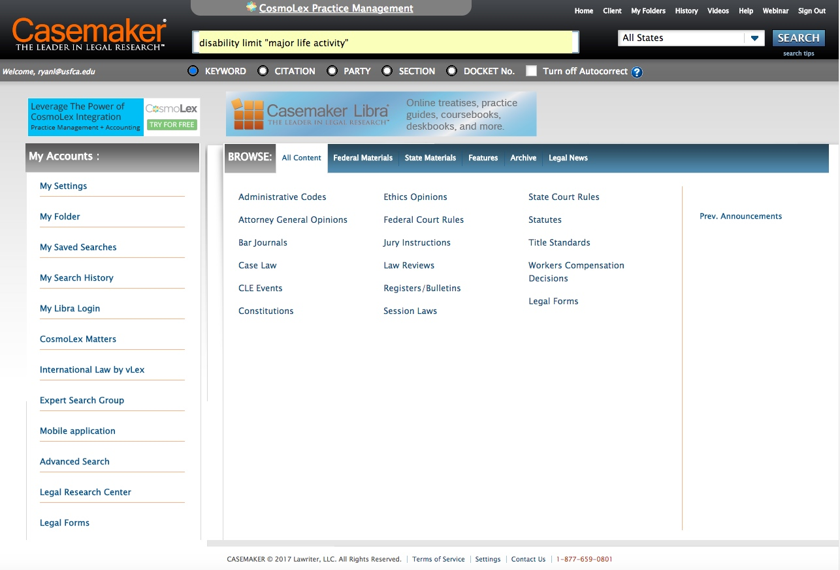
• Single search-box
• Folders
… more ...
Casemaker
Link for USF law students: http://www.casemakerx.com/
Notes:
Casemaker, my other current favorite low-cost tool, has the look of a simplified Westlaw.
You can search, you can browse, and you can use some value-added features for organizing your work.
(Naturally, Casemaker has less content than Westlaw …
but then Casemaker is also less expensive!)
Once again, I tested my “disability” search…

Slide 31
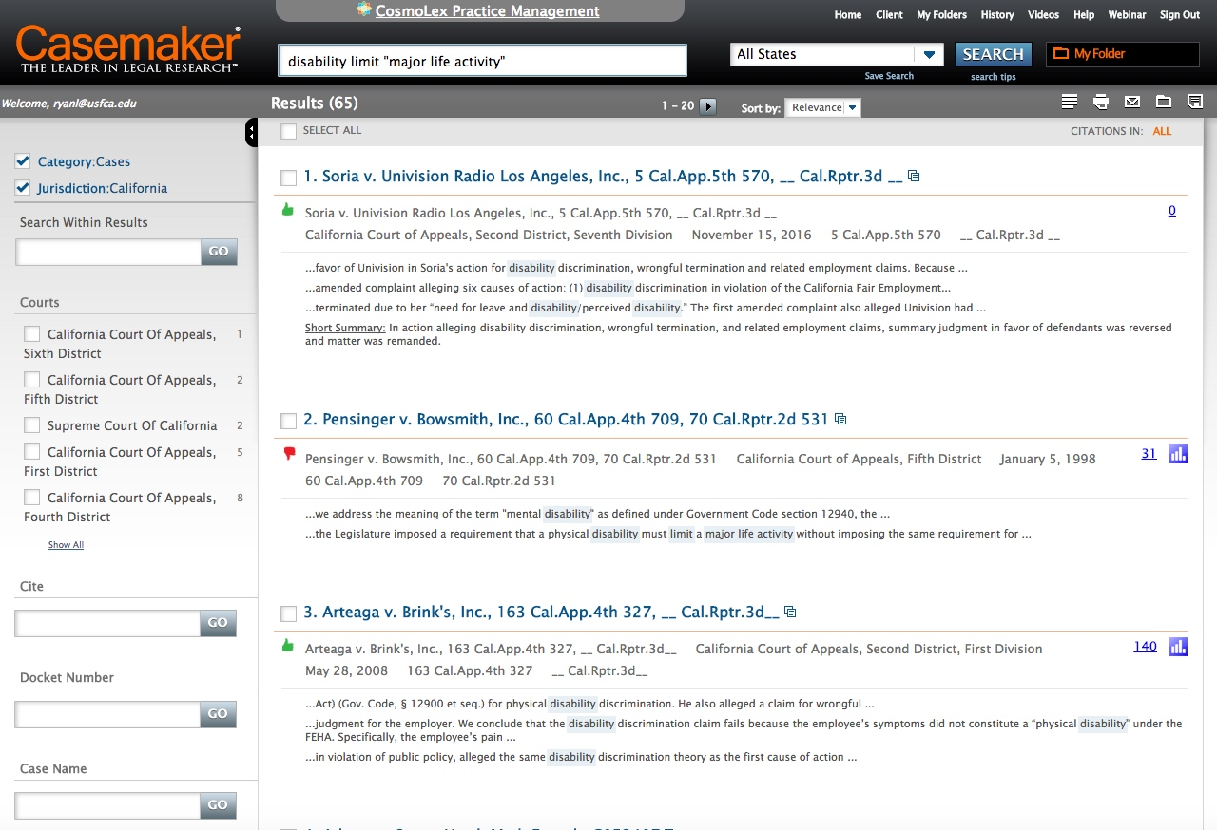
• Basic cite-checking
• Post-search filters
• Note-taking…
Casemaker — search results
Notes:
And it performed very well in terms of the relevance of my results
(which you see here, filtered to California cases).
(Casemaker also has some basic cite-checking (for EXPANDING your research) …
but it too is no substitute for KeyCite & Shepard’s.)

Slide 32
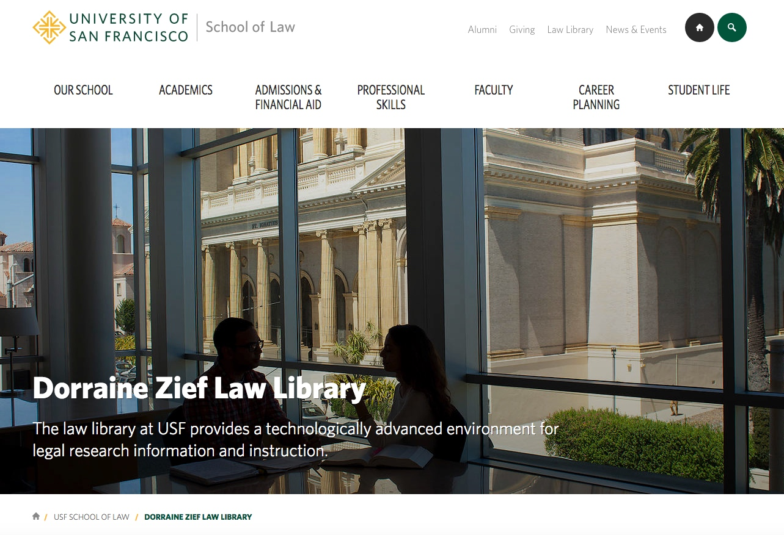
Zief Library — for alumni too!
Notes:
What if you need more than the free or low-cost services can give you?
One option, if you’re in SF, is to come back to our Zief Library here at USF.
(As alums, you’ll have FREE access, and we even have a BASIC Westlaw subscription (with KeyCite) that we can let alums use when they’re in the library.)

Slide 33
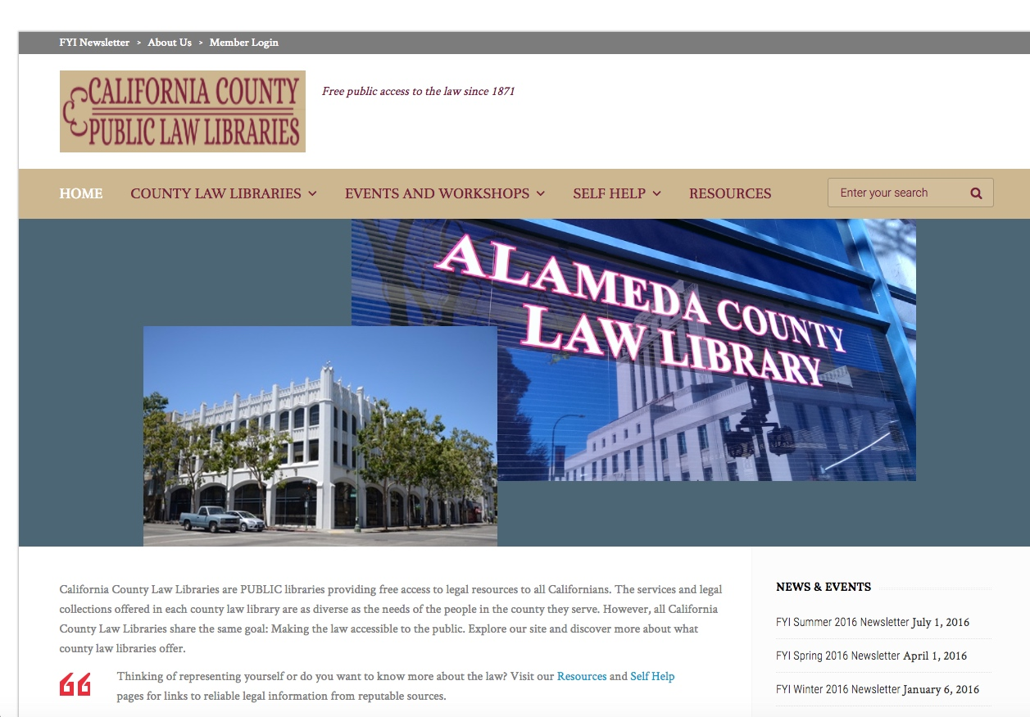
Find the public law library closest to you
When you need…
…Shepard’s or KeyCite
…Or other non-free resources
California’s Public Law Libraries
http://www.publiclawlibrary.org/
Notes:
Another option, especially if you’re not in San Francisco,
is to seek out one of the state’s free, public county law libraries.

Slide 34
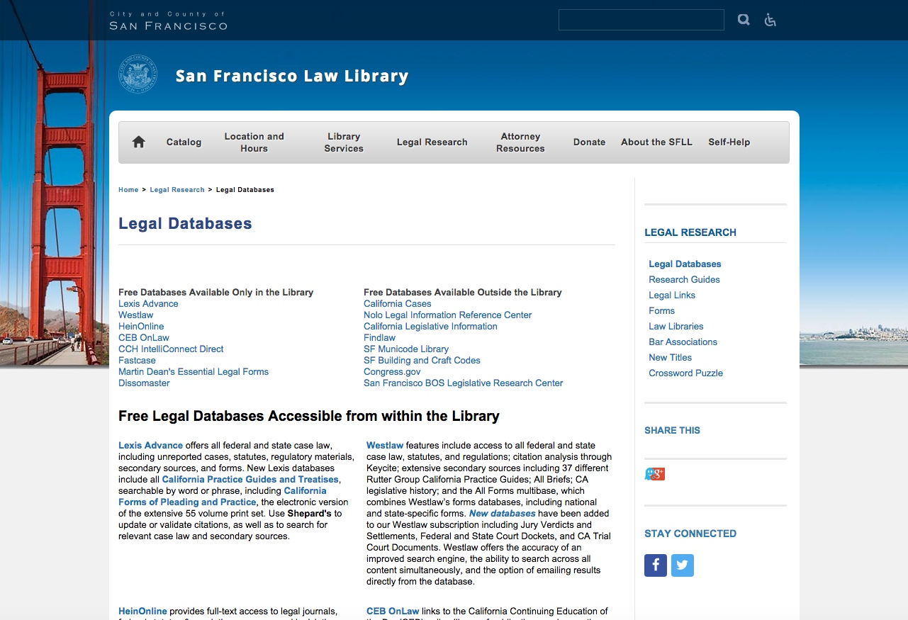
San Francisco Law Library
Databases for researchers in the library (including Shepard’s, KeyCite)
Notes:
Just as an example, here’s what the San Francisco Law Library has
in the way of non-free online research tools —
tools that you can use at no cost when visiting the library IN PERSON.
And most of the larger county law libraries will have a similar line-up.

Slide 35
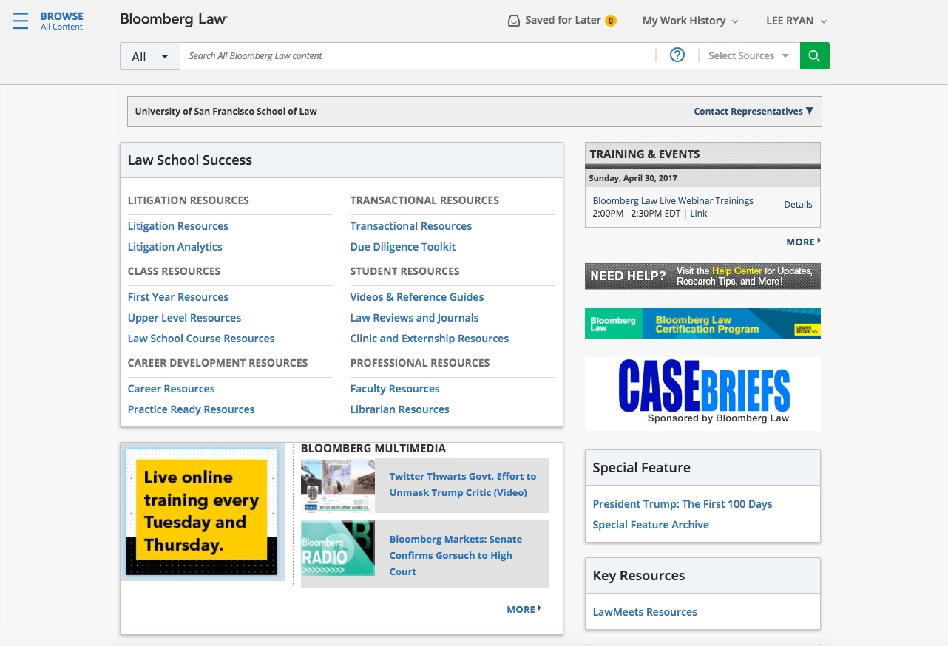
Bloomberg Law
Highlights — Live
Notes:
35
And now, to shift to the other end of the cost spectrum
(and the fancy-feature spectrum)…
I’ll go live to Bloomberg Law just to point out some of its particular strengths.
I’ve got a Highlights sheet for a takeaway, because this will be such a brief demo.)
As to pricing …
- In the “real world,” Bloomberg Law costs a bit less than $500 per month per attorney.
- At USF Law, it’s entirely free right now — and there are no restrictions on how you can use it
(in terms of summer or term-time internships, externships, paying jobs, etc.)
All students may register — and I’d encourage you to do so.
(Registration information is in the Bloomberg Law Highlights handouts — which is also on TWEN.)

Slide 36

Image courtesy of Véronique Debord-Lazaro, http://www.flickr.com/photos/debord/4932655275/

Slide 38
Supplemental Slides
Notes:
38

Slide 39
Cal. Official Reports
“advanced” searching
(terms & connectors searching)
Notes:
39
Additional screenshots of sites & products shown in class.
Some screenshots of other sites & products described in the outline (which is on TWEN and bepress).

Slide 40
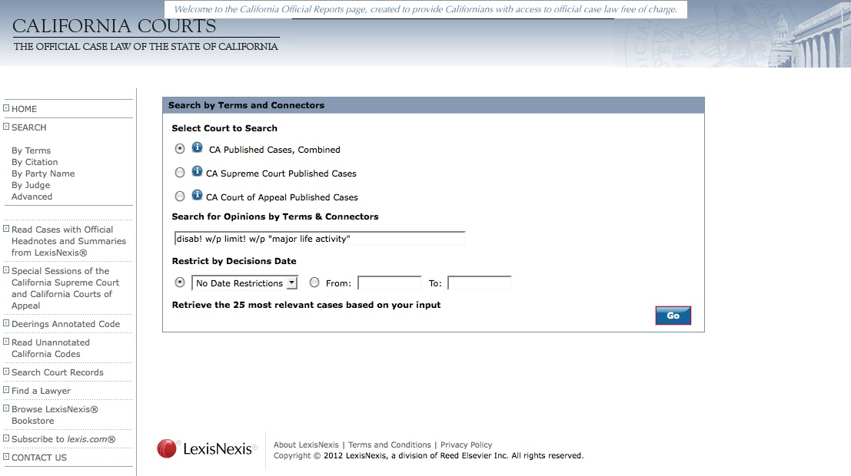
Full LexisNexis
“terms & connectors” options
Calif. Official Reports — advanced search form
Notes:
Search screen for California official reports searching by Terms and Connectors

Slide 41
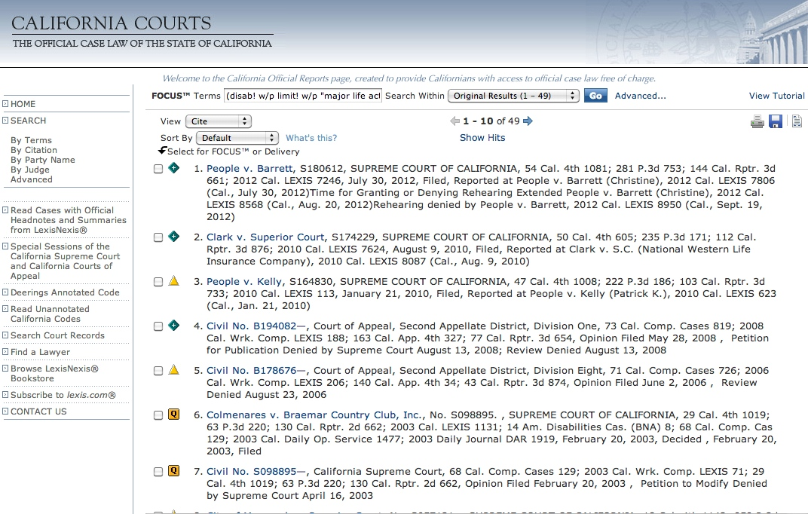
Can override 25-case limit...
See Word outline for details.
Calif. Official Reports — results (advanced)
Notes:
Search results for a California official reports Terms and Connectors search

Slide 42
Other
Free Case Law Options
Public Library of Law
+
fastcase app
Notes:
42
Screenshots from two free case law options not covered in class

Slide 43
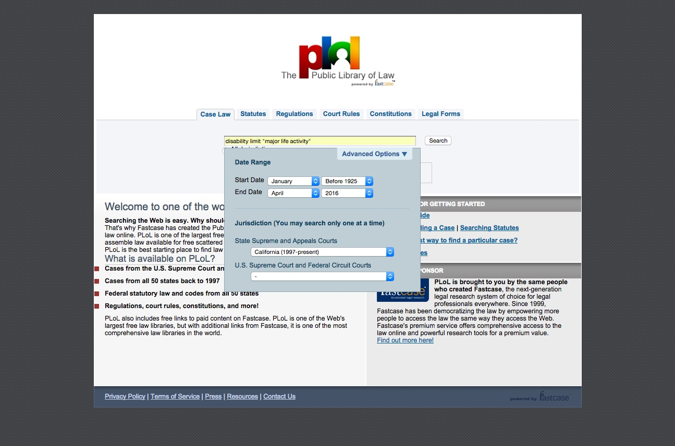
Can limit by jurisdiction/court
or date
Public Library of Law
http://www.plol.org/
Notes:
Search page for Public Library of Law — showing date range and jurisdiction options

Slide 44
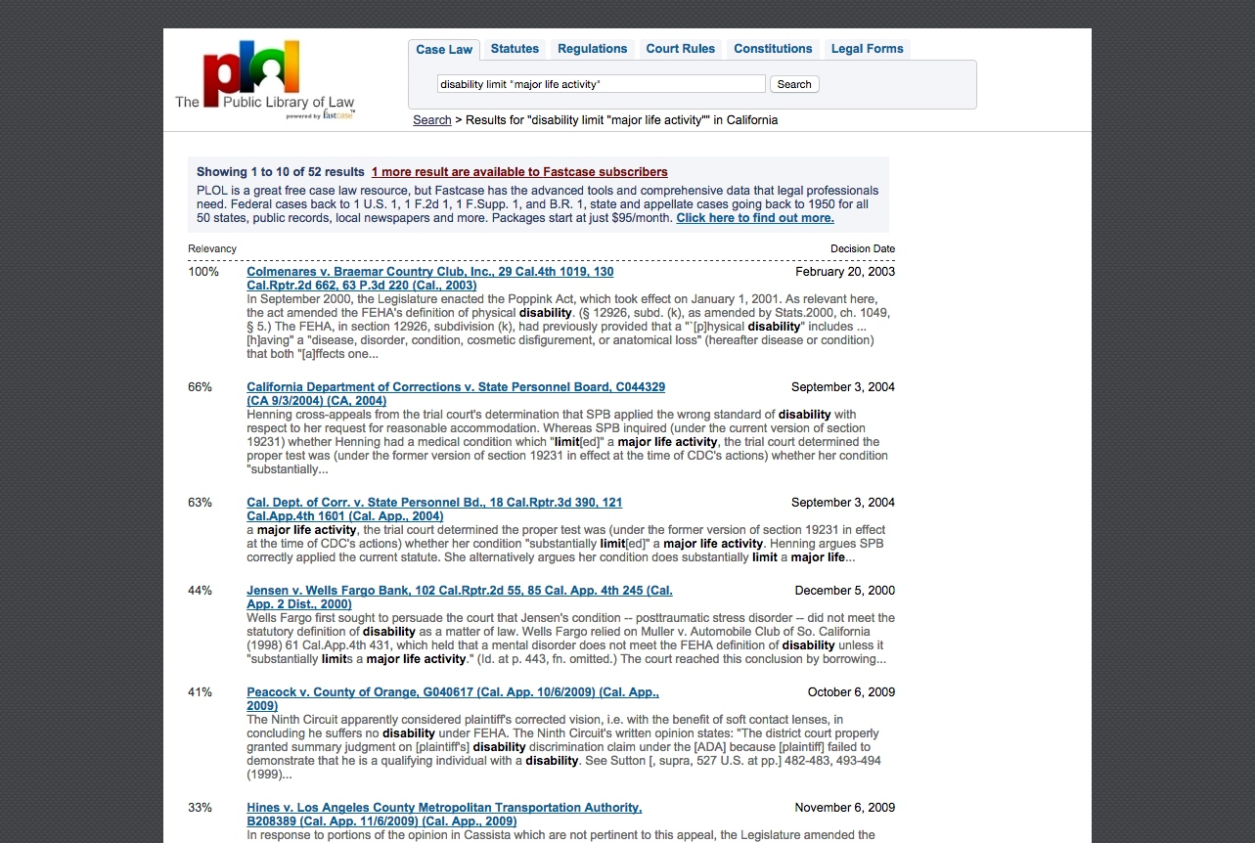
Public Library of Law — results
Notes:
Sample search results from Public Library of Law

Slide 45
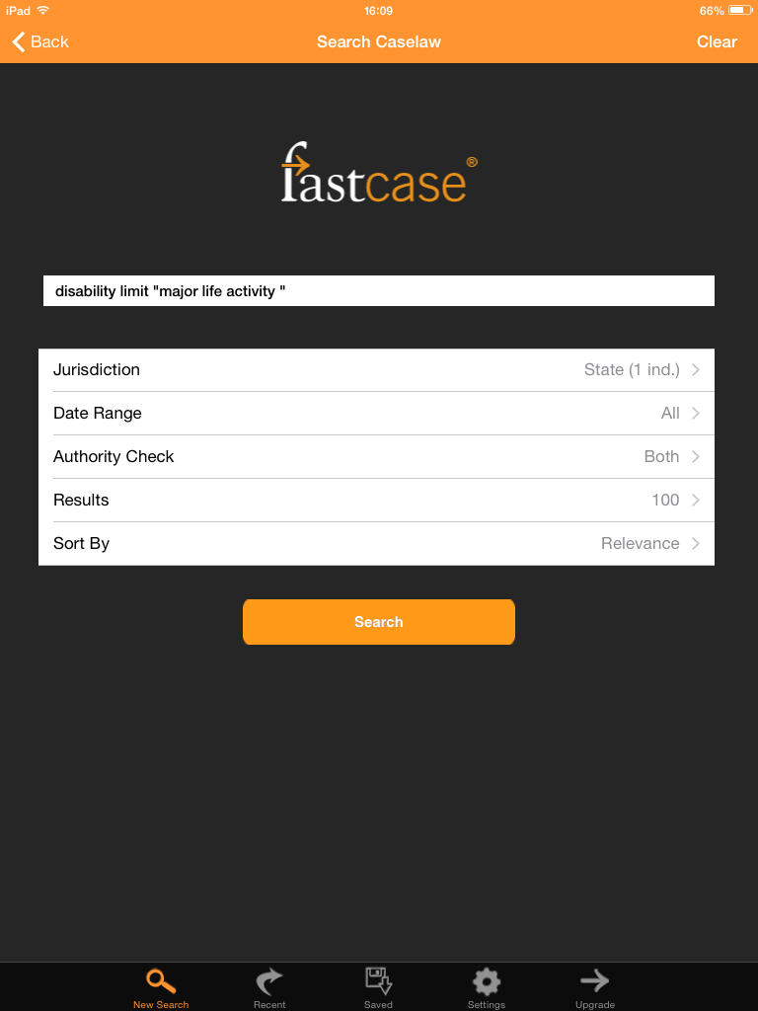
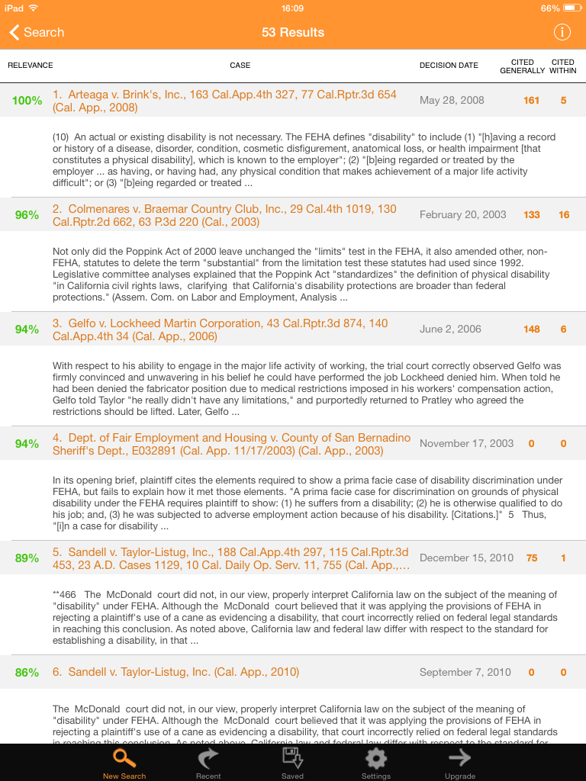
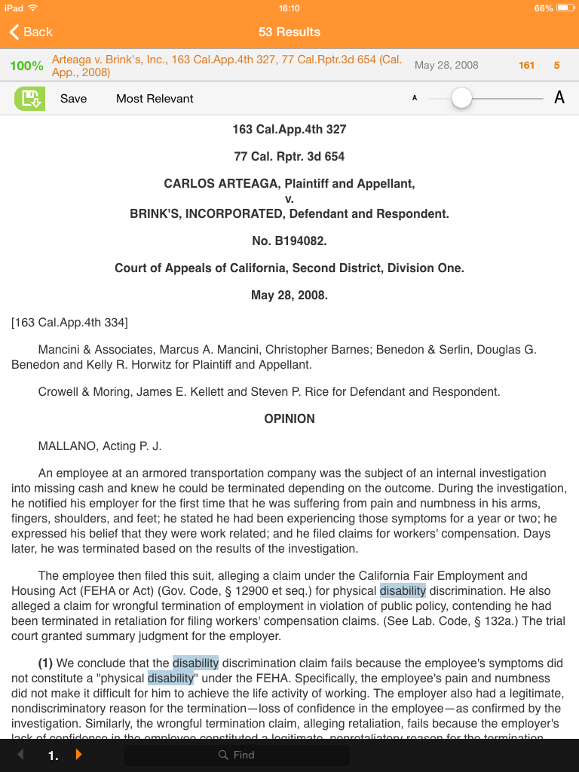
Fastcase iPad / iPhone / Android App
Notes:
Sample screens from Fastcase app showing search for California cases using terms:
disability limit “major life activity”
Search screen with search
Results list
Case from results

Slide 46
2 More
Low-Cost Options
Versuslaw,
AccessLaw
Notes:
46
Screenshots from low-cost options Versuslaw and AccessLaw

Slide 47
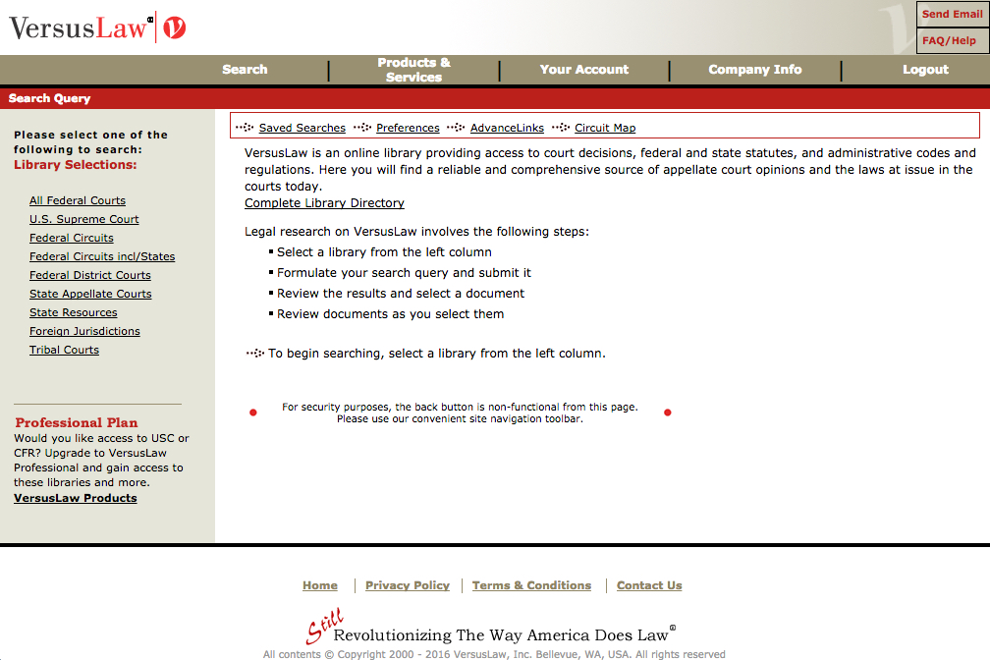
VersusLaw (USF Law subscription to Premium Plan)
Link for USF law students: http://www.versuslaw.com/
Notes:
Versuslaw home page for Premium plan (available to USF law students)

Slide 48
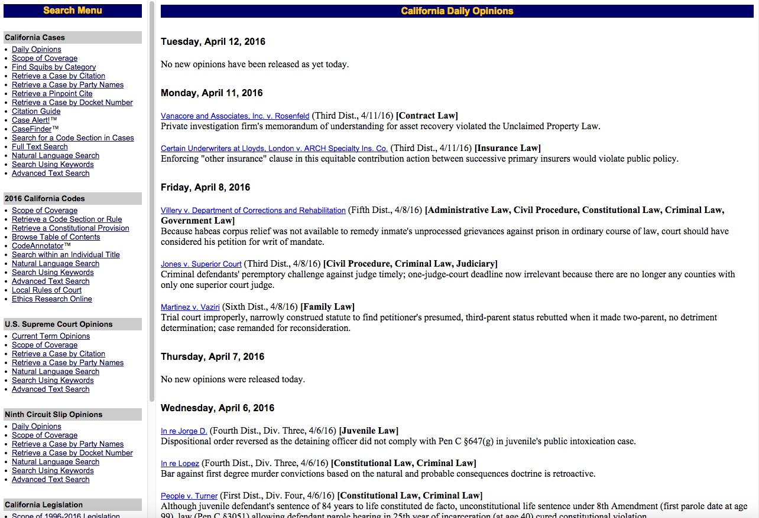
AccessLaw
http://www.accesslaw.com/
Notes:
[Slide last updated April 2016]

Slide 49
Portals
Notes:
49

Slide 50
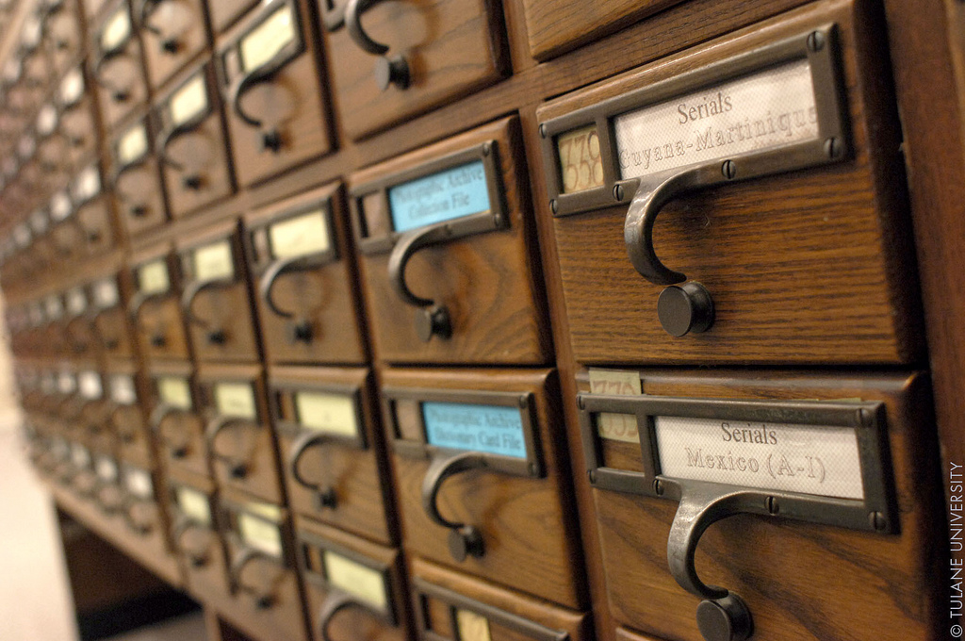
Image courtesy of Tulane Univ. Public Relations, http://www.flickr.com/photos/tulanesally/3638658173/
Are Portals Passé?

Slide 51
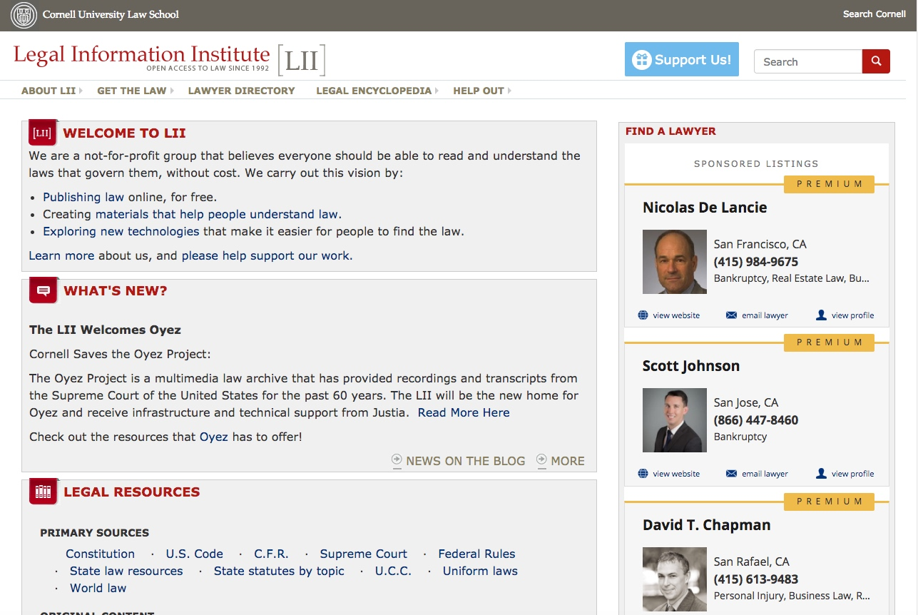
State Materials
(links to cases, codes, regs, etc.)
Topical Materials
(“Wex” legal encyclopedia)
Cornell Legal Information Institute
http://www.law.cornell.edu/
Notes:
Cornell Legal Information home page, highlighting links to state materials and to topical materials

Slide 52
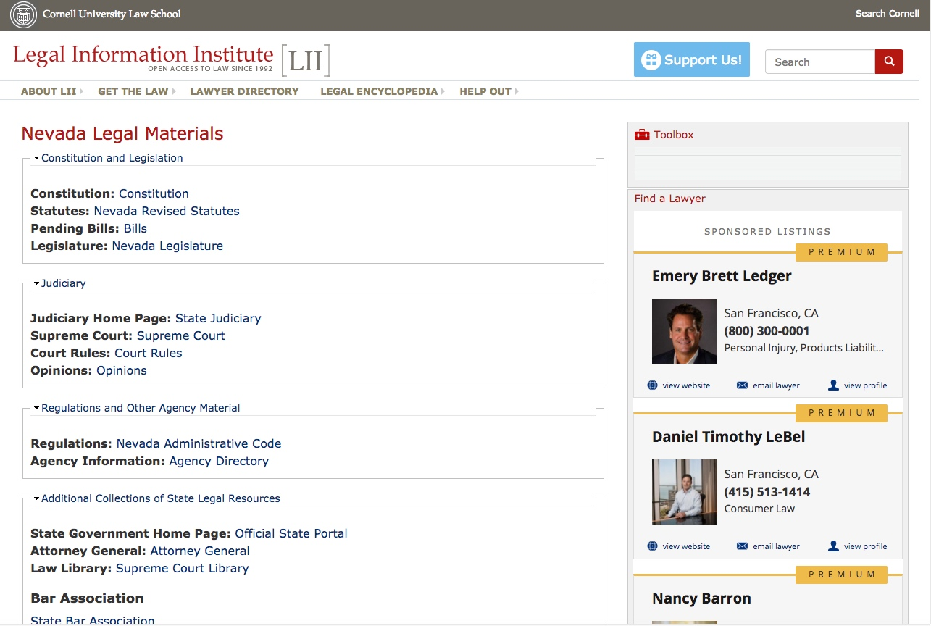
Cornell LII — typical state listing (Nevada)
Notes:
Cornell Legal Information page for Nevada materials

Slide 53
Search Engines
to find state law
or topical law sites
Notes:
53

Slide 54
Searching for primary law & legal topics —
nevada statutes
nevada case law
nevada "legal research"
illinois "legal research" site:.edu
health law research site:.edu
[ The last 2 searches target university sites to find the sorts of
helpful guides typically produced by law school research librarians. ]
Notes:
Sample Google searches to find state materials or topical research guides.

