Slide 1
Six ways to find cases
Part 1 — Introduction &
secondary sources
Lee Ryan, Research Librarian
University of San Francisco School of Law
Notes:
Welcome to this series of brief videos on the major ways to find cases relevant to a client’s issue.

Slide 2
Introduction
beyond keyword searches
Notes:
These days, the most common case-finding tactic is to run keyword searches in case law sources...

Slide 3
1746 results from search for:
cases on DUIs and marijuana
1,309 results from search for:
cases on liability of vessel owners
for employees’ negligence
Notes:
... searches such as this Westlaw search or ...
[ANIMATE]
... this Lexis search.
And because keyword searches are so popular,
when they don’t perform as hoped, it can be hard to come up with a Plan B.
But... there are LOTS of way to find cases relevant to a client’s issue, and full text keyword searching is just one.
[NEXT SLIDE]
Westlaw search, in California State Cases, for cases on DUIs and marijuana:
adv: driving /s "under the influence" or "while intoxicated" and marijuana or cannabis
Lexis search, in U.S. Federal Cases, for cases on liability of vessel owners for employees’ negligence:
vessel or ship /s owner and liab! s/ negligen! /s employee

Slide 4
Case-finding tools / techniques
Secondary sources
Annotated codes
Tables of authorities (cases cited by a known case)
Shepard’s and KeyCite
West’s Key Number System
Full-text keyword searches in case-law sources
Notes:
These seven videos will cover SIX major ways to find cases. They are:
[ANIMATE]
Consulting secondary sources on your topic or issue to find the cases they cite.
[ANIMATE]
Checking annotated codes to find cases that have interpreted a code section you’re researching.
[ANIMATE]
Retrieving cases cited by a case you’ve already found — by simply by reading the case, or
by using the “Table of Authorities” functions on Lexis or Westlaw.
[ANIMATE]
Shepardizing or KeyCiting cases
(or other types of documents, such as statutes or code sections) to find later cases that cite to them.
[ANIMATE]
Using the West Key Number System to find cases addressing particular topics, issues, or points of law.
And, of course,
[ANIMATE]
Running full-text keyword searches in case law sources on Lexis, Westlaw, or similar legal research platforms.

Slide 5
Case-finding tools / techniques
Secondary sources
Annotated codes
Tables of authorities (cases cited by a known case)
Shepard’s and KeyCite
West’s Key Number System
Full-text keyword searches in case-law sources
Notes:
This first video will focus on
[ANIMATE ARROW]
using secondary sources to find relevant cases.
[NEXT SLIDE]
[Tan and Blue text are in Theme Color line]

Slide 6
Secondary Sources
Notes:
Secondary sources explain the law and lay out the broad black-letter rules that courts will apply.
All good secondary sources should cite to at least SOME cases to support the assertions they make.
Secondary sources are useful for almost every legal research project.

Slide 7
Secondary Sources
Use when you want . . .
Cases stating a general rule
Analysis, explanation, discussion
A few helpful cases
Notes:
For case-finding, ...
[ANIMATE]
use them —
[ANIMATE AT BULLETS]
• when you’re hoping to find cases stating general rules that you can apply to your client’s unique facts;
• when you’d like some analysis, explanation, or discussion along with your cases; or
• when you want just a few good cases, and don’t necessarily need to see every single case on an issue.

Slide 8
Case citation in secondary source (Lexis)
Notes:
Here, the Lexis practice guide “California Drunk Driving Law” cites and links to
[ANIMATE]
cases on the effect of California’s Compassionate Use Act on marijuana DUI cases.
[NEXT SLIDE]
The cited cases are: People v. Clark, 230 Cal.App.4th 490 (2014) and People v. Mulcrevy, 233 Cal. App. 4th 127 (2015)

Slide 9
Case citation in secondary source (Westlaw)
Notes:
And here, Westlaw’s very similar practice guide “California Drunk Driving Defense” also cites to
[ANIMATE]
a case on the impact of the Compassionate Use Act.
[NEXT SLIDE]
The cited case is People v. Strasburg, 56 Cal. Rptr. 3d 306 (Ct. App. 2007)

Slide 10

Secondary Sources
Advantages & Disadvantages
Notes:
As case-finding tools, secondary sources have both advantages and disadvantages.
[NEXT SLIDE]

Slide 11
Advantages — secondary sources
Identification of “leading” cases
Case citations in context
Discussion and analysis
Notes:
On the plus side, secondary sources offer....
[ANIMATE]
• Identification of “leading” cases.
Secondary sources usually do a good job stating the general “black letter” rules that
apply in your client’s situation, and in citing major cases that state those rules.
Another advantage is ...
[ANIMATE]
• Presentation of case citations in a larger context
to help you understand the legal framework in which your issue falls.
And a third benefit of secondary sources is...
[ANIMATE]
• Discussion and analysis of the cases cited by the secondary source —
what they’ve held, and how they might relate to one another.

Slide 12
Disadvantages — secondary sources
Selectivity
“Big picture” focus
Lack of secondary sources for some topics
Notes:
But there ARE disadvantages as well.
These include —
[ANIMATE]
• Selectivity.
Usually at least some relevant cases will be left out.
Another downside can be...
[ANIMATE]
• A focus on general rules (the “big picture”)
— a focus that [, while often useful,] can leave you looking for
OTHER ways to find cases that are factually similar to your client’s issue.
And a third disadvantage is...
[ANIMATE]
• The possibility that for SOME issues or even whole areas of law, there may be no useful secondary source.

Slide 13

Ask the Zief Research Librarians!
https://legalresearch.usfca.edu/ZiefResearchHelp
Notes:
The Zief research librarians recommend using secondary sources for just about every legal research project.
If you have questions about using secondary sources to find cases, or would like advice on your research,
just ask one of the Zief research librarians.
[NEXT SLIDE]
Zief research help link: https://legalresearch.usfca.edu/ZiefResearchHelp

Slide 14
Annotated Codes
Up next . . .
Notes:
The next video in this series will cover
[ANIMATE]
annotated codes.

Slide 15
Photo credits
Questions by Nick Youngson, CC BY-SA 3.0, Alpha Stock Images,
http://www.picpedia.org/highway-signs/q/questions.html
Thumbs up and down image by Bunzellisa from Pixabay,
https://pixabay.com/?utm_source=link-attribution&amp;
utm_medium=referral&amp;utm_campaign=image&
amp;utm_content=3171760
Split — Christopher Titzer,
https://www.flickr.com/photos/qchristopher/3060799184
CC BY-NC-ND 2.0
(https://creativecommons.org/licenses/by-nc-nd/2.0/)

Slide 16
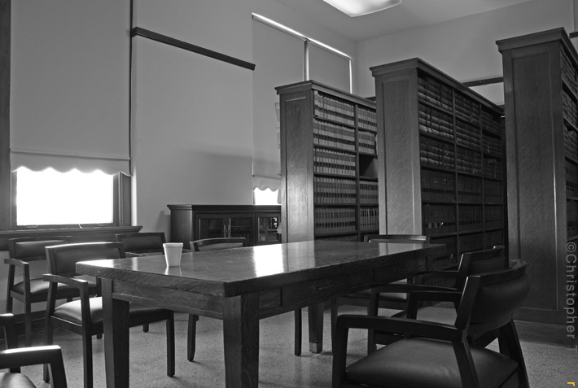
Notes:
END of DECK
Fade to black here!
[TIME: 4:10 or so]

Slide 18
Six ways to find cases
Part 2 — Annotated codes
Lee Ryan, Research Librarian
University of San Francisco School of Law
Notes:
Welcome to the SECOND of the SEVEN videos on ways to find cases relevant to your client’s issue.

Slide 19
Case-finding tools / techniques
Secondary sources
Annotated codes
Tables of authorities (cases cited by a known case)
Shepard’s and KeyCite
West’s Key Number System
Full-text keyword searches in case-law sources
Notes:
This video will focus on
[ANIMATE ARROW]
using annotated codes.
[NEXT SLIDE]

Slide 20
Annotated Codes
Notes:
Annotated codes give you citations to cases that interpret specific statutes or code sections.
[NEXT SLIDE]

Slide 21
Annotated Codes
Use whenever a statute is involved. . .
To find cases interpreting the statute
Notes:
Annotated codes ...
[ANIMATE]
are useful WHENEVER you need to know how the courts have interpreted
the statutes or code sections at issue in your client’s situation.
If your client’s problem involves a statute, ALWAYS use an annotated code to find cases.
(And, because annotated codes don’t COMPREHENSIVELY cite to cases that interpret a statute,
be sure to use Shepard’s or KeyCite with your statute as well.)

Slide 22
Annotated codes — Lexis — state codes
Notes:
In annotated STATE codes and statutes on LEXIS, select ...
[ANIMATE]
“Notes to Decisions” from the “Go to” menu to see citations to cases.
This scrolls you down to ...
[ANIMATE]
... the beginning of the “Notes to Decisions” section, which includes...
[ANIMATE]
... headnotes from and links to cases interpreting the code section.
[NEXT SLIDE]
[The code section illustrated is: Cal. Veh. Code § 23152]

Slide 23
Annotated codes — Lexis — U.S. Code
Notes:
In the annotated U.S. CODE on Lexis, the process is the same, EXCEPT that you select ...
[ANIMATE]
...“Case Notes” from the “Go to” menu to scroll down to the ....
[ANIMATE]
... “Case Notes” section to see citations to cases.
[NEXT SLIDE]
17 USC 106A

Slide 24
Annotated codes — Westlaw — state & federal
Notes:
In both state AND federal annotated codes and statutes on Westlaw, selecting the...
[ANIMATE]
... “Notes of Decisions” tab takes you to...
[ANIMATE]
...citations to cases interpreting the code section.
[NEXT SLIDE]
17 USC 106A

Slide 25
Annotated Codes
Advantages & Disadvantages
Notes:
Here’s an overview of the pros and cons of annotated codes....
[NEXT SLIDE]

Slide 26
Advantages — annotated codes
Access to lots of cases
Organization of citations
Brief descriptions of cases
Notes:
Advantages of annotated codes include —
[ANIMATE]
• Access to lots of cases.
The editors who create the annotated codes try to include as many citations as they can to
PUBLISHED cases that substantively interpret the code section you’re researching.
Another plus is...
[ANIMATE]
• Organization of citations.
The annotated code editors organize the case citations by topic,
to help you identify cases that might apply to your client’s situation.
And you’ll also get...
[ANIMATE]
• Brief descriptions of cases.
Annotated codes include headnotes from the cases they cite, so you can get
at least some idea of what a case might be about before you read it.

Slide 27
Disadvantages — annotated codes
Lack of analysis, context, or explanation
Access to lots of cases (!)
Lack of utility for common-law issues
Notes:
Downsides of annotated codes include —
[ANIMATE]
• Lack of analysis, context, or explanation.
The only information about cases is in the brief headnotes.
An advantage that can also be a disadvantage is...
[ANIMATE]
• Access to lots of cases (!)
If the annotated code cites to hundreds or thousands of cases interpreting the code section,
it can be hard to sift through those citations to find cases applicable to your client’s issue.
And a final [obvious] downside is...
[ANIMATE]
• Lack of utility if your issue is a common law, non-statutory issue

Slide 28
Ask the Zief Research Librarians!
https://legalresearch.usfca.edu/ZiefResearchHelp
Notes:
If you’re using annotated codes to find cases on your client’s issue,
and you have any questions about your project, ask one of the Zief research librarians.

Slide 29
Table of Authorities
Up next . . .
Notes:
The next video in the series will cover
[ANIMATE]
the “Table of Authorities” technique.

Slide 30
Photo credits
Questions by Nick Youngson, CC BY-SA 3.0, Alpha Stock Images,
http://www.picpedia.org/highway-signs/q/questions.html
Thumbs up and down image by Bunzellisa from Pixabay,
https://pixabay.com/?utm_source=link-attribution&amp;
utm_medium=referral&amp;utm_campaign=image&
amp;utm_content=3171760
Split — Christopher Titzer,
https://www.flickr.com/photos/qchristopher/3060799184
CC BY-NC-ND 2.0
(https://creativecommons.org/licenses/by-nc-nd/2.0/)

Slide 31
Notes:
END of EACH DECK
Fade to black here!
[TIME: 3:08 or so]

Slide 33
Six ways to find cases
Part 3 — Tables of authorities
Lee Ryan, Research Librarian
University of San Francisco School of Law
Notes:
Welcome to the third of the seven videos on ways to find cases relevant to your client’s issue.

Slide 34
Case-finding tools / techniques
Secondary sources
Annotated codes
Tables of authorities (cases cited by a known case)
Shepard’s and KeyCite
West’s Key Number System
Full-text keyword searches in case-law sources
Notes:
This video takes a quick look at the
[ANIMATE ARROW]
“Table of Authorities” method.
[NEXT SLIDE]

Slide 35
Table of Authorities
Notes:
A table of authorities in online research is a list of all of the cases cited by the case you’re viewing.
Conceptually, it’s similar to the table of authorities in a brief.
[NEXT SLIDE]

Slide 36
Table of authorities
Use when you . . .
Have a recent case from a lower court
and ...
you want to find earlier leading cases from higher courts in the same jurisdiction
Notes:
This simple method is especially useful
[ANIMATE]
when you have a recent case from a lower court and
you want to find earlier leading cases from higher courts in the same jurisdiction.

Slide 37
Cases cite older precedent
Notes:
For example, Bikis v. Oakland Unified School District, an unpublished disability-law case from 2017, cites to...
[ANIMATE]
Colmenares v. Braemar Country Club, a major California Supreme Court case from 2003.
If you have one relevant case — like Bikis—, it will probably cite as precedent at least
SOME prior cases that could also be relevant to your issue.
And although that case probably WON’T cite ALL of the prior relevant cases,
it might cite at least one leading case. Then you can use that leading case as a springboard for further research.
[PAUSE]
You can, of course, just read a relevant case and pay attention the cases that IT cites as you go along.
But if you’d like to see those cases as a list, you can use “Table of Authorities” feature on Lexis or Westlaw.
[NEXT SLIDE]
Unpublished cases addressing issue of what is a disability under Cal law cites to Colmenares, a leading California Supreme Court case — and a great springboard for finding more relevant cases.
Bikis v. Oakland Unified Sch. Dist., No. A142456, 2017 Cal. App. Unpub. LEXIS 198, 2017 WL 87040 (Cal. Ct. App. Jan. 10, 2017) - Bikis alleges she suffered from degenerative disk disease, migraines, muscle pain and sleep disturbances that were aggravated by the district's assigning her to teach more than three hours of computer classes per day and that required rest and accommodation. These allegations suffice to plead a qualifying disability because working is a major life activity under FEHA (§ 12926.1, subd. (c) [“under the law of this state, ‘working’ is a major life activity, regardless of whether the actual or perceived working limitation implicates a particular employment or a class or broad range of employments”]; see also Colmenares v. Braemar Country Club, Inc. (2003) 29 Cal.4th 1019, 1024 [chronic back injury that limits work activities qualifies as FEHA disability].) Bikis v. Oakland Unified Sch. Dist., No. A142456, 2017 WL 87040, at *9 (Cal. Ct. App. Jan. 10, 2017)
Colmenares v. Braemar Country Club, Inc., 29 Cal. 4th 1019, 63 P.3d 220 (2003)

Slide 38
Displaying the Table of Authorities — Lexis
Notes:
To see the table of authorities for a case on Lexis, first, click the...
[ANIMATE CALLOUT]
“Shepardize this document” link for the case you’re viewing.
This takes you to the...
[ANIMATE]
Shepard’s display.
Once you’re there, click the...
[ANIMATE CALLOUT]
“Table of Authorities” link to view ...
[ANIMATE]
the Table of Authorities itself.
[NEXT SLIDE]

Slide 39
Displaying the Table of Authorities — Westlaw
Notes:
On Westlaw, when you’re viewing the case, clicking the
[ANIMATE]
“Table of Authorities” tab takes you right to the...
[ANIMATE]
Table of Authorities.
[NEXT SLIDE]

Slide 40
Table of Authorities
Advantages & Disadvantages
Notes:
As for advantages and disadvantages...
[NEXT SLIDE]

Slide 41
Advantages — table of authorities
Simple to use
Likely to lead to relevant cases
Disadvantages — table of authorities
Not comprehensive
Only looks backward in time
Notes:
On the plus side,
[ANIMATE]
– this method is simple to use, whether you just read the starting case or use the table of authorities feature, and...
[ANIMATE]
– since you’re STARTING with a relevant case, the table of authorities is
fairly likely to lead you to additional relevant cases.
But....
[ANIMATE HEADER FOR CONS]
The Table of authorities method...
[ANIMATE]
– is not comprehensive (of course), and...
[ANIMATE]
– (of course) it also only looks backwards in time.
[NEXT SLIDE]
[from outline. OMIT?] But other case-finding techniques can make up for these shortcomings.]

Slide 42
Ask the Zief Research Librarians!
https://legalresearch.usfca.edu/ZiefResearchHelp
Notes:
If you have questions about the table of authorities feature on Lexis or Westlaw,
ask one of the Zief research librarians.

Slide 43
Shepard’s & KeyCite
Up next . . .
Notes:
The next video will be devoted to
[ANIMATE]
Shepard’s and KeyCite as case-finding tools.

Slide 44
Photo credits
Questions by Nick Youngson, CC BY-SA 3.0, Alpha Stock Images,
http://www.picpedia.org/highway-signs/q/questions.html
Thumbs up and down image by Bunzellisa from Pixabay,
https://pixabay.com/?utm_source=link-attribution&amp;
utm_medium=referral&amp;utm_campaign=image&
amp;utm_content=3171760
Split — Christopher Titzer,
https://www.flickr.com/photos/qchristopher/3060799184
CC BY-NC-ND 2.0
(https://creativecommons.org/licenses/by-nc-nd/2.0/)

Slide 45
Notes:
END DECK
Fade to black here!
[TIME: 2:40 or so]

Slide 47
Six ways to find cases
Part 4 — Shepard’s & KeyCite
Lee Ryan, Research Librarian
University of San Francisco School of Law
Notes:
Welcome to the fourth of the seven videos on techniques for finding cases relevant to your client’s issue.

Slide 48
Case-finding tools / techniques
Secondary sources
Annotated codes
Tables of authorities (cases cited by a known case)
Shepard’s and KeyCite
West’s Key Number System
Full-text keyword searches in case-law sources
Notes:
This video explores...
[ANIMATE ARROW]
Shepard’s and KeyCite as case-finding tools.
[NEXT SLIDE]

Slide 49
Shepard’s & KeyCite
Notes:
Shepard’s and KeyCite help you find cases
by linking you to cases that cite to whatever
relevant statute, or case (or other document) you’re starting with.
[NEXT SLIDE]

Slide 50
Shepard’s & KeyCite
Use when . . .
You want to find later cases that cite to:
• a statute
or
• a case
Notes:
Use Shepard’s and KeyCite WHENEVER you want to find
any later cases that cite to a statute OR to a case you already know about.
[NEXT SLIDE]

Slide 51
Finding cases citing a statute via Shepard’s
Notes:
With statutes on Lexis — such as 17 U.S. Code 107 (the copyright statute governing fair use) —, clicking the
[ANIMATE ARROW]
“Shepardize this document” link opens...
[ANIMATE]
the Shepard’s “Citing Decisions display” — giving access to
ALL of the cases on Lexis that have cited to Section 107
(... along with multiple filtering options to pare down the citations to what you most need).
[NEXT SLIDE]
17 USC 107 (fair use)
[NEXT SLIDE]
Unpublished cases addressing issue of what is a disability under Cal law cites to Colmenares, a leading California Supreme Court case — and a great springboard for finding more relevant cases.
Bikis v. Oakland Unified Sch. Dist., No. A142456, 2017 Cal. App. Unpub. LEXIS 198, 2017 WL 87040 (Cal. Ct. App. Jan. 10, 2017) - Bikis alleges she suffered from degenerative disk disease, migraines, muscle pain and sleep disturbances that were aggravated by the district's assigning her to teach more than three hours of computer classes per day and that required rest and accommodation. These allegations suffice to plead a qualifying disability because working is a major life activity under FEHA (§ 12926.1, subd. (c) [“under the law of this state, ‘working’ is a major life activity, regardless of whether the actual or perceived working limitation implicates a particular employment or a class or broad range of employments”]; see also Colmenares v. Braemar Country Club, Inc. (2003) 29 Cal.4th 1019, 1024 [chronic back injury that limits work activities qualifies as FEHA disability].) Bikis v. Oakland Unified Sch. Dist., No. A142456, 2017 WL 87040, at *9 (Cal. Ct. App. Jan. 10, 2017)
Colmenares v. Braemar Country Club, Inc., 29 Cal. 4th 1019, 63 P.3d 220 (2003)

Slide 52
Finding cases citing a case via Shepard’s
Notes:
And, with a case (such as Colmenares, a leading California disability law case), clicking on...
[ANIMATE ARROW]
“Citing Decisions” likewise opens...
[ANIMATE]
the Shepard’s “Citing Decisions” display —
giving access to ALL of the cases on Lexis that have cited to Colmenares.
[NEXT SLIDE]
Colmenares v. Braemar Country Club, Inc., 29 Cal. 4th 1019, 63 P.3d 220 (2003)

Slide 53
Finding cases citing a statute via KeyCite
Notes:
Westlaw’s KeyCite is very similar.
Selecting...
[ANIMATE ARROW]
“Cases” from the “Citing References” tab for 17 U.S. Code 107 [the fair-use copyright statute] opens...
[ANIMATE]
the KeyCite display for ALL of the cases on WESTLAW that have cited to Section 107
(and also gives access to multiple filtering options for these citing cases).
[NEXT SLIDE]
17 USC 106A? (moral rights)
17 USC 107? (fair use)

Slide 54
Finding cases citing a case via KeyCite
Notes:
Likewise, with a case (such as Colmenares), selecting...
[ANIMATE ARROW]
“Cases” from the “Citing References” tab also opens...
[ANIMATE]
the KeyCite display for ALL of the cases on Westlaw that have cited to Colmenares.
[NEXT SLIDE]
130 Cal. Rptr. 2d 662 (Colmenares)

Slide 55
Shepard’s & KeyCite
Advantages & Disadvantages
Notes:
Like all other case finding tools, Shepard’s and KeyCite have their plusses and minuses.
[NEXT SLIDE]

Slide 56
Advantages — Shepard’s & KeyCite
Comprehensiveness
Editorial judgment (for cases, to a degree)
Notes:
One major advantage of Shepard’s and KeyCite is...
[ANIMATE]
• Comprehensiveness.
Both Shepard’s and KeyCite will give you
ALL later published cases that cite to your case or statute, as well as a LOT of unpublished cases.
This is a HUGE advantage whenever you need to reassure yourself — or a supervisor — that you’ve done thorough research.
Another plus is...
[ANIMATE]
• Editorial judgment.
For cases, Shepard’s and KeyCite tag the CITING cases according to the issues from YOUR case that they discuss.
This helps when filtering the citing cases.
[NEXT SLIDE]

Slide 57
Disadvantages — Shepard’s & KeyCite
Lack of analysis or explanation
Dependence on citing relationships
Lack of access to prior cases
Comprehensiveness (!)
Notes:
As for disadvantages, one is...
[ANIMATE]
• Lack of any real analysis or explanation
(although KeyCite and Shepard’s MIGHT lead to practice guides and the like
that WILL have explanations and analysis.)
Another is...
[ANIMATE]
• Dependence on citing relationships.
Shepard’s and KeyCite naturally can’t help you find cases that are similar to
a case you started with, but don’t cite to that case.
Then, by virtue of their inherent design, Shepard’s and KeyCite...
[ANIMATE]
• can’t lead you to prior cases.
And, a big plus that can also be a minus at times...
[ANIMATE]
• Comprehensiveness(!).
Where there are hundreds or thousands of cases that cite to “your” case or statute,
it can be hard to sift through them,
even with help from the filters.

Slide 58
Ask the Zief Research Librarians!
https://legalresearch.usfca.edu/ZiefResearchHelp
Notes:
For advice on exploiting the case-finding power of Shepard’s and KeyCIte for YOUR research project, ask one of the Zief research librarians.

Slide 59
West
Key Number System
Up next . . .
Notes:
The next case-finding method in this series is...
[ANIMATE]
the West Key Number System.

Slide 60
Photo credits
Questions by Nick Youngson, CC BY-SA 3.0, Alpha Stock Images,
http://www.picpedia.org/highway-signs/q/questions.html
Thumbs up and down image by Bunzellisa from Pixabay,
https://pixabay.com/?utm_source=link-attribution&amp;
utm_medium=referral&amp;utm_campaign=image&
amp;utm_content=3171760
Split — Christopher Titzer,
https://www.flickr.com/photos/qchristopher/3060799184
CC BY-NC-ND 2.0
(https://creativecommons.org/licenses/by-nc-nd/2.0/)

Slide 61
Notes:
END DECK
Fade to black here!
[TIME: 3:42 or so]

Slide 63
Six ways to find cases
Part 5A — West Key Number System (What & When)
Lee Ryan, Research Librarian
University of San Francisco School of Law
Notes:
Welcome to this installment of the seven-video series on ways to find cases relevant to your client’s issue.

Slide 64
Case-finding tools / techniques
Secondary sources
Annotated codes
Tables of authorities (cases cited by a known case)
Shepard’s and KeyCite
West’s Key Number System
Full-text keyword searches in case-law sources
— What & When
Notes:
This installment introduces ...
[ANIMATE ARROW]
the West Key Number System, one of the oldest and most thorough methods for finding cases.
It will be broken into two videos. This first video will
[ANIMATE]
cover what the Key Number System is, and when to use it.
[NEXT SLIDE]

Slide 65
West Key Number System
(aka the “Digest”)
Notes:
The West Key Number System (sometimes called the “Digest”) helps you
find relevant cases that deal with the SAME ISSUES that your client’s problem presents.

Slide 66
West
Key Number System
Use when you want to find
cases that have specific issues or points of law in common —
even if
they don’t cite to one another
or
they aren’t from the same jurisdiction.
Notes:
Use the West Key Number System whenever
[ANIMATE]
you want to find cases that have specific issues or points of law in common,
EVEN IF they don’t cite to one another, OR they aren’t from the same jurisdiction.
[NEXT SLIDE]

Slide 67
every. point. of. law.
Notes:
The West Key Number System cites to:
every point of law
from ...

Slide 68
every. published. case.
Notes:
... every published case!
This makes the Key Number system a powerful, COMPREHENSIVE search tool.

Slide 69
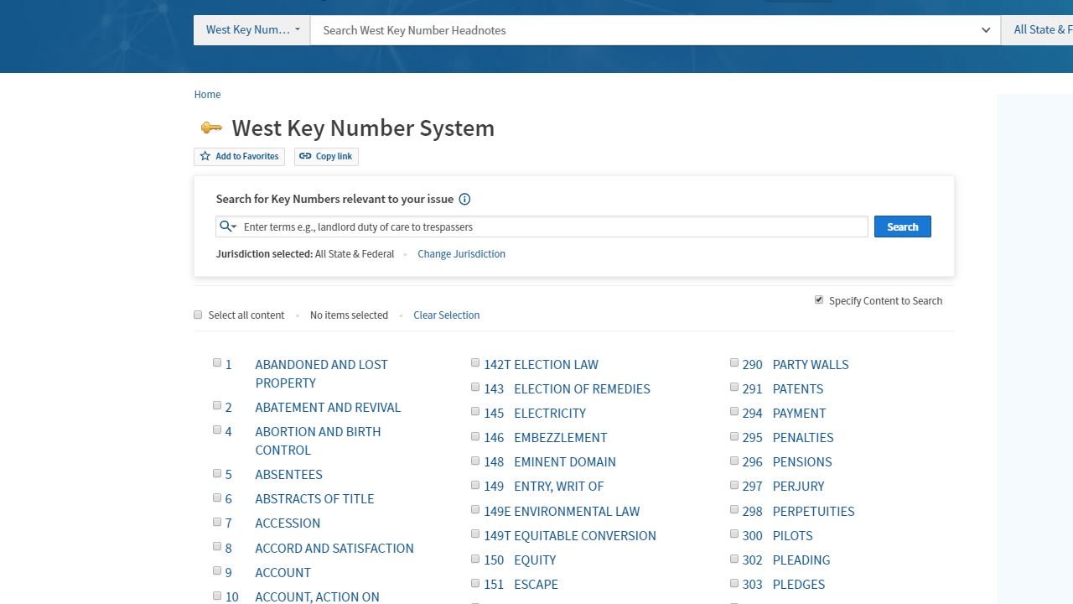
What is the
Key Number System?
Notes:
The Key Number System is a comprehensive, highly organized, and extremely detailed STRUCTURE
that sorts cases — ALL published cases — according to the points of law that they discuss.
[NEXT SLIDE]

Slide 70
Seven “Divisions” for all U.S. law
Notes:
To create the Key Number System,
West editors first organized the law into these “seven main divisions.”
[NEXT SLIDE]
[The seven divisions are: Persons; Property; Contracts; Torts; Crimes; Remedies; and Government.]

Slide 71
Divisions broken down into “Topics”
Notes:
Then, the West editors broke each “Division” down into a number of Topics.
For example, the
[ANIMATE]
“Contracts” division is divided into 5 Topics (including a Topic also named “Contracts.”)
All told, the seven divisions are broken down into almost FOUR HUNDRED topics!
On Westlaw,
[ANIMATE]
via the West Key Number System, you can see and browse these Topics in alphabetical order.
Some Topics are very broad — for example,...
[ANIMATE]
“Constitutional Law.”
Some are quite narrow — for example, ...
[ANIMATE]
“Riot.”
[NEXT SLIDE]

Slide 72
Topics are outlined, producing “Key Numbers”
Notes:
Each Topic is then outlined and divided into as many specific legal concepts (points of law or legal principles)
as necessary to cover that Topic.
These individual, specific legal concepts are the West “Key Numbers.”
In viewing a Topic (like Contracts), you can see the broad outline structure of the Topic.
Within the Topic, you can drill down into whichever sections of the Topic seem relevant.
So, if you’re looking for contracts cases about offers, you might open ...
[ANIMATE]
“I. Requisites and Validity.”
You can continue to drill down for more detail — for example, by opening ...
[ANIMATE]
“(B) Parties, Proposals, and Acceptance,” which likely covers offers.
[NEXT SLIDE]

Slide 73

Topics are outlined, producing “Key Numbers
Notes:
We’re now at the most detailed level of the Contracts Topic hierarchy.
Here we see...
[ANIMATE A CALLOUT]
the individual Key Numbers,
[ANIMATE A SNIPPET]
each representing a discrete “point of law” within the Contracts Topic.
[ANIMATE HIDDEN RECTANGLE (lower, right-hand corner)]
And sure enough, points of law related to “Offers”...
[ANIMATE A CALLOUT]
are covered in ...
[ANIMATE A SNIPPET]
Key Numbers 16 through 20.
Each of the 400 Topics is divided into as many Key Numbers as the West editors think are needed to capture all of the points of law related to that Topic.
There are about 100,000 Key Numbers in the 400 or so Topics in the Key Number System!

Slide 74
Key Numbers lead to case headnotes & citations
Notes:
Having found a precise Key Number for the specific point of law related to an issue ...
(such as
[ANIMATE CALLOUT]
Contracts Key Number 18, on
[ANIMATE]
how offers are made or communicated),
you can select that Key Number, to see
[ANIMATE]
headnotes from cases that West editors have determined deal with that same point of law.
So, having selected Contracts Key Number 18, we're now seeing
every point of law from every published case (here, for California, the selected jurisdiction)
that (as West editors see it) deals with making or communicating offers.
[NEXT SLIDE]

Slide 75
Key Number System
Advantages & Disadvantages
Notes:
The Key Number System’s size and structure lead to certain Pros and Cons.
[NEXT SLIDE]

Slide 76
Advantages — Key Number System
Has comprehensive coverage
Leads to analogous cases
Finds relevant cases where “descriptive” words are common, ambiguous, or vague
Finds cases representing broad topics
Notes:
The Key Number System has several major advantages.
First, as noted ...
[ANIMATE]
it’s comprehensive.
Second, it will ...
[ANIMATE]
lead to analogous cases — cases involving the same
RULES as your client’s issue — even if those cases
arose from very different FACTS than your matter.
Third, the Key Number System can help you...
[ANIMATE]
find cases with issues that can only be described with
common words, or words with multiple meanings (like “release” or “incorporation”).
And, the Key Number System can...
[ANIMATE]
lead you to cases on the broader legal concepts related to your client’s unique problem or issue.
[NEXT SLIDE]

Slide 77
Disadvantages — Key Number System
Comprehensive coverage (!)
Traditional approach to legal issues
Rigidity (to a degree)
Notes:
Of course, the Key Number System has some downsides.
One is...
[ANIMATE]
its comprehensive coverage!
The sheer size of a system with access to all published cases can make it overwhelming.
And, with almost 400 Topics and around 100,000 Key Numbers, it can be
hard to pinpoint the best Topics and Key Numbers for your client’s issue.
The Key Number System also has ...
[ANIMATE]
a traditional approach to legal issues.
The System takes a non-cutting-edge approach to the law.
And while it does adapt to new areas of law and new legal theories, this takes time.
So, there’s always a lag between developments in the law and updates to the Key Number System.
And, the Key Number System is ...
[ANIMATE]
somewhat rigid.
It may be hard to find cases on issues that don’t fit well into the Key Number System’s outlining scheme.
The West editors see law a certain way.
If your issue doesn’t fit neatly into their legal worldview,
the Key Number System might not be as useful to you for that issue.
[NEXT SLIDE]

Slide 78
Ask the Zief Research Librarians!
https://legalresearch.usfca.edu/ZiefResearchHelp
Notes:
If you’ve got any questions about the West Key Number system,
just ask one of the Zief research librarians.

Slide 79
West
Key Number System: Basic How-Tos
Up next . . .
Notes:
The next video will
[ANIMATE]
continue with the Key Number System, presenting some ways to use it to find cases.

Slide 80
Photo credits
Questions by Nick Youngson, CC BY-SA 3.0, Alpha Stock Images,
http://www.picpedia.org/highway-signs/q/questions.html
Thumbs up and down image by Bunzellisa from Pixabay,
https://pixabay.com/?utm_source=link-attribution&amp;
utm_medium=referral&amp;utm_campaign=image&
amp;utm_content=3171760
Split — Christopher Titzer,
https://www.flickr.com/photos/qchristopher/3060799184
CC BY-NC-ND 2.0
(https://creativecommons.org/licenses/by-nc-nd/2.0/)

Slide 81
Notes:
END of DECK
Fade to black here!
[TIME: 6:05 or so]

Slide 83
Six ways to find cases
Part 5B — West Key Number System (Basic How-Tos)
Lee Ryan, Research Librarian
University of San Francisco School of Law
Notes:
Welcome back to the “Key Number System” installment of the
seven-video series on ways to find cases relevant to your client’s issue.

Slide 84
Case-finding tools / techniques
Secondary sources
Annotated codes
Tables of authorities (cases cited by a known case)
Shepard’s and KeyCite
West’s Key Number System
Full-text keyword searches in case-law sources
— How-To
Notes:
THIS video will briefly go over...
[ANIMATE]
a few good ways to use the West Key Number system to find relevant cases.
[NEXT SLIDE]

Slide 85
Finding cases via the Key Number System
• Start with one “good” case
• Browse a known Topic
• Search for relevant Key Numbers
• Run synopsis,digest (sy,di) searches
Finding cases
via the
Key Number System
Notes:
How do you use the Key Number System (or information from it) to find relevant cases?
These
[ANIMATE]
FOUR ways are the most common. We’ll take a quick look at each one.
[NEXT SLIDE]
• Start with one “good” case
• Browse a known Topic
• Search for relevant Key Numbers
• Run synopsis,digest (sy,di) searches

Slide 86
One marginally
relevant case
One “good” case
Research hypo:
Find cases holding that a party who has partially performed a contract may recover for that partial performance.
Known case:
Filet Menu, Inc. v. C.C.L. & G. Incorporated, 79 Cal. App. 4th 852, 94 Cal. Rptr. 2d. 438 (2000)
Notes:
The so-called “one good case” method is useful because all it takes ... is for you to have found: one case on point.
And it doesn’t really take a GOOD case, just...
[ANIMATE]
a marginally-relevant one.
Suppose, for..
[ANIMATE]
example, you’re looking for cases HOLDING
that a party who has partially performed a contract may recover for that partial performance.
And suppose that the only case you have is Filet Menu v. C.C.L. & G., Inc.
[NEXT SLIDE]
[Filet Menu, Inc. v. C.C.L. & G. Incorporated, 79 Cal. App. 4th 852, 94 Cal. Rptr. 2d. 438 (2000)]

Slide 87
Find best headnotes in “good” (or so-so) case
Notes:
Well, Filet Menu is at best only MARGINALLY relevant. Partial performance is discussed only in dictum.
(The court ACTUALLY ruled that
[ANIMATE SNIPPET]
the contract was voidable on grounds of fraud.)
But the DICTUM was summarized by the West editors in
[ANIMATE]
this headnote, (headnote 2) ...
[ANIMATE ENLARGED SNIPPET]
which DOES state the point of law about partial performance we’re interested in.
Then…
[NEXT SLIDE]

Slide 88
actual, relevant case!
Use link to find similar cases.
Use links in headnotes to find other similar cases
Notes:
... if you click on ..
[ANIMATE]
this odd-looking link — (“95k319(1)” —
which on Westlaw stands for “Contracts Topic, Key Number 319-sub-1”)
You get...
[ANIMATE]
all of the case headnotes under the Topic Contracts, Key Number 319(1).
These are headnotes from every case (for California, the selected jurisdiction) that contains
a point of law dealing with (as the West editors put it),
[ANIMATE]
“Right to recover for partial performance in general.”
Among these headnotes is one from
[ANIMATE]
Lowy v. United Pacific Insurance.
The Lowy case looks more relevant than Filet Menu — and in fact Lowy DID HOLD that
a party could get partial compensation for partial performance of a divisible contract.
[NEXT SLIDE]
(BTW, the Digest is showing California cases — because Filet Menu was a California case. But you can use the “jurisdiction” pull-down menu to see similar cases from other jurisdictions.)

Slide 89
Search for useful Topics & Key Numbers
Research hypo:
Find cases addressing whether and when defendants in criminal trials can waive their right to a jury trial
Notes:
Another way to use the Key Number System is to search within it for relevant Topics & Key Numbers.
This next method is helpful when you DON’T have a case to use as a springboard.
Suppose, for..
[ANIMATE]
example, you’re looking for cases dealing with a relatively broad issue, such as
whether and when defendants in criminal trials can waive their right to a jury trial.
[NEXT SLIDE]

Slide 90
(search: waive right jury trial criminal)
Search within Key Number System
Notes:
Start by selecting the
[ANIMATE ARROW]
“Key Numbers” link on Westlaw’s home page.
This will take you into...
[ANIMATE]
the Key Number System.
In the
[ANIMATE ARROW]
“Search for Key Numbers relevant to your issue” search box, enter a few well-chosen terms, such as...
[ANIMATE]
“waive right jury trial criminal.”
The search results...
[NEXT SLIDE]

Slide 91
Explore results of Key Number System search
Notes:
...will list possible Topics and Key Numbers, such as
[ANIMATE]
these, for the topic “Jury.”
You can click on ...
[ANIMATE ARROW]
a helpful link.
Or you can click on the ...
[ANIMATE ARROW]
tiny “display the Key Number Hierarchy” icon to the left of
any Key Number to see ...
[ANIMATE]
where that Key Number falls within its Topic.
Displaying this “hierarchy” is helpful because often there’s
a RANGE of Key Numbers (adjacent to the one in your search results) that are ALSO helpful for your issue.
Here, in the hierarchy, suppose we clicked on ...
[ANIMATE]
“230 Key 29 in criminal cases.”
This will bring up ...
[NEXT SLIDE]

Slide 92
View headnotes of cases for selected Key Number(s)
Notes:
... a comprehensive list of the headnotes from (California) cases
dealing with waiver of jury trials in criminal cases.

Slide 93
Browsing a known Topic
Research hypo:
Find contract law cases on how offers are made or communicated
Notes:
The “Browsing a known Topic” method can ALSO be helpful when you don’t have a case to use as a springboard.
The previous video on the Key Number System had an example of using this method to find ...
[ANIMATE]
Contracts cases about making and communicating offers.
In that video...

Slide 94
Browsing a known Topic (“Contracts”)
Notes:
....we began in the Contracts Topic and drilled down, first to ...
[ANIMATE]
“I. Requisites and Validity,” and then to...
[ANIMATE]
“(B) Parties, Proposals, and Acceptance,”
and then to ...

Slide 95
Browsing a known Topic (“Contracts”)
Notes:
... a range of ...
[ANIMATE A CALLOUT]
key numbers ....
[ANIMATE A SNIPPET]
— Key Numbers 16 through 20 — related to “Offers.”...
And from there...

Slide 96
Key Numbers lead to case headnotes & citations
Notes:
... we picked....
[ANIMATE CALLOUT]
Contracts Key Number 18, on
[ANIMATE]
how offers are made or communicated,
and clicked it to see...
[ANIMATE]
headnotes from every published California case dealing with
making or communicating offers.
[NEXT SLIDE]

Slide 97
Synopsis, digest (sy,di) searching
Exploiting editorial enhancements
Research hypo:
Find relevant cases discussing the FEHA definition of a disability as a condition that limits a major life activity.
Notes:
This final method — synopsis/digest searching — doesn’t exploit the OUTLINE structure of the Key Number System.
Instead, it takes advantage of the headnotes and summaries (the “synopses”) that
the West editors create as they edit cases.
Because the headnotes end up in the Key Number System
(they are the “points of law from every published case”),
synopsis,digest searching (sometimes called “sy,di” searching)
is in a sense a useful BYPRODUCT of Key Number System.
So, suppose we’re looking for ...
[ANIMATE]
RELEVANT cases that discuss the California FEHA (“Fair Employment & Housing Act”)
definition of “disability” as a condition that limits a “major life activity.”

Slide 98
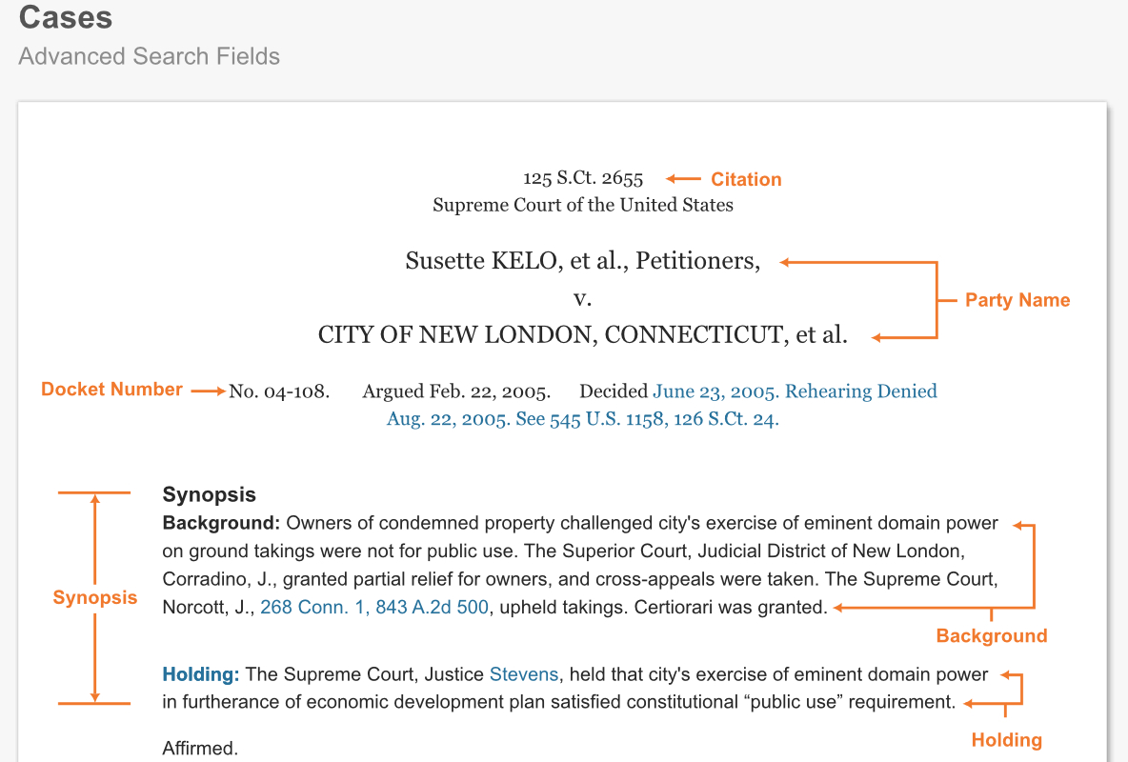
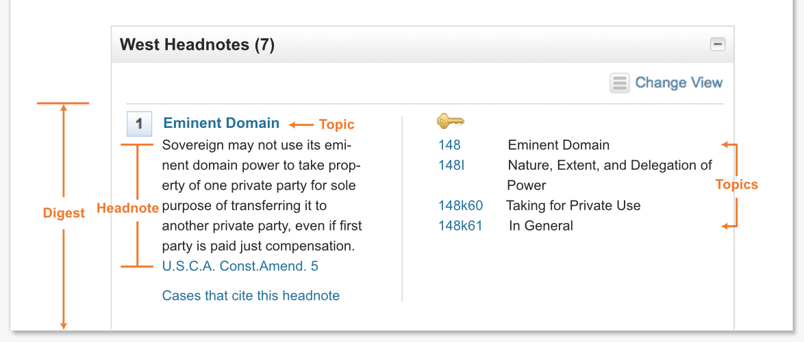
Digest
Headnotes (summaries of each point of law) plus
Topic and Key Number “classification” information
Synopsis — the bare essence of the case
The Synopsis & Digest fields of cases on Westlaw
Notes:
First, what ARE the “Synopsis” and “Digest” fields of cases?
The Synopsis is...
[ANIMATE]
a very brief summary of the case’s factual and procedural background, and the holding.
The Digest field contains...
[ANIMATE]
the text of the headnotes, plus information on what Topics and
Key Numbers those headnotes have been assigned to in the Key Number System.
The West editors don’t waste any words in the Synopsis and headnotes of a case.
So, if terms from your keyword searches appear in the Synopsis or Digest fields of a case,
it’s much more likely that the case will actually be ABOUT the issue those search terms describe.
To illustrate…
[NEXT SLIDE]
The West editors don’t waste any words in the Synopsis and headnotes of a case [— in contrast to wordy judicial opinions.]

Slide 99
Search:
advanced: SY,DI(disab! and limit and "major life activity")
Results: 17 cases, good relevance
Search:
advanced: disab! and limit /p "major life activity"
Results: 183 cases, mixed relevance
Results without and with “sy,di” searching
Notes:
For the FEHA disability definition issue, here’s a search that looks for the search terms in ANY part of a case.
The results were OK, BUT the ratio of irrelevant to relevant cases was pretty high.
By contrast...
[ANIMATE]
revising the search to look for the search terms ONLY in the “synopsis & digest” fields of cases,
led to a result set was both smaller AND, more importantly, much more relevant.
[NEXT SLIDE]
[183 cases and 17 cases, respectively, in March 2019]

Slide 100
Ask the Zief Research Librarians!
https://legalresearch.usfca.edu/ZiefResearchHelp
Notes:
If you’d like to use any of these Key Number System methods for your research project,
just ask one of the Zief research librarians.

Slide 101
Full-text keyword searching
Up next . . .
Notes:
The next video will
[ANIMATE]
focus on using full-text keyword searching to find cases.

Slide 102
Photo credits
Questions by Nick Youngson, CC BY-SA 3.0, Alpha Stock Images,
http://www.picpedia.org/highway-signs/q/questions.html
Thumbs up and down image by Bunzellisa from Pixabay,
https://pixabay.com/?utm_source=link-attribution&amp;
utm_medium=referral&amp;utm_campaign=image&
amp;utm_content=3171760
Split — Christopher Titzer,
https://www.flickr.com/photos/qchristopher/3060799184
CC BY-NC-ND 2.0
(https://creativecommons.org/licenses/by-nc-nd/2.0/)

Slide 103
Notes:
END of DECK
Fade to black here!
[TIME: about 6:43]

Slide 105
Six ways to find cases
Part 6 — Full-text keyword searching
Lee Ryan, Research Librarian
University of San Francisco School of Law
Notes:
Welcome to the final video in this series on
ways to find cases relevant to issues you’re researching.
[NEXT SLIDE]

Slide 106
Case-finding tools / techniques
Secondary sources
Annotated codes
Tables of authorities (cases cited by a known case)
Shepard’s and KeyCite
West’s Key Number System
Full-text keyword searches in case-law sources
Notes:
This video will focus on
[ANIMATE ARROW]
running full-text keyword searches for case law ... in legal research platforms such as Lexis, Westlaw, Bloomberg Law, fastcase, Casetext, and so forth.
[NEXT SLIDE]

Slide 107
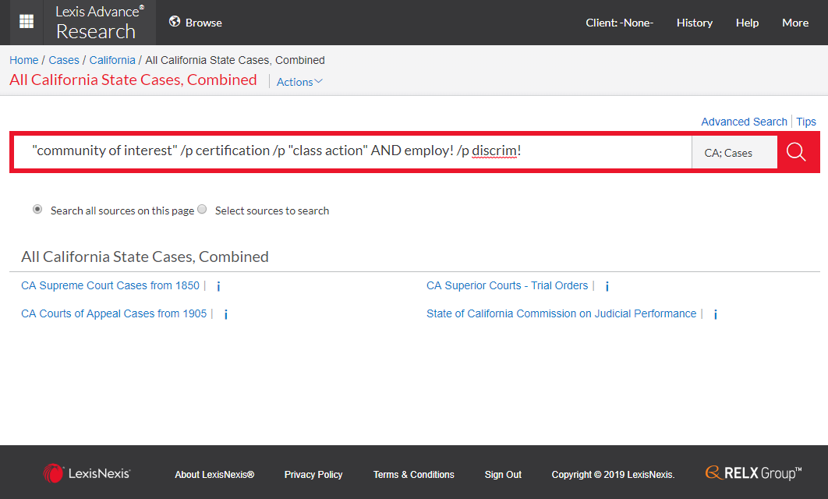
Full-text keyword searching
in case-law sources
Notes:
Like every method for finding cases, there’s a place for keyword searching of full-text case law databases.
Keyword searches of case law are particularly useful when
you’re looking for cases with facts similar to your case, or when
your search terms are fairly distinctive (that is, not too common, or vague, or ambiguous).
[NEXT SLIDE]

Slide 108
Full-text searching
Advantages & Disadvantages
Notes:
And, like every method for finding cases, full-text KEYWORD searching for cases has its pros and cons.

Slide 109
Advantages — full-text searching
Comprehensiveness
Freedom from others’ structures, categorizations
Choice of search methods
Ability to search for rare or unusual words / terms
Notes:
Advantages include —
[ANIMATE at BULLETS]
• Comprehensiveness. Most major legal research platforms have ALL published
case law from the state and federal courts (plus a substantial
amount of unpublished case law, particularly for California and federal courts).
Another plus is:
• Freedom from structures, categorizations or analyses imposed by other authors or editors.
Because you pick your search terms, you can create searches for
concepts or fact-patterns not covered in secondary sources,
the Key Number System, or other ways of organizing and describing case law.
A third advantage is:
• A choice of search methods.
Almost all legal research platforms let you pick either “terms and connectors”
or natural language searching.
And, fourth, you have
• The ability to search for rare or unusual words or terms.
This is useful for finding cases dealing with specific facts, and for
finding cases dealing with emerging areas of law (provided that
the terms of art in those emerging areas aren’t too common or ambiguous).
[NEXT SLIDE

Slide 110
Disadvantages — Full-text searching
"summary judgment"
"standard of review"
Comprehensiveness
Lack of analysis or context
Difficulty with common terms
Difficulty with ambiguous terms
Difficulty isolating cases with a certain outcome
release (verb)
release (document)
Notes:
Downsides of full-text keyword searching for case-law include —
[ANIMATE at BULLETS]
• Comprehensiveness(!)
Because of the sheer volume of case law available for most U.S. jurisdictions,
even well-crafted searches may return too many [relevant] cases to review.
A second downside is —
• A lack of analysis of or context for the cases in your results.
(BUT once you DO find relevant cases, Shepard’s or KeyCite may link to
practice guides, law review articles, or other secondary sources that
discuss or analyze those cases.)
The next three disadvantage are all related.
There’s —
• The difficulty the search engines have with common terms,
such as
[ANIMATE]
“summary judgment” or “standard of review.”
Then there’s —
• The difficulty the search engines have with ambiguous terms,
such as
[ANIMATE]
“release” (the verb) and “release” (the document).
And, there’s —
• The difficulty the search engines have isolating cases with a certain OUTCOME,
such as evidence being admitted (versus excluded), or
a motion being granted (versus denied).
However, as aspects artificial intelligence become more a part of online search engines,
the major legal research platforms will be better able to cope with
these last three disadvantages.

Slide 111
Tips for case-law keyword searches
Notes:
Here are four tips for getting the most out of full-text keyword searches for case law.
[NEXT SLIDE]
[ABOUT 3:15 minutes to the beginning of this slide]

Slide 112
California State Cases, Combined
Practice smart source selection
Notes:
The first tip is —
Take a moment to pick the best source to search — so you don’t get cases from jurisdictions or courts you’re not interested in.
For example, if you’re on Lexis...
and your goal is to find California state cases — and ONLY state court cases from California — then ...
[ANIMATE]
pick the narrowest possible source, which is ...
[ANIMATE]
“California State Cases, Combined.”
[NEXT SLIDE]

Slide 113
Use Natural Language and Terms & Connectors
Notes:
The second tip is —
Use both Natural Language and Terms & Connectors searches, switching between them as needed.
[NEXT SLIDE]
[FIND BETTER IMAGES?]

Slide 114
Try natural language when
You’re not familiar with the terminology
in an area of law
There are multiple ways to state your issue
You’re looking for broad concepts or topics
rather than specific facts or documents
You only need a few relevant documents as a start
Notes:
Natural language is useful when —
[ANIMATE AT BULLETS]
- you’re not yet familiar with the precise language used in the area of law you’re researching; or
- there are multiple ways to state your issue; or
- you’re searching for broad concepts or topics, rather than specific facts or documents; or
- you only need a few relevant documents to get a start on a project.
[NEXT SLIDE]

Slide 115
Try terms & connectors when
There’s specialized factual/legal terminology
You’re looking for specific facts
You’re looking for a particular document
You want maximal control over how
the search engine processes your search
Notes:
Terms & Connectors is useful when —
[ANIMATE AT BULLETS]
- there’s specialized terminology related to your facts or legal issue; or
- you’re looking for very specific facts; or
- you’re searching for a particular document; or
- basically, ANY time you want to have maximal control over the search process.
[NEXT SLIDE]

Slide 116
Exploit “Search Within Results”
Notes:
This third tip will help when your search gets a lot of results.
In that case, use
[ANIMATE CALLOUT]
“Search within Results” to
look for cases WITHIN THOSE RESULTS dealing with specific facts, terms, or legal concepts....
...such as here,
[ANIMATE]
where the “Search Within Results” is looking WITHIN
class action certification cases FOR Section 17200 cases.
(This is a Westlaw example, but Lexis and other platforms also have this feature.)
[NEXT SLIDE]
COMMUNITY OF INTEREST / 17200 SEARCH EXAMPLES — SOURCE & SEARCH
In “California State Cases, Combined” [Lexis] or “California State Cases” [Westlaw]
Search —
"community of interest" /p certification /p "class action"
“Search within results” search: —
"unfair competition" or 17200

Slide 117
Search:
writtenby(george) and
ln-summary("death penalty" or "capital punishment"
or (sentenc! /2 death) or "capital murder")
Take advantage of Field / Segment searching
Notes:
The fourth and final tip is —
To use Field searching (on Westlaw) or Segment searching (on Lexis) to find
documents where your search terms appear only in certain portions of the document.
These searches can give you better, more precise results.
For example, this search for California death penalty opinions by former Chief Justice George, uses
Lexis’s “writtenby” field to specify opinions BY Chief Justice George, and the
Lexis “summary” field to target cases that are actually ABOUT the death penalty.
[NEXT SLIDE]
[SAMPLE SEARCHES/SOURCES]
In “California State Cases, Combined” [Lexis] or “California State Cases” [Westlaw] — Search:
writtenby(george) and ln-summary("death penalty" or "capital punishment" or (sentenc! /2 death) or "capital murder") [Lexis]
judge(george) and synopsis("death penalty" or "capital punishment" or (sentenc! /2 death) or "capital murder") [Westlaw]

Slide 118
Ask the Zief Research Librarians!
https://legalresearch.usfca.edu/ZiefResearchHelp
Notes:
These were just a few ways to get the most out of full-text keyword searching for case law.
For advice for your project, ask one of the Zief research librarians

Slide 119
Photo credits
Questions by Nick Youngson, CC BY-SA 3.0, Alpha Stock Images,
http://www.picpedia.org/highway-signs/q/questions.html
Thumbs up and down image by Bunzellisa from Pixabay,
https://pixabay.com/?utm_source=link-attribution&amp;
utm_medium=referral&amp;utm_campaign=image&
amp;utm_content=3171760
Split — Christopher Titzer,
https://www.flickr.com/photos/qchristopher/3060799184
CC BY-NC-ND 2.0
(https://creativecommons.org/licenses/by-nc-nd/2.0/)

Slide 120
Notes:
END of DECK
Fade to black here!
[TIME: 5:55 or so ]

Slide 122

[wrap up & what’s next]
Notes:
122
[OMIT THIS?]
[NO NARRATION NEEDED?]
[NEXT SLIDE]
You’ve now completed the videos on TOPIC
[TIME]

Slide 123
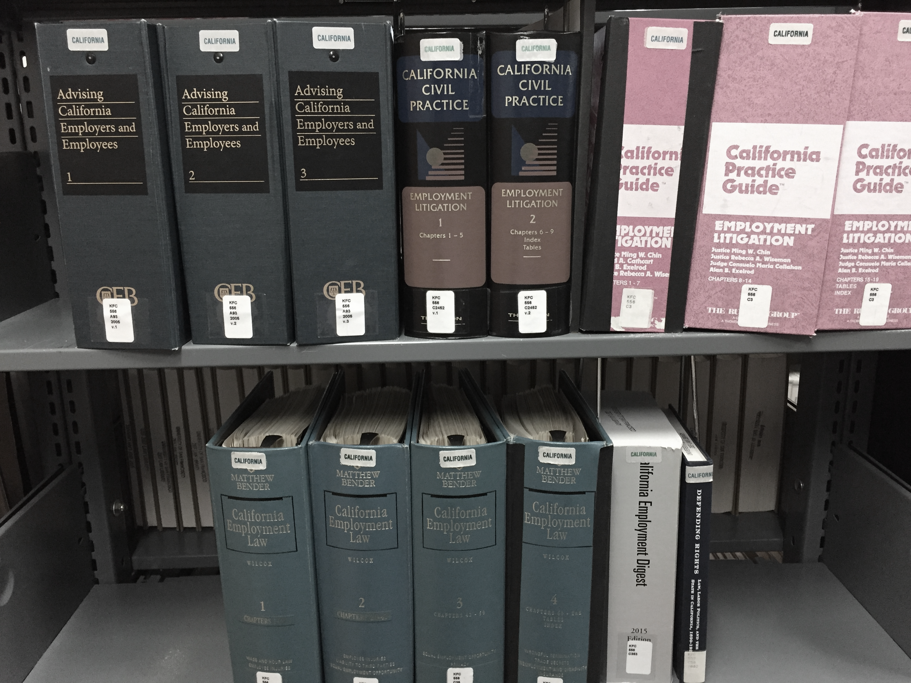
Secondary Sources

Slide 124
Photo credits
Questions by Nick Youngson, CC BY-SA 3.0, Alpha Stock Images, http://www.picpedia.org/highway-signs/q/questions.html
This is the End — Chris Goldberg, https://www.flickr.com/photos/chrisgold/10766099293, CC BY-NC 2.0 (https://creativecommons.org/licenses/by-nc/2.0)

