Slide 1
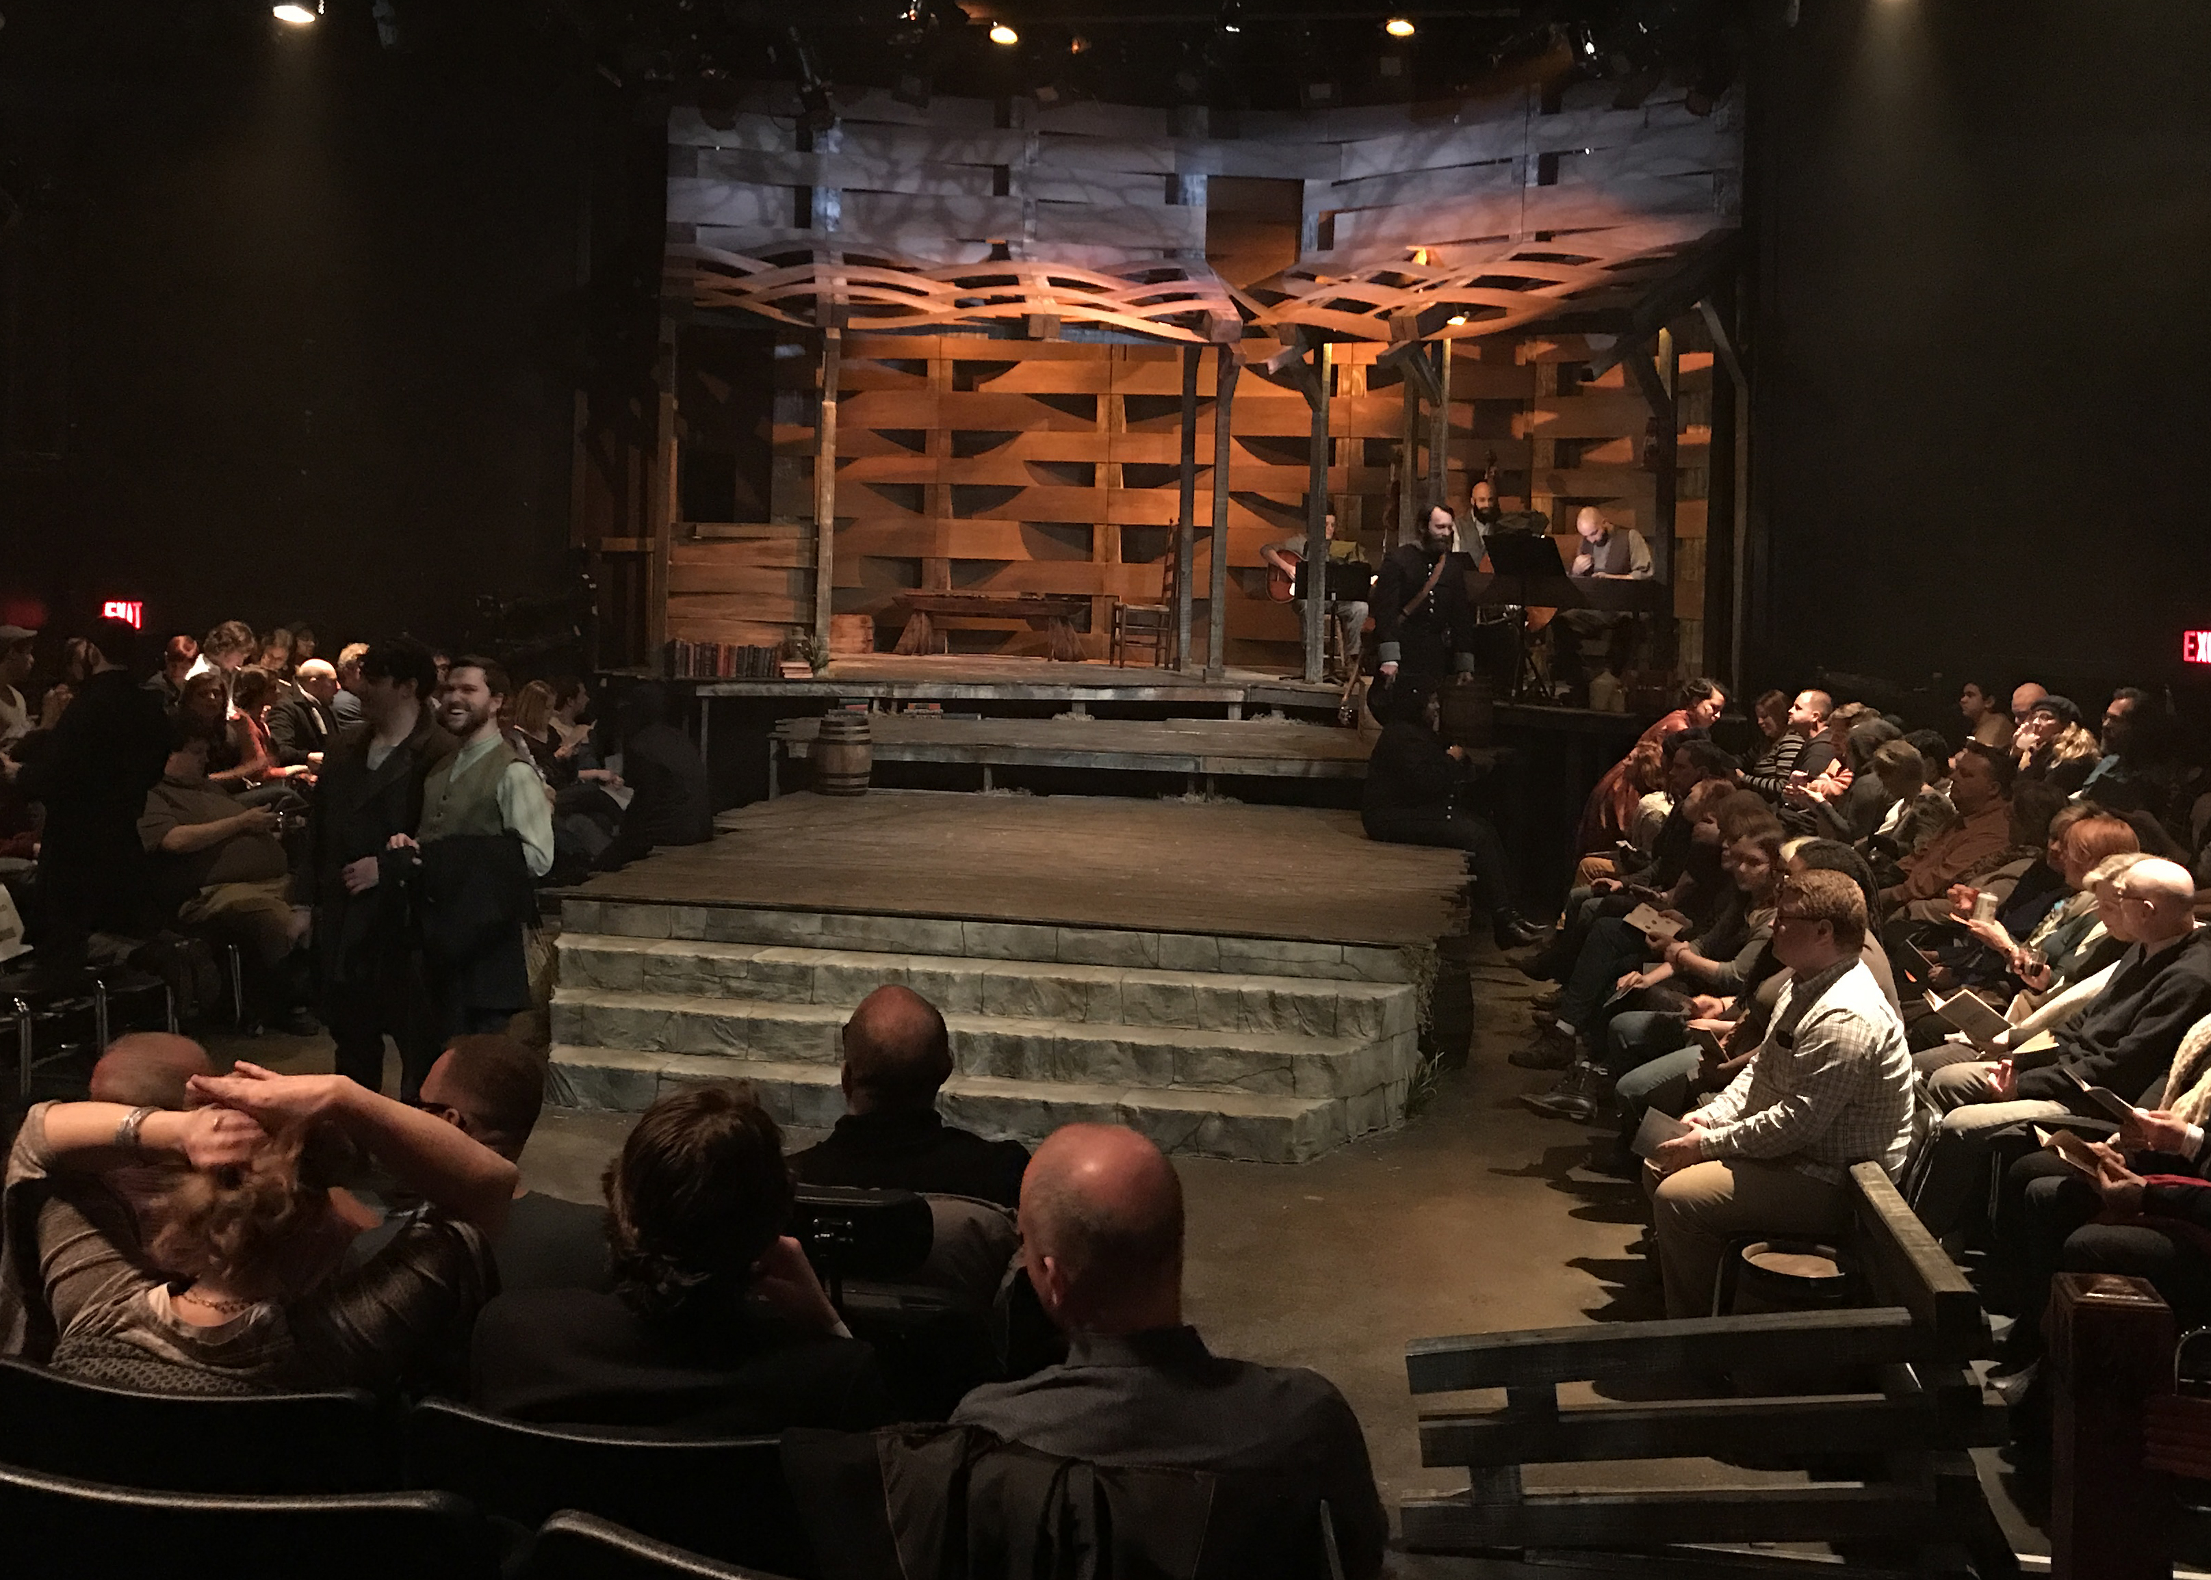
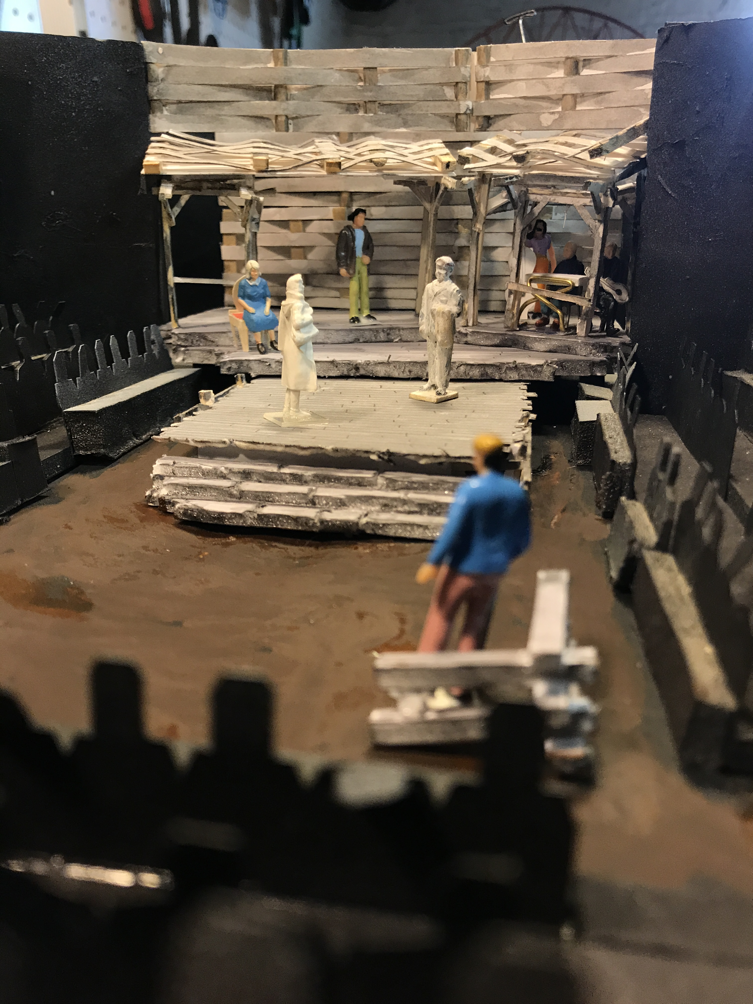
Lee Keenan
Senior Lecturer, Department of Fine and Performing Arts
SCENIC + LIGHTING DESIGN
Hatfield & McCoy
The House Theatre of Chicago

Slide 2
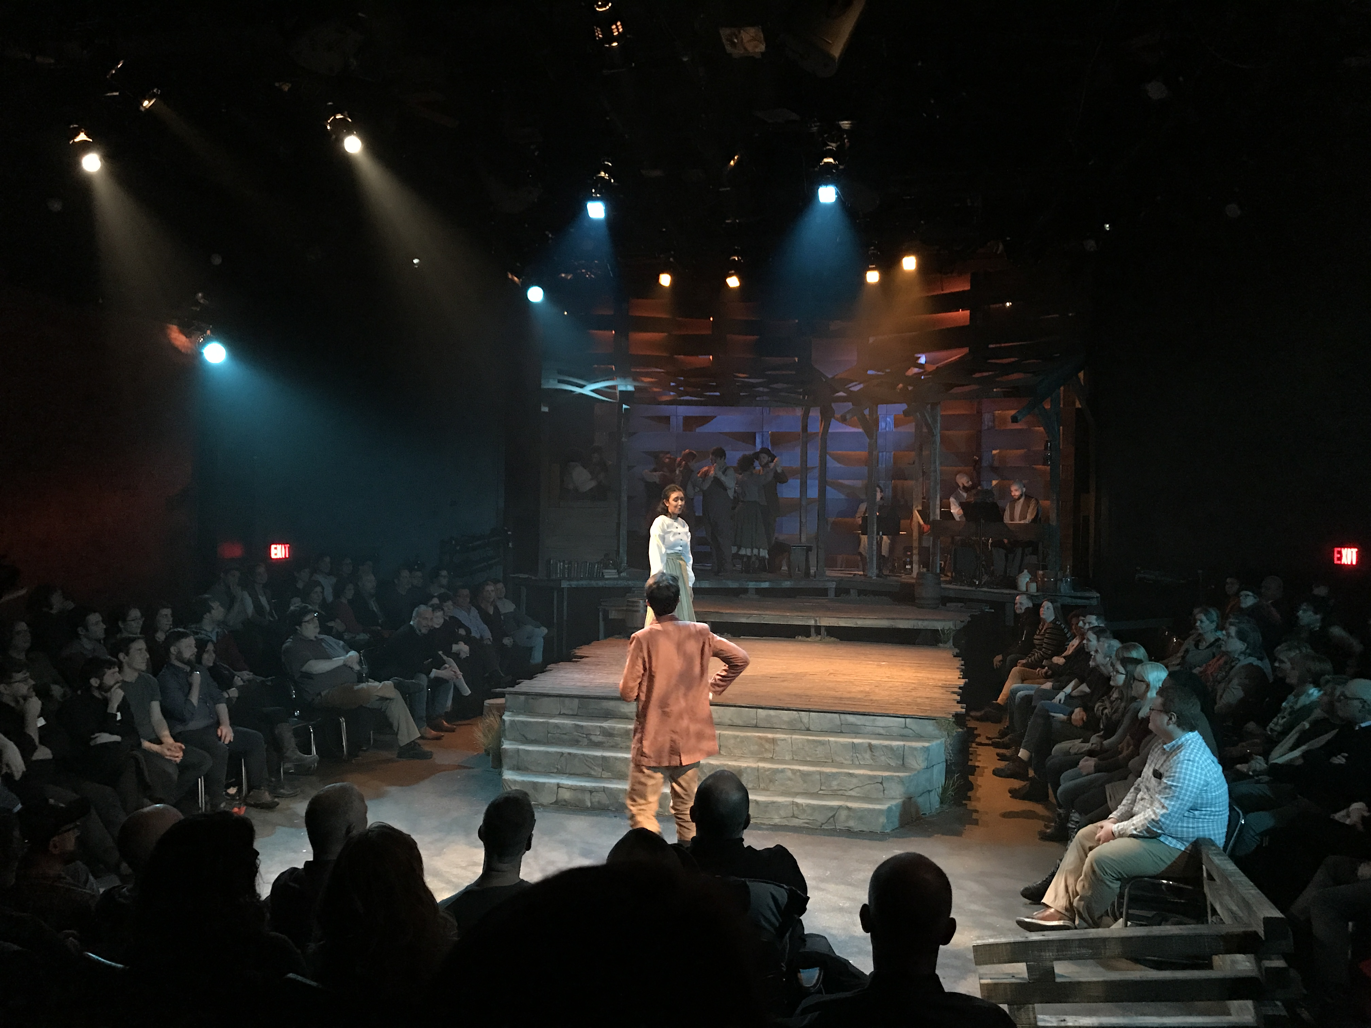
Lee Keenan
Senior Lecturer, Department of Fine and Performing Arts
SCENIC + LIGHTING DESIGN
Hatfield & McCoy
The House Theatre of Chicago

Slide 3
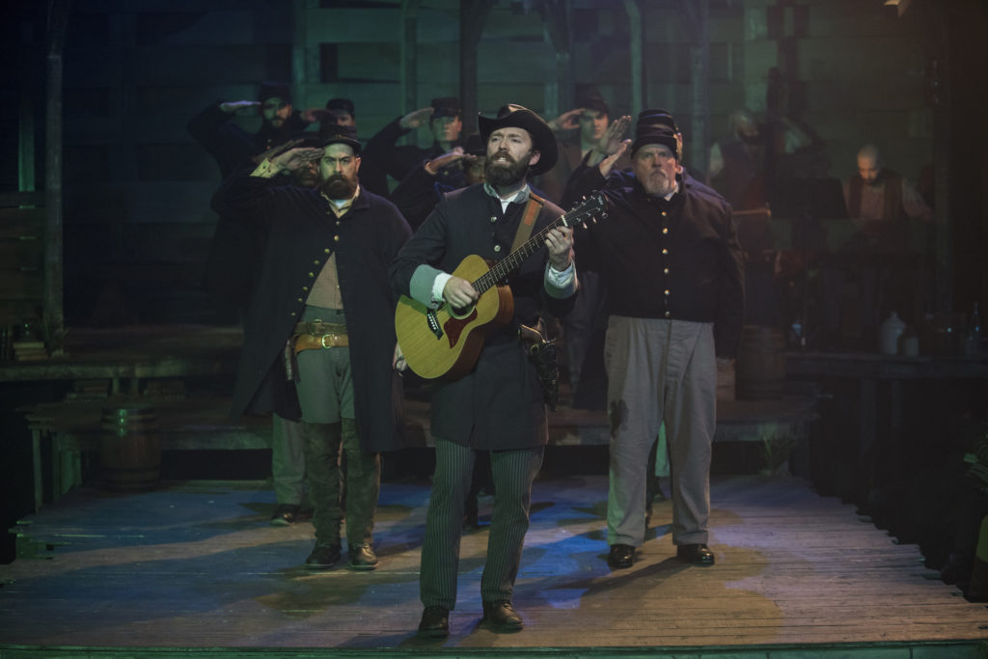
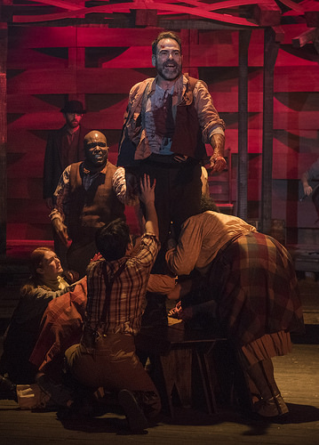
Lee Keenan
Senior Lecturer, Department of Fine and Performing Arts
SCENIC + LIGHTING DESIGN
Hatfield & McCoy
The House Theatre of Chicago

Slide 4
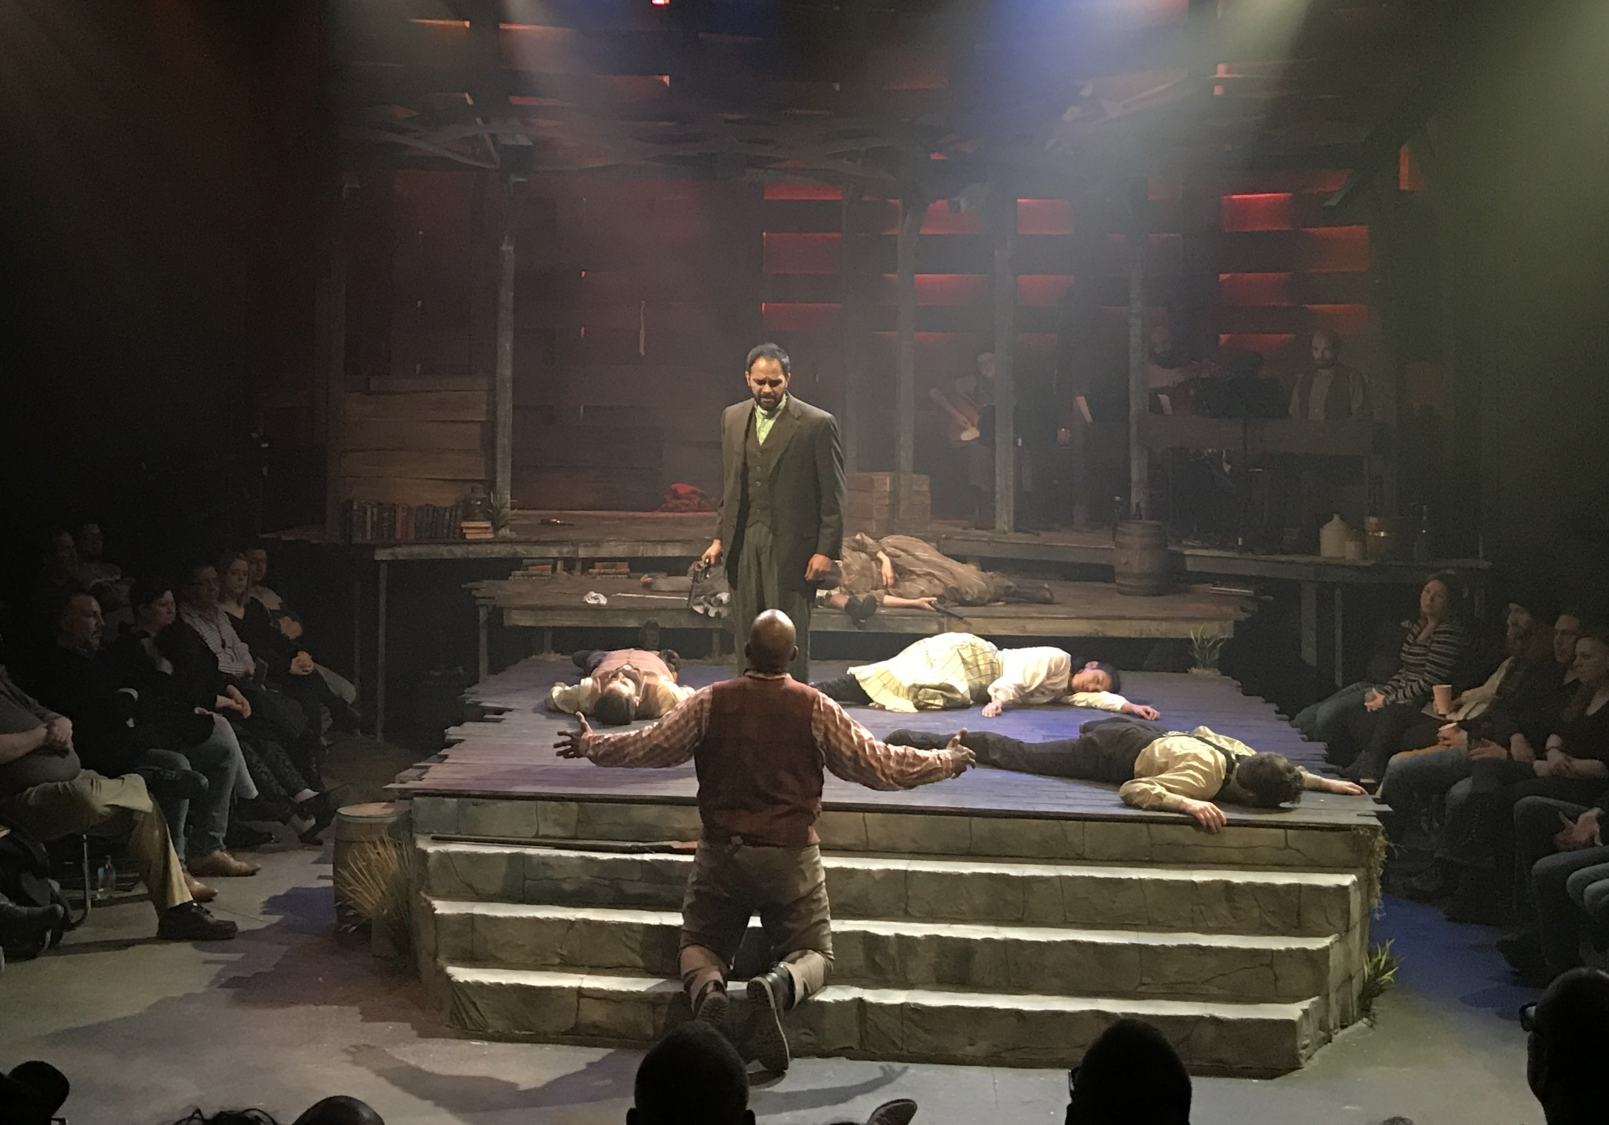
Lee Keenan
Senior Lecturer, Department of Fine and Performing Arts
SCENIC + LIGHTING DESIGN
Hatfield & McCoy
The House Theatre of Chicago

Slide 5
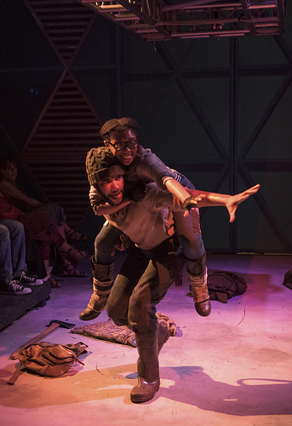
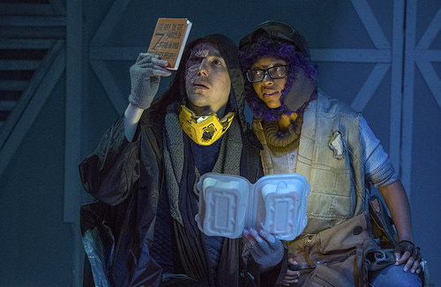
Lee Keenan
Senior Lecturer, Department of Fine and Performing Arts
LIGHTING DESIGN
Borealis
The House Theatre of Chicago

Slide 6
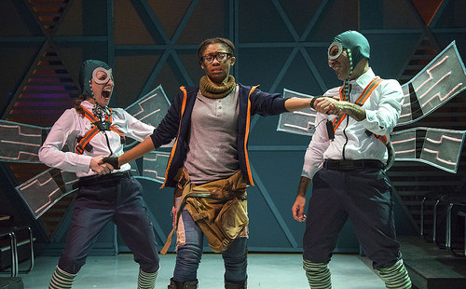
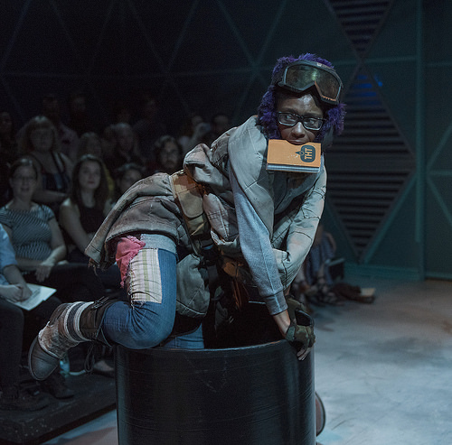
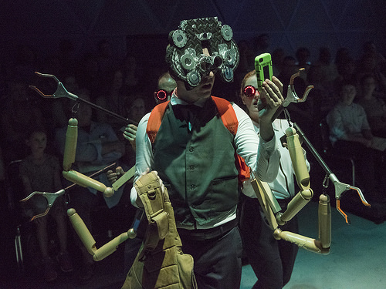
Lee Keenan
Senior Lecturer, Department of Fine and Performing Arts
LIGHTING DESIGN
Borealis
The House Theatre of Chicago

Slide 7
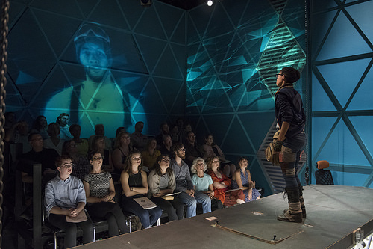
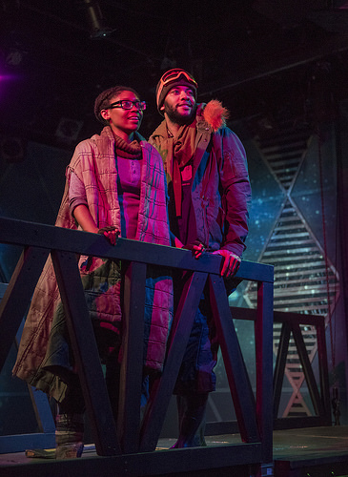
Lee Keenan
Senior Lecturer, Department of Fine and Performing Arts
LIGHTING DESIGN
Borealis
The House Theatre of Chicago

Slide 8
Lee Keenan
Senior Lecturer, Department of Fine and Performing Arts
SCENIC + LIGHTING DESIGN
Diamond Dogs
The House Theatre of Chicago

Slide 9
Lee Keenan
Senior Lecturer, Department of Fine and Performing Arts
LIGHTING DESIGN
Harvey
Court Theatre

Slide 10
Lee Keenan
Senior Lecturer, Department of Fine and Performing Arts
LIGHTING DESIGN
Harvey
Court Theatre

Slide 11
Lee Keenan
Senior Lecturer, Department of Fine and Performing Arts
LIGHTING DESIGN
Harvey
Court Theatre

Slide 12
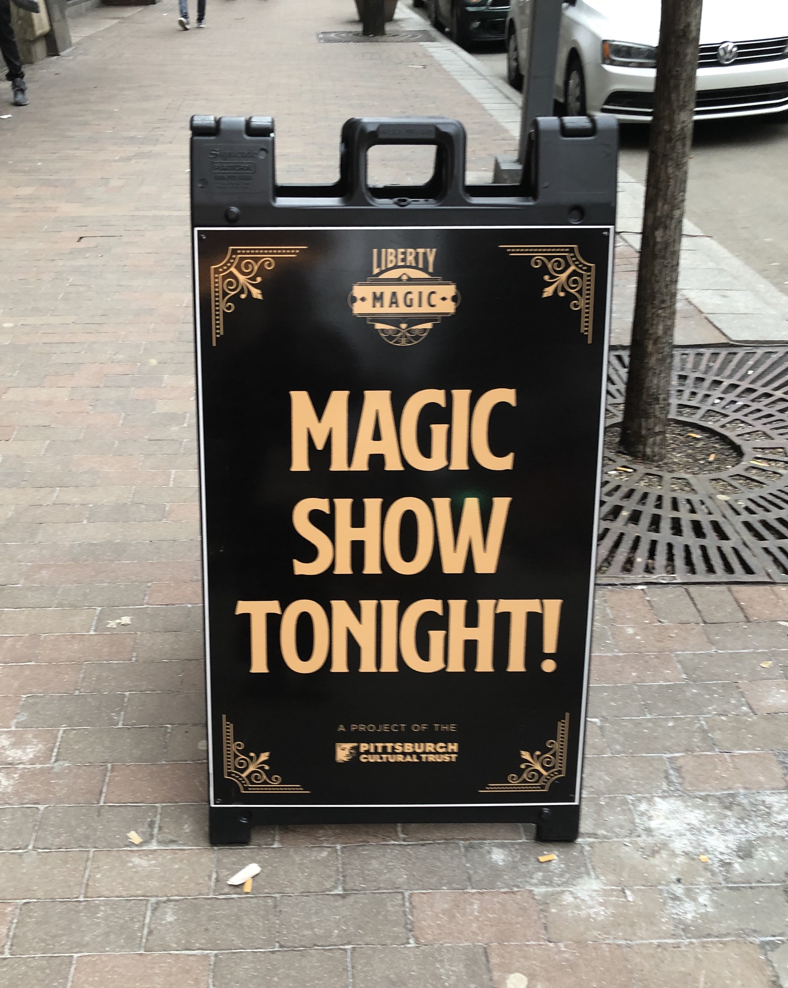
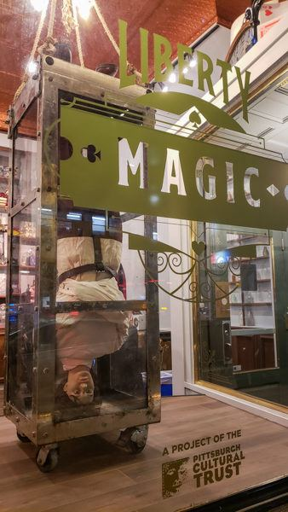
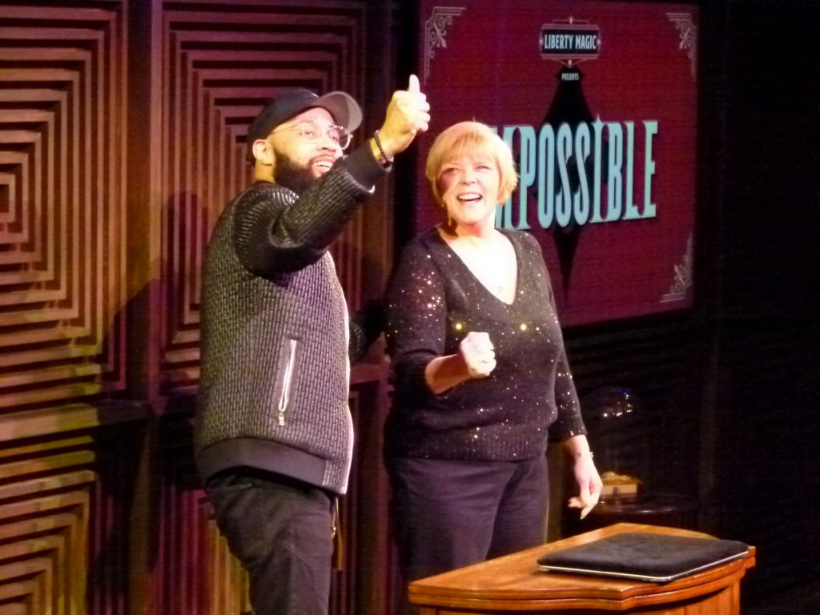
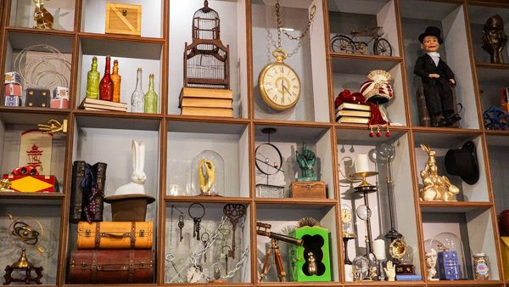
Lee Keenan
Senior Lecturer, Department of Fine and Performing Arts
Liberty Magic
A new venue for close up magic in Pittsburg, PA
Design + Theatre Consultant
Pittsburg Cultural Trust

Slide 13
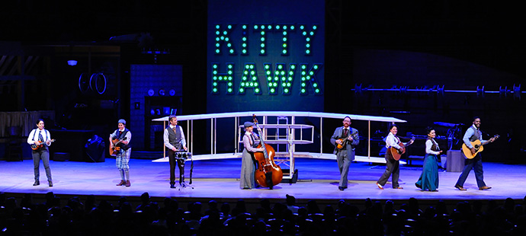
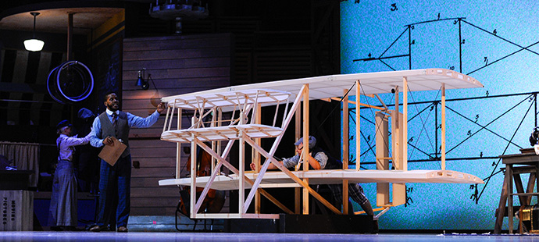
Lee Keenan
Senior Lecturer, Department of Fine and Performing Arts
SCENIC + LIGHTING DESIGN
Kitty Hawk
Adrienne Arsht Center - Miami, FL

Slide 14
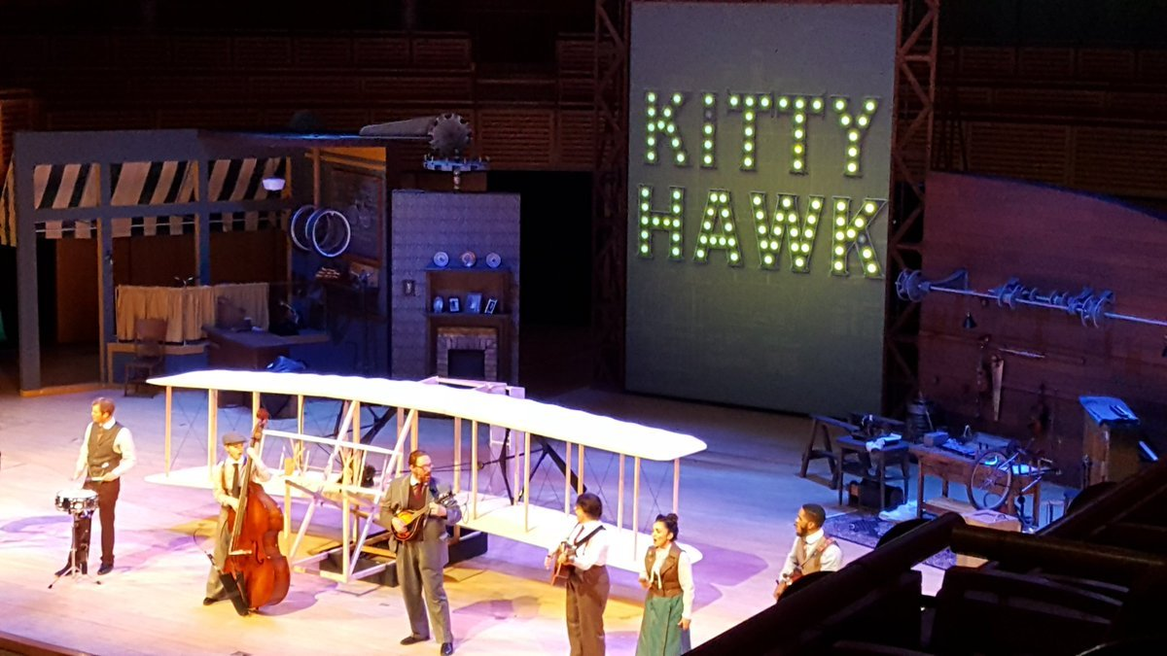
Lee Keenan
Senior Lecturer, Department of Fine and Performing Arts
SCENIC + LIGHTING DESIGN
Kitty Hawk
Adrienne Arsht Center - Miami, FL

Slide 15
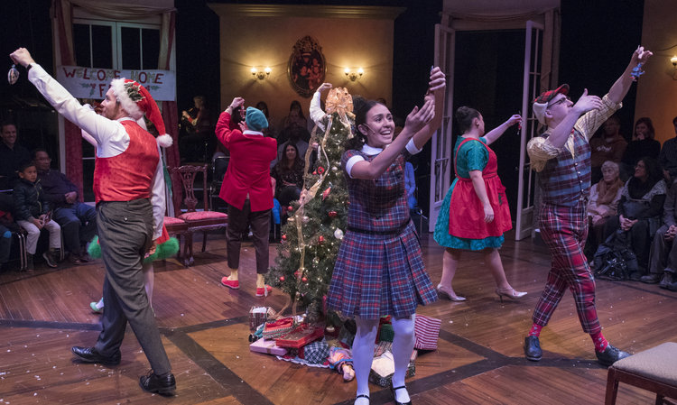
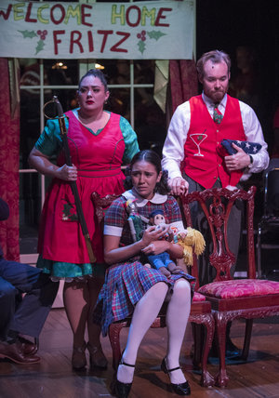
Lee Keenan
Senior Lecturer, Department of Fine and Performing Arts
LIGHTING DESIGN
The Nutcracker
The House Theatre of Chicago

Slide 16
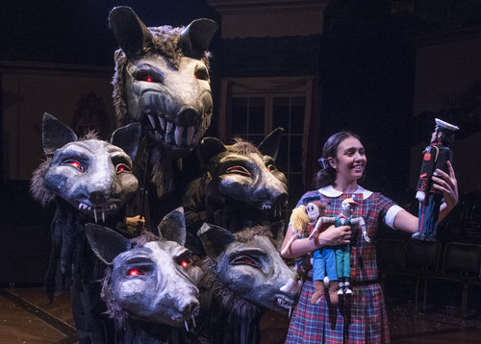
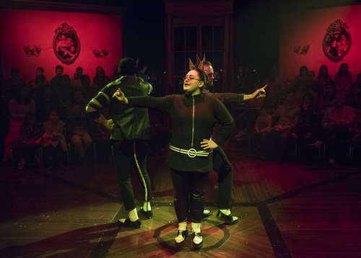
Lee Keenan
Senior Lecturer, Department of Fine and Performing Arts
LIGHTING DESIGN
The Nutcracker
The House Theatre of Chicago

Slide 17
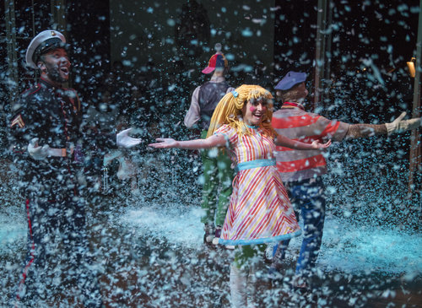
Lee Keenan
Senior Lecturer, Department of Fine and Performing Arts
LIGHTING DESIGN
The Nutcracker
The House Theatre of Chicago

