Slide 1
Communicating Your Research
STARS
UCF’s Institutional Repository
Lee Dotson
Digital Initiatives Librarian

Slide 2
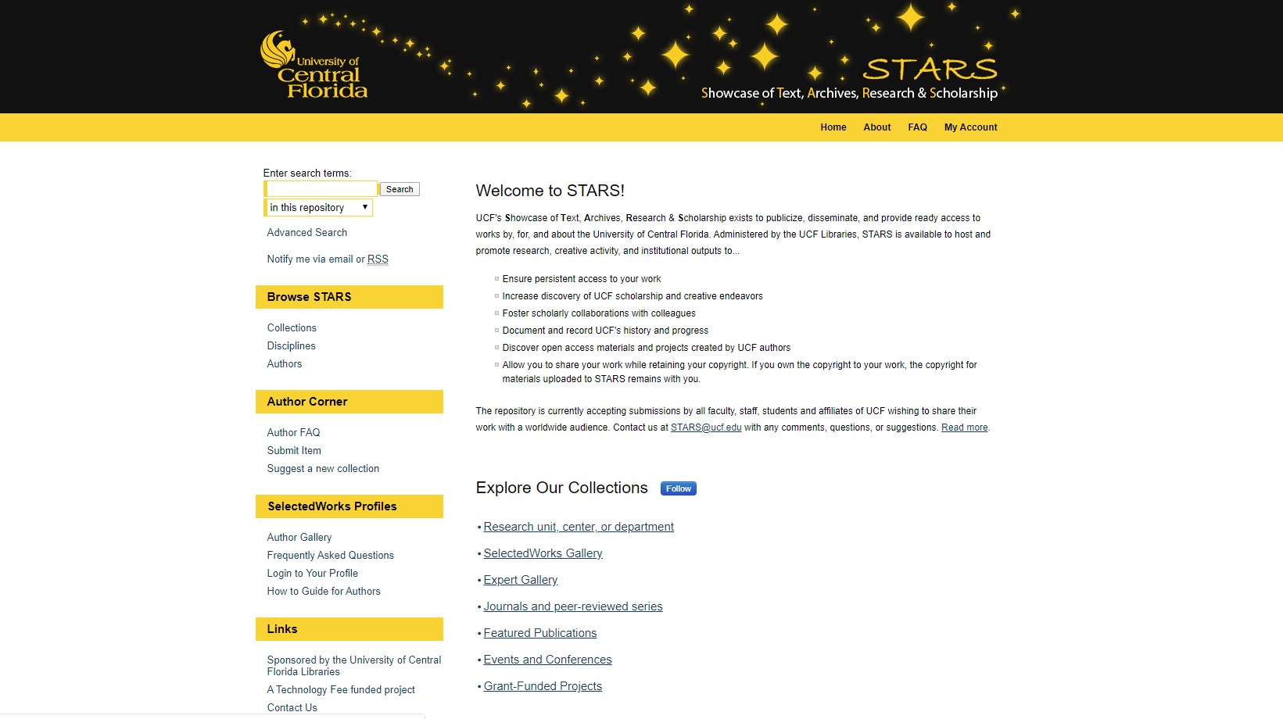
Notes:
STARS stars.library.ucf.edu
UCF's Showcase of Text, Archives, Research & Scholarship
Focus is on the institution
UCF branded Digital Commons platform
Content created by, for, at, and about UCF

Slide 3
Provide persistent, UCF branded access to works
Increase discovery of UCF scholarship and creative endeavors
Share open access materials and projects
Document and record history and progress
Why use STARS?

Slide 4
Organize & share the full spectrum of works
Indexing in Google and Google Scholar
Training - in person or online
Usage metrics in real-time, on demand, or monthly
Unlimited storage
STARS Features

Slide 5
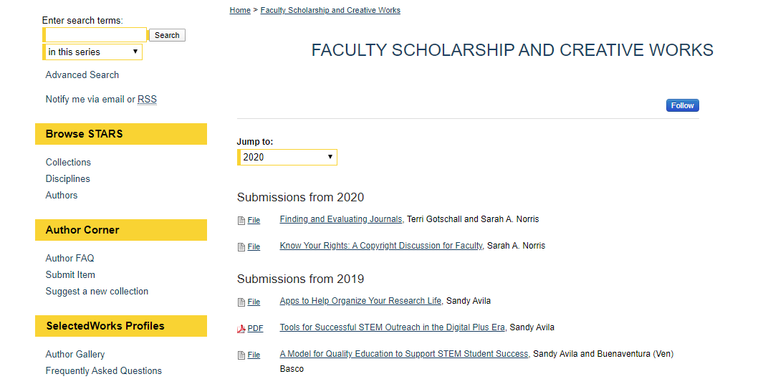
Showcase Research & Scholarship
Notes:
Copyright – Sarah Norris

Slide 6
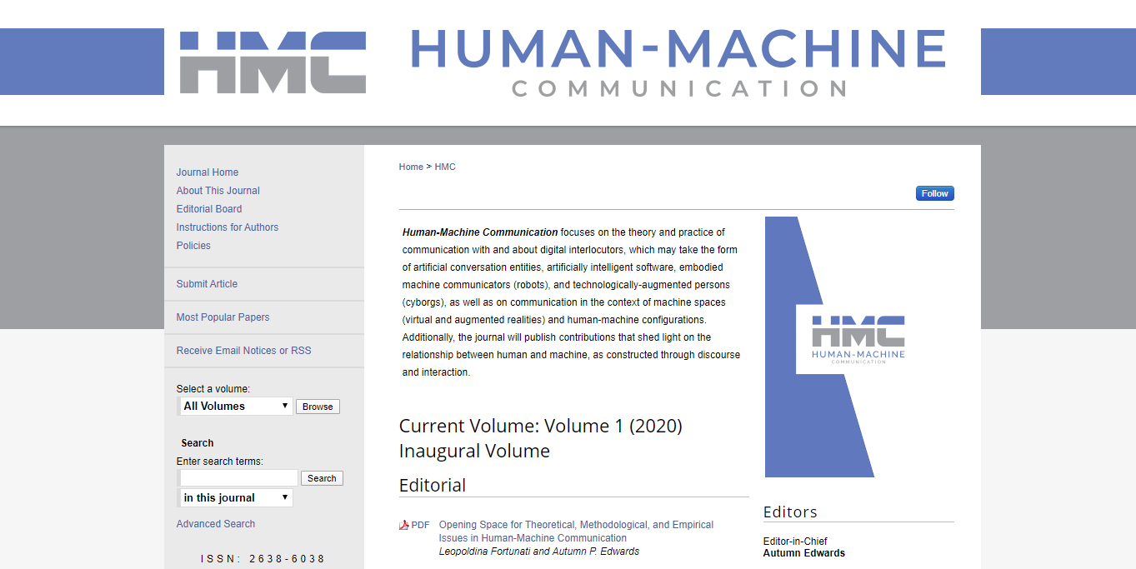
Launch Journals

Slide 7
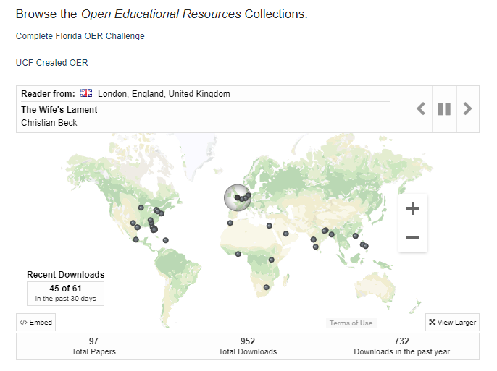
Share Teaching & Learning Items

Slide 8
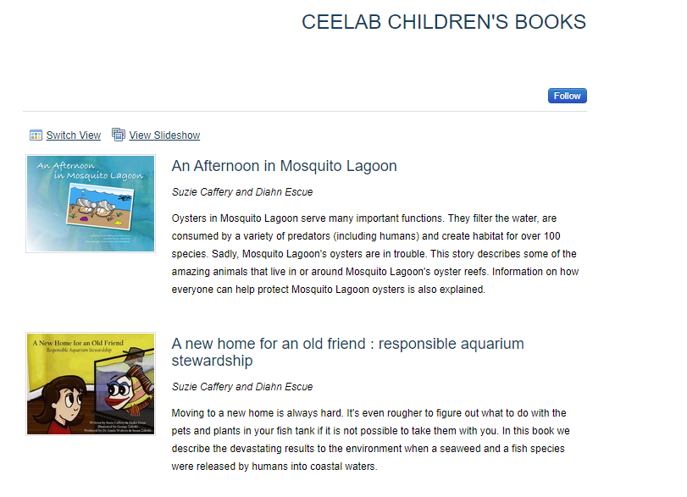
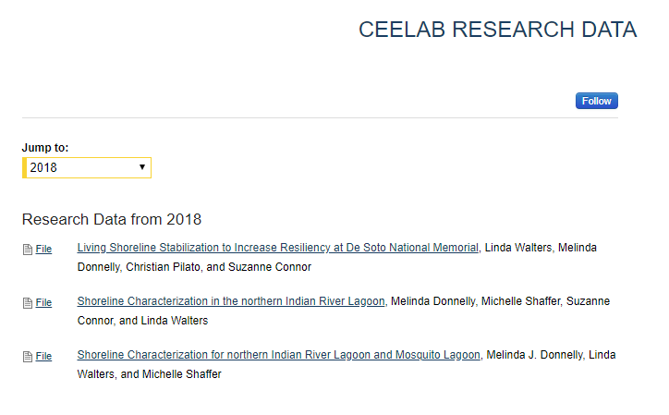
Access to Data & Grant Outputs

Slide 9
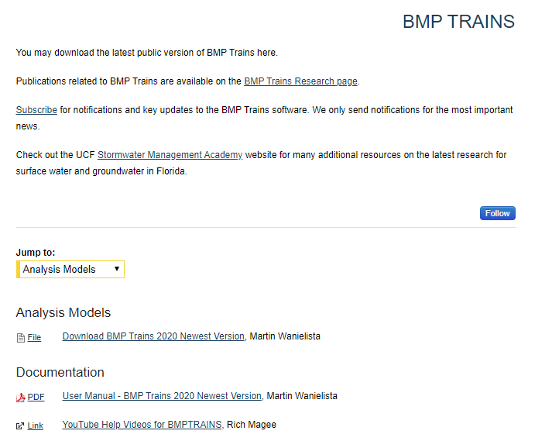
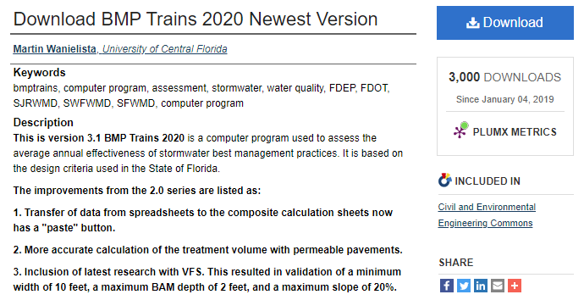
Highlight Projects

Slide 10
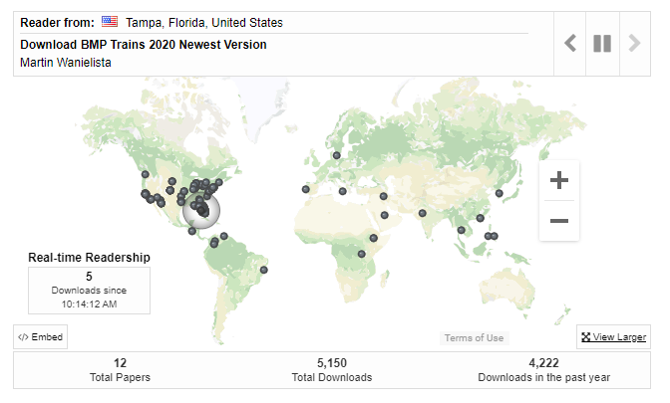
Notes:
Empower students
Utilize features - peer review, access control, streaming media, communication
Integrate with website - direct links, RSS feeds, search boxes, maps
Measure readership & impact

Slide 11
SelectedWorks
works.bepress.com
Online Profile Pages
  UCF branding / Hosted by bepress
Focus is on YOU
  Content created by you any time, anywhere
  Import your content from Digital Commons repositories

Slide 12
Tools to create and edit customizable, UCF branded profiles
Support for a variety of file formats
Indexing in Google & Google Scholar
Readership & usage metrics
Expert Gallery
SelectedWorks Features

Slide 13
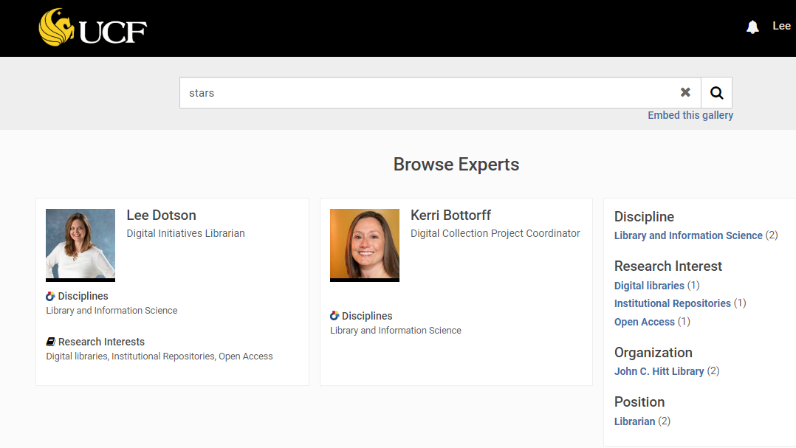


Slide 14
Readership & Impact Dashboards
Impact Dashboard
  Institution focused - STARS
  Available at all levels
Author Dashboard
  Individual focused - YOU
  One dashboard for ALL of your works in STARS and your SelectedWorks profile

Slide 15
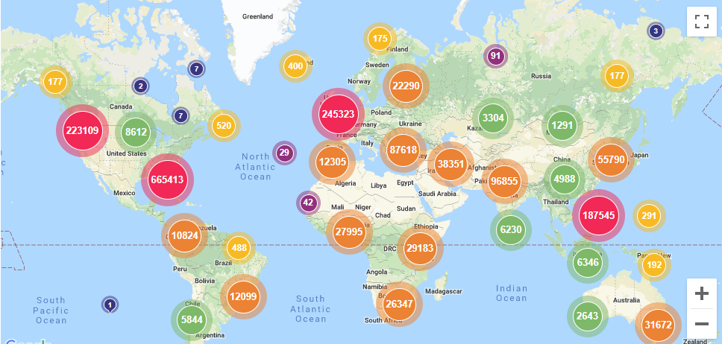


Slide 16
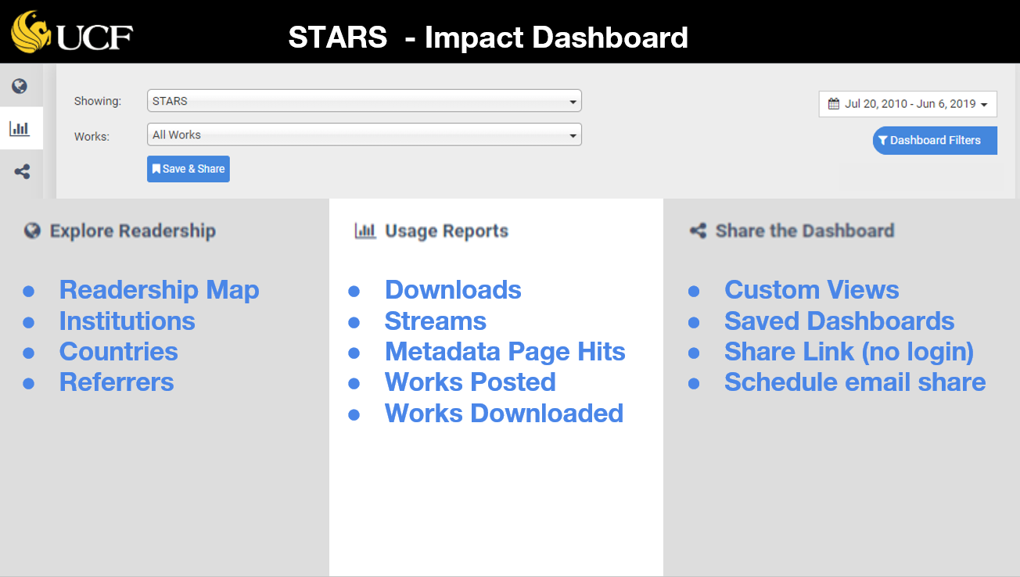

Readership and Impact Dashboard Overview

Slide 17
Tips for Using
STARS and SelectedWorks
Email address is important
Create a STARS account at https://stars.library.ucf.edu/cgi/useradd.cgi
Start your SelectedWorks profile at https://works.bepress.com/account/register/
Submissions to STARS are collection specific
Items can be virtually shared between collections
Need a new collection in STARS? Suggest one here
Questions? Check out the STARS FAQ
More questions? Ask us! STARS@ucf.edu

Slide 18
Featured Collections
Faculty Scholarship and Creative Works
  https://stars.library.ucf.edu/ucfscholar/
Human-Machine Communication journal
  https://stars.library.ucf.edu/hmc/
Open Educational Resources
  https://stars.library.ucf.edu/oer-home/
Coastal and Estuary Ecology Lab (CEELAB)
  https://stars.library.ucf.edu/ceelab/
BMP Trains
  https://stars.library.ucf.edu/bmptrains/

Slide 19
Lee Dotson
Digital Initiatives Librarian
823-1236
John C. Hitt Library
Room 304
Lee.Dotson@ucf.edu
stars@ucf.edu
Thank you!

