Slide 1
STARS
AMH 6939
Florida in WWI Digital Projects
Lee Dotson
Digital Initiatives Librarian
February 8, 2016

Slide 2
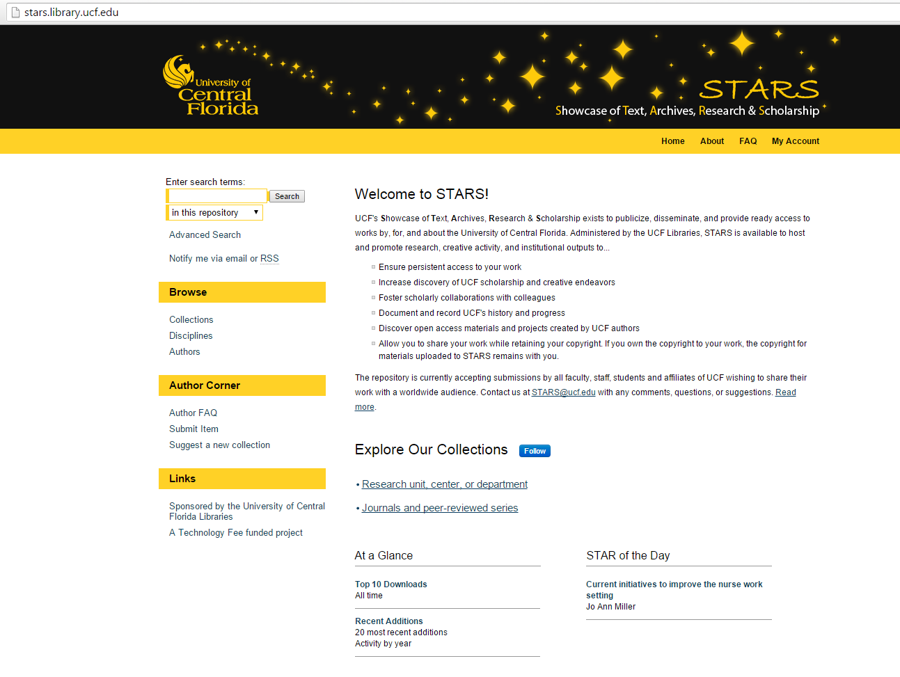
http://stars.library.ucf.edu/

Slide 3
About STARS
UCF's Showcase of Text, Archives, Research & Scholarship
The purpose of STARS is to disseminate, publicize, and share works by, for, and about UCF. The intention is to provide access to this work as broadly as possible, and for as long as possible.

Slide 4
Why STARS?
  Ensure persistent access to your work
  Increase discovery of UCF scholarship and creative endeavors
  Foster scholarly collaborations with colleagues
  Document and record UCF's history and progress
  Discover open access materials and projects created by UCF authors
  Allow you to share your work while retaining your copyright. If you own the copyright to your work, the copyright for materials uploaded to STARS remains with you.

Slide 5
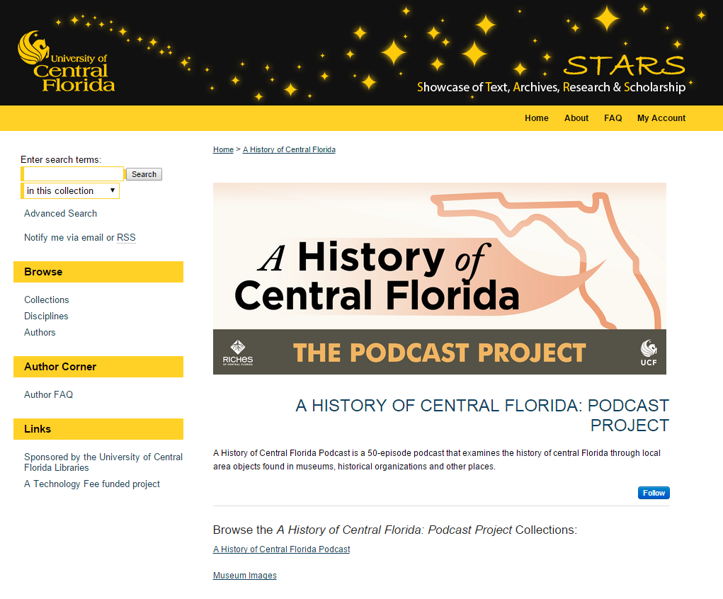
Digital Projects!
http://stars.library.ucf.edu/ahistoryofcentralflorida/

Slide 6
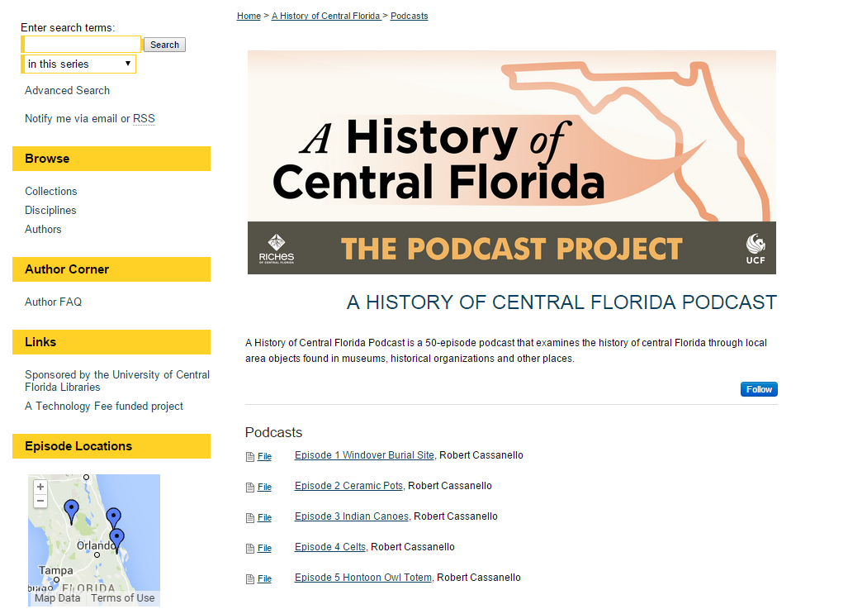

Slide 7
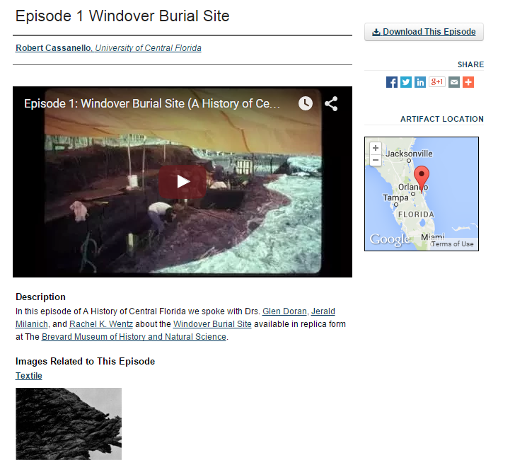

Slide 8
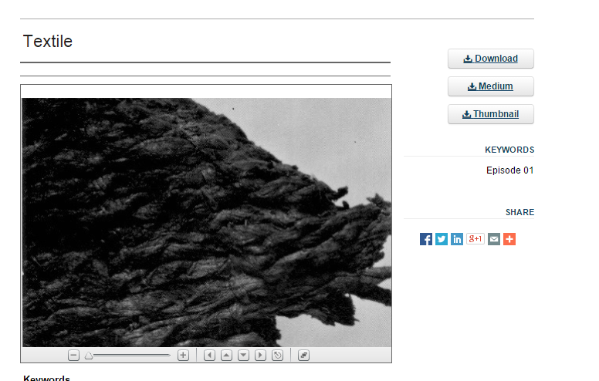

Slide 9
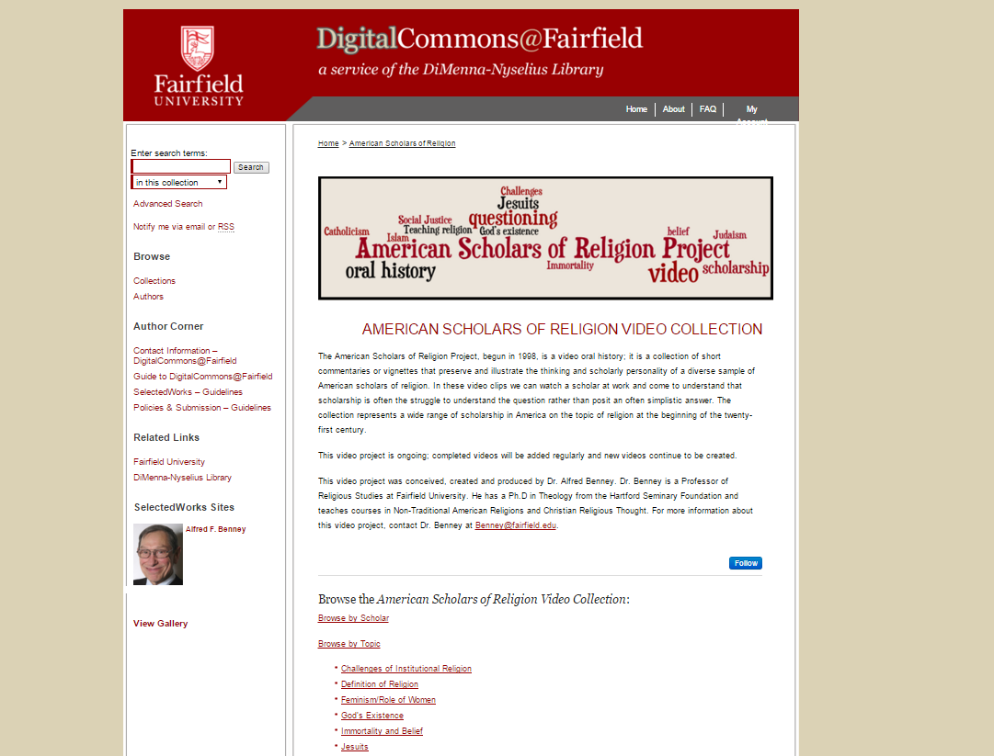
http://digitalcommons.fairfield.edu/americanscholarsreligion/

Slide 10
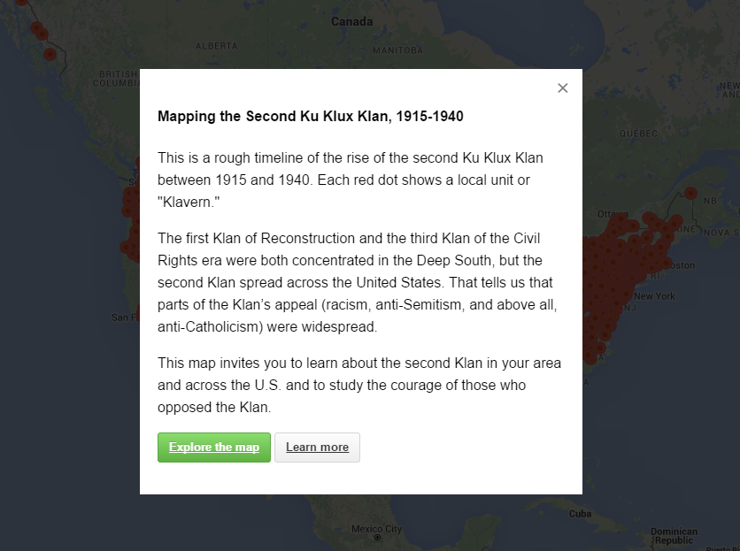
http://labs.library.vcu.edu/klan/

Slide 11
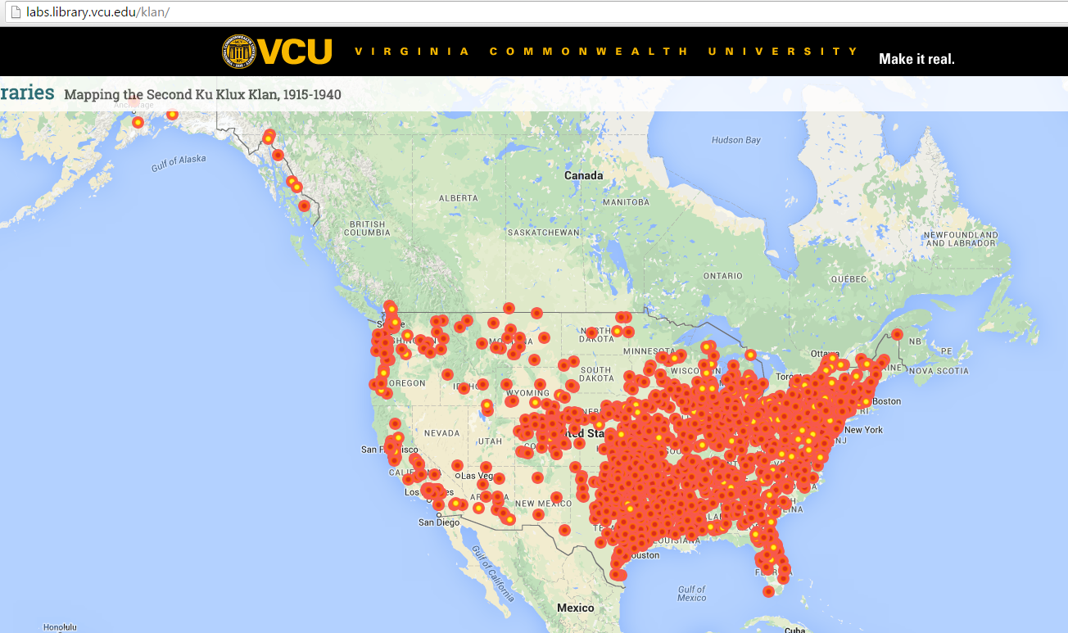

Slide 12
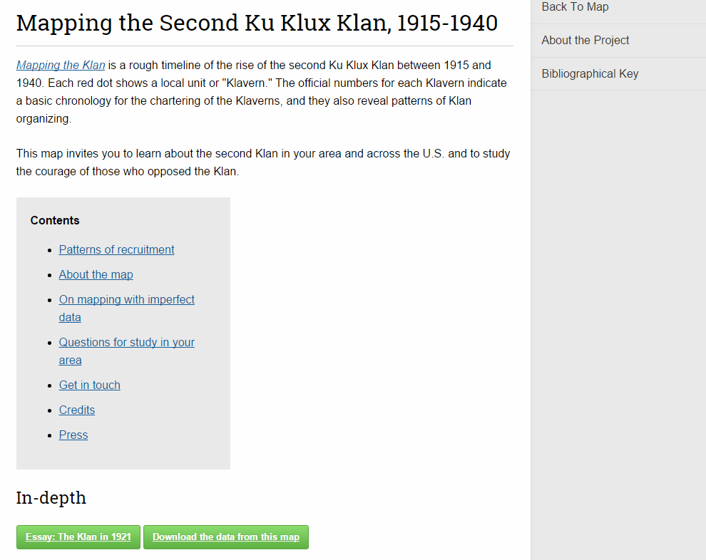

Slide 13
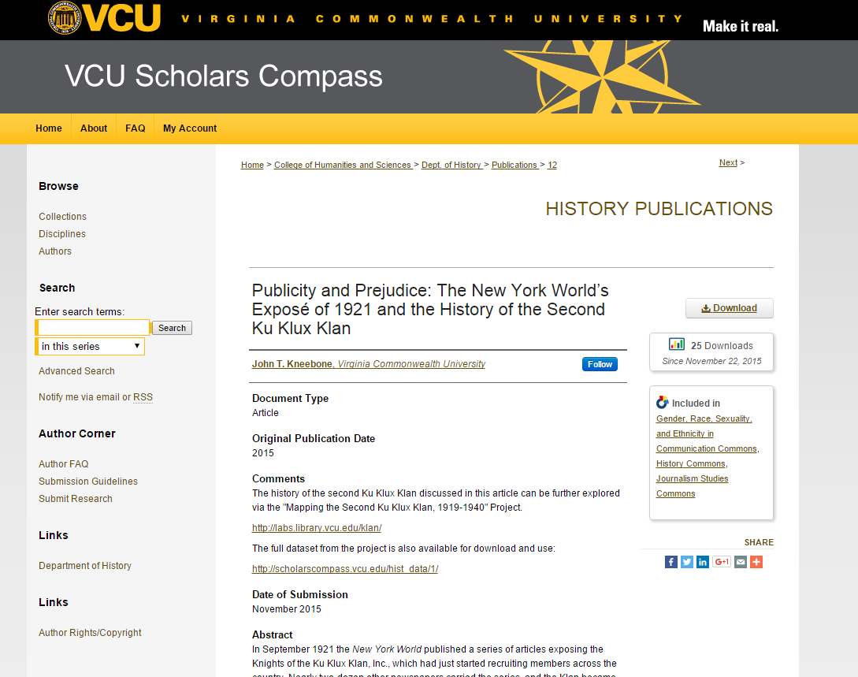

Slide 14
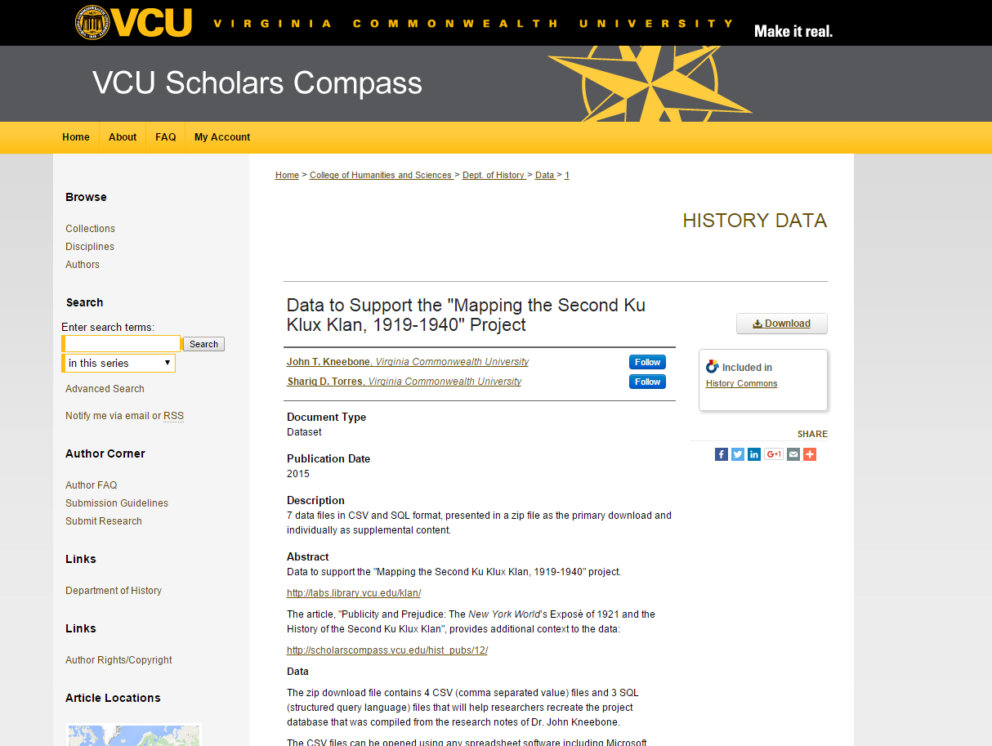

Slide 15
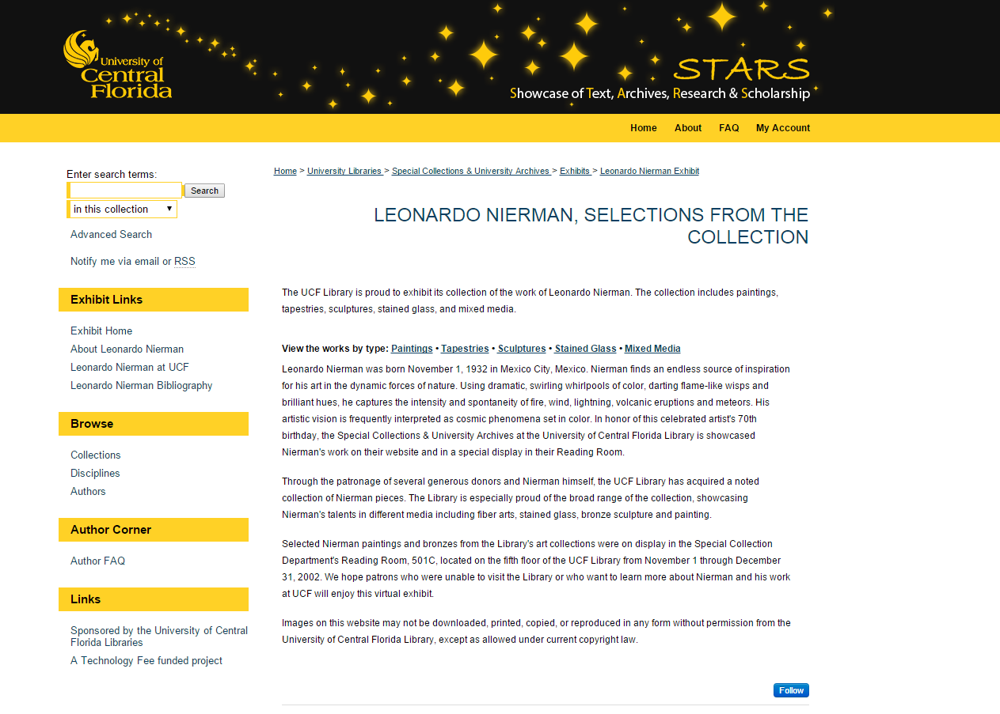

Slide 16
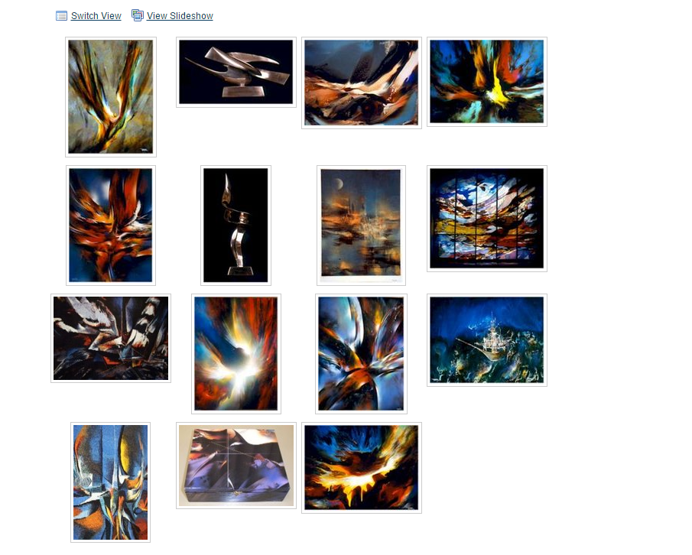

Slide 17
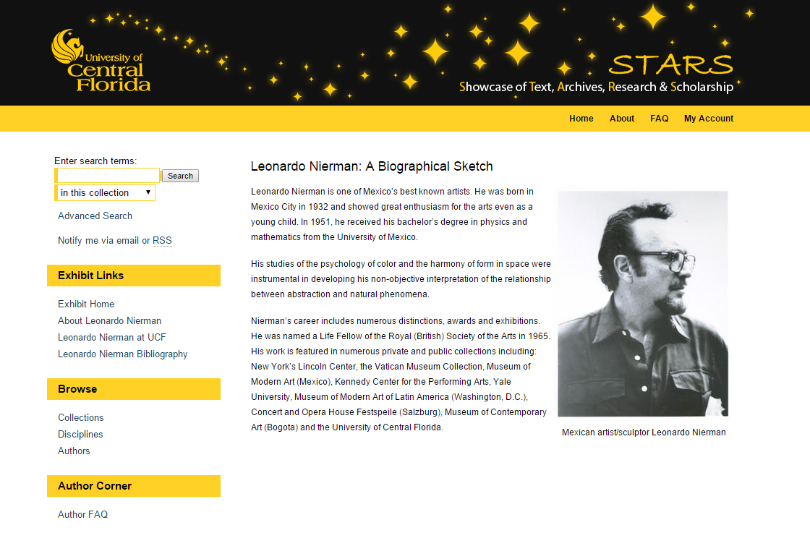

Slide 18
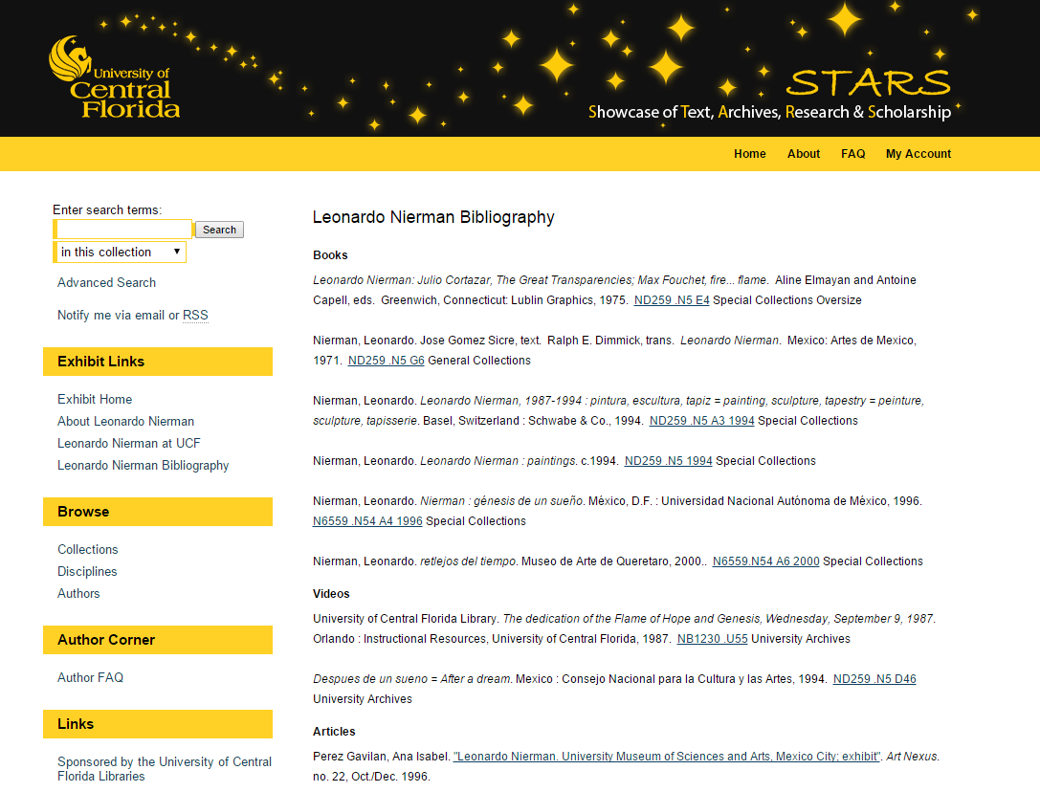

Slide 19
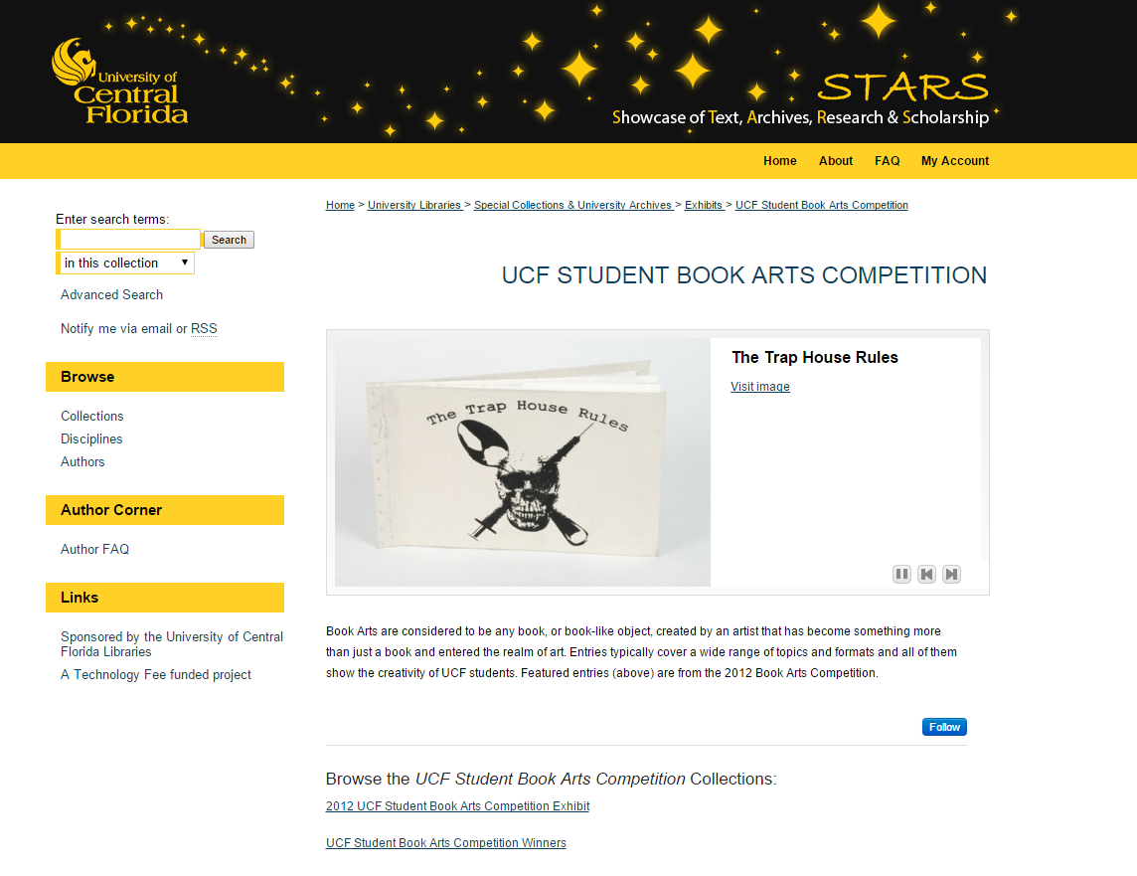

Slide 20
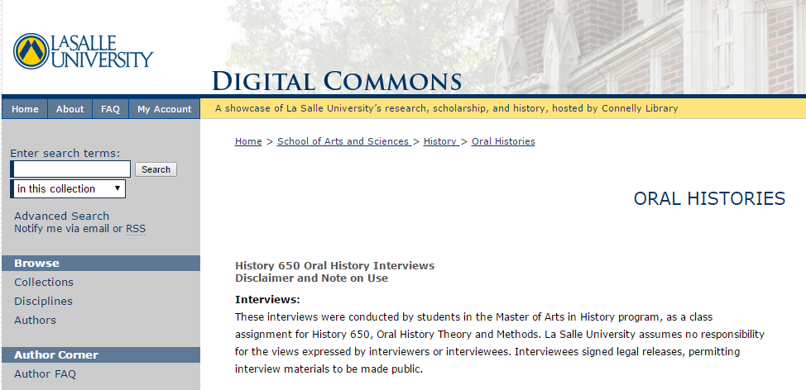
Oral Histories
http://digitalcommons.lasalle.edu/histdeptoh/

Slide 21
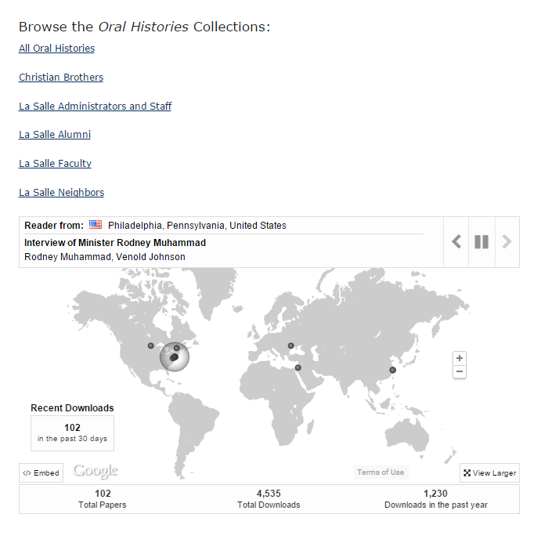

Slide 22
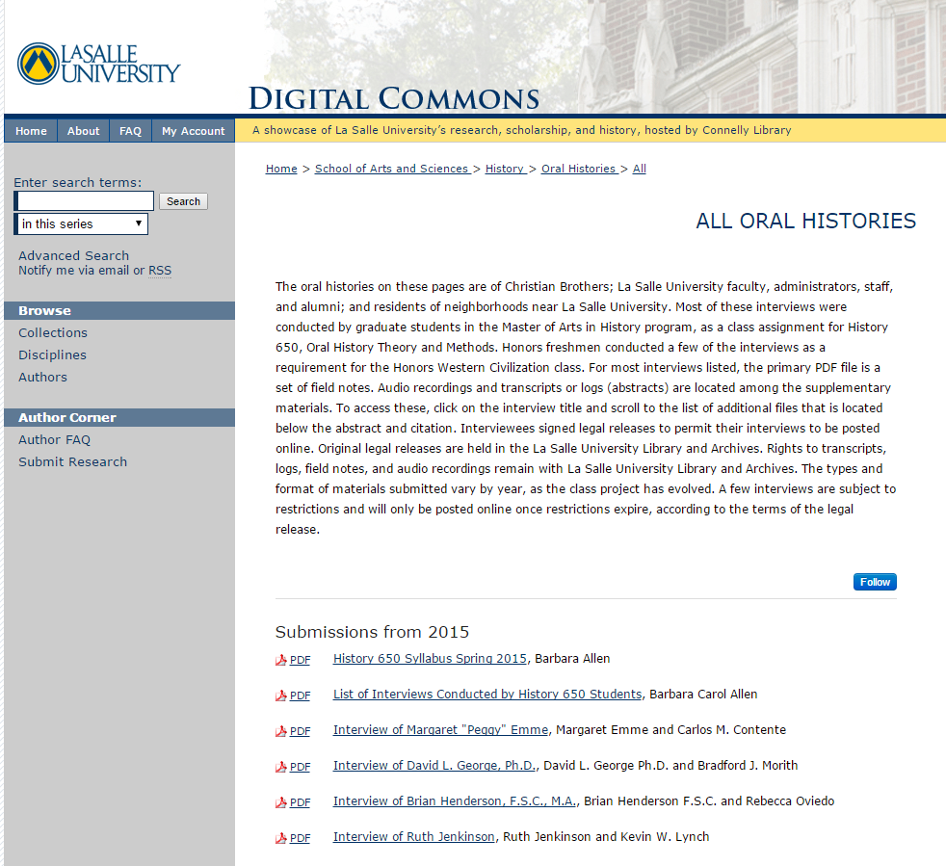

Slide 23
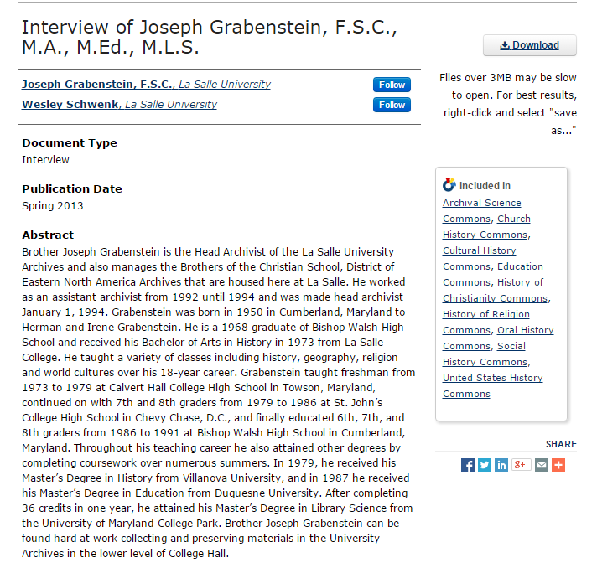

Slide 24
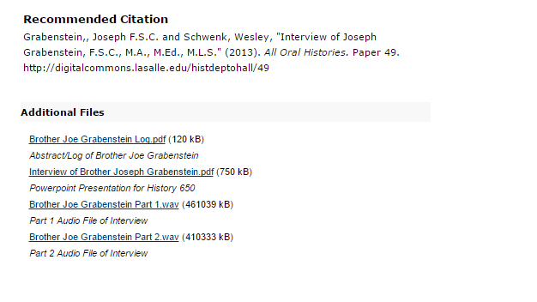

Slide 25
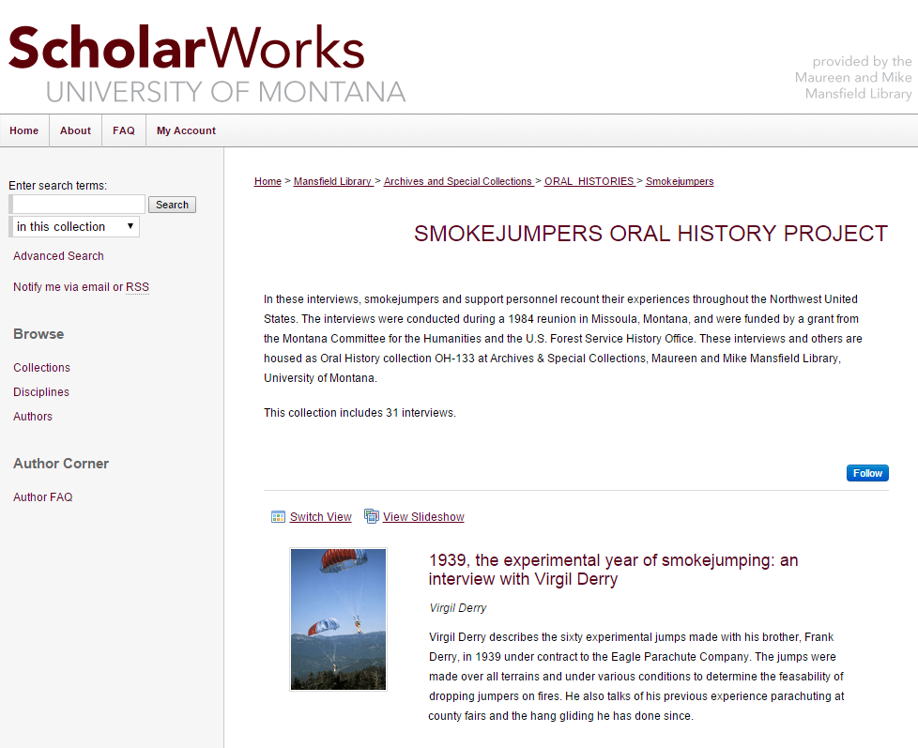
http://scholarworks.umt.edu/smokejumpers/

Slide 26
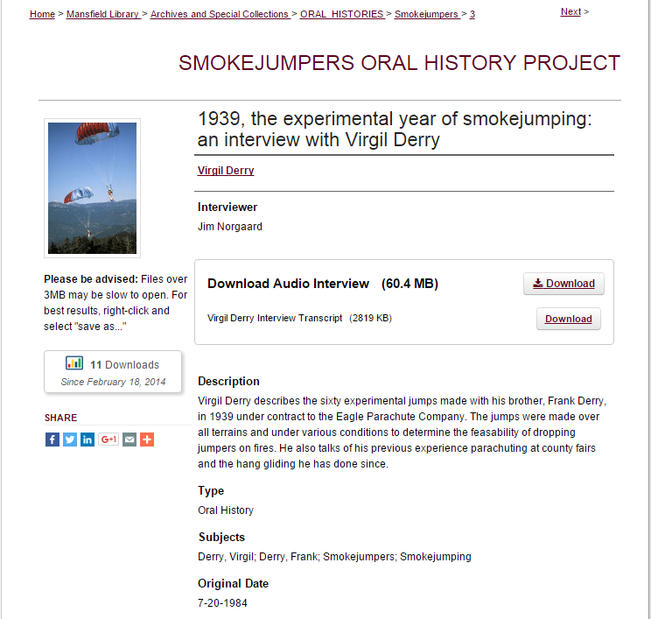

Slide 27
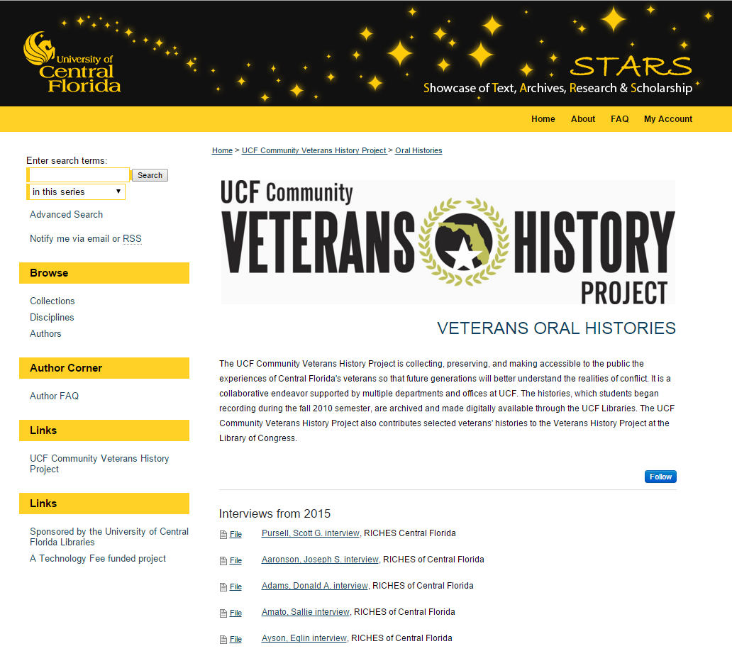

Slide 28
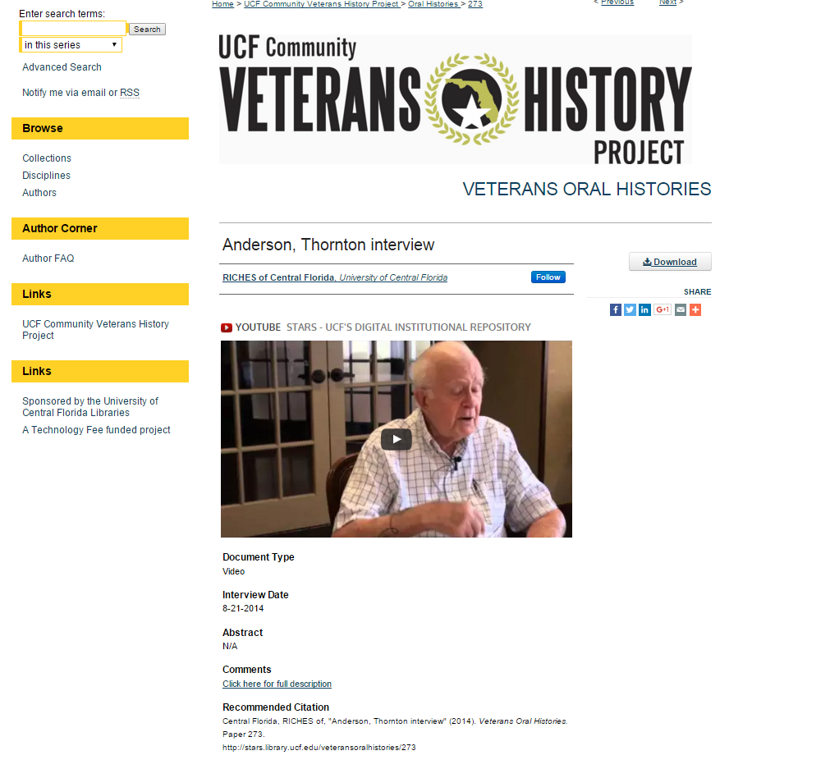

Slide 29
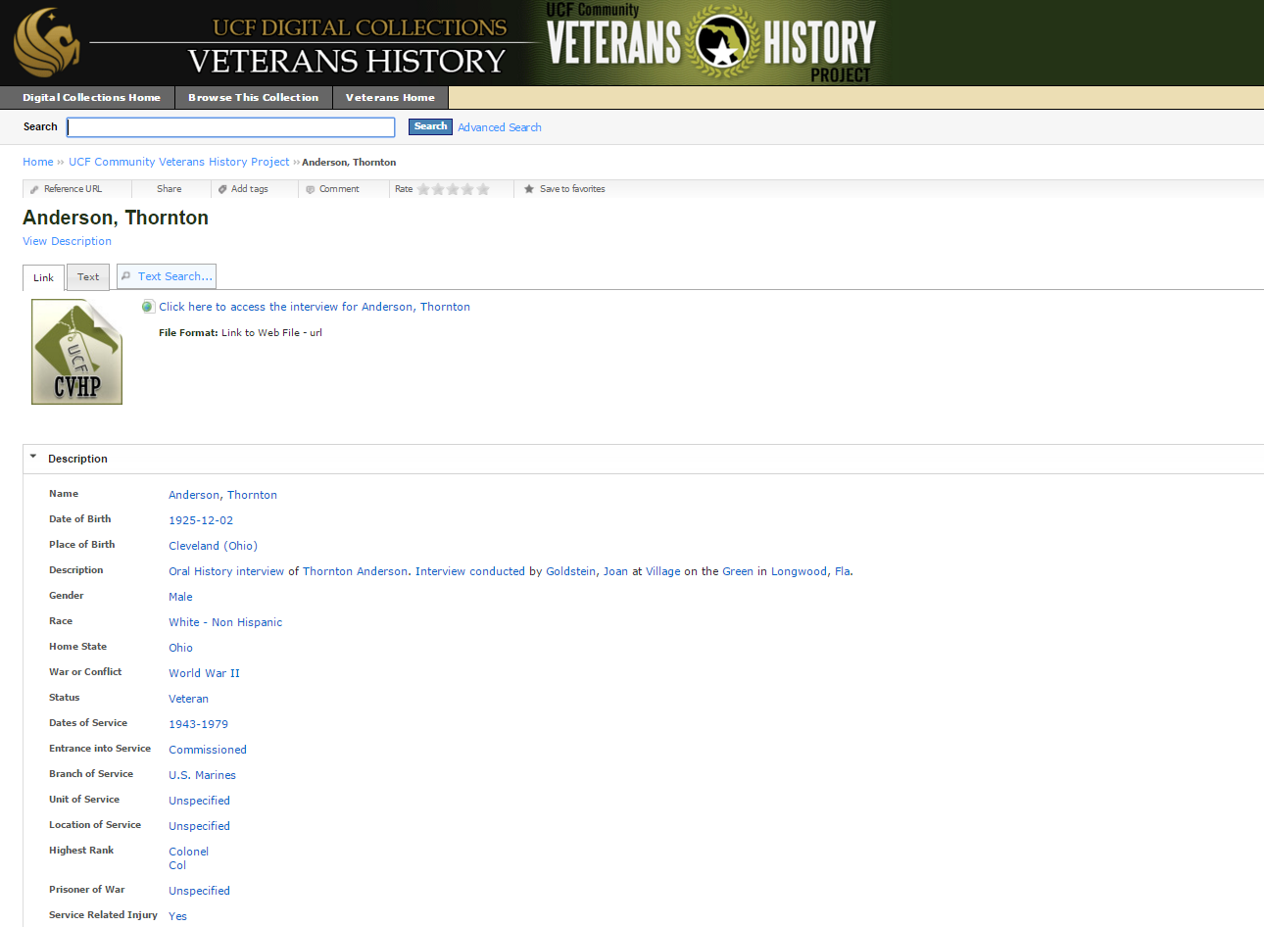
http://digitalcollections.net.ucf.edu/cdm/ref/collection/VET/id/444

Slide 30
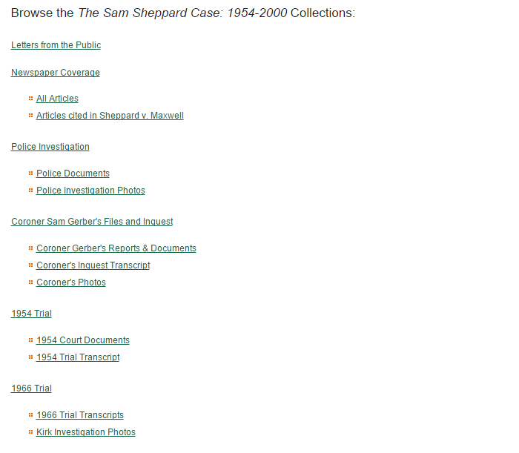
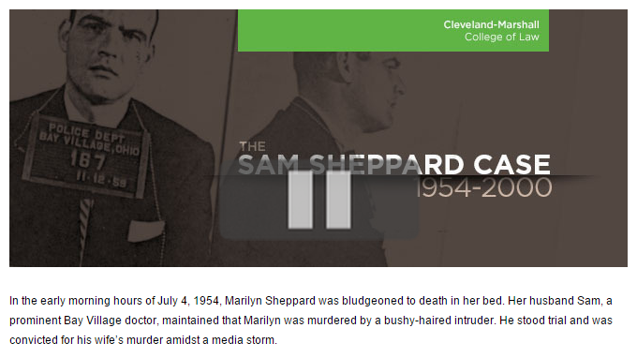
Special Collections
http://engagedscholarship.csuohio.edu/sheppard/

Slide 31
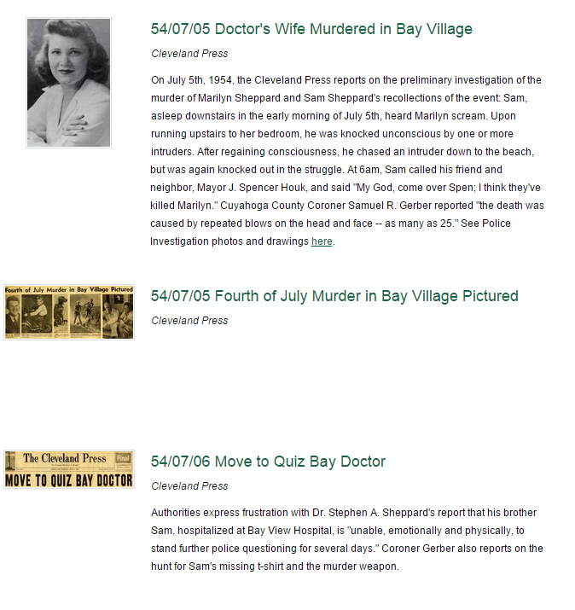

Slide 32
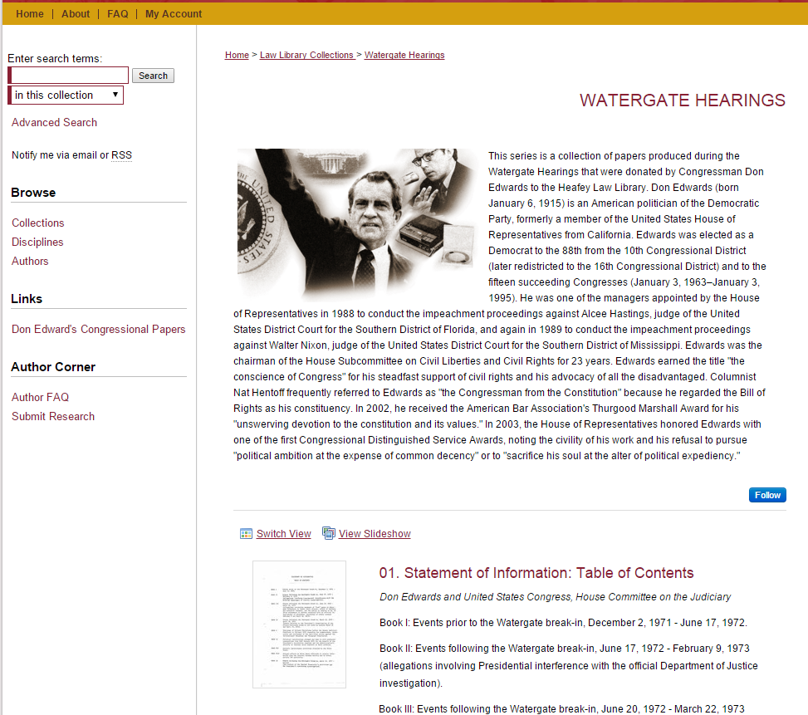
http://digitalcommons.law.scu.edu/watergate/

Slide 33
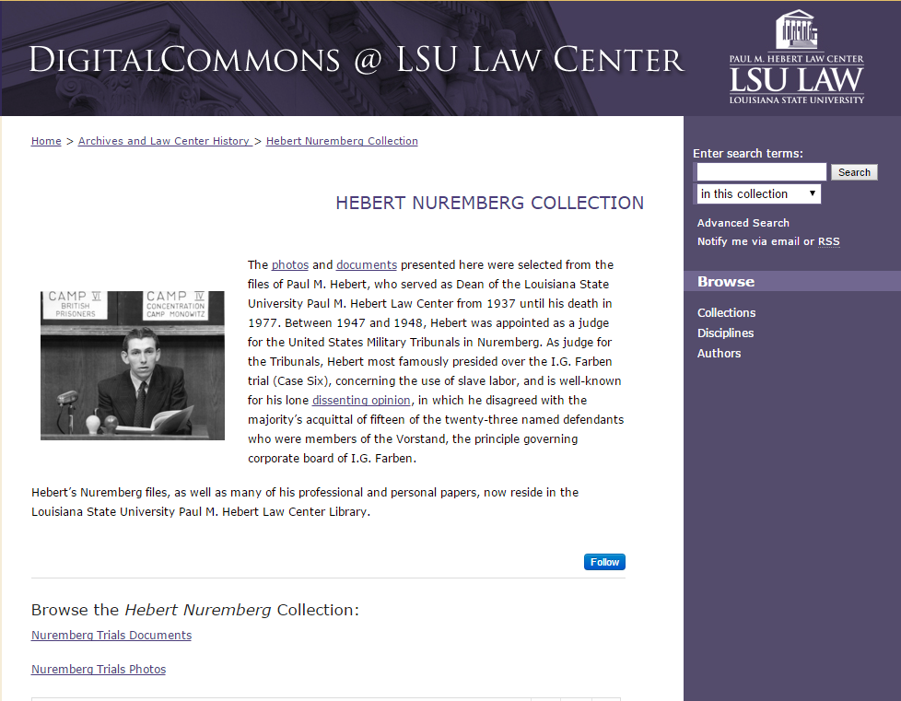
http://digitalcommons.law.lsu.edu/nuremberg/

Slide 34
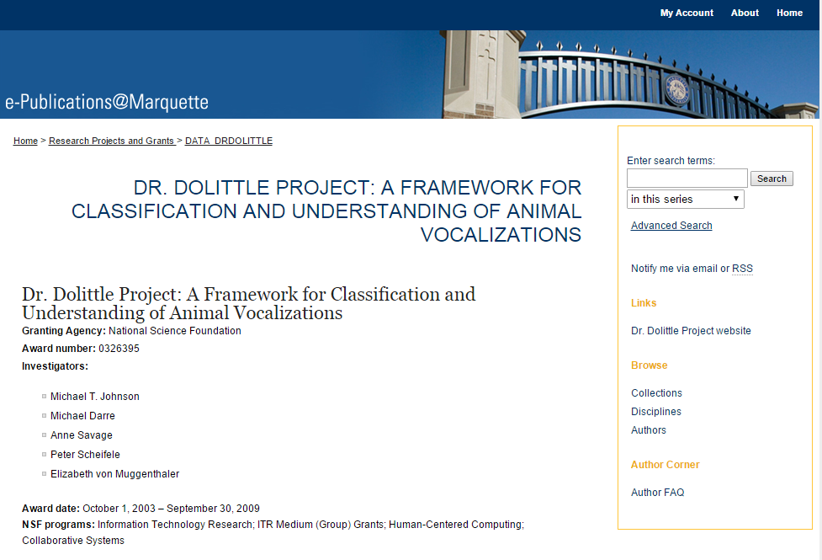
Research
http://epublications.marquette.edu/data_drdolittle/

Slide 35
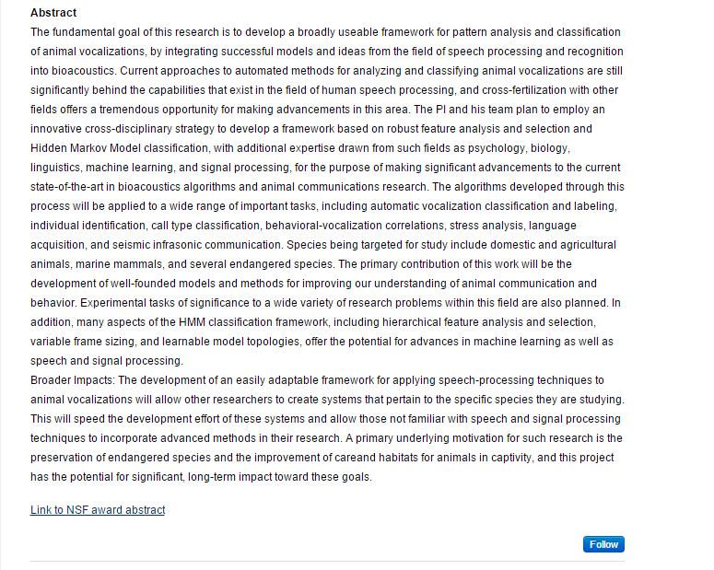

Slide 36
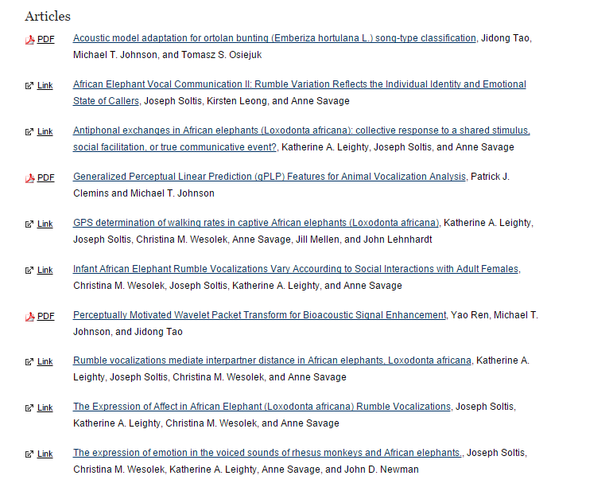

Slide 37
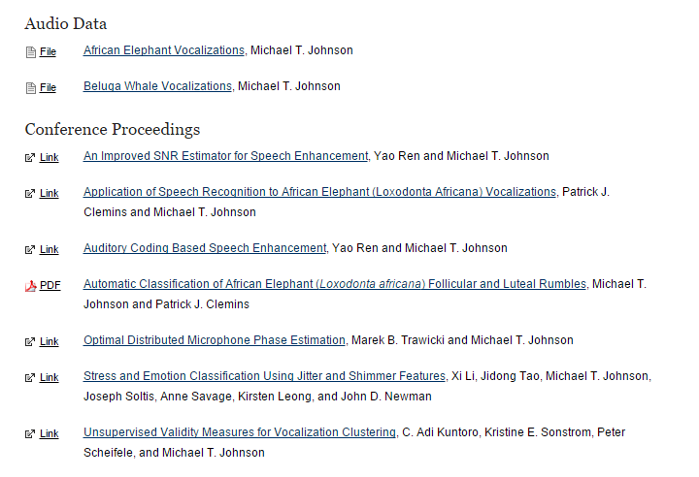

Slide 38
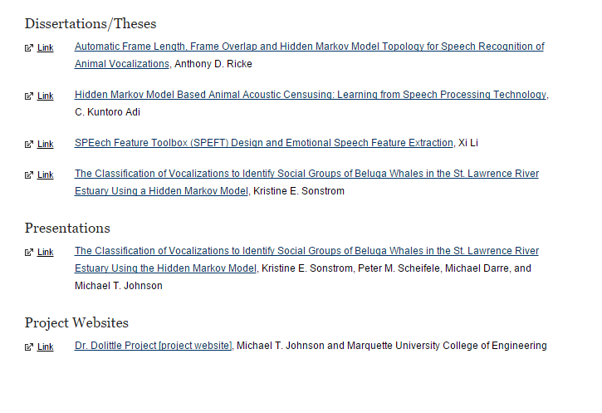

Slide 39
Join Us!
The repository is open to all faculty, staff, students and affiliates of UCF. Any UCF college, unit, department, lab, center, or institute is eligible to join. Student submissions may be subject to approval by the STARS coordinator in conjunction with a sponsoring faculty member.

Slide 40
Ready to get STARted?

Slide 41
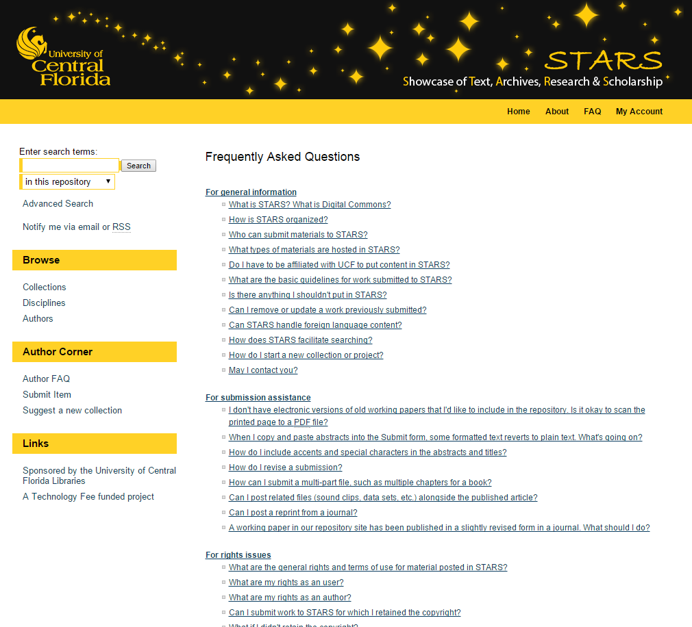

Slide 42
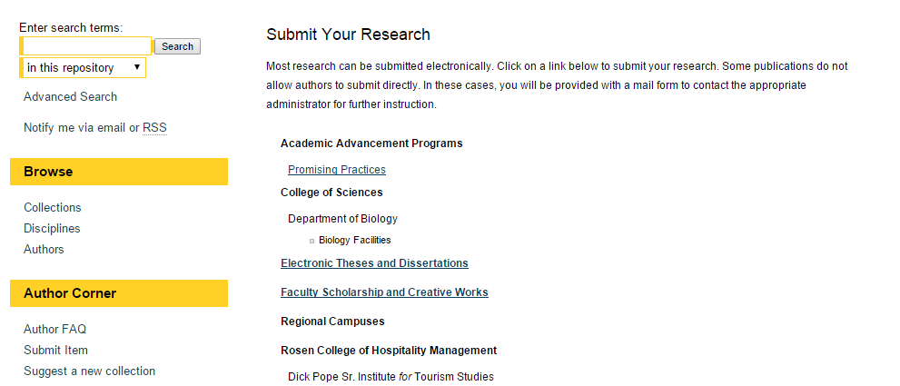

Slide 43
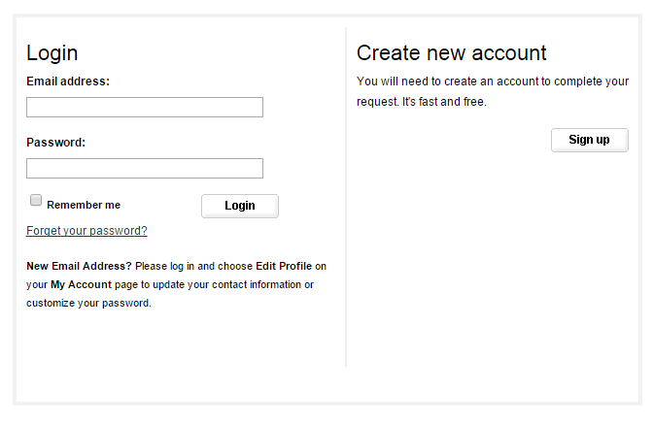

Slide 44
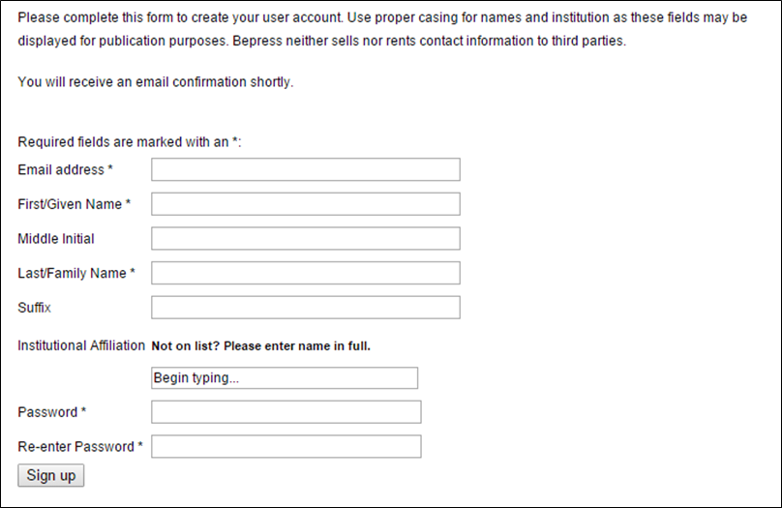

Slide 45
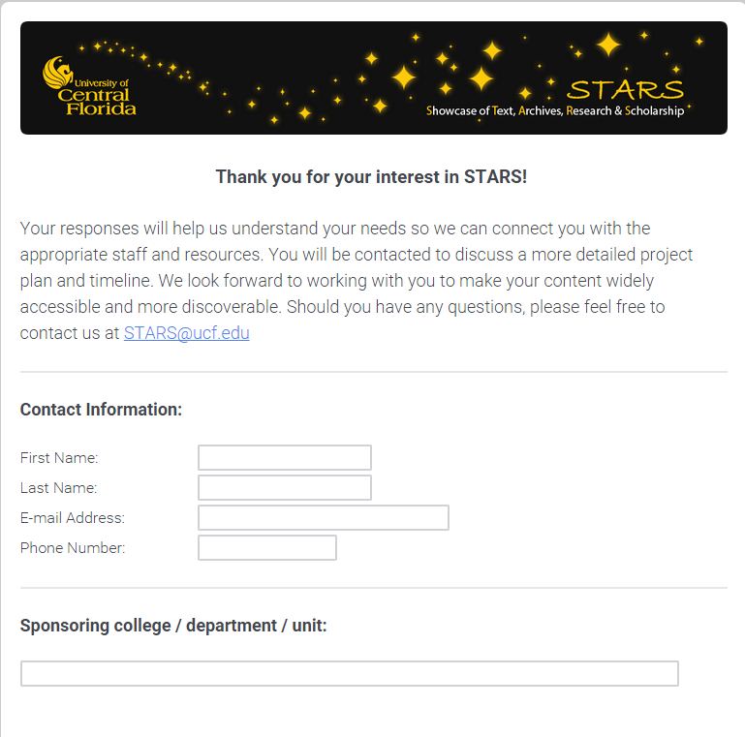

Slide 46
But wait - there's more...
To learn more about Institutional Repositories, please visit the Digital Commons IR research page at http://digitalcommons.bepress.com/repository-research/ .
More Digital Commons History Collection examples are available at http://digitalcommons.bepress.com/history/
View the 5 minute webinar to for an overview of the contents in the History Model Collection at https://vimeo.com/122680919 .
Feel free to contact us at STARS@ucf.edu with any comments, questions, or suggestions.

