Slide 1



How Hip is the Partnership?: The Value of a Generalist Journal in a Niche World
Robin Bergart, University of Guelph
Leanne Olson, Western University
Nathalie Soini, Queen’s University

Slide 2
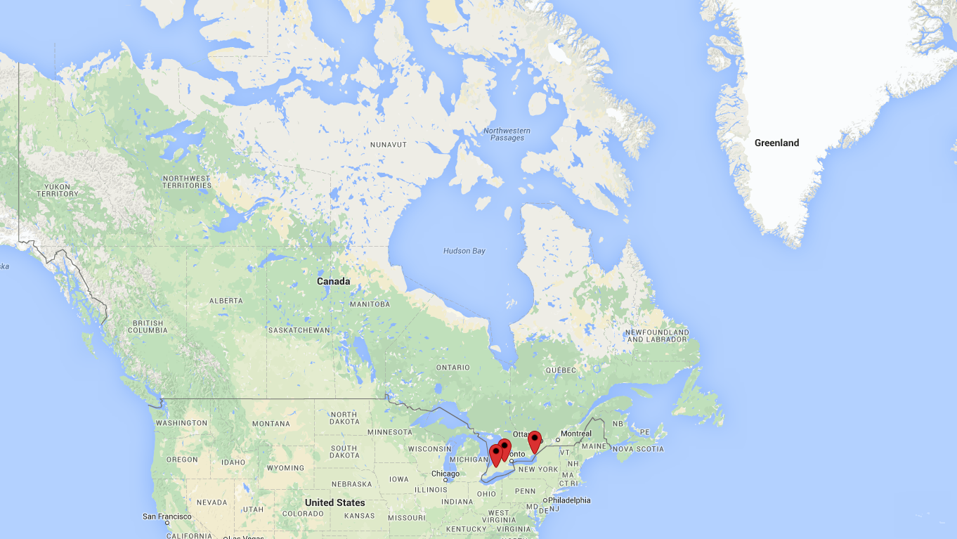
maps.google.ca

Slide 3
overview
Research questions and reason
What is the journal Partnership?
Interview insights
Preliminary survey results
  Reading & writing LIS literature
  Partnership’s role in the LIS literature community
Next steps & questions

Slide 4
Research questions
On Partnership’s 10 year anniversary, and with a new Editor-in-Chief
Where does Partnership fit into the LIS community?
What is valuable about Partnership? What is not valuable?
How do we improve the journal?
How important is a Canadian generalist journal in a globalized world?
Is it part of Partnership’s role to provide a venue for Canadian librarians who are required to publish in peer-reviewed journals, but whose work does not neatly fit into more niche publications?

Slide 5
partnership
The Canadian Journal of Library and Information Practice and Research

Slide 6
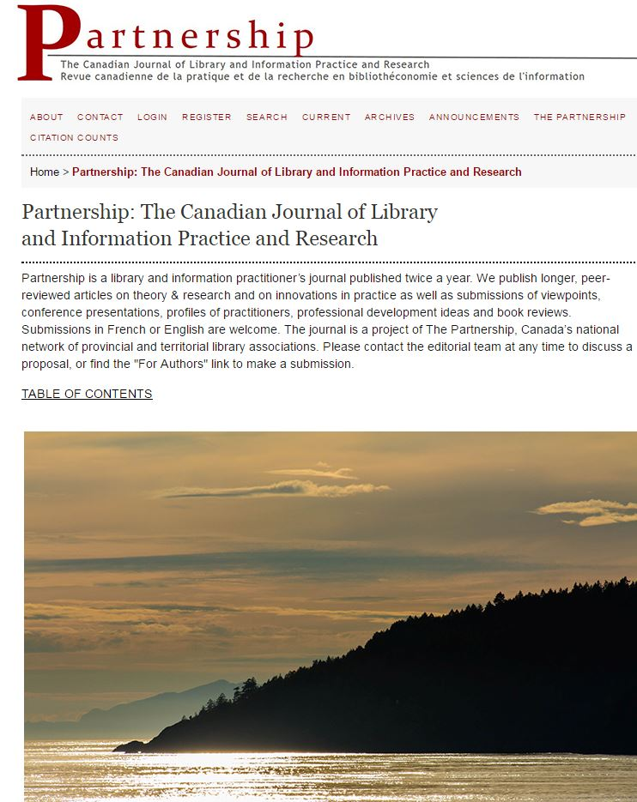
The journal
Established in 2006
Open access
Library practitioners
Every library sector, broad topics
Canadian
Notes:
How many of you have heard of the journal Partnership? How many know what the title refers to?

Slide 7
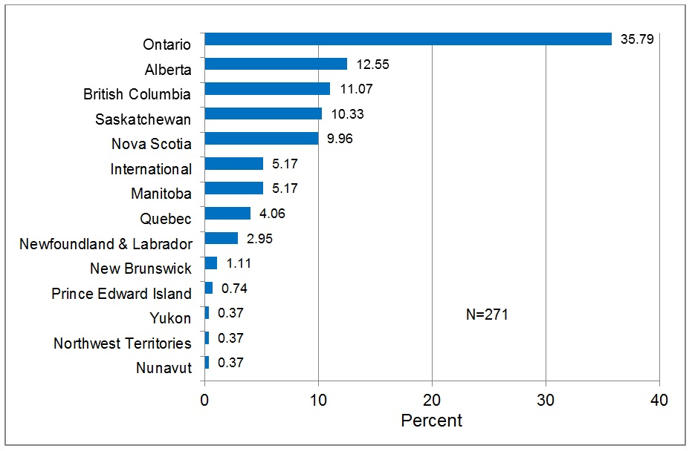
Authorship in P journal, 2006-2013

Slide 8
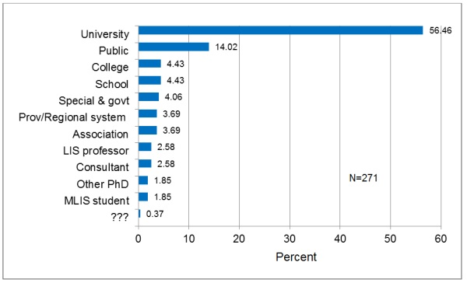
Authorship in P journal, 2006-2013

Slide 9
Most viewed articles in 2013
Web-based Citation Management Systems: Which One Is Best? | Mining Legal and Business Resources on Canadian Banking
Searching HathiTrust: Old Concepts in a New Context | Library and Information Science (LIS) Transferable Competencies
Seeing Through the Eyes of Students: Participant Observation in an Academic Library | Get Published! Straight Talk from the Editors at Partnership
Paws for a Study Break: Running an Animal-Assisted Therapy Program at the Gerstein Science Information Centre | Beyond Open Source Software: Solving Common Library Problems Using the Open Source Hardware Arduino Platform
MOOCs as a Professional Development Tool for Librarians | Book Review: Introduction to Information Science

Slide 10
Interview insights
19 Expert Interviews

Slide 11

Interview insights
19 interviews with LIS industry experts: journal editors, authors, librarians, library techs, managers, and other super-cool folks
30-60 minutes, asking about impressions of the LIS literature in general, Partnership in particular, and Canadian LIS trends
Intended to refine our survey
Conducted in early 2016
Image source: http://www.kde-look.org/content/show.php?content=14788
Notes:
Survey launched April 26, will close June 10.

Slide 12
Interview insights
How do you keep up with LIS literature?
Is Canadian content important to you?
What are the strengths and drawbacks of a generalist library journal?
What matters to you when you are choosing where to publish your work?
What words or images come to your mind when you think of the journal?
What is your sense of the journal’s reputation?
How important is it to include French language articles?
Notes:
Survey launched April 26, will close June 10.

Slide 13
Survey results
436 Responses…and Counting

Slide 14

Survey Results
426 responses to the English survey
10 responses to the French survey
http://tinyurl.com/partnership-survey-eng
Launched April 26, closing June 10
Calendar image By Mark L. Carson - http://markcarson.com/MarkCarson/Asp/SunbirdIcons.asp
Notes:
Survey launched April 26, will close June 10.

Slide 15
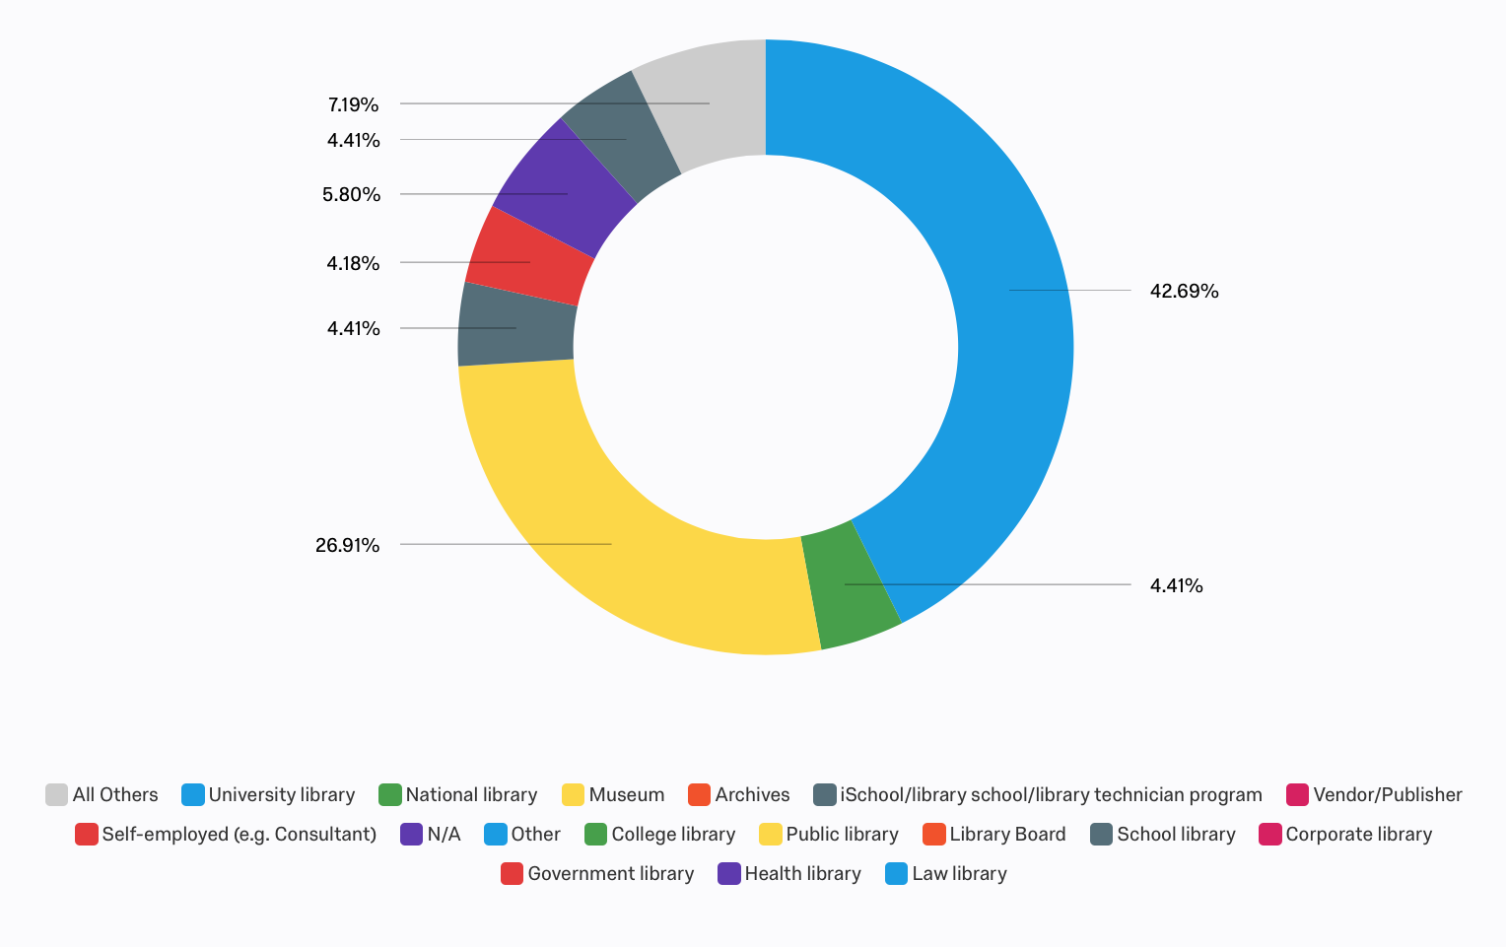
In which library sector do you work?

Slide 16
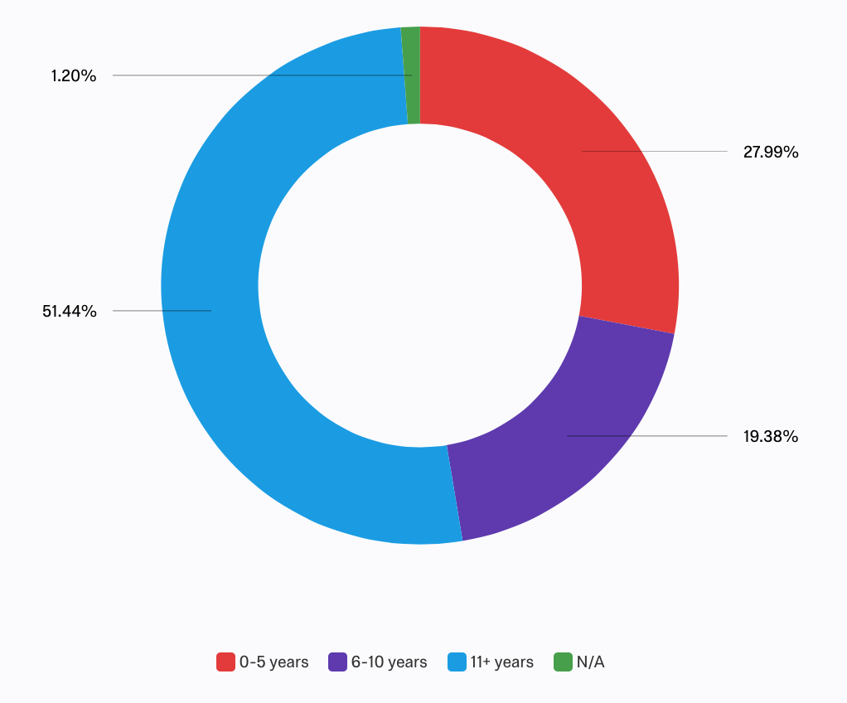
How many years have you worked in lis?

Slide 17
How often do you engage with Lis literature?
Every week 58%
A few times a month 28%
A few times a year 10%
Rarely 3%
Never 1%
Note: We define LIS literature very broadly to include non-textual information such as podcasts or YouTube.
Photo from Wikimedia Commons, author unknown

Slide 18
What types of lis literature do you read most frequently?

Slide 19
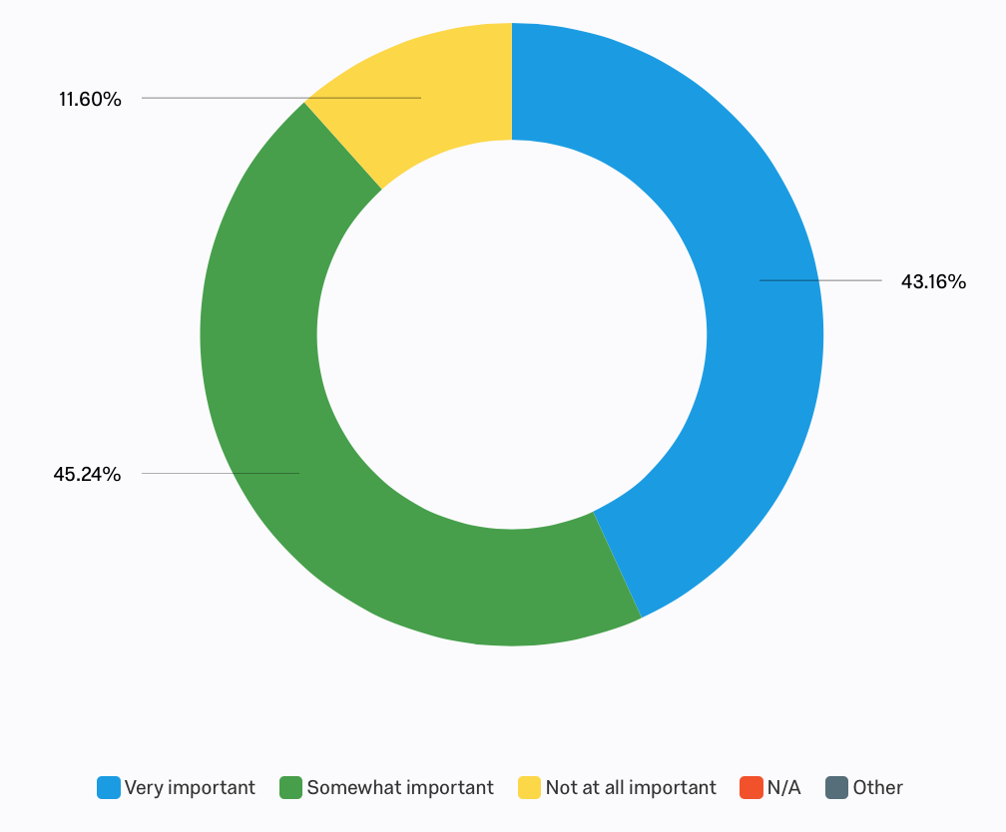
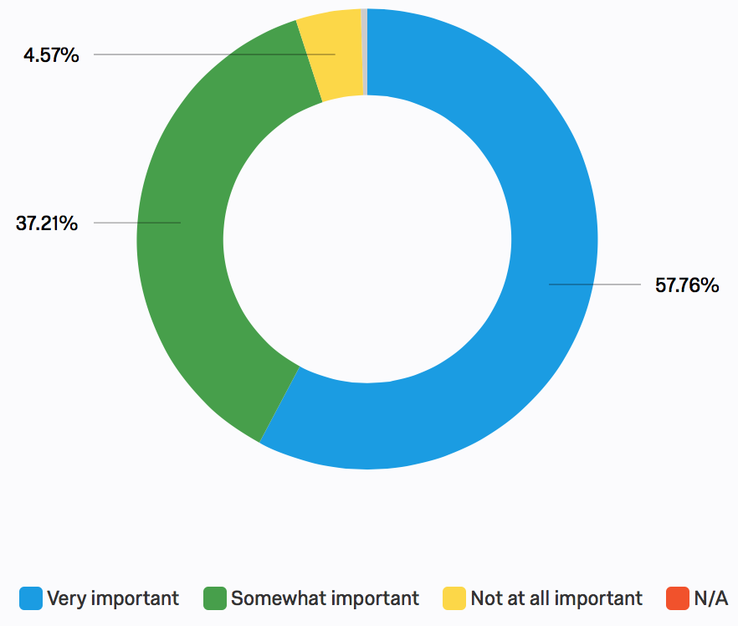
How important is it that some of the lis literature you read is…
Peer-reviewed?
Canadian?

Slide 20
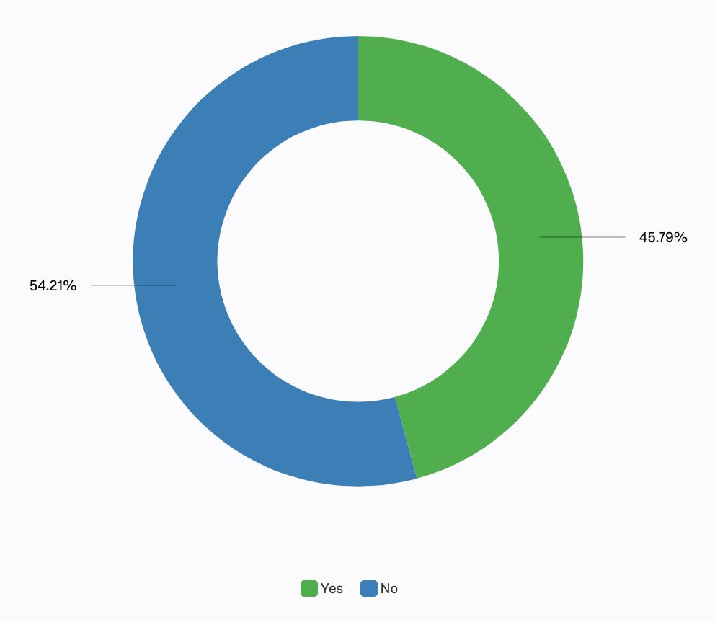
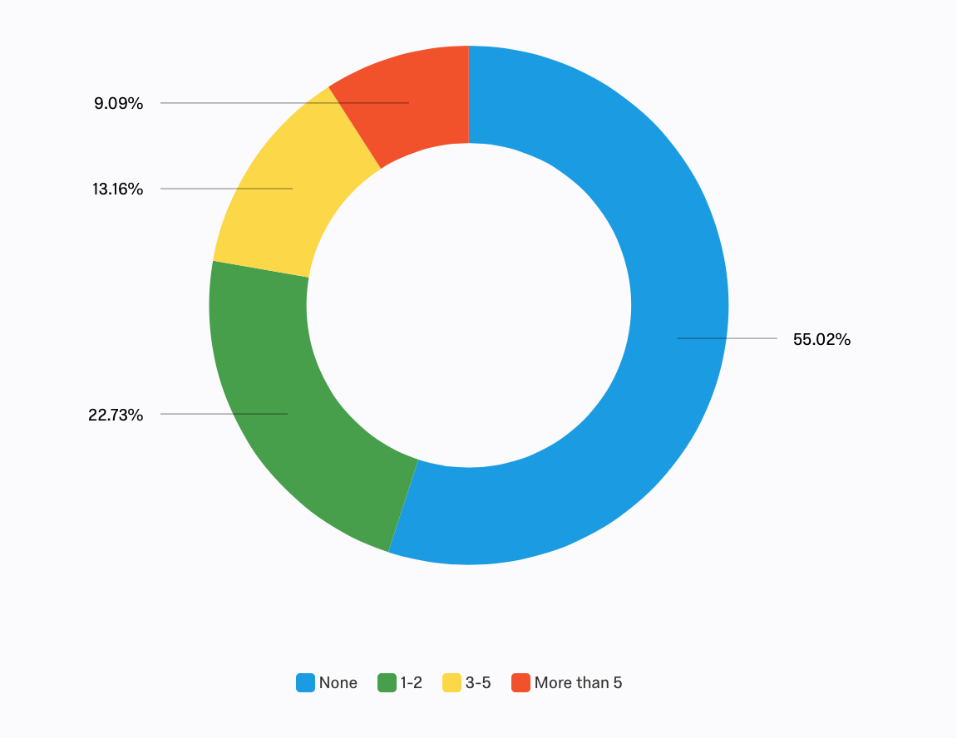
How many journal articles have you published in the past 5 years?
Have you ever submitted your writing to an lis journal?

Slide 21
Where are your preferred places to disseminate your work?
Other: Institutional repository; informal conversation

Slide 22
What do you consider when submitting an article?
The journal publishes on topics relevant to my subject area | 57.89% | 242
The reputation of the journal | 50.72% | 212
The journal publishes peer-reviewed articles | 44.02% | 184
The journal has the best audience for my writing | 44.02% | 184
The journal is open access | 43.06% | 180
The journal is Canadian | 25.12% | 105
The journal publishes articles relatively quickly | 20.33% | 85
The impact factor of the journal | 19.14% | 80
The journal has an intuitive submission process | 15.31% | 64
The journal editor invited me to submit my work | 15.31% | 64
The journal was recommended to me by someone I know | 12.92% | 54
The journal has a high acceptance rate | 8.61% | 36
The journal is international | 8.37% | 35
Other | 5.74% | 24

Slide 23
Other aspects we consider…
Focus on social justice
Cutting edge quality of research, thought provoking, innovative
Not limited by narrow perceptions of what LIS is
Transparent peer review process
Good working relationship with the editor
Supportive editor
Reputation of the editor
A journal I’ve never published in before
A journal I have published in with positive experience
Open access, pre-prints allowed to be shared
Articles are indexed, searchable
Which databases index the articles
Article length
Citation style

Slide 24
Which journals would you most like to be published in?
Partnership | 27
College and Research Libraries | 21
Evidence Based Library and Information Practice | 18
Canadian Journal of Information and Library Science | 12
Library Journal | 8
Portal | 7
Canadian Journal of Academic Librarianship | 6
Library Quarterly | 6
Journal of Documentation | 5

Slide 25
Which journals would you most like to be published in?
Others with 2-4 votes:
Journal of Radical Librarianship
Code4Lib
Progressive Librarian
Information and Organization
Service-specific journals (e.g. reference, collections)
Subject-specific journals (e.g. science, music, law, health, education)

Slide 26
The Partnership journal

Slide 27
What do you value most about the partnership journal?
Canadian content
Open access
Variety of content and perspectives
Balance between practical and theory
Quality of articles
“To be frank - not much. I don't find the articles to be of high quality, generally. I do not regularly read it. “

Slide 28
Canadian
I think I have a soft spot for it because it's Canadian and open access - I think it's a real success story for Canadian publications in librarianship
It covers Canadian topics or Canadian slants on topics that would not necessarily be considered in international journals.
That it's Canadian which is important because the US environment (especially in academic libraries) is very different. So I feel like the content of the Canadian articles are more relevant and applicable to where I work.

Slide 29
variety
Opportunity for exposure to aspects of librarianship that I wouldn't come across in the typical course of my job.
I'm an independent contractor wearing a lot of different library hats and I like reading about different sectors and aspects of library work and services.
Its mix of research and practice literature. As an LIS faculty member I'm primarily reading both kinds of literature for my research and for my teaching. I turn to Partnership a fair bit both for my teaching, both for the topics covered and to provide exemplars of the kinds of writing possibilities they might encounter in practice.
I don't care for the journal. Too many journals are fragmenting limited LIS research across too many publications

Slide 30
Open access
As a professional employed in a peripheral field (i.e. no access to campus resources), the journal is a fantastic starting point for my research.
I work at a small institution and cannot afford to subscribe to LIS databases with our limited collections budget.
This is a model that I think ALL journals, regardless of discipline, should follow.
I appreciate that it is an open access journal so that all the articles are freely available for my friends to read. This means that many of us can discuss the article through social media platforms.

Slide 31
Open to beginners
I find the submission and publication process very supportive.
It is a great vehicle for academic librarians to start their publishing careers.
[T]he submission experience was so positive and supportive, and I came away from that experience feeling like the people who run the journal really care about it and their authors and reviewers.
I thought that the Partnership Journal was originally designed to mentor writers to a publication. However the last one I sent in was rejected outright, with no suggestions for perhaps placing it in another part of the journal or developing it in any way. Not helpful.

Slide 32
What do you think would make the partnership journal better?
Higher quality articles, more serious slant, more research articles
More practical pieces
Publish more frequently
More rigorous peer review; Abandon peer review
Marketing and outreach, more visibility,
A better name
Improve website, submissions process, indexing
Download stats for authors
Themed issues, rotating editors
More content specific to Canada
A tighter focus

Slide 33
Next steps

Slide 34
Contact:
Leanne Olson – lolson3@uwo.ca http://tinyurl.com/partnership-survey-eng

Slide 35
How Hip is the Partnership?: The Value of a Generalist Journal in a Niche World
Robin Bergart, University of Guelph
Leanne Olson, Western University
Nathalie Soini, Queen’s University

