Slide 1
Elevating Access
Transitioning from OCLC discovery to EDS health
Tiffney Gipson, Head of Collections, University of Louisville
Lauren Robinson, Medicine Liaison Librarian, University of Kentucky

Slide 2
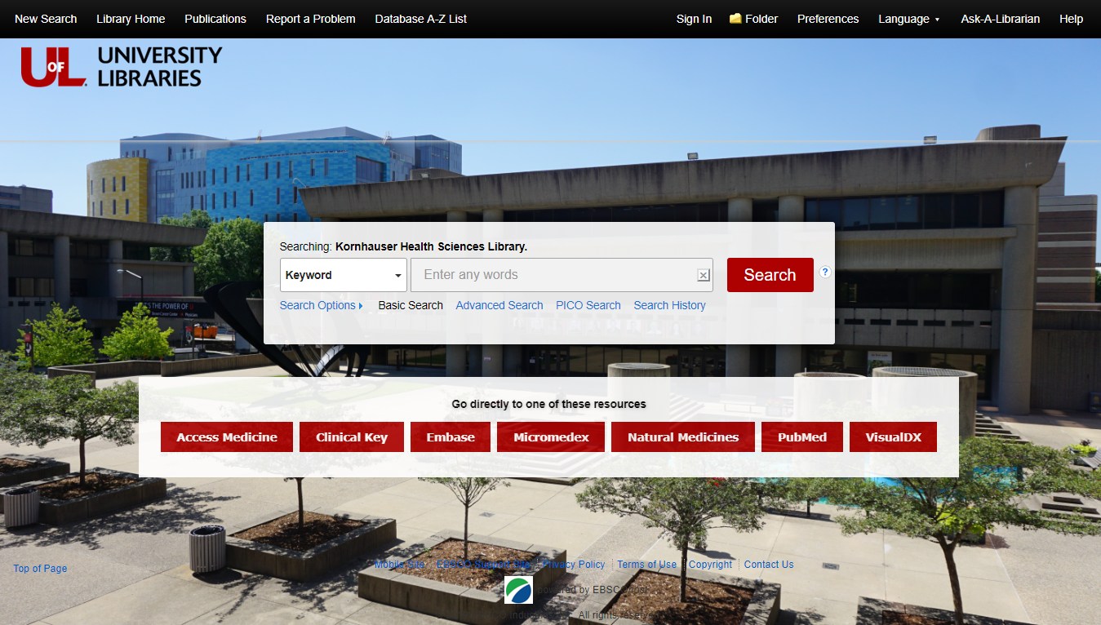
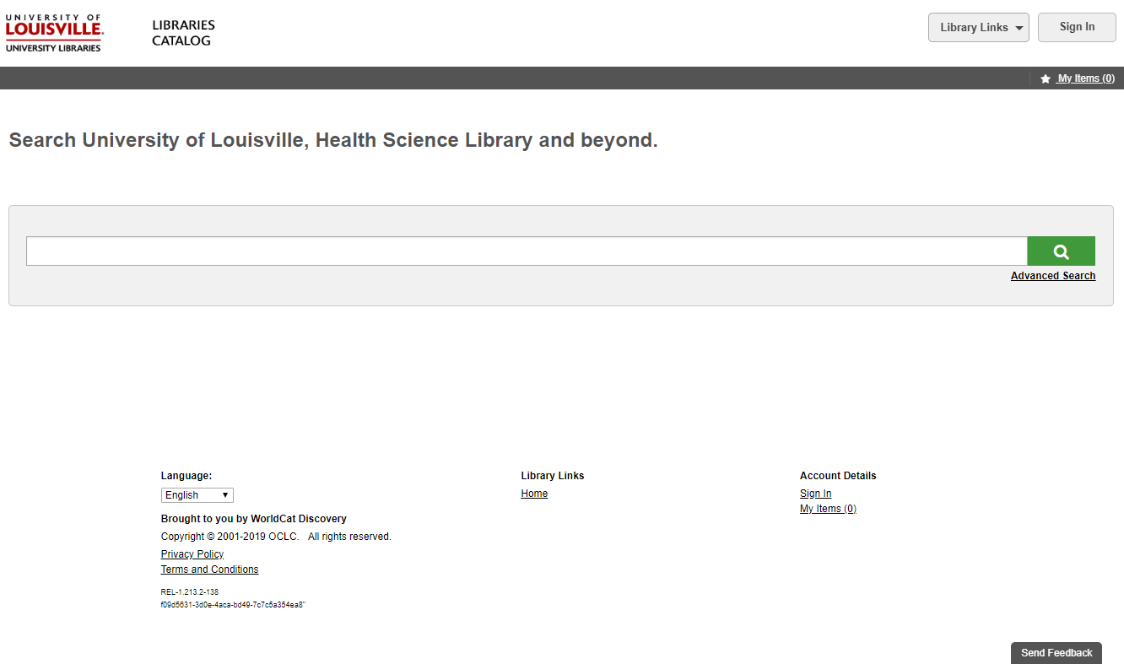
Background
Five years ago, the University of Louisville Libraries converted from Voyager to OCLC Discovery
Since the conversion to OCLC Discovery, library staff and patrons have complained about access issues. In a survey conducted among library patrons in the past year, there were over 70 complaints related to access

Slide 3
Is It Access or Collections?
Increase access to higher impact journals or more disciplined journals.
Increase number of journals available without having to go through inter library loan
Some of the articles I look up are not available through the online catalog, and sometimes, when it says that it is, it takes me to the journal and I have to look for the PDF through the Journal's website.
Access to more impactful journals in science ie Nature Microbiology
Obtaining articles on line is very problematic. Frequently I am unable to access a journal to read or copy an article which compromises patient care.
Librarians are really helpful in answering questions regarding journal searches. Logging on to the online database off site is difficult.
72
There are many journals of interest that the library does not subscribe to that would be helpful. Neurology is one of those and there are several others in the neurosciences.
We need more access to digital books. Especially for the students taking distance–learning or on–line courses. The University needs to invest in offer greater accessability to online format. I have had several instances in which I need a book and it is available digitally but UL does not grant access to the digital copy. So then I have to use ILL to get the books that I need. This is an
Improve the library's website. We should be easily able to search for journal articles by PubMedID or DOI. Finding that search ability is cumbersome which is shameful for any true research institution. It's also tedious to try and find current information on specific diseases using the access medicine database.
There are some pretty high impact online journals that we do not have access to such as cell host and microbe that would be super beneficial to my department.
WE MUST HAVE ACCESS THE e–COLLECTIONS; LIMITING e–COLLECTIONS WILL SUPPRESS RESEARCH.
It would be nice to have access to more online journals instead of having to wait for inter library loan
Journal collections inadequate for a real research university.
Journal collections inadequate for a real research university.
Increase access to additional journals

Slide 4

Transitioning to EDS Health
 | EDS Health | OVID Discovery
Price under $15,000 for annual subscription
Trial
Development Time | 12 weeks | N/A
Maintenance
Age of Product | 6 years | Brand New
Evaluating Products
Attracting Buy In and Securing Funding
Addressing challenges of transitioning between discovery platforms

Slide 5
Future Planning
Patrons can test EDS Health and provide feedback on a form through May 31, 2019
June 3 – 14 Feedback from Survey will be analyzed
June 17 Kornhauser Library will fully replace OCLC Discovery with EDS Health
January 2020 – 6 month evaluation of usage will be conducted
June 2020 – 1 year evaluation of usage will be conducted

