Slide 1
Developing a New MARC Load Profile and Process to Streamline Record Creation
Brandon Walker, Cleveland State University
Lauren Marshall, John Carroll University
Notes:
(Introduce selves) We will discuss the evaluation of our cataloging workflow, development of a new load profile with the goal of streamlining that workflow, the collaborative process between technical services and systems, and the outcomes of our project.

Slide 2
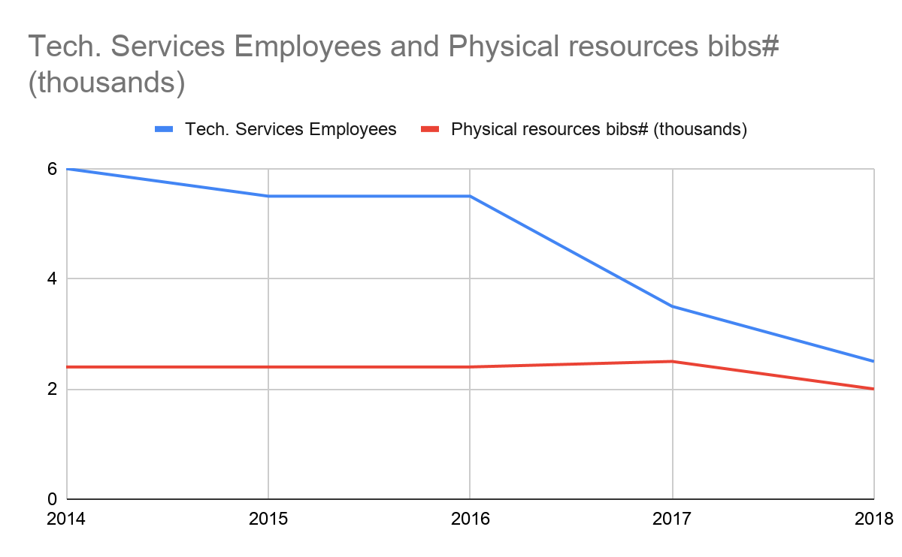
Background
We need a new workflow!
Notes:
Similar to many institutions, our department had been experiencing a drop in staffing, but pretty much steady workload in terms of the acquisitions, cataloging, and processing of physical items. A similar pattern existed in our student employee hours. By 2018, this had reached a critical level. Even though we periodically review our workflows, and had made tweaks to improve efficiency and eliminate steps that no longer seemed useful, we needed to make some more drastic changes in order to continue moving items through to circulation in a timely manner.

Slide 3
Old Process
Use paper slip info to look up item by bib#, create item record in Sierra, attach barcode, print spine label
Catalog in OCLC, apply constant data (below), export with .bo (bib and order) load profile into Sierra
Write down bib# and item information on a paper slip and put into book
Acquisitions receives item(s)
Give to cataloger
Give to student
Give to circulation
Check student's work
Return to cataloger
Notes:
Borrowing some ideas from the business world, we used a "Gemba walk" type process to review the workflow of item cataloging and processing to look for possible efficiencies. Gemba walks denote the action of going to see the actual process, understand the work, ask questions, and learn--in our case it basically meant hovering over the shoulder and watching and asking questions. After evaluating the cataloging process thoroughly, the step we wanted to eliminate was the writing down of information for the student to create the item record, and the rechecking of the student's work. It seemed redundant to write down something then have someone else type it in, and we found it to be the source point of a lot of errors in transcription by the students when creating the items, for example typing the wrong item type or location (affecting loan rules). We hoped to reduce errors to the point that there need for the cataloger to recheck the student's work, except during the initial training period.

Slide 4
Could it be done?
OCLC Constant Data Command Line (saved in online constant data file) added to bib record before export:
949__ *recs=bo;dflt=acqbib,acqord;ins=KathyC;vd=ybpa;co=1;c4=s;po=n; st=o;od=;rd=;fd=;ep=;bn=libj;
Could I just add another command line to the .bo command line to create the item record?
E.g. Item record command line in OCLC (does not need to reference a load table):
949_1 ǂt 0 ǂl libj ǂi xxxxxxxxxxxxx ǂs p ǂp price ǂn selector ǂc v.
Information for command lines in Sierra Manual, accessed under "Help" in Sierra:
Sierra Reference > Record Loading Basics > Using Local Fields When Downloading Records
Notes:
The process at the time used a pretty standard load table, the ".bo" load profile, to create bib with order records on export from OCLC using a 949 command line to input the bib and order record fields. I understood generally how the 949 command lines to create different types of records by accessing a load profile, in the old process the "bo" profile. And I knew we could add a stand alone command line to create an item record as well, without referencing a load table. Could we just combine those 2 command lines to create bib, order and item records? The answer: NO! Although I knew the recs=.bo part of the command accessed a load profile, but I didn't understand how that really dealt with the data. Next step was to get help from Brandon!

Slide 5
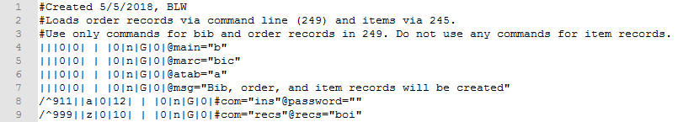
Well, could it?
That is a really great question - I really didn’t know.
So I asked on the appropriate mailing list.
It had been done. And because it had been done, That meant I could do it, too.
However, I needed to know more about loading records.
Notes:
Load profile training and the wording of the documentation seems to imply pretty strongly that you need to pick one kind of record to attach and design your profile around that. All the command and load table examples reference only bib + 1. Never is it explicitly indicated you can or can’t attach more record types. So I asked around in all the appropriate places, and it turns out it had been done. The one person had done this and was willing to share their work, but it turns out I didn’t have a full enough understanding about record loading to be able to apply it to JCU. In order to make it work for JCU, I needed to know more about JCU’s context. I needed a crash course in cataloging with Connexion.

Slide 6
Learning is a 2-way street
I needed to know more about the specific record loading context.
GENBA: 現場 = present spot; in industry, on-site
I looked over Lauren’s shoulder, asking questions and taking notes.
Copied the bib+order and bib+item load profiles to compare them.
I printed them to share with Lauren and she found a copy of the manual and started reading.
Notes:
So, Lauren already mentioned the Gemba walk. As someone with a background in IT work, I understand this concept pretty natively. I asked Lauren to show me how she loads a record from Connexion to Sierra, and I took notes and asked questions the whole way. I needed to understand her process as well as I possibly could. But I also needed to better understand load profiles, so I printed the two profiles we used for attaching order and for attaching item records and compared them, looking for similarities and differences. And Lauren helped. She may not have had the training, but she does know the record loading context better than me, and perspective is always helpful.

Slide 7
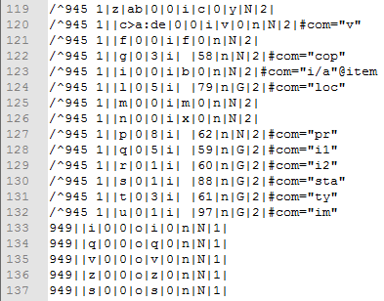
Communication is key
Compare notes
Keep the other party updated
Check in regularly to prevent progress from stagnating.
Know when to put things on hold for other priorities.
Iterative testing
  More communication at every iteration.
Notes:
One reason we were successful was due to regular communication. As we made progress we checked in and kept each other updated. We also had to be aware of our goal: to save staff time. That also means we didn’t have unlimited time to work on this. We had to be willing to put it aside to make room for the day-to-day work we were often struggling to keep up with. Communication was especially important in our testing, because one of the warnings I had been given was that my load profile most likely wouldn’t pass verification by the Sierra automated profile checker. This means I was flying a little blind, and could only assess the profile by the results, or lack thereof.

Slide 8
What we ended up with:
Load profile that creates a bib record, item record, and order record
  Bib on first pass
  Order on second pass from 949 field (commands go here)
  Item on third pass from 945 field (no commands, no template)
MARC File
3 - MARC 945
Item Record
2 - MARC 949
Order Record
1
Bib Record
Notes:
What we ultimately came up with was based off our standard bib + order profile. All the command line instructions apply to bib and order records. Templates are specified for bib and order, but not item. We kept item processing minimal, meaning all item information must be explicitly provided in the 945. It is possible we could have referenced a template, but in an effort to keep the moving parts simple and therefore reduce opportunities for problems, we did not.

Slide 9

New OCLC Constant Data for .boi Load Profile
949 _ _ *recs=boi;ov=;ins=KathyC;vd=ybpa;c4=s;co=1;po=n;br=libj;st=o;od=;rd=;
fd=100-01;ep=;bn=libj; ǂs Green
945 _1
ǂt 0 ǂl libj ǂi xxx ǂp 0 ǂs p
Notes:
Once the new load profile .boi was set up, we also needed to create the command lines for OCLC Connexion. The *recs= command points to the new .boi load profile. The cataloger enters data in the command fields (vendor, dates, locations, funds, price, selector for the order/bib line, and itype, location, barcode, price in the item). The 945 -1 line can be repeated for multi volume sets (delimiter c to enter the volume). Then we began the iterative process of trial and error, with Brandon tweaking the load profile, and me tweaking the export as needed until...

Slide 10
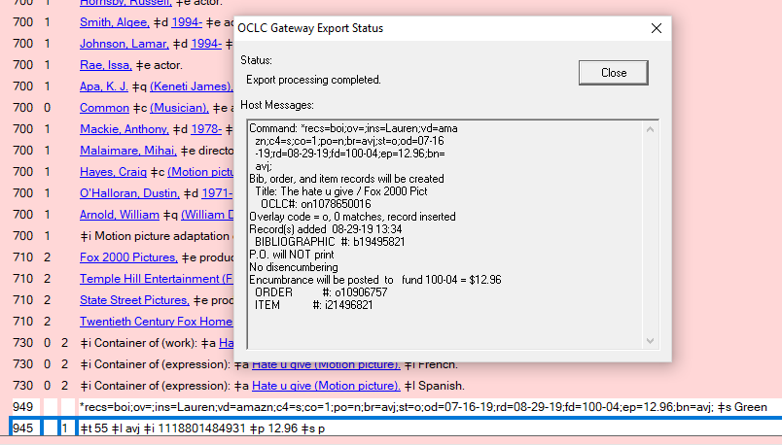

It worked!

Slide 11
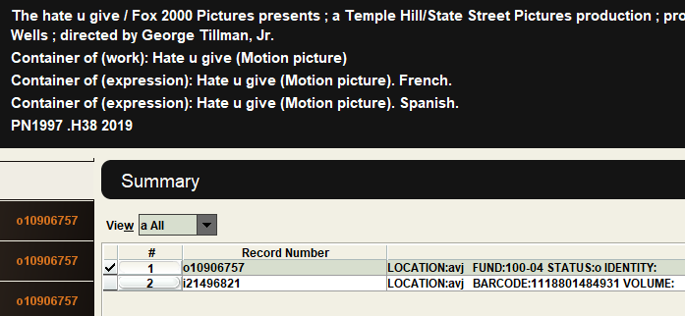
Result in Sierra: Bib, order, item created

Slide 12
New Process
Remember the old one:
Use paper slip info to look up item by bib#, create item record in Sierra, attach barcode, print spine label
Book received/ invoiced
Give to cataloger
Cataloged in OCLC and exported with .bo load profile into Sierra
Write down item information on a paper slip and put into book
Give to student
Give to circulation
Check student's work
Return to cataloger
Look up item by scanning barcode, print spine label
Book received/ invoiced
Give to cataloger
Cataloged in OCLC and exported with new .boi load profile into Sierra
Give to student
Give to circulation
Notes:
Once Brandon had created the new .boi load profile, and we had it working, the new workflow for cataloging and processing physical items looked like this! Fewer steps, took less time overall, less chance of error.

Slide 13
Outcomes
Expected / Hoped:
Reduced time for processing materials
Less opportunity for errors in record creation
Bonus!
Strengthened communication and understanding between systems and cataloging / technical services
Opportunity to better understand interaction between OCLC and Sierra Load Profile
Having done this project also enabled us to more efficiently solve …

Slide 14
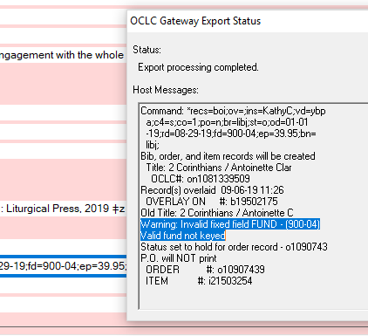
A new problem!
Old fund code: en-23
New fund code: 200-01
Unexpected Result:
"The load profile is broken"
Notes:
Earlier in 2019, we completely restructured our fund codes, replacing them with a whole new set of codes that was much smaller and more aligned with our University's codes and with the expense reporting we wanted to do. As a result, the format of the codes changed from (letter letter - 2 digit number) to (3-digit number - 2 digit number). Unexpectedly, when we started using those new fund codes in the OCLC constant data, we got an error. Any time Sierra can't validate fixed code field data it will show an "invalid" error in the export status. But because we already had this great communication channel, and improved understanding of the load profile and its interaction with OCLC exporting, we were quickly able to come up with some ideas of what might be happening, make some changes and do some testing, until we pinpointed the number of characters as the issue and Brandon was able to update the load profiles (.bo and .boi) to handle the new fund codes.

Slide 15
In Conclusion
Assess your needs carefully.
Make sure all involved parties have time and willingness to participate.
Take time to observe each other, learn from each other, and listen to each other.
  Communication, communication, communication!
Ping professional communities and mailing lists. Someone has probably attempted something similar.
You rarely get things right on the first try, so approach your project expecting to have to refine and iterate.

Slide 16

Brandon Walker
Cleveland State University
b.l.walker20@csuohio.edu
Lauren Marshall
John Carroll University
lmarshall@jcu.edu

