Slide 1

Improving Library Service for
International Students
Mina Chercourt
mchercourt@jcu.edu
Lauren Marshall
lmarshall@jcu.edu

Slide 2
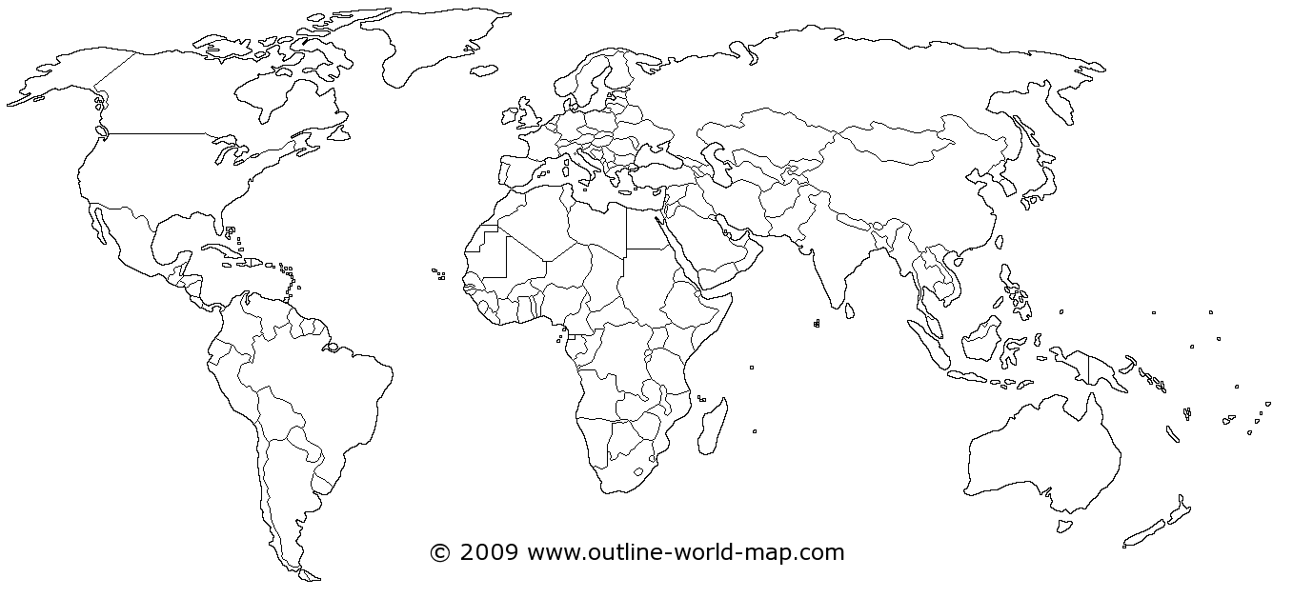

International Students
Spring 2012 (all programs)
Syria
Nigeria
Saudi Arabia
Kuwait
France
Netherlands
Hong Kong
China
Romania
India
Nepal
Turkey
Russia
Croatia
West Africa
Thailand
Czech Republic
Zimbabwe
Kenya
Vietnam
Hungary
Sweden
Singapore
England
** Includes graduate and undergraduate students and exchange students

Slide 3

Information Gathering:
Survey and Focus Group
Incentives (Pizza! Gift Certificates!)
Included some open ended questions in survey (e.g. What is one question you have about our library? What problems, if any, have you had using our library?)

Slide 4

Soft Landings International Students Fall 2012
Senegal
Vietnam
China
Kenya
South Africa
Myanmar

Slide 5
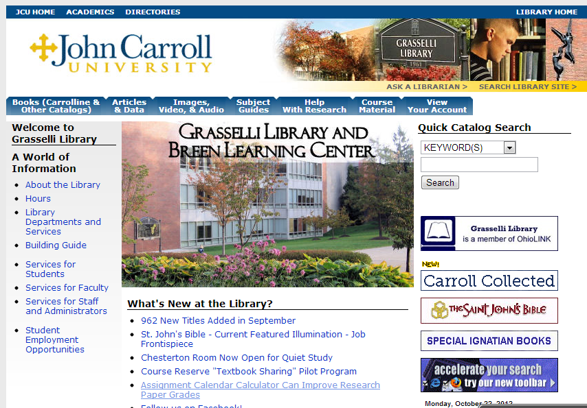
Library Tour and Orientation
Long tour with lots of opportunities to ask questions
Written guide for future reference
Tour of physical library and of library web site
We’re here to help!!!!

Slide 6
Database Research Instruction
AR 120: Purpose and Place: Exploring Campus, Community, and Self:
  Designed to help first-year students with the transition to college and to promote their engagement in all facets of their educational experience.
  For Soft Landings students, includes academic transition, but also social outings and introduction to American culture.

Slide 7
Future Plans . . .
Gather information from soft landings students at end of this year; see what worked for them and what didn’t
Expand into other groups that may have unique needs and experiences, such as early entry high school students

