Slide 1

WELCOME TO

Slide 2

Diabetes in KY Schools: Online Training Program
Leslie K. Scott, PhD, APRN, PPCNP-BS, MLDE, CDCES, FAANP
Leigh Anne Koonmen, PhD, RN, LDE
#ADCES22
2

Slide 3
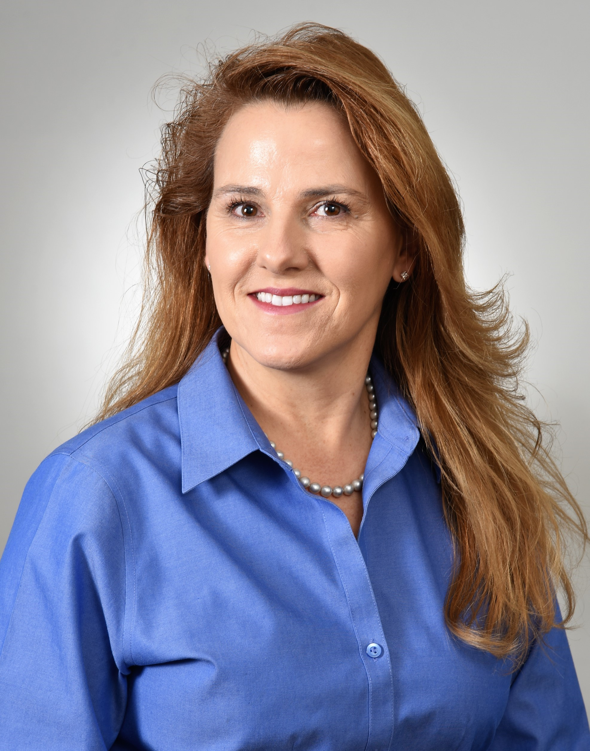
Leslie K. Scott
PhD, APRN, PPCNP-BS, MLDE, CDCES, FAANP
PI
Associate Professor
University of Kentucky College of Nursing
Lexington, KY
#ADCES22
3

Slide 4
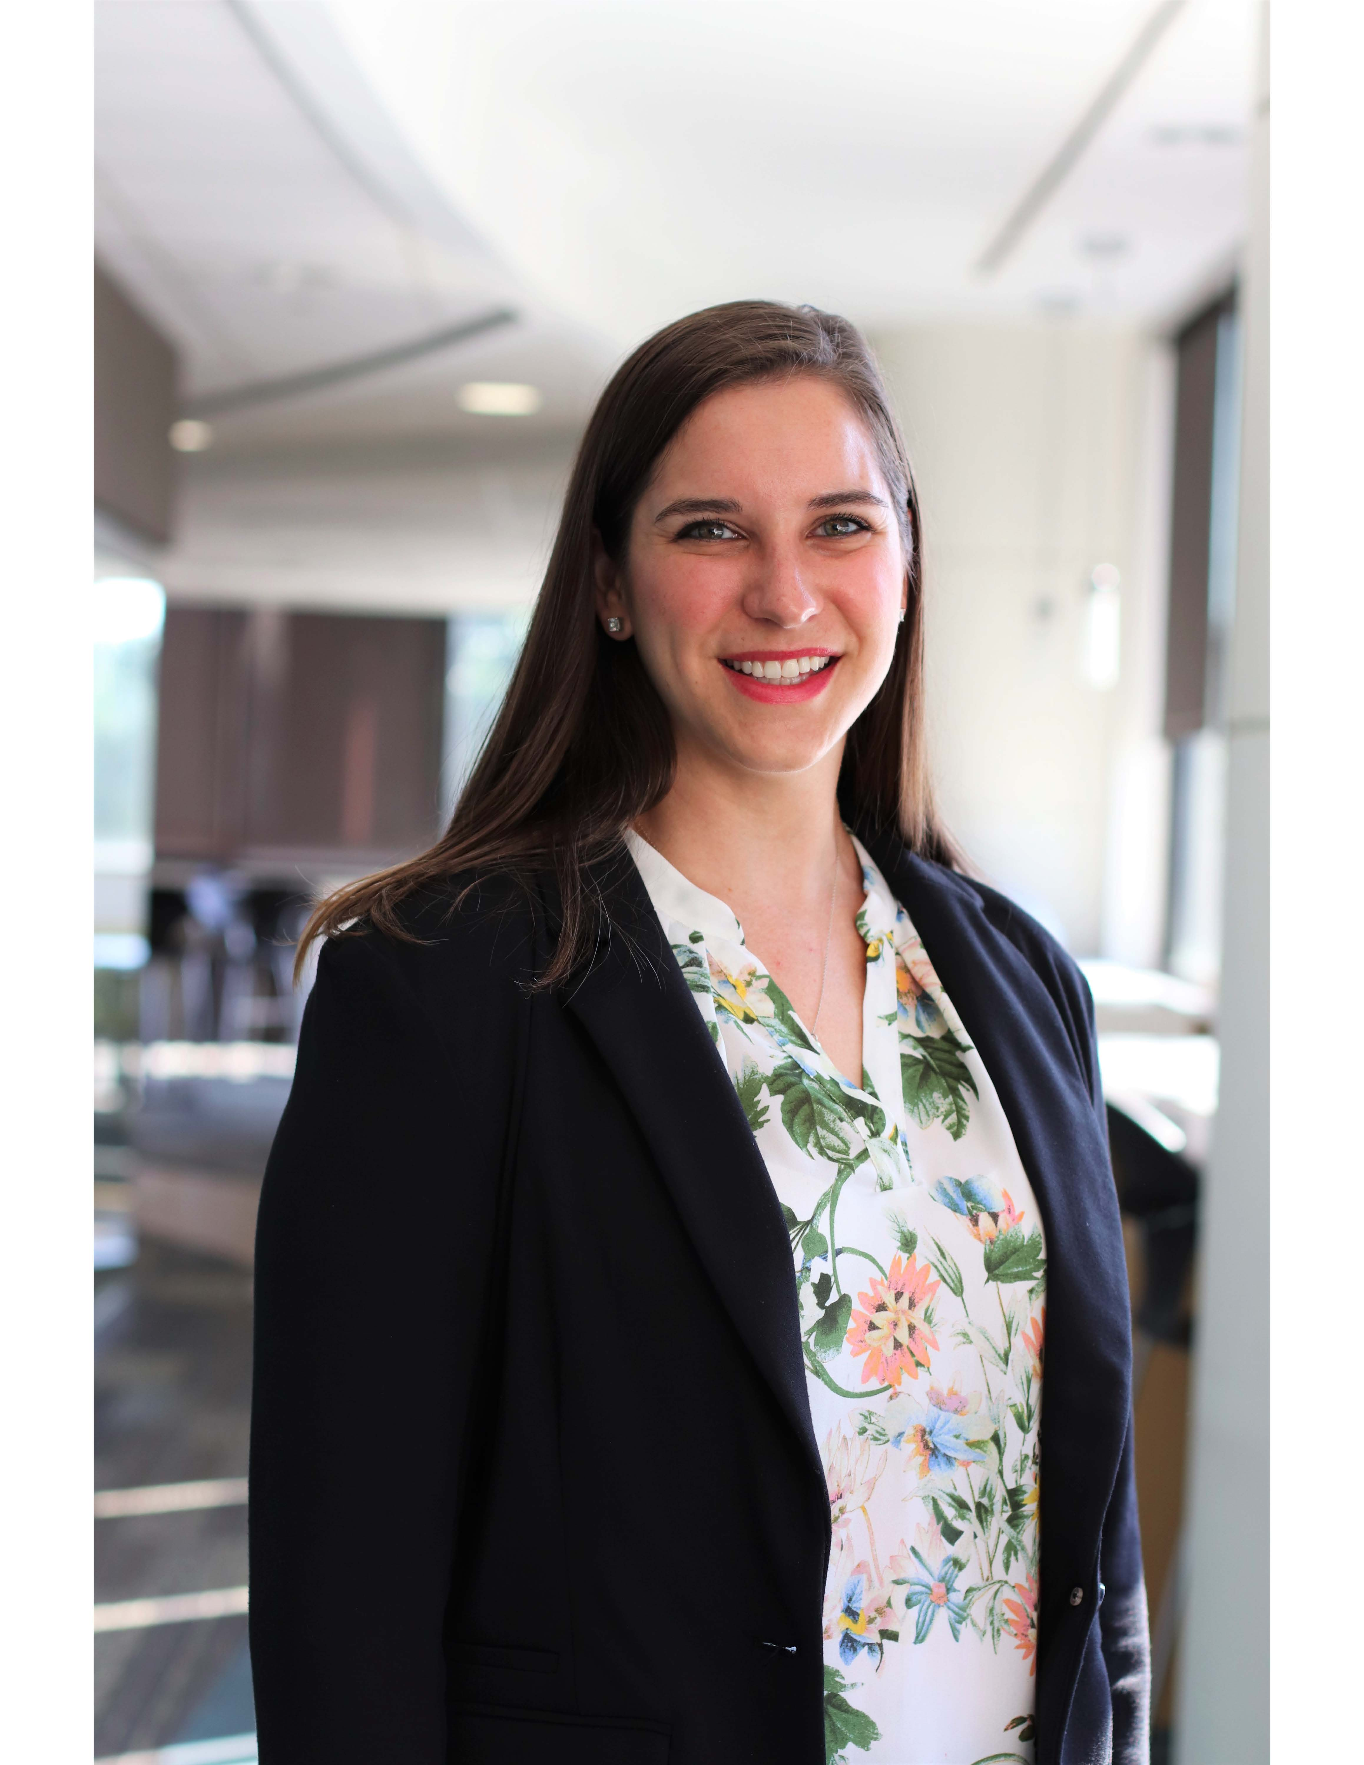
Leigh Anne Koonmen
PhD, RN, LDE
Co-I
Assistant Professor
Kirkhof College of Nursing
Grand Valley State University
Grand Rapids, MI
#ADCES22
4

Slide 5
Disclosure to Participants
NOTICE OF REQUIREMENTS FOR SUCCESSFUL COMPLETION
  Learners must attend the full session and complete the session and overall conference evaluation in order to claim continuing education credit/hours.
FACULTY DISCLOSURES:
In accordance with the ACCME Standards for Integrity and Independence, the Association of Diabetes Care & Education Specialists (ADCES) requires anyone in a position to affect or control continuing education content (e.g., authors, presenters, and program planners) to disclose all financial relationships with ineligible companies. It is the responsibility of ADCES to mitigate and disclose all relevant conflicts of interest. Disclosure of a relationship is not intended to suggest or condone bias in any presentation but is made to provide participants with information that might be of potential importance to their evaluation of the presentation. Relevant disclosures (or lack thereof) among this session’s speakers and/or content authors are as follows:
  Presenter: Leigh Anne Koonmen, PhD, RN, LDE – No financial relationships to report
  Leslie K. Scott, PhD, APRN, PPCNP-BS, MLDE, CDCES, FAANP – No financial relationships to report
  Disclosure and Mitigation of Relevant Conflicts of Interest: All identified relevant conflicts of interest have been mitigated.
OFF-LABEL USE:
  Participants will be notified by speakers to any product used for a purpose other than for which it was approved by the Food and Drug Administration.
#ADCES22
5

Slide 6
Funding
Funding for this project was provided through the Kentucky Diabetes Prevention and Control Program, Kentucky Department for Public Health support by Cooperative Agreement number 5 NU58DP006465 funded by the Centers for Disease Control and Prevention.
#ADCES22
6

Slide 7
KY School District Policies & Procedures
KRS 156.502
  Schools shall administer health services (including medication administration) to students who require this service during the school day or school-sponsored event.
Kentucky Administrative Regulation 702 KAR 1:160
  School districts must have emergency care procedures at all times when students are in school or participating in school activities.
  There must be a school employee who is trained to administer to a student or assist a student with the self-administration of glucagon, insulin, or seizure rescue medications.
KRS 158.838
  Each local public school district must have at least one school employee who has met KRS 156.502 requirements on duty during the entire school day to administer glucagon in an emergency.
This is a specialized training required ONLY if the school has one more more students
with diabetes.
#ADCES22
7

Slide 8

KY Public Schools at a Glance
171 school districts across Kentucky
647,978 public school students in the Commonwealth (2019-2020)
  122, 632 estimated students had a chronic health condition (2018-2019)
    1,767 students with diagnosed diabetes
      Type 1: 1,507 students
      Type 2: 260 students
Non-public schools (208) are not required to follow state
school health provisions.
#ADCES22
8
Kentucky Cabinet for Health & Family services (2019). Retrieved from https://chfs.ky.gov/agencies/dph/dpqi/cdpb/dpcp/DiabetesReport.pdf
Kentucky Dept. of Education (2020). Retrieved from https://education.ky.gov/districts/SHS/Pages/Student-Health-Data.aspx

Slide 9

KY School Nurses
1,017 nurses in the public school setting (March 2021)
  Coordinate and supervise diabetes care in the school
  Provide direct care (when available)
  Counsel, health teaching, train
  Communicate health concerns to parents/guardians/healthcare teams
  Evaluate care provided
35 KY school districts do not have a dedicated nurse in their district
  Leaving 54,979 students without access to a nurse during school hours
  Kentucky Dept. of Education (2021). Retrieved from
  https://education.ky.gov/districts/SHS/Pages/Student-Health-Data.aspx
  Kentucky Board of Nursing (2020). Retrieved from https://kbn.ky.gov/Pages/SearchResults.aspx?terms=number+of+school+nurses&affiliateId=kbn.ky.gov
#ADCES22
9

Slide 10
Education Need/Practice Gap
Unlicensed school personnel were given authority (2014) to administer insulin in school settings under the delegation of a physician, advanced practice registered nurse, or registered nurse by KRS 158.838
  Unlicensed school personnel are required to successfully complete an approved course for administration of insulin and validate competency.
Districts are responsible for ensuring that the proper staff are trained each year with the new materials and maintain records of the trainings.
KY schools need access to a diabetes-specific training program that satisfies KRS 158.838 and 702 KAR 1:160 and provides a repository to maintain records related to personnel training.
  Kentucky Dept. of Education (2021). Retrieved from
  https://education.ky.gov/districts/SHS/Pages/Student-Health-Data.aspx
  Kentucky Board of Nursing (2020). Retrieved from https://kbn.ky.gov/Pages/SearchResults.aspx?terms=number+of+school+nurses&affiliateId=kbn.ky.gov
#ADCES22
10

Slide 11










Stakeholder Team
The Diabetes in KY Schools training program stakeholder team is organized to lead the quest for educational support for school nurses and unlicensed school personnel to ensure children and adolescents with diabetes in Kentucky are safe at school.
#ADCES22
11

Slide 12

Training Program Overview
Online and on-demand module format
  Re-accessible throughout the year
  Able to be updated as diabetes-related care and guidelines change
Managed by CECentral at University of Kentucky
Nominal fee (collected by CECentral | Kentucky Department of Education approved)
  Nurses completing the program receive Kentucky Board of Nursing approved Continuing Education credits
  Unlicensed school personnel receive a certificate of completion
  School districts able to monitor and request access reports (through CECentral)
#ADCES22
12

Slide 13

Module Training Program Objectives
This group of modules is intended for unlicensed school personnel and school nurses who have accepted the delegation to train (nurses) and provide (designated unlicensed school personnel) diabetes-related care and medication administration to students with diabetes in a school setting and during school-related activities.
#ADCES22
13

Slide 14
Module 1: Welcome and Overview
Objectives:
  Review and recall the Kentucky state law(s) associated with diabetes in Kentucky schools
  Identify the responsibilities of the school nurse and unlicensed school personnel in diabetes-related care at school
    Identify the competency verification checklist to be utilized by school nurses for designated unlicensed individuals delegated to perform diabetes care tasks in their specific school
  Recognize state and federal legal considerations for school-age children with diabetes
  Understand diabetes and the self-care behaviors, related tasks, care, and monitoring relative to school-age children with diabetes
  Recognize the importance of healthy coping behavior in students with diabetes
#ADCES22
14

Slide 15

Module 2: Diabetes Management, Nutrition, and Exercise
Objectives:
  Review examples of diabetes medical management plans (DMMPs)
  Identify important components of nutrition and their role in the body
  Demonstrate food label reading and other useful tools in counting carbohydrates
  Define importance of exercise and preparing for changes in blood glucose during exercise
  Review signs and symptoms of hyperglycemia, hypoglycemia, and diabetic ketoacidosis (DKA) along with treatment plan
  Define ketones and their relation to diabetes and illness
    Demonstrate checking urine ketones
#ADCES22
15

Slide 16

Module 3: Diabetes Medications and Emergencies
Objectives:
  Identify therapies for management of type 1 and type 2 diabetes
  Identify types of insulin used by students and their various formulations
  Identify appropriate locations to give subcutaneous insulin injections and insulin injections with a vial and syringe and an insulin pen
  Discuss emergency action plans for treatment of severe hypoglycemia
  Define diabetic ketoacidosis (DKA), identify symptoms and causes
#ADCES22
16

Slide 17

Module 4: Type 2 in Youth (NEW)
Objectives:
  Define type 2 diabetes in children, adolescents, and teens
  Discuss differences in treatment between type 1 and type 2 diabetes
    Review nutrition and activity recommendations
  Discuss stigma around type 2 diabetes in youth
    Discuss strategies to facilitate healthy coping
  Review signs and symptoms of hypoglycemia
    Including treatment plan
#ADCES22
17

Slide 18

Module 5: Healthy Coping (NEW)
Objectives:
  Discuss what healthy coping means and ways students can utilize healthy coping strategies
  Review mental health risks associated with diabetes
    Diabetes distress
    Diabetes burn-out
  Identify signs of risky coping
    Including disordered eating and self-harm
  Review examples of safety plans
#ADCES22
18

Slide 19
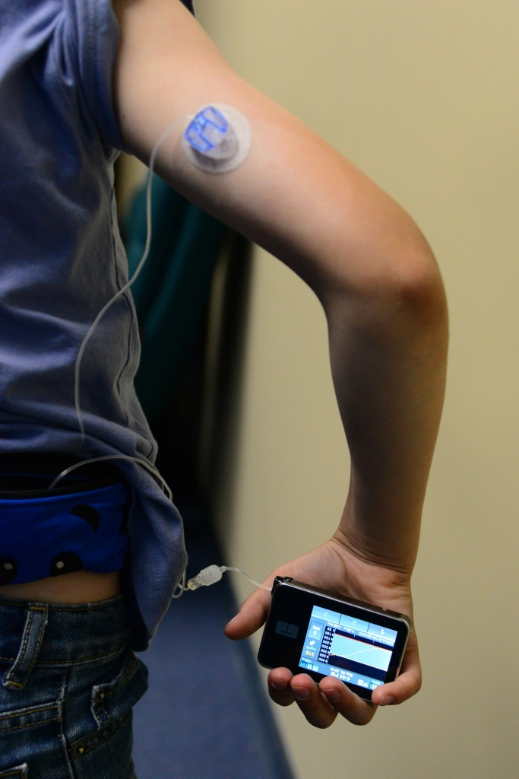
Module 6: Diabetes Technology (NEW)
Objectives:
  Review basics of basal bolus insulin therapy and blood glucose monitoring
  Introduce the Smart Pen and benefits for use
  Discuss Continuous Glucose Monitoring
    Including brands, benefits, and best practices
  Define Continuous Subcutaneous Insulin Infusion Therapy (CSII)
    Including brands, benefits, and best practices
  Discuss considerations for use of these technologies in the school setting
#ADCES22
19

Slide 20

Module 7: Tying It All Together
Objectives:
  Identify carbohydrate content in food items
  Calculate mealtime dosage using the prescribed insulin to carbohydrate ratio (I:C)
    Calculate routine and correction insulin dosages
    Review rounding dosages for insulin pumps, pens, and syringes
  Demonstrate correct management of situations that may occur during school hours or school-related activities
    Miscalculated dose, ketones, severe hypoglycemia
  Describe signs and symptoms of hypo- and hyperglycemia
    Demonstrate correct treatment of hypo- and hyperglycemic events
#ADCES22
20

Slide 21

Competency Verification Checklist
Unlicensed school personnel receive a competency checklist for in-person competency verification with a licensed school nurse
Personnel are required to score a minimum of 85% on an “open book” final exam AND 100% on skills competency evaluation (checklist)
Includes demonstration and correct administration of:
  Oral medications
  Subcutaneous injection
  Emergency medications prescribed for the treatment of hypoglycemia
  Also includes understanding of local school district policies and procedures
#ADCES22
21

Slide 22
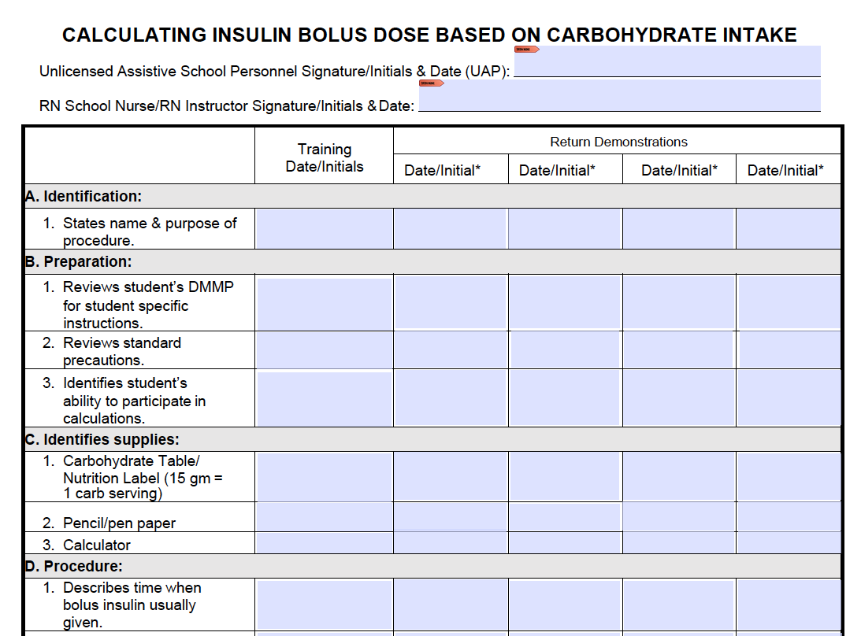
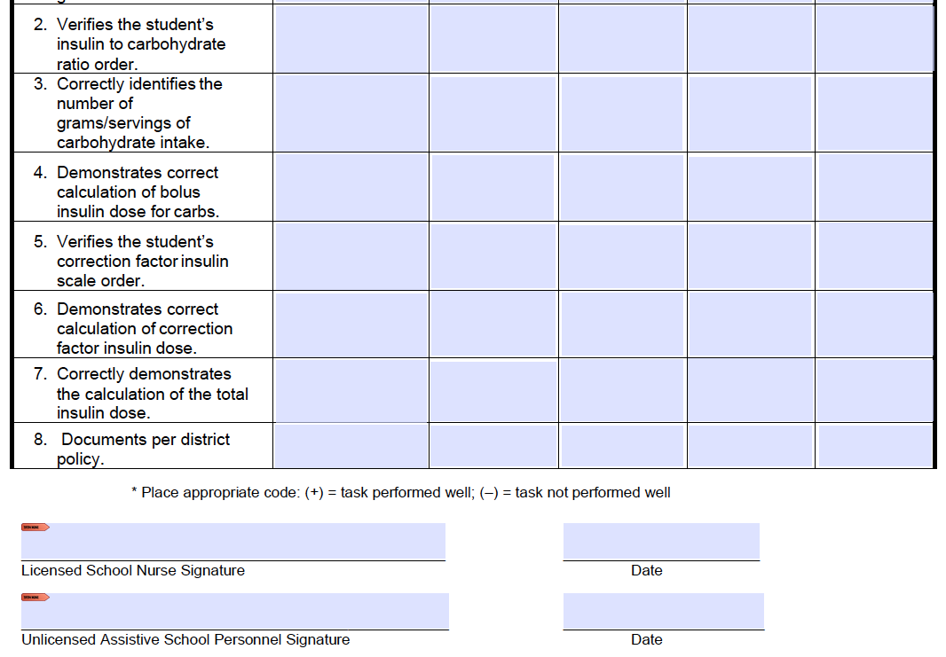
Competency Verification Checklist
#ADCES22
22

Slide 23

Healthcare Collaborations
Collaborative development of DMMPs through Epic
  Healthcare Teams: Barnstable Brown Diabetes Center, Norton Children’s Endocrinology/Wendy Novak Diabetes Center, and Cincinnati Children’s
  Plans are created so that documentation is constantly maintained for the patient, can be resent to the school easily, and can be adjusted with changes to insulin ratios, doses, or instruction specific to activities, snacks, or special class activities.
DMMPs are provided to schools covering the student’s unique diabetes diagnosis and include:
  Medications
  Treatment of hyperglycemia and hypoglycemia
  Comprehensive directions on use of technology
  Additional endocrinology medication administration (if applicable)
#ADCES22
23

Slide 24

Future Directions
Module delivery revisions
  Separate, tailored modules for school nurses and unlicensed school personnel
  Interactive module format
    Collaborative effort with undergraduate University of Kentucky College of Engineering
    Computer Science students
  Additional case studies
Research arm for tracking training program outcomes
  Pre- and post-test learning assessments
  Competency checklist verification
Increase cost-effectiveness of program
  Free for unlicensed personnel, reduced fee for school nurses
  Use of funds to cover portion of school nurse CE credits
#ADCES22
24

Slide 25
Leslie K. Scott, PhD, APRN, PPCNP-BS, MLDE, CDCES, FAANP
Associate Professor
University of Kentucky College of Nursing
lkscot0@uky.edu
THANK YOU!

